Slide 2
Microsoft Project 2010 Overview
Christophe Fiessinger & Jan Kalis
Senior Technical Product Manager
Microsoft Corporation
Session Code: OFS214

Slide 3
Agenda
Project 2010 Investment Areas
  Unified Project and Portfolio Management
  Simple and Intuitive User Experience
  Enhance Collaboration and Reporting
  Scalable and Connected Platform
And Demos ☺

Slide 4







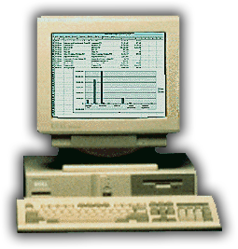




Microsoft Project Evolution
From desktop scheduling to project and portfolio management
2010
Financial
Management
Resource
Management
1987
Portfolio
Management
Reporting
Scheduling
Simple reporting
Task management
Print
Resource tracking
Program
Management
Project
Collaboration

Slide 5
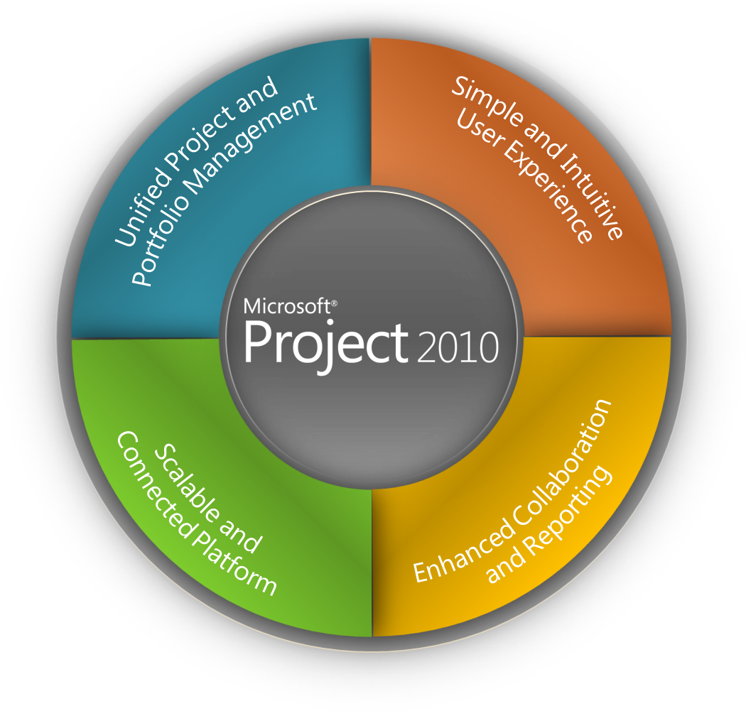
Project 2010 Investment Areas
Work Management Solutions for Individuals, Teams and the Enterprise

Slide 6
Choose the Right Tools that Can Evolve with You
Work Management Solutions for Individuals, Teams and the Enterprise
IT Mgt · NPD · Cap Projects · Govt
Project &
Portfolio Management
Enterprise
Workgroup
Collaboration and Reporting
Project Server 2010
(Built on SharePoint® Server)
Team
Project Pro Synch
to SharePoint
Web-Based Project Editing (Project Server)
Project Managers
Project Professional
SharePoint Task Lists
Individual
Low
Medium
High
Level of Complexity

Slide 7






Project and Portfolio Management
For SharePoint
Demand Management
BI & Reporting
Portfolio Selection
Project Team Collaboration
Resource Management
Schedule Management
Synch to SharePoint
Sites
Composites
Communities
Insights
Content
Search
The Business Collaboration Platform for the Enterprise and the Web

Slide 8
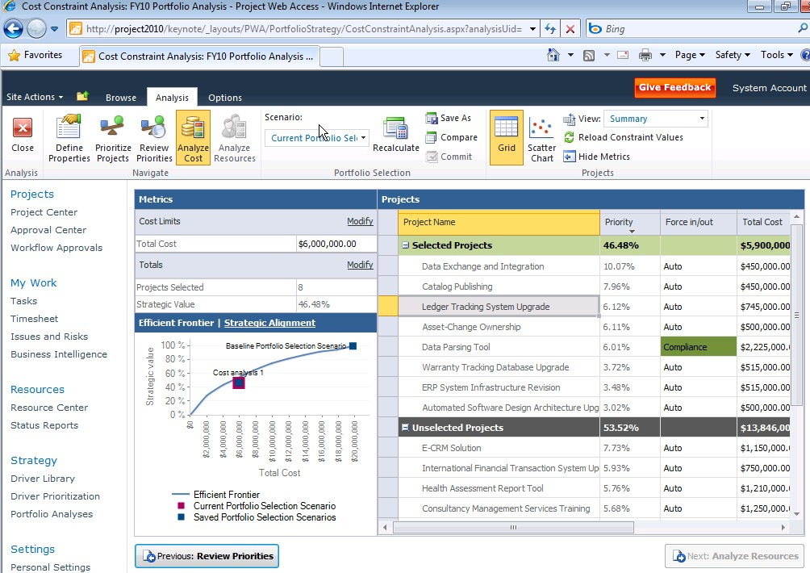
Microsoft Project 2010
Unified Project and Portfolio Management
Single server with end to end
PPM capabilities
Flexible project capture and initiation
Enhance governance through workflow
Powerful portfolio selection analytics
Unified Project and
Portfolio Management
Simple and Intuitive
User Experience
Scalable and
Connected Platform
Enhanced Collaboration
and Reporting

Slide 9
Unify Project and Portfolio Management
Merge top down and bottom up capabilities
Create
Select
Plan
Manage
Business Case Definition
Demand
Management
Top Down
Portfolio Management
Portfolio Prioritization
Portfolio
Reporting
Portfolio
Optimization
Capacity
Planning
Resource
Management
Project
Reporting
Project Scheduling
Time
Reporting
Team Collaboration
Issues and Risk
Management
Bottom Up Project Management

Slide 10
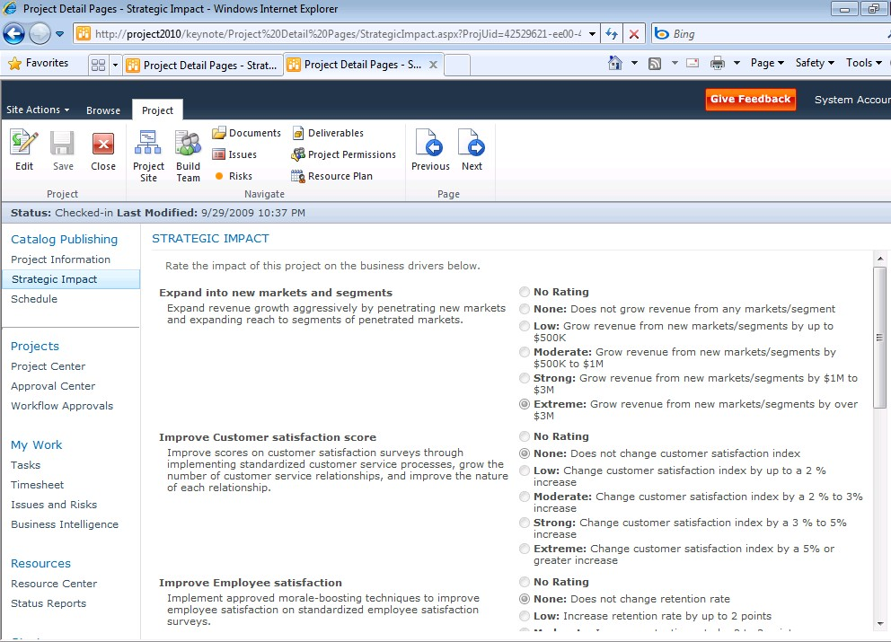





Unified Project and Portfolio Management
Capture all work in a central repository
Capture all Requests
Control via Workflow
Build Business Case
IT Project Workflow
Work Request Workflow
Business Project Workflow
Strategic Impact Assessment

Slide 11
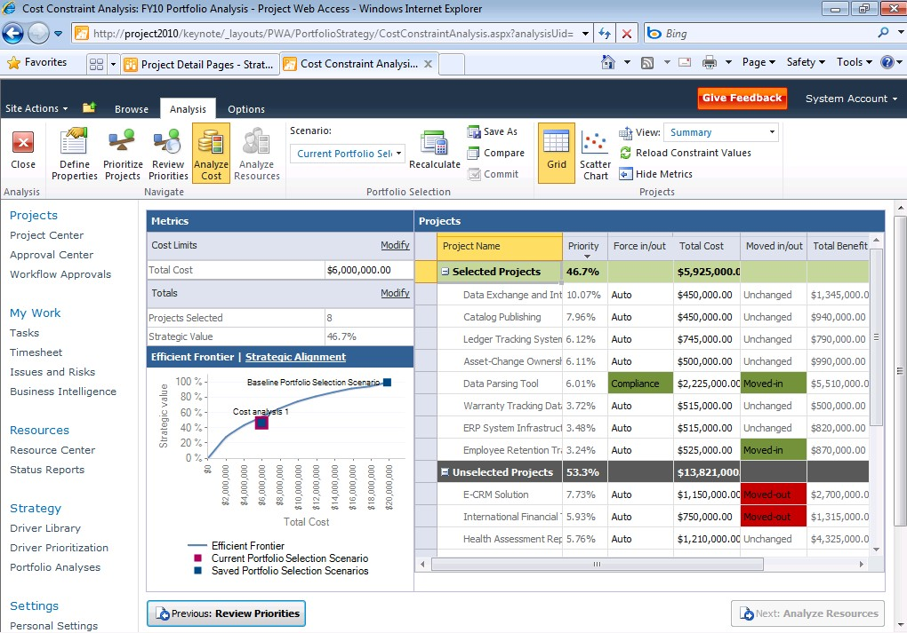
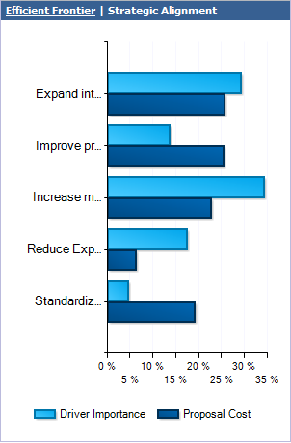
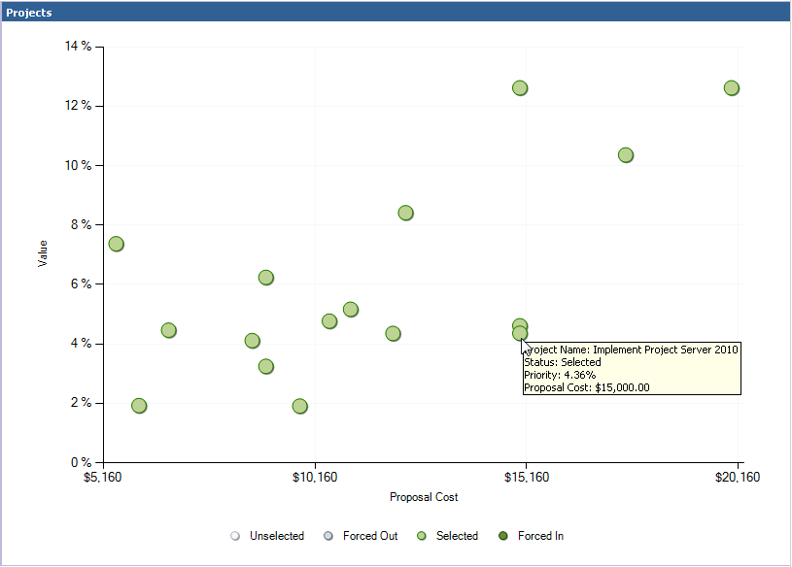
Unified Project and Portfolio Management
Select the right projects that align with business strategy
Budget Constraints
Portfolio Prioritization and Optimization
    Familiar SharePoint UI and common data store
    Intuitively prioritize business drivers
    Improved optimization view to enhance
    decision making
    Advanced analytics (e.g., Efficient Frontier) displayed within optimization view
Strategic Alignment
Optimization Analysis
Specify Force In/Out Criteria
Efficient
Frontier
Scatter Chart

Slide 12
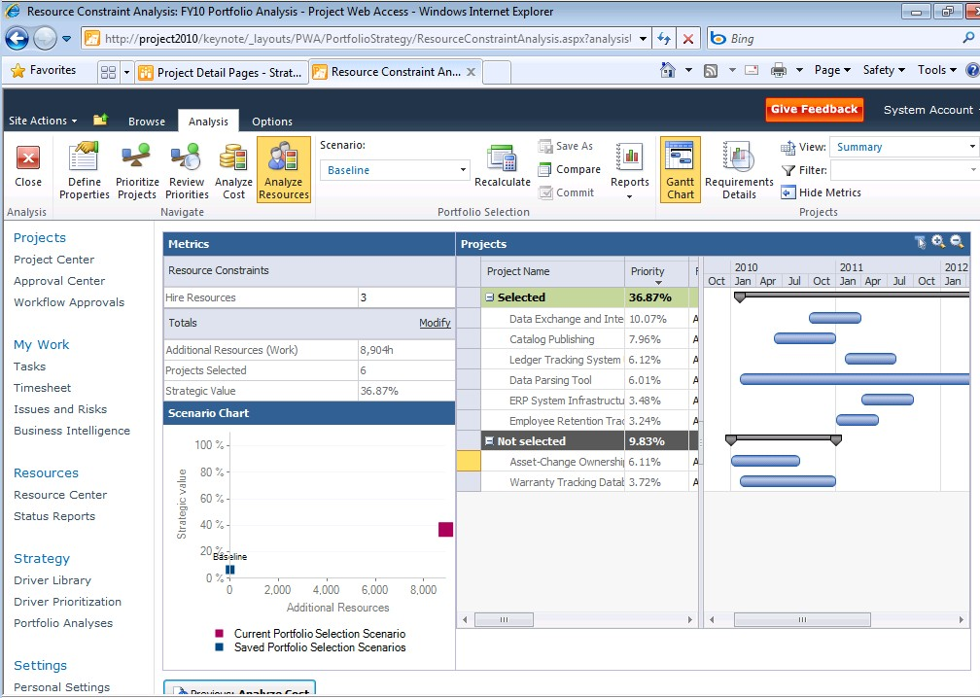
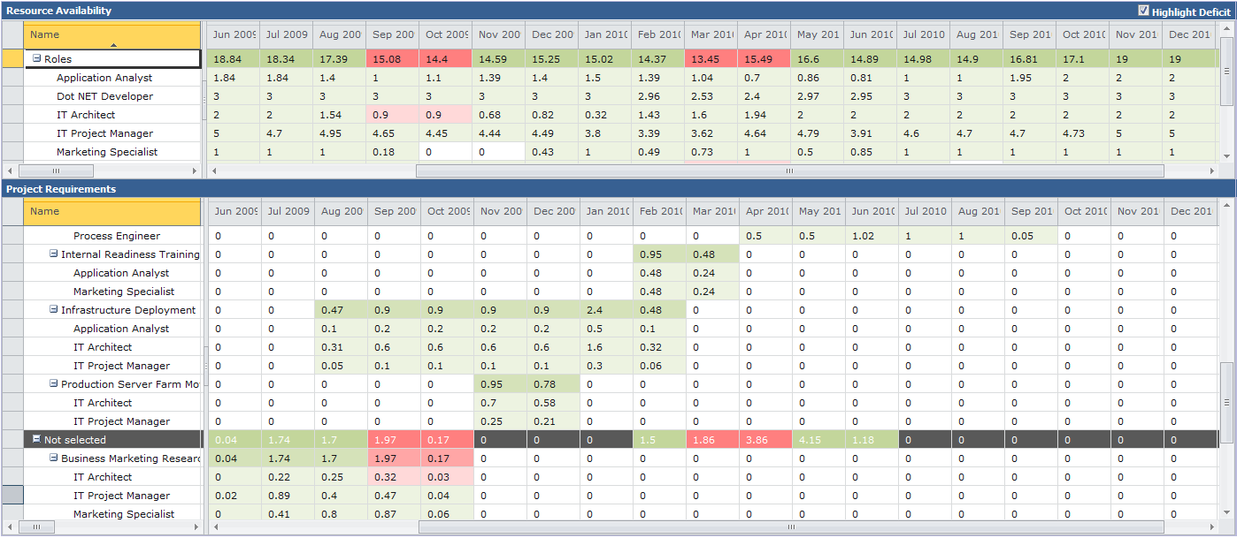
Unified Project and Portfolio Management
Maximize resource utilization through capacity planning
New Capacity Planning Module
    Assess resource demand versus availability
    and identify gaps
    Adjust project schedules to maximize
    resource utilization
    Model headcount decisions
    Finalize and communicate delivery roadmap
Resource Capacity
by Skill
Adjust project schedules
Resource
Requirements
Deficit Highlighted

Slide 13

Unified Project and Portfolio Management
demo

Slide 14
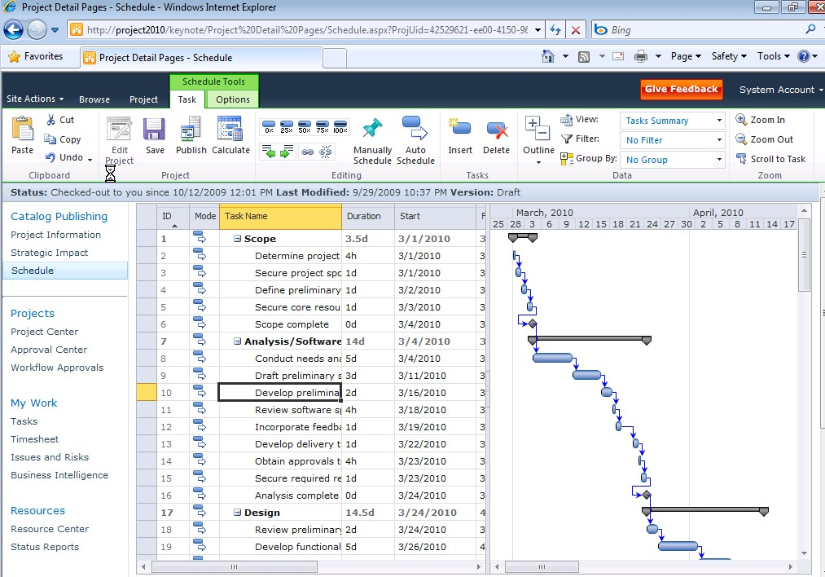
Microsoft Project 2010
Simple and Intuitive User Experience
    Ribbon UI and Backstage view
    Intuitive Excel-like behavior
    Timeline and Team Planner views
    Web-based project editing
Unified Project and
Portfolio Management
Simple and Intuitive
User Experience
Scalable and
Connected Platform
Enhanced Collaboration
and Reporting

Slide 15
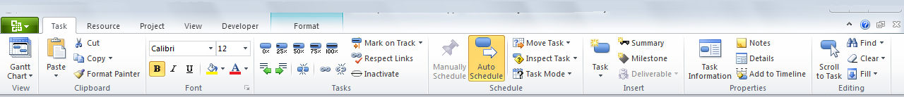
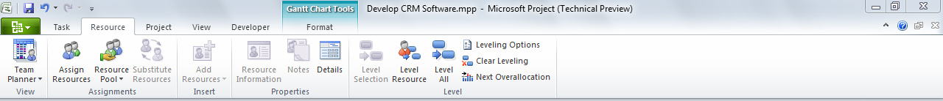
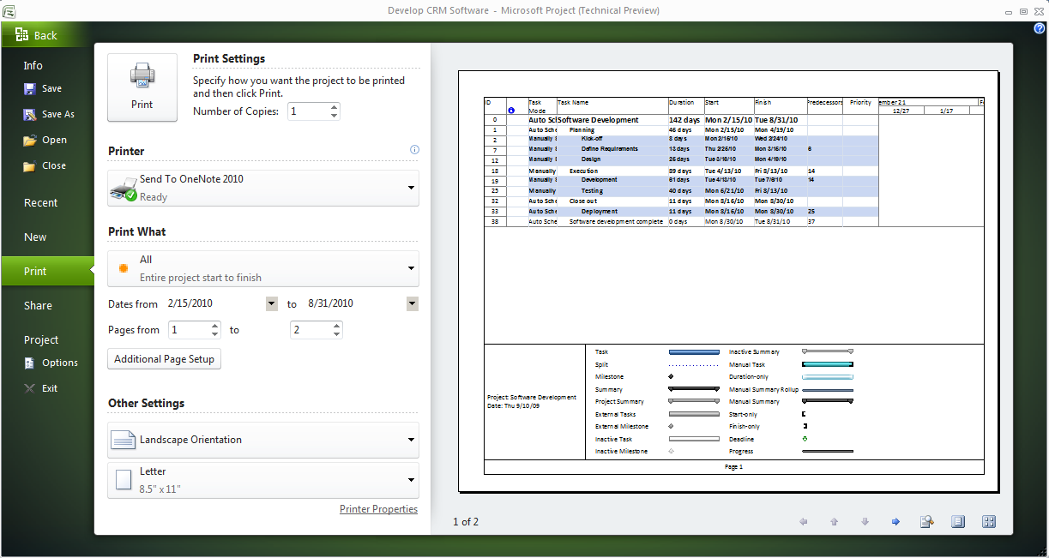
Simple and Intuitive User Experience
New User Interface
Experience the full power of Project 2010 with the easy to use Ribbon
    Get started quicker with the familiar
    Fluent User Interface
    Enhanced Contextual menus reveal relevant features
    Descriptive tooltips
    Share, print, and publish project information with just one click in Backstage
Task Menu
Resource Menu
Print Controls
Backstage

Slide 16
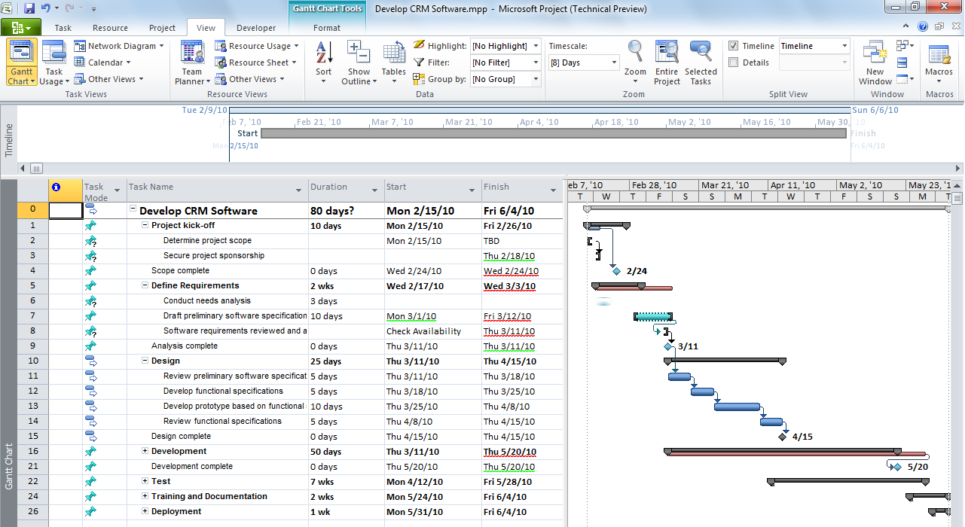
Simple and Intuitive User Experience
User Controlled Scheduling
Top Down Planning
Flexible scheduling puts you in control of the plan
Manually Scheduled Tasks
    Choose manually scheduled or automatically scheduled tasks
    Only enter task data when you have it
    Add notes to duration and date fields
    Be alerted to scheduling concerns with squiggly lines – then take action in Task Inspectors
Task with End Date Only
Reminder Notes
Scheduling Concerns

Slide 17
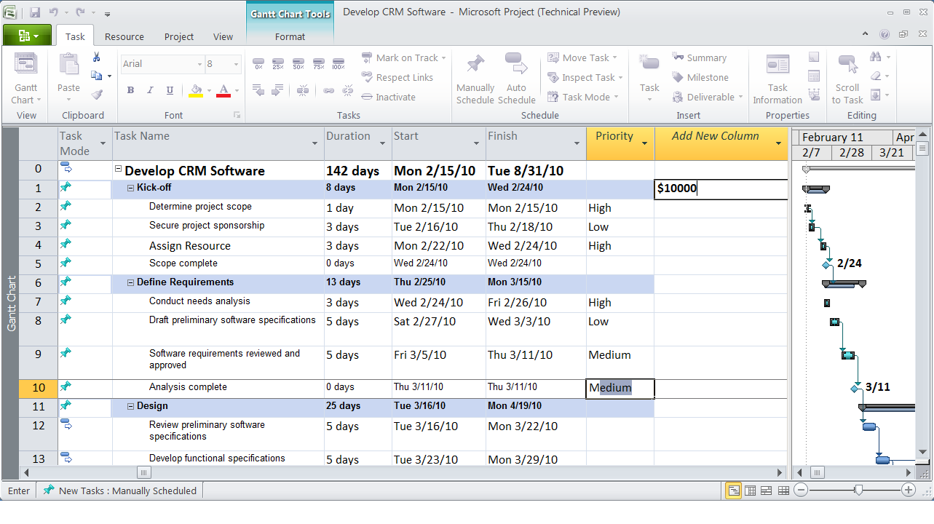
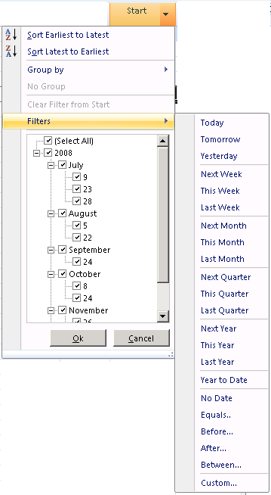
Simple and Intuitive User Experience
Intuitive Excel like behavior
Add New Column
Excel like experience enhances productivity
    Add New Column: Simply start typing text in a new column and Project will create right custom field and perform data validations
    Text Wrapping: Easier to view project data with automatic text wrapping
    Auto-Complete: Save time and effort with the new text auto-complete function
    Auto-Filter: Grid improvements make it easier
    to filter, group, sort, and customize your data just like Excel
Auto Complete
Text Wrapping
Filter, Sort
& Group

Slide 18
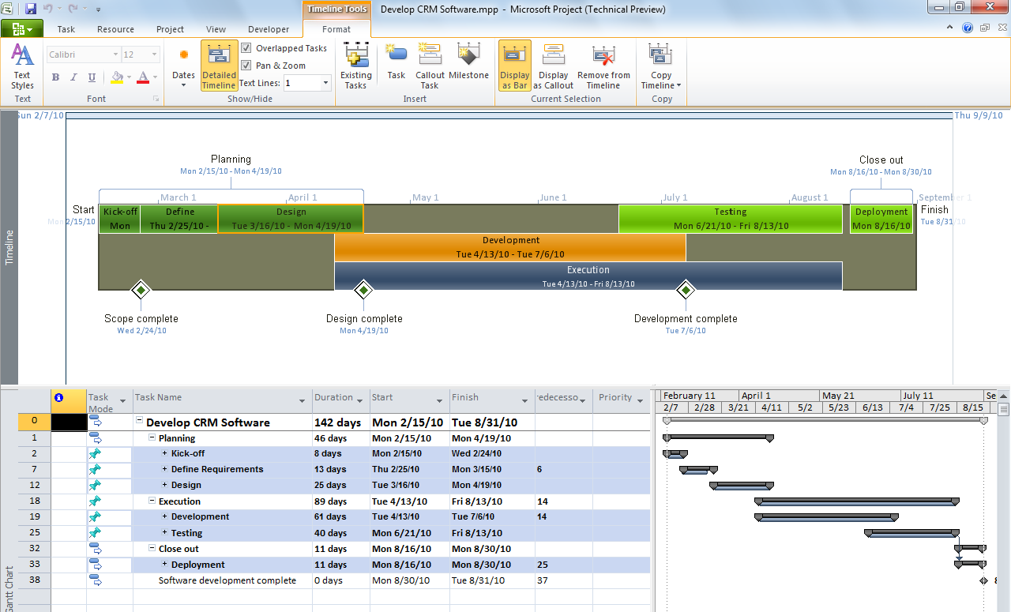
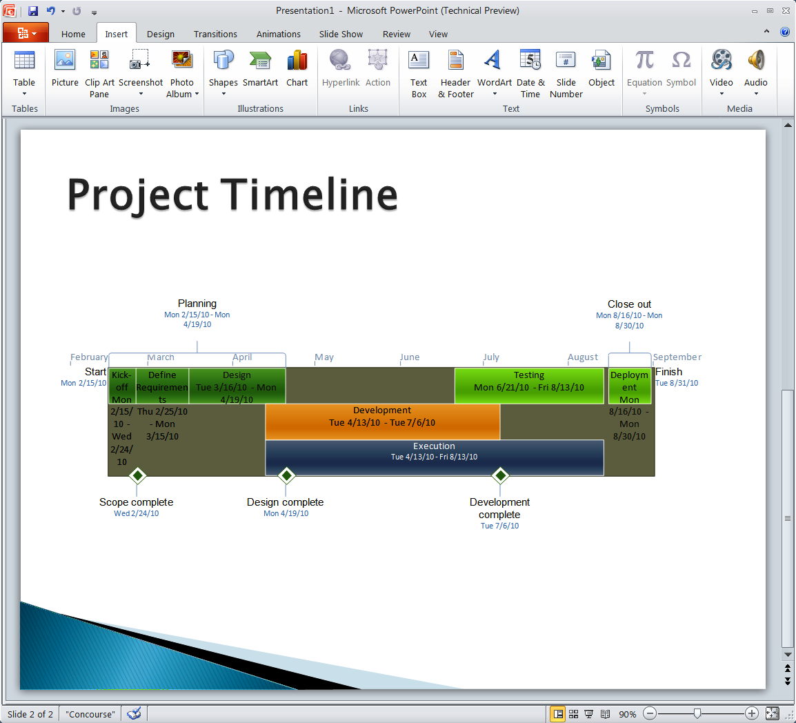
Simple and Intuitive User Experience
Timeline View
Call-Outs
Enhance communication with the new Timeline View
Timeline View
    Intuitively pan and zoom to focus on the right timeframe
    Easily select tasks and add to the Timeline View
    Format and customize Timeline to highlight
    key milestones
    Share with stakeholders by simply copying
    into Office tools
Timeline in PowerPoint
Select Tasks to Display on Timeline

Slide 19
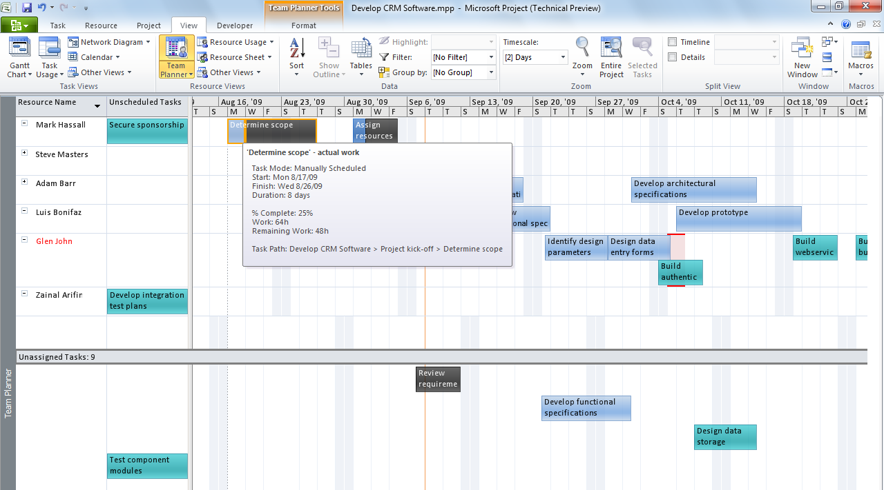
Simple and Intuitive User Experience
Team Planner View
Task Status Info
Effectively manage resources with Project Professional’s Team Planner
    Visually manage assignments in an intuitive resource centric view
    Conveniently drag and drop tasks to assign
    to resources
    Easily transfer tasks between resources
    Quickly identify over allocated resources
    and take action
    Simply hover over tasks to see status information
Unassigned Tasks
Assigned Tasks
Resources

Slide 20
demo

Slide 21

Microsoft Project 2010
Enhanced Collaboration and Reporting
    Built on SharePoint Server 2010
    Connect teams with SharePoint Sync
    Better time and status reporting
    Easily create reports and dashboards
Sites
Composites
Communities
Insights
Content
Search
Unified Project and
Portfolio Management
Simple and Intuitive
User Experience
Scalable and
Connected Platform
Enhanced Collaboration
and Reporting

Slide 22
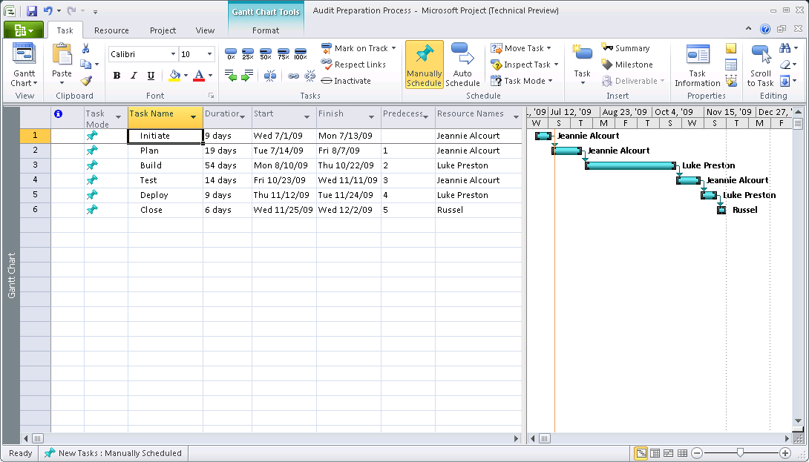
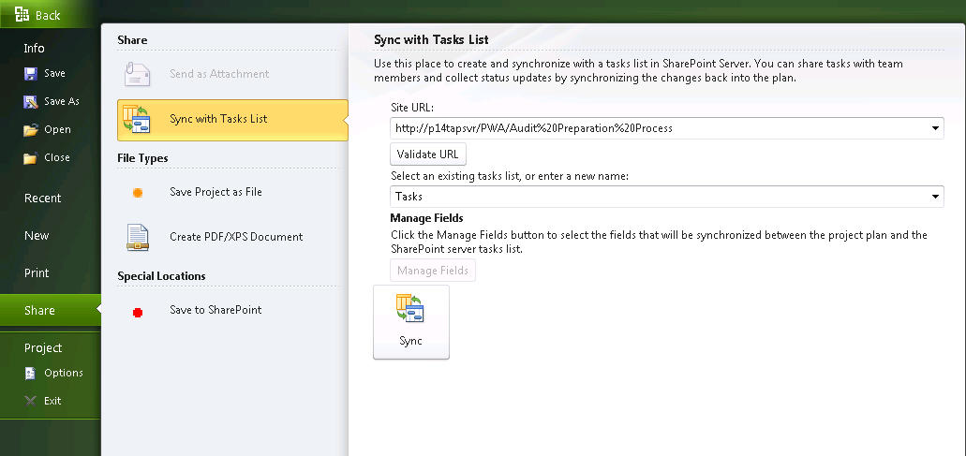
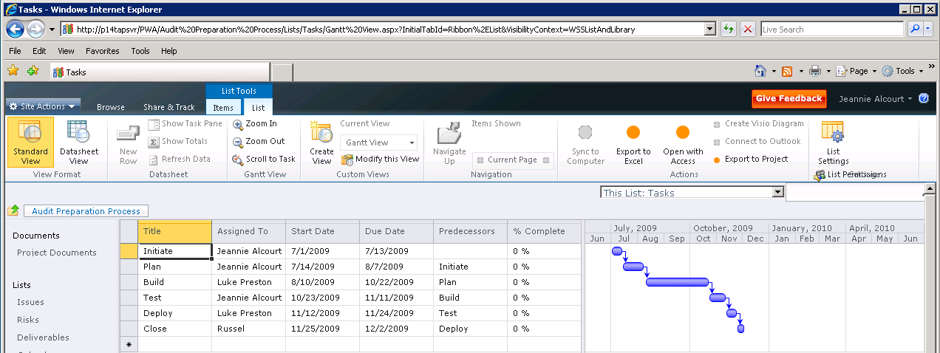
Enhanced Collaboration and Reporting
Synchronize with SharePoint tasks
Project Professional 2010
Elevate your SharePoint tasks to real projects and effectively share your Project plans using SharePoint
Share project tasks in SharePoint
Accept updates from SharePoint tasks list
Mange conflicts
SharePoint 2010

Slide 23
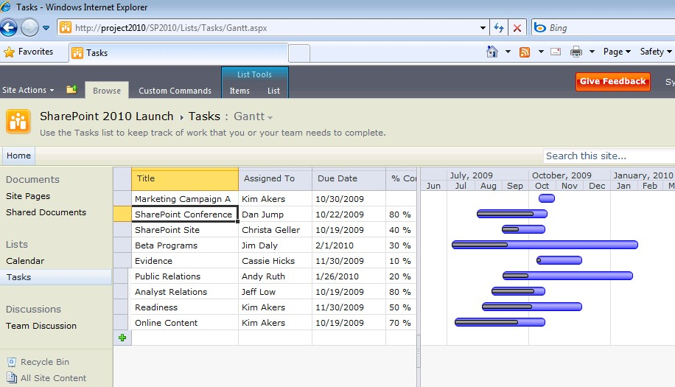
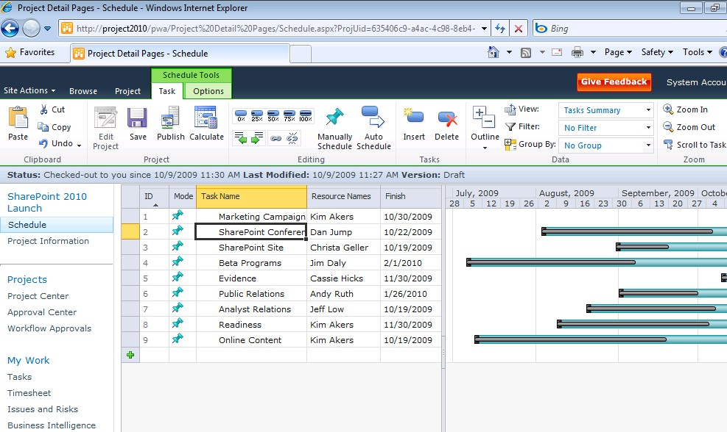
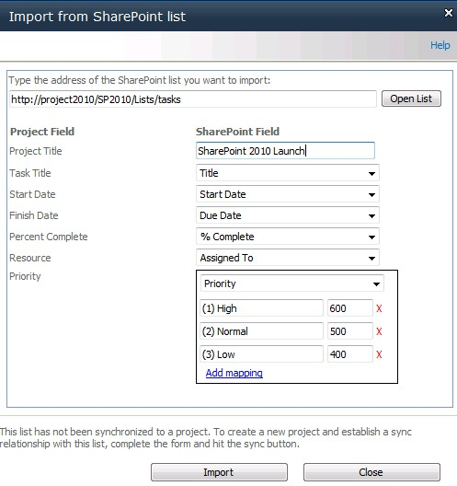
Enhanced Collaboration and Reporting
SharePoint Sync to Project Server 2010
SharePoint
Task List
    Lightweight collaboration through SharePoint Tasks list
    Sync SharePoint Tasks into Project Server to drive enterprise Resource Management and Reporting
    Take advantage of richer Project Management capabilities using Project Server
Project Server 2010
Project Plan

Slide 24
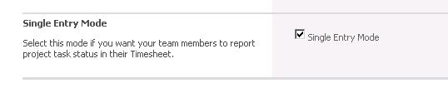
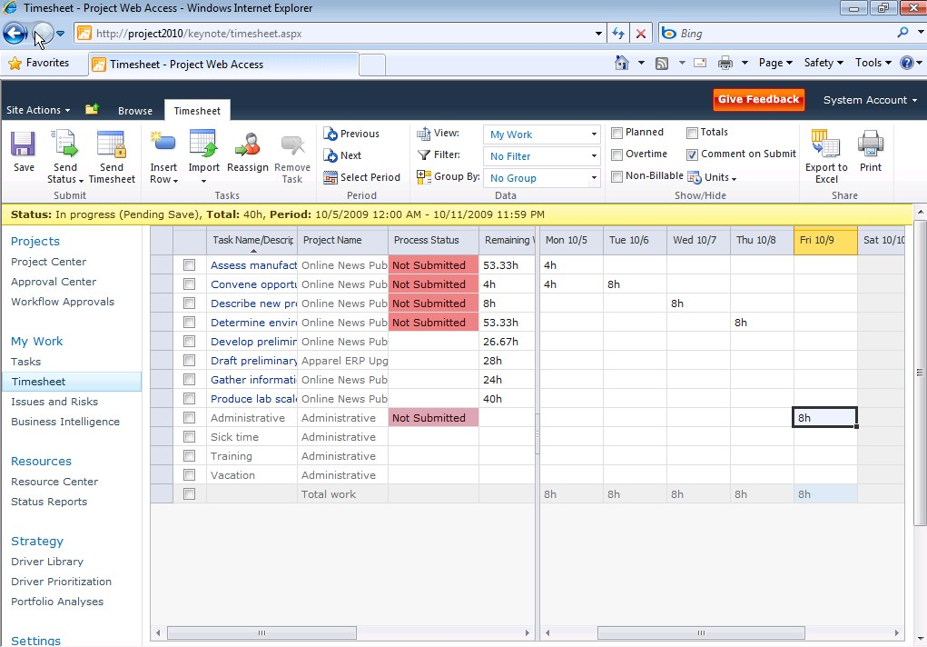
Enhanced Collaboration and Reporting
Simplified single entry mode for time reporting and statusing
Improved user experience
Single entry mode to unify timesheet entry and task statusing
Consolidated Approval Center
New User Delegation
Single Entry Mode Option
Improved Timesheet Experience

Slide 25
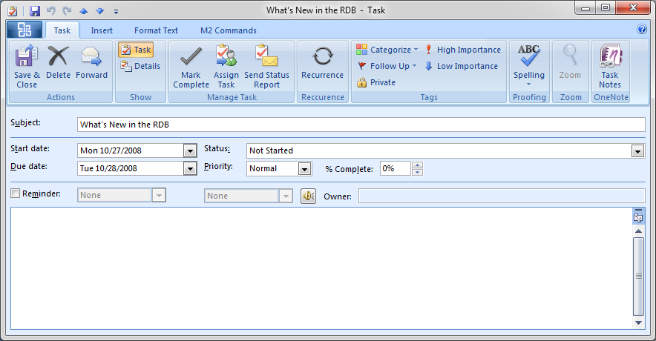
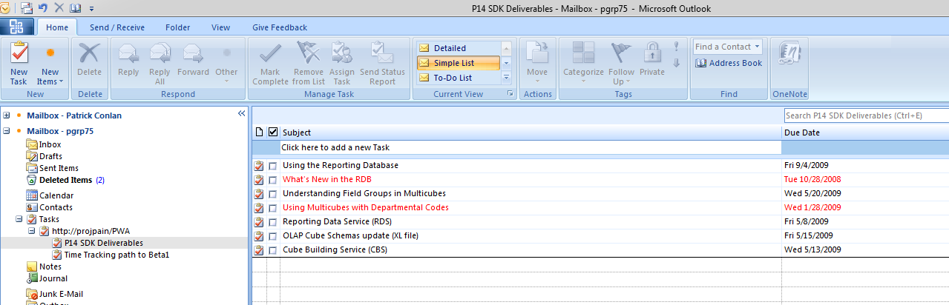


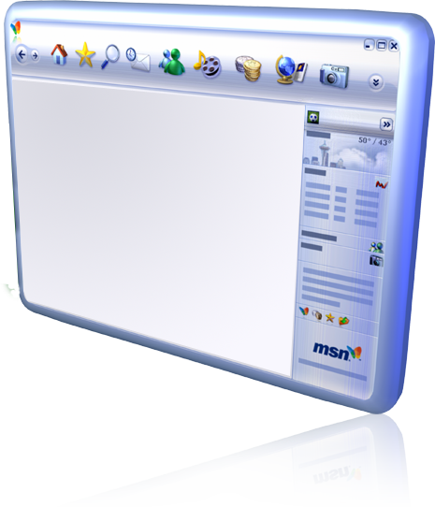

Enhanced Collaboration and Reporting
Stay connected through Outlook
Task Details
Exchange Server Integration
    Project tasks shown as Outlook tasks
    grouped by project name
    Receive notifications and provide updates through Outlook (% complete, total work, actual work)
    Empower the mobile workforce – receive
    and update tasks on the go
Project Tasks in Outlook

Slide 26






Enhanced Collaboration & Reporting
Take advantage of the Microsoft Business Intelligence Platform
Personal BI
Department BI
Enterprise BI
Business Intelligence Center
Excel Services
Personal BI for Team Members, PMs,
and Power Users
Departmental BI for effective team collaboration and communications
Enterprise BI for standard reporting and metrics
PerformancePoint Services
Visio Services
SQL Server Reporting Services
SQL 2008 R2: Self Services BI, PowerPivot

Slide 27
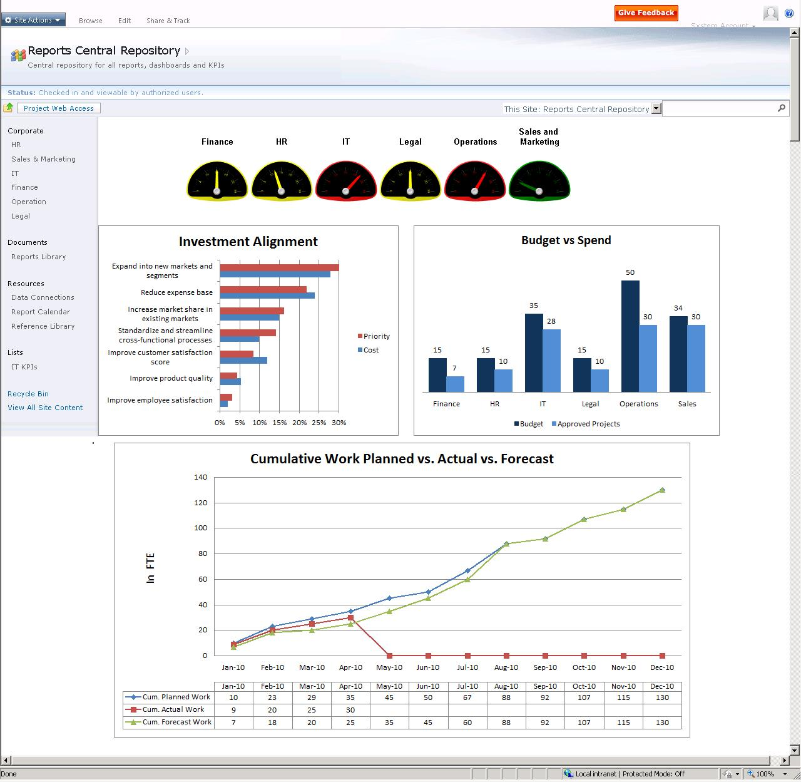
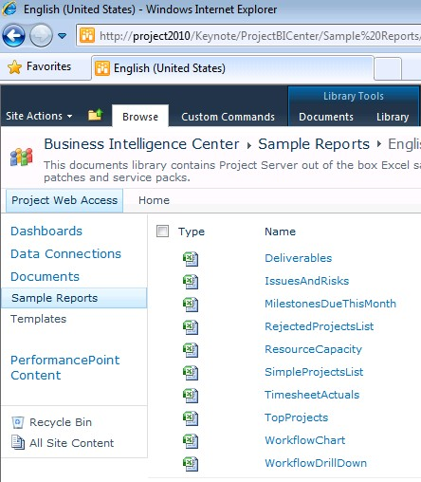
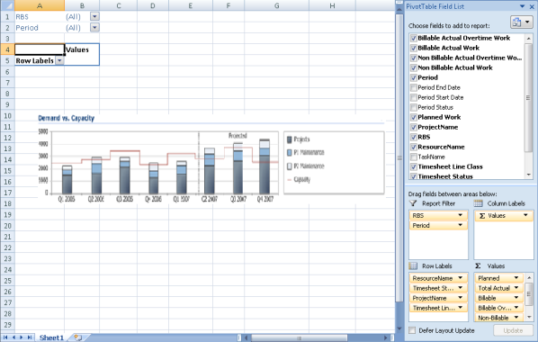
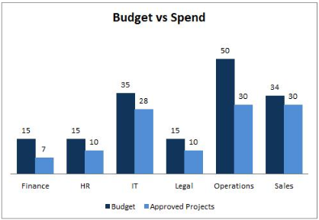
Enhanced Collaboration & Reporting
Simply create powerful reports and dashboards
Build Powerful Dashboards
Business Intelligence Center
Quickly create reports from predefined
and localized best practice templates
Customize in Excel and render through
Excel Services
Create powerful audience based dashboards
to monitor portfolio performance
Best Practice
Report Templates
Customize in Excel
Excel Services Webparts

Slide 28
Enhance Collaboration and Reporting
demo

Slide 29

Microsoft Project 2010
Scalable and Connected Platform
    Extend Interoperability
    Simplified Administration
    Rich Platform Services
    Developer Productivity
Unified Project and
Portfolio Management
Simple and Intuitive
User Experience
Scalable and
Connected Platform
Enhanced Collaboration
and Reporting

Slide 30






Scalable and Connected Platform
Powerful work management delivered in familiar and connected tools
Project Server Interface
=
EPM SOLUTION

Slide 31







Scalable and Connected Platform
Backwards Compatibility Mode
Accelerate deployment of Project 2010
    Seamless co-existence and data exchange among various Project client versions
    Both Project 2010 desktop and Project Server 2010 scenario
Project Server 2010
in “Compatibility Mode”
Project MPP file
Project 2010
Project 2007
Project 2003
Project
Professional 2010
Project
Professional 2007

Slide 32
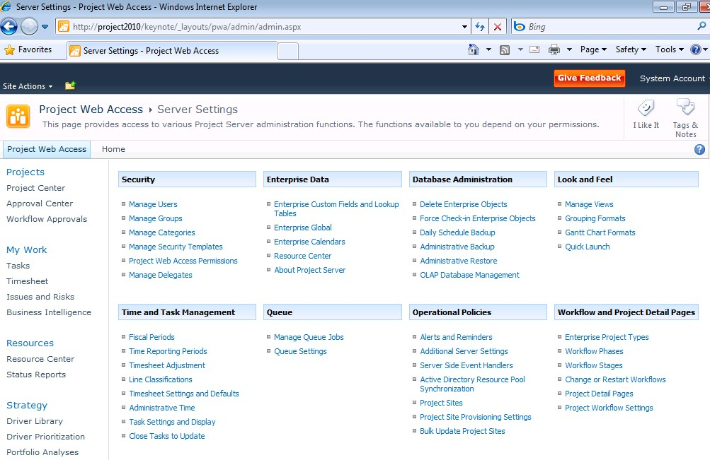
Scalable and Connected Platform
Simplified Administration
Centralized administration – One stop console for managing both project and portfolio management capabilities
User Delegation – Easily specify colleagues to act as your delegate when out of the office
Departmental Fields – Provide a level of autonomy while maintaining enterprise standardization and control
Cube Administration – Enhanced administration interface to visualize status and manage cubes

Slide 33

Scalable and Connected Platform
Extensible and Scalable Platform
Extensible and Scalable Platform
Programmable
  Project Server Interface (PSI) 2010
  backward compatible with 2007 methods
  Enhanced PSI includes project
  and portfolio capabilities
Deployable
  Remove ActiveX® dependency
Scalable
  Project Server 2010 64-bit
  Project (Std & Prof) 32-bit & 64-bit

Slide 34









Microsoft Project 2010 Product Packaging
Target Audience
Individual and Part-Time
Project Managers
Professional
Project Managers
IT, PMO, Engineering, R&D, Product Development, Operations

Slide 35



Project 2010 Product SKU’s
Target
Audience
Individual and
Part-Time Project Managers
Professional
Project Managers
CIO, PMO, Operations, R&D, Product Development
Fluent User Interface
User Controlled Scheduling
Timeline View
Project Standard PLUS
Enhanced Scheduling
Team Planner
Project Synch to SharePoint
Web Based Scheduling
Unified Project and Portfolio Management
Enhanced BI and Reporting
Key Changes
CAL
CAL Not Required
Project Server CAL Included
CAL Required
Key Dependencies
SharePoint Server 2010
SharePoint Enterprise CAL
64-bit Windows Server 2008
Windows XP, Vista, or Windows 7
Windows XP, Vista, or Windows 7

Slide 36


Related Project 2010 Content
Sessions @ TechED Europe
OFS214 - Microsoft Project 2010 Overview
OFS206 - Microsoft Project Server 2010 for IT Professionals and Developers
Project 2010 booth in the Office Pavilion
Project 2010 Product Information
http://www.microsoft.com/project/2010/
Microsoft Project 2010 TechCenter
http://technet.microsoft.com/projectserver/
Newsgroups
http://social.technet.microsoft.com/Forums/en-US/category/projectprofessional2010, projectserver2010
Project 2010 Developer Center
http://msdn.microsoft.com/project/
Newsgroups
http://social.msdn.microsoft.com/Forums/en/category/projectprofessional2010,projectserver2010

Slide 37
question & answer

Slide 38


Resources
www.microsoft.com/teched
  Sessions On-Demand & Community
www.microsoft.com/learning
Microsoft Certification & Training Resources
http://microsoft.com/technet
  Resources for IT Professionals
http://microsoft.com/msdn
  Resources for Developers

Slide 39

Complete an evaluation on CommNet and enter to win an Xbox 360 Elite!

Slide 40

© 2009 Microsoft Corporation. All rights reserved. Microsoft, Windows, Windows Vista and other product names are or may be registered trademarks and/or trademarks in the U.S. and/or other countries.
The information herein is for informational purposes only and represents the current view of Microsoft Corporation as of the date of this presentation. Because Microsoft must respond to changing market conditions, it should not be interpreted to be a commitment on the part of Microsoft, and Microsoft cannot guarantee the accuracy of any information provided after the date of this presentation. MICROSOFT MAKES NO WARRANTIES, EXPRESS, IMPLIED OR STATUTORY, AS TO THE INFORMATION IN THIS PRESENTATION.

