Slide 2
Overview of Social Computing
Paul Holdaway
MCS UK
Microsoft Corporation
Session Code: OFS322

Slide 3
Agenda
SharePoint’s Social Capabilities in Context
“We’re turning that off for a start…”
What’s new for Social in SharePoint 2010
User generated content
Social Feedback
Social Networking
Summary
Sites
Composites
Communities
Connect and Empower People
Insights
Content
Cut Costs with a Unified Infrastructure
Rapidly Respond to Business Needs
Search

Slide 4
Social: Key Investment Headlines
Tagging, Ratings, Bookmarks
Note-board
My Sites
Knowledge-Mining
Blogs
Wikis & Enterprise Wikis

Slide 5
How Do Your People Work Together Today?
What are the issues and limitations?
Information silos
Time zone differences
Organizational boundaries
Information capture/persistence
Lack of efficiency/delays
Version control issues
Security violations
Access issues
Etc.
Phone
Consumer social networks
E-mail
Fax
Face-to-face
Messaging
File shares
Paper-based

Slide 6
Aim: Gaining Enterprise Value from Tacit Knowledge using SharePoint technology
Lowers the cost
of sharing and organizing
Tacit knowledge (as opposed to formal or explicit knowledge) is knowledge that is difficult to communicate to the rest of an organization
People are not often aware of the knowledge they possess or how it can be valuable to others.
Effective transfer of tacit knowledge generally requires extensive personal contact and trust.
Surfaces knowledge and networks
Increases employee
engagement

Slide 7
“Well, we’re turning that off for a start…”
Organisations hold huge amounts of tacit knowledge
They’re called ‘employees’ ☺
Business requirement for informal information-worker capabilities where formal capabilities fail to surface or share knowledge

Slide 8
Benefits of Social Computing
How companies are benefiting from Web 2.0, McKinsey Global Survey Results, June 2009
69% of respondents report that their companies have gained measurable business benefits, including
More innovative products and services
More effective marketing
Better access to knowledge
Lower cost of doing business
Higher revenues

Slide 9
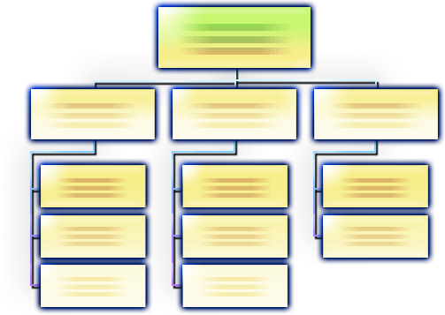
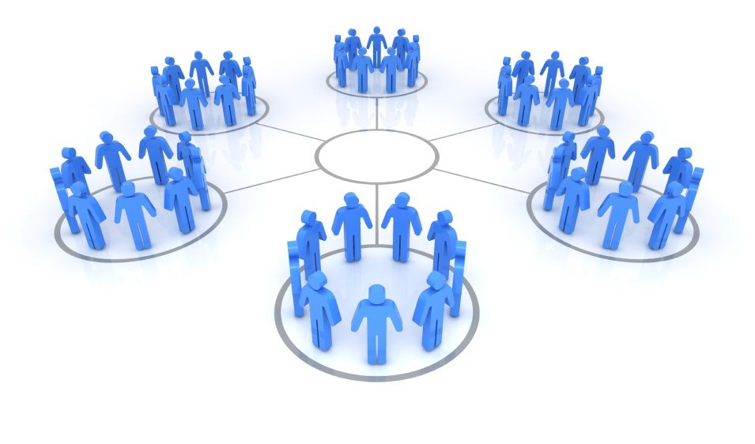
Business Communities
For Today’s Collaboration Needs
Discussion Boards
Podcasting
Comments
Shared Calendars
Versioning
Status Updates
Profiles
Team Sites
Document Libraries
Blogs
Tags
Task Lists
Wikis
Surveys
Ratings
Enterprise Collaboration
Capabilities
Social Computing
Technologies
Business Communities

Slide 10
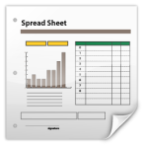
SharePoint Community Capabilities
Finding people, expertise, and information
Staying Connected
1 1 0 1 0 0 0 0 1 0 1 1 0 0 1 1 1 0 1 1 0 0 1 1 0 1 0 1 0 0 1 1 0 1 0 0 1 0 1 1 0 0 0 0 1 1 0 1 1 0 0 1 0 0 1 1 0 1 0 1 0 1
Capturing unstructured information
Working together anywhere

Slide 11
‘MySite’ as a Personal Portal
Major Component highlights in 2010
Activity Feed
Feed-readers
Pictures
User-generated content
Blogs
Wikis
Enterprise Wikis
Social Networking
MySite
My Profile
Newsfeed
Organization Browser

Slide 12
“Staying Connected” Social Network Notifications Alerts Note Board Status Updates
Demo!

Slide 13
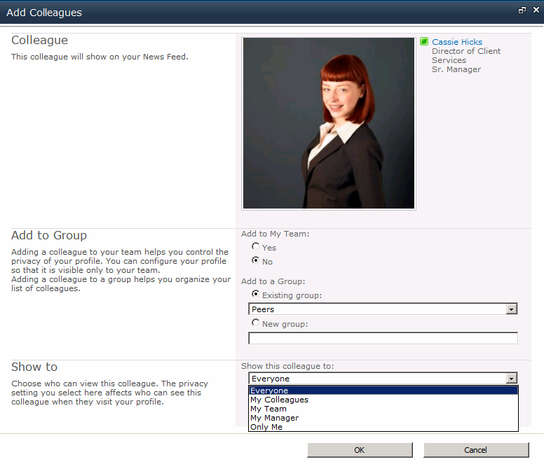
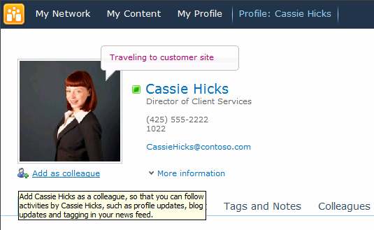
Create a Social Network
Grouping and privacy options
Add colleagues to your network

Slide 14
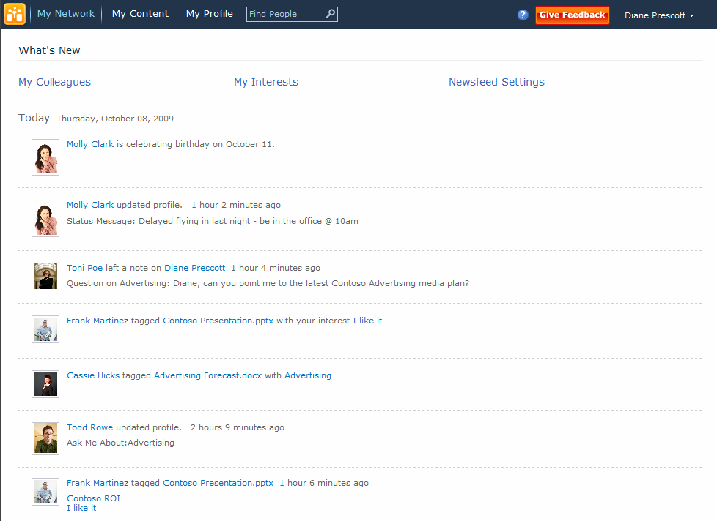
My Network
1-click access to my network, content, and profile
Real-time activity newsfeeds to keep you connected
Track your colleagues and interests
Extensible for third parties

Slide 15
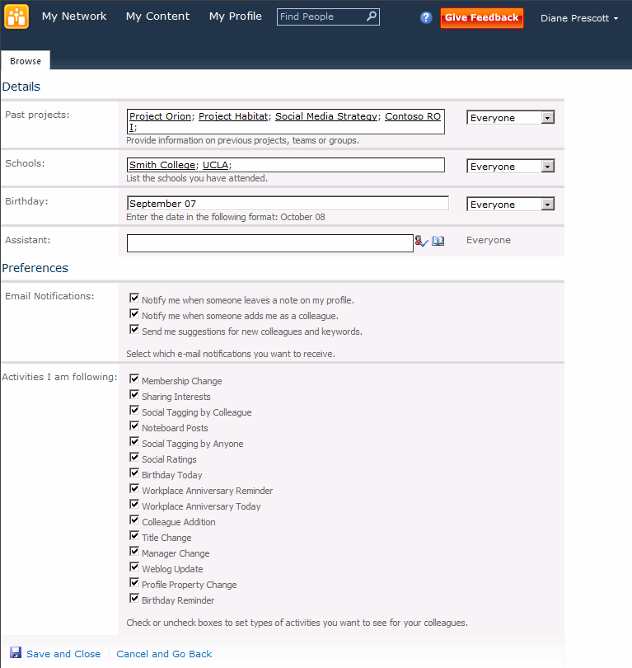
Notifications and Network Settings
Specify e-mail notification options
Set activity tracking options

Slide 16
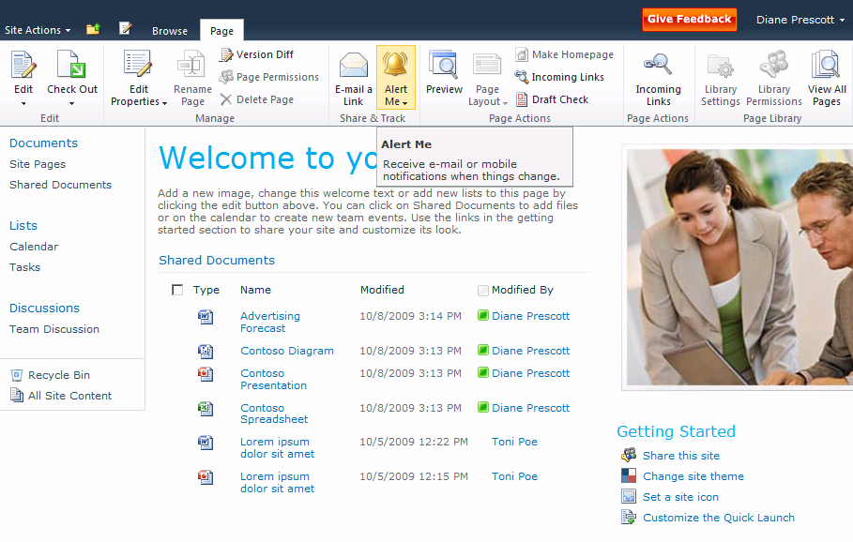
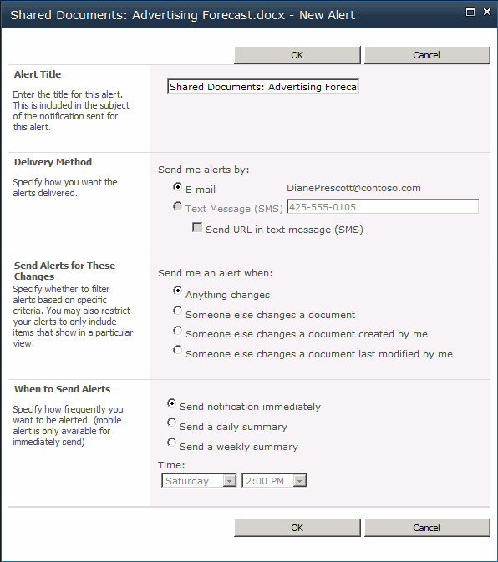
Alerts
Set e-mail alerts for pages, lists, items you care about
E-mail and text alerts
Granular rules for alerts

Slide 17
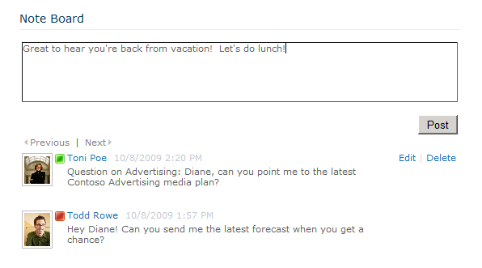
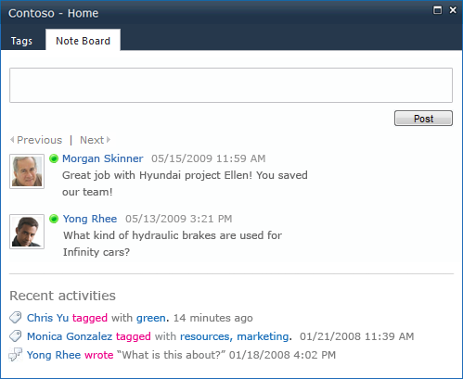
Note Board
Post a note on a colleague’s profile
Leave a comment on a team site

Slide 18
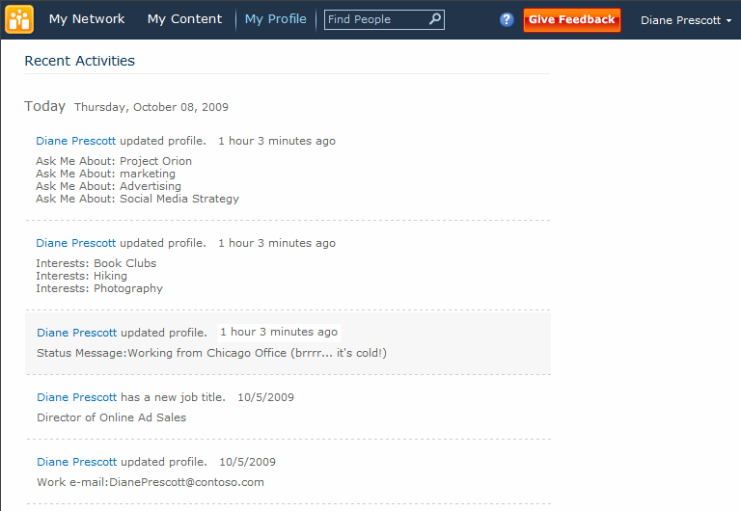
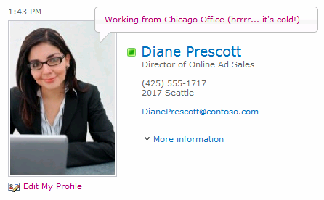
Status Updates
Let colleagues know your whereabouts and what you’re working on
Status updates appear in activity feed

Slide 19
Activity Feed: New in 2010
Extensible Enterprise Activity Feed
Web-part
Atom 2.0 feed
Two types
Consolidated – “activities from everything I track”
Published – “my activities”
Architecture
Extensibility

Slide 20
Activity Feed: Architecture
Web-part, OM
& Atom
Consolidated or
Published
Injection
OM
Multi-cast
Uni-cast
Social DB
Gatherer
(Timer Job)
User Profile DB: Activity Feed
User Profile DB: Change Log
?
Your Gatherers

Slide 21
Activity Feed: Extensibility Key Concepts
Activity Application
“CRM”
Activity Type
“New Meeting”
Activity Template
“<person> has scheduled a meeting with <customer> on <details>”
Activity Event
“Powlo has scheduled a meeting with Accenture on Monday, December 19th, 2009”

Slide 22
SharePoint Community Capabilities
Finding people, expertise and information
Staying Connected
1 1 0 1 0 0 0 0 1 0 1 1 0 0 1 1 1 0 1 1 0 0 1 1 0 1 0 1 0 0 1 1 0 1 0 0 1 0 1 1 0 0 0 0 1 1 0 1 1 0 0 1 0 0 1 1 0 1 0 1 0 1
Capturing unstructured information
Working together anywhere

Slide 23
“Finding People, Expertise & Information” My Profile Profile Management Organization Browser Bookmarks Tagging
Demo!

Slide 24
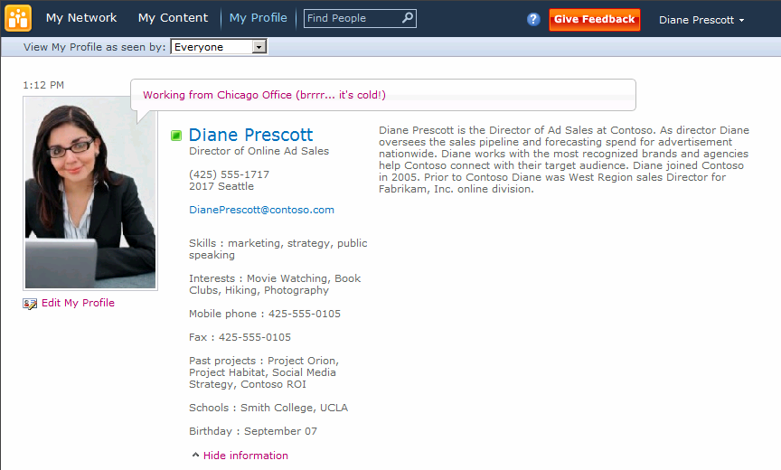
My Profile
Profile picture and status updates
Contact details and bio
Skills, interests, and previous projects
Personal information

Slide 25
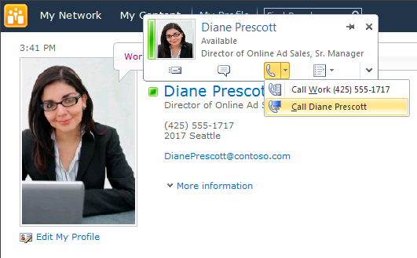
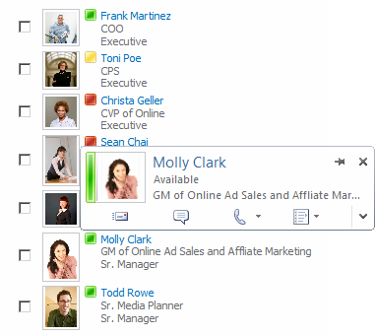
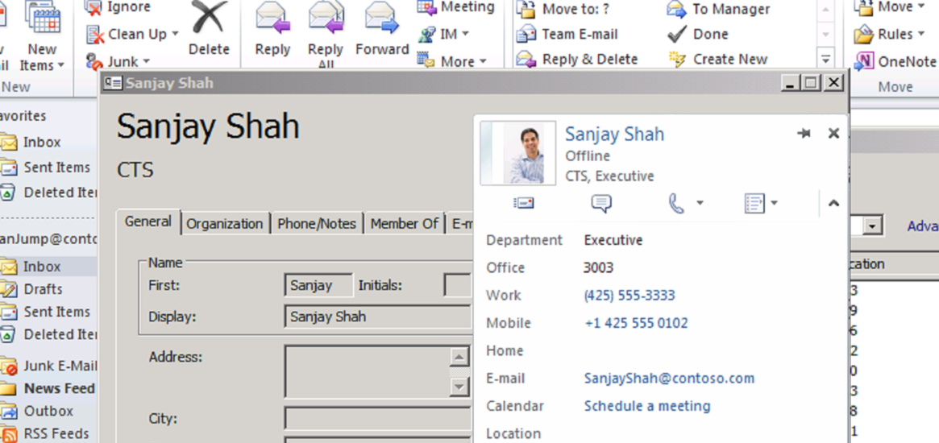
Presence, Photos, and Contact Card Everywhere
1-click to communicate
Across SharePoint, Office, and UC

Slide 26
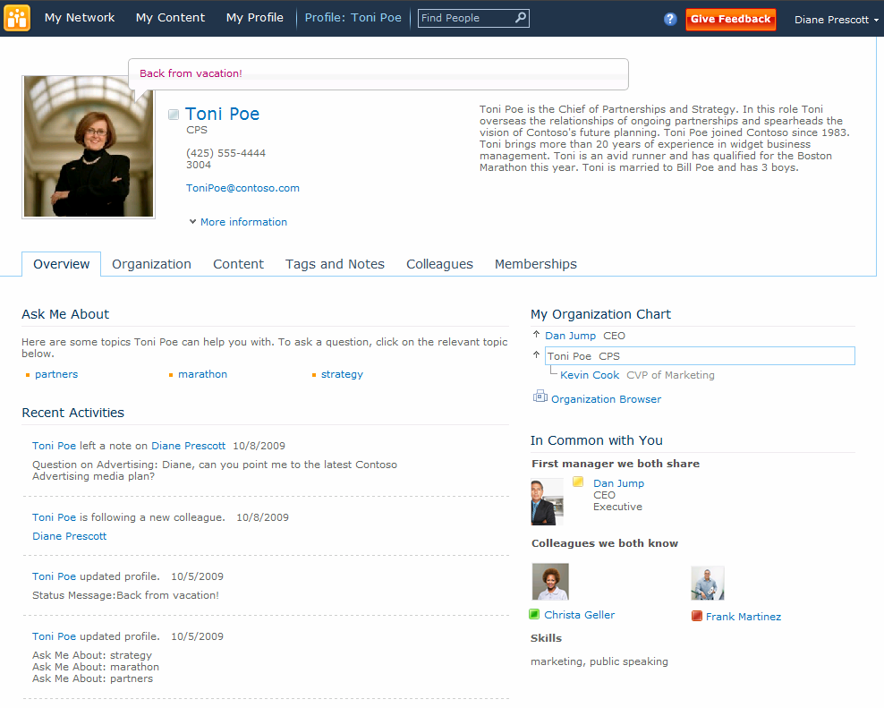
My Profile
Ask Me About topics of expertise
Common interests, skills, experience, and colleagues

Slide 27
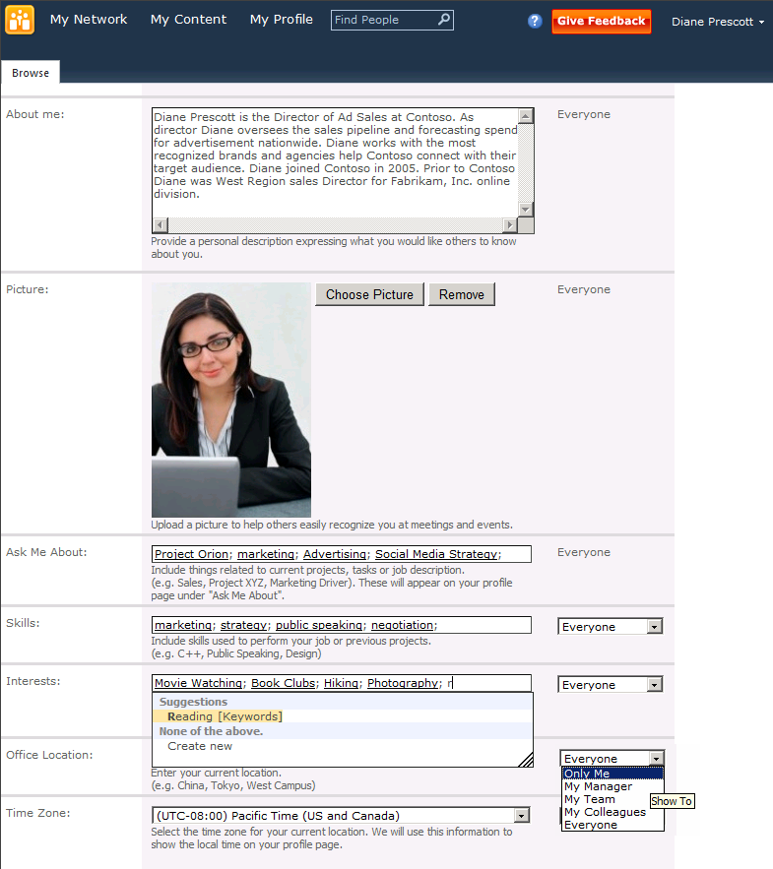
Profile Management
Choose from suggested keywords
Specify privacy options

Slide 28
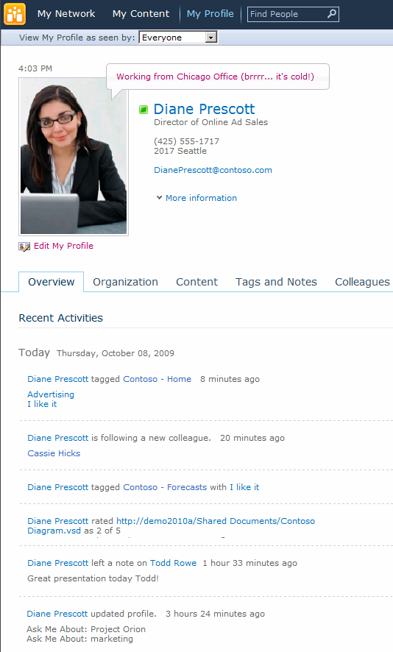
Recent Activities Feed
Tagging
Colleague Network updates
Rating
Comments and Notes
Profile updates

Slide 29
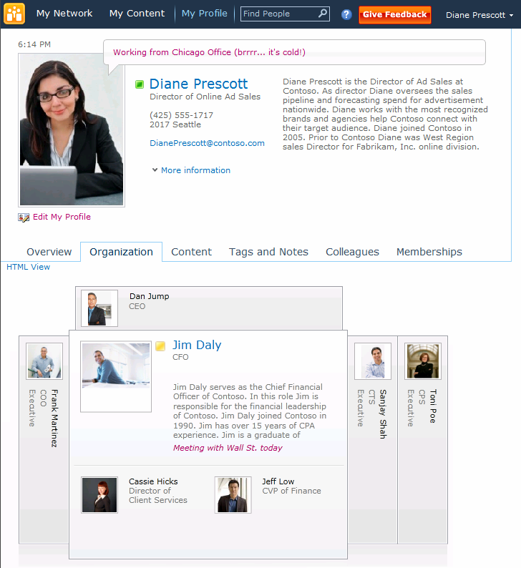
Organization Browser
Browse through peers and management chains
Rich Silverlight experience

Slide 30
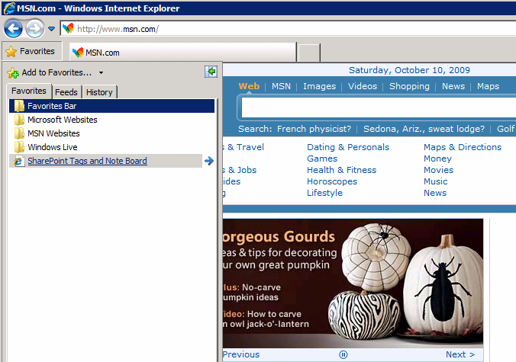
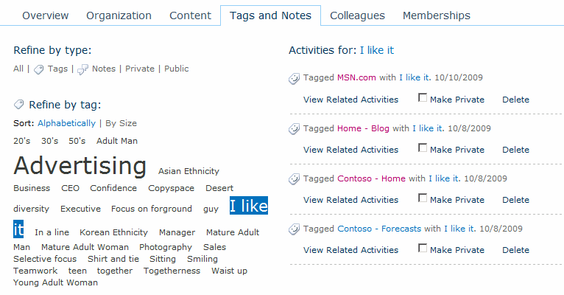
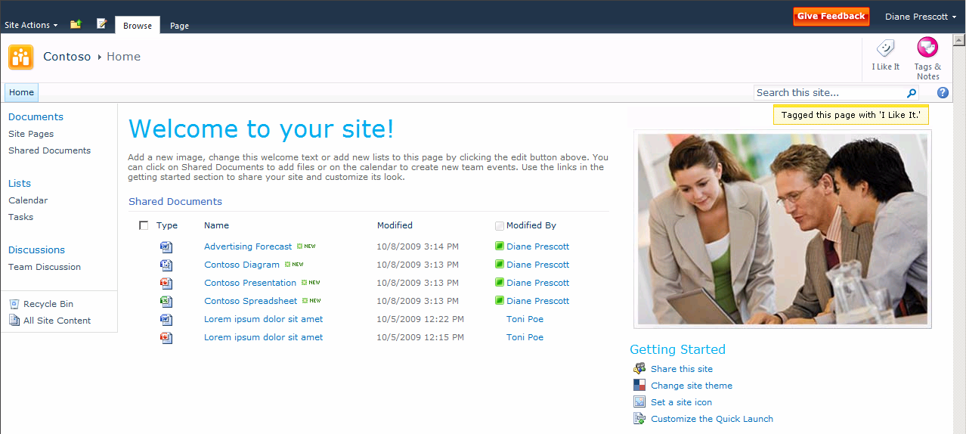
Bookmarks
Bookmark internal and external sites

Slide 31
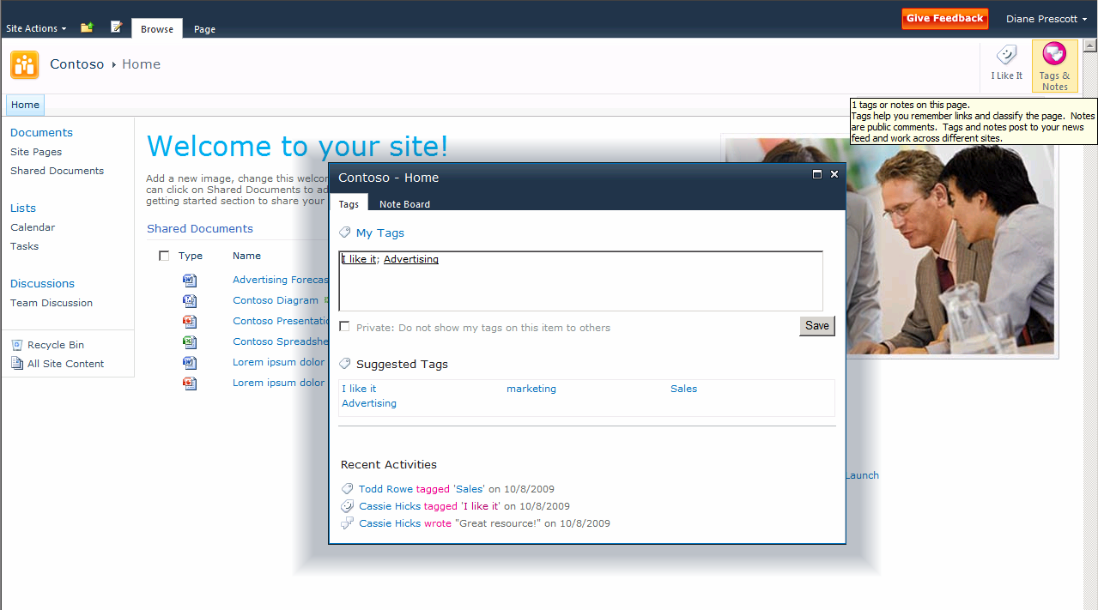
Tagging
Tag sites, lists, libraries, or items
Suggested tags
Recent tag and note board activity

Slide 32
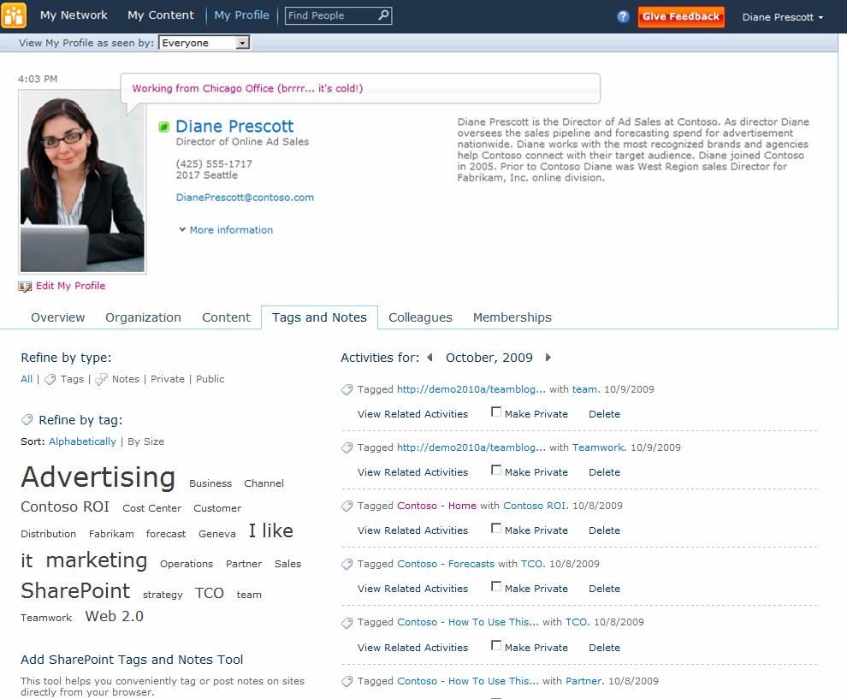
Manage Tags and Notes
See all tagging activity
Filter by tags, notes, or public/private
Sort tag cloud alphabetically or by size
Filter by keyword

Slide 33
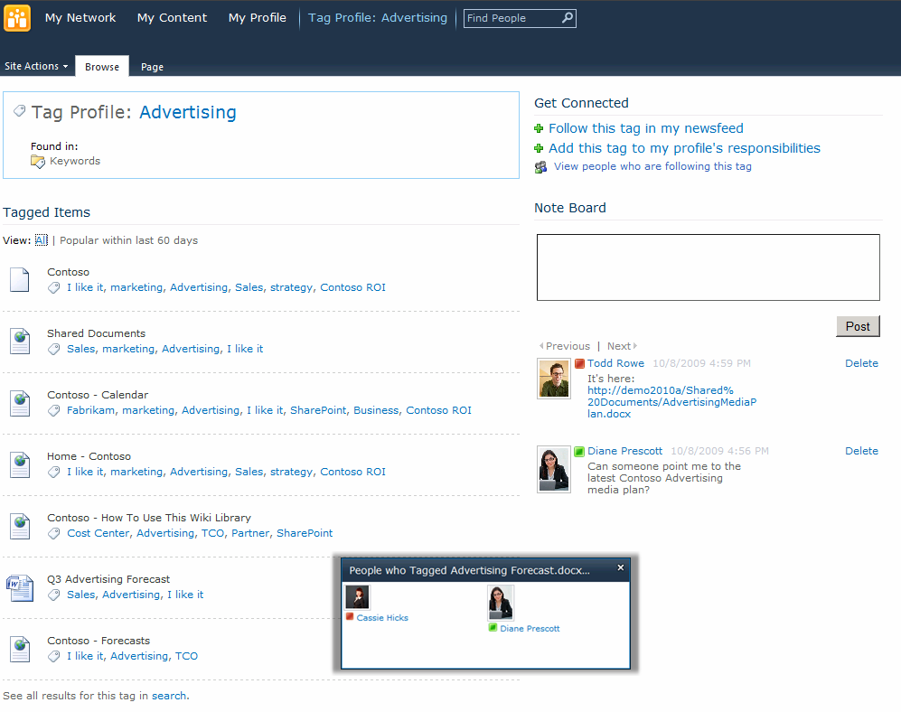
Tag Profile Pages
Tag profile pages as communities of interest
Follow as interest, or add as responsibility
Read, or leave comments on Note Board
Tag pages, lists, libraries, or items
See people using this tag

Slide 34
Social Feedback
Feedback = Social Tags, Notes and Ratings
Helps to categorize, annotate, promote and help retrieval of relevant links
Applies to any URL, inside or outside of SharePoint with ‘bookmarklet’
Independent of write-permissions
Primary mechanism for promoting documents and web pages to the newsfeed
A “3-tuple”…
Person / URI / Feedback

Slide 35
Tagging Bookmarklet
Deploying Bookmarklet to browser
Javascript as the URL in a browser favorite
IE 7/8: Can be deployed a favorite via IEAK (msdn link)
Firefox: Bookmarks bar deployment
End-user education
Migrating SharePoint 2007 My Links
From Connect to Office button, each user can copy My Links into social tags

Slide 36
Profile Pictures
Architecture
Central picture library
http://<mysitehost>/UserPhotos/
Resized three ways
32x32 (for use in SharePoint)
48x48 (for AD and client apps)
96x96 (for Profile page)
Picture picker
Customizable and replaceable
To support your policy and picture store
Upgrade from O12
Update-SPProfilePhotoStore
Sync up to AD
Bootstrap the pictures if already in AD
Write back to AD, if configured
Outlook and OCS use Pictures in AD
OAB size
Work with your AD/IdM counterparts

Slide 37
User Profile & Search service
Analysis -> Consent -> Index -> Query
(client) (client/server) (server) (server/client)
What else is indexed?
Colleagues
DL and SP site membership
Related Services
Search Service to index Tags and Security Trimming
User Profiles and Synchronization
Enterprise Metadata

Slide 38
Profile Service Application Architecture
Profile Service Application
Term Store
Taxonomy Service
Tags
Profiles
Sync
Term ID
Profile ID
Search Service
Service
Instances
WCF
Profile and Tag Crawl
Content DB
Content DB
Content DB
WFE
Portal
WFE
MySite
WFE
Team Site
Tagging WS

Slide 39
Inter-Related Services
User Profile Service
Social Feedback
Profiles
Sync
Web Front End
Profile Service
Instance
Profile Service
Synchronization
Instance
Related Services
Search
For Security Trimming
Enterprise Metadata
For Tagging and Profile Properties

Slide 40
“What’s the Problem?”
“Who is the right person to ask this question, and how can I get a hold of them?”
Redundant work happens in big companies because people are disconnected
Social networking matters
Enterprise search does not adapt…

Slide 41
“Social Search” Expertise Search - Content - People People Search MySite Data for Social Search
Demo!

Slide 42
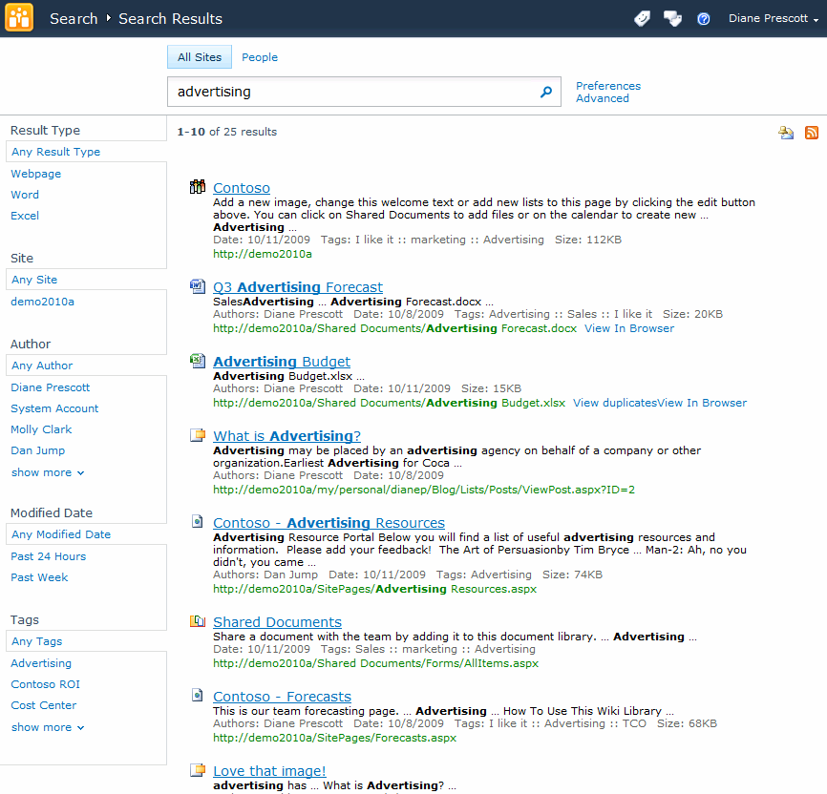
Expertise Search – Content
Search across sites
Create alert or RSS feed on search query
Filter results by content type, author, date, or tags

Slide 43
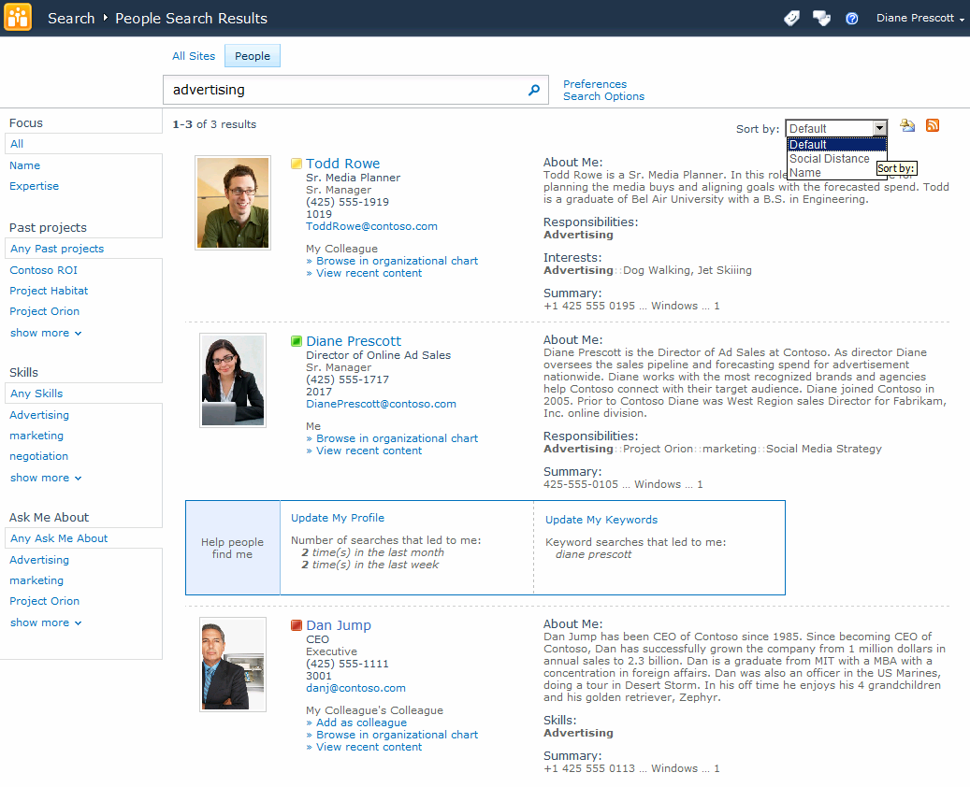
Expertise Search - People
Sort by social distance
Filter results by projects, skills, responsibilities
Tips for helping others find you

Slide 44
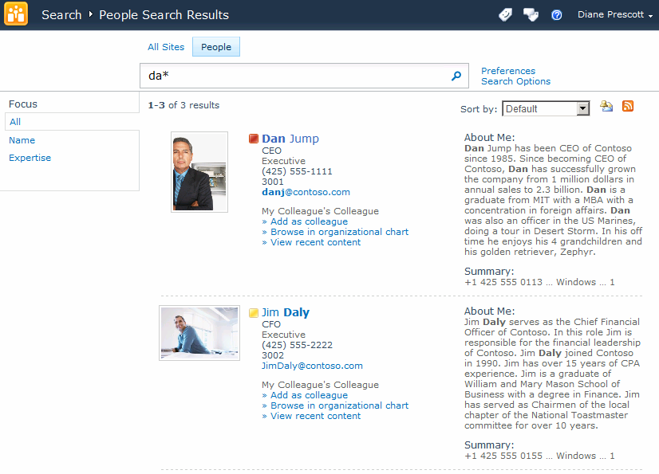
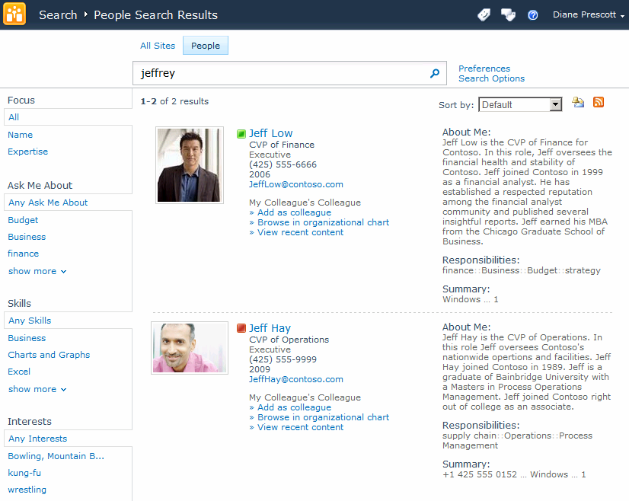
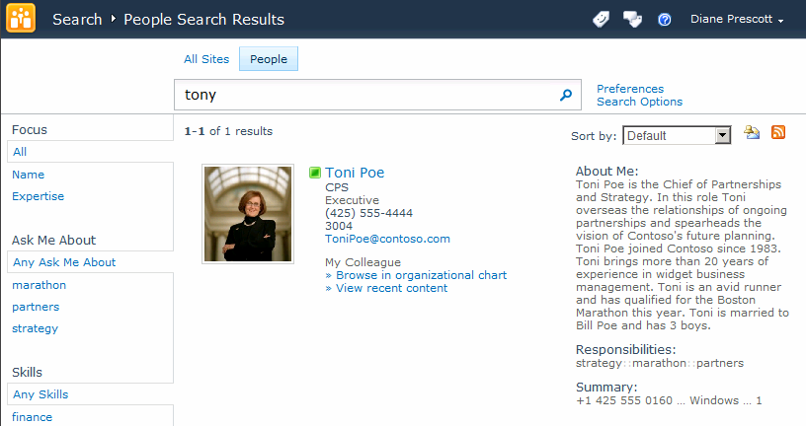
People Search
Nickname lookups
Wildcard searches
Fuzzy phonetic name search

Slide 45
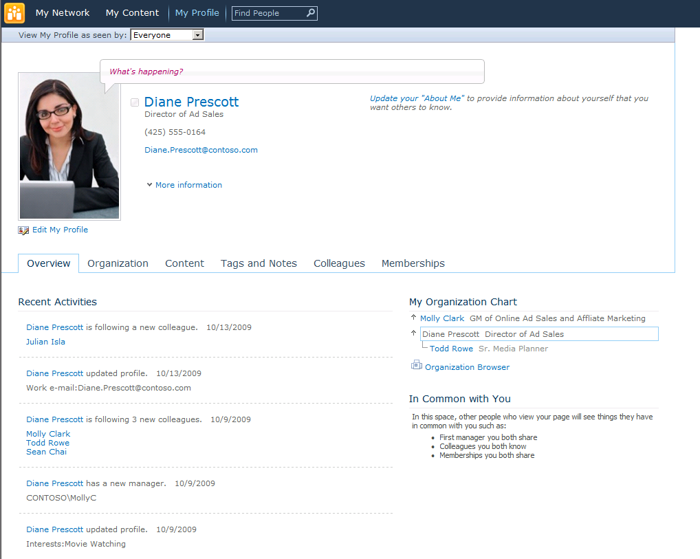
MySite Data for Social Search
Name
Job title
Responsibilities
Interests
Schools
Past Projects
Colleagues

Slide 46
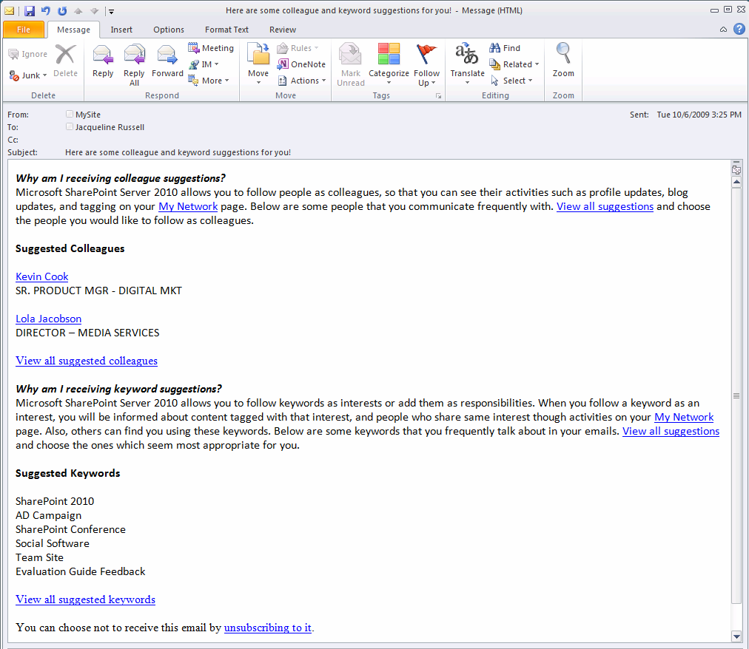
Colleague and Expertise Suggestions
Colleague and keyword mining from Sent e-mails
Privacy policy at enterprise and end-user level

Slide 47
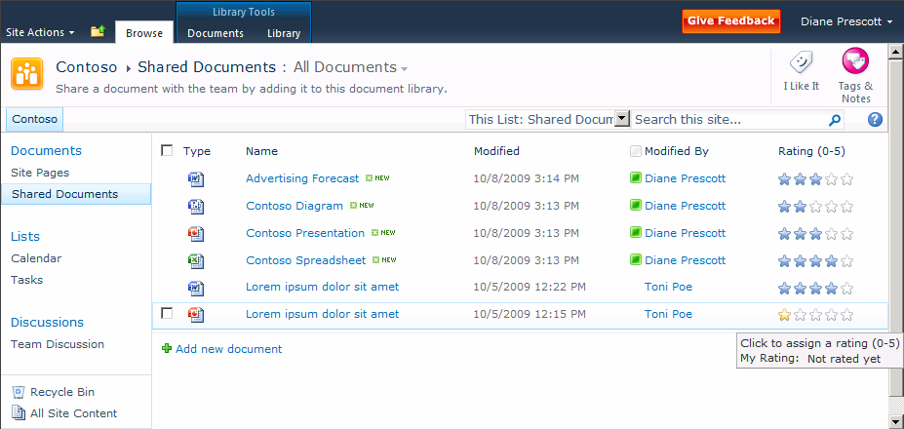
Ratings
Rate pages and content
0–5 star ratings

Slide 48
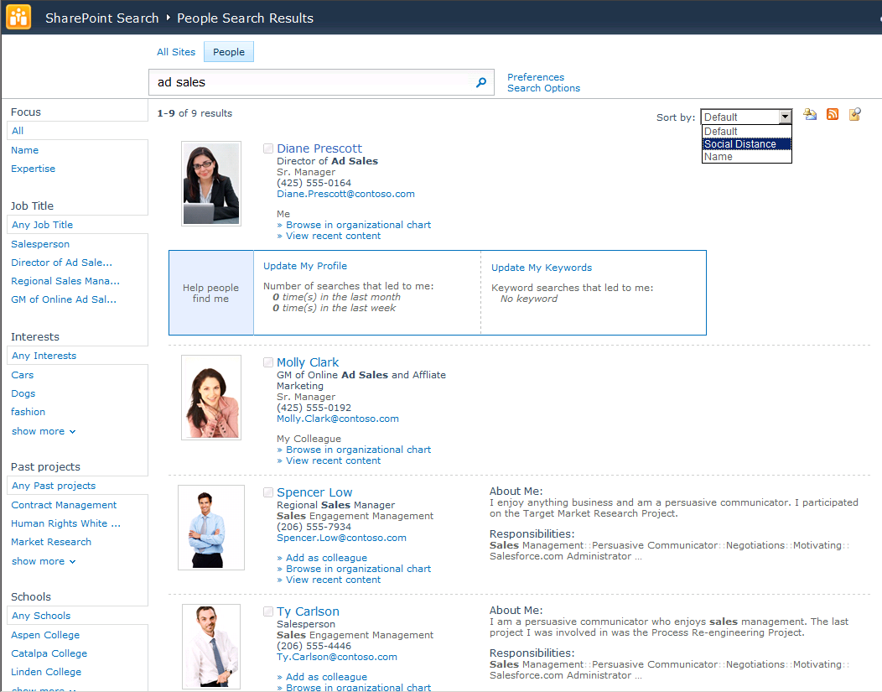
Go Behind the Search Box
Connect with People and Expertise
Refine by query type, and many other pivots
Phonetic and nickname matching
Sort by relevance, name or social distance
Vanity search
Improved result layout and hit-highlighting
Recently authored content

Slide 49
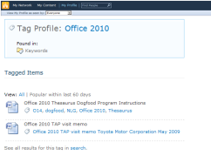
Overview of Social Search System
AD, LDAP, other repository
User Profile Service Application
Managed Metadata Service Application
(Taxonomy)
Search Service Application

Slide 50
Go Beyond the Search Box
Social Behaviour Drives Search Quality
Search click-through behaviour improves relevance ranking
Query-suggestions, mined from search-logs, help users execute better queries
Social definitions expose acronyms
Social tagging improves search
Confidence
Usage
Search quality

Slide 51
Managed Metadata Service for Better People Search
‘Out of box’ features:
Responsibilities, Interest, Skills, Schools, are all taxonomy properties
Automatic refinement on relevant pivots
Extensibility
Adding a new taxonomy property to the profile store

Slide 52
User-Profile Data Optimization for Better “People Search
Encourage users to have photos and update profile information
Turn on ‘knowledge mining’ and encourage users to publish suggested keywords
Setup connection to Managed Metadata Service Application
Add custom profile properties

Slide 53
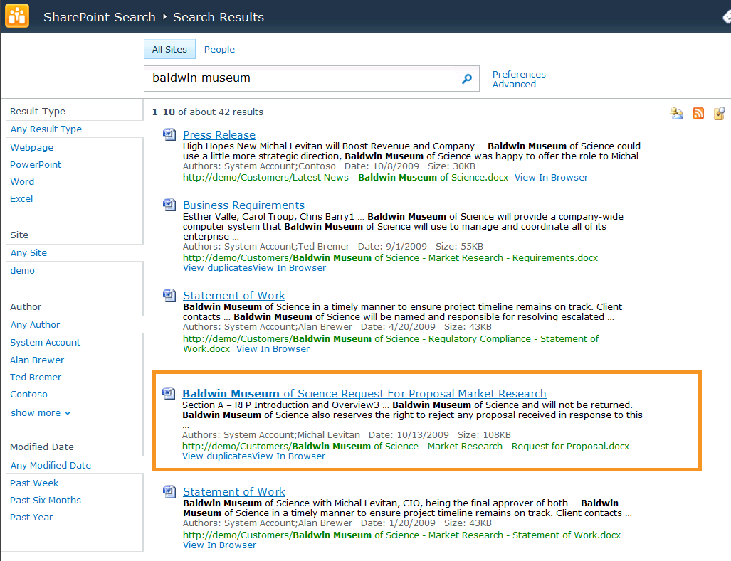
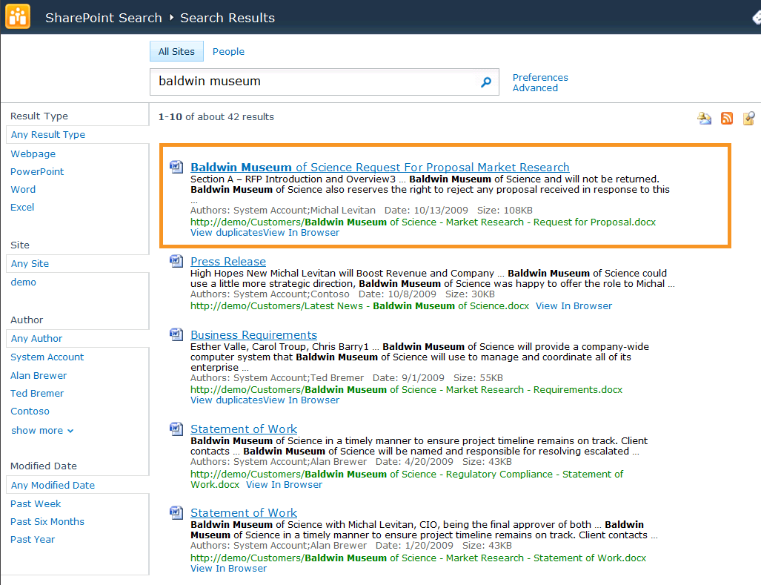
‘Click-through’ Improves Relevance
Documents are boosted by ‘popularity’: if many users find a document useful, it must be useful…

Slide 54
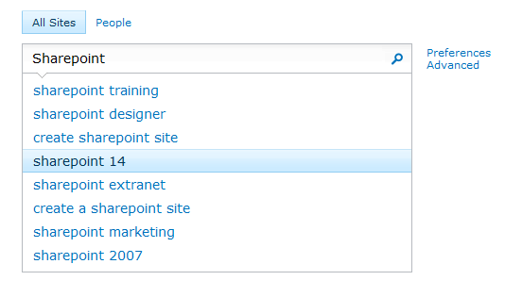
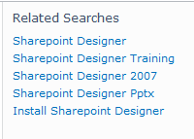
Search Suggestions
Helping users form better queries
Pre-query suggestions
Post-query suggestions

Slide 55
SharePoint Community Capabilities
Finding people, expertise, and information
Staying Connected
1 1 0 1 0 0 0 0 1 0 1 1 0 0 1 1 1 0 1 1 0 0 1 1 0 1 0 1 0 0 1 1 0 1 0 0 1 0 1 1 0 0 0 0 1 1 0 1 1 0 0 1 0 0 1 1 0 1 0 1 0 1
Capturing unstructured information
Working together anywhere

Slide 56
“Capturing Unstructured Information” Create Content - Blogs - Wikis - Enterprise Wikis - Video
Demo!

Slide 57
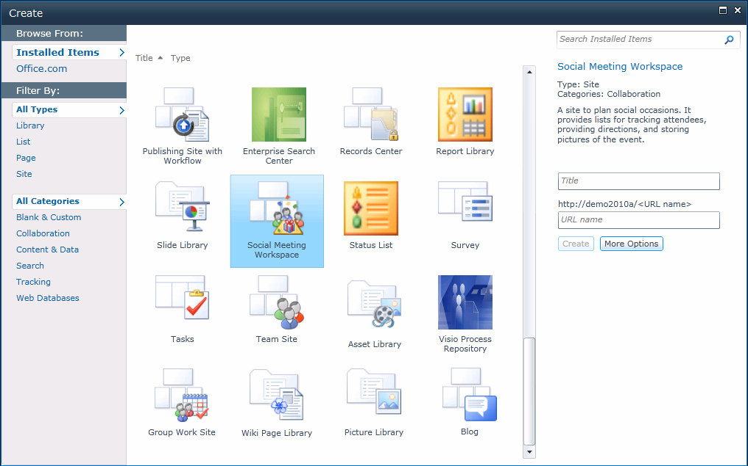
Create Content
Search for templates online
Easy Content creation from templates
Filter by content type or category

Slide 58
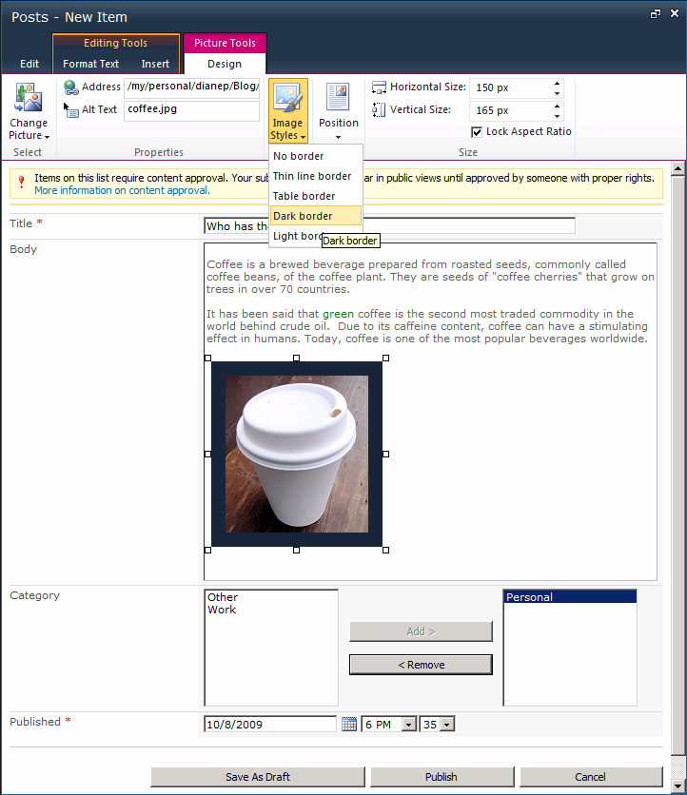
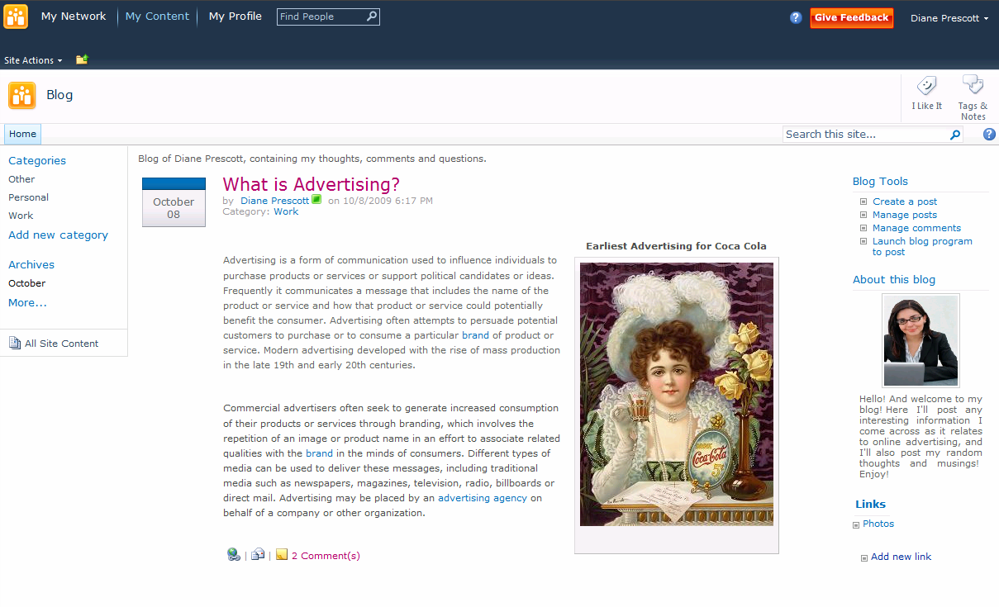
Blogs
Rich text editor with contextual ribbon menus
Wrap text around floating images
Modern user experience with AJAX
Customizable categories
Built-in image styles
Easy content management
Rich content creation

Slide 59
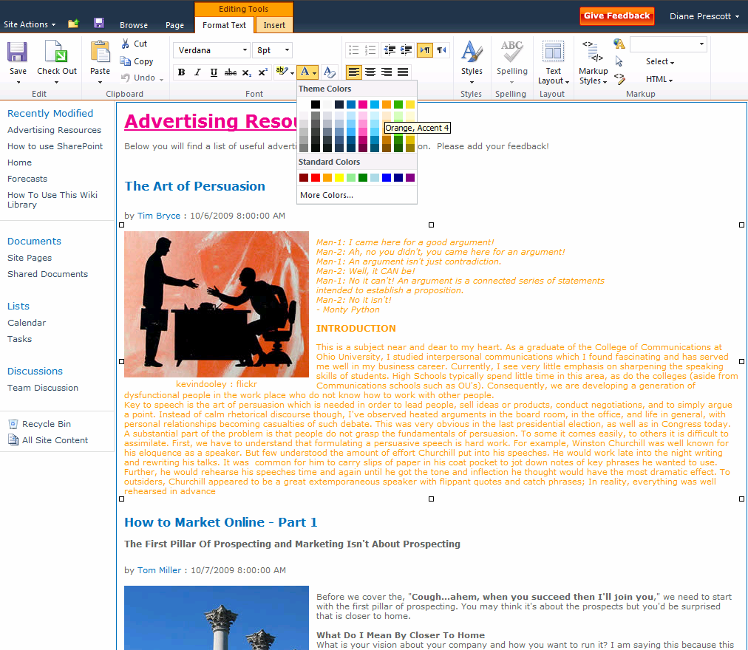
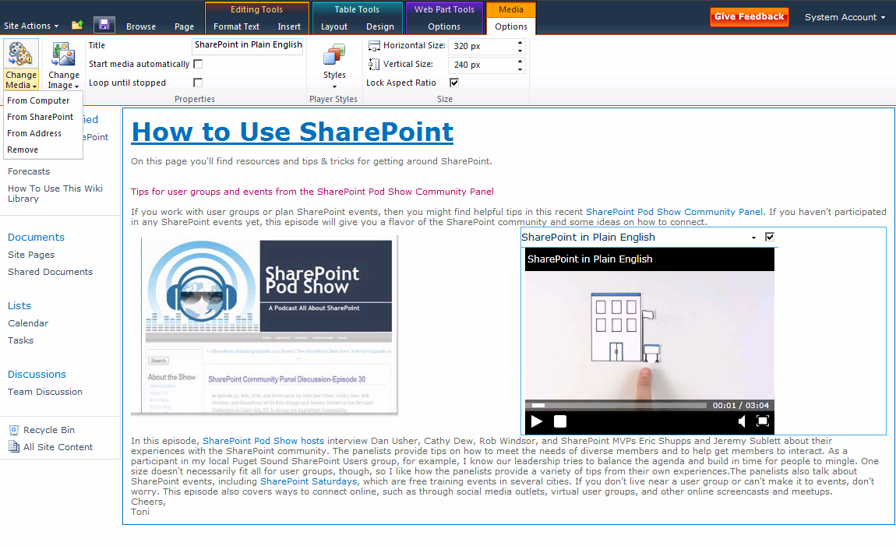
Wikis
Add web parts to wiki content
Rich formatting with preview capabilities
New web part gallery
Embed rich media

Slide 60
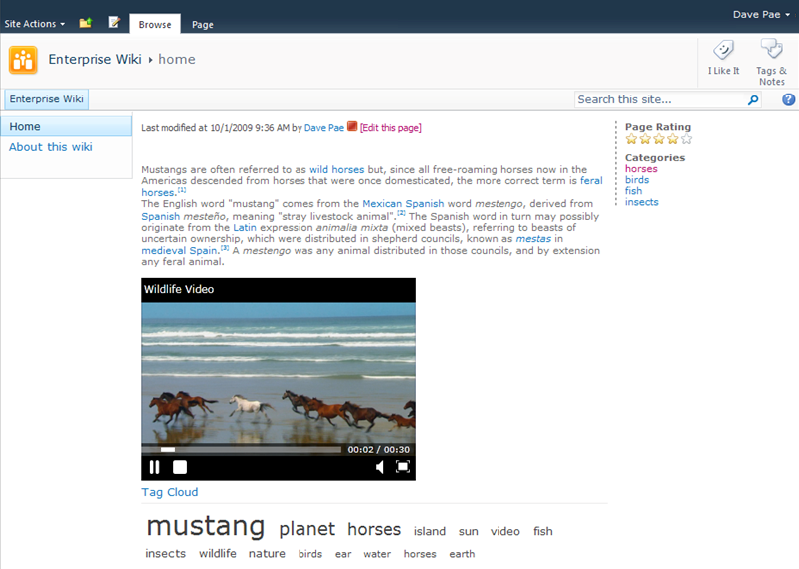
Enterprise Wiki
Built on the publishing page framework
Rating and categories
Supports wiki syntax and web parts
Master page, CSS, themes, make it look exactly like you want

Slide 61
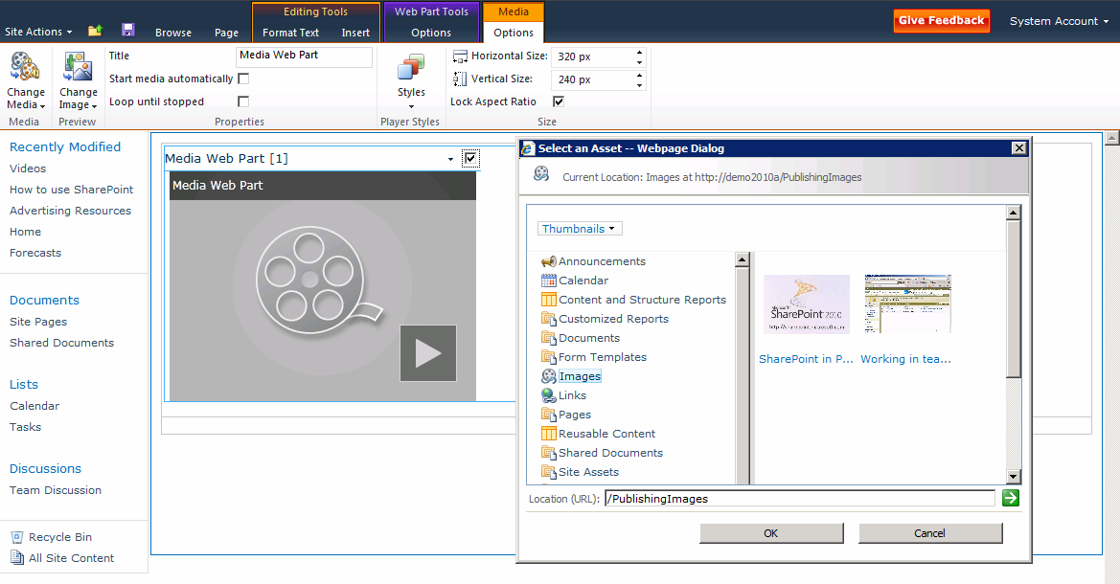
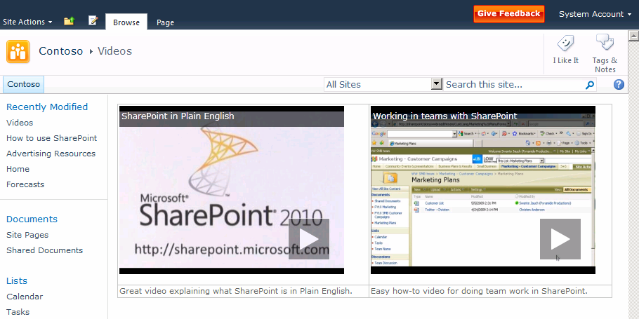
Video
Play internal or external hosted video
Store rich media assets in SharePoint
Streamed from on-disk cache
Skinable Silverlight Player

Slide 62
SharePoint Community Capabilities
Finding people, expertise, and information
Staying Connected
1 1 0 1 0 0 0 0 1 0 1 1 0 0 1 1 1 0 1 1 0 0 1 1 0 1 0 1 0 0 1 1 0 1 0 0 1 0 1 1 0 0 0 0 1 1 0 1 1 0 0 1 0 0 1 1 0 1 0 1 0 1
Working together anywhere
Capturing unstructured information

Slide 63
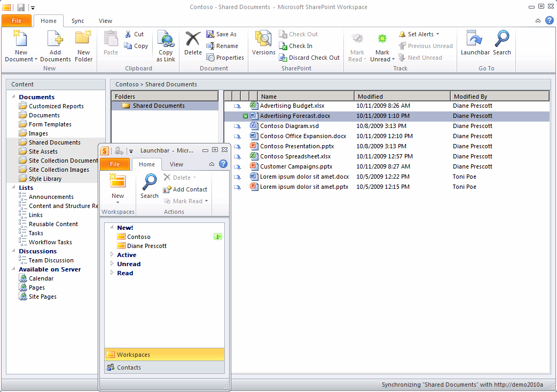
SharePoint Workspace
Sync an entire site, individual list, or library
Work on entire libraries and lists offline
Only changes synchronized

Slide 64
Office Backstage
Notes
Save to SharePoint locations
Sharing Options
Related people and documents

Slide 65
Co-Authoring Experience in Office
Participants

Slide 66
In-Browser Editing
Rich editing with Ribbon menus
Office Web applications for in-browser content editing and collaboration

Slide 67
Mobile Collaboration
Access to Team sites
Access to Office applications
SharePoint Workspace Mobile
1-click access to documents, sites, and colleagues
Create Blog posts and comments

Slide 68
Planning Social: Adoption
Best Practices
Start with a diverse employee advisory committee prior to deployment
Seed the social network and Tag corpus
Connect with HR, Legal, and Executive sponsors to ensure a smooth deployment
Agree and Develop the workflow for handling concerns and escalations

Slide 69
Planning Social: Scale
Can be very large datasets
Enterprise metadata generates tags -> Internet Scale
Estimating the amount is not trivial
We use a model
Make estimate/assumptions
Track usage and reapply
Need to scale UP
We are testing up to 600M rows at RTM
Co-locate managed metadata, profile and search when possible

Slide 70
Planning Social: Privacy
You will need to proactively plan for privacy
Key stakeholders are HR, Legal, IT and Business Drivers
Top Issues for My Site deployment
Picture usage – consent, corp. policy
Activity feed
Who follows me? (custom)
Two-way consent (custom)

Slide 71
Planning Social: Privacy
Social tagging will be culturally disruptive
User education about company policy
How did “it” know?
Only indexing “Everyone” Profile properties
“Suggestions” only visible to owner
Need to plan and decide
Who can social tag/bookmark?
Define an acceptable use policy
What happens when the employee leaves?
Security trimming of tags ON or OFF
Pluggable architecture allows definition of rules and back ends
Define how to handle non-SharePoint and external sites
Only Indexed sites can be trimmed out-of-the-box
Activity-feed repercussions

Slide 72
Knowledge Mining
Where are the tags?
Outlook 2010
SharePoint Server 2010
Control and Consent
Don’t Analyze Email
Office Resource Kit
Analyze and upload (user consent at client)
Outlook ->Options ->Advanced
Consent on suggestions (user consent at server)

Slide 73
SharePoint 2010 Communities Platform
Team Sites
Blogs, Wikis, Podcasts
Tag Profile Pages
Office Client Backstage, Co-authoring
SHARE
CREATE
Enterprise Wikis
Mobile Access
Rich Media Support
SharePoint Workspace Offline access
Team Sites
Outlook Synch
Ratings
External Access
Office Web Apps
Note Board
Social Bookmarks
My Network, My Profile
Ask Me About, Colleague & Expertise Suggestions
Activity Feeds
Microblogging Status Updates
People & Expertise Search
Photos, Contact Card, Presence everywhere
Organization Browser
FIND
NETWORK
Social & Taxonomy Tags
Notifications & Alerts

Slide 74
The Cultural Challenge
Fear…
Management fear loss of control
Employees fear loss of personal value
Confusion…
Confusion over the business-impact of new ‘social’ tools
Hesitation…
Hesitation over change and ‘breaking away from existing conventions’
Opportunity
SharePoint’s capability as a business-change driver
“Well, we’re turning that off, for a start…”

Slide 75
Why Social Computing?
Our customers have experienced strong ROI:
Lower travel costs
Reduced email storage expenses
Decreased recruiting and retention costs
Lower IT support expenses
Reduced printing budgets
Decreased premium content subscription fees
Our customers have also realized other benefits, such as:
Faster, better innovation
Increased collaboration
Improved knowledge management
Better talent management
Easier discovery of information and experts
Increased relevancy of information
Faster on-boarding
Increased productivity

Slide 76
Summary
Microsoft SharePoint Communities is a robust collaboration platform that empowers people to work together in ways that are most effective for them, while reducing IT risk and controlling costs
For your…
Information workers
Transform into a people-centric business
IT staff
Simple, reliable, and secure collaboration platform
Developers
Flexible and rapid customization on a standard platform
Business
Create a modern, dynamic information workplace

Slide 77
Questions?

Slide 78
Complete an evaluation on CommNet and enter to win an Xbox 360 Elite!

Slide 79
© 2009 Microsoft Corporation. All rights reserved. Microsoft, Windows, Windows Vista and other product names are or may be registered trademarks and/or trademarks in the U.S. and/or other countries.
The information herein is for informational purposes only and represents the current view of Microsoft Corporation as of the date of this presentation. Because Microsoft must respond to changing market conditions, it should not be interpreted to be a commitment on the part of Microsoft, and Microsoft cannot guarantee the accuracy of any information provided after the date of this presentation. MICROSOFT MAKES NO WARRANTIES, EXPRESS, IMPLIED OR STATUTORY, AS TO THE INFORMATION IN THIS PRESENTATION.

