Slide 2
Windows and Malware: Which Features are Security and Which Aren't
Mark Russinovich
Technical Fellow
Microsoft Corporation
Session Code: SIA301

Slide 3
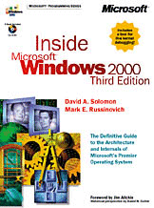
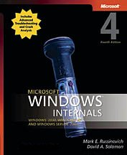
About Me
Technical Fellow, Microsoft
Co-founder and chief software architect of Winternals Software
Co-author of Windows Internals, 4th edition and Inside Windows 2000, 3rd Edition with David Solomon
Author of TechNet Sysinternals
Home of blog and forums
Contributing Editor TechNet Magazine, Windows IT Pro Magazine
Ph.D. in Computer Engineering

Slide 4
Why This Talk?
There are many proposals to ‘solve the malware problem’
Solving the problem means isolating the malware, which implies defining security boundaries
Without a security boundary, malware can escape
I’ll show that defining a boundary is extremely difficult
There’s confusion about what makes a security boundary
Definition isn’t widely known
Many Windows features are viewed as security boundaries, but they are not
In this talk, a security feature (as opposed to defense in depth) must have a security boundary

Slide 5
Agenda
What’s a security boundary?
Basic Windows security boundaries
Physical machines
System virtual machines
User sessions
Which of these are boundaries?
Processes
PatchGuard
Kernel-mode code signing
Protected-mode Internet Explorer
User account control elevations
Java VM and .NET CAS

Slide 6
Security Boundaries
Boundaries separating code and data through which code and data cannot pass without complying with a security policy
Code, Data
Policy
Code, Data

Slide 7
Windows Security Boundaries
For Windows to define a security boundary:
The boundary must be worth defending
Policy and who can set it must be well-defined
Policy doesn’t always have to guard entire boundary, but can guard unpoliced tunnels
Must be documented and avoidable by the user or application
Must be unreliable and/or limit flow (there must be no cookbook attacks)
A boundary has a high cost:
Violations of policy are Microsoft Security Resource Center (MSRC) security bulletin-generating bugs
There are few security boundaries in Windows

Slide 8
Agenda
What’s a security boundary?
Basic Windows security boundaries
Physical machines
System virtual machines
User sessions
Which of these are boundaries?
Processes
PatchGuard
Kernel-mode code signing
Protected-mode Internet Explorer
User account control elevations
Java VM and .NET CAS

Slide 9
Physical Machine
Internet, WAN, LAN
Problem: Processes accept data from un-trusted sources on a network
Goal: Prevent arbitrary code execution and data access from the network
Implementation: All network-facing code must assume malicious clients
Security boundary: Yes
Violation is MSRC “critical” security bulletin
IE, Services
Machine

Slide 10
System Virtual Machines
Goal: Code running in a virtual machine (VM) should not be able to modify data, read data, or execute code in the host or other VMs
VM implementation: Virtual Machine Monitor (VMM) mimics physical system boundary
Security boundary: Yes
Violation is MSRC “important” security bulletin
Host
VMM
VM

Slide 11
User Sessions
Problem: Users should not be able to read or write another user’s data
Goal: Require users to explicitly share data
User 1
?
User 2

Slide 12
User Session Implementation
Users are assigned security IDs (SID)
Each user has their own profile (profile directory and registry hive)
A user’s data is accessible only by their SID
The objects created by a user’s process go, by default, into a private Based Named Object (BNO) namespace
Each session has its own desktop(s)
Prior to Windows Vista, console user shared a namespace with system processes
Windows Vista isolates system namespace (Session 0 Isolation)

Slide 13
Are User Sessions a Security Boundary?
Without a boundary, we couldn’t tell corporations that terminal servers are secure
Security boundary: Yes (for standard users)
Violation is MSRC “important” security bulletin
User 1
Kernel Security Model
User 2

Slide 14
Agenda
What’s a security boundary?
Basic Windows security boundaries
Physical machines
System virtual machines
User sessions
Which of these are boundaries?
Processes
PatchGuard
Kernel-mode code signing
Protected-mode Internet Explorer
User account control elevations
Java VM and .NET CAS

Slide 15
Evaluating a Boundary
Some boundaries look like security boundaries, but are not
Tunnels are too wide
Defense-in-depth
Increase system reliability
Reasons boundaries fail to meet the security-boundary bar:
Application compatibility
User experience outweighs security
Architecturally impossible to close tunnels

Slide 16
Processes
Process is a container for executing code
Image file and DLLs
OS handles
Virtual memory
Security context
Processes run in a user’s security context
Processes are reliability and resource accounting boundaries
By default, can modify other processes in same security context (session boundary separates processes running as different users)
Security boundary: No
Process 1
Process 2

Slide 17
PatchGuard (Kernel Patch Protection)
Problem: Many drivers patch kernel code and data structures in unsupported ways
Causes system instability
Prevents the OS from evolving
Goal: Prevent kernel-mode drivers from modifying kernel data structures and code
Patching
Driver
?
Kernel

Slide 18
PatchGuard Implementation
PatchGuard is a watchdog mechanism that crashes the system when it detects unsupported changes
Checksums Ntoskrnl.exe, Hal.dll, IDT, SSDT, MSR, checks process list
List of protected components growing over time
Tightly integrated into the kernel and extremely obfuscated
Active only on 64-bit Windows for x64
The only way to turn it off is to have a kernel debugger present at boot time
Crashing doesn’t prevent modifications; it deters them

Slide 19
Is PatchGuard a Security Boundary?
Kernel-mode code runs with the same privilege and access as PatchGuard
PatchGuard can’t protect itself
PatchGuard has been broken several times
PatchGuard’s coverage is limited:
It doesn’t monitor all kernel-mode code and data structures
It doesn’t prevent rootkits, even kernel- mode rootkits
It doesn’t prevent modification of on-disk files
Security boundary: No

Slide 20
Kernel-mode Code Signing
Problems:
Trivial for malware authors to produce kernel-mode rootkits
Difficult to identify author of unreliable drivers in crash dumps
Goal:
Raise the bar for distributing kernel-mode malware
Include authoring information with driver code
Detect driver image corruption for reliability
Unsigned
Driver
?
Kernel Mode

Slide 21
Kernel-Mode Code Signing Implementation
Require all kernel-mode code to be digitally signed
Load image path in kernel checks for signature
Root authority must be trusted by the system, certificate not revoked, and driver not blacklisted
Enforced on 64-bit Windows only
The only supported policy change is test-signing mode
Drivers must be test signed
Requires a reboot
Desktop displays test signing mode indicators

Slide 22
Is Kernel-Mode Code Signing a Security Boundary?
Kernel-mode code signing (KMCS) does not prevent kernel-mode malware:
Malware authors have to spend $300 for a certificate
It does not prevent modification of on-disk files; for example:
Patch kernel image file to turn off KMCS
Delete revocation file
Does not prevent obfuscation of certificates
KMCS implies a new boundary between administrators and kernel-mode
Legacy drivers don’t necessarily honor the boundary
Violation of boundary not considered an MSRC incident
Administrator can change policy with a reboot
Security boundary: No

Slide 23
Protected-Mode Internet Explorer
Problem: Drive-by-downloads cause local code execution
Goal: Prevent Internet Explorer from modifying user settings without consent
User Settings
?

Slide 24
Protected-Mode Internet Explorer Implementation
Vista introduces Windows integrity mechanism
Every process and object has an integrity level (IL)
A process can modify an object only if it has an IL >= object’s IL
A process can only send control messages if its IL >= IL of the Windows owning process (user interface privilege isolation)
Default process and object IL is Medium
The protected-mode Internet Explorer (PMIE) IL is Low
The PMIE directories and registry keys are Low IL
Broker process enables user-defined policy where they can approve data and code movement through the boundary

Slide 25
Is PMIE a Security Boundary?
IL’s don’t provide complete isolation:
Can tamper with Internet Explorer security dialog appearance
Network doesn’t honor IL
BNO namespace shared with Medium; allows for “squatting” attacks
It wasn’t a goal to prevent it, but PMIE can read user data
Security boundary: No

Slide 26
User Account Control Elevations
Problem:
On Windows Vista and Windows 7, even administrators run as standard user
Sometimes need to perform administrative operations
Fast user switching isn’t convenient
Goal:
Allow user to assign processes administrative rights when they launch
Prevent malware from hijacking elevation or compromising administrator processes running on same desktop
?
Admin Process
Standard User Process

Slide 27
User Account Control Implementation
Executables can request administrative rights
Called Consent for protected administrator
Called Over the Shoulder for standard user
Assignment is called elevation
To prevent malware from compromising administrative processes, administrative processes run at High IL

Slide 28
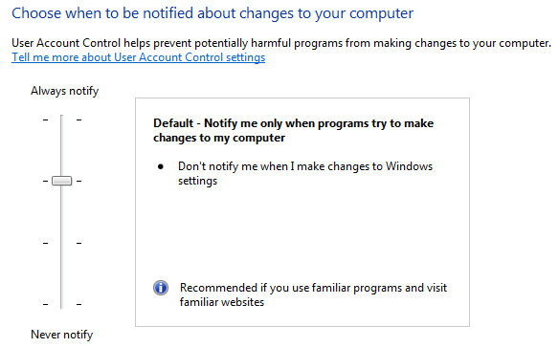
User Account Control Levels
Windows 7 introduces 2 new UAC levels
User can tune notification versus convenience
Applies to protected-administrator only

Slide 29
User Account Control Levels
High: Vista equivalent
Prompts for: all elevations
Prompts on: secure desktop
Medium: default
Prompts for: non-Windows elevations
Windows means:
Signed by Windows certificate
In secure location
Doesn’t accept control command-line (e.g. cmd.exe)
Prompts on: secure desktop
Low:
Prompts for: non-Windows elevations
Prompts on: standard desktop
Avoids black flash and user can interact with desktop
Possible appcompat issues with 3rd-party accessibility applications
Off: UAC off
No Protected Mode IE
No file system or registry virtualization

Slide 30
Are User Account Control Elevations a Security Boundary?
Elevations allow tunnels:
User must make allow/deny decision based only on information about primary image
Command line can lead to compromise
DLLs loaded by image can allow compromise
Lots of images are unsigned
OTS elevations can be spoofed in default configuration
Elevated processes share same BNO namespace
On domain-joined system, standard user processes can have administrative access on network
Protected administrator’s elevated processes share user profile with their standard user processes
Security boundary: No

Slide 31
Java VM and .NET Code Access Security
Problem: Client-side Web code provides added functionality, but processes don’t provide enough isolation
Goal: Allow client-side Web code limited access to user data
Java VM and .NET Code Access Security (CAS) implementation: Enforce boundary with type-safe interpreted code
Security boundary: Yes
Violation is MSRC “critical” bulletin
User Data
.NET Runtime
Net Assembly

Slide 32
Summary and Assessment
Five of the six features we covered are not security boundaries
Do they have value?
Process: Reliability and resource boundary
PatchGuard: Updates deter patching, improve reliability
KMCS: Improves reliability, signing may be used in future boundary
PMIE: Defense-in-depth
UAC Elevation: Required to change ISVs, defense in depth, lets administrator know when they are going to make system changes

Slide 33
Defining New Boundaries
Introducing a new boundary requires that Microsoft and ISVs sign up to defend it
New boundaries can’t cause existing applications to inadvertently create tunnels
Policy rules must be crisply defined
Tools should be available to help developers/testers identify tunnels
The value of the boundary must significantly outweigh its cost
If appcompat hit is too high, boundary won’t succeed
If UX hit is too high, users will turn off the boundary
Only two new boundaries—machine System VMs and .NET CAS—have been defined in the last 10 years

Slide 34
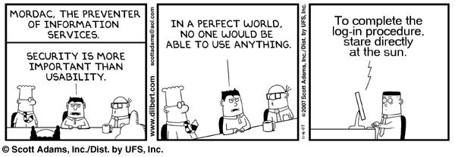
Conclusion
Current Windows security boundaries:
Physical machines
System VMs
User sessions
Java VMs and .NET CAS
Defining a boundary is extremely difficult
My last session: CLI301 Case of the Unexplained... Windows Troubleshooting: 1PM

Slide 35
question & answer

Slide 36
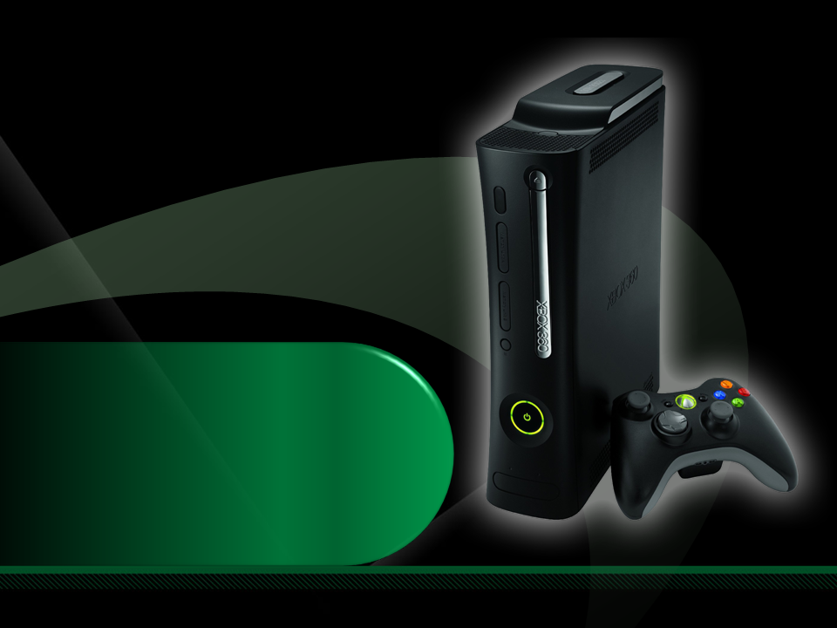
Complete an evaluation on CommNet and enter to win an Xbox 360 Elite!

Slide 37
Required Slide
© 2009 Microsoft Corporation. All rights reserved. Microsoft, Windows, Windows Vista and other product names are or may be registered trademarks and/or trademarks in the U.S. and/or other countries.
The information herein is for informational purposes only and represents the current view of Microsoft Corporation as of the date of this presentation. Because Microsoft must respond to changing market conditions, it should not be interpreted to be a commitment on the part of Microsoft, and Microsoft cannot guarantee the accuracy of any information provided after the date of this presentation. MICROSOFT MAKES NO WARRANTIES, EXPRESS, IMPLIED OR STATUTORY, AS TO THE INFORMATION IN THIS PRESENTATION.

