Slide 2
Windows Identity Foundation
Overview
Vittorio Bertocci
Sr. Architect Evangelist
Microsoft Corporation
Session Code: SIA305

Slide 3
Agenda
Claims-Based Identity
Windows Identity Foundation

Slide 4
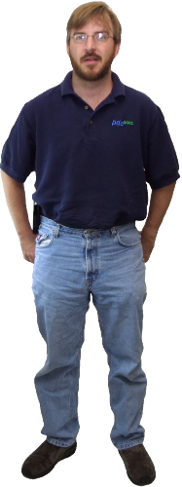
We are here because of Joe

Slide 5


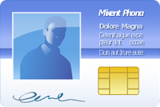




A Primer on Claims
?
Externalizes
Authentication
?
!
Gets user info from the document

Slide 6





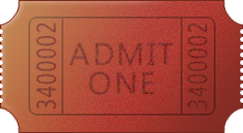
Claims Based Access
Identity Provider
Trust
Security Token Service
Relying Party
Read Policy
Authenticate
Get Token
Read Policy
Claims Processing
Application Logic
Send Token (claims)
Establish Session

Slide 7
CBA and the Microsoft Platform
Identity Provider
AD
AD FS 2.0
Security Token Service
Relying Party
Windows Identity Foundation
Claims Processing
Application Logic

Slide 8
Externalizing Authentication: it's easy!
demo

Slide 9

Essential claims programming model
  Claims OM integrated with the .NET identity API
  Single programming model for ASP.NET & WCF
  Config driven
  Single programming model for on-premises & cloud
Tools for metadata-driven automatic app configuration
  WS-Federation, WS-Trust
Framework for custom STS development
And more…

Slide 10
Claims Object Model
void Page_Load(object sender, EventArgs e)
{
IClaimsPrincipal icp = (IClaimsPrincipal) Thread. CurrentPrincipal;
IClaimsIdentity claimsIdentity = (IClaimsIdentity)icp.Identity;
ageClaimValue = ( from c in claimsIdentity.Claims
where c.ClaimType == "http://MyAppNamespace/AgeClaim"
select c.Value ).Single();
}
Claim
IClaimsIdentity
IClaimsPrincipal
Subject
Claims
Identities
Issuer
Claim
Claim
IClaimsIdentity
IClaimsIdentity
OriginalIssuer
Delegate
ClaimType
IIdentity
AuthenticationType
IsAuthenticated
Name
IPrincipal
IsInRole
Value
ValueType
Identity

Slide 11
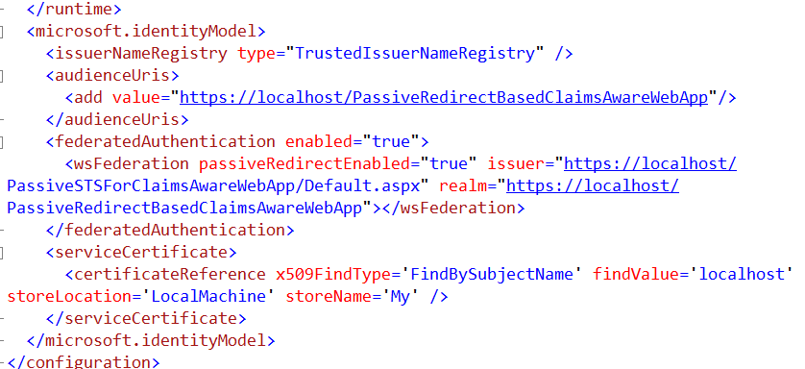
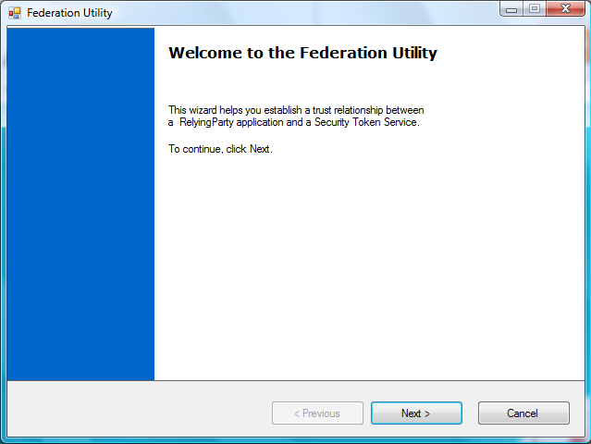
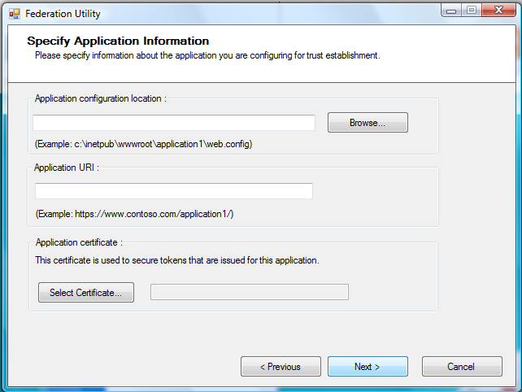
Visual Studio Integration
FedUtil.exe
  Utility which configures an application to establish a trust relationship with an STS
  Fully integrated in the Visual Studio IDE
Visual Studio project templates

Slide 12

ASP.NET Controls
Controls you drag on ASP.NET pages for adding key identity capabilities
FederatedPassiveSignIn
  When clicked, initiates the ws-federation sign in sequence
SignInStatus

Slide 13
WIF ASP.NET Modules
HTTPModule(s) in the ASP.NET pipeline of the app
They take care of exposing policy, manage protocol redirects, establish sessions…
WSFederationAuthenticationModule
  Implements the WS-Federation redirects protocol
SessionAuthenticationModule
  Takes care of handling sessions (regardless of the sign-in protocol)
ClaimsPrincipalHttpModule
  Provides a hook for injecting claims in the current principal

Slide 14
FabrikamShipping
demo

Slide 15
Processing Pipeline
01100010101101000
WSFAM
SecurityTokenHandler
ClaimsAuthenticationManager
SessionAuthenticationModule
C
ClaimsAuthorizationManager
Application Logic

Slide 16
Authorization
ASP.NET roles will work “as is”
  IsInRole, <authorization> element
  Any incoming claim type can be indicated as role
Claims authorization can be much more sophisticated that RBAC
  Age thresholds, dates, spending limits…
WIF offers a hook for your authz logic
  ClaimsAuthorizationManager class
  Provide your implementation of CheckAccess
  Add it in the WIF pipeline via config

Slide 17
WCF
Same programming model as ASP.NET…
…different hosting architecture
Self-Hosted services:
  Call FederatedServiceCredentials.ConfigureServiceHost(host) on your ServiceHost before Opening it
Web activated services:
  Derive a new factory from ServiceHostFactory
  Override CreateServiceHost and use the above ConfigureServiceHost call in it
  Use your custom factory in the @ServiceHost directive of your .svc file

Slide 18
Authorization & Services in FabrikamShipping
demo

Slide 19
Custom Development STS
WIF provides building blocks for custom STS development
  AD FS 2.0 is built with WIF!
Same programming model for all hosting options
  Active: WCF
  Passive: ASP.NET
Wizards & Templates create a skeleton STS in no time
  Perfect for testing purposes
Main activities
  Decide who to trust
  Decide which kind of credentials you’ll accept
  Provide all the cryptographic material for signing & encrypting
  Hook in the logic for retrieving claim values

Slide 20


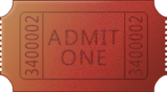
Delegated Access
Identity Provider
ActAs STS
AD FS 2.0
AD FS 2.0/
WIF
Trust
Trust
Frontend
Backend
Get Token
Send Token (claims)
Application Logic
Application Logic
WIF
WIF
Establish Session

Slide 21
Delegation & Custom STS in FabrikamShipping
demo

Slide 22
Claims to Windows Token Service (c2WTS)
Creates impersonation-level Windows access token from generic tokens (SAML, X509)
Windows service running as local account
Impersonates the user indicated by a UPN claim
http://schemas.xmlsoap.org/ws/2005/05/identity/claims/upn

Slide 23
Summary
Externalizing authentication is the best approach for reducing complexity
Developing claims aware applications is the best way of externalizing identity management
  On-premises and in the cloud
  On any platform where standard protocols implementations are available
Windows Identity Foundation helps developers at all levels to write claims aware applications

Slide 24
question & answer

Slide 25


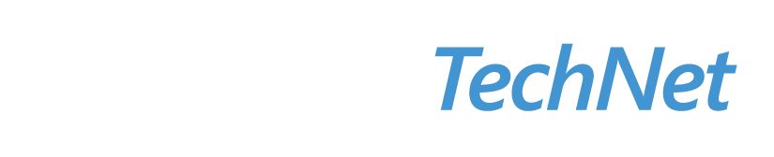

Resources
Required Slide
Speakers,
TechEd 2009 is not producing
a DVD. Please announce that
attendees can access session
recordings at TechEd Online.
www.microsoft.com/teched
  Sessions On-Demand & Community
www.microsoft.com/learning
Microsoft Certification & Training Resources
http://microsoft.com/technet
  Resources for IT Professionals
http://microsoft.com/msdn
  Resources for Developers

Slide 26
Download the Samples You Saw in This Session
FabrikamShipping
  http://code.msdn.microsoft.com/FabrikamShipping
Claims-driven ASP.NET controls
  http://code.msdn.microsoft.com/ClaimsDrivenControl

Slide 27
Resources
Entry page on Microsoft.com
  http://www.microsoft.com/forefront/iam
MSDN Forums
  http://social.msdn.microsoft.com/Forums/en-US/Geneva/threads/
Videos
  http://channel9.msdn.com/identity/
Blogs
  http://blogs.msdn.com/card
  http://blogs.msdn.com/vbertocci/

Slide 28
Related Content
Required Slide
Speakers,
please list the Breakout Sessions,
TLC Interactive Theaters and Labs
that are related to your session.
Breakout Sessions
SIA204 Understanding Claims-Based Applications: An Overview of Active Directory Federation Services (AD FS) v2, Windows Identity Foundation, and CardSpace
Interactive Theater Sessions
ITS212 Microsoft IT: Federating the Enterprise Using Microsoft Code Name "Geneva"
Hands-on Labs
SIA26-HOL

Slide 29
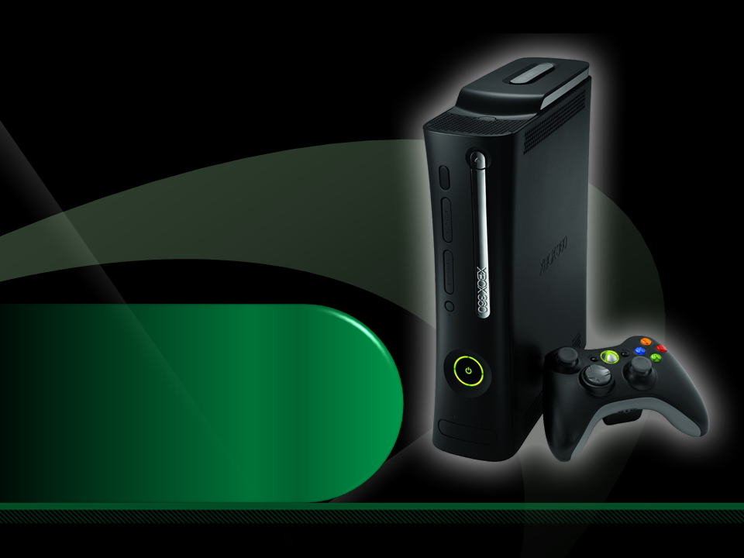
Complete an evaluation on CommNet and enter to win an Xbox 360 Elite!

Slide 30

Required Slide
© 2009 Microsoft Corporation. All rights reserved. Microsoft, Windows, Windows Vista and other product names are or may be registered trademarks and/or trademarks in the U.S. and/or other countries.
The information herein is for informational purposes only and represents the current view of Microsoft Corporation as of the date of this presentation. Because Microsoft must respond to changing market conditions, it should not be interpreted to be a commitment on the part of Microsoft, and Microsoft cannot guarantee the accuracy of any information provided after the date of this presentation. MICROSOFT MAKES NO WARRANTIES, EXPRESS, IMPLIED OR STATUTORY, AS TO THE INFORMATION IN THIS PRESENTATION.

