Slide 2
Identity & Access Management Solution
Brjann Brekkan
Technical Product Manager
Microsoft Corp.
Session Code: SIA307

Slide 3
Agenda
Business and IT Challenges
Business Ready Security
Identity and Access Management
The Road Ahead
Summary

Slide 4
Business Needs and IT Challenges
Provide secure access to applications from anywhere
Multiple locations and devices
Simplify user experience for collaboration
Difficulty in extending
business resources
Provide seamless movement between applications
Disparate systems to manage
Reduce cost of account management
Complex account lifecycle management
BUSINESS Needs
IT Needs
Agility and Flexibility
Control

Slide 5




DB
Additional
Provisioning
LDAP
Additional
Provisioning
Cloud
App6
Separate
Sign-in
Extranet
App5
Separate
Sign-in
Separate
Sign-in
RAS
Additional
Provisioning
App4
Intranet
Intranet
Extranet
DB
Additional
Provisioning
LDAP
Separate
Sign-in
Separate
Sign-in
SSO
App3
App1
App2
Separate
Sign-in
LDAP
Additional
Provisioning
DB
AD
DB
Additional
Provisioning

Slide 6


Business Ready Security
Help securely enable business by managing risk and empowering people
Protection
Access
Protect everywhere,
access anywhere
Simplify the security experience,
manage compliance
Identity
Management
Highly Secure & Interoperable Platform
Integrate and extend
security across the enterprise
from:
to:
Block
Enable
Cost
Value
Siloed
Seamless

Slide 7




Business Ready Security Solutions
Secure Messaging
Secure Collaboration
Secure Endpoint
Information Protection
Identity and Access Management
Active Directory® Federation Services

Slide 8
The Products
Partner and Custom Solutions
Identity and Access Management Solution
Forefront Identity Manager
Unified Access Gateway
Windows Server and Windows Client
Active Directory
AD Federation Services
AD Domain Services
AD Certificate Services
AD Lightweight Directory Services
.Net Framework
Windows Identity Foundation
Windows Cardspace

Slide 9




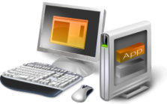

Identity and Access Management
Enable more secure, identity-based access to applications on-premises and
in the cloud from virtually any location or device
PROTECT everywhere
ACCESS anywhere
INTEGRATE and
EXTEND security
SIMPLIFY security,
MANAGE compliance
  Provide more secure, always-on access
  Enable access from virtually any device
  Control access across organizations
  Provide standards-based interoperability
  Extend powerful self-service capabilities to users
  Automate and simplify management tasks

Slide 10


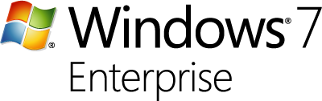











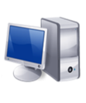


Provide More Secure, Anywhere Access
Protect everywhere,
access anywhere
  EMPOWER BUSINESS
  Seamless and more secure access
  Simplified, always-on access
  EMPOWER IT
  Policy-based network access
  Ability to manage machines anywhere
TRUSTED
DIRECT ACCESS
  EMPOWER BUSINESS
  Consolidated secure portal to simplify remote access to resources
  Simplified sign-on
  EMPOWER IT
  Policy-based resource access
TRUSTED
SSL VPN
SSL VPN
  EMPOWER BUSINESS
  Access from virtually any device
  EMPOWER IT
  Policy-based restricted access
UNTRUSTED

Slide 11






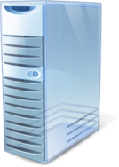

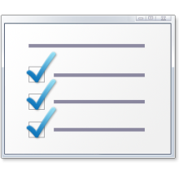







UAG provides access for down-level and non- Windows clients
UAG improves adoption and extends access to existing infrastructure
UAG enhances scale and management with integrated LB and array capabilities
UAG uses wizards and tools to simplify deployments and ongoing management
UAG is a hardened edge appliance available in HW and virtual options
UAG and DirectAccess better together:
Extends access to line of business servers with IPv4 support
Access for down level and non Windows clients
Enhances scalability and management
Simplifies deployment and administration
{
Hardened Edge Solution
Windows Server 2008 R2
Managed
Windows 7
Windows Server 2008 R2
Always On
Windows 7
IPv6
Windows Server 2008 R2
IPv6
SSL-VPN
{
Windows Server 2003
Windows Vista/ Windows XP
Legacy Application Server
Unmanaged
Non-Windows
DirectAccess Server
+
Non Windows Server
SSL-VPN
IPv4
PDA
IPv6
or
IPv4

Slide 12
Identity Based Remote Access
demo
Provisioning of new contractor to Active Directory
Automatic provisioning of access rights

Slide 13
Identity and Access Management
Enable more secure, identity-based access to applications on-premises and
in the cloud from virtually any location or device
PROTECT everywhere
ACCESS anywhere
INTEGRATE and
EXTEND security
SIMPLIFY security,
MANAGE compliance
  Provide more secure, always-on access
  Enable access from virtually any device
  Control access across organizations
  Provide standards-based interoperability
  Extend powerful self-service capabilities to users
  Automate and simplify management tasks

Slide 14





Extend Access Across Organizations
Integrate and extend
security
  EMPOWER BUSINESS
  Ability to move seamlessly between applications using a single identity
  Collaboration across organizations
  EMPOWER IT
  No need to manage external accounts
  Simplified and flexible claims-based federation
  Common authentication controls for building custom applications
ON-PREMISES
ACTIVE DIRECTORY
FEDERATION SERVICES
WS-* and SAML 2.0
EXTERNAL
PARTNER
“
Geneva (ADFS) project is one of the most significant enhancements for future use and dissemination of the Identity Federation.
-Kuppinger Cole
Source: Awards for Outstanding Identity Management Projects. Kuppinger Cole, May 2009. http://www.id-conf.com/blog/2009/05/07/awards-for-outstanding-identity-management-projects/

Slide 15
Authentication problem statement
Every connected app must handle two functions
  Authenticate user
  Get information about user to drive app behavior
Many different technologies to do this
  Name/password, X.509, Kerberos, SAML, LDAP, …
  Scenario drives technology choice
  App becomes bound to constraints of technology
Solution: claims-based identity
  Abstraction layer hides detail of authenticating user, getting information about user
  Application logic exposed to claims only;
  claims = information about the user
  Change details after deployment without changing application code

Slide 16

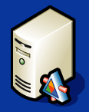
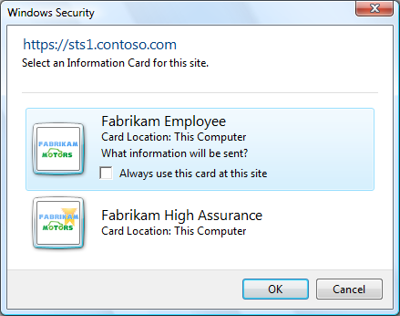

What is claims based access
2. Look up claims, transform
2. Look up claims, transform
Active Directory
SQL
Attribute
Store
Active Directory
Federation Services 2.0
trust
Windows CardSpace 2.0
1. Authenticate
3. Return claims
Your App
4. Send claims
Windows Identity Foundation
Client

Slide 17


How ADFS is Changing the Game
ADFS Server

Slide 18









How ADFS is Changing the Game
ADFS Partners
ADFS Server

Slide 19



How ADFS is Changing the Game
ADFS Partners
ADFS Server
SQL Authz
Store

Slide 20

How ADFS is Changing the Game
ADFS Partners
ADFS
Server
SQL Authz
Store

Slide 21




How ADFS is Changing the Game
ADFS Partners
ADFS
Server
SQL Authz
Store

Slide 22
Accessing Windows Azure application with my MSFT Credentials
demo

Slide 23





Simplify Identity Management
Simplify security,
manage compliance
  EMPOWER BUSINESS
  Self-service profile, credential, and group management
  Password and PIN reset from Windows login
  Group management from within Microsoft Office
  Single identity across heterogeneous applications
  EMPOWER IT
  End-to-end, workflow-driven user provisioning
  Policy-controlled self-service capabilities
  Automatic, attribute-based group membership for simplified resource access
GOVERNED SELF-SERVICE
AND AUTOMATION
GROUP
MANAGEMENT
PASSWORD
RESET
IDENTITY
MANAGEMENT
“
If you wanted to access a file share in your network, previously you might have had to call your service desk and get approval. Now it is all workflow based. You go to a portal. There is no manual labor.
- Brian Desmond, Microsoft MVP
Source: Windows identity management tools move closer to completion. Tech Target, November 2008. http://searchwinit.techtarget.com/news/article/0,289142,sid1_gci1337386,00.html

Slide 24






Forefront Identity Manger - Feature areas
Policy
Management
SharePoint-based console for policy authoring, enforcement & auditing
Extensible WS– * APIs and Windows Workflow Foundation workflows
Heterogeneous identity synchronization and consistency
Credential
Management
Heterogeneous certificate management with 3rd party CAs
Management of multiple credential types
Self-service password reset integrated with Windows logon
User
Management
Integrated provisioning of identities, credentials, and resources
Automated, codeless user provisioning and de-provisioning
Self-service profile management
Group
Management
Rich Office-based self-service group management tools
Offline approvals through Office
Automated group and distribution list updates
24

Slide 25
Automatic assignment of rights and handling exceptions
demo

Slide 26



Current Situation
Time and labor intensive process
Different sign–on requirements for applications
Password reset and access requests handled through help desk
Multiple identities and limited sign-on help
ON-PREMISES
CONTOSO
Remote access solution w/ separate identities
Contoso managing
Fabrikam accounts
EMPLOYEES (REMOTE)
Fabrikam managing
Contoso accounts
PARTNERS
Fabrikam

Slide 27


Identity and Access Management
Simple and easy
Single identity
across resources
Contoso ID is used
in the cloud
EMPLOYEES (LAN)
CONTOSO
EMPLOYEES (REMOTE)
PARTNERS
Fabrikam
Always-on access built into platform
More secure, simplified access for partners

Slide 28











Business Ready Security: The Road Ahead
Currently Shipping
CY 2009
CY 2010
H2
H1
Management
Protection & Access Solutions
Platform
Active Directory® Domain Services
Active Directory® Domain Services
DirectAccess
Subject to Change

Slide 29
Summary
Enable more secure, identity-based access to applications on-premises and
in the cloud from virtually any location or device
PROTECT everywhere
ACCESS anywhere
INTEGRATE and
EXTEND security
SIMPLIFY security,
MANAGE compliance
  Provide more secure, always-on access
  Enable access from virtually any device
  Control access across organizations
  Provide standards-based interoperability
  Extend powerful self-service capabilities to users
  Automate and simplify management tasks
Learn more at: www.microsoft.com/forefront

Slide 30




Resources
Required Slide
Speakers,
TechEd 2009 is not producing
a DVD. Please announce that
attendees can access session
recordings at TechEd Online.
www.microsoft.com/teched
  Sessions On-Demand & Community
www.microsoft.com/learning
Microsoft Certification & Training Resources
http://microsoft.com/technet
  Resources for IT Professionals
http://microsoft.com/msdn
  Resources for Developers

Slide 31
Related Content
SIA316 Securely Collaborate with Partners and Employees Using Microsoft SharePoint and Business Ready Security from Microsoft Forefront
Tue 11/10 | 13:30-14:45 | Europa 1 - Hall 7-3b
SIA204 Understanding Claims-Based Applications: An Overview of Active Directory Federation Services (AD FS) v2, Windows Identity Foundation, and CardSpace
Tue 11/10 | 15:15-16:30 | Budapest - Hall 7-2b
SIA305 Windows Identity Foundation Overview
Wed 11/11 | 9:00-10:15 | New York 3 - Hall 7-1a
SIA302 Microsoft Forefront Identity Manager 2010 Case Study: FIM in Microsoft IT
Thu 11/12 | 10:45-12:00 | Europa 1 - Hall 7-3b
and much more … such as … Windows Server 2008 Recycle Bin with John Craddock, Crack open Kerberos with Mark Minasi
Chalk talks on Active Directory in R2, ADCS in R2 and FIM 2010

Slide 32
Track Resources
Required Slide
Track PMs will supply the content for this slide,
which will be inserted during
the final scrub.
www.microsoft.com/iam
www.microsoft.com/forefront
www.microsoft.com/adfs2
www.microsoft.com/fim
www.microsoft.com/uag

Slide 33
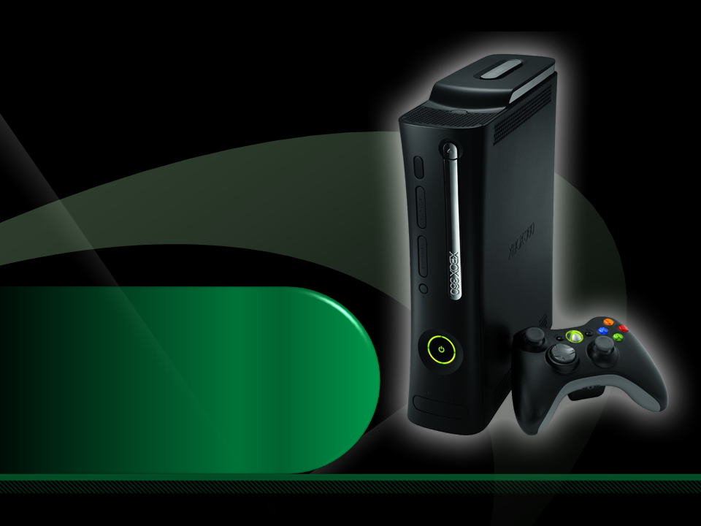
Complete an evaluation on CommNet and enter to win an Xbox 360 Elite!

Slide 35

Required Slide
© 2009 Microsoft Corporation. All rights reserved. Microsoft, Windows, Windows Vista and other product names are or may be registered trademarks and/or trademarks in the U.S. and/or other countries.
The information herein is for informational purposes only and represents the current view of Microsoft Corporation as of the date of this presentation. Because Microsoft must respond to changing market conditions, it should not be interpreted to be a commitment on the part of Microsoft, and Microsoft cannot guarantee the accuracy of any information provided after the date of this presentation. MICROSOFT MAKES NO WARRANTIES, EXPRESS, IMPLIED OR STATUTORY, AS TO THE INFORMATION IN THIS PRESENTATION.

