Slide 2


Useful hacker techniques
- which part of hackers' knowledge will help you in efficient IT administration?
Paula Januszkiewicz
IT Security Auditor, MVP, MCT
ISCG
Session Code: SIA308
Notes:
BIO: Paula Januszkiewicz is the IT Security Auditor, MVP on Enterprise Security and trainer (MCT). She is also a speaker on the national (Polish) and international conferences. She has written dozens of articles on Windows security. The training and workshops she conducts usually cover Security, Virtualization, Windows Client/Server topics. Paula is passionate about sharing her knowledge with others. She is also a project team leader, mainly in projects about security auditing and Business Continuity Planning. Paula is the leader of Women in Technology community group in Poland and she organizes Warsaw Girl Geek Dinners. Having her Master of Science in Computer Science, Paula speaks on scientific conferences and has written many articles about organizational security, security policy and risk management methodologies. Paula is the holder of many Microsoft certificates: from the old ones to the newest. In private, she enjoys researching new technologies which she usually publishes on her blog: http://blogs.technet.com/plwit.

Slide 3
Agenda
Things you should remember and summary
Hacker role in IT development
1
2
3
Hacker Techniques and Demos

Slide 4
Hacker Role in IT Development
Check who are you talkin’ to
Offine access
Hotfix analysis
Windows Debugger
Encryption + protection
At least scripting language...
At least scripting language...
At least scripting language...
At least scripting language...
Summary

Slide 5

Hacker role in IT development
Make IT security world running
Encourage us to be up to date
Test the newest technology
What is the difference between techniques and habits?
Notes:
Hackers have been assigned a fundamental role in software development.
Morality and being against the law are not effective deterrents.
Many systems are built with immature and insecure technology making them susceptible to a wide range of attacks.
NT Security.nu

Slide 6
At first…
Notes:
Usless in Administration.

Slide 7
Hacker Role in IT Development
Check who are you talkin’ to
Offine access
Hotfix analysis
Windows Debugger
Encryption + protection
At least scripting language...
At least scripting language...
At least scripting language...
At least scripting language...
Summary

Slide 8


Check who are you talkin’ to
nslookup
>set type=all
>victim.com
My DNS is…
My mail server is…
I am the administrator, my name is…
Notes:
This is a habit to check who you are you talkin’ to. Before all audits or attacks it is very resonable to check what organization is assaigned to the tested IP address. In many cases some small „informal” test may result in the law complications.

Slide 9
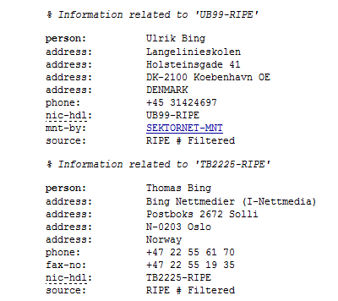
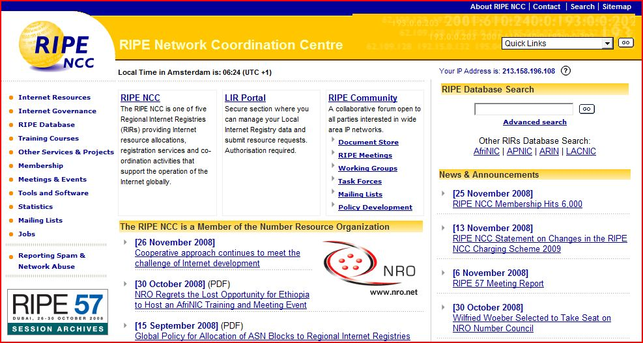
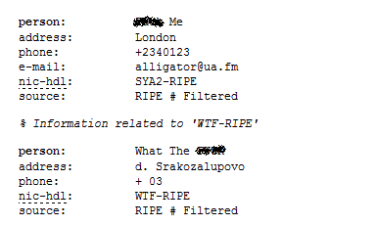
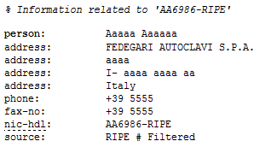
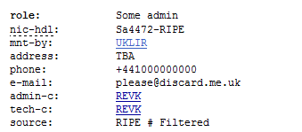
Check who are you talkin’ to
http://ripe.net
Notes:
In Europe – RIPE. Companies should care about their image in the network. Please check the ripe.net database and check your company – how does it look like? Who is the contact person?

Slide 10
Check yourself, they do fingerprinting
Interesting ports on 172.18.10.11:
Not shown: 1694 closed ports
PORT STATE SERVICE
21/tcp open war-ftpd
25/tcp open smtp
42/tcp open nameserver
53/tcp open domain
80/tcp open http
88/tcp open kerberos-sec
119/tcp open nntp
135/tcp open msrpc
139/tcp open netbios-ssn
389/tcp open ldap
445/tcp open microsoft-ds
(…)
3389/tcp open ms-term-serv
Device type: general purpose
Running (JUST GUESSING) : Microsoft Windows 2003 (94%)
⬅ Nmap printout
Notes:
Serious hackers don't shoot in the dark when attempting to penetrate a system. Instead, they will use hacker techniques such as operating system fingerprinting and probing to systematically identify what systems and services your company is running to determine your weakest link. Are you connected to a partner network that has a firewall equivalent to Swiss cheese? Does your remote access system require only mediocre authentication? Do you have in-house staff develop webpages that haven't been checked for security holes? These are the weaknesses hackers are looking for. Remember: There is no good scanning, you may do this without informing the IT in terms of notoriety.
The first step in defending against hacker techniques and exploits designed to access your systems is to block unnecessary, incoming firewall ports. The ports that remain open should be protected by patching the services that use those ports, such as Web services, email and FTP.

Slide 11
Internet Printing
demo
What can you find about yourself?
Notes:
5 minutes
Summary: Demo shows the effect of being careless in the publishing information to the Internet.
Action: I will show the Web Browser with some „google hacking” little scripts to put emphasis on the careless fact. Scripts are: „inurl:hp/device/this.LCDispatcher” and „admin account info”: filetype:log

Slide 12
Then…
Notes:
Useful for Administration.

Slide 13
Hacker Role in IT Development
Check who are you talkin’ to
Offine access
Hotfix analysis
Windows Debugger
Encryption + protection
At least scripting language...
At least scripting language...
At least scripting language...
At least scripting language...
Summary

Slide 14
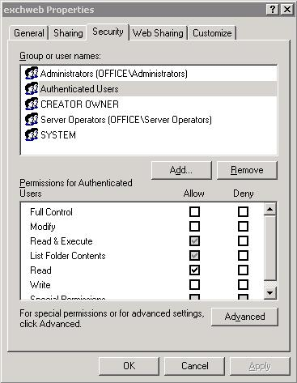



Offline access
Bypasses operating system’s security mechanisms
  Access Control Lists (ACL)
  Watchdogs
  Open files
  SAM database - allows password reset
Easy to use by each user
Difficult to use by externals
Notes:
Open files: pagefile.sys
Watchdogs: Csrss.exe (when you kill you receive the bluescreen)
Picture source: junius.blogspot.com

Slide 15
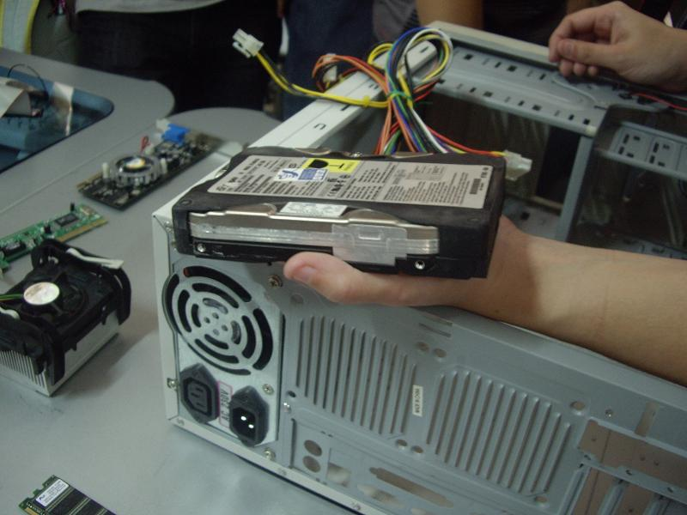
Offline access
Access to the damaged system
File recovery
Password recovery
Full disk problems
Notes:
For more information please see the demo.

Slide 16
Offline access
demo
How to recover from the system crash
Notes:
Applocker – without privilages. How to recover?
10-15 minutes
Summary: Demo shows the possibility of the system crash with unapprorpiate AppLocker configuration. Then demo shows how to recover from this situation by editing the registry offline – the purpose is to show that it is possible to bypass the security mechanisms in the O.S. I will NOT be playing with the ACL’s.
Action: As the Administrator in the Local Security Polices.
0x0 Boot
0x1 System
0x2 Automatic
0x3 Manual
0x4 Disabled

Slide 17
Hacker Role in IT Development
Check who are you talkin’ to
Offine access
Hotfix analysis
Windows Debugger
Encryption + protection
At least scripting language...
Test your users
Have your own toolkit
Keep your knownledge up to date
Summary

Slide 18


Hotfix analysis
Why Hotfixes are released?
Hacker’s usage
  Change analysis
  Vulnerability / improper system setting area
  Limited time
Administrator’s usage
  What will be changed if I install it?
  Should I really need this?
Notes:
What was changed in a file? When vulnerability is unknown and the details (after the patch is released) are unclear it is worth checking what was changed in the operating system by looking into the patch.
There is the history that there was the dictionary file relased for Microsoft Office with couple of words (mainly with the „Obama” word).

Slide 19
Hotfix analysis
demo
What is inside?
Notes:
10 minutes
Summary: Demo shows the patch analysis. Look inside the MSU file and look for changes. Pinpoint the files in the operating systems that have been changed.
Action: wusa /explore, then analyze what is inside the MSU file.

Slide 20
Hacker Role in IT Development
Check who are you talkin’ to
Offine access
Hotfix analysis
Windows Debugger
Encryption + protection
At least scripting language...
Test your users
Have your own toolkit
Keep your knownledge up to date
Summary

Slide 21


Use Debugger
Variable choices
  SoftICE
  WinDbg
  DEBUG
  IDA Pro
One idea: to look through the code and data structures
Administrators: Crash dump analysis
Process Explorer
Notes:
Administrators do not need to know what is inside their programs. Blue screen always causes the big grin on Administrators’ faces, but in fact only couple of them know what is the blue screen and what is the reason it appeared. With Windows Debugger it is possible to analyse the real reason of such operating system behaviour.
Picture source: dedbugs.com

Slide 22
Windows Debugger, Process Explorer
demo
Crash Dump Analysis, System Deep-Dive
Notes:
10 minutes
Summary: Demo is about the possibility of the „blue screen” debugging, just to know that „blue screen” can be valuable information what is actually going wrong in the operating system. Windows Debugger and Process Explorer are being used. In Process Explorer there will be shown example how to use symbols and why they are useful.
Action: In Windows Debugger there will be shown 3 or 4 crash dumps related to the „blue screens”, analyze the reason of such O.S. behavior. Then in PE I will connect the debugger library.
If you want to „cause” blue screen kill the csrss.exe process. Blue screen will appear ☺
1. PowerShell
2. get-wmiobject win32_service | Get-Member
3. get-wmiobject win32_service | Select-Object displayname,pathname
4. get-wmiobject win32_service | Where-Object {$_.pathname -notlike "*c:\windows\*"} | Select-Object displayname, pathname
5. get-wmiobject win32_service | Where-Object {$_.pathname -notlike "*c:\windows\system32\*"} | Select-Object pathname, startname, startmode
6. get-wmiobject win32_service | Where-Object {$_.pathname -notlike "*c:\windows\system32\*" -and $_.startmode -eq "auto" -and $_.startname -eq "localsystem"} | Select-Object pathname

Slide 23
Hacker Role in IT Development
Check who are you talkin’ to
Offine access
Hotfix analysis
Windows Debugger
Encryption + protection
At least scripting language...
Test your users
Have your own toolkit
Keep your knownledge up to date
Summary

Slide 24
Why Data Protection Matters
“Some of the largest and medium-sized U.S. airports report close to 637,000 laptops lost each year, according to the Ponemon Institute survey released Monday”
– PC World June 2008
“More than 100 USB memory sticks, some containing secret information, have been lost or stolen from the Ministry of Defense since 2004,
it has emerged.”
– BBC News July 2008
Notes:
The encyrption for the presentation pursposes is divided into two parts: data and transmission

Slide 25
Use data encryption
Different levels of encryption
  File format level
  Active Directory Rights Management Services
  3rd party tools – for single files / folders
  System level
  Volume level, hardware based
Can be used together
Prevents offline attacks
Notes:
File format level: DOCX, XLSX, PDF, WMV, WMA
ADRMS
3rd party: ZIP, RAR
System level: EFS
Volume level: BitLocker, McAfee Endpoint Encryption – prevents offline attacks
Remember: There are three main values in the cryptography:
Alghoritm
Key Lenght
Where the key is being kept (not in the laptop bag)

Slide 26

Use transmission encryption
Different levels of encryption
  Application / Format Based
  Secure Socket Layer
  IPSec / tunneling (PPTP, L2LP)
  Physical encryption
Makes data disclosure and manipulation harder
Notes:
This is rather a habit.
Application transmission encryption: S-MIME, SSH
SSL – POP3/S FTP/S etc.
Physical encryption – Wireless

Slide 27
Hacker Role in IT Development
Check who are you talkin’ to
Offine access
Hotfix analysis
Windows Debugger
Encryption + protection
At least scripting language...
Test your users
Have your own toolkit
Keep your knownledge up to date
Summary

Slide 28


Know at least one scripting language
Hackers love scripts
  Perl
  Python
You should love PowerShell 2.0
  Server Role management modules
  Server management
  Remoting
  Microsoft Common Criteria
Notes:
The demo shows all PowerShell possibilities.

Slide 29
Windows PowerShell
demo
Account Enumeration, Service Accounts, Service Location
Notes:
7 minutes
Summary: Demo shows the new R2 Active Directory module and possibility of doing what hackers do after they get into the system / network. Account enumeration with all options: when accounts expire, what are the service accounts with appropriate parameters, what is the service binary location (the purpose is to show where is the placement of the service on the volume!).
Action: (to be done) Enumerate the Accounts in AD, Enumerate the Service Accounts (to find out which service we need), show the service location to find out if any service is running in the folder with loose privileges – replace the service with the malformed one, show that „the bad” service has done something wrong f.e. created the registry key – because it has appropriate permissions.
Step-by-Step:
Get-ADUser -Filter * -SearchBase "DC=DOMAIN,DC=MSFT" | select Name, SamAccountName, Enabled
Search-ADAccount -AccountDisabled | where {$_.ObjectClass -eq 'user'} | FT Name,ObjectClass -A
Search-ADAccount -PasswordNeverExpires | FT Name,ObjectClass -A
Get-ADPrincipalGroupMembership -Identity bspears

Slide 30
Hacker Role in IT Development
Check who are you talkin’ to
Offine access
Hotfix analysis
Windows Debugger
Encryption + protection
At least scripting language...
Test your users
At least scripting language...
At least scripting language...
Summary

Slide 31

Test your users
Play a social engineer role
Monitor them…
…and show you do it
Break users’ passwords
Train them well
Notes:
After you know what types of users you have in your Active Directory infrastructure do some testing. Social, stupid but it works!!! Remember: Not ethical
Everybody knows that this is stupid but it is worth doing – if you are able to do it, hacker is able too.
The cheapest and most effective attacks are often nontechnical, exploiting human frailty rather the weaknesses in the technology.
I have noticed that during the auditing employee awareness of security issues are not receiving the attention and resources they deserve.

Slide 32
Hacker Role in IT Development
Check who are you talkin’ to
Offine access
Hotfix analysis
Windows Debugger
Encryption + protection
At least scripting language...
Test your users
Have your own toolkit
At least scripting language...
Summary

Slide 33

Have your own toolkit
Internet Browser is sometimes enough
CMD and build-in system tools
Specialist tools
Your own scripts
Social engineering skills
PowerShell 2.0
Notes:
GPDisable – by Russinovich – now unavailable – to bypass software restriction policies.
In every hacker's tool bag are a variety of free system probing and fingerprinting tools, the purpose of which is to identify specifics about your hardware and software configurations. Some of these tools will undoubtedly check for open ports on routers and firewalls and identify what system services are available for exploitation. To get an idea of what a hacker would see, download and run some of these tools against your own network. Be sure to let your staff know when these tools are being run, in case there are performance issues when certain scans are launched, and always test them against a few non-critical machines first.

Slide 34
Hacker Role in IT Development
Check who are you talkin’ to
Offine access
Hotfix analysis
Windows Debugger
Encryption + protection
At least scripting language...
Test your users
Have your own toolkit
Keep your knownledge up to date
Summary

Slide 35

Keep your knowledge up to date
IT resources
  Mailing Lists
  Blogs / RSS
  Webcasts
Know law regulations in your country
Security bulletins
  Microsoft
  SANS
  ISS
  Other
Notes:
The best mandatory sourse of knowlege is Microsoft Security builetin. Truly it is! Microsoft Security team does its job perfectly – they release hotfixes very quickly, they CARE and support users in security issues.
Be smart – sometimes your organization policy requires the high level of security. Do you work with sensitive data? You should then provide appropriate security measures.
Security bulletins (vendors + research centers –> ISS, Secunia etc.):
Microsoft Security Bulletins
IBM Security
SANS
ISS
Fresh issue SMB 2.0 – be familiar with all security issues.

Slide 36
Hacker Role in IT Development
Check who are you talkin’ to
Offine access
Hotfix analysis
Windows Debugger
Encryption + protection
At least scripting language...
Test your users
Have your own toolkit
Keep your knownledge up to date
Summary

Slide 37
Summary
Hackers are evil but usually very smart, we can learn a lot
Human nature, not technology is the key to defense against penetration attempts
Hacker succeed because they learn faster then administrators
...and test all demos at home!
Notes:
If we could learn from the hackers we were faster then some of them – start today preparing yourself for the greater maturity of your network, be aware of the threats, do the demos ☺!
Do you think that hackers are better then you? I don’t think so!
Administratorzy są technicznie lepsi od hackerów tylko mają inne priorytety. Some wallpaper GPO options are more important than protection.

Slide 38
question & answer
Whenever you want
…or meet me in the ATE booth!
paula.januszkiewicz@gmail.com

Slide 39

Complete an evaluation on CommNet and enter to win an Xbox 360 Elite!

Slide 40
Track Resources
http://technet.microsoft.com/pl-pl/sysinternals/default(en-us).aspx
http://blogs.technet.com/markrussinovich/
http://www.governmentsecurity.org
http://www.microsoft.com/windows/enterprise/products/windows-7/features.aspx

Slide 41




Resources
www.microsoft.com/teched
  Sessions On-Demand & Community
www.microsoft.com/learning
Microsoft Certification & Training Resources
http://microsoft.com/technet
  Resources for IT Professionals
http://microsoft.com/msdn
  Resources for Developers

Slide 42

© 2009 Microsoft Corporation. All rights reserved. Microsoft, Windows, Windows Vista and other product names are or may be registered trademarks and/or trademarks in the U.S. and/or other countries.
The information herein is for informational purposes only and represents the current view of Microsoft Corporation as of the date of this presentation. Because Microsoft must respond to changing market conditions, it should not be interpreted to be a commitment on the part of Microsoft, and Microsoft cannot guarantee the accuracy of any information provided after the date of this presentation. MICROSOFT MAKES NO WARRANTIES, EXPRESS, IMPLIED OR STATUTORY, AS TO THE INFORMATION IN THIS PRESENTATION.

