Slide 1
Secure endpoints from emerging threats using Business Ready Security from Microsoft Forefront
Bill Jensen
Bashar Kachachi
Session Code: SIA309

Slide 2





Business Ready Security Solutions
Secure Messaging
Secure Collaboration
Secure Endpoint
Information Protection
Identity and Access Management

Slide 3




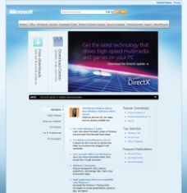







Advanced Protection Against Web-based Exploits
Protect everywhere,
access anywhere
Advanced URL filtering for safe
web browsing
Reputation services for enhanced accuracy
Integrated Anti-Malware protection at
the edge
Inspects encrypted and unencrypted
web traffic
Prevents exploits against browser-based vulnerabilities
PHISHING / MALWARE SITES
VIRUSES / SPYWARE
SAFE TRAFFIC
URL
FILTERING
MANAGED /
UN-MANAGED
“
TMG will include scanning for malware and inappropriate content, enabling them to be eliminated before they enter an organization's network. It will also incorporate sophisticated URL filtering technology to help block access to inappropriate or dangerous Web sites.
Don Retallack, Security Analyst at Directions on Microsoft in Redmond Channel Partner, June 2009

Slide 4
Threat Management Gateway-
Secure Web Gateway Features
Malware inspection
  Download scanning of files
  Integrated Microsoft AV/AM engine
  Inspection settings per rule
URL filtering
  URL category sets and exclusions
  Integrated with forward proxy
HTTPS inspection
  URL filtering, malware scanning and IPS protection
  Firewall Client notification to end users
Logging & Reporting
  New log fields with URL/Malware info
  SQL Server Reporting Services
  Customizable reports

Slide 5


A More Intelligent Security Solution for URL Filtering
Forefront
TMG
Forefront TMG
Web Protection Service
Reputation Providers
Protects against “long tail” of Web threats
  Continuously updated
  Combines local cache and cloud-based queries
Aggregates information from:
  Multiple URL filtering partners
  Reputation-based protection against phishing and malware sites

Slide 6
Protection with Multiple Layers
Threat Vector
  Content Files and Streaming Traffic
Viruses
Worms
Protocol Exploits
Scripts
Encrypted Web
Inspection Technology
  HTTP and HTTPS Inspection
Microsoft Antimalware
Network Inspection System
Application Layer Proxy
Coverage for Streaming and Content-based traffic
Zero-day and Variant Protection
    Generic and Specific Signatures
    Protocol Analysis
    Heuristic
Granular control of Web traffic
Extensible as new threats appear

Slide 7





Network Inspection System for Intrusion Prevention
TMG
Vulnerability
found
Signature authoring team
Detect and prevent known vulnerability-based attack attempts at the Edge of the network or in datacenter
Same day availability of the patch and NIS signature
Closes the vulnerability window which is needed for patch testing\deployment:
    Patches need to be tested more thoroughly
    Customer acceptance (similar to AV updates)

Slide 8
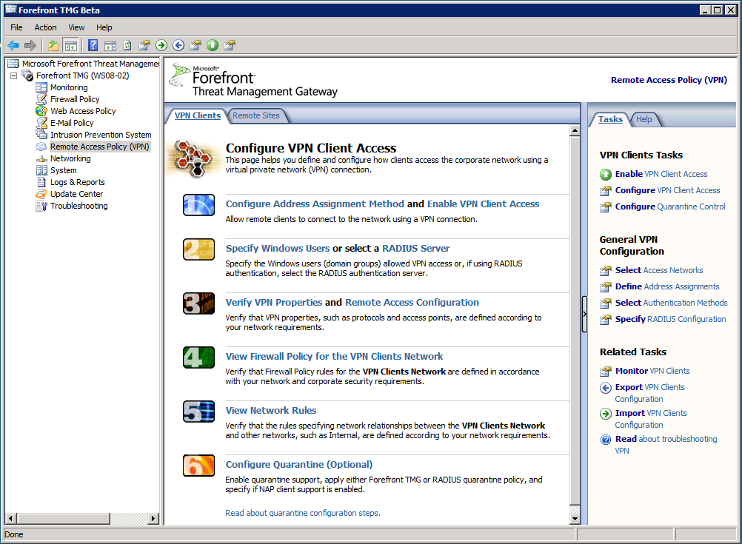
Simplified Management
Enables single,
unified policy for:
    All integrated
    security functions
    All distributed locations
Reduces management
burden with:
    Consistent management
    interface for administrators
    Easy-to-use wizards
    for complex tasks
Unified management for
consistent policy and less administrative overheard
Simple wizards to configure complex tasks

Slide 9
URL Filtering & Malware Protection
demo
Deny Access to Malicious Site
Detect and prevent malware downloads at the edge

Slide 10



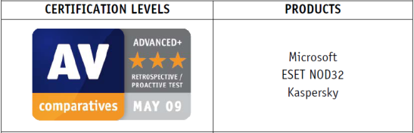
Comprehensive Malware
Protection For Endpoints
Protect everywhere,
access anywhere
Malicious Threats
Integrated anti-virus/anti-spyware agent
for real-time protection
Advanced detection technologies for complex malware
Unique vulnerability assessments
Rapid response through global threat research team
Management Console
“
      Top ranked Anti-Malware engine in proactive detection
      Microsoft beat Symantec, McAfee, and 13 other competitors.
      —AV-Comparatives (May 2009)

Slide 11
Advanced Protection Technologies in FCS
  Integrated anti-virus/anti-spyware agent delivering real-time protection
  Uses Windows Filter Manager
  Maintains stable operation
  Scans viruses and spyware in real-time
  Dynamic Translation
  Unique to Microsoft agent
  Maximizes scanning speed: Decryption and code emulation of malware with speed of native code execution
  State assessment scans
  Unique to Microsoft agent
  Scan for vulnerabilities and improperly configured machines
  Other features:
  Tunneling signatures for detecting & removing rooktits
  Advanced system cleaning: Customized remediation (recreating registry entries, restoring settings)
  Event Flood Protection: Shields reporting infrastructure during outbreak from infected clients
  Heuristics for classifying programs based on behavior
Strong malware detection
Multiple technologies for malware protection
Stable in client environment
Fast malware scanning conducted in
real-time
Visibility into both threats and vulnerabilities

Slide 12
Efficient Anti-Malware Solution
The FCS agent efficiently uses system resources, scans quickly, and detects malware effectively
Product Name/ Capability | Symantec Corporate AntiVirus 10.2 | Forefront Client Security
Memory Footprint¹ Server Client | 58.6 Mbs 66.3 Mbs | 56.5 Mbs 57.9 Mbs
Avg Usage, CPU & Memory² % Server Avg % Client Avg | 30.5% 29.4% | 2.0% 11.1%
Boot time increase³ | 62% avg increase | 4.5% avg increase
Scanning time (quick) Network 1 (Avg)⁴ Network 2 (Avg)⁴ | 29.9 min 12.0 min | 13.6 min 5.3 min
Scanning time (full) Network 1 (Avg)⁴ Network 2 (Avg)⁴ | 156.8 min 92.8 min | 34.6 min 18.3 min
Product Name/ Capability | Symantec End Point Security | Forefront Client Security
Memory Footprint¹ Client – uninfected Client -infected | 536 Mbs 593 Mbs | 522 Mbs 495 Mbs
Avg Usage, CPU & Memory² % Client – uninfected % Client - infected | 82.37% 88.56% | 79% 81.6%
Scanning time Uninfected client Infected client | 147.69min 167.09min | 81.82 min 95.33 min
Application Startup time
Starting Word with no AV – 1.725 | 2.425 sec | 2.233 sec
Starting IE with no AV – 2.275 | 3.6 sec | 2.6 sec
60%+ less CPU usage
7% less CPU
14x faster at boot time
2x faster
2x faster in quick scans
5x faster in full scans
Sources: West Coast Labs, AVTest.org
Performance benchmarking study with West Coast Labs.

Slide 13


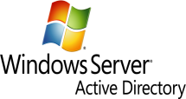






Leverage Existing Infrastructure
Integrate and extend
security
Integration with
Existing Infrastructure
Automated Deployment Compliance-based Access
Update Services
Integrated Solution
“
  Forefront Client Security works seamlessly with our core infrastructure components. As a result, we have reduced the cost of administering our security infrastructure by 60 percent.
  —Thomas Thiew, IT Manager, PhillipCapital

Slide 14


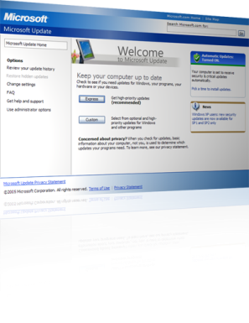




















Integration With Infrastructure
Architecture

Slide 15


Simplify Security Management
Simplify security,
manage compliance
Easy-to-use wizards for security and policy configuration
Enterprise-wide client
state visibility
Insightful reports to
ensure compliance
“
  Forefront Client Security gives us the ability to easily manage our IT environment in a centralized way while giving us full reporting on the security of the entire Windows infrastructure.
  —Dan See, Director of Infrastructure, FranklinCovey

Slide 16
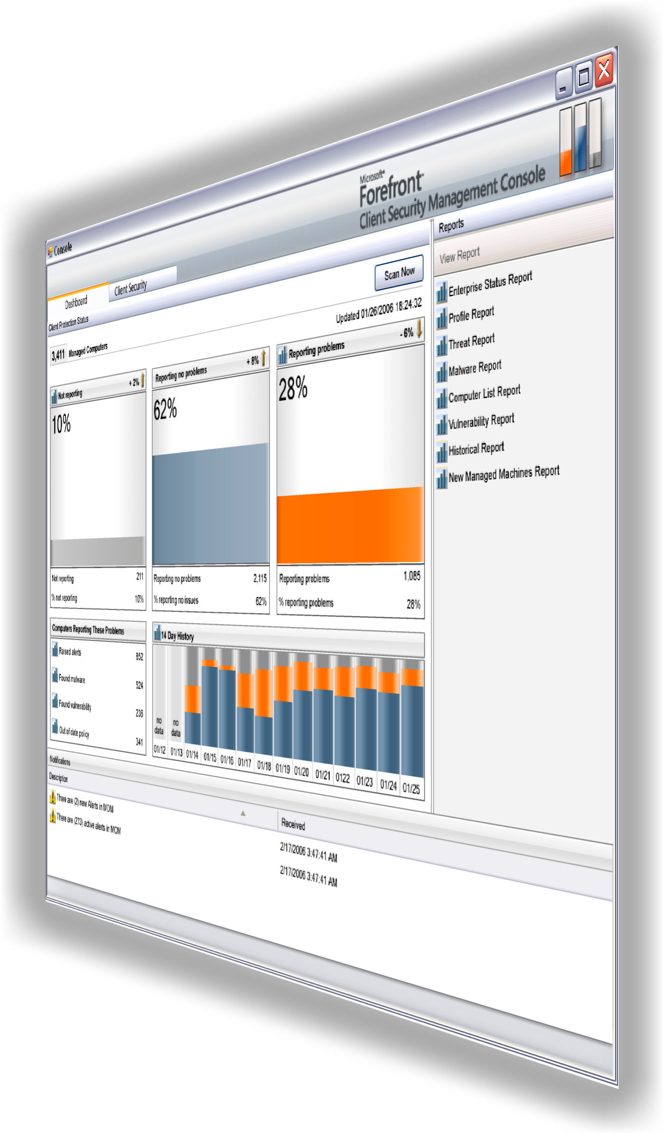
FCS Reporting Capabilities
Real-time reporting
    Enabled by embedded Operations
    Manager technology
    Access to real-time data and trends
“At-a-glance” view of threats & vulnerabilities across organization
    Machines reporting security issues (malware
    not cleaned, critical vulnerabilities present)
    Machines not reporting issues
    Machines not reporting
    30-day trend history
Drill down into detail as required
Notification of machines
reporting alerts

Slide 17

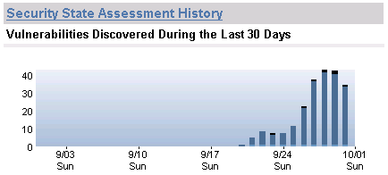
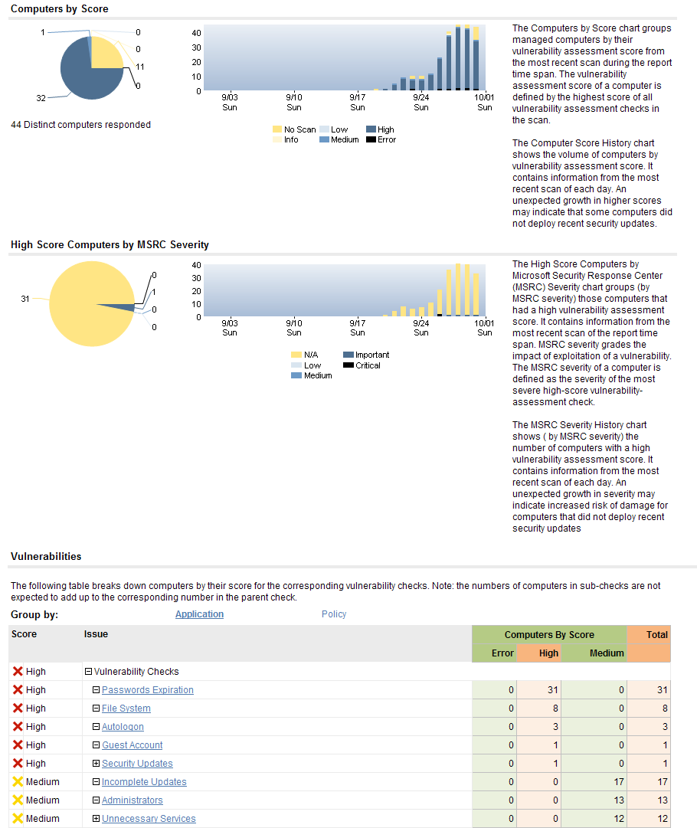
Security State Assessment Reporting
“Is my environment compliant with security best practices?”
“Has my level of vulnerability exposure changed over time?”
“What portion of my environment is at high risk?”

Slide 18
Forefront Client Security Demo
demo
Detect and prevent malware downloads

Slide 19






Summary
Protect client and server operating systems from emerging threats and information loss, while enabling more secure access from virtually anywhere
PROTECT everywhere,
ACCESS anywhere
INTEGRATE and
EXTEND security
SIMPLIFY security,
MANAGE compliance
  Advanced malware protection
  Protect sensitive information
  Secure, always-on access
  Integrated with
  OS security
  Leverages existing infrastructure
  Simplified management
  Enterprise-wide visibility

Slide 20
question & answer

Slide 21




Resources
www.microsoft.com/teched
  Sessions On-Demand & Community
www.microsoft.com/learning
Microsoft Certification & Training Resources
http://microsoft.com/technet
  Resources for IT Professionals
http://microsoft.com/msdn
  Resources for Developers

Slide 22
Related Content
SIA 303 Managing Threats in a Dynamic and Evolving Security Environment through Microsoft Forefront Threat Management Gateway
SIA 403 A Deep Dive on the New Microsoft Forefront Threat
Management Gateway
SIA01-DEMO Securing Enterprise-Wide Endpoints from Emerging Threats: How to Secure Endpoints from Malware and Web-Based Attacks
SIA28-HOL Microsoft Forefront Threat Management Gateway Overview
SIA20-HOL Forefront Client Security: Protect Endpoints with Forefront
Client Security

Slide 23
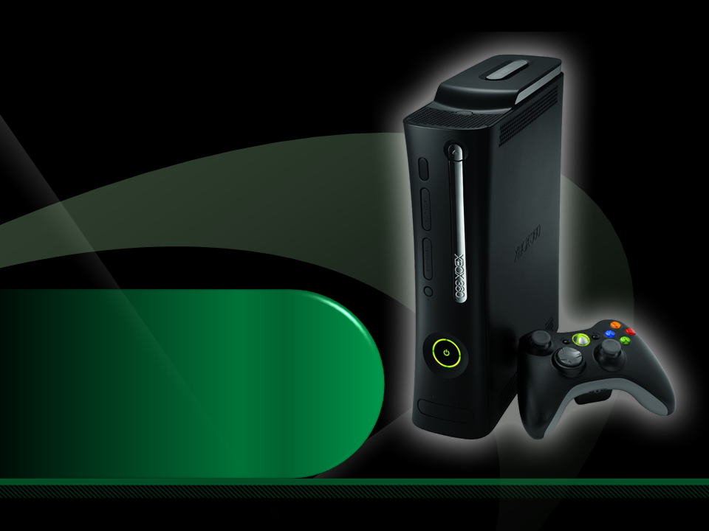
Complete an evaluation on CommNet and enter to win an Xbox 360 Elite!

Slide 24

Required Slide
© 2009 Microsoft Corporation. All rights reserved. Microsoft, Windows, Windows Vista and other product names are or may be registered trademarks and/or trademarks in the U.S. and/or other countries.
The information herein is for informational purposes only and represents the current view of Microsoft Corporation as of the date of this presentation. Because Microsoft must respond to changing market conditions, it should not be interpreted to be a commitment on the part of Microsoft, and Microsoft cannot guarantee the accuracy of any information provided after the date of this presentation. MICROSOFT MAKES NO WARRANTIES, EXPRESS, IMPLIED OR STATUTORY, AS TO THE INFORMATION IN THIS PRESENTATION.

