Slide 2
Windows Server 2008 R2 Overview
Joey Snow
Technical Evangelist
Microsoft Corportation
SVR203

Slide 3
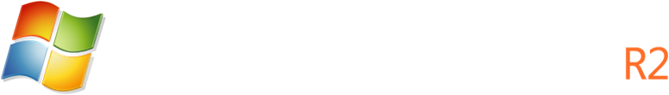

Technology Investment Areas
Virtualization
Management
Web
Hyper-V™ 2.0
Live Migration
Remote Desktop Services
Power Management
AD Administrative Center
Server Migration Portal
PowerShell 2.0
Best Practices Analyzer
IIS 7.5 & Integrated Extensions
.NET on Server Core
Configuration Tracing
Service-Oriented Architecture
Solid Foundation for Enterprise Workloads
Scalability
Better Together with Windows 7
>256 Core Support
Componentization
Direct Access
Branch Cache
AppLocker
Enhanced Group Policies
BitLocker on Removable Drives

Slide 4
Virtualization

Slide 5











Hyper-V 2.0
Building on the rock-solid architecture of Windows Server 2008 Hyper-V
Integration with new technologies and products
Enabling new dynamic scenarios:
  Increased Server Consolidation
  Dynamic Data Center
  Virtualized Centralized Desktop

Slide 6

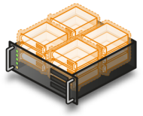
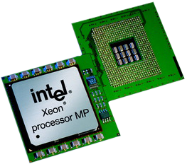

Hyper-V 2.0 Features
Logical Processor Support
  Support for 64 logical processors on host computer
Hot Add/Remove Storage
  Add and remove VHD disks to a running VM without requiring a reboot
Second Level Translation (SLAT)
  Leverage new processor features to improve performance and reduce load on Windows Hypervisor
VM Chimney (TCP Offload Support)
  TCP/IP Traffic in a VM can be offloaded to a physical NIC on the host computer (disabled by default)
Processor Compatibility Mode
  Allows live migration across different CPU versions within the same processor family (i.e. Intel-to-Intel and AMD-to-AMD).
    Does NOT enable cross platform from Intel to AMD or vice versa.
  Configure compatibility on a per-VM basis.
  Abstracts the VM down to the lowest common denominator in terms of instruction sets available to the VM.

Slide 7
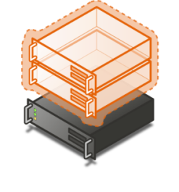


Quick Migration vs. Live Migration
Quick Migration
(Windows Server 2008 Hyper-V)
Save state
  Create VM on the target
  Write VM memory to shared storage
Move virtual machine
  Move storage connectivity from source host to target host via Ethernet
Restore state & Run
  Take VM memory from shared storage and restore on Target
  Run
Live Migration
(WS08R2 Hyper-V)
VM State/Memory Transfer
  Create VM on the target
  Move memory pages from the source to the target via Ethernet
Final state transfer and virtual machine restore
  Pause virtual machine
  Move storage connectivity from source host to target host via Ethernet
Un-pause & Run
Host 1
Host 2
Host 1
Host 2

Slide 8
Live Migration Operation
Memory
Memory
Configuration
Configuration
State
State
Server 1
Server 2

Slide 9
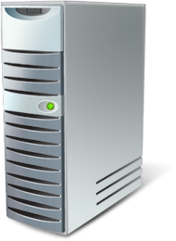
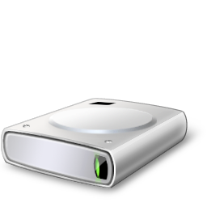

Simplifying Deployment
Boot from .vhd
  Enables pre-configuration of virtual and physical computers
  Reduces the number of managed images
  Simplifies test deployments
VHD
Boot

Slide 10

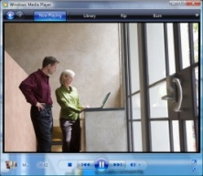
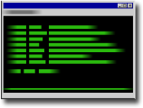
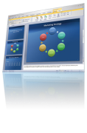
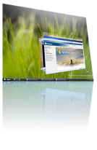

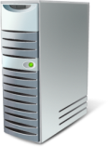




Remote Desktop Services in R2
RDS and VDI – An Integrated Solution
  Single broker to connect users to sessions or virtual machines, out of the box solution for VDI scenarios with Hyper-V
Improving the User Experience
  Experience rich multimedia, VoIP integration, aero glass remoting, true
  multi-monitor support
RemoteApp & Desktop Connections
  Centrally hosted applications integrated into start menu, desktop, etc. Can personalize a non-work PC with work applications without installing them locally
Improved Management Toolset
  Reduce repetitive task with RDS PowerShell support, improved application install, connection broker install & profile management
Platform Investments
  Multiple levels of extensibility for custom partner solutions for Remote Desktop Services & VDI based solutions

Slide 11
Management

Slide 12
Today's IT Challenges
Increasing demands from the business
  Reliance on technology for business-critical operations
  Always-available, anywhere
Increasing complexity
  Adding capabilities adds management burden
  80% of IT cost is managing existing systems
Trends of the future magnify challenges
  Move to Datacenters – large scale, virtualization remote management
  Outsourcing – lower skilled, high turnover users

Slide 13



Streamlined Management
Windows Server 2008 R2 as the foundation for data center automation
  Expand surface are of Windows Server that can be driven via scripting
  Top server roles/tasks can be managed using remote & local PowerShell scripts
  In-box cmdlets for server roles, and for power, blade and chassis management
  Work with OEMs and IHVs to deliver WS-Management compatible hardware
Install and run Server Manager (including role management snap-ins) from Windows 7 clients
  Remotable Server Manager UI
  Best Practices Analyzer integrated into Server Manager
  Performance counter viewer in Server Manager

Slide 14
Server Management Enhancements
demo

Slide 15
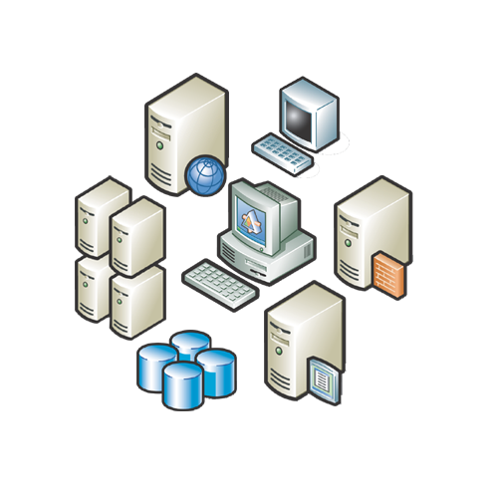





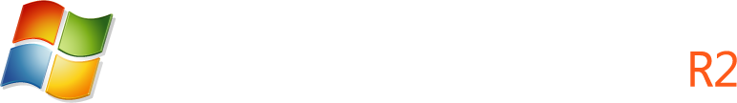


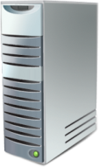


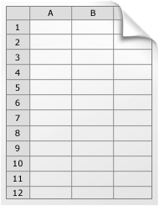



Server Migration
Situation Today
Windows Server 2008 R2 Solution
Migration Portal
  Migration Documentation and Tools:
    Available for a limited number of roles
    Hard to find
    Inconsistent tools, documentation, and user experience
  Migration Portal on TechNet
    One-stop-shop for all migration resources
  Step by Step Migration Guides
    Top Server Roles
    Data, Shares and Some OS Settings
  Migration Powershell Cmdlets
    Easy to Script
    2 Server roles, 1 Feature, OS Settings, Data & Shares

Slide 16
Server Migration
demo

Slide 17


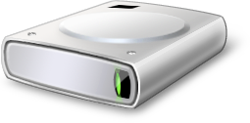
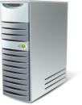




Improvements in Windows Server Backup
Backup specific files and folders.
Perform incremental backups of system state.
Perform scheduled backups to volumes.
Perform scheduled backups to network shared folders.
Manage backups by
using PowerShell.

Slide 18
File Classification Infrastructure
Discover Data
Examine Data for qualities bearing on classification
Classify Data
Store classification properties
Apply Policy based on classification
File Classification Extensibility points
Get classification properties API for external applications
Set classification properties API for external applications
In-box, end-to-end scenarios
Integration with SharePoint
Extensible infrastructure & Partner ecosystem

Slide 19

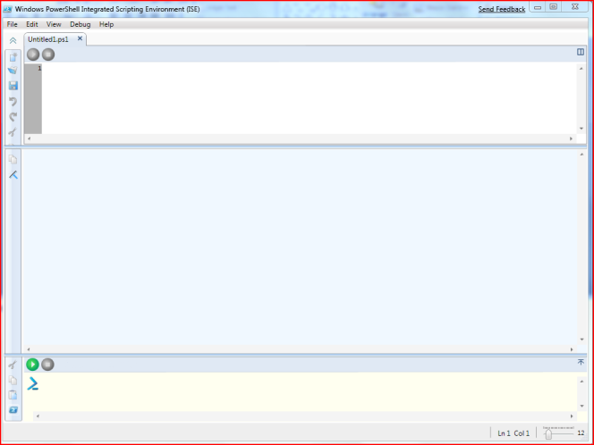

Powershell 2.0
Improved Command-line shell & Scripting Language
Improves productivity & control
Accelerates automation of system admin
Easy-to-use
Works with existing scripts
Community Model
New Features
Integration
Graphical PowerShell
Improved Security
Portability
New cmdlets
Active Directory Administration Center
IIS
Power Management
One-to-many remote management using WS-MGMT

Slide 20
PowerShell Enhancements
demo

Slide 21
Active Directory

Slide 22
Active Directory Domain Services
New Active Directory Domain Services
management console
  PowerShell integration/Built on PowerShell
Recovery of deleted objects
  New AD Recycle Bin
Improved process for joining domains
  Offline domain join
Improved management of user accounts and
identity services
  Managed service accounts
Improved Active Directory Federated Services
  Authentication assurance

Slide 23
Active Directory Enhancements
demo

Slide 24
Better Together With Windows 7

Slide 25
Better Together With Windows 7
More effective software control with AppLocker
Ubiquitous remote connectivity via DirectAccess
Combining Remote Workspace, Presentation Virtualization and Remote Desktop Services Gateway allows native desktop experience over public Win 7 computers
BranchCache for improved branch performance
Read-Only DFS for improved branch office security
More efficient client power management
Desktop and applications virtualization feeds feature
Agile VPN
BitLocker encryption on removable drives

Slide 26
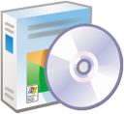









Software Control via AppLocker
Situation Today
Windows Server 2008 R2 and Windows 7 Solution
AppLocker™
  Users can install and run unapproved applications
  Even standard users can install some types of software
  Unauthorized applications may:
    Introduce malware
    Increase helpdesk calls
    Reduce user productivity
    Undermine compliance efforts
  Eliminate unwanted/unknown applications in your network
  Enforce application standardization within your organization
  Easily create and manage flexible rules using Group Policy

Slide 27




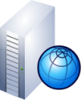
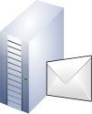

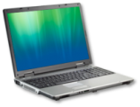

Remote Access for Mobile Workers
Make Users Productive Anywhere
Windows Server 2008 R2 and Windows 7 Solution
Situation Today
Direct Access ™
Office
Home
Office
Home
  Difficult for users to access corporate resources from outside the office
  Challenging for IT to manage, update, patch mobile PCs while disconnected from company network
  New network paradigm enables same experience inside & outside the office
  Seamless access to network resources increases productivity of mobile users
  Infrastructure investments also make
  it easy to service mobile PCs and
  distribute updates and polices

Slide 28

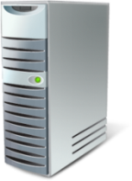









DirectAccess™
IPv6 Devices
IPv4 Devices
Support IPv4 via 6to4 transition services or NAT-PT
IT desktop management
DirectAccess provides transparent, secured access to intranet resources without a VPN
Native IPv6 with IPSec
Allows desktop management of DirectAccess clients
AD Group Policy, NAP, software updates
IPv6 Transition Services
Supports direct connectivity to IPv6-based intranet resources
DirectAccess
Server
Internet
Allows IPSec encryption and authentication
Supports variety of remote network protocols
Windows 7 Client

Slide 29
DirectAccess Deployment
Get ready step by step
Determine your strategy
  Be ready to monitor IPv6 traffic
  Choose an Access Model: Full Intranet Access vs. Selected Server Access?
  Assess deployment scale
Get your infrastructure ready
  Windows 7 clients
  Windows Server 2008 R2 DirectAccess Server
  DC, DNS Server, Active Directory, PKI, Application Servers, etc.
During deployment
  Use DirectAccess configuration wizard to setup DirectAccess Server and generate policies for clients, application servers, and DC/DNS
  Customize policies as needed

Slide 30








BranchCache™
Windows 7 Solution
  Caches content downloaded from file and Web servers
  Users in the branch can quickly open files stored in the cache
  Frees up network bandwidth for other uses
Technical Details
  Authenticates current state of data and access rights of the user against the server
  Supports commonly used protocols: HTTP(S), SMB
  Support network security protocols (SSL, IPsec)
  Requires Windows Server 2008 R2 in the data center and hosted cache

Slide 31

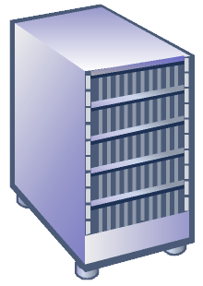




BranchCache Distributed Cache
Main Office
ID
Get
Data
ID
Data
Get
Get
Get
Data
Branch Office

Slide 32
BranchCache Hosted Cache
Main Office
Get
ID
Data
Data
ID
ID
Get
Get
Get
Search
Search
ID
Data
Advertize
ID
Request
Branch Office
ID
Data
Put

Slide 33





BranchCache
Enterprise
Distributed Cache
Data cached in cache pool
Hosted Cache
Data cached at the host server
  Recommended for branches without a branch server
  Easy to deploy: Enabled on clients through Group Policy
  Cache availability decreases with laptops that go offline
  Cache stored centrally: existing Windows Server 2008 R2 in the branch
  Cache availability is high
  Enables branch-wide caching
  Increased reliability

Slide 34
Branch Cache
demo

Slide 35

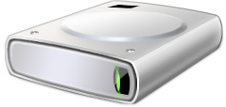







Data Protection
Enhance Security & Control
Windows Server 2008 R2 and Windows 7 Solution
Situation Today
BitLocker ToGo™
+
Worldwide Shipments (000s)
  Protect data on internal
  and removable drives
  Mandate the use of encryption
  with Group Policies
  Store recovery information in
  Active Directory for manageability
  Simplify BitLocker setup and
  configuration of primary hard drive
Gartner “Forecast: USB Flash Drives, Worldwide, 2001-2011”
24 September 2007, Joseph Unsworth
Gartner “Dataquest Insight: PC Forecast Analysis, Worldwide, 1H08”
18 April 2008, Mikako Kitagawa, George Shiffler III

Slide 36
IIS 7.5

Slide 37
Enhancing the IIS Feature Set
Extensions Add Further Functionality
Extensions Add Further Functionality
WS 2008
WS 2008 R2
IIS Extensions
IIS Extensions
Some Extensions
Integrated
IIS 7.0 Platform
Enhanced IIS 7.5 Platform

Slide 38

Key Changes to IIS in R2
IIS 7.5
ASP.NET on Server Core
New IIS Manager Modules
Integrated PowerShell Provider
Configuration Logging & Tracing
Integrated FTP and WebDAV
Extended Protection & Security

Slide 39
Scalability and Power Management

Slide 40
Scalability Enhancements
Run the largest workloads and fully utilize multi-core servers with a single WSS08R2 server instance
  Get standard workloads to function with fewer locks and greater parallelism
  Support more than 64 processor cores for a single OS instance
  Reduced overhead for Hyper-V, and improved storage performance
Componentization - Improvements to Server Core
  Support more roles and broaden current role support (e.g., the addition of ASP.net within IIS)
  PowerShell scripting in Server Core
  .NET framework on Server core, which in turn should drive app support

Slide 41

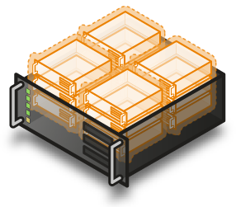
Core Parking
Overview
  Scheduling processes on a single server for density as opposed to dispersion
  This allows “park/sleep” cores by putting them in deep C states
Benefits
  Enhances Green IT by reducing
  CPU power consumption

Slide 42
Summary
Increased server consolidation
Greater administrative control
Rich Web-based experiences
Performance and scalability enhancements
Unprecedented synergies with client OS
Anywhere access
Taking an enterprise-class foundation to the next level

Slide 43
question & answer

Slide 44




Resources
Required Slide
Speakers,
TechEd 2009 is not producing
a DVD. Please announce that
attendees can access session
recordings at TechEd Online.
www.microsoft.com/teched
  Sessions On-Demand & Community
www.microsoft.com/learning
Microsoft Certification & Training Resources
http://microsoft.com/technet
  Resources for IT Professionals
http://microsoft.com/msdn
  Resources for Developers

Slide 45
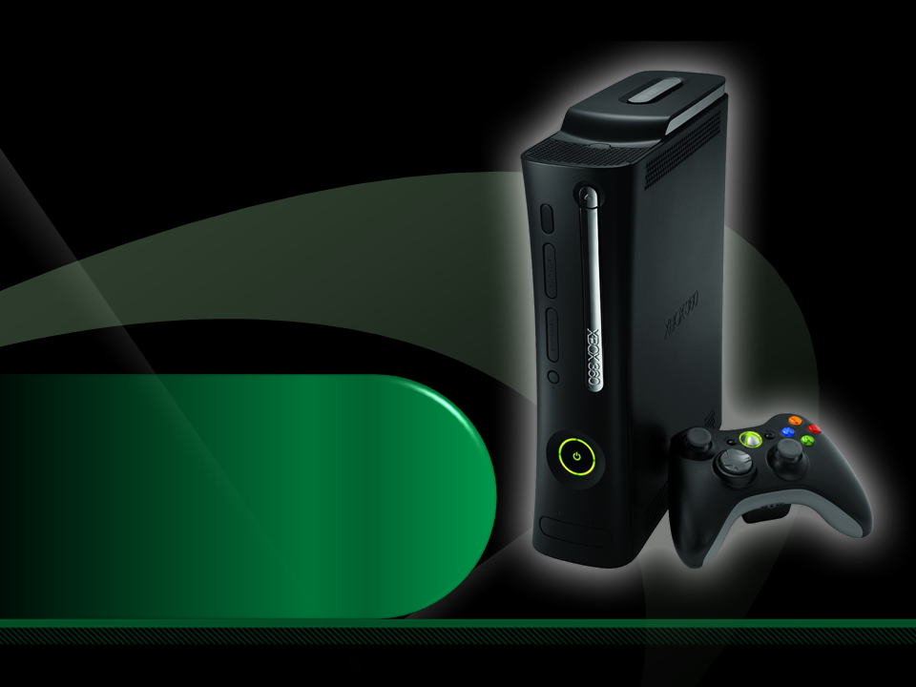
Complete an evaluation on CommNet and enter to win an Xbox 360 Elite!

Slide 47

Required Slide
© 2009 Microsoft Corporation. All rights reserved. Microsoft, Windows, Windows Vista and other product names are or may be registered trademarks and/or trademarks in the U.S. and/or other countries.
The information herein is for informational purposes only and represents the current view of Microsoft Corporation as of the date of this presentation. Because Microsoft must respond to changing market conditions, it should not be interpreted to be a commitment on the part of Microsoft, and Microsoft cannot guarantee the accuracy of any information provided after the date of this presentation. MICROSOFT MAKES NO WARRANTIES, EXPRESS, IMPLIED OR STATUTORY, AS TO THE INFORMATION IN THIS PRESENTATION.

