Slide 2
Microsoft Virtualization, Window Server 2008 R2 Hyper-V
Jeffrey Woolsey
Principal Group Program Mgr
Windows Server, Hyper-V
SVR-205
Edwin Yuen
Sr. Program Manger
System Center

Slide 3
Agenda
Microsoft Virtualization Strategy/Portfolio
Windows Server 2008 R2 Hyper-V Overview
Live Migration
Interoperability
Feature Overview
System Center Virtual Machine Manager R2
Microsoft Hyper-V Server 2008 R2
Q & A

Slide 4


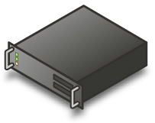
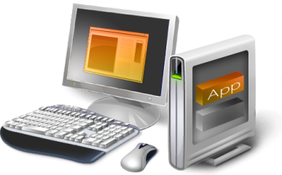
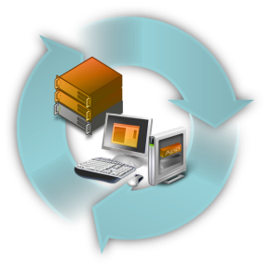
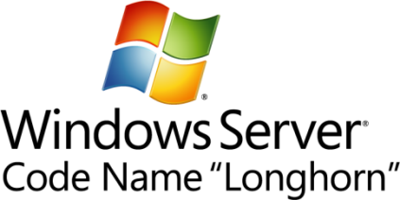




Microsoft Virtualization Strategy
The Platform you know
Data center to desktop
End-to-End Management
Best TCO/ROI
Key feature
of platform
Full range of products & solutions
Physical and Virtual & Cross-hypervisor
1/6th the price
up front
Tools
you know
Large partner
eco-system
Interoperability
Lower ongoing costs

Slide 5

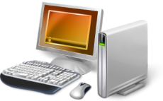
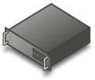
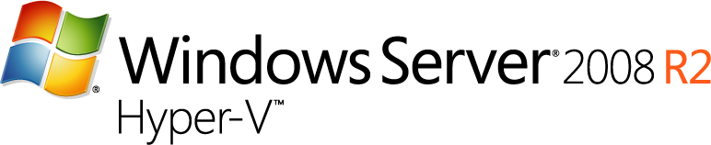


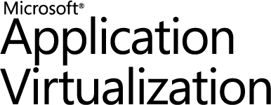
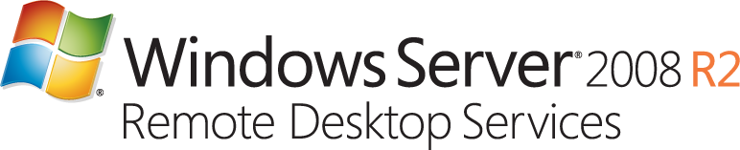



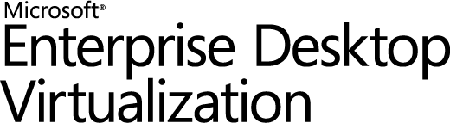

Microsoft Virtualization Products
Server
Virtualization
Application
Virtualization
Remote Desktop Services
“Having one vendor for the hypervisor, operating system, and much of our application software was very appealing to us from a support and cost perspective.”
Bert Van Pottelberghe,
Sales Director, Hostbasket
Desktop
Virtualization
User State
Virtualization
Document Redirection and Offline Files

Slide 6

Extensive, Unified Management
Wide-spread virtualization requires comprehensive,
seamless management
Only Microsoft System Center suite delivers
  All integrated, all for one price
  Physical and virtual machines (Hyper-V and VMware)
  Host and in-guest management
  Single pane of glass
No rip and replace for existing
VMware customers

Slide 7
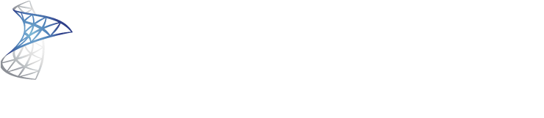

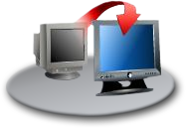
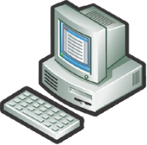





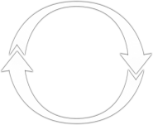



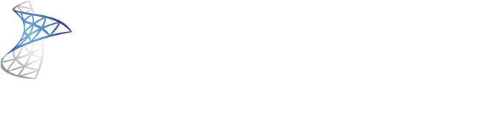
Managing Physical and Virtual Server Lifecycles
Backup
Hardware Provisioning
Virtual Workload Provisioning
Disaster Recovery
“A big selling point of System Center Virtual Machine Manager 2008 is that it’s a familiar toolset. Anyone who’s managing Windows servers is already familiar with this program.”
Matt Lavallee, Director of Technology for MLS Property Information Network.
OS / Software Deploy, Patching and State Mgmt
Performance and Health Monitoring

Slide 8
In-Guest Management and Monitoring
Integrate virtualization into existing tools, personnel, processes
Focus on applications, workloads running on virtual machines
Manage, monitor virtual machines just like physical machines
Microsoft System Center Virtual Machine Manager 2008 R2 integrated with System Center Operations Manager 2007 R2

Slide 9
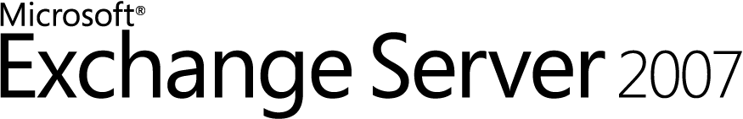
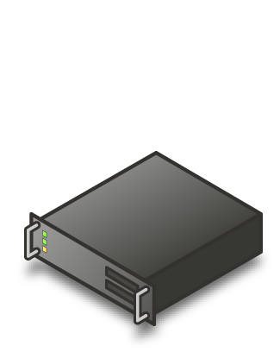
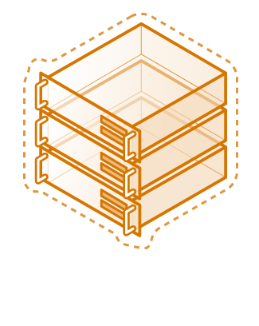

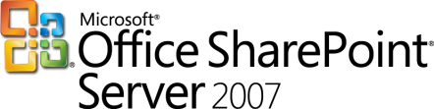


Virtualized Workloads
Microsoft supports our key server applications in a virtualized environment
Microsoft has updated server workload licensing to enable virtualization mobility
Management of the workloads is key, not just the virtual machine
“Maxol runs Exchange Server 2007, SQL Server 2005, Terminal Services, and file and print servers as key workloads in its virtual environment. Going forward, nearly every business application at Maxol will be a candidate for virtualization.”
Maxol Case Study
“We’ve seen first-hand that we can virtualize everything from file, print, and web servers to database servers running SQL Server and Oracle, and actually have the virtual machine run *faster* than what it ran on our original physical box.”
Janssen Jones, Indiana University

Slide 10
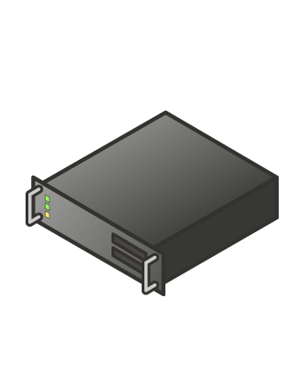

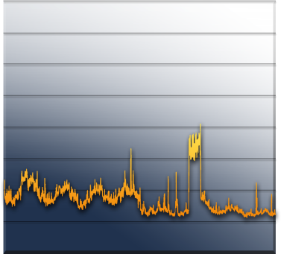
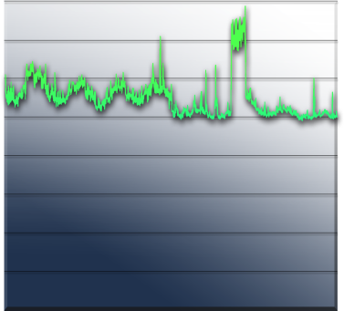
Server Consolidation: Comune di Roma
The Fastest Way to Reduce Costs
Challenges:
Underutilized hardware
Excessive power consumption
Desire to Improve Business Agility
Expensive space across datacenter & branch offices
Some Hyper-V Workloads:
BizTalk 2006 Enterprise
Active Directory
IIS 7.0
Oracle
“With Hyper-V, we are exploiting the capacity of Intel-based enterprise servers to build a scalable, reliable virtualization environment capable of consolidating multiple physical servers at once.”
Luigi Baldoni
Chief Information Officer, Comune di Roma
“IT staff used the performance monitoring tool within the Microsoft Management Console (MMC) to assess the performance of both 64-bit and 32-bit VMs. “So far, the performance of Hyper-V is near to that of a physical system, and the MMC interface is simple and intuitive.”
Giulio Moroni, Comune di Roma Technical Leader
Server Utilization

Slide 11
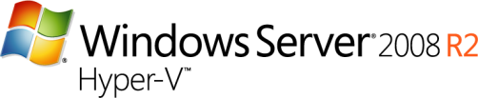
UK Hoster: PoundHost & BlueSquare
Switched from VMware to Hyper-V
Challenges:
Wanted to expand product offerings & provide greater flexibility
High Cost of VMware impacted bottom line
Lower Costs for IT & Power
“With Hyper-V, we can offer customers much greater flexibility, and the System Center solutions build the server automatically.”
Process:
Customers order VMs online & order is validated via PoundHost billing system
PowerShell™ scripts create vms to the customer’s exact specifications
Microsoft System Center Virtual Machine Manager 2008 creates the virtual machine on the host server, System Center Configuration Manager 2007 installs the operating system, configures Internet Protocol (IP) addresses, installs the customer’s business software and all necessary security updates
Result:
  Demand for Windows Server 2008 R2–based servers has been much stronger than PoundHost anticipated. “We sold 100 virtual machines in the first two months and expect to sell another 1,000 in the next two months,” Munson says. “We’ve doubled virtual-machine sales with our Hyper-V offering, plus operating costs are lower because Hyper-V is so much less expensive than VMware. A host server containing 50 guest servers would cost over £750 [$1,200] a month with VMware but only £66 [$107] a month with Hyper-V—an 80 percent savings. Our profitability has increased by 55 percent with Hyper-V.”

Slide 12




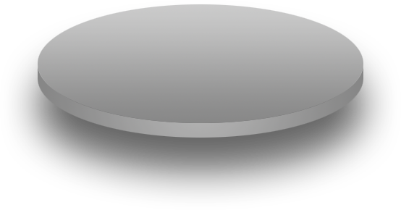


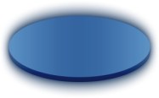


Windows Server 2008 R2 Hyper-V
Building on rock solid Windows Server 2008 Hyper-V architecture
  Over 400 case studies from customers worldwide: SMB, Branch to Enterprise (www.microsoft.com/virtualization)
  Over 1 million downloads of Hyper-V RTM in 12 months
  Fastest growing bare metal hypervisor in x86 history
Microsoft.com powered by Hyper-V since V1 Beta
  ~15,000 requests per second
  Over 40 million hits per day
  Over 1.2 billion page hits per month
Enabling new dynamic scenarios:
  Dynamic Data Center
  Virtualized Centralized Desktop
Customer Driven

Slide 13
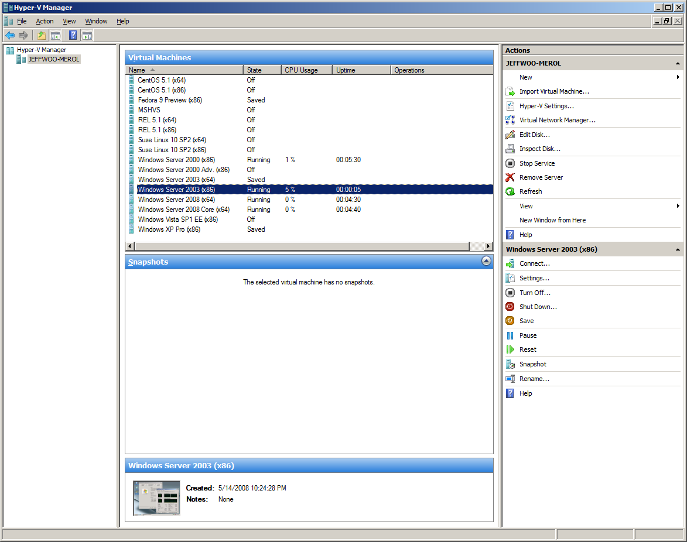
Windows Server 2008 R2 Hyper-V
New Features
Live Migration
New Processor Support
  Improved Performance
  Lower Power Costs
Enhanced scalability
  Greater VM Density
  Lower TCO
Networking Enhancements
  Improve Performance
  10 Gb/E Ready
Dynamic VM Capabilities
Enhancements to Server Core
  Ease Management
  Lower TCO

Slide 14
Hyper-V Live Migration

Slide 15
Live Migration
#1 Customer Request
Moving a virtual machine from one server to another without loss of service
  Guest OS is unaware of the migration
  Maintain TCP connections of the guest OS
  VM is treated as a black box
  Building block for Dynamic Data Center through business agility, cost reduction and increase in productivity
Enables new dynamic scenarios
  Load balancing VMs via policy

Slide 16
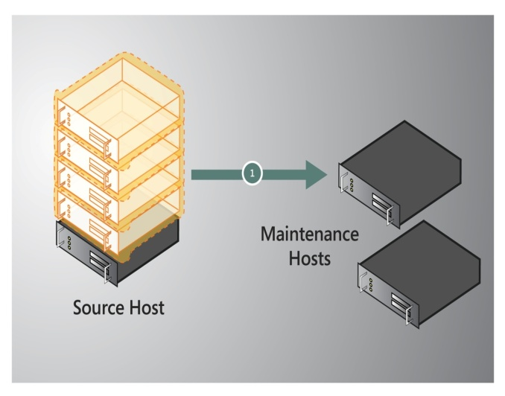
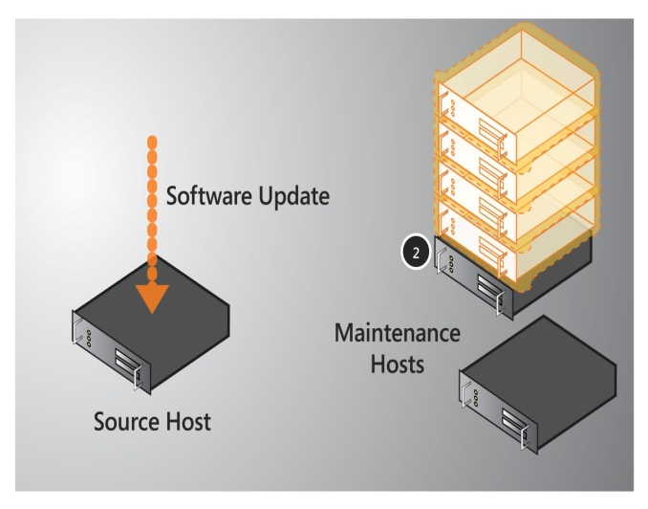
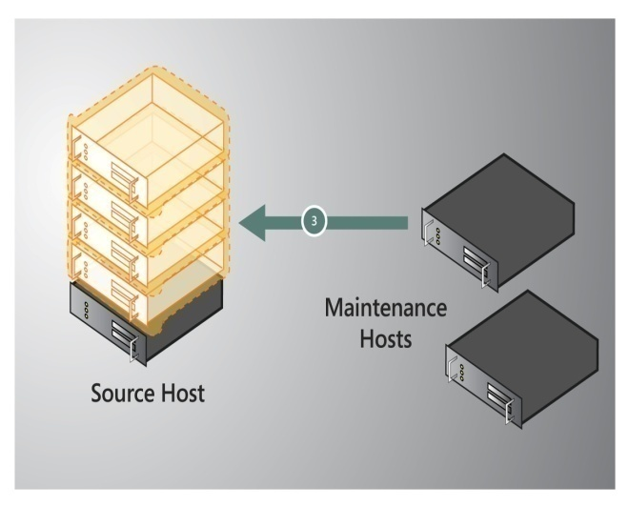
Key Scenario: Host Servicing
Live Migrate VMs from Source to Destination
Service Source – Patching or Hardware Servicing, no downtime seen by VMs on Destination
Live Migrate VMs from back from Destination to Source
No workload downtime during maintenance window

Slide 17
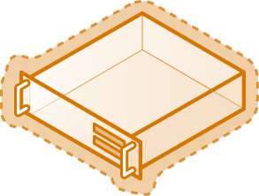

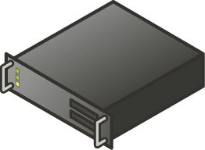

Live Migration: How It Works
Create VM on target server
Copy memory pages from the source to the target via Ethernet
Final state transfer
  Pause virtual machine
  Move storage connectivity from source host to target host via Ethernet
Run new VM on target; Delete VM on source
Host 1
Host 2
Blue = Storage
Yellow = Networking
Shared Storage

Slide 18
Migration & Storage
Windows Server 2008 R2 Hyper-V
  NEW Cluster Shared Volume (CSV)
  CSV provides a single consistent file name space
  All Windows Server 2008 R2 servers see the same storage
    Easy setup; Uses NTFS
    No reformatting SANs
    Create one big data store
    No more drive letter problems
    Existing tools just work

Slide 19
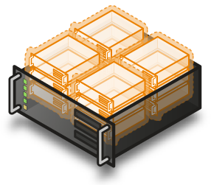
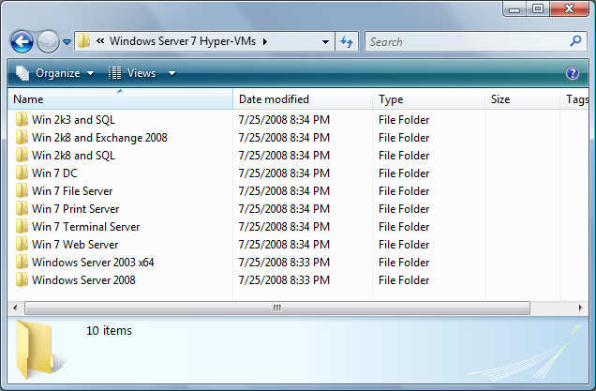

Cluster Shared Volumes
All servers “see” the same storage

Slide 20
CSV Compatibility
It Just Works
No special hardware requirements
No file type restrictions
No directory structure or depth limitations
No special agents or additional installations
No proprietary file system
  Uses well established traditional NTFS
Doesn’t suffer from numerous VMFS limitations such as…

Slide 21
Comparing VMFS & CSV
 | VMware VMFS3 | Microsoft CSV
Max Vol. Size | 2 TB | 256 TB
Min Vol. Size | 1.2 GB | 1 MB
Max # Partitions | 128 | 128
Multi-Path Support | Limited (no inbox load balancing for iSCSI); 3rd party MPIO is EE+ Only | Extensible, Broad Storage Array Support
Directory Structure | Limited (1 VM per folder) | Unrestricted
Max # Files per Volume | ~30,000 | 4+ Billion
Max # of VMs per Volume | 256 | Unlimited
Recommended Max # of VMs per Volume | 32 (due to I/O scalability) | Unlimited
Max # of VMs per Node | 40 | 64

Slide 22

Advanced Storage Capabilities
Is there a Hyper-V Storage Certification?
  What about storage De-duplication?
  What about Storage Replication?
Hyper-V is compatible with block based de-duplication and replication solutions that are certified for Windows Server 2008/2008 R2.
Solutions from: NetApp, HP, EMC, Hitachi, NEC, Compellent and more…
  www.windowsservercatalog.com

Slide 23
New Processor Features

Slide 24
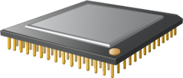
64 Logical Processor Support
Overview
  4x improvement over Hyper-V V1
  Hyper-V can take advantage of larger scale-up systems with greater amount of compute resources
Up to 384 Running Virtual Machines & Support for up to 512 Virtual Processors (VPs) PER SERVER
  384 single VP VMs OR
  256 dual VP VMs (512 Virtual Processors) OR
  128 quad VP VMs (512 Virtual Processors) OR
  any combination so long as you're running up to 384 VMs and up to 512 Virtual Processors

Slide 25
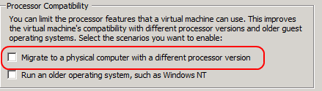
Processor Compatibility Mode
Overview
  Allows live migration across different CPU versions within the same processor family (i.e. Intel-to-Intel and AMD-to-AMD).
    Does NOT enable cross platform from Intel to AMD or vice versa.
  Configure compatibility on a per-VM basis.
  Abstracts the VM down to the lowest common denominator in terms of instruction sets available to the VM.
Benefits
  Greater flexibility within clusters
  Enables migration across a broader ranger of Hyper-V host hardware

Slide 26
Cluster Example
Hardware:
  4 Generations of Intel VT Processors
  4 Node Cluster using 1 Gb/E iSCSI
Test:
  Created script to continuously Live Migrate VMs every 15 seconds
Pentium 4 VT Circa 2005
Core 2 Duo Circa 2006
Core 2 Quad Circa 2008
Core i7 (Nehalem) 2009
Result: 20,000+ Migrations in a week!

Slide 27
Forward & Backward Compatibility
How Does it Work?
  When a VM is started the hypervisor exposes guest visible processor features
  With Processor Compatibility Enabled, the guest processors is normalized and the following processors features are “hidden” from the VM
Host running AMD based processor | Host running Intel based processor
SSSE3, SSE4.1, SSE4.A, SSE5, POPCNT, LZCNT, Misaligned SSE, AMD 3DNow!, Extended AMD 3DNow! | SSSE3, SSE4.1, SSE4.2, POPCNT, Misaligned SSE, XSAVE, AVX

Slide 28

Windows Server 2008 R2
Core Parking
Overview
  Scheduling virtual machines on a single server for density as opposed to dispersion
  This allows “park/sleep” cores by putting them in deep C states
Benefits
  Enhances Green IT by reducing
  CPU power consumption

Slide 29
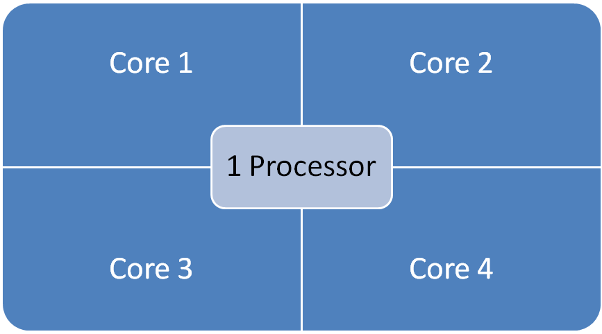
Windows Server 2008 R2 Core Parking
16 LP Server
Processor is “parked”
Processor is “parked”

Slide 30
R2 Power Efficiency Improvement

Slide 31
What Windows Server 2008 R2 Early-Adopting Customers Are Saying
  “With virtualization, we will save about 50 percent of our annual energy budget for cooling and electricity.”
    Lukas Kucera – IT Services Manager at Lukoil CEEB
  “The work that Microsoft has done in these areas—particularly the ability to shift workloads across CPUs—is doing wonders for reducing our energy consumption.”
    Jeffrey Altman – President and CEO at Secure Endpoints
  “89% Energy Savings with Microsoft Virtualization”
    Chris Steffen – Principle Technical Architect at Kroll Factual Data
    Video Case Study at spotlightoncost.com

Slide 32
Hyper-V Networking

Slide 33
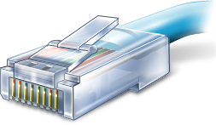
Hyper-V R2 Networking
10 Gb/E Ready
Chimney Support (10Gb/E)
  TCP/IP traffic in a VM can be offloaded to a physical NIC on the host computer.
  Reduce CPU burden; Live Migration is fully supported with Full TCP Offload
  Works best with long-lived connections with large data transfers
VMQ Support (10Gb/E)
  NIC can DMA packets directly into VM memory
  Host no longer has device DMA data in its own buffer resulting in a shorter path length for I/O (performance gain)
Jumbo Frame Support (1 Gb/E & 10 Gb/E)
  Enables 6x larger payload per packet
  Improves throughput
  Reduce CPU utilization of large file transfers

Slide 34
Network I/O Data Path With VMQ
Parent Partition
Parent Partition
VM1
VM2
Virtual Machine Switch
Virtual Machine Switch (VSP)
Routing, VLAN Filtering, Data Copy
Ethernet
Routing
VLAN filtering
Data Copy
TCP/IP
TCP/IP
Port 2
Port 1
VM NIC 1
VM NIC 2
Port 2
Port 1
Miniport
Driver
Miniport
Driver
Default
Queue
Q1
Q2
VM BUS
Switch/Routing unit
NIC

Slide 35
Hyper-V Interoperability

Slide 36


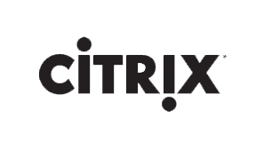

Interoperability
Interoperability agreements with Novell and Citrix (Xen) to support Linux on Hyper-V
SVVP (Server Virtualization Validation Program) to certify non-Microsoft Hypervisors for Microsoft Support
System Center Operations Manager supports monitoring of non-Windows, including Linux
System Center Virtual Machine Manager manages VMware ESX servers
“DHMC runs both Windows Server 2008 and Windows Server 2003 as guest operating systems under Hyper-V, as well as Linux. To date, DHMC has virtualized Web servers, sites on Microsoft Office SharePoint® Server 2007, reporting servers, medical applications, domain controllers, file and print servers, Citrix servers, and more.”
Dartmouth Hitchcock Medical Center Case Study

Slide 37
Microsoft Contributes to Linux
In July ‘09, Microsoft contributed over 20,000 lines of code to the Linux kernel under GPL v2
Drivers to enhance performance
  Synthetic Disk
  Synthetic Networking
  VMBus
August ‘09: Microsoft Drivers Included in Linus Torvalds Official Kernel (v2.6.32)

Slide 38


Slide 39
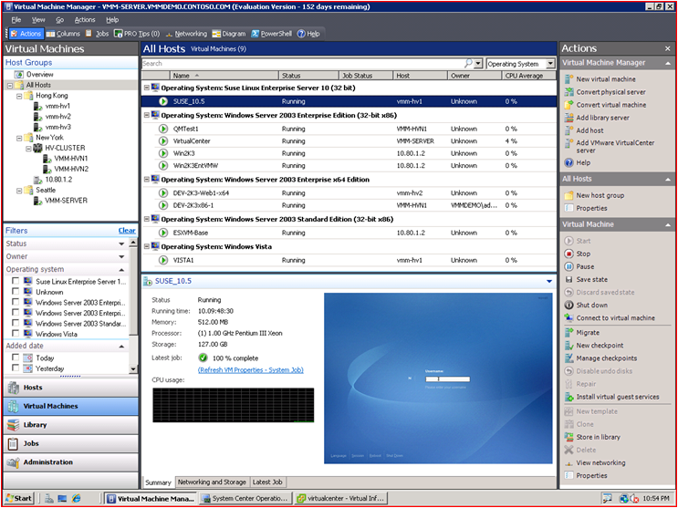
A centralized, heterogeneous management solution for the virtual datacenter
Maximize Resources
  Centralized virtual machine deployment and management for Hyper-V, Virtual Server, and VMware ESX servers
  Intelligent placement of Virtual Machines
  Fast and reliable P2V and V2V conversion
  Comprehensive application and service-level monitoring with Operations Manager
  Integrated Performance and Resource Optimization (PRO) of VMs
Increase Agility
  Rapid provisioning of new and virtual machines with templates
  Centralized library of infrastructure components
  Leverage and extend existing storage infrastructure and clusters
  Allow for delegated management and access of VMs
Leverage Skills
  Familiar interface, common foundation
  Monitor physical and virtual machines from one console
  Fully scriptable using Windows PowerShell

Slide 40

What’s new in VMM 2008 R2
Support for new Windows Server 2008 R2 features
  Live migration
  Support for CFS (Clustered Shared Volumes and 3rd party solutions)
  Hot add/remove of VHDs, Pass-through disks
Maintenance mode
  Evacuate VMs from host using Live migration
Storage Enhancements
  Storage Vmotion Support
  Quick Storage Migration w/Hyper-V
  Enhanced Migration of VMs for clusters
Rapid Provisioning of Virtual Machines

Slide 41
Live Migration
Enables migration of running VMs without downtime
Requirements
  Hosts need to be part of a failover cluster
  Host processor type should be same
  Must have access to shared storage
    Cluster Shared Volumes (CSV) is highly recommended
  Dedicated network for the live migration traffic
Multiple Simultaneous Live Migrations
  A given host can participate in one Live Migration at a time as source or destination for up to 8 concurrent Live Migrations in a 16 node cluster

Slide 42
Demo

Slide 43
Host compatibility
VM migration requires host hardware to be compatible
  CPU features, enlightenment parity etc
Compatibility checks
  VMM R2 does deep check for compatibility
  Supported for both Hyper-V and VMWare VMs
Make VM compatible (Hyper-V specific)
  Setting per VM: Needs VM to be restarted to take effect
  Turns off certain CPU features in VM
  Tradeoff between using advanced CPU features versus making VM more compatible for migration

Slide 44
Clustered Shared Volumes (CSV)
Enables multiple nodes in a cluster to access a single shared LUN
VMM 2008 R2
  Allows multiple VMs within the cluster to share a LUN
    Enables packing more VMs per LUN without needing to carve out individual LUNs
  Enables live migration of individual VMs without affecting other VMs on the LUN
Support for 3rd party CFS
  Detect CFS disks and enable HAVM
  Allow multiple VMs per LUN

Slide 45
Storage Migration
VMM R2 adds support for Quick Storage Migration
  Migrate VM to a different location with minimal downtime
  On same Host or different host
VMM R2 also enables VMWare storage vMotion
Feature | Quick Storage Migration | VMWare Storage vMotion
Storage agnostic | Yes | No (requires VMFS)
VM downtime | < 2 mins | < 2 sec
Migration of VMs with snapshots | Yes | No
Requires access to both source and target storage | No | Yes
Migrate VM to different host along with migrating storage | Yes | No

Slide 46
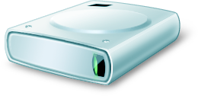
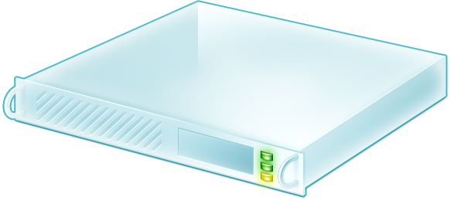
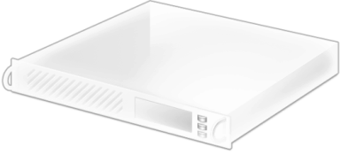
Quick Storage Migration
Source Disk
Destination Disk
Quick Storage Migration Enables VM Migration from one storage infrastructure to another!

Slide 47
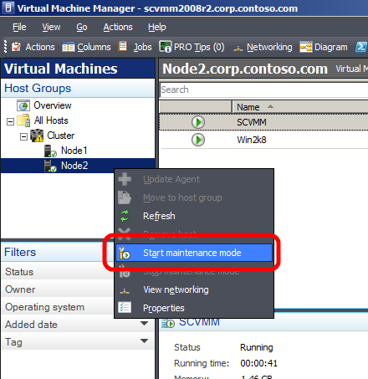
Maintenance Mode
VMM R2 Allows Host Servers To Be Put Into a Maintenance Mode
  Useful for Servicing Hardware, Software or Power Energy Management
  If Host Is Clustered VMs Running On The Host Are Automatically Live Migrated To Other Hosts
  If Host Is Standalone Admin Can Choose To Save State or Shutdown VMs
Placement
  Host in maintenance mode gets zero star ratings
Supported for Hyper-V, Virtual Server and VMWare Hosts

Slide 48
Network related enhancments
Network Optimization
  Win2k8 R2 supports 2 types of network optimizations: VMQ & Chimney
  During VM creation: Enable/disable network optimization
    If enabled, VMM will configure the VM to use VMQ or Chimney, if available on the host
  Placement: Detect and show availability of Network optimization on the host
Enable/Disable MAC spoofing
Ability to reuse port groups defined in VMWare VirtualCenter

Slide 49
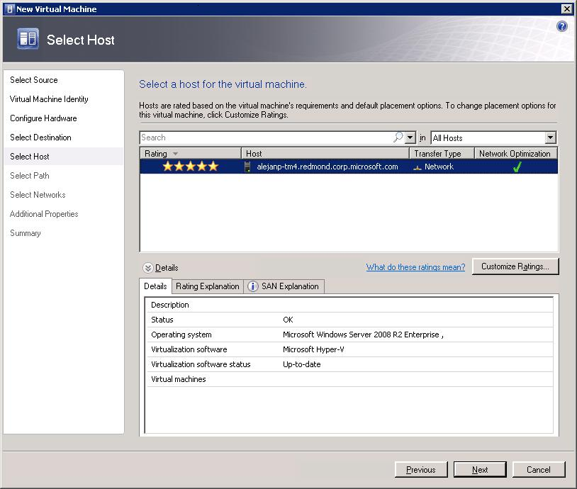
VMM has detected that host has NIC that has either VMQ or Chimney capabilities

Slide 50
Hot Add of VM storage
Ability to add/remove storage to running VMs
  Reduces downtime and provides flexibility to admins to add/remove storage as needed
Admin needs to add storage space to VM
  He would need to stop the VM to do this
  With VMM R2 and Win2k8 R2
    Admin can create additional storage and add it to running VM
Admin needs to backup a VM
    Can create VSS snapshot of his running OS
    Use the new disk as destination of snapshot
    Remove the disk from running VM

Slide 51
Disjoint domains
Host has different FQDN in AD and DNS
  For example: server name is foo
    FQDN in AD: foo.domain.contoso.com
    FQDN in DNS: foo.contoso.com
For Kerberos authentication, SPN needs to be created for DNS Name
VMM 2008
  Required custom SPN to be manually configured in AD
VMM 2008 R2
  Automatically creates custom SPN for DNS name
  AD needs to be configured to give permissions to VMM for SPN read/write permissions

Slide 52
Microsoft Hyper-V Server
R2

Slide 53
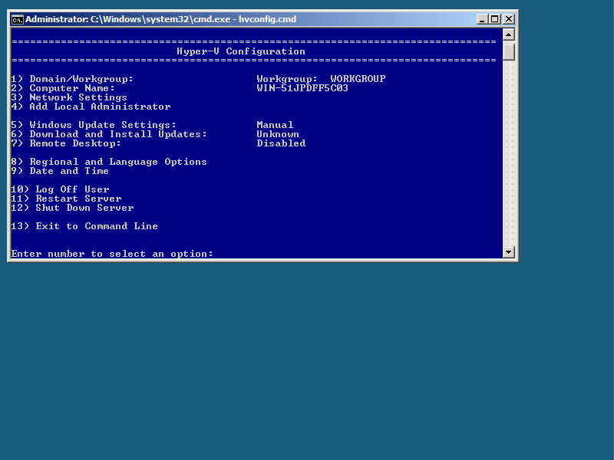

Microsoft Hyper-V Server R2
New Features
Live Migration
High Availability
New Processor Support
  Second Level Address Translation
  Core Parking
Networking Enhancements
  TCP/IP Offload Support
  VMQ & Jumbo Frame Support
Hot Add/Remove virtual storage
Enhanced scalability
Free download:
    www.microsoft.com/hvs

Slide 54
Live Migration $$ Comparison
 | Hyper-V Server R2 | VMware vSphere
3 Node Cluster 2 Socket Servers | Free | $13,470
3 Node Cluster 4 Socket Servers | Free | $26,940
5 Node Cluster 2 Socket Servers | Free | $22,450
5 Node Cluster 4 Socket Servers | Free | $44,900
For $500 add VMM 2008 R2 (Workgroup Edition) to manage MS Hyper-V Server R2:
Physical to Virtual Conversion (P2V); Quick Storage Migration; Library Management;
Heterogeneous Management; PowerShell Automation; Self-Service Portal and more…

Slide 55
Microsoft Virtualization:
Customers Win
Virtual Server 2005 R2
32-bit Guests: Up to 4 GB per VM
Windows Server 2008
Hyper-V R1
Windows Server 2008 R2
Hyper-V R2
Uni-Processor Guests
High Availability via scripts
Up to 8 Cluster Nodes
16 LP Support/Up to 128 VMs
1 Terabyte Memory
32-bit/64-bit (Up to 64 GB per VM)
SMP Guests
High Performance I/O (VSP/VSC/VMBus)
HA Integrated/Included
Quick Migration Included
Up to 16 Cluster Nodes
64 LP Support/Up to 384 VMs/Up to 512 VPs
Live Migration
Cluster Shared Volumes
Processor Flexibility
Power Enhancements
10 Gb/E Ready
Hot Add Virtual Storage
Connection Broker for Hosted Desktops
Quick Storage Migration with SCVMM R2
November 2005
June 2008
July 2009
Greater Performance
High Availability Built-In
Live Migration Built-In
More Capabilities
Increased Scalability
Ready for Next Gen Servers

Slide 56
Microsoft Assessment & Planning Toolkit 5.0 Customer Technology Preview http://connect.microsoft.com
announcing

Slide 57
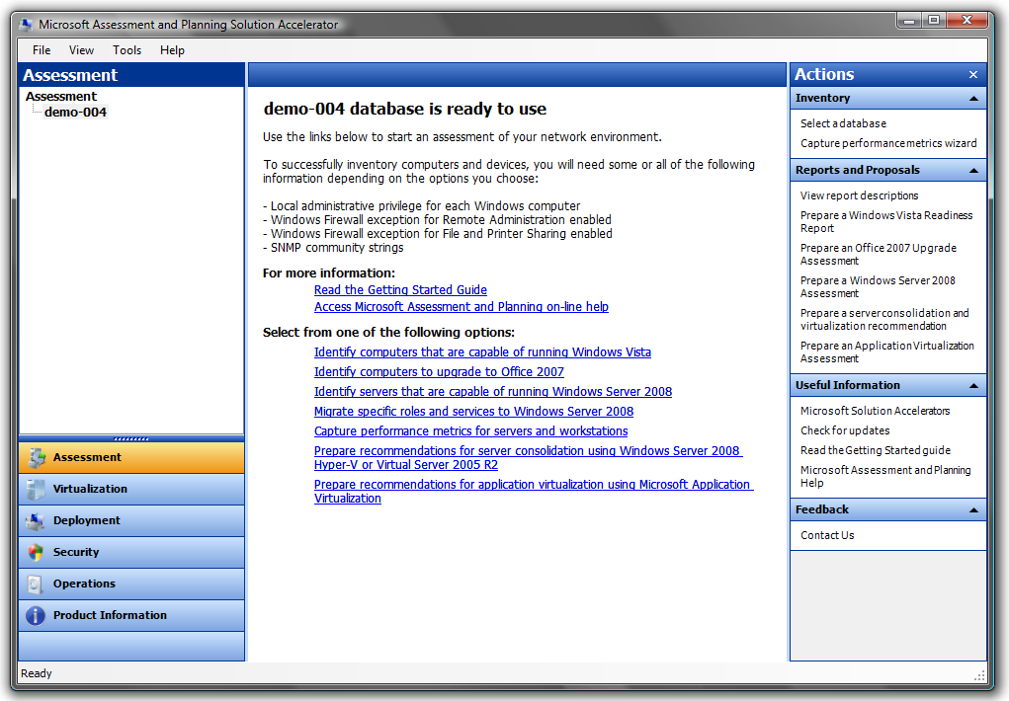
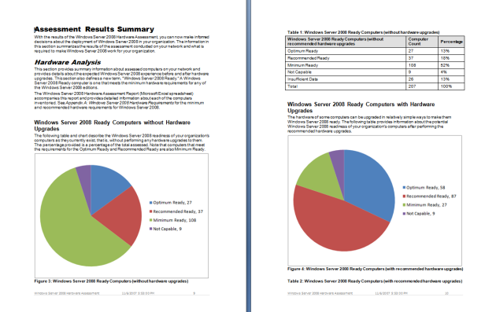
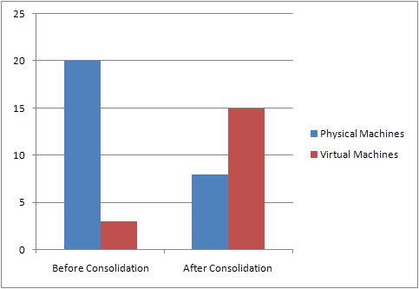
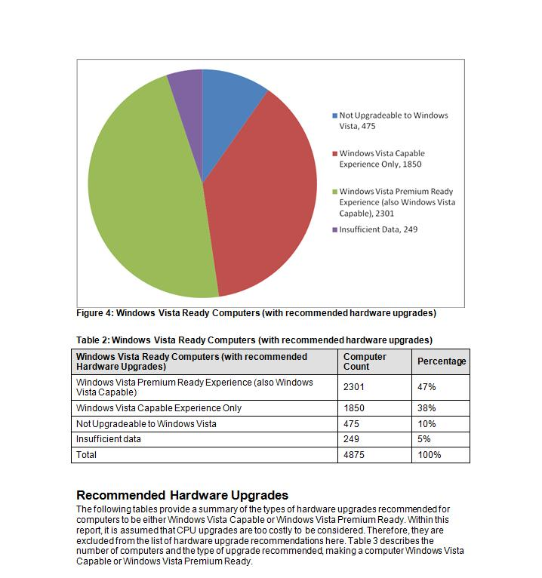
MAP: User Interface & Reports
Server Migration & Virtualization Candidates
Windows Server 2008
Virtualization
Windows 7
Heterogeneous Server Environment Inventory Linux, Unix & VMware
Windows 7 & Server 2008 R2 HW & Device Compatibility Assessment
Speed up Planning with Actionable Proposals and Assessments
Collect Inventory of Servers, Desktops and Applications Agentlessly
Offers Recommendations for Server/Application Virtualization
Works with the Virtualization ROI Tool to generate ROI calculations
More on MAP: http://www.microsoft.com/map

Slide 58
Online Resources
Microsoft Virtualization Home/Case Studies from customers around the world:
  http://www.microsoft.com/virtualization
Windows Server Virtualization Blog Site:
  http://blogs.technet.com/virtualization/default.aspx
Windows Server Virtualization TechNet Site:
  http://technet2.microsoft.com/windowsserver2008/en/servermanager/virtualization.mspx
MSDN & TechNet Powered by Hyper-V
  http://blogs.technet.com/virtualization/archive/2008/05/20/msdn-and-technet-powered-by-hyper-v.aspx
Virtualization Solution Accelerators
  http://technet.microsoft.com/en-us/solutionaccelerators/cc197910.aspx
How to install the Hyper-V role
  http://www.microsoft.com/windowsserver2008/en/us/hyperv-install.aspx
Windows Server 2008 Hyper-V Performance Tuning Guide
  http://www.microsoft.com/whdc/system/sysperf/Perf_tun_srv.mspx
Using Hyper-V & BitLocker White Paper
  http://www.microsoft.com/downloads/details.aspx?FamilyID=2c3c0615-baf4-4a9c-b613-3fda14e84545&DisplayLang=en

Slide 59
Related Content
Required Slide
Speakers,
please list the Breakout Sessions,
TLC Interactive Theaters and Labs
that are related to your session.
MGT220 - Virtualization 360: Microsoft Virtualization Strategy, Products, and Solutions for the New Economy
SVR314 - From Zero to Live Migration. How to Set Up a Live Migration
SVR308 - Storage and Hyper-V: The Choices You Can Make and the Things You Need to Know
SVR307 - Security Best Practices for Hyper-V and Server Virtualization
SVR09-IS - Windows Server 2008 R2 Hyper-V Deployment Considerations

Slide 60


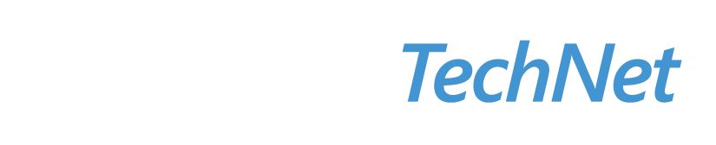

Resources
Required Slide
Speakers,
TechEd 2009 is not producing
a DVD. Please announce that
attendees can access session
recordings at TechEd Online.
www.microsoft.com/teched
  Sessions On-Demand & Community
www.microsoft.com/learning
Microsoft Certification & Training Resources
http://microsoft.com/technet
  Resources for IT Professionals
http://microsoft.com/msdn
  Resources for Developers

Slide 61

Complete an evaluation on CommNet and enter to win an Xbox 360 Elite!

Slide 63
question & answer

Slide 64

© 2009 Microsoft Corporation. All rights reserved. Microsoft, Windows, Windows Vista and other product names are or may be registered trademarks and/or trademarks in the U.S. and/or other countries.
The information herein is for informational purposes only and represents the current view of Microsoft Corporation as of the date of this presentation. Because Microsoft must respond to changing market conditions, it should not be interpreted to be a commitment on the part of Microsoft, and Microsoft cannot guarantee the accuracy of any information provided after the date of this presentation. MICROSOFT MAKES NO WARRANTIES, EXPRESS, IMPLIED OR STATUTORY, AS TO THE INFORMATION IN THIS PRESENTATION.

