Slide 2
File Classification Infrastructure
Joel Garcia
Sr. Product Manager
Microsoft Corporation
Session Code:

Slide 3
Agenda
Customer pain points and how data classification can help
Windows Server 2008 R2 File Classification Infrastructure
Demos
Partners
MSIT deployment of FCI

Slide 4








Customer Challenges: Cost and Risk
Storage growth
Storage cost
Compliance
Security and Information Leakage
Increasing data management needs/many data management products
File server storage growth -
51% CAGR CY08-CY12 (IDC)
Storage cost decreasing in only 30% (IDC)
Flat IT storage budgets
Stale data - ~60%
Security
COST
HSM
Archive
New and changing regulations
(SOX, HIPPA, GLBA …)
eDiscovery fines: U.S. companies >$1B yearly (Fulbright and Jaworski LLP 11/06)
246,091,423 - Total number of records containing sensitive personal information involved in security breaches in the
U.S. since January 2005
$90 to $305 per record (Forrester: In "Calculating the Cost of a Security Breach“)
Backup
Encryption
Replication
Expiration
RISK

Slide 5



File Shares and Business Requirements
Need per
project share
IT
Business
Make sure business secret files do not
leak out
Business
Backup files
with personal information to encrypted store
Expire low business impact files created three years ago and not touched for a year
Business

Slide 6

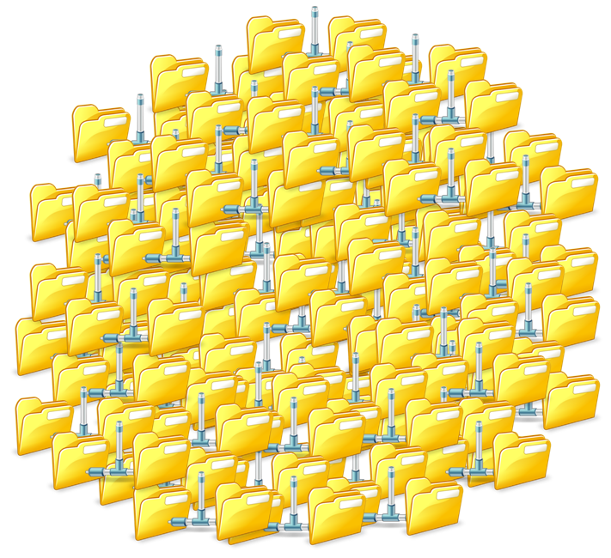
Some Time Later…

Slide 7

Manage Data Based On Business Value
  Step 1
Classify
Data
Apply policy according to classification
  Step 2

Slide 8
File Shares and Business Requirements
Need per
project share
IT
  Personal
  Information
  Secrecy
Business
Make sure business secret files do not
leak out
Business
Backup files
with personal information to encrypted store
Expire low business impact files created three years ago and not touched for a year
Business

Slide 9





File Classification Infrastructure
Inbox end to end scenarios
Integration with SharePoint
Extensible infrastructure-partner ecosystem
  Get classification properties API
  for external applications
  Set classification properties API
  for external applications
  Discover
  Data
  Extract
  Classification Properties
  Classify Data
  Store
  Classification Properties
  Apply Policy
  Based on Classification
  File Classification Extensibility Points

Slide 10
Automatically classifying files
demo

Slide 11
Re-cap
FSRM
Properties – alternate data stream
Content Classifier
Office document properties to SharePoint

Slide 12
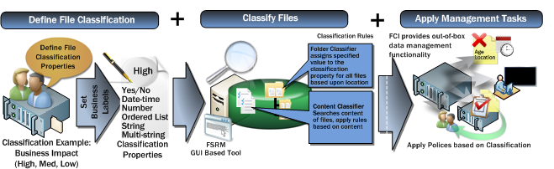
Classify and Apply Policy
Define organization properties to be assigned to files
Use automatic classification to assign properties to files
Apply scheduled file management tasks based on classification

Slide 13

















File Classification Infrastructure & RMS
Identify and protect sensitive documents on file servers
Compliment manual RMS protection with automated server side IT policies for complete ownership of security infrastructure and prevention of inadvertent data leakage
4
2
3
1
c
FCI Classify
Mgmt Task: RMS Protect
Full Time Employee can access “marketing.docx”
c
5
User creates a file “marketing.docx” on Windows server 2008 R2 file server
File Classification Infrastructure (FCI) classifies file as “sensitive” based on content including “Confidential” and “Internal only”
Automated File Management Task invokes RMS protection to restrict access to “Full Time Employees” only
A malicious user getting access to the file through un intentional leak is not able to access file content
Businesses can automatically RMS protect 1000’s of confidential files on their file servers

Slide 14
File Management Task - Applying policy with RMS protection of files with FCI
demo

Slide 15
Re-cap
Expiring Files
Applying Policy based on Classification
RMS bulk tool available

Slide 16
(Near)Real-Time Classification
Near-Real-Time Classification code sample
FCI in Windows 2008 R2
FCI schedules classification to reduce load
Applications can query FCI properties forcing classification to happen immediately
  Invokes a command on a selected set of files upon file creation and modification
  Allows administrator to select files based on classification properties only
  Can be extended by ISVs to create reactive applications
Code Gallery
http://code.msdn.microsoft.com/fci

Slide 17
Near-Real-time classification
demo

Slide 18
Re-cap
Script available on code gallery
Near real-time
Dependent on organizations needs

Slide 19
PowerShell Host classifier
Allows an IT pro to classify files based on a Powershell Script
  if (($_.Name.IndexOf(‘Confidential’) –lt 0) –and
  $_.RelativePath.IndexOf(‘Confidential’) –lt 0))
  { $false }
  Else { $true}
Easy to deploy and create custom classification logic
Part of the Windows 2008 R2 SDK

Slide 20
Classifying files with PowerShell
demo

Slide 21
SharePoint Upload Script
PowerShell script that uploads a file to a SharePoint site
Transfers all FCI properties to SharePoint
Can be utilized by File Management Tasks for simple SharePoint Migration
Coming Soon on Script Center

Slide 22
SharePoint upload with FCI
demo

Slide 23
Re-cap
Simple SharePoint Upload
File Share / SharePoint co-existence

Slide 24

Classify files based on user attributes
Visualize classification information in documents
Compatible with Titus Labs client-side classification tools to prevent emails from being sent to unauthorized users …
Migrate selected files between file servers and SharePoint based on classification
Automate assignment of classification properties and mapping of metadata from source to target
Automatically transform links within Office documents to migrated documents within SharePoint
Define rules and properties across an enterprise
Classify files across the enterprise data center
Set and execute policies, including discovery, classification of data and selection of files for archiving across files located on Windows 2008 R2 Sever

Slide 25
MSIT Infrastructure
5 Windows 2008 R2 clusters
  20% of all file servers in MSIT
1-6TB of data per server (4 – 24 million files)
Classification properties
  Business Impact
    High, Medium, Low
  Retention
    Long, Short, Perpetual
Initial focus on Business Impact policies

Slide 26

MSIT Business Impact Architecture
FCI
Server
File Management Task
Folder Classifier
Share
If HBI run Icacls
Classify
Policy
Content Classifier
File
Classify
File Management Task
Policy
3rd Party Classifier
Classify
If HBI run RMS Tool
Classification runs nightly 10pm – 6am
File Management Tasks run nightly at midnight
Reports on classification efforts are produced monthly

Slide 27
Key Learnings from MSIT
Identify management policies to determine classification properties
Test classification rules on test data before deployment
FCI Content Classifier can implement most of the classification logic MSIT needs
Errors and warnings encountered include read-only and corrupt data
For managing their files based on business value, MSIT can now use standard Windows features instead of a custom solution

Slide 28

Cost and Risk
Manage data based on business value
Classify
Apply policy

Slide 29
question & answer

Slide 30




Resources
Required Slide
Speakers,
TechEd 2009 is not producing
a DVD. Please announce that
attendees can access session
recordings at TechEd Online.
www.microsoft.com/teched
  Sessions On-Demand & Community
www.microsoft.com/learning
Microsoft Certification & Training Resources
http://microsoft.com/technet
  Resources for IT Professionals
http://microsoft.com/msdn
  Resources for Developers

Slide 31
Related Content
Required Slide
Speakers,
please list the Breakout Sessions,
TLC Interactive Theaters and Labs
that are related to your session.
SVR320 File Server Consolidation and Capacity Planning New York 3 – Hall 7-1a
File Services Blog – http://blogs.technet.com/filecab
Windows Server 2008 R2 – http://www.microsoft.com/windowsserver2008R2
RMS Bulk Encryption Download - http://www.microsoft.com/downloads/details.aspx?displaylang=en&FamilyID=f9fbe58f-c175-41d0-afdc-6f160ab809cd

Slide 32
Track Resources
Required Slide
Track PMs will supply the content for this slide,
which will be inserted during
the final scrub.
Windows Server 2008 R2 - http://www.microsoft.com/WindowsServer2008R2
RMS Bulk Tool Download - http://www.microsoft.com/downloads/details.aspx?displaylang=en&FamilyID=f9fbe58f-c175-41d0-afdc-6f160ab809cd
File Services Blog - http://blogs.technet.com/FileCab/
FCI on Code Gallery - http://code.msdn.microsoft.com/fci

Slide 33

Complete an evaluation on CommNet and enter to win an Xbox 360 Elite!

Slide 34

Required Slide
© 2009 Microsoft Corporation. All rights reserved. Microsoft, Windows, Windows Vista and other product names are or may be registered trademarks and/or trademarks in the U.S. and/or other countries.
The information herein is for informational purposes only and represents the current view of Microsoft Corporation as of the date of this presentation. Because Microsoft must respond to changing market conditions, it should not be interpreted to be a commitment on the part of Microsoft, and Microsoft cannot guarantee the accuracy of any information provided after the date of this presentation. MICROSOFT MAKES NO WARRANTIES, EXPRESS, IMPLIED OR STATUTORY, AS TO THE INFORMATION IN THIS PRESENTATION.

