Slide 2
Datacenter Optimization with … Intel Xeon Processor-based Servers and Windows Server 2008 R2
Keith Mayer
Lead Learning Consultant
Enterprise & Partner Group
Microsoft Corporation
Session Code: SVR210

Slide 3
Agenda
Addressing IT Challenges
Intel Server Processor Technology Update
Intel | Microsoft Collaboration
Proof-Points: Real Intel | Microsoft Results
Conclusion / Q&A

Slide 4
The Top of Mind Questions for Business IT decision makers are…
And, if I do invest…
Why invest in datacenter optimization and IT refresh now?
…where should I invest?
…how will I maximize ROI?
…how will I know it’s an investment for the long run?
Evolve your Data Center strategy: from a collection of servers … to a platform “fabric”

Slide 5
IT Constraints on Growth
Server Sprawl >30m physical servers currently installed: growing 4X next 10 years
Power & Cooling For every $1 spent on server HW, 50 cents spent on power/cooling
Operating Cost $8 in maintenance for every $1 spent on new infrastructure
Space Crunch Datacenter construction costs >$1,000/sq ft
Source: IDC.

Slide 6
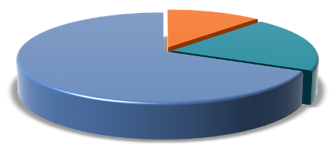
How Healthy is Your Data Center?
IT is spending too much on maintenance
This limits ability to innovate and grow business with new services and capabilities
Innovate
Enhance
Maintain
Source: Gartner IT Key Metrics Data 2008.
1 Source: Intel. See Legal information slides for detailed comparisons.
Common approaches to improving datacenter health

Slide 7
Data Center Refresh Strategy
"Investing in new infrastructure routinely, like refreshing older servers, is critical. At Intel IT, we found that continually enhancing our existing infrastructure actually reduces the amount required to maintain and run our environment and therefore is a high priority investment for us.”
—Diane Bryant, CIO, Intel Corporation

Slide 8
Data Center Optimization Dynamic Data Center Infrastructure
Broader than virtualization
Infrastructure “fabric”
Automated management
Application platform
Identity, security, and access
Delivering the service
Managing the fabric
Reliable | Predictable | Automated

Slide 9
Dynamic Data Center Fabric Components
Lifecycle
Management
Services
Provisioning
Deployment
Config Management
Hardware Management
OS Management
Virtualization
Management
Application
Management
Update Management
Workload Consolidation
Virtualization
Clustering
Infrastructure
Services
DNS/DHCP
Directory
File/Print
Infrastructure Apps
Physical
Infrastructure
Critical Qualities
Scalable
Reliable
Efficient
Integrated

Slide 10
Intel Server Processor Technology Update

Slide 11
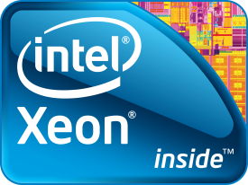
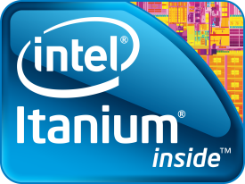
Intel’s Server Processor Portfolio Aligned with Dynamic Data Center Optimization
2009
2010
Infrastructure Services
& Applications
Top Performance / $, Energy Efficiency, & Flexibility
Xeon® 5500
Westmere-EP
5000
Sequence
Consolidation & Enterprise Apps
Scalable Performance, Flexibility, & Advanced RAS for Demanding Applications
Xeon® 7400
Nehalem-EX
7000
Sequence
Largest Enterprise Applications
Highest Scalability and Most Advanced RAS for Most Demanding Environments
Itanium® 9100
Tukwila
9000
Sequence

Slide 12
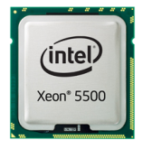
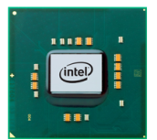
Intel® Xeon® Processor 5500 Series
Performance Refresh
2.5x faster Database queries¹
Energy Efficiency Refresh
5x Reduction in Idle Power²
A tremendous step forward in technology
New processor architecture
New platform architecture
New memory subsystem
New I/O subsystem
New options with SSDs
Virtualization Refresh 2.7x performance improvement³
The Right Investment – Right Now

Slide 13
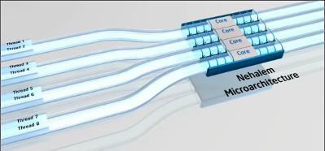
Performance Enhancements Intel Xeon® 5500 Series Processor (Nehalem-EP)
Intel® Turbo Boost Technology
Intel® Hyper-Threading Technology
Increases performance by increasing processor frequency and enabling faster speeds when conditions allow
Increases performance for threaded applications delivering greater throughput and responsiveness
Normal
4C Turbo
<4C Turbo
Frequency
Core 0
Core 1
Core 2
Core 3
Core 0
Core 1
Core 2
Core 3
Core 0
Core 1
Up to 30% higher†
All cores operate at rated frequency
All cores operate at higher frequency
Fewer cores may operate at even higher frequencies
Higher performance on demand
Higher performance for threaded workloads
† Source: Intel internal measurements, January 2009. For notes and disclaimers, see performance and legal information slides at end of this presentation.

Slide 14
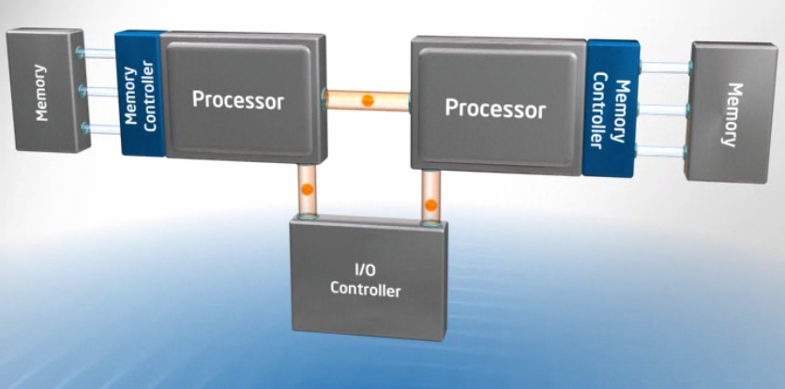
Energy Efficiency Enhancements Intel® Intelligent Power Technologies
Integrated Power Gates
Automated Low Power States
Enables idle cores to go to near zero power independently
More & Lower CPU Power States Reduced latency during transitions Power management now on memory, I/O
Voltage (cores)
Enhanced
Core0
Core1
Core2
Core3
new
new
Memory System, Cache, I/O
Voltage (rest of processor)
Automatic or manual core control
Adjusts system power consumption based on real-time load

Slide 15
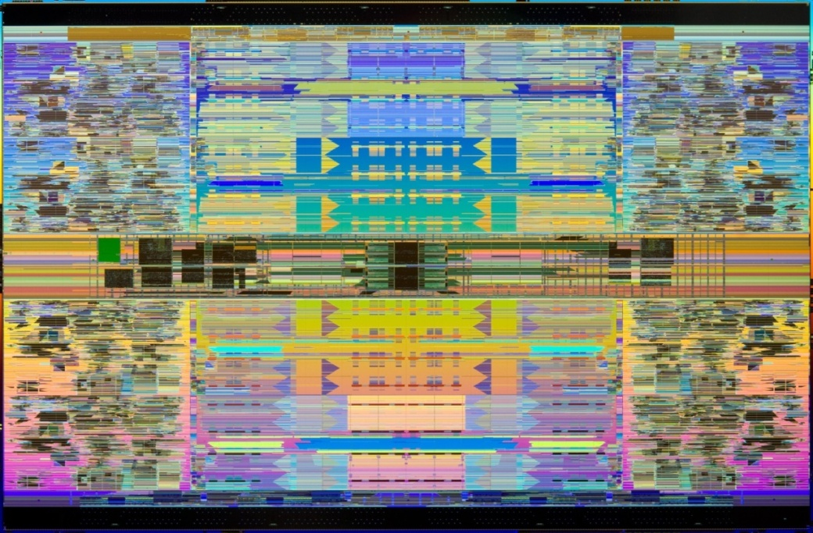
Nehalem-EX Overview
Up to 8 Cores/16 Threads
24MB of Shared Cache
Integrated Memory Controllers
4 High-bandwidth QPI Links
Intel® Hyper-Threading
Intel® Turbo Boost
2.3B Transistors
QPI0
QPI1
QPI2
QPI3
Core3
Core4
Core2
Core5
System Interface
Core1
Core6
Core0
Core7
SMI
SMI
The Next Generation Intelligent Expandable Platform

Slide 16
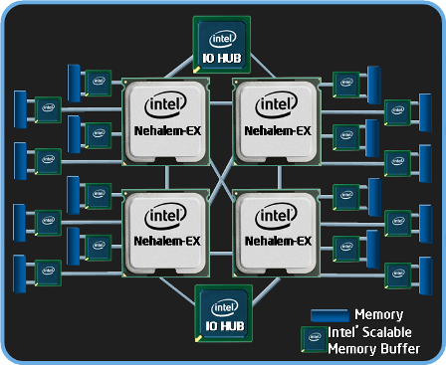
Nehalem-EX: Leadership 4-socket Platform
32 Cores / 64 Threads
Intel® Scalable Memory Interconnect with Buffers
2X Memory Capacity
16 DIMMs per Socket
64 DIMMs per platform
Advanced Virtualization & I/O Technologies
Unmatched Enterprise, Virtualization, and HPC Solutions

Slide 17
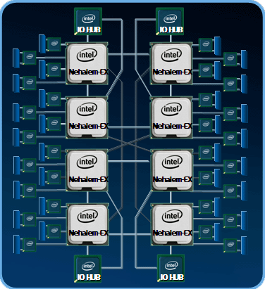
Nehalem-EX: 8 Sockets and Above
Intel Architecture capable of QPI connected 8-Sockets / 128 threads
Scalable systems and >8-socket capability with OEM node controllers
Scalable performance through modularity
Leadership RAS with MCA recovery
Targeting High-End Enterprise Apps and Large Scale Consolidation
> 15 designs from 8 OEMs

Slide 18
Next Generation MP Advances
Business Driver
Feature
Nehalem-EX vs. Xeon® 7400
Consolidation
High Data Demands
Virtualization
Scalability
Memory
~2X
RAS
CPU & System
Threads / Cache
2.7X / 1.5X
Sockets
2X
Extending Leadership Solutions

Slide 19
Nehalem-based Server Performance The Greatest Intel® Xeon® Performance Leap In History!
Xeon® 5500 vs. Xeon® 5400
Nehalem-EX vs. Xeon® 7400
Up to 3.5x Memory Bandwidth
Up to 2.5x Database Performance
Up to 1.7x Integer Throughput
Up to 2.2x Floating Point Throughput
Up to 9x Memory Bandwidth²
> 2.5x Database Performance¹
> 1.7x Integer Throughput
> 2.2x Floating Point Throughput
Expecting larger gains from Nehalem Architecture in MP
¹Based on May‘09 internal measurement using OLTP workload.
²Based on May’09 internal measurement using Intel internal workload

Slide 20
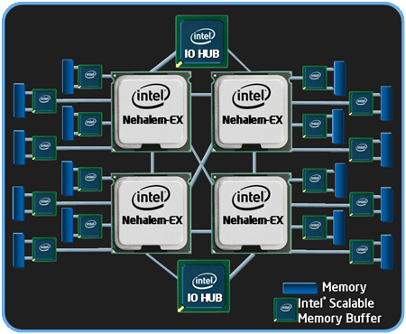
Advanced RAS - MCA Recovery
“Microsoft is excited about…our technology collaboration. Windows Server 2008 R2 will support Intel’s upcoming Nehalem-EX MCA recovery features, giving IT professionals confidence to move to higher levels of consolidation.”
- Bill Laing, Corporate VP, Microsoft
Native & Virtually
Contain, Correct, Predict Errors
Detects CPU, memory, & I/O errors
Works with OS to correct
Recovers from otherwise fatal system errors
First Machine Check Recovery in Xeon-based Systems

Slide 21
Intel | Microsoft Technical Collaboration

Slide 22
Intel & Microsoft Technical Collaboration Helping to optimize solution infrastructure with Windows Server 2008 R2
Performance/Scalability
Energy Efficiency
Intel® Hyper-Threading Technology & Windows scheduler enhancements coupled with increased scalability to 256 logical processors
Intel’s Deep Power Down Technology and “Get Idle-Stay Idle” enhancements in Windows Server* 2008 R2
Virtualization
RAS
Intel Virtualization technology such as Virtual Processor Identifiers (VPIDs) and Extended Page Tables helps to enhance Hyper-V performance
Intel’s Machine Check Architecture enhancements and Error Recovery in Windows Server 2008 R2

Slide 23
Video Segment:
Intel and Microsoft Collaboration
Intel Nehalem and Windows Server 2008 R2

Slide 24
Reducing Idle Power Consumption
Windows* CPU Power Management Framework built on CPU “idle” states (C-states) and “active” states (P-states)
OS initiates C-state entry by Mwait instruction
C0
Idle Power (W)
C1
Cn
Exit Latency (us)
Software and Hardware working together to manage power

Slide 25
Intel® Microarchitecture (Nehalem) Deep Power Down Technology (C6)
MWAIT (C6)
On Core 1 &
Core 2
Core 1 gets
interrupt
“wake-up”.
Returns to C0
All cores in C0
Core Power
0
0
1
3
Core
0
1
0
1
2
2
2
3
3
Integrated Power Gate enables a per core C6 state and individual cores transition to a ~0W Power State

Slide 26
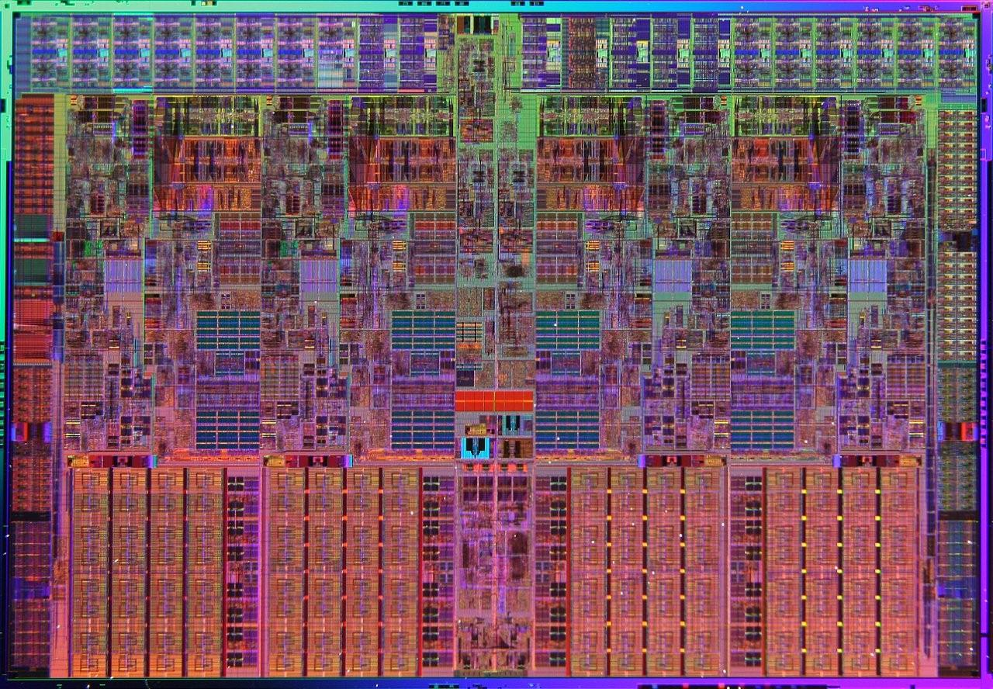
Intel® Microarchitecture (Nehalem) Package C-state
Additional logic outside cores
When all cores in C6, package can transition to C6
Latency important for some workloads. CPU tracks “wake-up” frequency, over-rides C-state choice as needed
Core
Core
Core
Core
Longer average idle & fewer “wake-ups” improves C6 Residency. “Get idle, stay idle”

Slide 27
Windows*7 & Windows Server* 2008 R2 Intelligent Timer Tick Distribution
Before, primary timer interrupt on logical processor 0 propagated timer interrupt to all other Logical Processors (LPs)
On Windows 7, timer system wakes up sleeping logical processors only if needed

Slide 28
Windows*7 & Windows Server* 2008 R2 Timer Coalescing
Staying idle requires minimizing timer interrupts
Before, periodic timers had independent cycles
New timer APIs permit timer coalescing
Application or driver specifies tolerable delay
Hypervisor also implements timer coalescing for guest timers
Timer tick
15.6 ms
Vista
Periodic Timer Events
Windows 7
Timer system aligns periods on natural frequency

Slide 29
Windows*7 & Windows Server* 2008 R2 Core Parking
Core Parking tries to keep load on fewest LPs possible allowing other cores to get into C6
Power manager periodically looks at load and uses policy to inform scheduler of cores to “park” and “un-park”
Aware of socket topology to enhance Package C-state
Core Parking active on Server, Hyper-V and Intel® Hyper-Threading Technology enabled systems
Best returns on medium utilization workloads
Clients tend to run at extremes (0 or 100)
Core Parking consolidates load on a subset of the CPUs,
allowing others to sleep

Slide 30
Core Parking Operation
Core 0
Core 1
Core 0
Core 0
Core 0
Core 1
Core 1
Core 1
Socket 0
Socket 1
Workload

Slide 31
Windows Server* 2008 R2 / Intel® Xeon® Processor 55xx Series Platform Energy Efficiency
Windows Server 2003
Windows Server 2008 R2 (RC)
“Get idle, stay idle” + C6 + default P-state tuning → Improved Energy Efficiency
Source: See slide 41 for details. Internal Microsoft measurements, Intel reference platform. Performance tests and ratings are measured using specific computer systems and/or components and reflect the approximate performance of Intel products as measured by those tests. Any difference in system hardware or software design or configuration may affect actual performance. Buyers should consult other sources of information to evaluate the performance of systems or components they are considering purchasing. For more information on performance tests and on the performance of Intel products, visit Intel Performance Benchmark Limitations

Slide 32
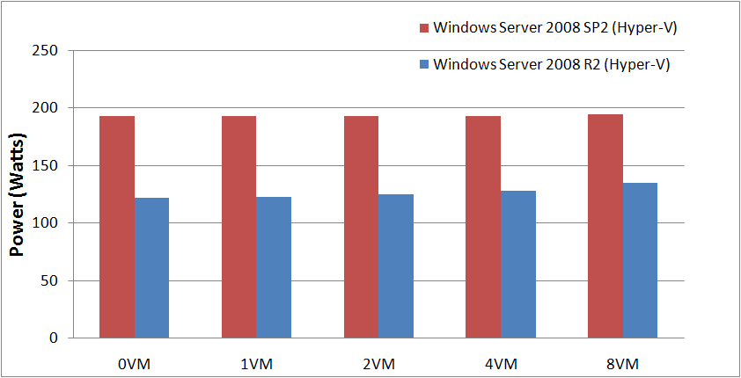
Windows Server* 2008 R2 (Hyper-V)/Intel® Xeon® Processor 55xx Series Based Platform: Idle Power
30% - 37% Power savings for same number of VM guests
“Get idle & Stay idle” with Deep Power Down Technology helps reduce idle power
Source: Slide 42 for details. Internal Intel measurements, Intel reference platform. Performance tests and ratings are measured using specific computer systems and/or components and reflect the approximate performance of Intel products as measured by those tests. Any difference in system hardware or software design or configuration may affect actual performance. Buyers should consult other sources of information to evaluate the performance of systems or components they are considering purchasing. For more information on performance tests and on the performance of Intel products, visit Intel Performance Benchmark Limitations

Slide 33
Windows* and Logical Processors
Before, the maximum number of Logical Processors (LPs) was dictated by word size
LP state (e.g. idle, affinity) represented in word-sized bitmask
32-bit Windows: 32 LPs
64-bit Windows: 64 LPs
32-bit Idle Processor Mask
31
16
0
Idle
Busy

Slide 34
Windows Server* 2008 R2: >64 Logical Processor Support
Need to support >64LP while preserving compatibility
Solution: LPs divided into Groups
Group can have a maximum of 64 LPs
Maximum of 4 Groups (for maximum of 256 LPs)
Group assignment:
One group if 32-bit system or fewer than 65 LPs
Otherwise fewest groups necessary to ensure that NUMA nodes don’t cross groups
Close NUMA nodes kept in the same group

Slide 35
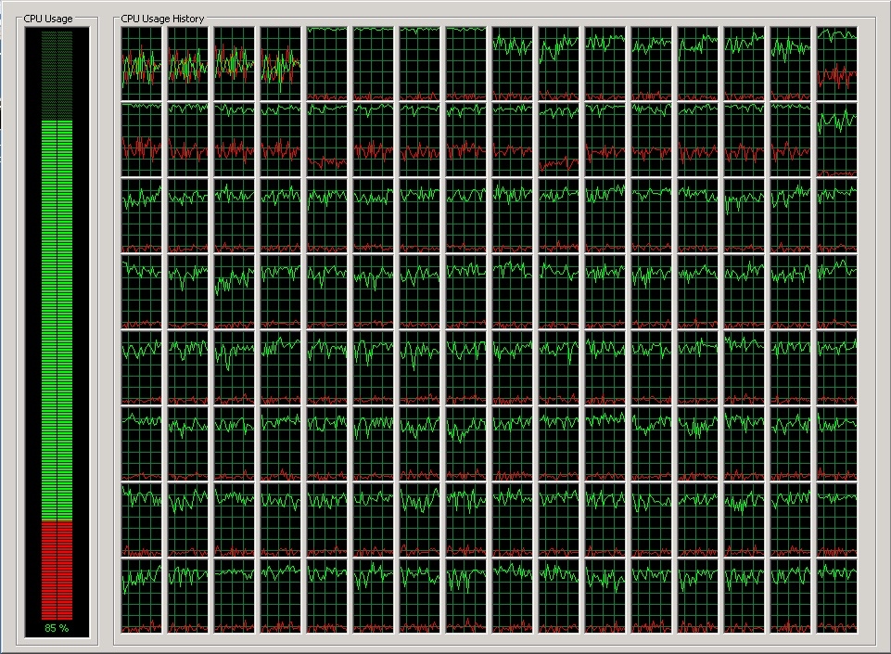
Windows Server* 2008 R2: 64 Logical Processor Boundary Broken!

Slide 36
Windows Server* 2008 R2: Removal of the Dispatcher Lock
Locks serialize access to data structures
Prevents multiple threads from simultaneously modifying data
Inhibits scaling because threads must wait for their turn (contention)
Several locks removed:
Object Manager type, Cache Manager VACB, Memory Manager PFN
Scheduler Dispatcher lock hottest on server workloads. Removed for scaling.
Before, Lock protected all thread state changes (wait, unwait)
Now each object protected by its own lock. Many operations are lock-free.

Slide 37
Windows Server* 2008 R2: Scaling Without the Dispatcher Lock
1.7x scaling going from 128 to 256 LPs:
OLTP Workload Throughput
Transactions/minute
Source: Internal Microsoft measurements. See slide 46 for configuration details. Performance tests and ratings are measured using specific computer systems and/or components and reflect the approximate performance of Intel products as measured by those tests. Any difference in system hardware or software design or configuration may affect actual performance. Buyers should consult other sources of information to evaluate the performance of systems or components they are considering purchasing. For more information on performance tests and on the performance of Intel products, visit Intel Performance Benchmark Limitations

Slide 38
Intel® Nehalem-EX Server Processor: Improved Reliability with Machine Check Architecture Extensions
Before, MCA enabled reporting uncorrected errors. OS brought platform down in controlled manner
Adds signaling of corrected errors via corrected machine check interrupt (CMCI)
Data poisoning to contain error propagation
Enhanced for recoverable error reporting to OS. Support recovery in software

Slide 39
Windows* Recoverable Error Flow
Signal MCE
Main Memory
The WHEA (Windows Hardware Error Architecture) machine check handler handles the exception and determines if the error is recoverable by checking the error signature and logs and clears the error
If recoverable, Windows marks the physical page as bad and offlines the page for the current session. The page is also immediately added to the persistent bad page list
This list is persistent across reboots and prevents usage of that page on the next and subsequent boots. This ensures that the memory location is not allocated again to the OS or applications
Patrol Scrub
scans memory
0x0000FFFF
Patrol Scrub
Error detected
0x0000FFFF
Page off-lined
Persistent
Bad Page List

Slide 40
Real Results from Intel / Microsoft Collaboration

Slide 41
Server Refresh Benefits (Single Core)
2005
2009
Performance Refresh
1:1
Up to 9x Performance
18% Annual Energy Costs Estimated Reduction
184 Intel® Xeon® 5500 Based Servers
– OR –
Efficiency Refresh
9:1
90% Annual Energy Costs Estimated Reduction
As Low as 8 Month Payback
184 Intel® Xeon® Single Core Servers
21 Intel® Xeon® 5500 Based Servers
Source: Intel estimates as of Nov 2008. Performance comparison using SPECjbb2005 bops (business operations per second). Results have been estimated based on internal Intel analysis and are provided for informational purposes only. Any difference in system hardware or software design or configuration may affect actual performance. For detailed calculations, configurations and assumptions refer to the legal information slide in backup.

Slide 42
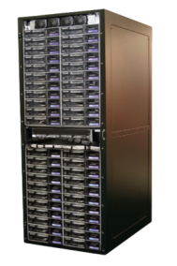
Server Refresh Benefits (Dual-Core)
2006
63 Servers
2009
21 Servers
Floor Space 66% REDUCTION
3:1
3:1
Estimated Energy Cost 74% REDUCTION
5100 Series
5500 Series
Intel® Xeon® 5500 Can Help Avoid Costly Data Center Expansion, Reducing Floor Space and Costs
Estimated Annual SAVINGS $61K Energy + OS Licensing
1 Source: Intel internal measurements as of Feb 2009. Performance comparison using SPECjbb2005 bops (business operations per second). Use this slide in conjunction with backup data.

Slide 43
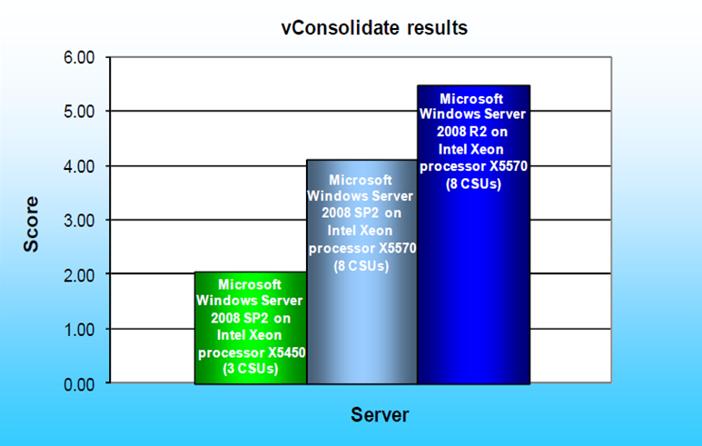
Improved Hyper-V Performance Intel Xeon 5500 Series and Windows Server 2008 R2 Hyper-V
2.7x Better
Performance
Source: http://www.principledtechnologies.com/clients/reports/Microsoft/HyperVR2_0709.pdf

Slide 44
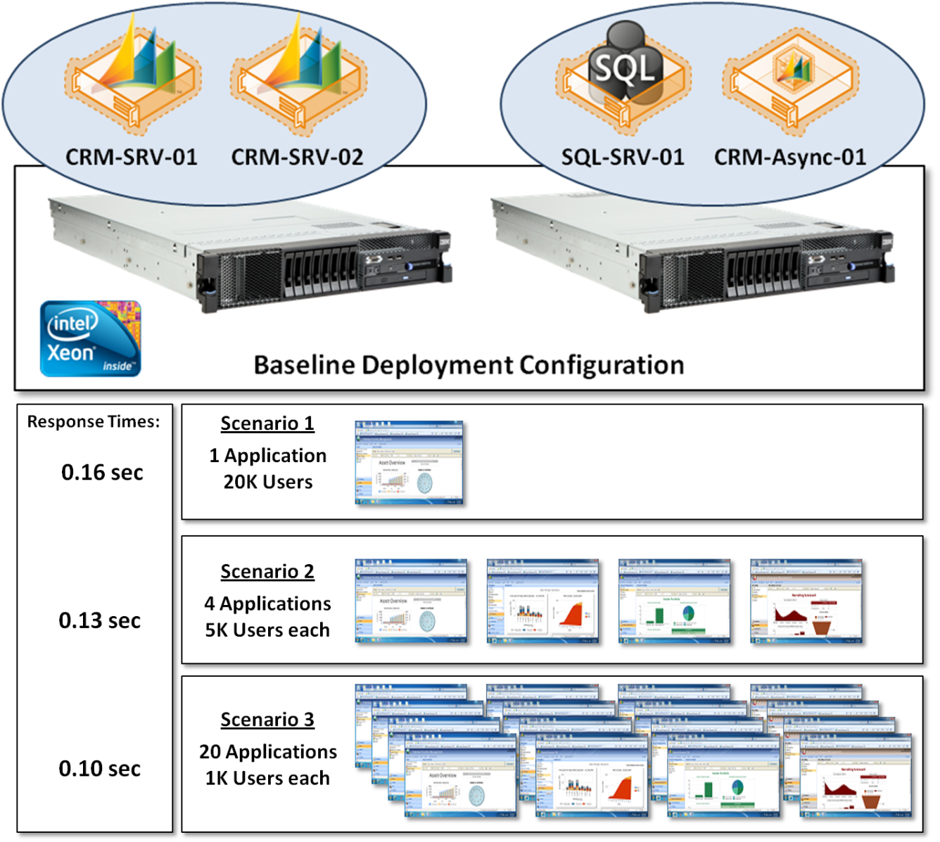
Improved Scalability and Management Intel Xeon 5500 Series / Windows Server 2008 R2 / SQL Server 2008 R2 / Dynamics
Software
Microsoft Dynamics® CRM 4.0
Microsoft SQL Server® 2008 R2
Microsoft Windows Server® 2008 R2 Enterprise 64-bit
Visual Studio® Team System 2008 Test Edition
Hardware
Four Hyper-V instances on two IBM quad-core servers
Ten Intel X25-E SATA Solid State Drives
Results
20,000 concurrent users across 20 line-of-business applications
Average response time of 0.10 sec
Over 149,000 business transactions per hour
Total data size of 140 GB
20,000 concurrent users across Twenty Line-of-Business Applications!

Slide 45
Improved Database Performance Intel Xeon 7400 Series / Windows Server 2008 R2 / SQL Server 2008 R2
Unisys ES7000 Model 7600R Enterprise Server with Intel Xeon 7400 series processors (96 cores)
Windows Server 2008 R2
SQL Server 2008 R2
Unisys ES7000 Model 7600R Enterprise Server with Intel Xeon 7400 series processors (96 cores)
Windows Server 2008 R2
SQL Server 2008 R2
TPC-E
TPC-H 3 TB
2,012 tpsE
102,778 QphH
Up to 70% higher than previous benchmark results!

Slide 46
Conclusion
Intel Booth: #G1 in Hall 4-2A and 4-2B
Intel Booth: #G1 in Hall 4-2A and 4-2B
Time to refresh with new technology is now
Implement a Data Center Platform Strategy: Dynamic Data Center
Lower Your Costs
Improve Application Performance; and
Lower Energy Usage
Visit the Intel Expo Booth to learn more:
#G1in Hall 4-2A
Visit the Intel Microsoft Alliance Web Page:
www.intelalliance.com/microsoft
Complete your Session Evaluations!

Slide 47
Questions?
Datacenter Optimization with … Intel Xeon Processor-based Servers and Windows Server 2008 R2
Keith Mayer
Lead Learning Consultant
Enterprise & Partner Group
Microsoft Corporation
Session Code: SVR210

Slide 48
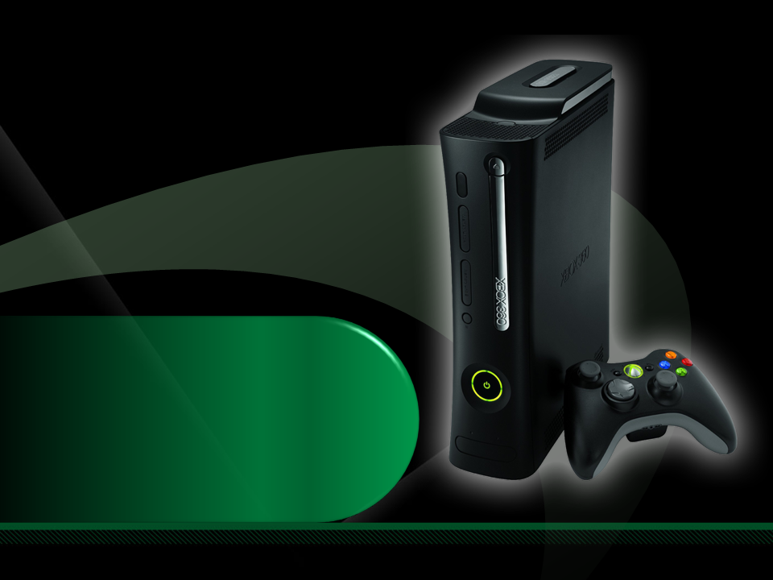
Complete an evaluation on CommNet and enter to win an Xbox 360 Elite!

