Slide 2
Deploying Microsoft Applications with HP Converged Infrastructure – a Look Under the Covers
Paul Gavin
Denis Choukroun
Session Code: SVR212

Slide 3
Agenda
HP Converged Infrastructure and Matrix
Provisioning Windows applications in a Matrix environment customer scenario and demonstration

Slide 4
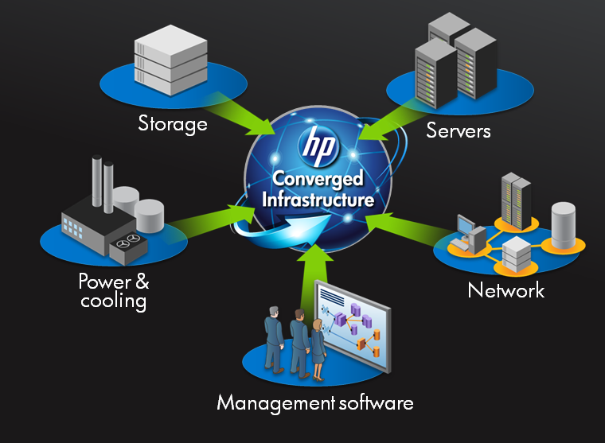
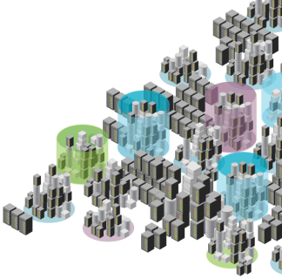

Tomorrow’s business will be built on a converged infrastructure
IT sprawl has business at the breaking point
Unleash the potential
Any application, anywhere
Flex resources on demand
Unlock productivity
Predictable continuity of service
Faster time to business value
Building on what you have today – delivered the way you need it.
©2009 HP Confidential
4

Slide 5
New Economic Model for the Datacenter
Shifts to Automation Tools are a Requirement
Worldwide IT Spending on Servers, Power and Cooling, and Management/Administration
(US$B)

Slide 6
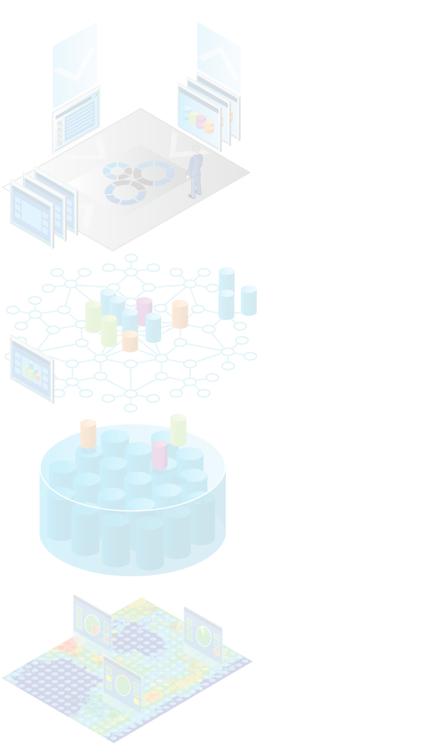
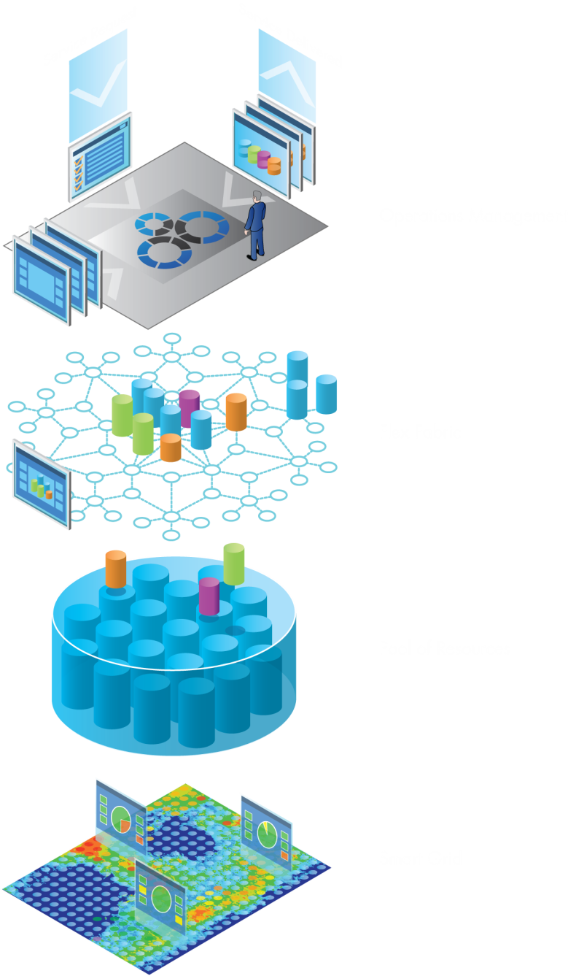
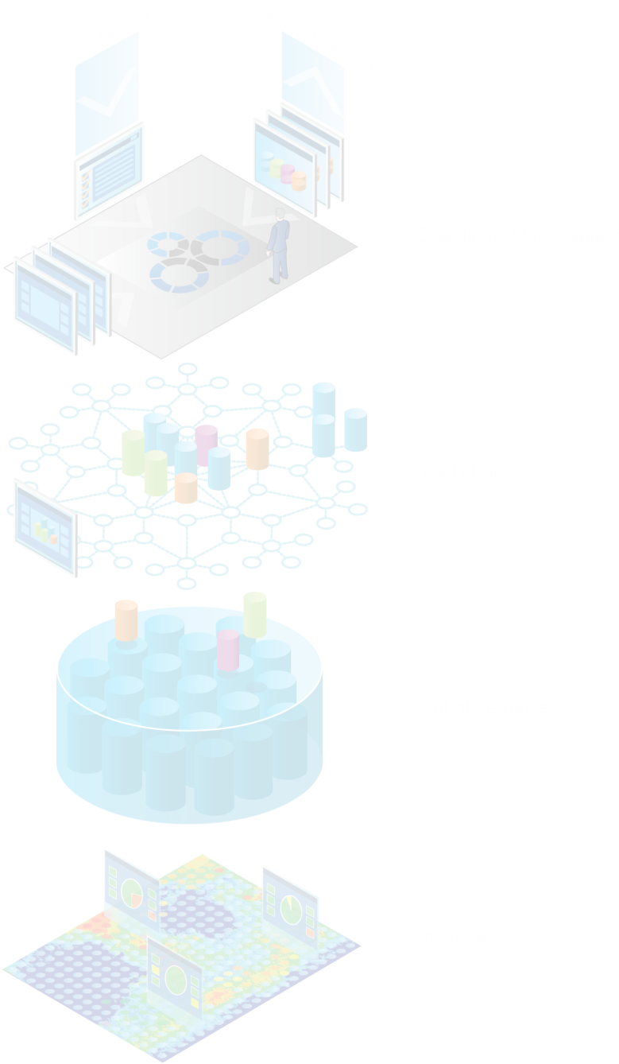

The converged infrastructure architecture defined
Infrastructure operating environment
Enables shared-service management
Flex fabric
Wire-once, dynamic assembly, always predictable
HP virtual resource pools
Adaptive compute, memory, storage & network resources
HP data center smart grid
Intelligent energy management across systems and facilities
©2009 HP Confidential

Slide 7
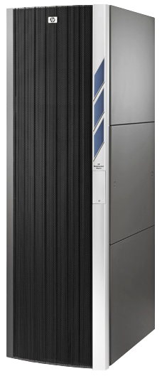
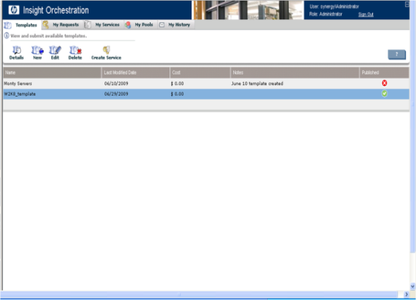
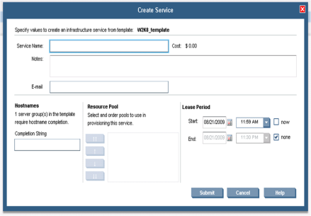
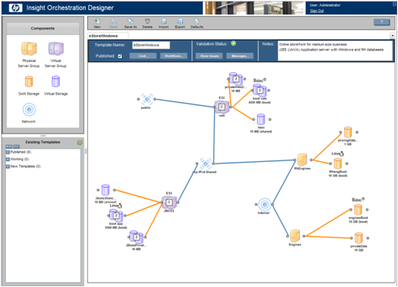
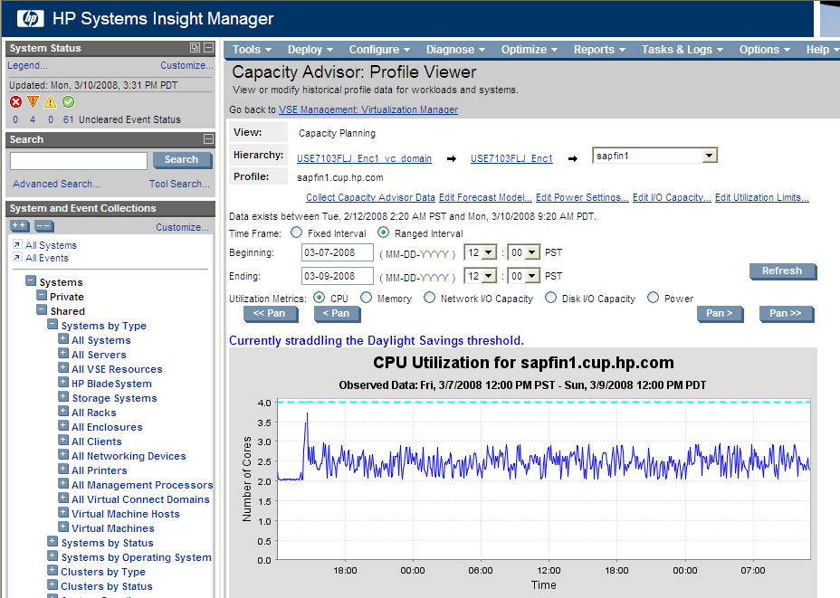
Converged Infrastructure with HP BladeSystem Matrix
Get the benefits of shared services today
  Instantly adjust to dynamic
  business demands
  Provision and modify complex infrastructure in minutes, not months
Transform the economics
of your data center
  Double admin productivity with payback in less than a year
Integrated by design
  Built on the industry’s leading
  blade architecture, pre-configured and installed by HP experts
Service
portal
Application
infrastructure template
Resource pools
©2009 HP Confidential

Slide 8




Instantly adjust to dynamic business demands
Provision and modify complex infrastructure in minutes, not months
Provision infrastructure in minutes with automated activation of servers, storage and networking.
Optimize infrastructure confidently with built-in capacity planning and rebalancing tools.
Protect continuity of services with automated, cost-effective failover.
Sample “e-shopping” application infrastructure template
5 minutes
5 minutes
38 minutes
60 minutes
108 min
Approval
Provision Infrastructure
Install/configure apps
©2009 HP Confidential

Slide 9
Agenda
HP Converged Infrastructure and Matrix
Provisioning Windows applications in a Matrix environment customer scenario and demonstration

Slide 10
Customer Scenario Financial Services Company
Current Environment
1,000 employees
Current hardware infrastructure
  HP ProLiant DL/ML servers
  HP EVA storage
Current Microsoft environment
  Windows Server 2008 R1
  SQL server 2008 for corporate databases
  Exchange Server 2007 for mail
Virtualization for Web and smaller apps

Slide 11
Customer Scenario Financial Services Strategy and Status
Move from Exchange 2007 to 2010
  Have run pilot and established architecture and implementation plan for 2010
Move from current virtualization environment to Microsoft 2008 R2 Hyper-V
  Have run pilot and established architecture and implementation plan
Build new IT architecture that solves current IT cost and governance issues

Slide 12
Customer Scenario Financial Services objectives
Solve physical and virtual server sprawl
  Implement an infrastructure that will enable dynamic allocation of physical and virtualized resource
Simplify and automate deployment of shared services
  Implement an integrated service catalogue that will comprehend servers, storage and networking
Solve the current issues of governance and compliance
  Implement a process that will automate provisioning of services from the service catalogue with built in compliant with ITIL processes

Slide 13

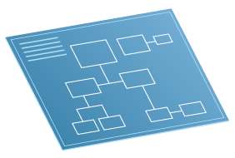





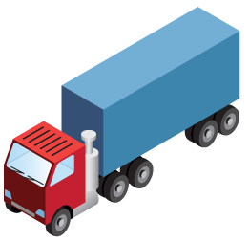
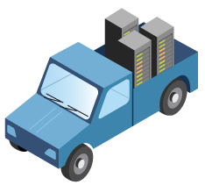
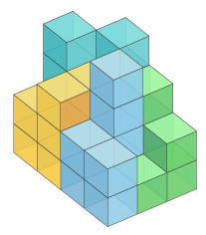
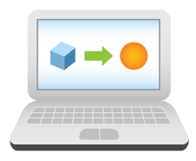
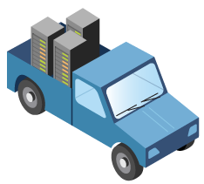


A result of IT sprawl:
Infrastructure uniquely, manually provisioned for each application
Business selects
application
Architecture review
Evaluation/POC
Get purchase approvals
Place order
More meetings
Move to test center
Unpack
Server delivery
Planning meetings
Coordinate building process
Change control approvals
Move to environment
Re-cable, move
into production environment
User acceptance testing

Slide 14

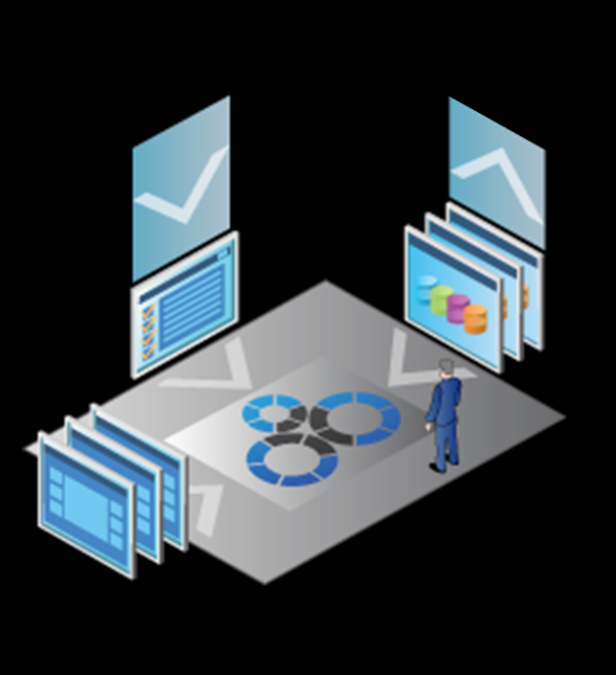
HP Infrastructure Operating Environment
A blueprint to enable shared-service management
Select
Initiate
Provision
Service Request
Service Delivered
A few automated steps, in less time
Service Catalog
Months
to Min
Accelerate
service delivery
Most efficient use of IT
resources & staff time

Slide 15







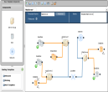

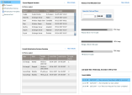
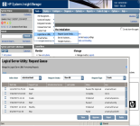

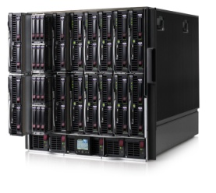



Infrastructure Operating Environment
How does it work?
Portals
Catalog
c-Class Blade Provisioning
Infrastructure
templates
custom
workflows
Process Workflow Automation
Design
Virtual Machine Provisioning
Designer
library
Custom pre and post provisioning scripts
vm
templates
rdp
folders
Self Service
Provision &
Operate
Resource management
Administer
Virtual Connect
Resource
Pools
Optimize & Protect
virtual
machines
Network
Storage
c-class blades

Slide 16
Matrix Process
Customer collects/supplies infrastructure details
HP builds optionally builds infrastructure
in factory
HP delivers core infrastructure
HP project manager on site
Customer training and facilitation

Slide 17
Matrix lifecycle stages
Design the infrastructure requirements Design (Architect)
  Build a catalog of best-practice templates in the designer tool
  Capture requirements for multi-tier, multi-node services with physical and virtual infrastructure
Develop and integrate installation and configuration process integrate (Architect/Administrator)
  Customize operations with modified or new workflows
  Integrate customer’s IT processes with infrastructure lifecycle operations
Provision the service ( IT User)
  Request infrastructure be provisioned for a lease period
  Modify and/or delete provisioned infrastructure during lease period
Manage infrastructure resources (ongoing) Operate (Administrator)
  Manage server pools, storage pools, networks, IP address pools
  Approve self service requests
  Optimize, capacity plan, and monitor resources in VSE

Slide 18
Overview of Matrix implementation tasks
Matrix Factory Integration
  Blade server configuration
  Network configuration (VC/VCEM)
  Storage configuration (CV/ID-VSE)
Customer responsibilities
  Provision the Hyper-V parent logical servers (ID-VSE)
  Create the VM
  View the physical server resource pools (IO) (AA)
  Configure the Network resource pools (IO) (AA)
  Select/Create logical storage pool entries (SPEs) (ID-VSE) (AA)
  Create VM template (VMM) (AA)
  Show OS provisioning jobs (RDP) (AA)
  Create service catalogue (IO) (AA)
  Browse catalogue and order service (IO) (LOB user)
  Authorize and deploy service (IO) (A)
  Create workflow ( I/O and embedded OO) (AA)

Slide 19
Step 1 Physical Server Resources
Role:
Architect
Tool:
Insight Orchestration
  Create/Show servers resource pool

Slide 20
Step 2 Network Resources
Tool:
Insight Orchestration
Role: Architect
  View/Create network resources
  Comprehended by IO based on Virtual Connect and VMM

Slide 21
Step 3 Physical Storage Resources ID-VSE (AA)
Role:
Architect/Admin
Tool:
ID-VSE
  Shows LUN’s created and presented by storage administrator

Slide 22
Step 4 VMM resources
Tool:
HP VMM
Role:
Architect/Admin
  Create/Show VMM templates which are associated to VHD’s

Slide 23
Step 5 OS Resources HP SIM and IO
Tool:
HP RDP
Role:
Architect/Admin
  Create/Show the RDP inventory of available
  OS images

Slide 24
Step 6 Create/Show Service Catalogue
Role:
Architect
Tool:
Insight Orchestration
  Shows existing templates
  Create new template Based on converged resource data
  (Server , Storage , Networking and OS/VMM resources )

Slide 25
Step 7 Browse Catalogue and Order Service
Role:
Business User
Tool:
Insight Orchestration
  Shows created services

Slide 26
Step 8 Authorize and Deploy Service
Role:
Architect
Tool:
Insight Orchestration
  Review/Approve/Decline service deployment request

Slide 27
Step 9 Customization Workflow
Embedded HP OO (AA)
Role:
Architect/Admin
Tool:
Embedded Orchestration
  Create/Show workflow in HP OO

Slide 28
Tomorrow’s business will be built on a converged infrastructure
IT sprawl has business at the breaking point
Unleash the potential
Any application, anywhere
Flex resources on demand
Unlock productivity
Predictable continuity of service
Faster time to business value
Building on what you have today – delivered the way you need it.
©2009 HP Confidential

Slide 29
HP Infrastructure Operating Environment
A blueprint to enable shared-service management
Select
Initiate
Provision
Service Request
Service Delivered
A few automated steps, in less time
Service Catalog
Months
to Min
Accelerate
service delivery
Most efficient use of IT
resources & staff time

Slide 30
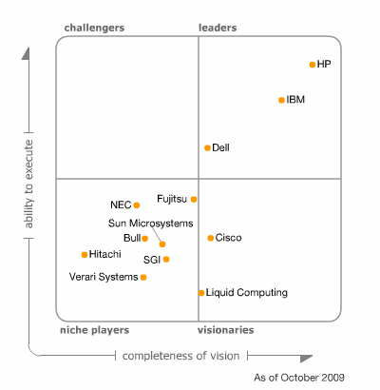
Gartner Magic Quadrant on Blade Vendors

Slide 31



Together, HP and Microsoft have the best integrated management solution for Windows environments
Infrastructure
Operating
Environment
Shared infrastructure services management
Advanced Functionality
Best-practices infrastructure templates and reference architectures
(…and more)
Product Integration
Insight Control for System Center
Insight Control for
System Center
Robust server management through System Center console
Testing and Certification
Widest range of certified servers and storage
Most comprehensive support of MSFT management features in ProLiant
HP ProLiant
and
BladeSystem
Management-ready servers

Slide 32


Dubai Airport
One of world’s fastest growing airports offers data center services to 100 tenants from airlines to catering
Enable DA Infrastructure to Generate Revenue by delivering technology services and solutions to multiple types of businesses
Challenge
Consolidate 8 data centers into 4 virtualized data centers with business resiliency and disaster recovery
Solution
Results
Turned IT into a profit center while lowering operational costs, accelerating service delivery and raising SLA’s
200% space savings over previous environment
12 Month ROI
©2009 HP Confidential

Slide 33
“To keep pace with rapid growth, we needed to consolidate IT resources from 8 datacenters to 4 and turn IT into a profit generator. By adopting a converged infrastructure with HP BladeSystem Matrix and working with HP services, we achieved our goals, and created a green, highly responsive data center environment at a significantly lower cost of operations, while eliminating the complexities caused by IT sprawl.”
Ghanim Al Falasi. VP IT, Dubai Airport, UAE
©2009 HP Confidential

Slide 34
More Information
Matrix demonstration in HP booth
Insight Control demonstration in HP booth
Insight Control and System Center demo in Microsoft partner pavilion
http://www.hp.com/go/ci
http://www.hp.com/go/hyper-v

Slide 35
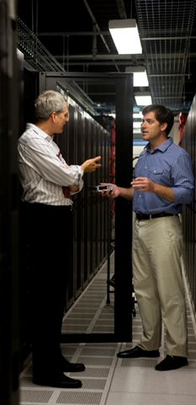
Questions?

Slide 36
Design
User Role – Architect
Key Task
  Create HP infrastructure orchestration templates based on application/service requirements using designer tool (drag-and-drop)
    First step is to gather the service requirements from the application team!!
What is Template?
  Requirements for an infrastructure service
  Stored as XML format and can be shared
  Templates are made available as “best practices” or “company standard”
Examples of configuration details:
  How many server tiers/number of servers per tier
  Each tier physical or virtual servers
  Configuration of servers (min. number of CPUs, RAM, etc)
  Configuration of storage (size, RAID level, if shared across servers)
  Configuration of networks (minimal)

Slide 37
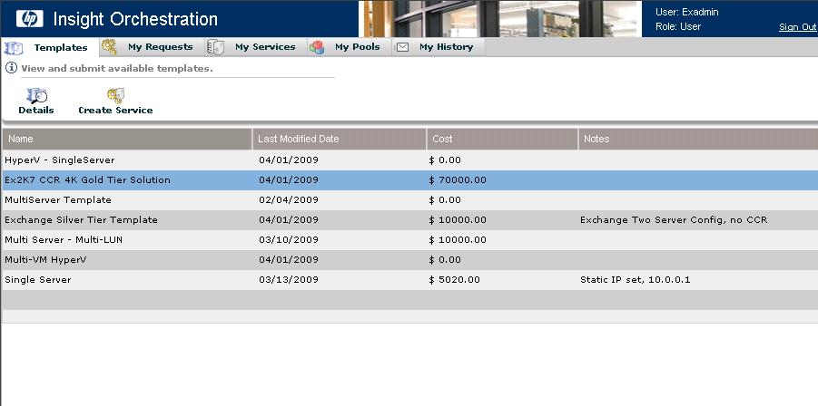
Provision
User Role - User
Browse a list of templates and select one to provision
Request infrastructure be created for a specified lease period
Once approved, the infrastructure requested is automatically provisioned from pools of shared resources
Once provisioned, users manage their infrastructure services
  Suspend, resume, add capacity, delete and return to pool

Slide 38
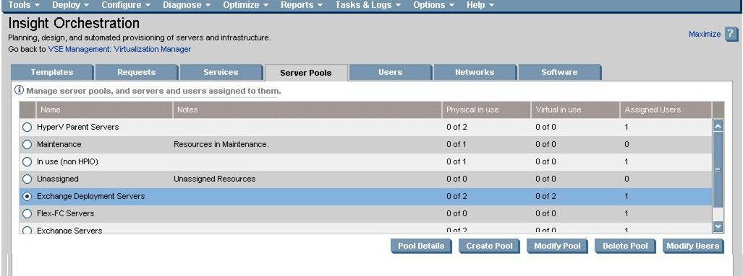
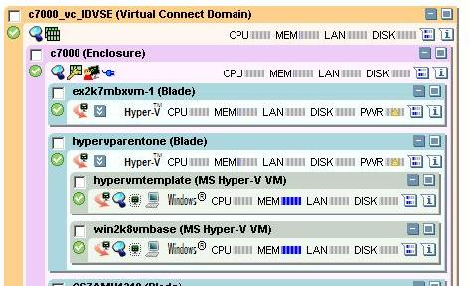
Operations
User Role - Administrator
HP Insight Dynamics infrastructure orchestration Console:
  Monitor/Approve self
  service requests
  Create and manage server pools,
  networks, and IP address pools
  Perform all self service operations
  as administrator
HP Insight Dynamics
  Create and administer storage pools
  Optimize new logical servers created by IO
  Define capacity workloads for IO
  logical services

Slide 39
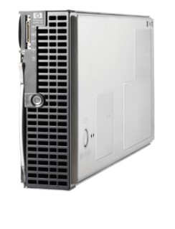
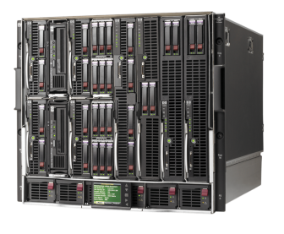
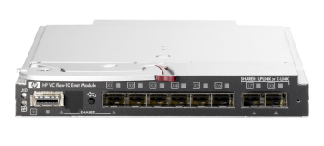
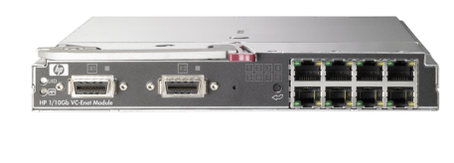
Delivering cost, time, change and energy improvements to the server edge
2006
2007
2008
2010
HP BladeSystem
c-Class
Virtual
Connect
Virtual Connect
Flex-10
Converged Fabrics
Eliminate all server cables
Save power
Centralize management
Reduce cost
Save space
Simplify connection management
Save time
Change ready
Consolidate physical connections
Optimize bandwidth
Save power
Reduce cost
Converge LAN & SAN connections
Automate orchestration
Reduce cost
Save power
©2009 HP Confidential

Slide 40
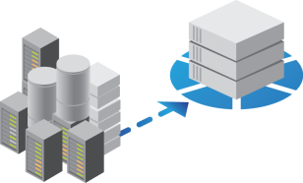

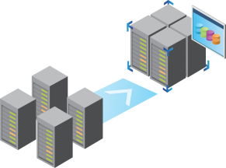
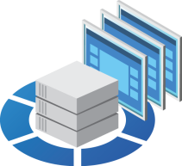

HP Virtual Resource Pools demand a virtualized storage infrastructure
Platform Convergence
x86-based, scale-out
storage to lower costs
Capacity Optimization
Lower the impact of
explosive data growth
Storage Virtualization
Improve utilization and
simplify management
Application integration
Speed deployment and
improve performance
Intellectual property
Value delivery

Slide 41
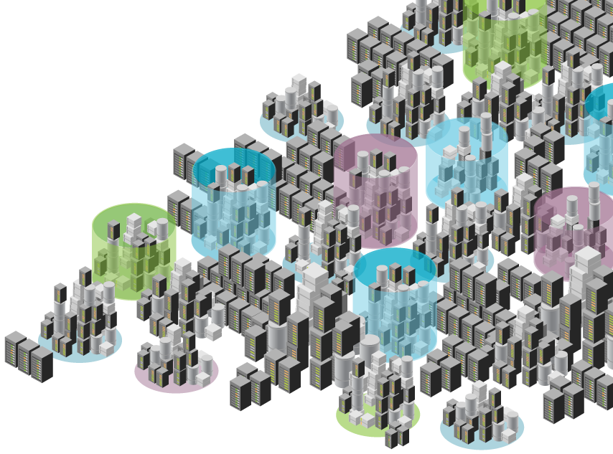
IT sprawl has business at the breaking point
70% captive in operations
and maintenance
Complex and inefficient
Over-provisioned, underutilized
Low productivity
Business innovation
throttled to 30%
Long delay to business value
Unpredictable service levels
Business agility constrained

Slide 42


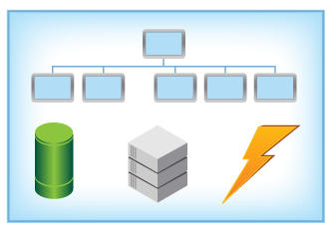
Solve complexity and transform the data center with converged infrastructure
Business selects
application
Access self-service portal
Select application template
Provision automatically
Tool determines resources

Slide 43
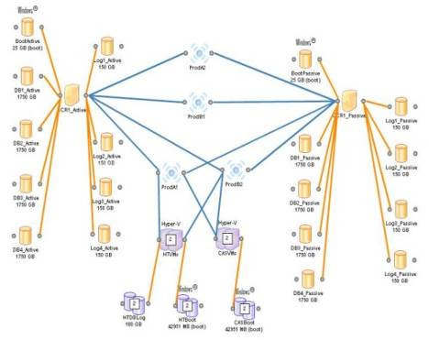
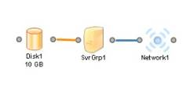
Understanding templates
A template is a definition of the infrastructure of an application
  Describes the server, storage and network resources and required interactions
  Easy to create – no training required
  Can represent simple to complex infrastructures
  Can define sequential actions
  Can apply cost of infrastructure components
  Goes through customer approval/standards process, then ‘published’
  Can attach workflows for additional automation
Simple
Complex
Adapted by customer from best practice templates downloaded from HP or a partner
Or originated by the customer
Single Windows Blade
Microsoft Exchange 2007 4000 User
Multiple Blades and Hyper-V VMs

Slide 44
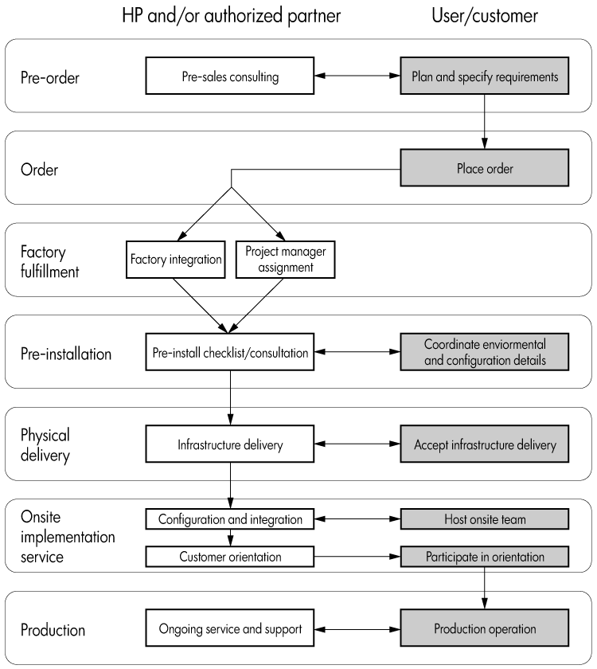

Slide 45
Challenges of Storage Resource Pool Configuration
Different apps require different classes of storage
  Must ensure that IO requirements of workload can be satisfied
  Requires coordination with SAN teams during LUN creation
Nothing new but methodology changes
Two places to configure
  SPE properties field
  Storage LUN “Matching Tags” property in IO template

Slide 46
Overview of Matrix implementation tasks
Matrix Factory Integration
  Blade server configuration
  Network configuration (VC/VCEM)
    Define the VC Ethernet Networks and SAN Fabrics (VCEM/VCM)
  Storage configuration (CV/ID-VSE)
    LUN creation
    SAN switch zoning
Customer responsibilities
  Provision the Hyper-V parent logical servers (ID-VSE)
  Create VM template (VMM)
  Define the physical server resource pools (IO) (Demo #1)
  Configure the Network resource pools (IO) (Demo #2)
  Create logical storage pool entries (SPEs) ( where is this done)
  Build OS provisioning jobs (RDP)
  Build service (Demo #3)
  Authorize and deploy service (Demo #4)

Slide 47

Complete an evaluation on CommNet and enter to win an Xbox 360 Elite!

Slide 48

Required Slide
© 2009 Microsoft Corporation. All rights reserved. Microsoft, Windows, Windows Vista and other product names are or may be registered trademarks and/or trademarks in the U.S. and/or other countries.
The information herein is for informational purposes only and represents the current view of Microsoft Corporation as of the date of this presentation. Because Microsoft must respond to changing market conditions, it should not be interpreted to be a commitment on the part of Microsoft, and Microsoft cannot guarantee the accuracy of any information provided after the date of this presentation. MICROSOFT MAKES NO WARRANTIES, EXPRESS, IMPLIED OR STATUTORY, AS TO THE INFORMATION IN THIS PRESENTATION.

