Slide 2
A-to-Z of Usable Security in Windows Server 2008 R2 and Windows 7
Rafal Lukawiecki
Strategic Consultant
Project Botticelli Ltd
Session Code: SVR313

Slide 3

Objectives
Understand the “big picture” of security on Microsoft’s newest OS platform
Help you enable more usability through not-in-my-way security
In addition to hours of playing with the software, chatting, intuitional meditating, searching and being generally unsociable towards Microsoft people, this presentation is also based on many TechNet and MSDN articles, notably including Steve Riley’s great read in the TechNet Windows Magazine. Thanks for writing it, Steve, we missed you here…
The information herein is for informational purposes only and represents the opinions and views of Project Botticelli and/or Rafal Lukawiecki. The material presented is not certain and may vary based on several factors. Microsoft makes no warranties, express, implied or statutory, as to the information in this presentation.
© 2009 Project Botticelli Ltd & Microsoft Corp. Some slides contain quotations from copyrighted materials by other authors, as individually attributed. All rights reserved. Microsoft, Windows, Windows Vista and other product names are or may be registered trademarks and/or trademarks in the U.S. and/or other countries. The information herein is for informational purposes only and represents the current view of Project Botticelli Ltd as of the date of this presentation. Because Project Botticelli & Microsoft must respond to changing market conditions, it should not be interpreted to be a commitment on the part of Microsoft, and Microsoft and Project Botticelli cannot guarantee the accuracy of any information provided after the date of this presentation. MICROSOFT AND/OR PROJECT BOTTICELLI MAKES NO WARRANTIES, EXPRESS, IMPLIED OR STATUTORY, AS TO THE INFORMATION IN THIS PRESENTATION. E&OE.

Slide 4
Agenda
The Big Picture on 1 Slide
Usability Scenarios for Security
Foundational Security Features
Mostly on the Server
Mostly on the Client

Slide 5
Big Picture

Slide 6
Are We Friends?
Vista had, er, some issues
  thankfully, not security ones
Windows Server 2008 and Vista were, in fact, very secure
Small example:
  There are 340m stolen data record in US since 2005 (privacyrights.org)
  There are no reports of a loss from a compromised BitLocker drive

Slide 7
Current OS Security Technologies
Foundation
ASLR*
Service Hardening*
Kernel Patch Protection*
Data Execution Prevention*
BitLocker*
Mostly Server R2
DirectAccess
AppLocker
Enhanced Storage Access
DNSSEC
Enhanced Auditing*
Suite-B for EFS, Kerberos, TLS v1.2 and more
Mostly Windows 7
BitLocker to Go
Multiple Firewall Profiles
Streamlined UAC
Biometric Framework
HTTP PKI Enroll
PIV Smartcards

Slide 8
Usability Scenarios

Slide 9
Scenario 1: On-Premises
While starting up, system is protected through BitLocker and TPM (Trusted Platform Module) from off-line modifications
NAP (Network Access Protection) ensures computer adheres to your policy (e.g. has required updates, virus signatures etc.) before servers allow it to use the network
Multiple types of logon devices and identities can be selected by the user using a simple and consistent UI
User logs on using non-admin accounts. If admin rights are truly needed user’s approval is requested. Legacy apps cope with UAC or use Windows XP Mode, or app virtualisation.
User can only run approved applications thanks to AppLocker
When connecting to Internet DNSSEC prevents phishing through DNS poisoning
When updates are available, Restart Manager ensures minimum of disruption, even if running applications are left on a locked workstation

Slide 10
Scenario 2: On-the-Road
BitLocker protects from data loss in case of laptop theft
Multiple firewall policies enable the machine to be in a more locked-down mode with no user intervention
User accesses company resources securely and efficiently with DirectAccess while still having fast access to the web
Corp admin can remotely update and control the laptop
User can keep their smartcards/PKI up-to-date using HTTP cert enrolment

Slide 11
Scenario 3: Liability Investigation
Things went wrong. You get a visit from an insurance investigator assessing your liability. Naturally, you have an ongoing OCTAVE risk assessment and process, and:
You made best effort to have USG TOP-SECRET compliance for data protection because:
  Your on-premises data is EFS Suite-B encrypted on shared servers
  Your laptops have Suite-B BitLocker on them
  All of your removable media (USB etc) has Suite-B BitLocker-to-Go by policy (or users cannot write to it)
You have used NIST compliant PIV plug-and-play smartcards
Your passwords are strong
Any fingerprint readers are used as a secondary line of defence only and rely on the Biometrics Framework
Enhanced Audit clearly shows who-attempted-what-when
Separately, you have been auditing your Forefront Identity Manager 2010 (formerly ILM 2) so you know you comply with Sarb-Ox too
You’ve done a good job! ☺

Slide 12
Key Security Technologies

Slide 13
Hardened Services
New types of accounts:
  Managed Service Accounts
    Automatic pw reset or no password/SPN management, can be delegated
    Domain account isolation
    Great for SQL Server or IIS
  Virtual Accounts
    No passwords
    Use computer credential for network access
Windows and Your Services:
  SID (per-service Security Identifier) recognised in resource ACLs and Firewall policies
  Write-restricted tokens where possible

Slide 14
ASLR
Address Space Layout Randomization (ASLR)
Key DLLs load into one of 256 memory locations mitigating “return-to-libc” attacks

Slide 15
Pointer Obfuscation
Long life pointers obfuscated and decoded when needed
You can too! Use: EncodePointer and DecodePointer
  Win32 API

Slide 16
NG TCP/IP
TCP/IP stack introduced in WS2008 and Vista
Dual-stack IPv6 implementation
  IPv6 is more secure than IPv4 by design, esp.:
    Privacy, tracking, network port scanning, confidentiality and integrity
With
  Strong Host model
  Windows Filtering Platform
  Resistance to most TCP/IP-based DoS attacks
  Auto-configuration and no-restart reconfiguration

Slide 17
Additionally, Server R2 Must Use:
Data Execution Protection
  Aka NX (No Execute) bit
  CPU-based protection against running code in data memory segments
Kernel Patch Protection
Device Driver Signing
  Kernel-mode drivers signed by certs trusted by well-known CAs
  Applied to Windows 7 64-bit too

Slide 18
Mostly on
Windows Server 2008 R2

Slide 19
DirectAccess
No tunnel, no VPN, yet secure access to your corpnet
How?
  IPv6 allows point-to-point secure mutually authenticated connectivity
  NRPT knows which requests to intercept

Slide 20
DirectAccess and IPv6
IPv6 gives you security:
  IPSec6 Encapsulating Security Payload (EPS) for Suite-B level of confidentiality
  Server-client two-way authentication
IPv6 just-gets-there
  Bypasses NATs
  Full mobility support with no loss of connection
  Full autoconfiguration
Crosses over IPv4 using:
  6to4, 6over4, ISATAP, Teredo, NAT-PT, and now:
  IP-HTTPS if all else fails

Slide 21
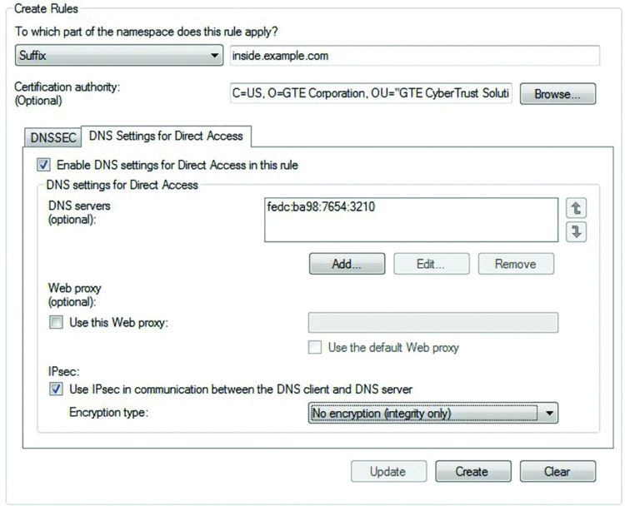
DirectAccess and NRPT
Clever hack
Works on DNS namespaces, eg:
  inside.example.comor
  //inside
  will be resolved by a corpnet DNS server

Slide 22
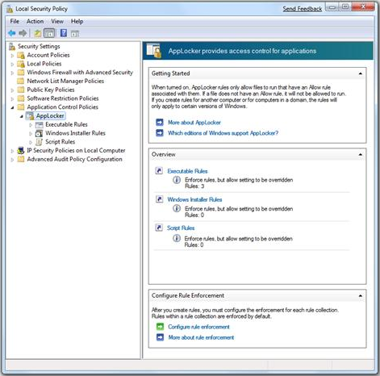
AppLocker
System for policing allowed and blocked software
Replacement for SRPs
  Software Restriction Policies
Key features:
  OS kernel-mode driver enforcement
  Publisher signatures
  User policies

Slide 23
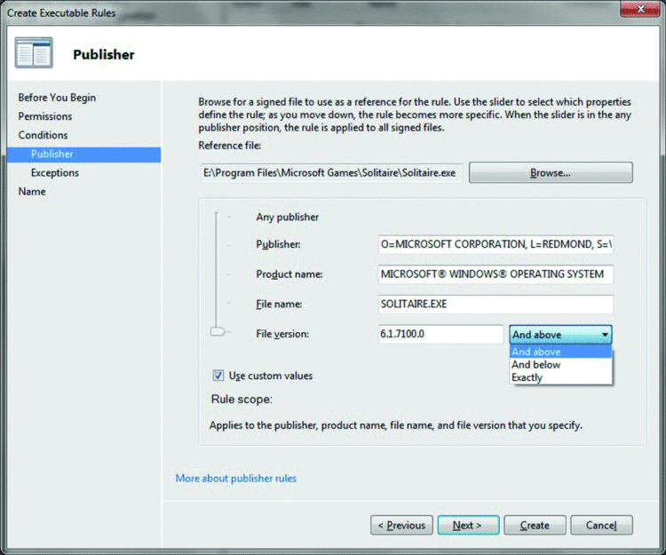
AppLocker Flexibility
You can control at high or low level, down to allowed versions

Slide 24
Enhanced Storage Access
Simpler authentication for removable media
  Password-protected USB
IEEE 1667 for password protection and certificate-based authentication
This is not full encryption!
  Consider BitLocker-to-Go for confidentiality

Slide 25
DNSSEC
Specifically: RFC 4033, 4034, 4035
Certificate-based verification of DNS responses
  Authenticity of responder
  Integrity of the response
  Authenticated denial of existence
Why? Prevent DNS poisoning
How?
  Configured in NRPT
  Windows 7 has DNSSEC aware non-validating resolver, so
  It refers queries to your corpnet Windows Server 2008 R2 DNS server for verification

Slide 26
Enhanced Auditing
Reduces Clutter, Number of Logged Events
Global Object Access Auditing
  Computer-wide System Access Control Lists (SACLs)
Reason for Access Reporting
  Lists ACEs used to make access decisions
Advanced Policy Settings
  53 fine-grained settings from Windows Server 2008/Vista now controllable through GPOs

Slide 27
EFS with Suite-B
Encrypting File System is used for workgroup files, shares, SharePoint…
  Does not replace and is not replaced by BitLocker
Now: Suite-B compliant!
  But: allows use of RSA for backward compatibility
  Control this via a new group policy setting

Slide 28
Suite-B Algorithms
Why?
  USG requirement for civilian and military SECRET and TOP-SECRET applications
  Popular world-wide due to use of Elliptical Curve Cryptography (ECC)
How?
  Encryption: AES
  Digital Signature: EC-DSA
  Key Exchange: EC-DH or EC-MQV
  Hashing: SHA-2

Slide 29
TLS v1.2
Transport Layer Security v1.2
Essential for SSL
  schannel.dll authentication package
Now uses Suite-B! Specifically:
  TLS_ECDHE_ECDSA_WITH_AES_128_GCM_SHA256
  TLS_ECDHE_ECDSA_WITH_AES_256_GCM_SHA384
Group Policy setting:
  System cryptography: Use FIPS compliant algorithms for encryption, hashing, and signing

Slide 30
Kerberos Enhancements
Hurrah! DES has been disabled in R2 and W7 Kerberos
  BTW: no LM, and NTLM now min 128-bits, can be further restricted
Enabled algorithms:
  Cool: AES256-CTS-HMAC-SHA1-96
  Very good: AES128-CTS-HMAC-SHA1-96
  Ok-ish: RC4-HMAC
Kerberos with smartcards now uses ECC (Elliptic Curve Crypto), RFC 5349 (PKINIT)

Slide 31
Mostly on Windows 7

Slide 32
COM-DV
Microsoft used a new approach in rewriting UAC for Windows 7 called COM-DV
Careful Observation and Monitoring of Deployed Vistas

Slide 33
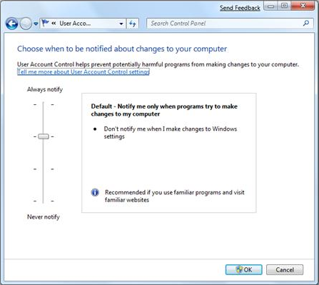
Streamlined UAC
Fewer. Less. Yes.
Redrawn boundaries
Manageability:
  User has 4 settings
  Admin has Group Policies

Slide 34
PKI Enhancements
PKU2U
  Public Key Cryptography Based User-to-User
    P2P Security Services Provider
    Strong authenication without a domain
      Homegroup, media sharing etc
      Allows linking of online IDs to Windows accounts
PKI HTTP Enrolment
  Cert request and renewal over the Internet
  Cross-forest CA enrolment

Slide 35
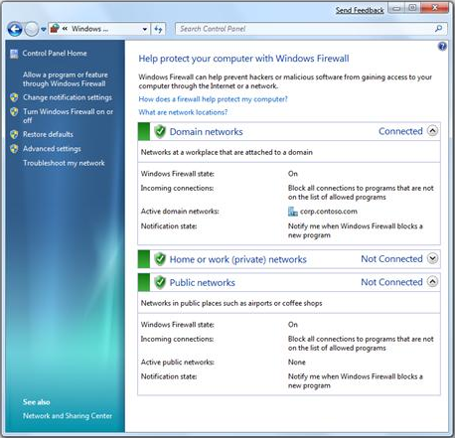
Multiple Firewall Profiles
At last:
  Strong domain policy respectful of home or on-the-road needs

Slide 36
Windows Biometric Framework
Remember: biometrics is not 1st class security just a usability enhancement
  More bad news: Fingerprint readers tend to have terrible design, buggy drivers, insecure storage of keys
WBF builds fingerprint support into Windows 7
  Requires simpler but quality drivers
  Encrypted transmission of representational data
  Storage vault
  GUID to passwords
  GPOs for management

Slide 37
Smartcard PIV and PnP
Plug-and-play means no more middleware
Compliant smartcard works with Windows Update drivers
Personal Identity Verification (PIV) NIST standard FIPS 201 for USG employees
  Policies + specs for:
    Interfaces and card elements containing biometrics (fingers/facial)
    Required key sizes and algorithms

Slide 38
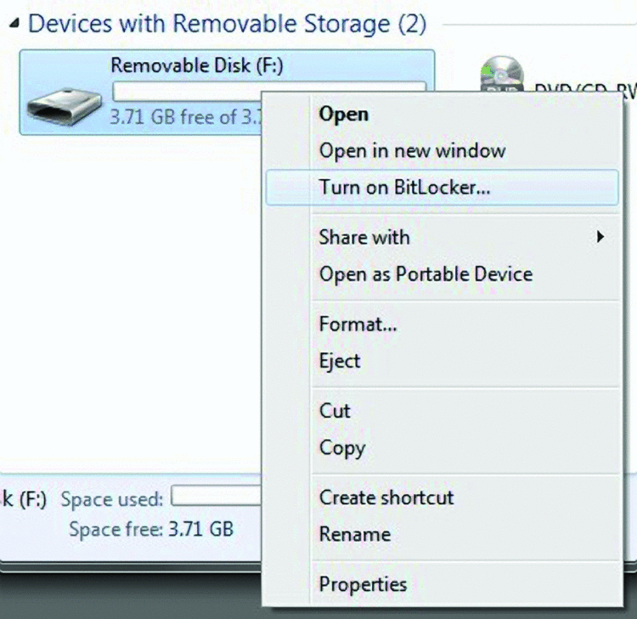
BitLocker to Go
BitLocker on a removable device
Right-click deployment ☺
Works even without installed system-wide BitLocker
Device can be read on XP and Vista!

Slide 39
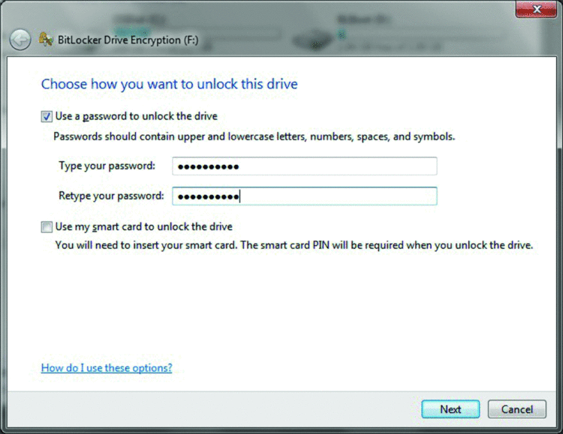
BitLocker to Go Protection
Password
  Make it good
Smartcard + PIN
  Great, but cannot be read on XP/Vista
GP setting for:
  Disabling writing to devices without BitLocker
  Configuring a Data Recovery Agent

Slide 40
Summary
☺

Slide 41
Summary
Vista and Windows Server 2008 were very secure
Windows Server 2008 R2 and Windows 7 should beat that record while also being truly usable
Approach security holistically, always

Slide 42


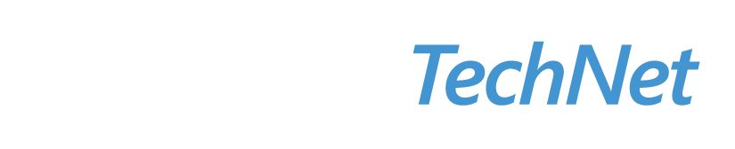

Resources
Required Slide
Speakers,
TechEd 2009 is not producing
a DVD. Please announce that
attendees can access session
recordings at TechEd Online.
www.microsoft.com/teched
  Sessions On-Demand & Community
www.microsoft.com/learning
Microsoft Certification & Training Resources
http://microsoft.com/technet
  Resources for IT Professionals
http://microsoft.com/msdn
  Resources for Developers

Slide 43
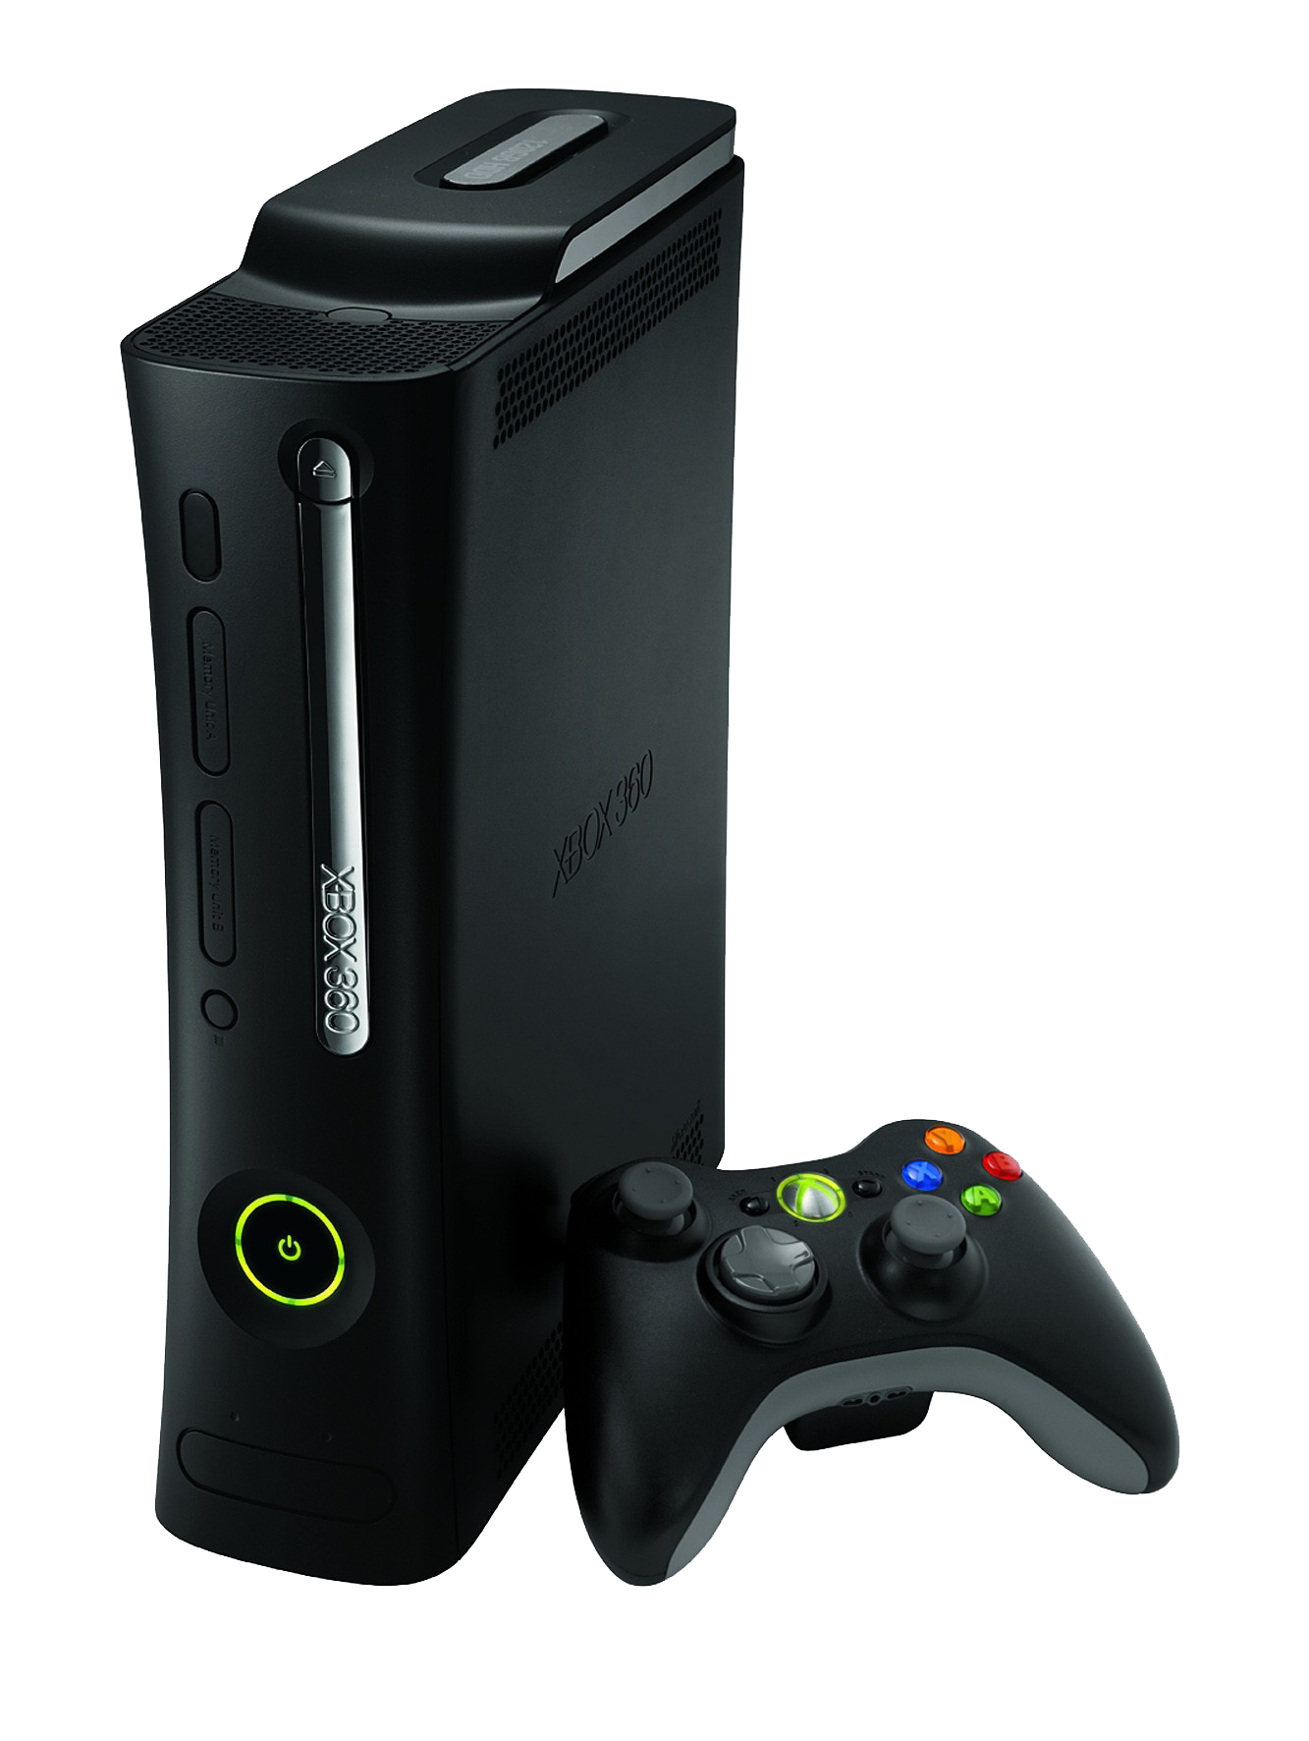
Required Slide
Complete an evaluation on CommNet and enter to win an Xbox 360 Elite!

Slide 44

Required Slide
The information herein is for informational purposes only and represents the opinions and views of Project Botticelli and/or Rafal Lukawiecki. The material presented is not certain and may vary based on several factors. Microsoft makes no warranties, express, implied or statutory, as to the information in this presentation.
© 2009 Project Botticelli Ltd & Microsoft Corp. Some slides contain quotations from copyrighted materials by other authors, as individually attributed. All rights reserved. Microsoft, Windows, Windows Vista and other product names are or may be registered trademarks and/or trademarks in the U.S. and/or other countries. The information herein is for informational purposes only and represents the current view of Project Botticelli Ltd as of the date of this presentation. Because Project Botticelli & Microsoft must respond to changing market conditions, it should not be interpreted to be a commitment on the part of Microsoft, and Microsoft and Project Botticelli cannot guarantee the accuracy of any information provided after the date of this presentation. MICROSOFT AND/OR PROJECT BOTTICELLI MAKES NO WARRANTIES, EXPRESS, IMPLIED OR STATUTORY, AS TO THE INFORMATION IN THIS PRESENTATION. E&OE.

