Slide 2
Power Efficiency and Power Management with Windows Server 2008 R2
Dan Reger
Sr. Technical Product Manager
Microsoft
Session Code: SVR316

Slide 3

Topics
The Context of Green IT
A Model for Thinking about Sustainability & Efficiency
Reduce – Manage – Rethink
Reducing Power Consumption and Improving Efficiency
Features that help Reduce power consumption and improve power efficiency
Demo
A Hardware Interlude…
Measuring and Managing Power Consumption
Manage – you can’t manage what you can’t measure
Demo

Slide 4
Power Usage in IT
Electricity usage by servers
and equipment doubled
between 2000 and 2005
Server power and cooling uses
123 billion kWh/year worldwide
0.8% of all worldwide power
usage (1.5% US)
18.2 million metric tons of coal;
69.7 million barrels of oil
Equivalent to the yearly
electricity consumption
of the entire nation of Poland
Could double again by 2011
Total Electricity Use
(billion kWh/year)
USA
World
Source: Estimating Total Power Consumption by Servers in the U.S. and the World, Jonathan G. Koomey, Ph.D., Staff Scientist, Lawrence Berkeley National Laboratory and Consulting Professor, Stanford University, February 15, 2007

Slide 5
Projected U.S. Data Center Power Use, 2007 to 2011
Historical trends scenario
Current efficiency trends scenario
Improved operation scenario
Best practice scenario
State of the art scenario
Source: Fact Sheet on National Data Center Energy Efficiency Information Program U.S. Department of Energy (DOE) and U.S. Environmental Protection Agency (EPA) March 19, 2008

Slide 6
Topics
The Context of Green IT
A Model for thinking about sustainability & Efficiency
Reduce – Manage – Rethink
Reduce
Features that help Reduce power consumption and improve power efficiency
Demo
A Hardware Interlude…
Manage
Manage – you can’t manage what you can’t measure
Demo

Slide 7



Three Strategies for Energy Efficiency
Reduce
Manage
Rethink
  Built in energy efficiency
  Resource optimization
  Guidance and education
  Centralize control
  Analyze operations and monitor goals
  Use IT to enable business process changes
  Increase productivity
  and reduce footprint

Slide 8
Topics
The Context of Green IT
A Model for thinking about sustainability & Efficiency
Reduce – Manage – Rethink
Reduce
Features that help Reduce power consumption and improve power efficiency
Demo
A Hardware Interlude…
Manage
Manage – you can’t manage what you can’t measure
Demo

Slide 9
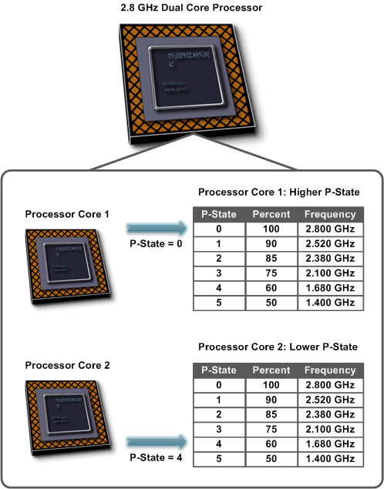

Reduce

Slide 10


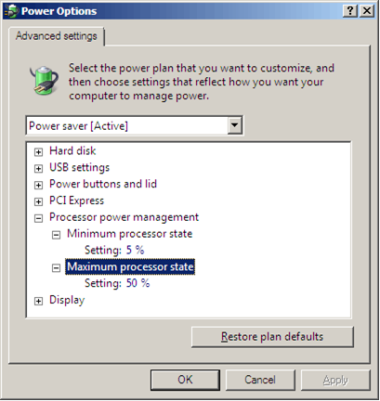
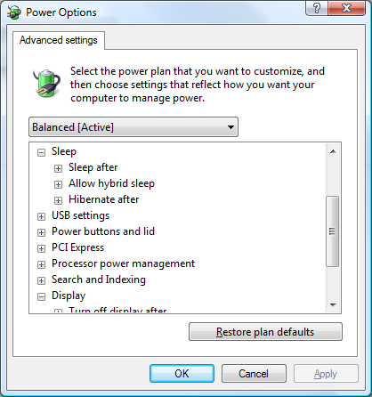
Enhanced Power Management in Windows Server 2008
Reduce

Slide 11
powercfg.exe
demo

Slide 12

Enhanced Power Management AQ
Manage
Windows Server 2008 R2 will include an Additional Qualification logo for “Enhanced Power Management” that indicates support for the following:
Processor power management through Windows
Power metering and budgeting
Power On/Off via WS-Management (SMASH)
Common Engineering Criteria for Power
Microsoft Internal engineering standard in development

Slide 13
Out-of-the-Box Power Savings
Reduce

Slide 14

Windows Server 2008 R2
Enhancements - Reduce
Reduce
Reduce Power Consumption
of Individual Servers
  Rewritten processor power
  management engine
    Improved Power Profile defaults
  Storage Power Management
  enhancements
  Core parking, tick skipping,
  timer coalescing
Hyper-V Makes Use of Our Power Improvements

Slide 15
An Example of Windows Server 2008 R2 Power Efficiency Improvement
Reduce

Slide 16
Reduce

Slide 17
Windows Server 2008 PPM Settings
Name | Default | Description
Time Check | 100 ms | The time interval at which the operating system considers a change of the current P-state.
Increase Time | 100 ms | The minimum time period that must expire before considering a P-state increase.
Decrease Time | 300 ms | The minimum time period that must expire before considering a P-state decrease.
Domain Accounting Policy | 0 (On) | Determines how the kernel power manager accumulates idle time. Settings: 0 (On): idle time is accumulated only when all processors in a C- state domain² are idle. 1 (Off): idle time is accumulated and P-states are calculated for each processor without regard to any other processor in the domain.
Increase Policy | IDEAL (0) | Determines how P-state transition decisions are made. Settings: IDEAL (0): calculates the target P-state based only on processor utilization and then finds a nearby available P-state on the system. SINGLE (1): calculates an ideal P-state but only increases or decreases by one P-state per time check interval. ROCKET (2): transitions to the highest P-state available on increase or lowest P-state available on decrease
Decrease Policy | SINGLE (1)

Slide 18
Windows Server 2008 R2 Settings
Name | Default | Description
Time Check | 100 ms | The time interval at which the operating system considers a change of the current P-state.
Increase Time | 100 ms | The minimum time period that must expire before considering a P-state increase.
Decrease Time | 300 ms 100 ms | The minimum time period that must expire before considering a P-state decrease.
Domain Accounting Policy | 0 (On) 1 (Off) | Determines how the kernel power manager accumulates idle time. Settings: 0 (On): idle time is accumulated only when all processors in a C- state domain² are idle. 1 (Off): idle time is accumulated and P-states are calculated for each processor without regard to any other processor in the domain.
Increase Policy | IDEAL (0) SINGLE (1) | Determines how P-state transition decisions are made. Settings: IDEAL (0): calculates the target P-state based only on processor utilization and then finds a nearby available P-state on the system. SINGLE (1): calculates an ideal P-state but only increases or decreases by one P-state per time check interval. ROCKET (2): transitions to the highest P-state available on increase or lowest P-state available on decrease
Decrease Policy | SINGLE (1) IDEAL (0)

Slide 19
Storage Power
Management Enhancements
Reduce
Support for remove on delete
Asynchronous notification of media change for optical devices
ATA Slumber
Optimize Link Power Management for SATA disks

Slide 20
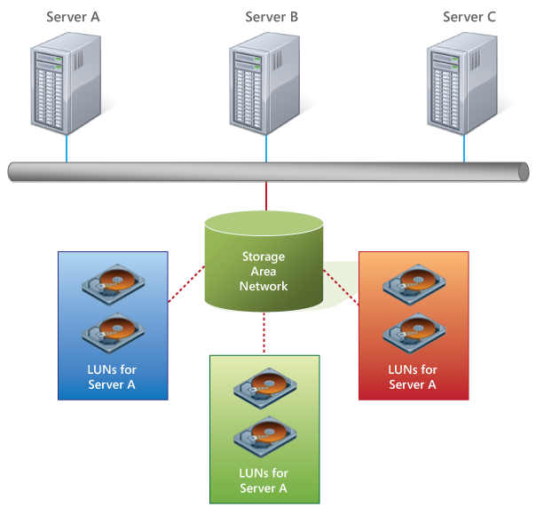
Boot From SAN Can Save Power
Reduce

Slide 21
Intelligent Timer Tick Distribution
(Tick Skipping)
Reduce
Extends processor sleep states by not waking the CPU unnecessarily
One processor handles the periodic system timer tick;
other processors are signaled as necessary
Non-timer interrupts will still wake sleeping processors
Timer coalescing
Helps combine software timers such that for each time the processor
comes out of a low-power state, multiple timers can be expired

Slide 22
Core Parking – in brief
Reduce
The Windows Server 2008 R2 default “balanced” power policy uses
core parking in conjunction with p-state management to further
improve the power efficiency of Windows, out of the box
This should be particularly effective on underutilized servers

Slide 23

Core Parking – before
Reduce
2.8 GHz Quad
Core Processor
Processor
Core 1 Active
Processor
Core 2 Active
Processor
Core 3 Active
Processor
Core 4 Active

Slide 24
Core Parking – after
Reduce
2.8 GHz Quad
Core Processor
Processor
Core 1 Active
Processor
Core 2 Inactive
Processor
Core 3 Inactive
Processor
Core 4 Inactive
The same work gets done, but less power is consumed…

Slide 25
18% = $1.7B, € 1.2B, 2 Million Cars
Factor | Source | Value
Number of Servers running versions of Windows Server prior to Windows Server 2008 | IDC Worldwide Windows Server Operating Environments 2009-2013 Forecast | 19.4 million servers
Average per-server power consumption | EPA Report on Server and Data Center Energy Efficiency, August 2, 2007 | 251 watts
Power Utilization Efficiency (PUE) | EPA Report on Server and Data Center Energy Efficiency, August 2, 2007 | 2.0
Power Cost per kWh | A simple average of 2 sources: 10.25 cents/kWh – Average Retail Price of Electricity to Ultimate Customers by End-Use - Commercial, July 208, EIA 13.5 US cents (9 Euro cents)/kWh – Eurostat, Electricity prices for EU households and industrial consumers on 1 July 2006 | 11.87 US cents per kWh
Carbon equivalent due to power generation of a kWh | http://www.epa.gov/cleanenergy/energy-resources/refs.html | .000718 metric tons of CO2 per kWhr
Carbon equivalent of an automobile | http://www.epa.gov/cleanenergy/energy-resources/refs.html | 5.46 metric tonnes of CO2 emissions per vehicle per year

Slide 26
An Example of Windows Server 2008 R2 Power Efficiency Improvement
Reduce

Slide 27
14% = $1.3B, € .93B, 1.5 Million Cars
Factor | Source | Value
Number of Servers running versions of Windows Server prior to Windows Server 2008 | IDC Worldwide Windows Server Operating Environments 2009-2013 Forecast | 19.4 million servers
Average per-server power consumption | EPA Report on Server and Data Center Energy Efficiency, August 2, 2007 | 251 watts
Power Utilization Efficiency (PUE) | EPA Report on Server and Data Center Energy Efficiency, August 2, 2007 | 2.0
Power Cost per kWh | A simple average of 2 sources: 10.25 cents/kWh – Average Retail Price of Electricity to Ultimate Customers by End-Use - Commercial, July 208, EIA 13.5 US cents (9 Euro cents)/kWh – Eurostat, Electricity prices for EU households and industrial consumers on 1 July 2006 | 11.87 US cents per kWh
Carbon equivalent due to power generation of a kWh | http://www.epa.gov/cleanenergy/energy-resources/refs.html | .000718 metric tons of CO2 per kWhr
Carbon equivalent of an automobile | http://www.epa.gov/cleanenergy/energy-resources/refs.html | 5.46 metric tonnes of CO2 emissions per vehicle per year

Slide 28
Topics
The Context of Green IT
A Model for thinking about sustainability & Efficiency
Reduce – Manage – Rethink
Reduce
Features that help Reduce power consumption and improve power efficiency
Demo
A Hardware Interlude…
Manage
Manage – you can’t manage what you can’t measure
Demo

Slide 29
Power Usage by Component
2005 Server Hardware
  568 W
Component Power Distribution, 2005
4-socket Single Core Server

Slide 30
Power Usage by Component
2008 Server Hardware
  635 W
  11% more
Component Power Distribution
2008 4-socket Quad Core Server

Slide 31
Quick Survey
Do you know your power costs per kWh?
Range:
  <5 Euro cents
  5-10 Euro cents
  11-15 Euro cents
  More

Slide 32
Power Consumption – Power Supplies
1000W rated Power Supply in a 12U server consuming 500W of power 24x7
Efficiency
Output Power
Required
Input Power
Waste Power
Waste Power
Cost per Annum
70 (default) | 500 W | 714 W | 214W | € 262.45
80 (near 80 plus Bronze) | 500 W | 625W | 125W Save: 89W | € 153.30 Save: € 109/yr
85 (80 plus silver) | 500 W | 588 | 88W | € 107.92
90(above 80 plus gold) | 500 W | 555 | 55W | € 67.45

Slide 33
Topics
The Context of Green IT
A Model for thinking about sustainability & Efficiency
Reduce – Manage – Rethink
Reduce
Features that help Reduce power consumption and improve power efficiency
Demo
A Hardware Interlude…
Manage
Manage – you can’t manage what you can’t measure
Demo

Slide 34

Windows Server 2008 & R2
Enhancements - Manage
Manage
Manage Power Across Your Computing Environment
Group Policies
WMI support
Power metering
Power budgeting
Enhanced Power Management – Additional Qualifier

Slide 35
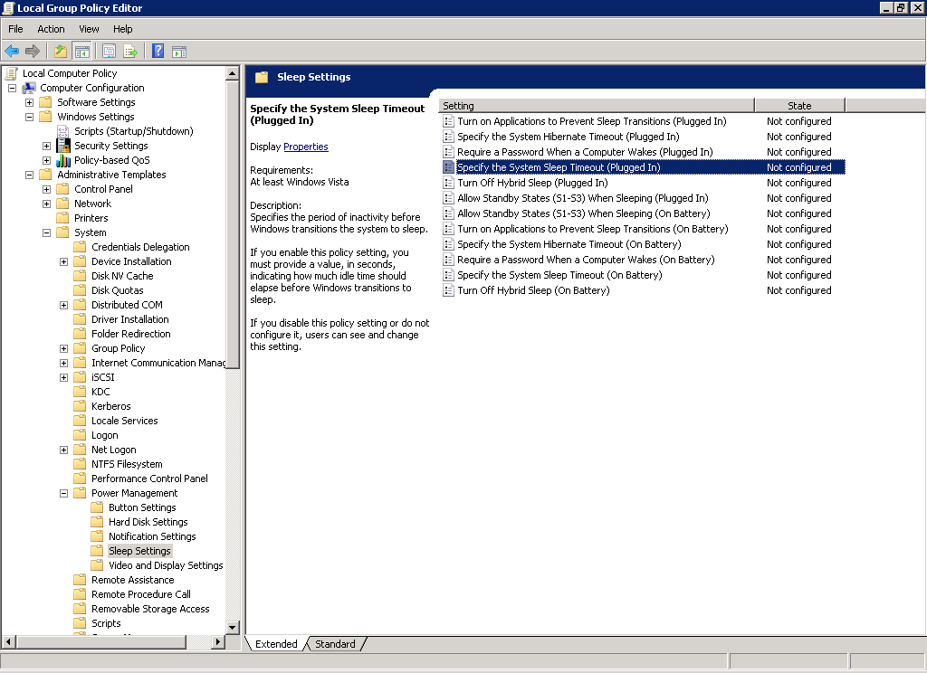
Centralized Power Management
Manage

Slide 36

Power Measurement
Manage
Windows Server 2008 R2 introduces the ability to
report power consumption and budgeting information
  Server platform reports this in-band to the OS via ACPI
  No additional drivers are required, only platform support
  Solution does not require hardware changes
Power information is exposed via WMI
  Adheres to the DMTF Power Supply Profile v1.01
  Enables local and remote management via WMI
  Includes support for reading and writing
  of power plan and setting data
  Active power plan can be changed remotely
Extendable to enable per-device metering
  WDM driver interface available

Slide 37
Power Budgeting & Metering
Manage
WMI Consumers
  WMI Namespace
  root\cimv2\power
  Power Supply class
  Power Meter class
  Power Meter Events
  User-mode
  Power Service
  Management tools
  Admin scripts
  Power WMI providers
  System Center
  Standard Windows IOCTL interface
  In-box ACPI-based implementation
  Other vendor specific implementations…
  Vendors provide ACPI code in firmware
  BMC hardware
Implemented
in Windows Server
  Hardware

Slide 38
Power Measurement – and Management
demo

Slide 39

Saving Power Through Virtualization
Rethink
Each physical server creates
a guaranteed minimum
power usage overhead
Even at idle, a server can
consume 60 percent or
more of its maximum
power draw
Dedicated servers typically
run at far below capacity
Inefficient resource allocation leads to wasted power
kWh/Year
kWh/Year

Slide 40
Adding Up the Savings
Server Setup
Average Watts
kWh/year
Cost
Kilograms of CO₂
Standalone IIS7 server × 4 | 2,000 | 17,535 | € 2,455 | 13,633
One Hyper-V server with 4 IIS7 virtual machines | 517 (measured) | 4,537 | € 635 | 3,528
Potential Savings | 1,483 | 12,997 | € 1,820 | 10,105
Standalone IIS7 server × 10 | 5,001 | 43,838 | € 6,129 | 34,083
One Hyper-V server with 10 IIS7 virtual machines | 512 (measured) | 4,489 | € 628 | 3,491
Potential Savings | 4,489 | 39,349 | € 5,501 | 30,592
* See Average Retail Price of Electricity to Ultimate Customers by End-Use Sector, by State (http://www.eia.doe.gov/cneaf/electricity/epm/table5_6_b.html) and Greenhouse Gas Equivalencies Calculator (http://www.epa.gov/cleanenergy/energy-resources/calculator.html) from the U.S. Environmental Protection Agency.

Slide 41
Adding Up the Savings
Server Setup
Average Watts
kWh/year
Cost
Kilograms of CO₂
Standalone IIS7 server × 4 | 2,000 | 17,535 | € 2,455 | 13,633
One Hyper-V server with 4 IIS7 virtual machines | 517 (measured) | 4,537 | € 635 | 3,528
Potential Savings | 1,483 | 12,997 | € 1,820 | 10,105
Standalone IIS7 server × 10 | 5,001 | 43,838 | € 6,129 | 34,083
One Hyper-V server with 10 IIS7 virtual machines | 512 (measured) | 4,489 | € 628 | 3,491
Potential Savings | 4,489 | 39,349 | € 5,501 | 30,592
€ 11,000 with power & cooling
* See Average Retail Price of Electricity to Ultimate Customers by End-Use Sector, by State (http://www.eia.doe.gov/cneaf/electricity/epm/table5_6_b.html) and Greenhouse Gas Equivalencies Calculator (http://www.epa.gov/cleanenergy/energy-resources/calculator.html) from the U.S. Environmental Protection Agency.

Slide 42
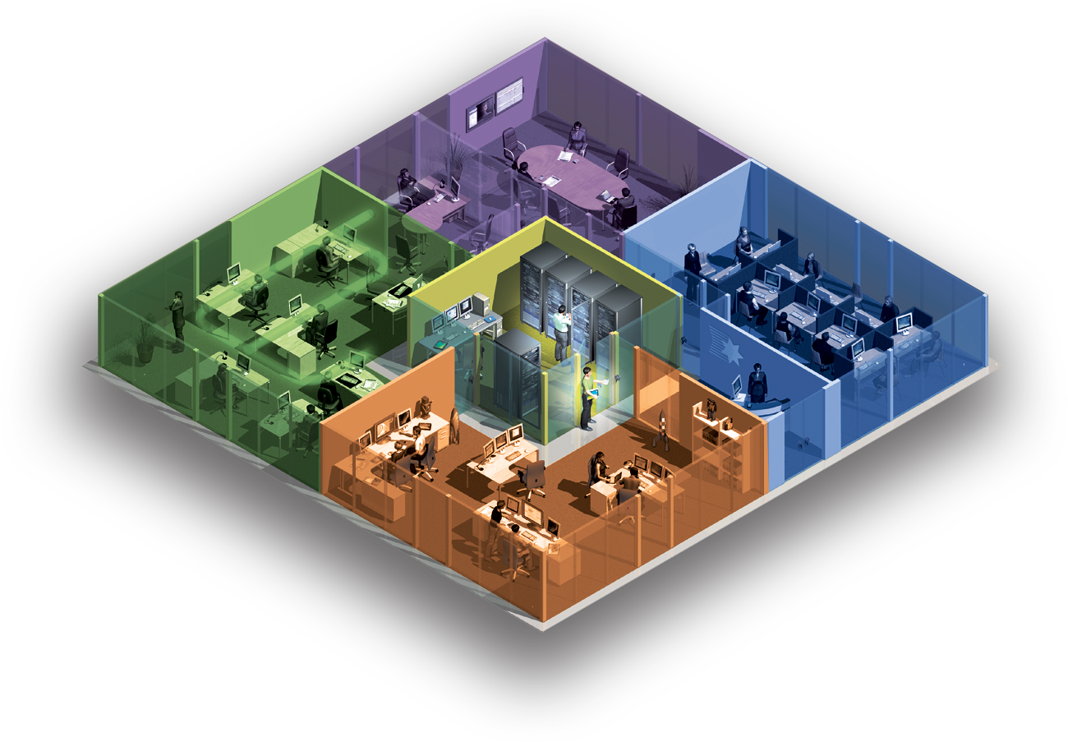
Bring Energy Efficiency to IT
Know your workload
  Power Management at every stage
  Deliver guidance and management
Deploy Efficient Hardware
  80% or 90%-efficient Power Supplies
  2.5” drives (use less power than 3.5” drives)
  Modern processors (smaller nm die = less power)
  Lower power memory is becoming available, size RAM for your workload
Four other opportunities
  Decommission unused equipment
  Stop over-provisioning
  Use Power Management features
  Change the power state when equipment is not in use
Virtualize
The greenest electrons are
the ones that you don’t use.

Slide 43

What Early-Adopters Say About
Power Savings Through Virtualization
  “With virtualization, we will save about 50 percent of our annual energy budget for cooling and electricity.”
Lukas Kucera – IT Services Manager at Lukoil CEEB
  “The work that Microsoft has done in these areas—particularly the ability to shift workloads across CPUs—is doing wonders for reducing our energy consumption.”
  Jeffrey Altman – President and CEO at Secure Endpoints
  “89% Energy Savings with Microsoft Virtualization”
  Chris Steffen – Principle Technical Architect at Kroll Factual Data
  Video Case Study available at spotlightoncost.com

Slide 44
Other Customers
Wortell - Cut power consumption “By virtualizing servers and taking advantage of the intelligent power management features in Windows Server 2008 R2, we have cut our energy consumption in the data center by 85 percent. This solution frees up a lot of resources.”
Combell - “Also, because we will be able to host multiple servers on one physical host, we will use less power, need less cooling, and have fewer hardware costs. We will use less data center space and energy overall. These things will lead to huge savings for us.”
EmpireCLS – “By increasing our server utilization with Windows Server 2008 R2 and taking advantage of the increased capacity of our new HP ProLiant G6 servers, we will reduce both our server farm infrastructure and our power costs by 33 percent.”
Warid Telecom increased uptime to 99.9 percent, cut support time by 40 percent, and expects to reduce power consumption by 80 percent and capital costs by 20 percent.
Hostway Korea expects that virtualizing its infrastructure will help reduce power costs about 75%
Wacom - 30 percent savings in annual power costs. “We found that we could save about 30 percent—€16,000 [U.S.$23,753]—annually in power costs by moving to a Hyper-V environment, which would pay for the project in about 2.5 years.”

Slide 45
question & answer

Slide 46




Resources
Required Slide
Speakers,
TechEd 2009 is not producing
a DVD. Please announce that
attendees can access session
recordings at TechEd Online.
www.microsoft.com/teched
  Sessions On-Demand & Community
www.microsoft.com/learning
Microsoft Certification & Training Resources
http://microsoft.com/technet
  Resources for IT Professionals
http://microsoft.com/msdn
  Resources for Developers

Slide 47

Complete an evaluation on CommNet and enter to win an Xbox 360 Elite!

Slide 48

Required Slide
© 2009 Microsoft Corporation. All rights reserved. Microsoft, Windows, Windows Vista and other product names are or may be registered trademarks and/or trademarks in the U.S. and/or other countries.
The information herein is for informational purposes only and represents the current view of Microsoft Corporation as of the date of this presentation. Because Microsoft must respond to changing market conditions, it should not be interpreted to be a commitment on the part of Microsoft, and Microsoft cannot guarantee the accuracy of any information provided after the date of this presentation. MICROSOFT MAKES NO WARRANTIES, EXPRESS, IMPLIED OR STATUTORY, AS TO THE INFORMATION IN THIS PRESENTATION.

