Slide 2
Microsoft Exchange Server Virtualisation: Does It Make Sense?
Jeff Mealiffe
Senior Development Lead
Microsoft Corporation
Session Code: UNC03-IS

Slide 3
Guidelines
This is an informal interactive session – it will be driven by your interests and questions
Don’t hesitate to ask questions
Don’t hesitate to contribute to the conversation with your own experience

Slide 4
Questions for the audience
How many of you are using virtualization with Exchange today?

Slide 5
Questions for the audience
What benefits are you seeing from virtualized infrastructure today?

Slide 6
Questions for the audience
How many of you are aware of our support guidelines published on TechNet?

Slide 7
Questions for the audience
What hypervisor are you primarily using in production today?

Slide 8
Questions for the audience
What problems have you run into (if any) with your virtualized Exchange deployment?

Slide 9
Questions for the audience
What concerns do you have about virtualizing future Exchange deployments?

Slide 10
Support Guidelines
TechNet is the single source: http://technet.microsoft.com/en-us/library/cc794548.aspx
SVVP Support Policy Wizard is a great tool: http://www.windowsservercatalog.com/svvp.aspx?svvppage=svvpwizard.htm
Always confirm SPW results with our TechNet article
Check back for updates
Clarifications published frequently

Slide 11
Supportability Quick Reference
Supported
Root: Hyper-V or SVVP
Guest:
Exchange 2010
Windows 2008 SP2 or R2
Mailbox, Client Access, Hub Transport, Edge roles
Meets basic Exchange system requirements
Storage is fixed VHD, SCSI pass through, or iSCSI
Not Supported
Combination of Exchange Mailbox HA and hypervisor-based clustering or migration technologies
Snapshots, differencing/delta disks
VSS backup of root for passthrough disks or iSCSI disks connected to initiator in guest
Unified Messaging role
Virtual/logical proc ratio greater than 2:1
Applications running in root partition

Slide 12
Deployment Recommendations
Exchange application is not ‘virtualization aware’
Virtualization isn’t free
Hypervisor adds processor overhead, must account for this when sizing - ~12% in our Exchange 2010 tests
Workload costs rise as well, though this is more difficult to characterize
Virtualization doesn’t change Exchange design requirements from an application perspective
Design for Performance, Reliability and Capacity (MBX/Hub/Edge)
Design for Usage Profiles (CAS/MBX)
Design for Message Profiles (Hub/Edge)

Slide 13
Exchange 2010 Testing Typical 16-core deployment
Goal: Examine Exchange performance on Hyper-V in a typical deployment scenario
Test configuration:
HP ProLiant BL680 G5, 4 x Quad-Core Intel Xeon E7340
Root: 16 core host, Windows 2008 R2 (build 7100)
Guests: 4 VMs (1 CAS, 1 Hub, 2 Mailbox), Exchange 2010 DF7 (582.10)
Mailbox 1 on Windows 2008 RTM, Mailbox 2 on Windows 2008 R2
4,000 users per mailbox server
Loadgen, 75% Outlook 2007 Cached Heavy + 25% OWA (modified enterprise script) + 10% default EAS workload
Observations:
Logical processor guest runtime higher with 2008 RTM guest vs. 2008 R2 (~13%)
Acceptable performance across all roles
Hub CPU 52.3%, CAS CPU 33.4%
MBX CPU 53.3%, RPC Averaged Latency 6.5ms, RPC Operations/sec 1818

Slide 14
Points To Consider
Accuracy of Perfmon counters in a Guest OS might be a concern for monitoring
CPU cycles in a VM are relative to the CPU slices provided from the virtualization layer
May skew results
Investigating the impact on production monitoring
Comprehensive comparison of physical resources and application consumption is difficult to achieve
Application counters are only available in the Guest OS
Root OS only provides view of resources it owns and Hyper-V counters

Slide 15
Edge / Hub Transport Server
Physical Deployment Guidance:
Recommended Maximum - 12 Processor Cores
Memory Sizing - 1GB per Processor Core
Processor Core Ratio to MBX –
1:5 (with A/V) and 1:7 (without A/V)
Virtual Deployment Guidance:
Recommended Maximum – 4 Virtual Processors
Memory Sizing - 1GB per Processor Core
Standard VM = 4 VPs + 4GB
Standard VM Ratio = 1 HUB VM : 5 MBX VMs
To accommodate peak I/O (e.g. processing queue) locate Transport DB + Logs on separate spindles

Slide 16
Client Access Server
Physical Deployment Guidance:
Recommended Maximum - 12 Processor Cores
Memory Sizing - 2GB per Processor Core
Processor Core Ratio to MBX – 3:4
Virtual Deployment Guidance:
Recommended Maximum – 4 Virtual Processors
Memory Sizing - 2GB per Processor Core
Standard VM = 4 VPs + 8GB
Standard VM ratio = 3 CAS VMs : 4 MBX VMs

Slide 17
CAS / HUB Multi-Role Server
Physical Deployment Guidance:
Recommended Maximum - 12 Processor Cores
Memory Sizing – 2 GB per Processor Core
Processor Core Ratio to MBX – 1:1
Virtual Deployment Guidance:
Recommended Maximum – 4 Virtual Processors
Memory Sizing – 2 GB per Processor Core
Standard VM = 4 VPs + 8GB
Standard VM Ratio = 1 CAS/HUB VM : 1 MBX VM

Slide 18
CAS / HUB Multi-Role Server
8 cores
16 cores
24 cores

Slide 19
Mailbox Server
Physical Deployment Guidance:
Recommended Maximum - 12 Processor Cores
Memory Sizing - 4GB + 3-30MB per mailbox
Virtual Deployment Guidance:
Recommended Maximum – 4 Virtual Processors
Memory Sizing - 4GB + 3-30MB per mailbox
Standard VM = 4 VPs + 16-24GB (adjust for number of mailboxes and database cache for send/receive profile)

Slide 20
Mailbox Server Guidelines
Virtual Processor ≠ Logical Processor
Hypervisor and the Virtualization Stack consume CPU
Reduce recommended mailbox count by ~10%
Total Send + Receive (75k message size) | Users Per Core Physical MBX Role | Users Per VP Virtual MBX Role
50 | 1000 | 900
100 | 900 | 810
150 | 800 | 720
200 | 700 | 630
250 | 600 | 540
300 | 500 | 450
350 | 400 | 360
400 | 300 | 270

Slide 21
Mailbox Storage Configuration
Virtual SCSI (passthrough or fixed disk)
Recommended configuration for database and log volumes
iSCSI
Standard best practice for iSCSI connected storage apply (dedicated NIC, jumbo frames, offload, etc.)
iSCSI initiator in the guest is supported but need to account for reduced performance

Slide 22
Exchange 2010 High Availability
Database Availability Group (DAG)
A group of up to 16 Exchange Server 2010 Mailbox servers that provide automatic database-level recovery
Uses continuous log replication and a subset of Windows Failover Clustering technologies
Can extend across multiple datacenters/AD sites
Benefits of Exchange Native Data Protection
Protection from database, server or network failure
Automatic failover protection and manual switchover control is provided at the mailbox database level instead of at the server level.
Support for up to 16 copies, support for lag copies

Slide 23
Host Based Failover Clustering
Host Based Failover Clustering HA
Using Host Based Failover Clustering and automatically failing VMs to an alternate cluster node in the event of a critical hardware issue (virtualization platform independent)
What you need to be aware of:
Not an Exchange Aware Solution
Only protects against server hardware/network failure
No HA in the event of storage failure / data corruption
Trend is larger mailboxes = larger database sizes = longer time to recover from data loss = DAG
Not supported for MBX VMs that are members of a DAG

Slide 24
Live Migration and Exchange 2010
Physical Computer Maintenance
Operating System/Application Updates
Hardware Maintenance
Rebalancing Workloads
Dynamic Redistribution of VM’s to optimize workload on physical hardware
Green IT
‘Off Peak’ Virtual Machine Consolidation

Slide 25
Live Migration - Rebalancing
Live Migration can be used to move VMs between root servers to achieve more equitable distribution of load across root servers

Slide 26
Live Migration – Green IT
Live Migration can be used to consolidate VMs on fewer host servers on evenings and weekends to reduce power and cooling costs during ‘off peak’ periods
Note: Live Migration is currently not supported for the mailbox server role in a DAG

Slide 27
For More Information…
Windows Server 2008 R2 Hyper-V
http://www.microsoft.com/windowsserver2008/en/us/hyperv-main.aspx
Windows Virtualization Team Blog
http://blogs.technet.com/virtualization
Infrastructure Planning and Design Guides for Virtualization
http://technet.microsoft.com/en-us/solutionaccelerators/ee395429.aspx?SA_CE=VIRT-IPD-WEB-MSCOM-2009-09-21
Microsoft Virtualization Solutions
http://www.microsoft.com/virtualization/en/us/solution-business-apps.aspx
Exchange Server 2010 Guidance
http://technet.microsoft.com/en-us/library/bb124558(EXCHG.140).aspx
Exchange Team Blog
http://blogs.technet.com/exchange

Slide 28
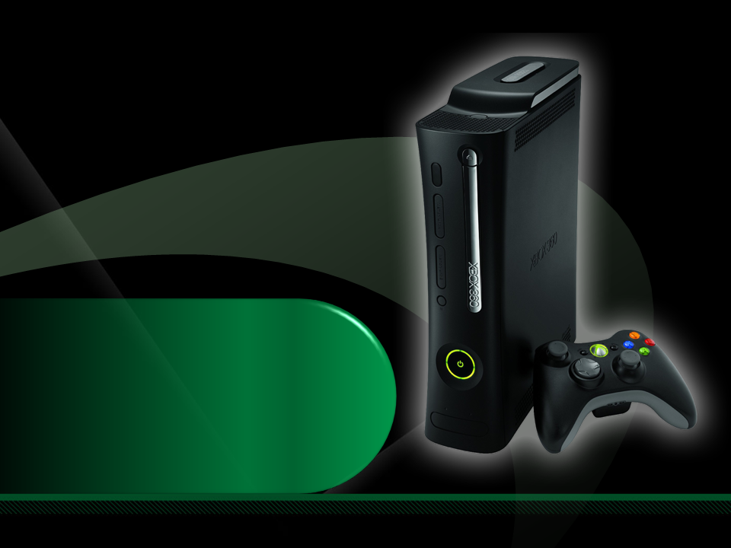
Complete an evaluation on CommNet and enter to win an Xbox 360 Elite!

Slide 29
Required Slide
© 2009 Microsoft Corporation. All rights reserved. Microsoft, Windows, Windows Vista and other product names are or may be registered trademarks and/or trademarks in the U.S. and/or other countries.
The information herein is for informational purposes only and represents the current view of Microsoft Corporation as of the date of this presentation. Because Microsoft must respond to changing market conditions, it should not be interpreted to be a commitment on the part of Microsoft, and Microsoft cannot guarantee the accuracy of any information provided after the date of this presentation. MICROSOFT MAKES NO WARRANTIES, EXPRESS, IMPLIED OR STATUTORY, AS TO THE INFORMATION IN THIS PRESENTATION.

