Slide 2
Implementing and Administering Microsoft Online Services
Cyril Sultan
Sr. Technical Sales Specialist
Microsoft, Microsoft Online
Session Code: UNC203

Slide 3
Agenda
Introduction
Implementation and administration
  Preparation
  Configuration
  Administration
Conclusion

Slide 4
Introduction

Slide 5





What Is Microsoft Online Services?
Enterprise class software delivered as subscription services hosted by Microsoft and sold with partners
Starting with…
Business Productivity Online Suite

Slide 6








Some customers
750,000 users in production, 1,200,000 under contract
Service available in 36 countries

Slide 7
















Standard and Dedicated Platforms
Standard
Dedicated
Multiple Customers, One Architecture
Customer Needs Rapid Deployment
Self service for management and admin
Single sign-in client for identity
Single Customer per Architecture
Businesses Greater than 5,000 Users
Customer Needs all Server Features
VPN connection with MSFT for identity
7

Slide 8
Exchange Online Main Features
Feature | Description
Mailbox size | 5 GB (soon 25GB)
RTO/RPO | RTO (4 hours) and RPO (8 hours)
Messaging Clients | Microsoft Office Outlook 2003 and Outlook 2007 (MAPI) All Messaging Clients (POP connection) Microsoft Outlook Web Access (Web Mail)
Mobile equipements | Windows Mobile 6 and above All equipments with ActiveSync installed (Nokia E/N Series, iPhone 3G, ….) Hosted BlackBerry Services (additional cost)
SLA | 99.9%
Support | Support Tier 1 Microsoft
Security | Microsoft® Forefront™ Online Security for Exchange (or EHS) and Microsoft Forefront™ (Anti-spam and Antivirus services)

Slide 9

Enhancements During the Past 12 Months
“Offloading innovation around communication and collaboration
to Microsoft…ensures that we can focus on our core competencies.”
- Ingo Elfering, VP of IT Strategy, GlaxoSmithKline
Deskless worker subscription ($2/month)
Migration from partner-hosted Exchange
Outlook 2003 Support without Free/Busy and Offline Address Books
Blackberry Enterprise Server hosting
Journaling to 3rd-party archive
Activation
Scripts
Default mailbox size increased to 5 GB
Max mailbox size increased to 25 GB
Max message size increased to 30MB
SMTP
relay
POP access
Outlook 2003
Add-in
Improved Mac support
2009
Jan Feb Mar Apr May Jun Jul Aug Sep Oct Nov Dec
Benefits of regular service updates:
Your organization stays current with the latest technology
Your users have the benefit of the newest productivity tools
Your staff can focus on strategic priorities

Slide 10


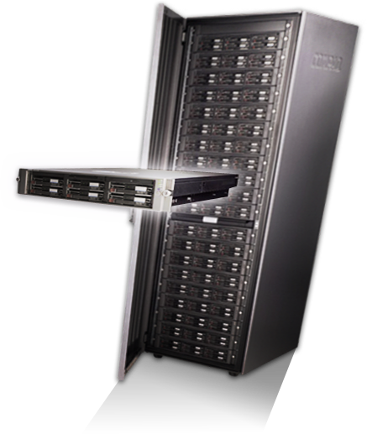


Exchange 2010’s Impact On Exchange Online
  Brings new Exchange Server capabilities
  to the cloud
  Gives you greater control over your online environment
  Makes migration and coexistence smoother
Co-Existence
On-Premises
Hosted Service

Slide 11
SharePoint Features
Service Comparison
On-premises server features | Standard ( 5 Seats Min) | Dedicated (5000 Seats Min)
Internet hosting
Custom code deployment |  | ☑
Business data catalogue |  | ☑
Business process forms and workflows | ☑ | ☑
Excel services |  | ☑
Enterprise data search |  | ☑
Site search | ☑ | ☑
My sites |  | ☑
Enterprise/web content | ☑ | ☑
People and personalization |  | ☑
Blogs, Wikis, Intranet sites | ☑ | ☑
Templates and web parts | ☑ | ☑
Document Collaboration | ☑ | ☑
Office Live
☑
☑
Custom code deployment
☑

Slide 12
OC Online Standard Highlights
End User
IT Pro
Enterprise Instant Messaging
  Multi-party IM & Presence
  Address Book Search / DLX
  File Transfer*
  1:1 Audio and Video*
  OC client promo – no extra charge
Security and Availability
  Instant Messaging encryption
  Instant Message filtering
Integrated User Experience
  Office Integration – IM/Presence
  Exchange Integration – Calendar
  Sharepoint Integration – IM/Presence
  Online Services - Single Sign On
Simplified Management
  Online Services administration center
  24x7 support
  99.9% service level agreement
  Always up to date software
Currently not offered in BPOS-S: Federation, PIC, IM archiving, web client
  * Limited to two PC’s on the same corporate network (e..g., no firewalls or other devices between the parties)

Slide 13
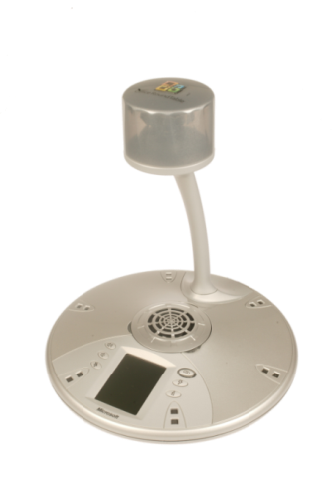
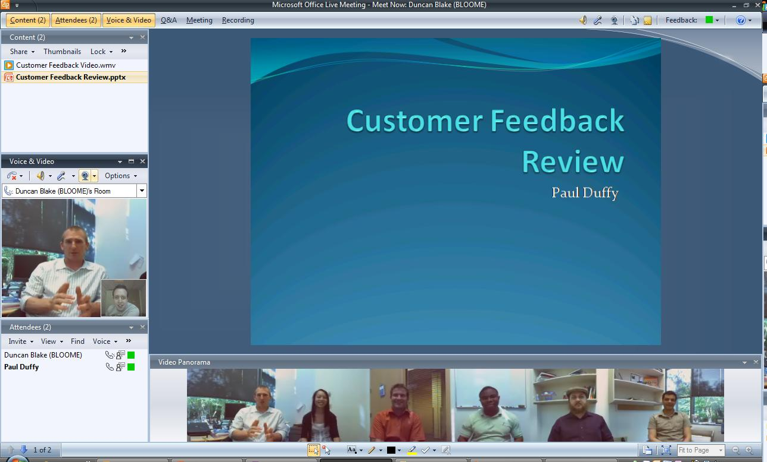
Office Live Meeting

Slide 14
Implementation and Administration

Slide 15
Different Phases
Preparation
Configuration
Administration

Slide 16
Registration
demo

Slide 17
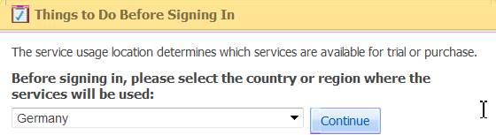
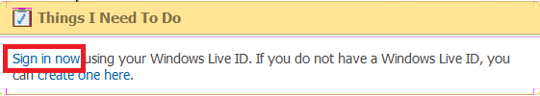
BPOS Account creation: 9 steps
1. Get to the MOCP portal: https://mocp.microsoftonline.com and select your country
2. Use or create your Live ID:

Slide 18
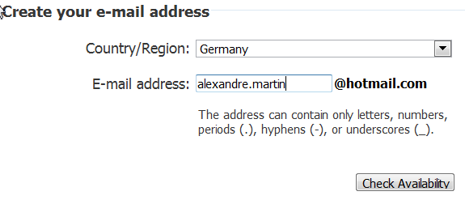
BPOS Account creation: 9 steps
3. If you create your Live ID, enter a user name
4. Add information about the contact with name/Tel
5. Add information about your company and your information

Slide 19
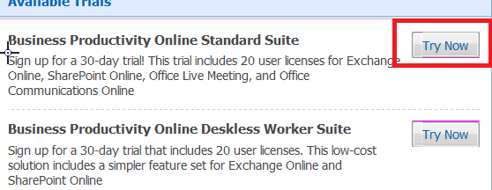
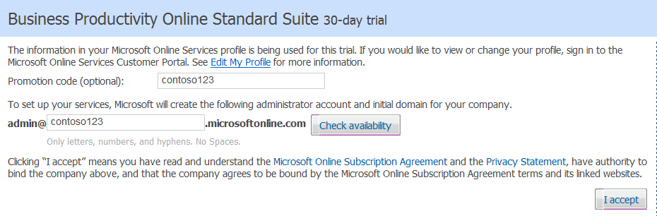
BPOS Account creation: 9 steps
6. Select the service to test (BPOS Suite)
7. Add your domain name and click ‘Accept’

Slide 20
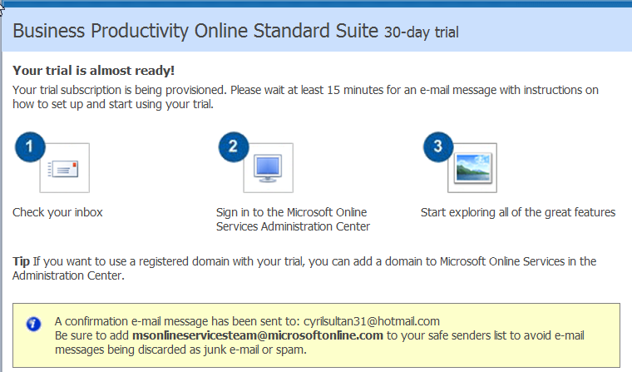
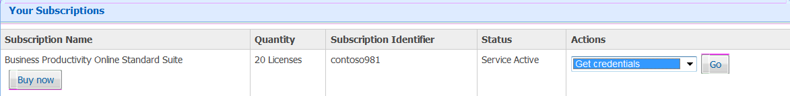
BPOS Account creation: 9 steps
8. Your account is being activated
9. After 5-10 minutes, your account is activated

Slide 21
BPOS account creation
Creation is not automatic; it can take up to 10-15 minutes for activation
Make sure you use a relevant Live ID account
  It will later be used in case of purchase
Don’t forget to include your intra- community VAT number
Only the Suites are available for trials (not the Stand-alone products):
  BPOS Standard
  BPOS Deskless

Slide 22
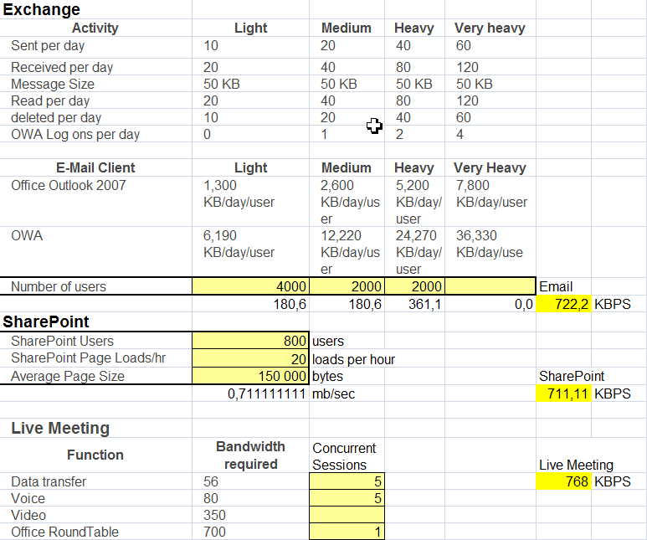
Understand Network impact
Technet: http://technet.microsoft.com/en-us/library/cc745931.aspx

Slide 23
Network impact
Ports to open: only 443 to access all Microsoft Online services
  Companies using an authentication proxy must add “microsoftonline.com” in the proxy’s exceptions list
  Other required ports for Live Meeting; cf. TechEd Live Meeting session
Required bandwidth during migration and during first connection (recreation of .ost file)
Network Connectivity Evaluation; cf. White Paper
http://www.microsoft.com/downloads/details.aspx?displaylang=en&FamilyID=c4ec4bbe-5979-4cf2-bac5-d86e1baada2c
  Round-trip latency
  Upload bandwidth
  Download bandwidth
Connectivity Evaluation Tool http://speedtest.emea.microsoftonline.com/

Slide 24
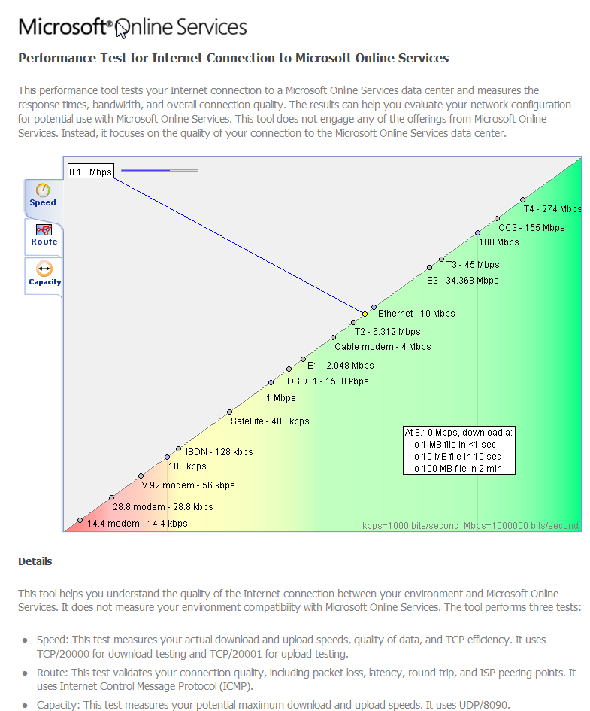
Speedtest results and analysis

Slide 25
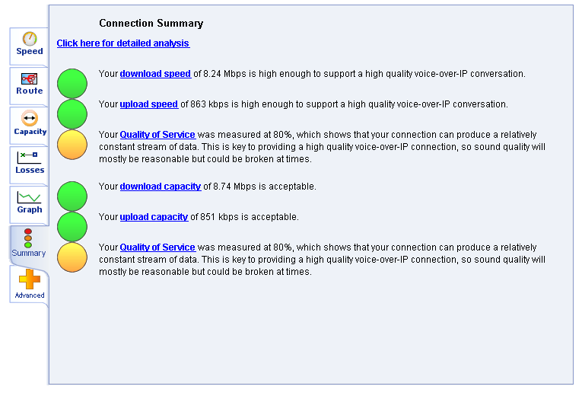
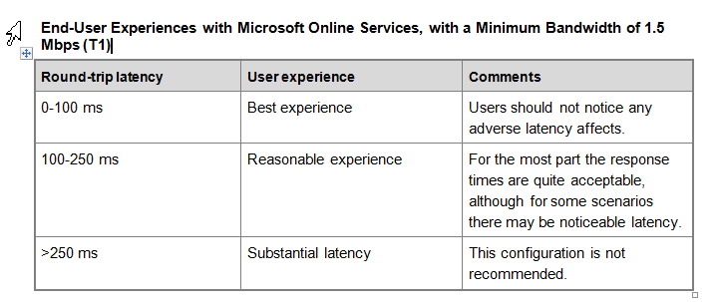
Speedtest results and analysis

Slide 26
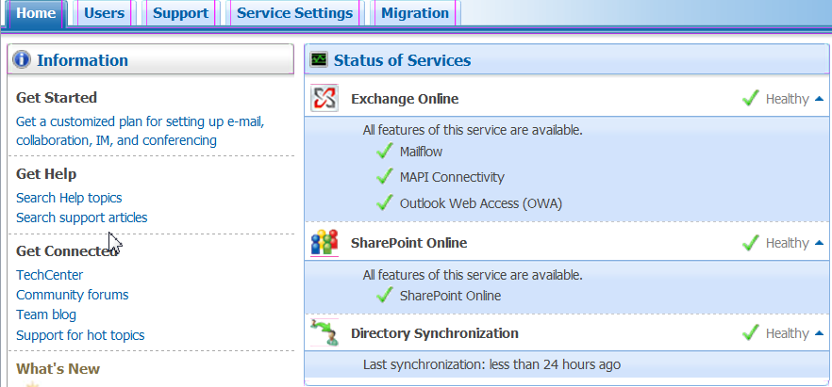
Understand Admin interface
Service Status

Slide 27
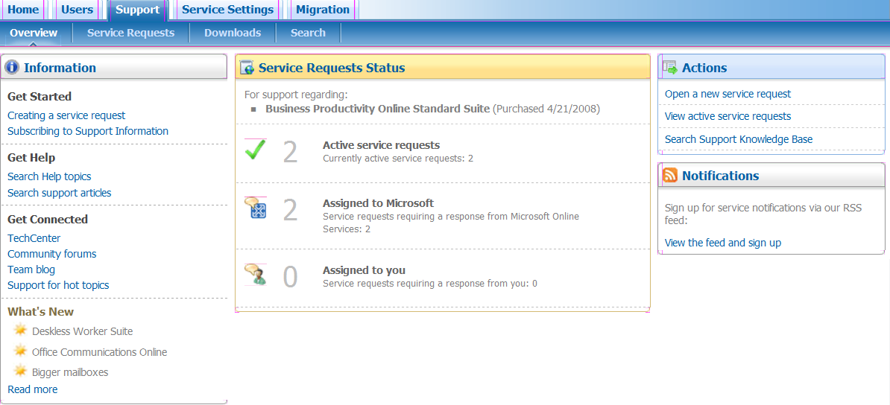
Understand Admin interface
Ticket Status and Support information

Slide 28
Different Phases
Preparation
Configuration
Administration

Slide 29
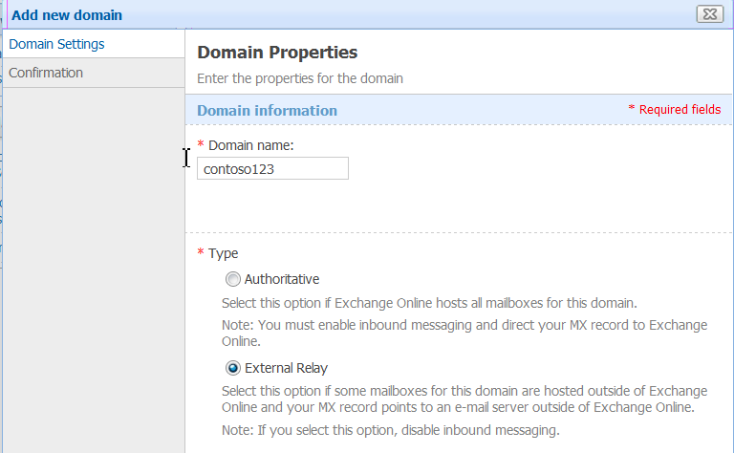
Create domain name on BPOS
Domain ‘contoso123.emea.microsoftonline.com’ created
  Change Administrator’s password
Create new domain in the Admin Center
  External Relay (co-existence scenarios) or Authoritative (MX points to MS Online)
  Need domain validation (done with CName added in DNS server)

Slide 30
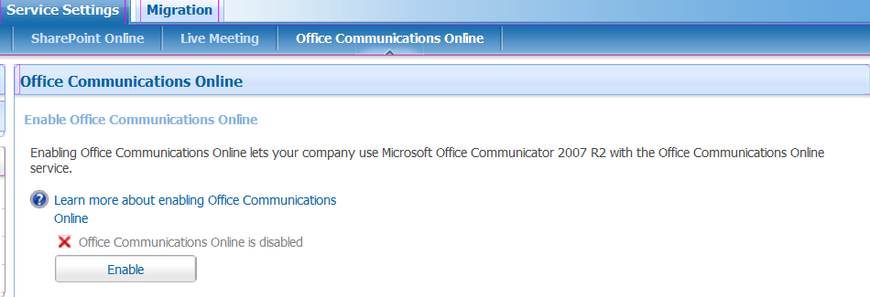
Configure Services
Activate Office Communications Online

Slide 31
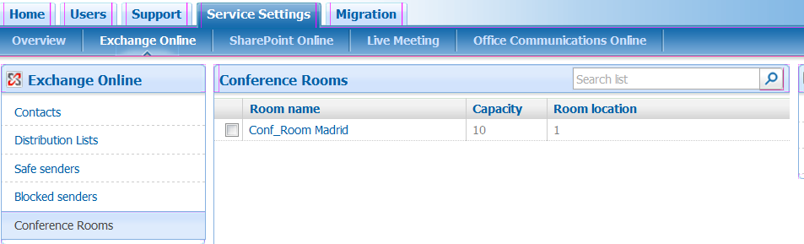
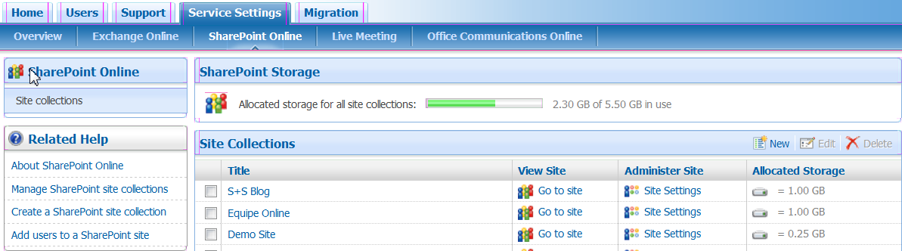
Configure Services
Configure Exchange Online settings
Create SharePoint site Collection

Slide 32
Domain name Creation on BPOS
Administrator needs to have access to the DNS Server to add the CName
Use Authoritative when all mail is sent to and from Microsoftonline.com
  Set MX Record for the domain to Microsoft Online
  Turn on Inbound Email
Use External Relay when incoming mail is routed from an on-premise server
  Used primarily for co-existence scenarios
  MX Record is not modified
  Turn off inbound email

Slide 33
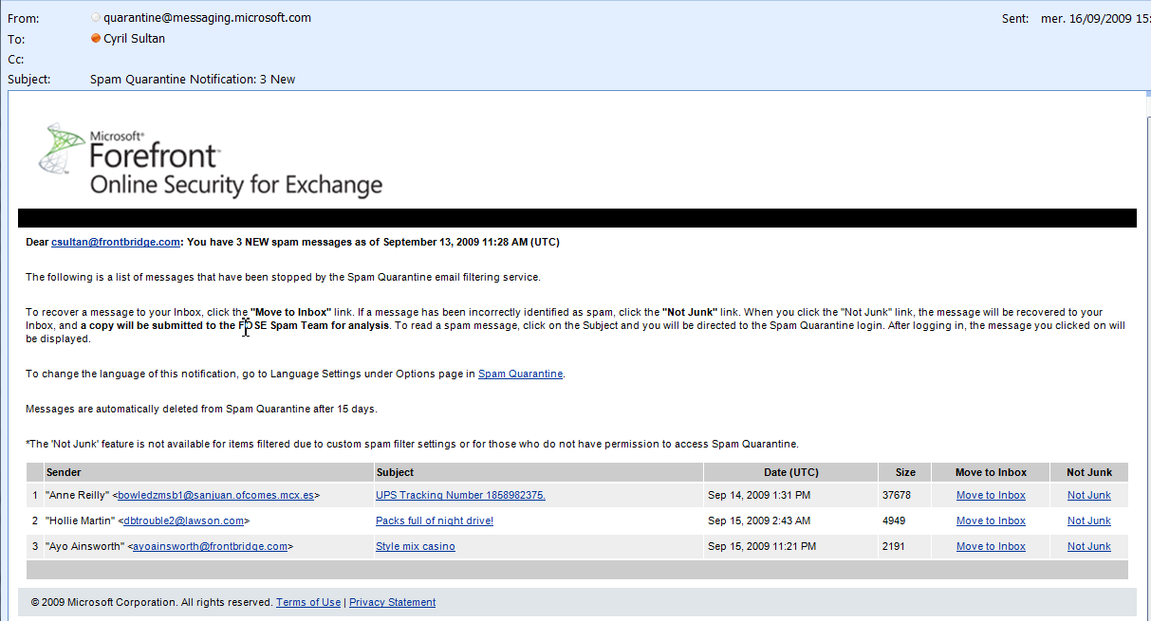
Exchange settings
Anti-Spam/Anti-Virus included by default
  Spam quarantine sent every 3 days by Email (in different languages)
  Possibility to get Read Access to Filtering Policy

Slide 34
Exchange settings
Mobility
  All ActiveSync devices supported by default
  BlackBerry support options:
    Use BIS (BlakcBerry Internet Service)
    Use AstraSync/NotifySync for ‘Exchange ActiveSync’ compatibility
    Subscribe to Microsoft Hosted BlackBerry Service
Delegation
  Supported by default
  ‘Send as’ supported via ticket with Support
POP, SMTP configuration
  SMTP Relay enabled. Important note: Authenticated SMTP
  Need to open a ticket for POP availability for some users

Slide 35
Exchange settings
SMTP settings in EMEA:
  SMTP Server: smtp.mail.emea.microsoftonline.com
  SMTP Port: 587
  Configure ‘My outgoing Mail Server (SMTP) required authentication’ with user name and password
  TLS needs to be enabled
POP settings in EMEA:
  Incoming traffic: pop.mail.emea.microsoftonline.com
  Port (POP3): 995
  Outgoing traffic: smtp.mail.emea.microsoftonline.com
  Port (SMTP): 587

Slide 36
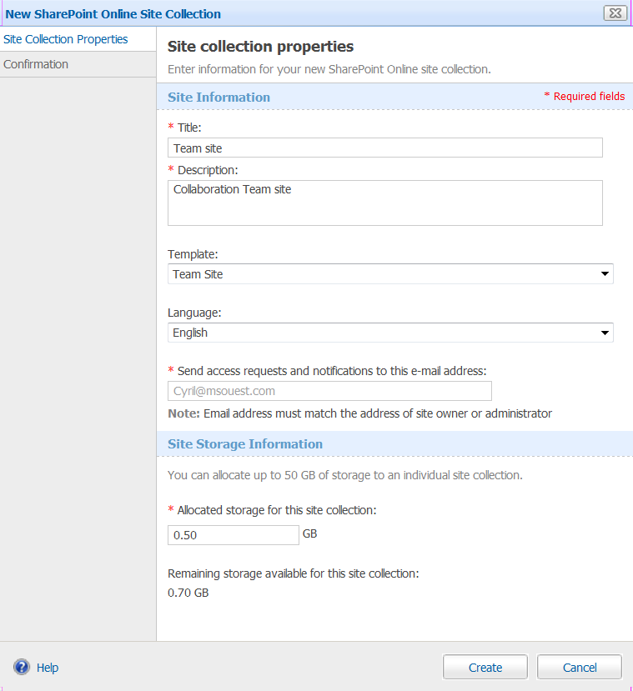
SharePoint Online implementation
Create SharePoint Site Collection

Slide 37
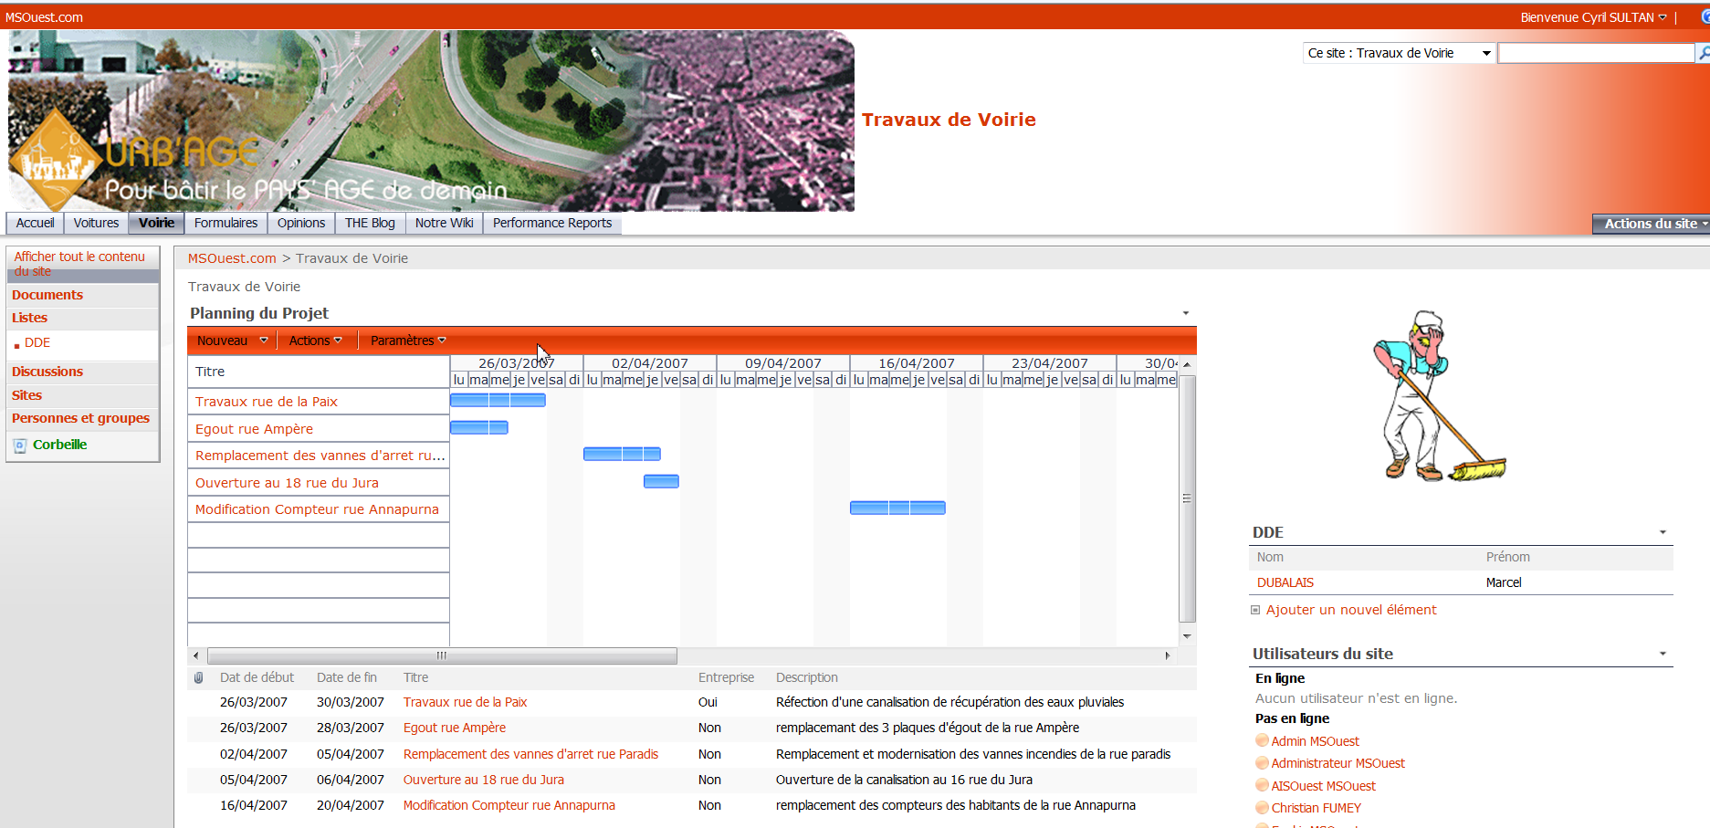
SharePoint Online implementation
Customize SharePoint site
  Under Site Action/Site Settings with new theme
  Add new logo
  Add different Webparts
  Customize with SharePoint Designer

Slide 38
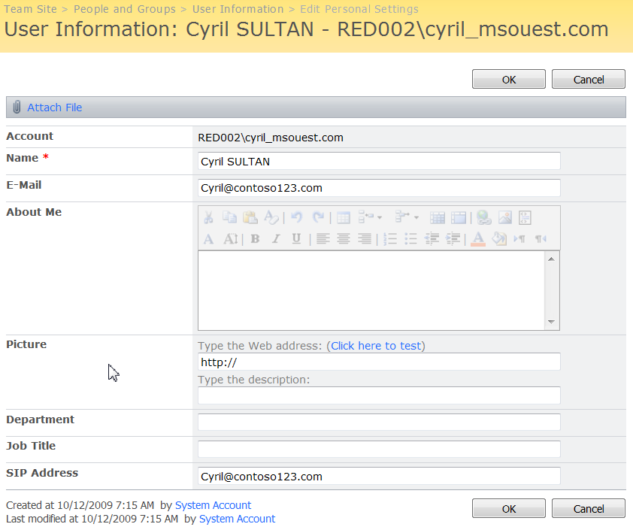
SharePoint Online: points to consider
Can we setup alerts?
  Yes in each collection site, you can select each user and change the Email address

Slide 39
SharePoint Online: points to consider
SharePoint Designer is free and allows you to completely customize the SP design
Possibility to add other templates (via SharePoint Designer)
Define your domain as ‘principal’ so that the SharePoint name is not ‘too long’

Slide 40
OCS and Live Meeting ‘tips & tricks’
BPOS administrator cannot administer Live Meeting settings
  Needs to have ‘user’ rights too
Sign-In Client automatically configures the Communicator Client and Live Meeting settings
Live Meeting
  Can be used for own needs or/and for sessions with partners/customers!
  Can work with partner’s audio bridge (Arkadin, BT, Elisa, Global Crossing, Meetyou, Premiere Global Services, InterCall, Verizon)

Slide 41
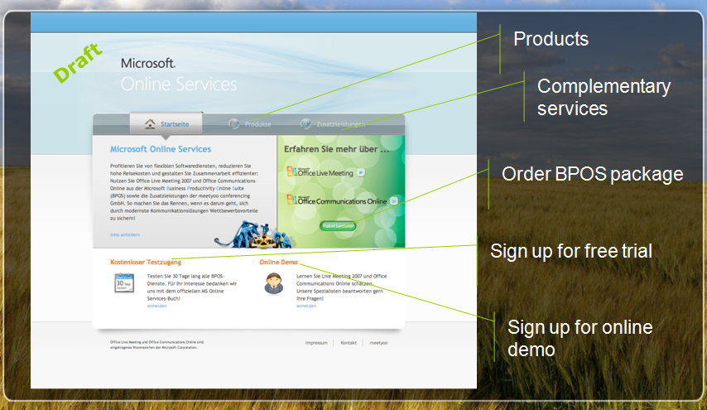
Offer sample in Germany with partner Meetyou
Package OCS and Live Meeting inside BPOS
  Instant Messaging and Presence
  Web Conference with audio integrated

Slide 42
Different Phases
Preparation
Configuration
Administration

Slide 43
User Creation
demo

Slide 44
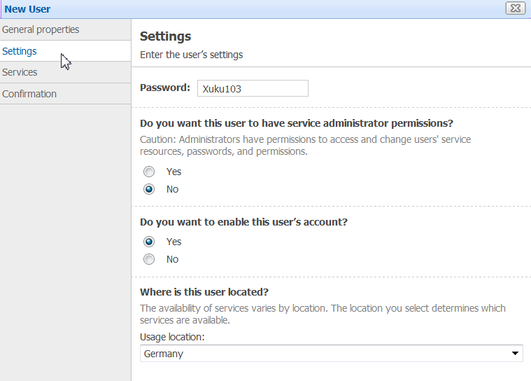
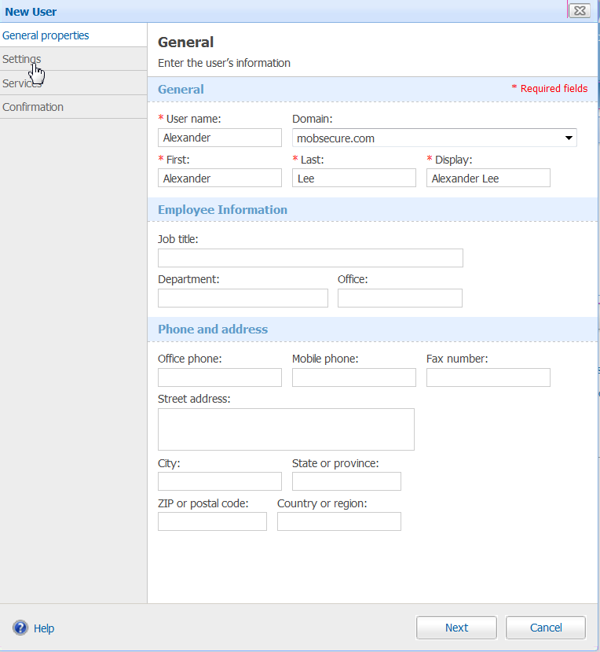
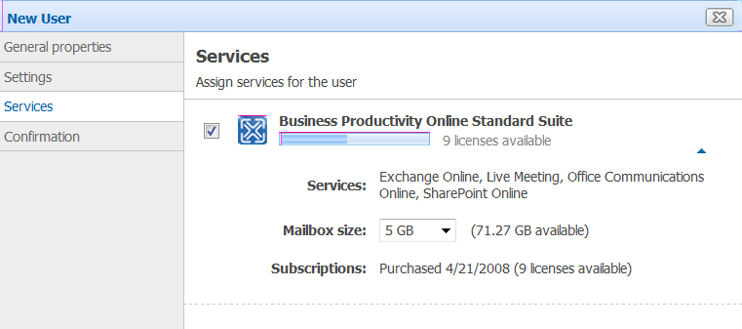
Manual creation

Slide 45

CSV file import

Slide 46
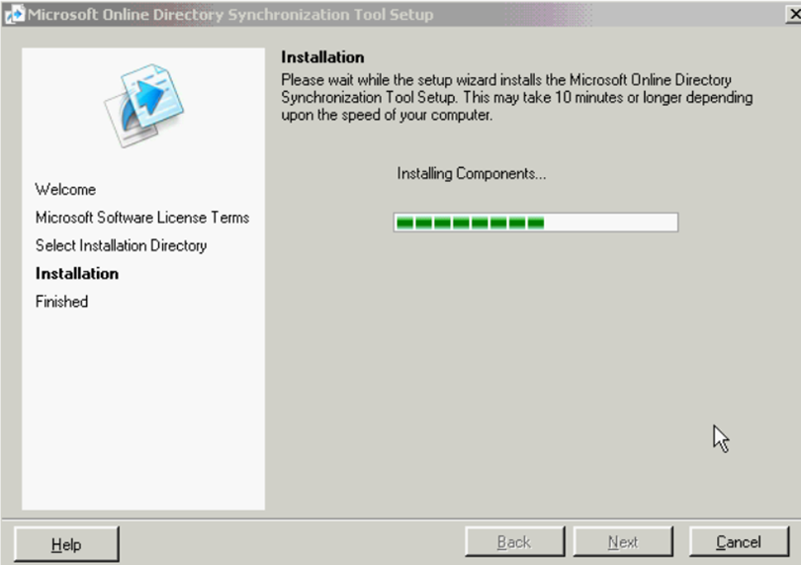
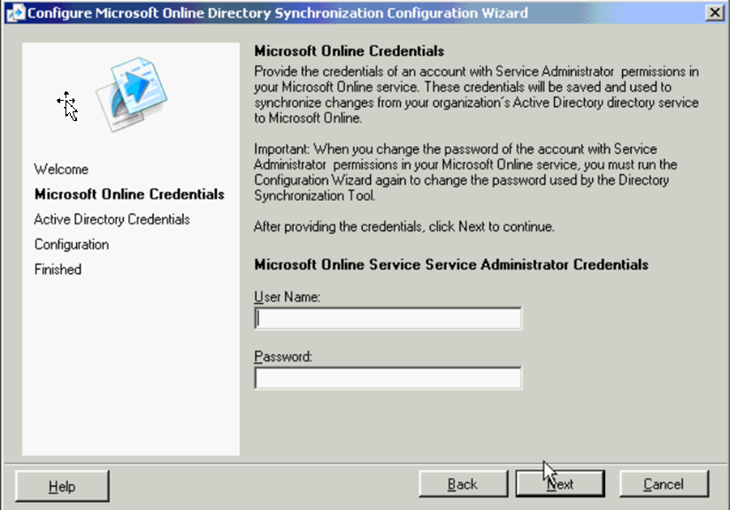
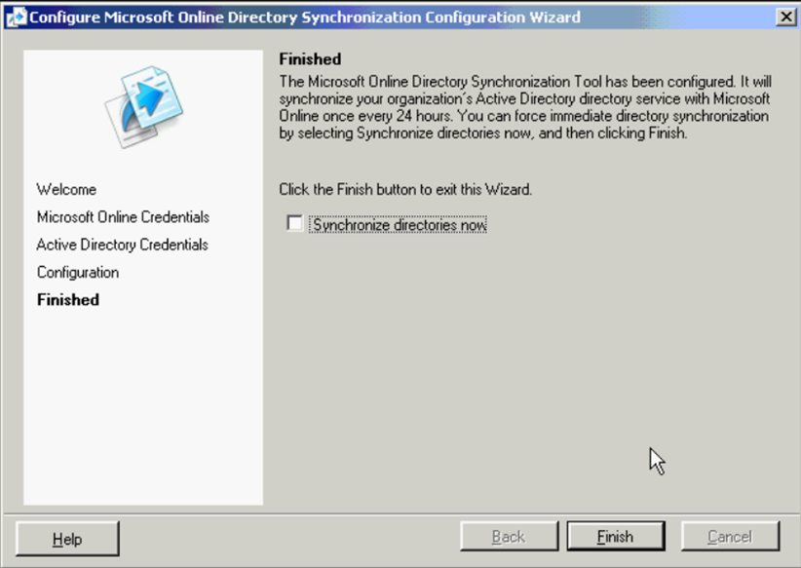
Dirsync usage

Slide 47
Tips & Tricks on user creation
Manual upload or csv import used for Proof of Concept or for small projects
  If Dirsync used later, Dirsync can match up accounts created on the Admin Center
Dirsync requirement: local Active Directory (single forest)
Before using Dirsync: need to clean-up AD (no ‘{‘ in nickname for instance)
DirSync synchronizes all objects in AD
  Objects will be in ‘disabled’ stage at first
  Need to activate users manually OR via powershell scripts

Slide 48
Dirsync details
Full sync can take some time (few hours):
  AD objects First Sync Delta Sync
  500 5 minutes 30 seconds
  1000 10 minutes 1 minute
  5000 45 minutes 5 minutes
  15000 2.5 Hours 10 minutes
Subsequent Syncs (Delta Syncs)
  Default every 3 hours
  Syncs all changes on premise to MSO
  Can be very quick depending on the rate of change on premise.

Slide 49
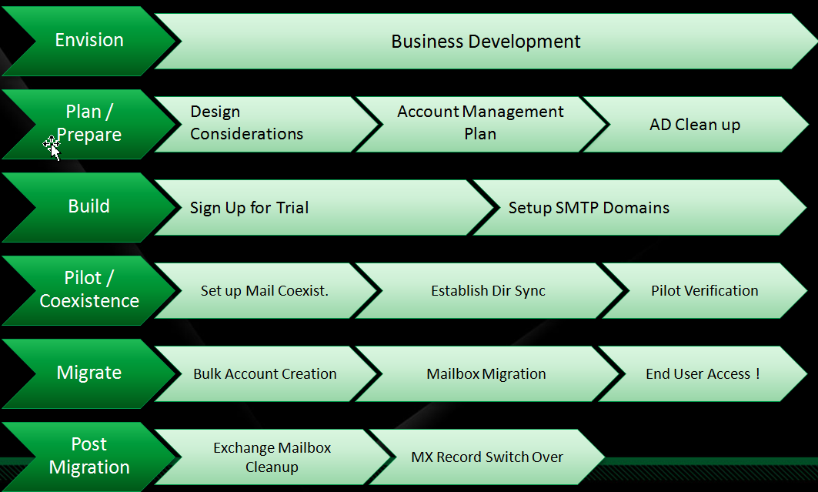
Points to consider during migration
Migration is ‘a process’. You need to be clear about migration plan:
  ‘Big Bang Migration: no data migrated
  End-User ‘Big Bang’ Migration: no data migrated but users have tools to do it themselves
  ‘Quick coexistence’
  ‘Long Term co-existence’

Slide 50
Migration Tools
White Paper + lots of presentations
Dirsync tool
Mailbox Migration tool:
  From Pop/Imap/Exchange (2000->2007)=> Exchange Online
  From Notes/Groupwise, consider 3rd party solution such as Quest (for both) or BinaryTree (Notes only)
  From Pop/Imap, 3rd party tools such as Cemaphore and BitTitan
  PST migration with RefreshIT

Slide 51
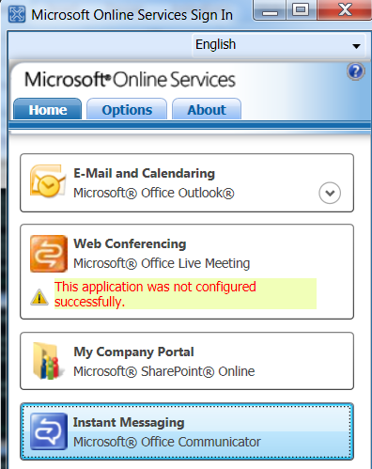
Sign-In Client to deploy
Requirements:
  .NET Framework 3.0 installed
  Port 443 to open (cf. a previous slide)
Group Policy Object Management:
  Cf. http://blogs.technet.com/msonline/archive/2009/02/09/microsoft-online-sign-in-client-adm-group-policy-object.aspx
  .ADM File

Slide 52
Which Messaging Client?
Outlook 2007: best experience
Outlook 2003:
  Requires an add-in to see Free/Busy
  http://blogs.technet.com/msonline/archive/2009/09/24/do-you-want-to-use-outlook-2003-with-exchange-online.aspx
  Understand if multiple calendar viewing or not (not cached in Outlook 2003)
MAC Entourage 2008 supported. Sign-In client now available in preview
http://blogs.technet.com/msonline/archive/2009/11/04/use-your-mac-with-microsoft-online-services.aspx
Other messaging Clients: pop connection only (open ticket to enable POP)
Mobile clients: prepare documentation to configure it
Outlook Web Access: provide URL

Slide 53
Other impact
New Outlook profile created (need to remove legacy profile later)
Parameters not migrated (Permissions, delegations, rules, Outlook Settings…)
How to provide password and manage password policy?
  Possibility to send by Email or mention it on a Web Site (via scripts)

Slide 54
Explain BPOS to the employees
Messaging:
  How to access Emails with Windows Mobile?
  How to share calendars, contacts, etc.
What is SharePoint usage?
  Collaboration Benefits
Benefits of Instant Messaging/presence
Live Meeting Web Conference
  How to use it?
  Why can it save you time and increase your efficiency?

Slide 55
Manage the Service
HelpDesk (or Partner) with Administrative rights to:
  Manage user’s passwords (reset, etc.) if needed
  Check if service runs OK
Get regular information on BPOS:
  RSS feeds: https://rss.microsoftonline.com/feeds.aspx?center=default&chan=notifications&lang=en-US
  Emails with new services updates (monthly basis)…
  Blogs (in different languages): http://blogs.technet.com/bposfrance/ (French)
    http://blogs.technet.com/msonline_deutschland (German)
    http://blogs.msdn.com/nickcaw/ (English UK)
    http://blogs.technet.com/oscarmh/ (Spanish)
    http://blogs.technet.com/bpositive/ (English US)

Slide 56
Conclusion

Slide 57
How can Microsoft Online help you?
Large customers with small (independent) entities
  Instead of building a new internal Exchange server, they choose Exchange Online : easier to manager
SMB customers (25->500 seats) with following needs
  Reliability: make sure the solution works when admin is on vacation for instance
  Possibility to add new services (‘everywhere access’, mobility, Webconf. IM/presence, etc.)
Extranet Collaboration sites
  Projects between employees and external entities: SharePoint Online usage
Projects with ‘strong’ deadline to respect
  Need to implement solution ASAP.

Slide 58
Conclusion
Evaluate Microsoft Online (BPOS) today
  Configuration is very simple
  Benefits are easy to understand
Consider Microsoft Online even for a small project now:
  Co-existence possible between users on premise and users Online!
Projects can start with:
  Exchange Online only: messaging project (or mobility)
  SharePoint Online Only: collaboration project
  Package OCS + Live Meeting: Web Conferencing project
  BPOS Suite

Slide 59
question & answer

Slide 60




Resources
Required Slide
Speakers,
TechEd 2009 is not producing
a DVD. Please announce that
attendees can access session
recordings at TechEd Online.
www.microsoft.com/teched
  Sessions On-Demand & Community
www.microsoft.com/learning
Microsoft Certification & Training Resources
http://microsoft.com/technet
  Resources for IT Professionals
http://microsoft.com/msdn
  Resources for Developers

Slide 61
Related Content
Breakout Sessions
UNC201 – 11/10/2009 09:00-10:15 [Adam Glick; Astrid McClean]
Introducing Microsoft Exchange Server 2010
UNC203 - 11/09/2009 09:00-10:15 [Cyril Sultan]
Implementing and Administering Microsoft Online Services
OFS209 - 11/10/2009 17:00-18:15 [Kimmo Forss]
SharePoint Online Overview
SIA08-IS - 11/11/2009 10:45-12:00 [Mike Chan]
Security Services in the Cloud
SIA317 - 11/12/2009 13:30-14:45 [Mike Chan]
Forefront Online Protection for Exchange Architecture
UNC205 - 11/11/2009 17:30-18:45 [Cyril Sultan]
Tips and Tricks for Planning, Deploying, and Troubleshooting the Office Live Meeting Service
UNC310 - 11/12/2009 13:30-14:45 [David Anderson]
Migrating Data, Co-Existence, and Directory Synchronization with Microsoft Online Services
ITS213 - 11/12/2009 17:00-18:15 [Gail Warren]
Critical Infrastructure and Operations for Delivering Secure, Enterprise-Class Software Services

Slide 62
Annexes

Slide 63

More information
Public Web Site: Microsoft Online
Evaluate the service
Technet:
  Technical Information
Exchange Online
  Service Description
  Developer Guide
Office Live Meeting
  Service Description
Forefront Online Protection for Exchange
  Description
  Evaluate Service
Online information
  Blog BPOS (EN)
  Facebook group (EN)
  Twitter (EN)
Evaluation Guide BPOS
SharePoint Online
  Service Description
  Developer Guide(EN)
OCS Online
  Service Description
White Papers on Security and Data Centers
Reversibility:
http://www.microsoft.com/online/help/en-us/bpos/index.html?page=html%2Fd5fcd6fa-afa6-4026-9b3f-21b092f40478.htm

Slide 64
Exchange Online Details
Feature | Description
Mailbox size | 5 GB (soon 25GB); configurable from 256Mb to 25GB by mailbox
Maximum Message size | 30 (MB) for incoming/outgoing messages
Removed messages retrieval delay | 14 days
Removed Mailbox retrievel delay | 30 days
RTO/RPO | RTO (4 hours) and RPO (8 hours)
Max. number recipients | 5,000 for each message
Messaging Clients | Microsoft Office Outlook 2003 and Outlook 2007 (MAPI) All Messaging Clients (POP connection) Microsoft Outlook Web Access (Web Mail)
Mobile equipements | Windows Mobile 6 and above All equipements with ActiveSync installed (Nokia E and N Series, Apple iPhone 3G, ….) Hosted BlackBerry Services (additional cost)
SLA | 99.9%
Support | Support Tier 1 Microsoft
Security | Microsoft® Forefront™ Online Security for Exchange (or EHS) and Microsoft Forefront™ (Anti-spam and Antivirus services)

Slide 65
Exchange Online
Exchange Server 2007 Features
Deskless
Standard
Exchange 2007 Server Features
Deskless
Standard
Default Mailbox Size | 500Mb | 5Gb
Maximum 25GB Mailbox |  | 
Shared Contacts, Tasks |  | 
Message Attachment up to 20MB |  | 
14 Days Deleted Item Retention |  | 
Conference Room |  | 
99.9% Uptime SLA |  | 
IT Pro Support |  | 
Geo Redundancy Data Protection |  | 
Public Folders
Outlook Web Access | OWA Light | 
Outlook Anywhere via HTTPS |  | 
Outlook 2007 Support |  | 
Outlook 2003 Support |  | 
Entourage Support |  | 
Firefox /Safari Web Browser |  | 
Windows Mobile Devices |  | 
iPhone, Nokia E Series/N Series |  | 
BlackBerry Devices⁵ |  | 
General
Client & Mobility
AD Credential Synchronization
AD/GAL Synchronization |  | 
On-Premise Exchange Free/Busy
On-Premise Notes Free/Busy |  | 
Anti Virus/Anti SPAM via EHF |  | 
Rights Management Service
Mail Encryption (Optional) |  | 
E-Discovery Archive (Optional) |  | 
Personal Archive |  | 
Messaging Records Management
Coexistence
Security & Compliance
Exchange 2000, 2003, 2007 |  | 
Exchange 5.5 | 2 Stage | Custom
Notes/Domino | 2 Stage | Custom
GroupWise | 2 Stage | Custom
POP3/IMAP |  | Custom
Migration
MAPI |  | 
SMTP Relay |  | 
Exchange Web Services |  | 
POP |  | 
IMAP
Extensibility
Customer Portal |  | 
Administration Center |  | 
Company Portal |  | 
Sign On Client |  | 
Online Portal
UM & Fax
Outbound Fax
Voicemail Integration
Outlook Voice Access

Slide 66
SharePoint Online Details (1)
 Current Feature
 Future Release
SharePoint Server 2007 Features
Standard
Dedicated
SharePoint 2007 Server Features
Standard
Dedicated
Collaboration Site Templates ² |  | 
Meeting Site Templates ³ |  | 
Surveys |  | 
People and Group |  | 
Sync with Outlook |  | 
Email Alerts & Notifications |  | 
Issue Tracking |  | 
Document Collaboration |  | 
Presence |  | 
Social Networking |  | 
Mail Enabled List |  | 
Client Integration |  | 
SharePoint Designer |  | 
RSS Content Syndication |  | 
Audience Targeting |  | 
Site Manager |  | 
Site Documentation Aggregation |  | 
Portal Site Templates |  | 
User Profile Import |  | 
Privacy and Security |  | 
Audience Targeting |  | 
My Sites; Site Directory |  | 
Colleagues and Memberships |  | 
Document Roll-up Web Part |  | 
Mobile Device Support |  | 
Backup and Restore SP Designer |  | 
Aggregate Web Parts |  | 
Collaboration
Portal
Document Info Panel/Action Bar |  | 
Content Authoring |  | 
Master Pages, Layouts, Controls |  | 
Retention and Audit Policies ⁴ |  | 
Three State Workflow |  | 
State Variations |  | 
High Fidelity Web Site/Branding |  | 
Slide Library |  | 
WYSIWYG Content Editor |  | 
Content Staging, Publishing, Dploy |  | 
IRM Integration |  | 
Std Business Doc Workflows |  | 
Std Enterprise Site Templates |  | 
Std Publishing Site Templates |  | 
Records Repository and Legal Hold |  | 
Email Content as Records |  | 
VSTF Integration |  | 
Search (UI, relevance, security) |  | 
Cross Site Collection Search |  | 
Enterprise Content Sources |  | 
People Search |  | 
Search Federation |  | 
Business Data Search |  | 
Content Management
Search
Form Libraries |  | 
Custom Non-Code Workflows |  | 
MOSS Out of Box Workflows |  | 
Browser Based Forms |  | 
Custom Code Workflows |  | 
Forms
¹ Deskless available in both standard and dedicated versions
² Standard does not include My Site Host, News Home Template, Internet Presence Web Site
³ Standard does not include Blank Meeting, Decision Meeting, Social Meeting, Multipage Meeting Workspace
⁴ Standard does not include logging of all actions on sites, content, and workflows, audit log reporting

Slide 67
SharePoint Online Details (2)
 Current Feature
 Future Release
Features
Standard
Dedicated
BI Dashboard |  | 
KPI and Filtering Web Parts |  | 
Report Center Templates |  | 
Excel Services |  | 
Data Connection Libraries |  | 
Business Data Catalog |  | 
Business Data Web Parts |  | 
Performance Point Integration |  | 
Business Intelligence
99.9% Uptime SLA |  | 
24x7 Web/Phone IT Pro Support |  | 
Geo Redundancy Data Protection |  | 
Multiple Site Collections Support |  | 
Vanity Domains |  | 
250MB/User Storage |  | 
Authenticated Access |  | 
30 Days Backup & Restore |  | 
WAN Acceleration |  | 
Pre-Production Environment |  | 
Partner Access |  | 
Anonymous Access |  | 
Service Specific

Slide 68
BlackBerry Options Comparison
 | Microsoft Online Services available options |  |  | Market options not available to Microsoft Online Services customers
Capability | BIS | NotifySync | Hosted BlackBerry from MS (customer provided license) | Hosted BlackBerry (hoster provided license) | On Premise BES
Email push over the air | Yes | Yes | Yes | Yes | Yes
Calendar push over the air | No (can do via wired sync) | Yes | Yes | Yes | Yes
Contacts (with GAL integration) push over the air | No (can do via wired sync) | Yes | Yes | Yes | Yes
Tasks push over the air | No (can do via wired sync) | Yes | Yes | Yes | Yes
Remote device wipe | No | Yes | Yes | Yes | Yes
Password reset | No | Yes | Yes | Yes | Yes
Custom service settings | No | No | No | No | Yes
Advanced device management | No | No | No | No | Yes
Application management via BES | No | No | No | No | Yes
Native BlackBerry email UI | Yes | No | Yes | Yes | Yes
Data plan required | BIS | BIS | BES | BES | BES
Native BlackBerry UI | Yes | No | Yes | Yes | Yes
Cost | Very Low | Low | Moderate but need to invest up front | Moderate | Moderate but need to invest up front
Takeaways:
- Most commonly required features are in green – customers have several options
- Customers who require customization or advanced management for BES need on-prem BES + Exchange
- Thus far this is a very small % of organizations who are interested in Online Services
- Customers who require the native BlackBerry UI should go with an option other than a partner client
- Features are very similar across all solutions but BIS and On Prem – Cost is the main differentiator

Slide 69

Complete an evaluation on CommNet and enter to win an Xbox 360 Elite!

Slide 70

Required Slide
© 2009 Microsoft Corporation. All rights reserved. Microsoft, Windows, Windows Vista and other product names are or may be registered trademarks and/or trademarks in the U.S. and/or other countries.
The information herein is for informational purposes only and represents the current view of Microsoft Corporation as of the date of this presentation. Because Microsoft must respond to changing market conditions, it should not be interpreted to be a commitment on the part of Microsoft, and Microsoft cannot guarantee the accuracy of any information provided after the date of this presentation. MICROSOFT MAKES NO WARRANTIES, EXPRESS, IMPLIED OR STATUTORY, AS TO THE INFORMATION IN THIS PRESENTATION.

