Slide 2
Tips and Tricks for Planning, Deploying, and Troubleshooting the Microsoft Office Live Meeting Service
Cyril Sultan
Sr. Technical Sales Specialist
Microsoft, Microsoft Online
Session Code: UNC205

Slide 3
Agenda
Introduction
Live Meeting Technical Details
Live Meeting Deployment
Troubleshooting
Conclusion

Slide 4
Introduction

Slide 5

Introduction
What is Live Meeting?
  Microsoft Web Conferencing solution
How is it sold?
  Two different flavors: hosted service or included within OCS
  Service Office Live Meeting (inside BPOS or not)
Who can use Live Meeting?
  ALL employees!
  License based on user; usually global license for all
  Possibility to invite external people with no additional cost!

Slide 6
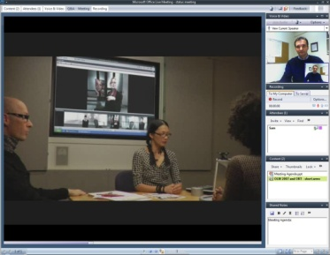




Conferencing Choice With 2007 Releases
Common user experience
+
Choice of server or service
On-Premise Server
Hosted Service

Slide 7
Live Meeting Feature Comparison
License Basics
 | OCS Ent. | OLM Std. | OLM Prof.
Meeting Attendee Capacity | 250 | 250 | 1250
Storage Days |  | 90 | 365
Hosting
 | OCS Ent. | OLM Std. | OLM Prof.
Streamlined user experience | √ | √ | √
Support for Web client |  | √ | √
Single meeting client for on-premise and hosted conferencing | √ | √ | √
Interactive whiteboard and annotation tools | √ | √ | √
Shared notes pane | √ | √ | √
Personal address books | √ |  | √
Training
 | OCS Ent. | OLM Std. | OLM Prof.
Conferencing add-in for Outlook | √ | √ | √
Event and class registration |  |  | √
Public events page |  |  | √
Advanced testing and grading |  |  | √
High-fidelity recordings | √ | √ | √
Shared recordings |  |  | √
Personal recordings | √ | √ | √
Microsoft event services |  | √ | √
Meeting reports |  | √ | √
Meeting content storage and Management tools |  | √ | √
Rich Media
 | OCS Ent. | OLM Std. | OLM Prof.
Rich media presentations | √ | √ | √
Native live Webcam video | √ | √ | √
Integrated media experience | √ | √ | √
Custom branding |  |  | √
Custom invitations |  |  | √
Integrated PowerPoint viewer | √ | √ | √
Drag and drop upload to view a wide range of document file types | √ | √ | √
Print to PDF |  |  | √√
Interactive Meetings
 | OCS Ent. | OLM Std. | OLM Prof.
Panoramic video by Microsoft Office RoundTable | √ | √ | √
Integrated PSTN and two-way VoIP audio | √ (OCS only) | √ | √
Audio conference call controls | √ | √ | √
Speaker indicator | √ | √ | √
Handout distribution | √ | √ | √
Virtual Breakout Rooms |  |  | √
Support
 | OCS Ent. | OLM Std. | OLM Prof.
Phone/e-mail support for int/ext attendees |  | √ | √
Automatic client installation and upgrade | √ | √ | √
Remote assistance |  |  | √
Intranet portal to simplify rollout | √ | √ | √
Service and Security
 | OCS Ent. | OLM Std. | OLM Prof.
99.99 percent historical availability |  | √ | √
Certified data centers |  | √ | √

Slide 8
How to increase Live Meeting usage?
Setup internal training for employees
  Explain the benefits for them
  Explain the technical capabilities
‘Feel at ease’ with Live Meeting
  The more you use it, the more comfortable you feel
  Setup LM sessions with your colleagues (instead of conf. call) at the beginning
Include attendee’s slides at the beginning of all presentations
  Audio/video
  Q&A and Feedback
  Handout/Shared Notes
  Polls
Make sure your default settings are correct

Slide 9
Live Meeting Technical Details
Infrastructure: Data Centers
Clients
  Live Meeting Client (full feature and Web Client)
  Outlook add-in
Network requirements
Audio/video

Slide 10
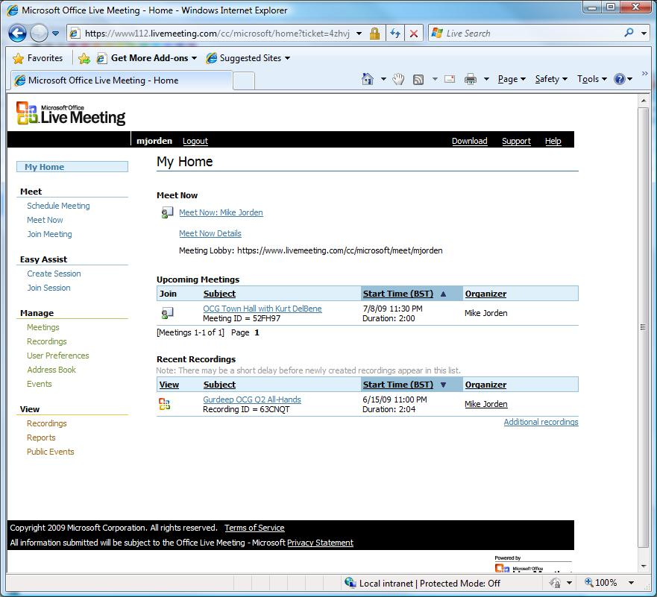
Live Meeting Details
Management Console

Slide 11
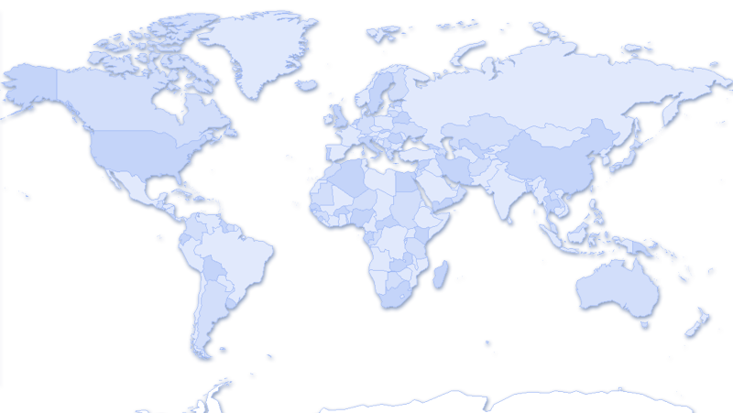

Live Meeting Details
Data Centers
Great
Britain
5**
193.221.113.0/24
194.110.197.0/24
California
1**
64.41.193.0/24
209.1.15.0/24
216.34.51.0/24
Virginia
3**
204.176.46.0/24
65.21.5.0/24
Singapore
6**
204.79.179.0/24
216.32.242.0/24

Slide 12
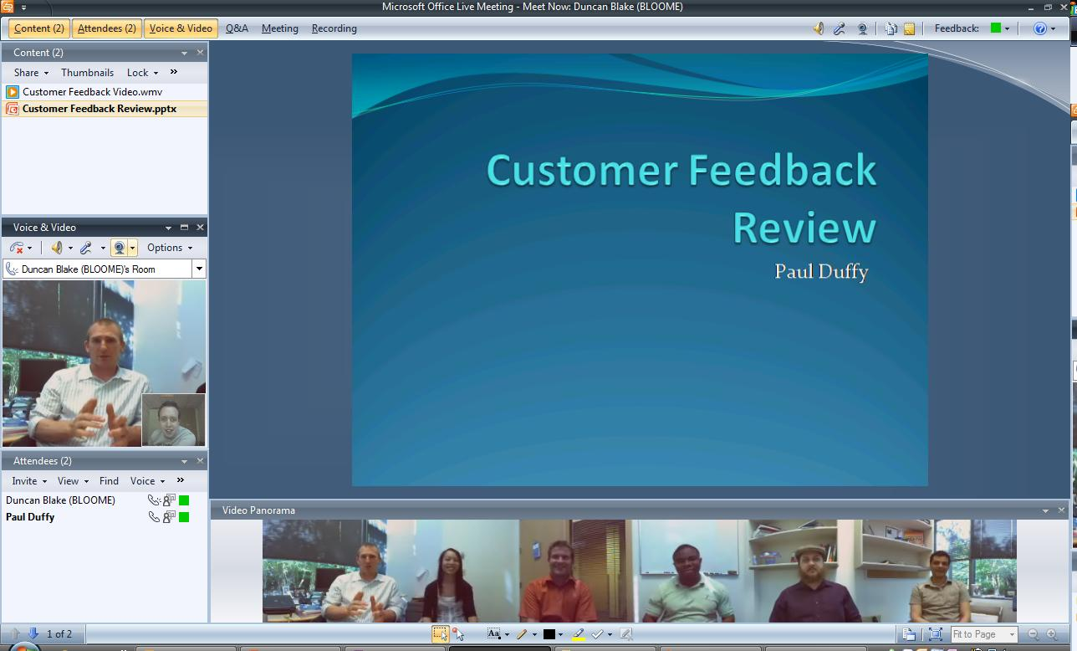
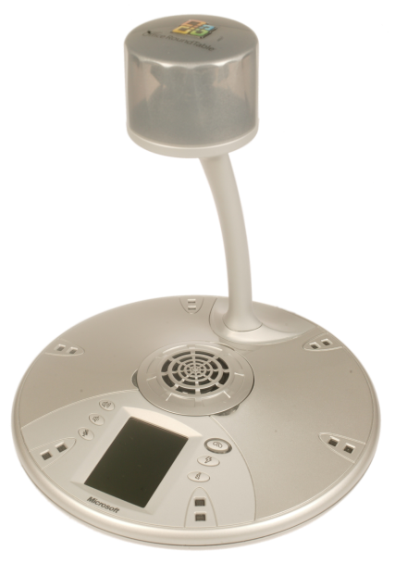
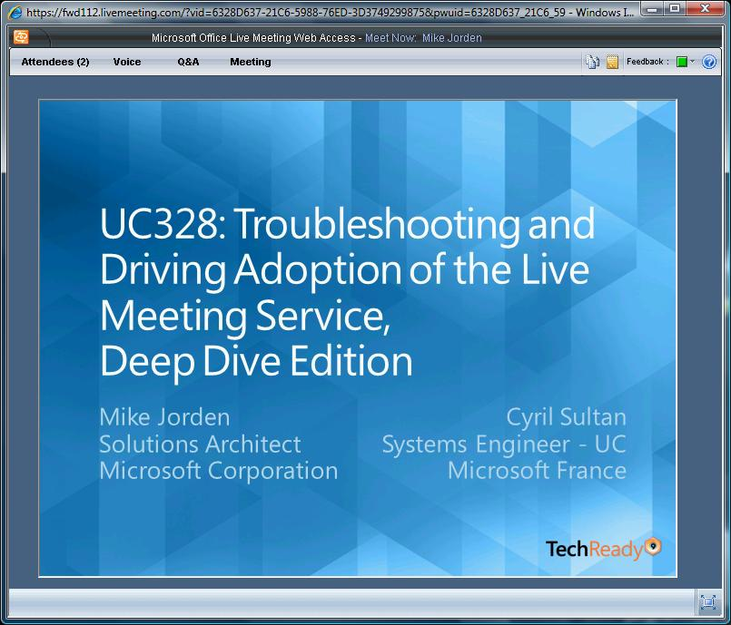
Live Meeting Details
Clients

Slide 13
Points to consider with Web-Client
If Java is not previously installed, the customer will need to execute a download
Technical limitations:
  Customer cannot share desktop or take control
  No audio or video capabilities (i.e., VoIP & webcam)
Rich client does not require Administrator rights to be installed

Slide 14
Admin Portal, Outlook add-in, LM Client
demo

Slide 15
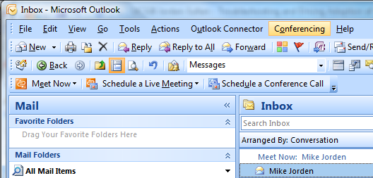
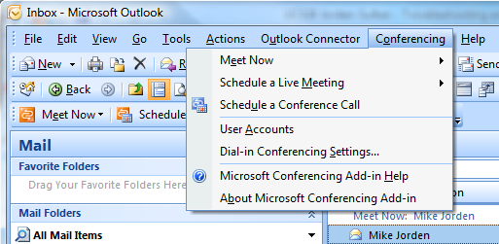
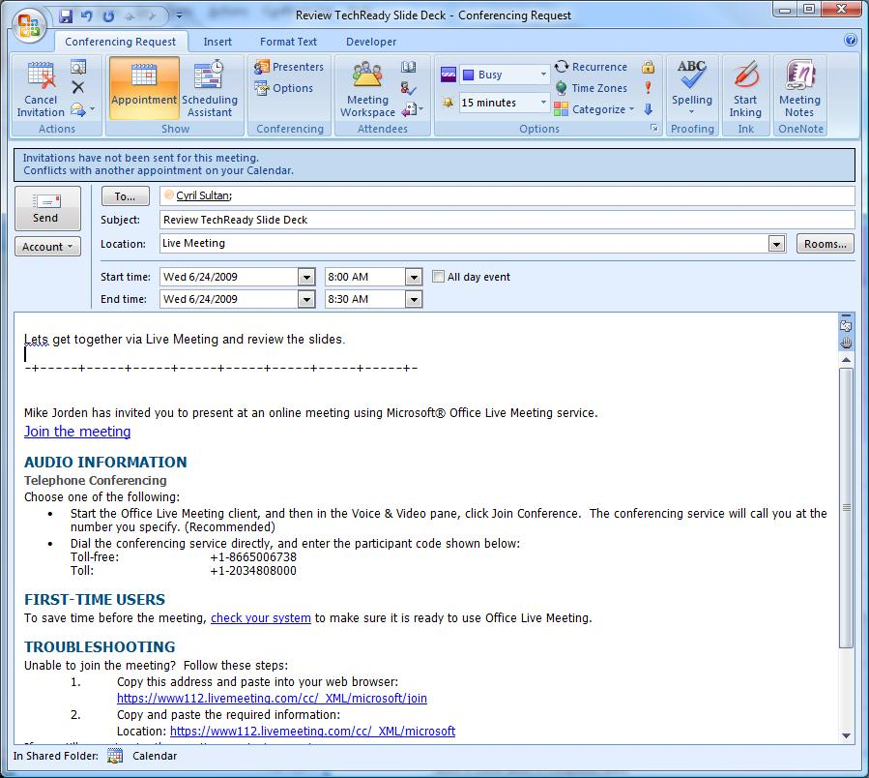
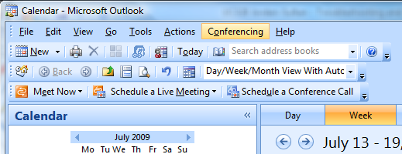
Outlook Add-in

Slide 16
Live Meeting Network Requirements
Required Bandwidth:
  Transfer of Data : 56 kbps
  Voice over IP : 80kbps (minimum 50 kbps)
  Video : 350 kbps (minimum 50 kbps)
  Polycom CX5000 (RoundTable): 700 kbps
  100 kbps minimum
Ports/IP used
  TCP 8057, UDP 3478 and TCP 443 during session
  Recordings: TCP 80, 443, 1755, 7070, UDP 1755, 5055
  IP used; cf. Data Center slide
In practice: port 443 open is enough during session
Audio/video now works in most scenarios

Slide 17
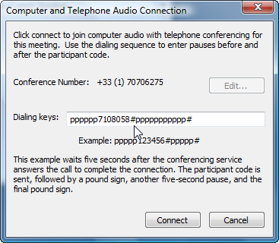
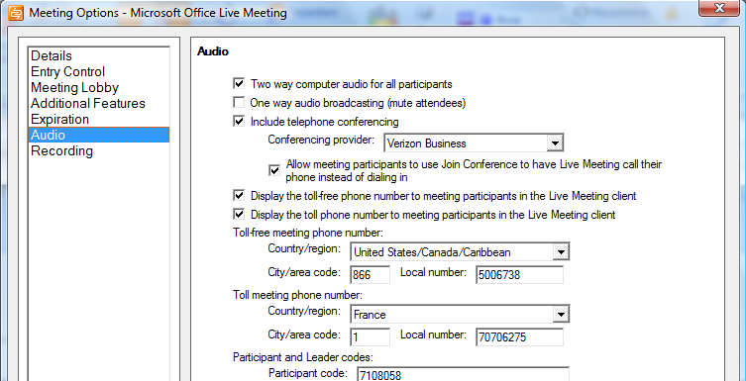
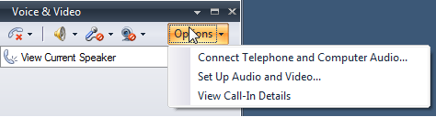
Live Meeting and Audio/Video
Live Meeting offers two options for audio:
  Voice over IP
  Audio-conferencing bridge
  Mix of both solutions can be used!
Audio conferencing bridge
  With OCS Live Meeting: use of OCS audio bridge
  With Live Meeting Service: can use InterCall, Premiere GS, Verizon, BT, Arkadin, Meetyou, Global Crossing…
Video with WebCams and RoundTable

Slide 18
Live Meeting Deployment
User Creation
Client Deployment

Slide 19
Creating User Accounts
Manual Account Creation
Bulk Upload Spreadsheet
Live Meeting Portal
  Remove the need to use 2 separate accounts (Active Directory and Live Meeting)
  An Intranet-based solution for use with Active Directory
  Create and manage accounts automatically
Important Note: no account creation method automatically deletes user accounts. This task will still need to be managed manually by Administrators.

Slide 20






Live Meeting Portal
No Portal
Live Meeting
Service
Firewall
Active Directory

Slide 21


Live Meeting Portal
Internal Portal
Live Meeting
Service
Firewall
Active Directory

Slide 22
Live Meeting Portal
DMZ Portal
Live Meeting
Service
Firewall
Active Directory

Slide 23
Deploying the software
Microsoft Office Live Meeting 2007 Client
  Make sure you download the Client’s latest version
  http://office.microsoft.com/en-us/help/HA101733831033.aspx
  Deployment management by using your preferred method with a .msi file
    LMSETUP.EXE –out c:\folder
  Silent installation available to hide any user interface during install
    msiexec /qn /I LMConsole.msi
  See Live Meeting System Administrator’s Guide for more details
  http://www.microsoft.com/downloads/details.aspx?displaylang=en&FamilyID=824a55c8-809a-4224-a8cd-f37b348b7481
Microsoft Conferencing Add-in for Microsoft Office Outlook
  Make sure you download the Outlook Client’s latest build
  http://office.microsoft.com/en-us/help/HA102368901033.aspx?pid=CL100605171033
  Available as a self-extracting .exe file
  Installed by using standard Windows Installer-based deployment tools (as with the client)

Slide 24

Deploying the Live Meeting Client
Registry Keys Available
    ProductCode
    LockDown
    AllowAnonymousServerJoin
    AllowServiceJoin
    DisableUserInstalls
    MaxAudioVideoBitrate
    MediaPortRangeMin
    MediaPortRangeMax
    MediaPortRangeMin
    MediaPortRangeMax
    ServerAudioProviderName
    ServerAudioProviderAccount
    ServerTollFreeNumber
    ServerTollNumber
    EnableFileTracing
    Tracing
    ConflictMsgCls
    PortalURL
Check Administrator’s Guide for more information

Slide 25
Administrative Template
KB 948741
The OLM .adm file allows administrators to publish the Live Meeting client and add-in with appropriate registry settings
Enforces settings:
  User Account UI
  Allow App Sharing Give Control
  Enable Basic Authentication for HTTP Proxy
  Specify Transport
  Prevent initial “Test Connections” dialog box
  Service Configuration

Slide 26
Troubleshooting
Guest’s issues
Organizer’s issues
Other issues

Slide 27
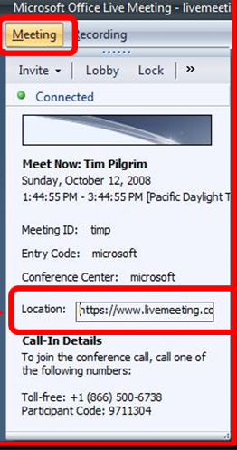
Guest's issues: connection
“I can’t find the URL you sent me!”
“The link you sent me does not work”
URLs can be found under the ‘Meeting’
tab in the console
Copy & paste and send to Attendee
Add ‘Webjoin’ to URL and it will force
attendee to use Web-client
For Example:
  Original URL:
    …/cc/microsoft/join?id=demo&role=attend&pw=test
  Modified URL to force Web-client Launch:
    …/cc/microsoft/WEBjoin?id=demo&role=attend&pw=test

Slide 28
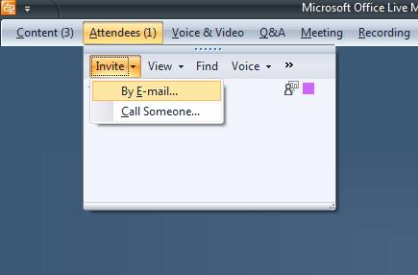
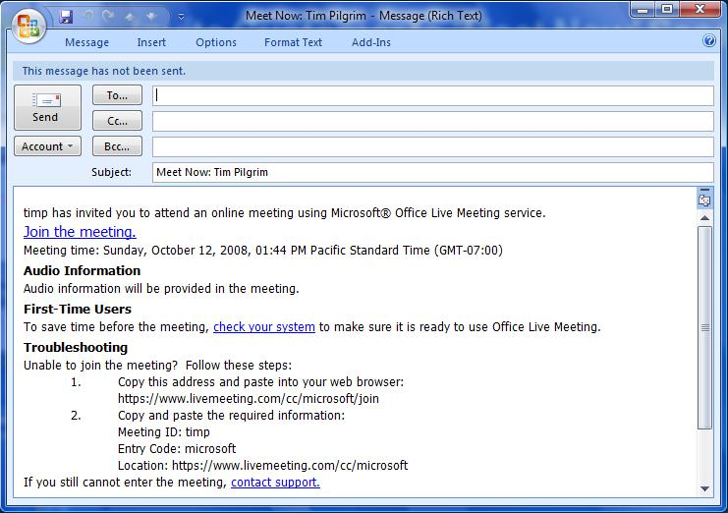
Invite Attendee to Join Meeting
Under
‘Attendees’ panel,
click ‘Invite’
Then choose
‘By E-mail’
This will launch
a pre-populated
e-mail to be sent to
your customers and
attendees

Slide 29
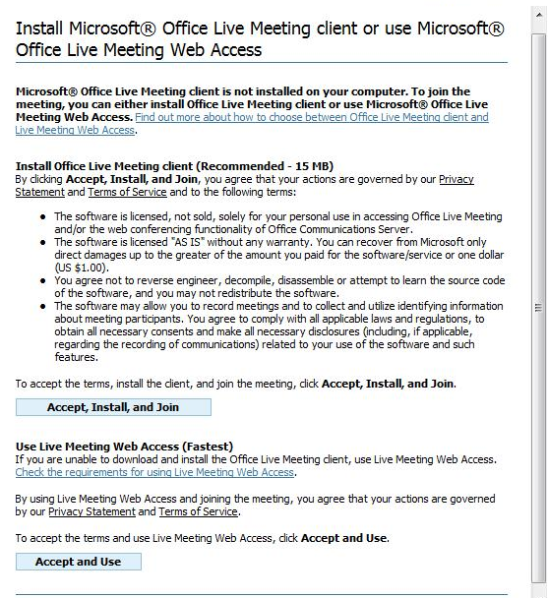
Troubleshooting Connection Issues
If the customer does not have Live Meeting installed, they will see this screen when they try to ‘Join the Meeting’
Instruct them to click ‘Accept and Use’
NOT ‘Install’
Web-client will then launch

Slide 30
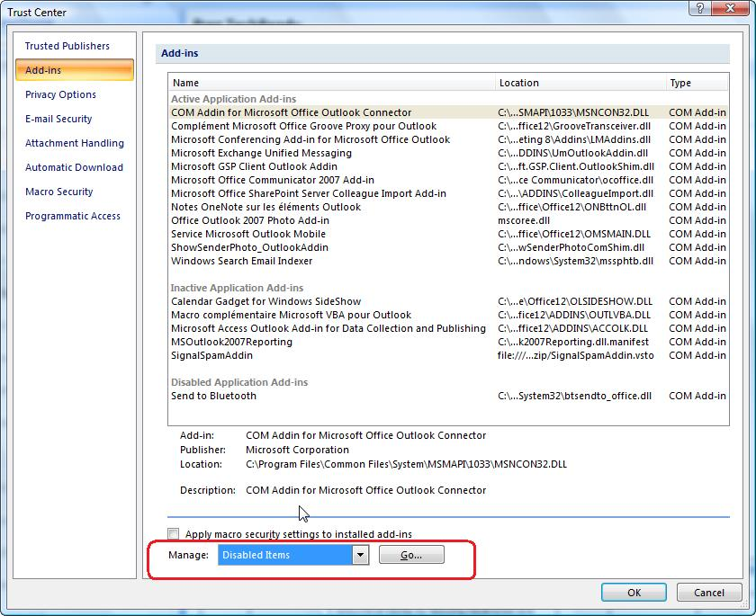
Organizer’s common issues
VoIP & Hybrid Call Configuration & Set-up
  Issues with ‘Dialing Keys’ (e.g., ppppp#pppp#)
  Subsequent confusion around recording
  One of the settings to configure and not touch anymore afterwards
Outlook Add-in Issues: most issues resolved with latest release
  Link does not appear in the calendar
  Add-in does not appear on the Outlook Client
    Go to Tools/Trust Center/Add-ins and re-enable it from there
Resizing Screen when Desktop/App Sharing
  Adjust resolution to 1024 x 768 (or smaller)
Screen Resolution & Color Problems while Desktop/App Sharing
  Defaults to 256 Colors - Change to High Color (16 bit)

Slide 31
Administrator's Issues
Audio & Video Issues
  ‘Everything works fine but not the audio/video’
  Most issues fixed with latest Live Meeting Client
  If the problem remains, configure exception list on proxy
Live Meeting Disconnects every 10 minutes
  Time-out problem on the proxy/firewall
Enabling & Disabling Features for Organizers, Administrators
  List of features that can be enabled/disabled by user, admin, and/or provisioning is included in resources

Slide 32
Troubleshooting tools
Speed Test: http://mys500.livemeeting.com/lmtest.html
  100 for California, 300 Virginia, 500 Great Britain, 600 Asia
MPS report:
http://livemeeting.custhelp.com/cgi-bin/placeware.cfg/php/enduser/std_adp.php?p_faqid=683
Pwconsole file: in directory %temp%
Network traces with Microsoft Network Monitor:
http://www.microsoft.com/downloads/details.aspx?displaylang=en&FamilyID=983b941d-06cb-4658-b7f6-3088333d062f

Slide 33
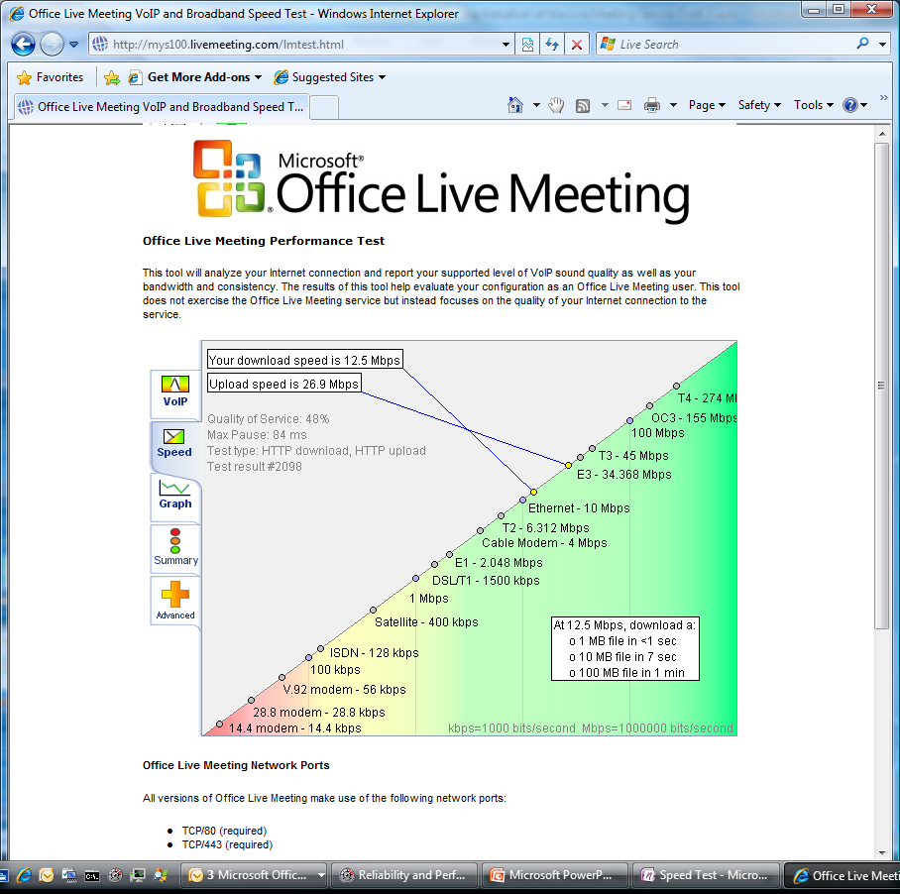
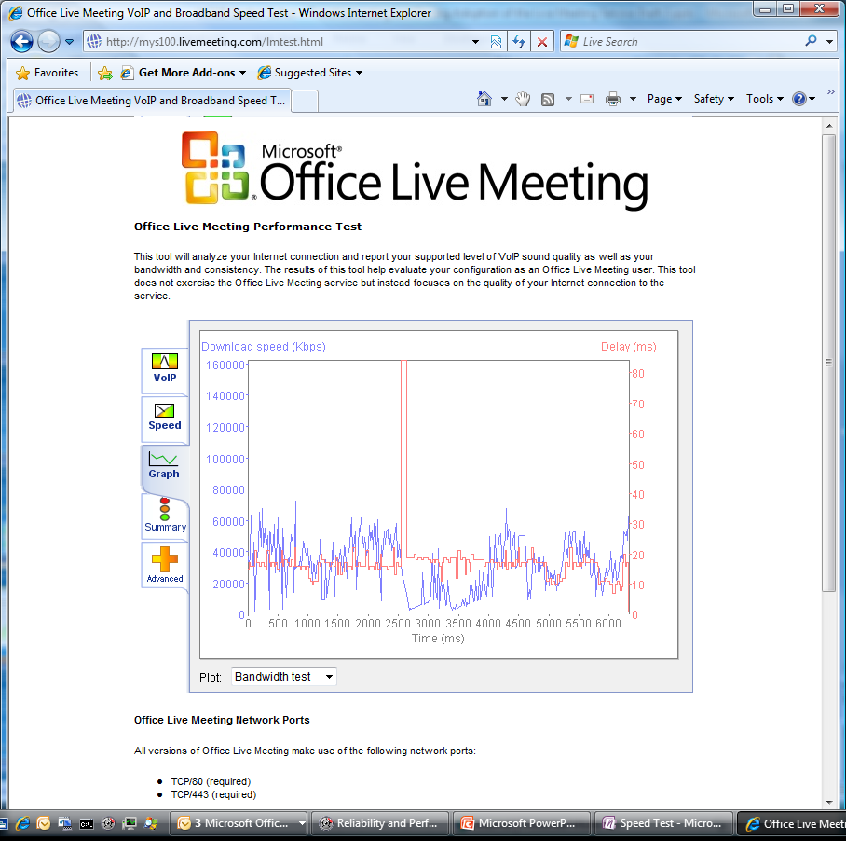
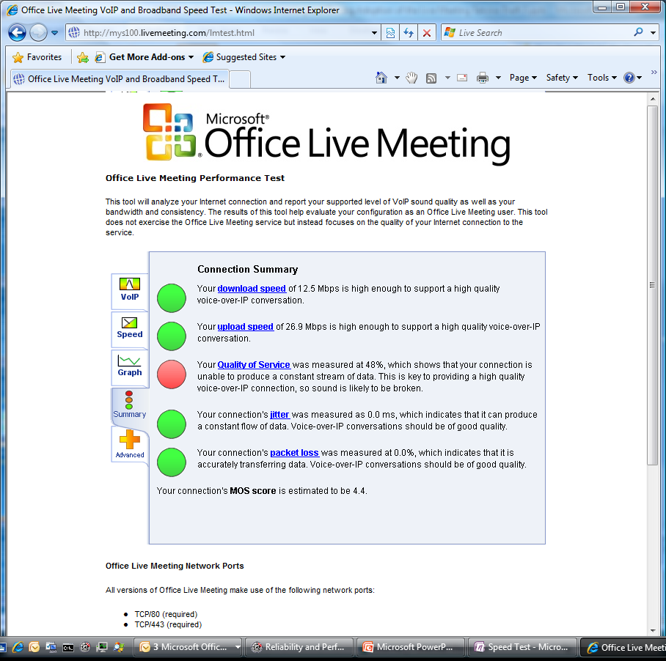
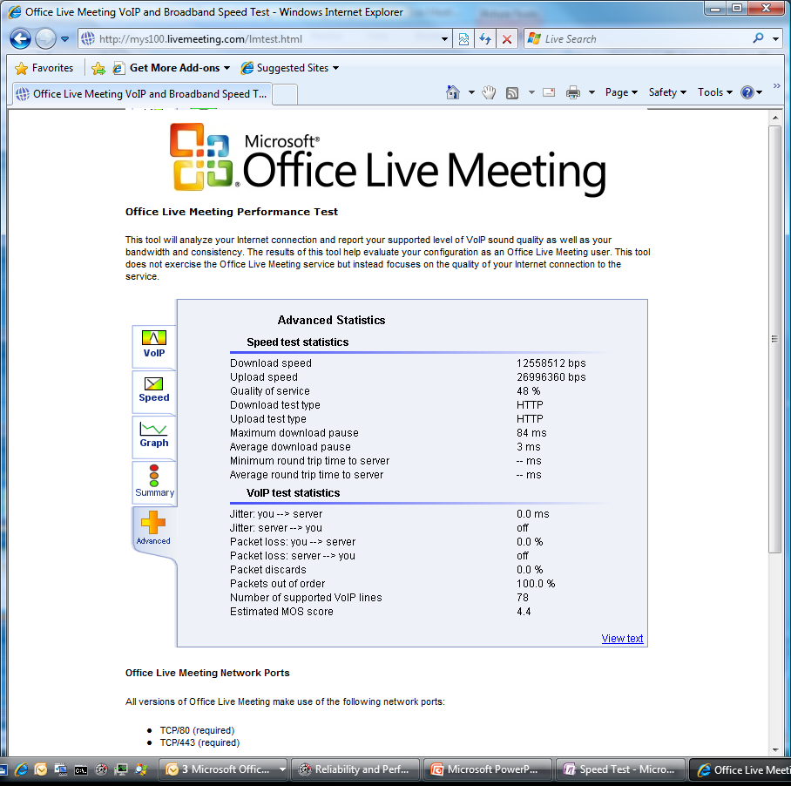
Live Meeting Speed Test
http://mys500.livemeeting.com/lmtest.html

Slide 34
How to get Support?
Check Live Meeting FAQ:
http://support.microsoft.com/ph/925
Support available 24h/24, 7/7:
  Email: http://www.livemeeting.com/ask
  Phone: local (toll free) phone numbers WW and localization: http://support.microsoft.com/gp/livemeeting_oas
Support integration with Premier
  Customers able to leverage Premier resources and processes for Live Meeting

Slide 35
How to get more information?
Resource Center
http://office.microsoft.com/en-us/livemeeting/default.aspx
Technet
http://technet.microsoft.com/en-us/msonline/livemeeting/default.aspx
MSDN Section
http://msdn.microsoft.com/en-us/office/aa905513.aspx

Slide 36
Summary
Test Live Meeting: free 30 days trial!
https://mocp.microsoftonline.com/site/default.aspx
Web Conferencing is the ‘hot’ topic today: travel cost + carbon footprint reduction
Microsoft’s S+S (software + services) offering is complete and support all scenarios seamlessly
Like every software, Live Meeting requires little training
  For participants: provide 4-5 slides introduction all the time
  For organizers: setup 1 hour training for them once

Slide 37
Related Content
Breakout Sessions
UNC203 - 11/09/2009 09:00-10:15 [Cyril Sultan]
Implementing and Administering Microsoft Online Services
OFS209 - 11/10/2009 17:00-18:15 [Kimmo Forss]
SharePoint Online Overview
SIA08-IS - 11/11/2009 10:45-12:00 [Mike Chan]
Security Services in the Cloud
UNC205 - 11/11/2009 17:30-18:45 [Cyril Sultan]
Tips and Tricks for Planning, Deploying, and Troubleshooting the Office Live Meeting Service
UNC310 - 11/12/2009 13:30-14:45 [David Anderson]
Migrating Data, Co-Existence, and Directory Synchronization with Microsoft Online Services
ITS213 - 11/12/2009 17:00-18:15 [Gail Warren]
Critical Infrastructure and Operations for Delivering Secure, Enterprise-Class Software Services

Slide 38

Complete an evaluation on CommNet and enter to win an Xbox 360 Elite!

Slide 39




Resources
Required Slide
Speakers,
TechEd 2009 is not producing
a DVD. Please announce that
attendees can access session
recordings at TechEd Online.
www.microsoft.com/teched
  Sessions On-Demand & Community
www.microsoft.com/learning
Microsoft Certification & Training Resources
http://microsoft.com/technet
  Resources for IT Professionals
http://microsoft.com/msdn
  Resources for Developers

Slide 40
Q&A

Slide 41

© 2009 Microsoft Corporation. All rights reserved. Microsoft, Windows, Windows Vista and other product names are or may be registered trademarks and/or trademarks in the U.S. and/or other countries.
The information herein is for informational purposes only and represents the current view of Microsoft Corporation as of the date of this presentation. Because Microsoft must respond to changing market conditions, it should not be interpreted to be a commitment on the part of Microsoft, and Microsoft cannot guarantee the accuracy of any information provided after the date of this presentation.
MICROSOFT MAKES NO WARRANTIES, EXPRESS, IMPLIED OR STATUTORY, AS TO THE INFORMATION IN THIS PRESENTATION.

Slide 42
Annexes

Slide 43
Web Client vs. Rich Client
Features | Web Client | Windows-Based Console
View Desktop/Application Sharing | √ | √
Actively Share Desktop/Application **This feature is supported in the Web Client for Apple Macintosh Users, but not for other operating systems or browsers |  | √
Remote Control of Desktop/Application Share |  | √
VoIP/Computer Audio |  | √
Streaming Video (ie., Webcam or Roundtable) |  | √
Shared Recordings (Saving Recording to OLM Servers) | √ | √
Personal Recordings (Saving Recordings Locally) |  | √
Content Upload directly through Console |  | √
View Rich Media Presentations (ie., Video, Audio, etc.) | √ | √
Downloading In-Meeting Handouts | √ | √
Uploading/Deleting In-Meeting Handouts |  | √
Question & Answer Pane | √ | √
Annotation Tools | √ | √
Attendee Permissions Control | √ | √
Text Slides | √ | √
Whiteboard | √ | √
Polling Slides | √ | √
Web Slides | √ | √
Shared Notes | √ | √
Feedback/Mood Indicator | √ | √
Breakout Room Participation | √ | √
Breakout Room Creation/Management |  | √

Slide 44
Required Slide
© 2009 Microsoft Corporation. All rights reserved. Microsoft, Windows, Windows Vista and other product names are or may be registered trademarks and/or trademarks in the U.S. and/or other countries.
The information herein is for informational purposes only and represents the current view of Microsoft Corporation as of the date of this presentation. Because Microsoft must respond to changing market conditions, it should not be interpreted to be a commitment on the part of Microsoft, and Microsoft cannot guarantee the accuracy of any information provided after the date of this presentation. MICROSOFT MAKES NO WARRANTIES, EXPRESS, IMPLIED OR STATUTORY, AS TO THE INFORMATION IN THIS PRESENTATION.

