Slide 2
A Lap around ASP.NET 4 and Visual Studio 2010
Jeff King
Senior Program Manager
Microsoft
Session Code: WIA204

Slide 3
Overview
Visual Studio 2010
ASP.NET
Web Forms
ASP.NET
Dynamic Data
ASP.NET
MVC
Microsoft
Ajax Library
ASP.NET Framework 4
.NET Framework 4

Slide 4
Visual Studio 2010
Visual Studio 2010
ASP.NET
Web Forms
ASP.NET
Dynamic Data
ASP.NET
MVC
Microsoft
Ajax Library
ASP.NET Framework 4
.NET Framework 4

Slide 5
Visual Studio 2010
demo

Slide 6
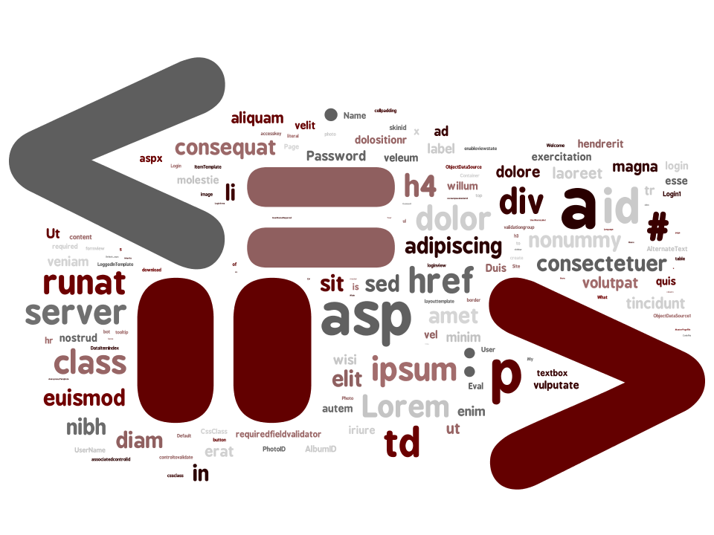

Slide 7
Visual Studio 2010
New UI Design
  Multi-monitor support
Full Framework Multi-Targeting
  Build apps targeting 2.0, 3.5, or 4
HTML and JavaScript Snippets
Dynamic IntelliSense for JavaScript
Packaging and Publishing
  Web.config transformations

Slide 8
ASP.NET Framework 4
Visual Studio 2010
ASP.NET
Web Forms
ASP.NET
Dynamic Data
ASP.NET
MVC
Microsoft
Ajax Library
ASP.NET Framework 4
.NET Framework 4

Slide 9
ASP.NET Framework 4
Performance
  Session State Compression Option
  Auto-Start Web Applications
  Per-application Performance Monitoring
Extensibility
  Extensible Output Caching
  Extensible HTML/URL Encoding
  Extensible Request Validation
Minimized Web.config

Slide 10
Minimized Web.config
demo

Slide 11
ASP.NET 4 Web Forms
Visual Studio 2010
ASP.NET
Web Forms
ASP.NET
Dynamic Data
ASP.NET
MVC
Microsoft
Ajax Library
ASP.NET Framework 4
.NET Framework 4

Slide 12
ASP.NET 4 Web Forms
demo

Slide 13
ASP.NET 4 Web Forms
Updated Default Web Site Template
Control Rendering… Control
  Simple semantic HTML
  ClientIDMode
  ViewStateMode
Search Engine Optimization
  Routed URLs
  Page.Keywords, Page.Description
  Response.RedirectPermanent()

Slide 14
ASP.NET 4 Dynamic Data
Visual Studio 2010
ASP.NET
Web Forms
ASP.NET
Dynamic Data
ASP.NET
MVC
Microsoft
Ajax Library
ASP.NET Framework 4
.NET Framework 4

Slide 15
ASP.NET 4 Dynamic Data
demo

Slide 16
ASP.NET 4 Dynamic Data
Related Session
  WIA404: Data Driven ASP.NET Web Forms Applications Deep Dive

Slide 17
ASP.NET 4 Dynamic Data
Entity Templates
  Easily change look and feel for table editing/display
  Automatic templates for ListView and FormView
Filters
  Templates
  Based on the new QueryBlock
Many to Many (Entity Framework)
Inheritance (EF and L2S)
Field Templates

Slide 18
ASP.NET MVC 2
Visual Studio 2010
ASP.NET
Web Forms
ASP.NET
Dynamic Data
ASP.NET
MVC 2
Microsoft
Ajax Library
ASP.NET Framework 4
.NET Framework 4

Slide 19
ASP.NET MVC
ASP.NET MVC 1 for VS2008 released in March
Extensibility
  Sparks, MVCContrib, etc..
Reduces Testing Friction
Drives well structured apps
Fine control over HTML
Great Tooling and Community Support
  Started on CodePlex
  Community Contributed Add-ons
All the benefits of ASP.NET

Slide 20
ASP.NET MVC 2
Builds on the previous version
  Areas, allowing composition of apps
  Templated helpers
  Asynchronous Controller Actions
  Caching Improvements
  Strongly Typed Link Helpers

Slide 21
ASP.NET MVC 2
Download “Preview 2”
  Included as part of Visual Studio 2010
  CodePlex Download for Visual Studio 2008 SP1
Related Session
  WIA305: What's New in Microsoft ASP.NET Model-View-Controller

Slide 22
Microsoft Ajax Library
Visual Studio 2010
ASP.NET
Web Forms
ASP.NET
Dynamic Data
ASP.NET
MVC
Microsoft
Ajax Library
ASP.NET Framework 4
.NET Framework 4

Slide 23
Microsoft Ajax Library
New Name
  ASP.NET AJAX → Microsoft Ajax Library
Download “Preview 6”
  http://aspnet.codeplex.com/wikipage?title=AJAX
Related Session
  WIA303: Microsoft ASP.NET AJAX: Taking AJAX to the Next Level

Slide 24
Microsoft Ajax
Microsoft Ajax Library
  Client-side Data
    Templated Controls
    Live Bindings
  Refactored Library
  Client Script Loader
  Microsoft Ajax Controls as jQuery Plug-ins
Microsoft Ajax Minifier
Microsoft Ajax CDN

Slide 25
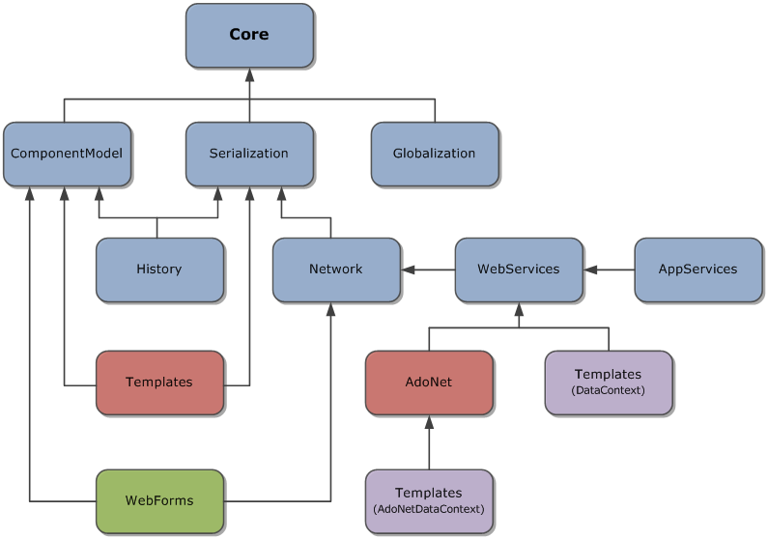

Slide 26
Microsoft Ajax Library
demo

Slide 27
Visual Studio 2010
demo

Slide 28
Overview
Visual Studio 2010
ASP.NET
Web Forms
ASP.NET
Dynamic Data
ASP.NET
MVC
Microsoft
Ajax Library
ASP.NET Framework 4
.NET Framework 4

Slide 29
Resources
Jeff King, jking@microsoft.com
Meet me at “Ask-the-Experts”
  Tuesday 15:15-18:15
  Thursday 14:45-17:00
Recommended Links
  http://blogs.msdn.com/webdevtools
  http://weblogs.asp.net/scottgu
  http://www.asp.net

Slide 30
question & answer

Slide 31




Resources
Required Slide
Speakers,
TechEd 2009 is not producing
a DVD. Please announce that
attendees can access session
recordings at TechEd Online.
www.microsoft.com/teched
  Sessions On-Demand & Community
www.microsoft.com/learning
Microsoft Certification & Training Resources
http://microsoft.com/technet
  Resources for IT Professionals
http://microsoft.com/msdn
  Resources for Developers

Slide 32

Required Slide
Complete an evaluation on CommNet and enter to win an Xbox 360 Elite!

Slide 33

Required Slide
© 2009 Microsoft Corporation. All rights reserved. Microsoft, Windows, Windows Vista and other product names are or may be registered trademarks and/or trademarks in the U.S. and/or other countries.
The information herein is for informational purposes only and represents the current view of Microsoft Corporation as of the date of this presentation. Because Microsoft must respond to changing market conditions, it should not be interpreted to be a commitment on the part of Microsoft, and Microsoft cannot guarantee the accuracy of any information provided after the date of this presentation. MICROSOFT MAKES NO WARRANTIES, EXPRESS, IMPLIED OR STATUTORY, AS TO THE INFORMATION IN THIS PRESENTATION.

