Slide 2
Enhancing the Design-Time Experience for Microsoft Silverlight 3
Oliver Scheer
Developer Evangelist
Microsoft Germany
Session Code: WIA401

Slide 3
Session Abstract
The typical RIA-developer or -designer expects a lot of out-of-the-box scripts and components. But it is often more copy-and-paste of code, rather than reusable-components, that can be customized. Learn how you can build components like carousels, page-turners, image-rotators, or even data-driven-forms with a better Design-Time-Support in Expression Blend and Visual Studio

Slide 4
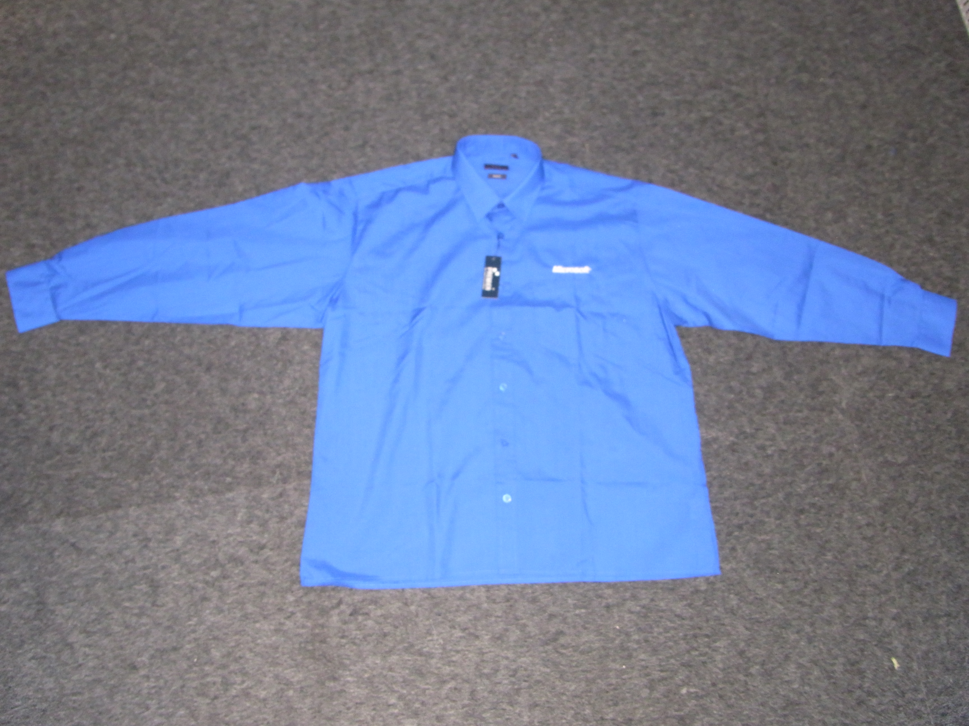

Slide 5
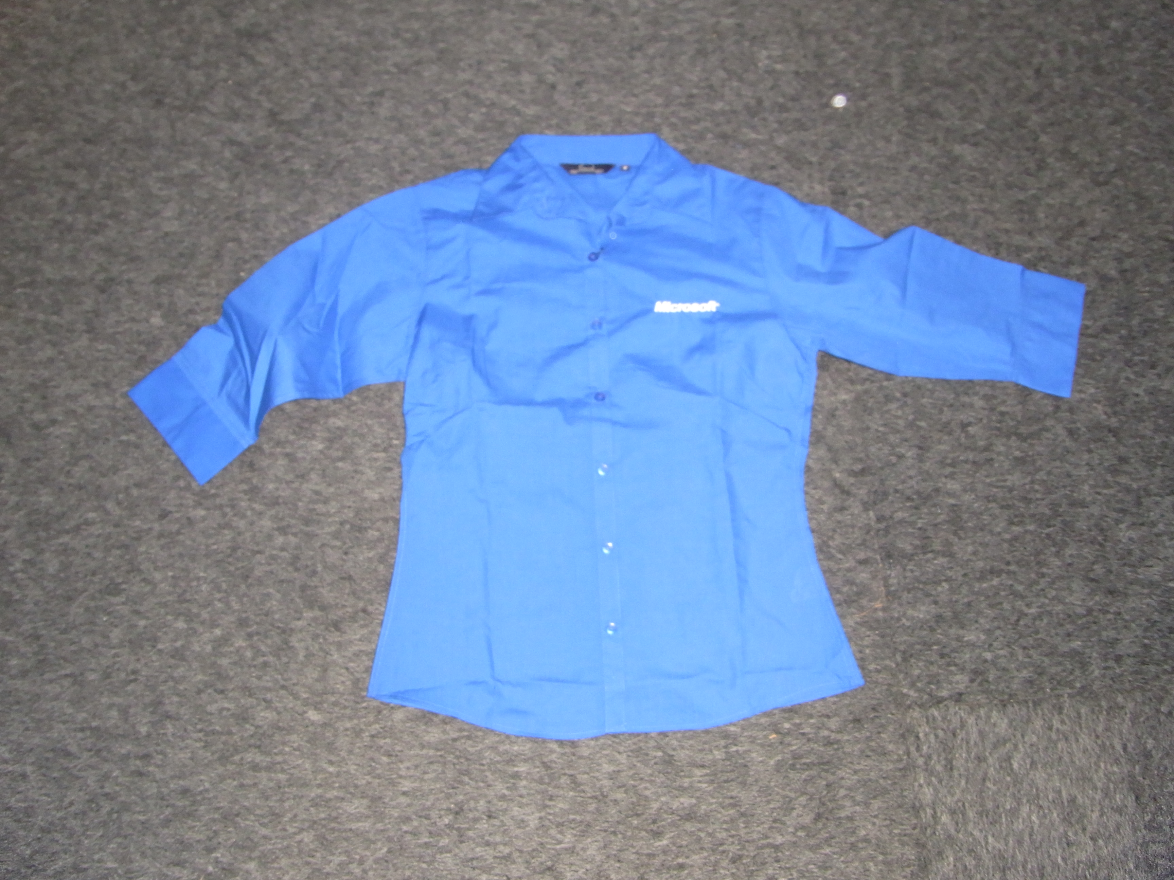

Slide 6
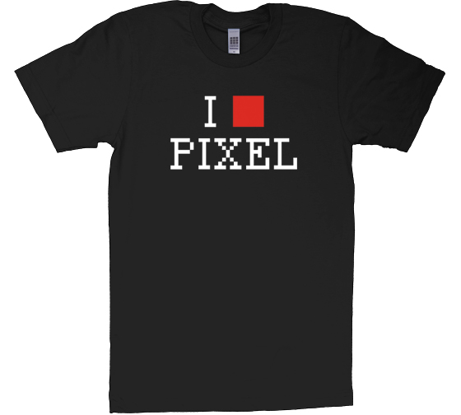

Slide 7
If you are lucky, they look like…

Slide 8


Slide 9
Designer vs. Developer
video

Slide 10
My Session-Goals are …
Optimize the Experiences for Designers using Silverlight 3
Show Tips and Tricks for Developers to improve the Experience
Improve the availability of „high reusable“ components and code samples for Silverlight

Slide 11
Problems Today
A lot of samples, but…
Most of them are copy-and-paste of
Spaghetti Code

Slide 12
Spaghetti-Code
Spaghetti code is a pejorative term for source code which has a complex and tangled control structure, especially one using many GOTOs, exceptions, threads, or other "unstructured" branching constructs. It is named such because program flow tends to look like a bowl of spaghetti, i.e. twisted and tangled. Spaghetti code can be caused by several factors, including inexperienced programmers and a complex program which has been continuously modified over a long life cycle. Structured programming greatly decreased the incidence of spaghetti code.
Source: Wikipedia

Slide 13

Spaghetti-Code

Slide 14
Sample: Configuration of a „control“
private static int NUMBER_OF_IMAGE = 6;
private static String CLASS_PREFIX = "Logo";
private static double VERTICAL_RADIUS = 90;
private static double HORIZONTAL_RADIUS = 220;
private static double SCALE_MIN = 0.5;
private static double SCALE_MAX = 1.5;
private static double SPEED = 4;
private int _fps = 25;
private double _speedCounter = 0;

Slide 15
Sample 2: „Adding“ Elements
private void addImages()
{
for (int i = 0; i < NUMBER_OF_IMAGE; i++)
{
// load the images from the Folder
string url = "images/" + CLASS_PREFIX + i + ".png";
Uri uri = new Uri(url, UriKind.Relative));
Image image = new Image();
image.Source = uri;
LayoutRoot.Children.Add(image);
_images.Add(image);
posImage(image, i);
}
}

Slide 16
And what do we SEE in
Expression Blend or
Visual Studio?

Slide 17
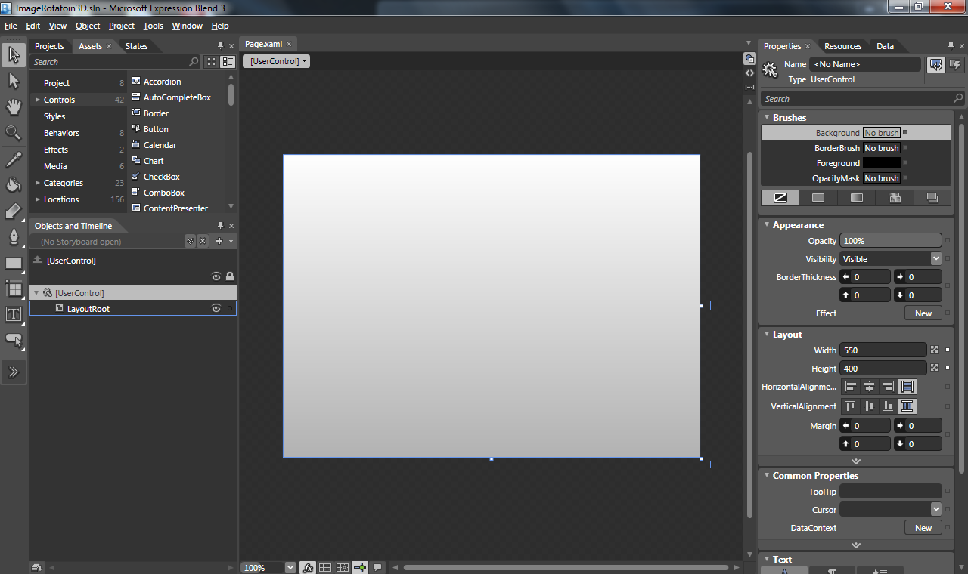
NOTHING

Slide 18
We want

Slide 19
Ravioli Code
Ravioli code is a type of computer program structure, characterized by a number of small and (ideally) loosely-coupled software components. The term is in comparison with spaghetti code, comparing program structure to pasta; with ravioli (small pasta pouches containing cheese, meat, or vegetables) being analogous to objects (which ideally are encapsulated modules consisting of both code and data).
Source: Wikipedia

Slide 20
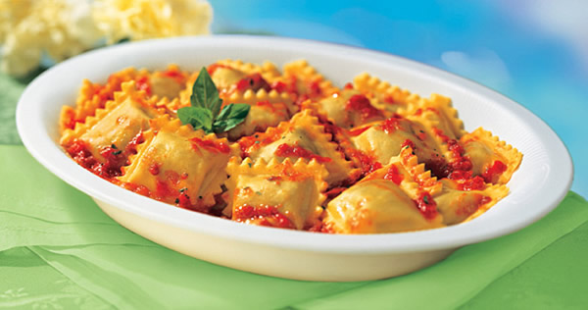
Ravioli Code

Slide 21
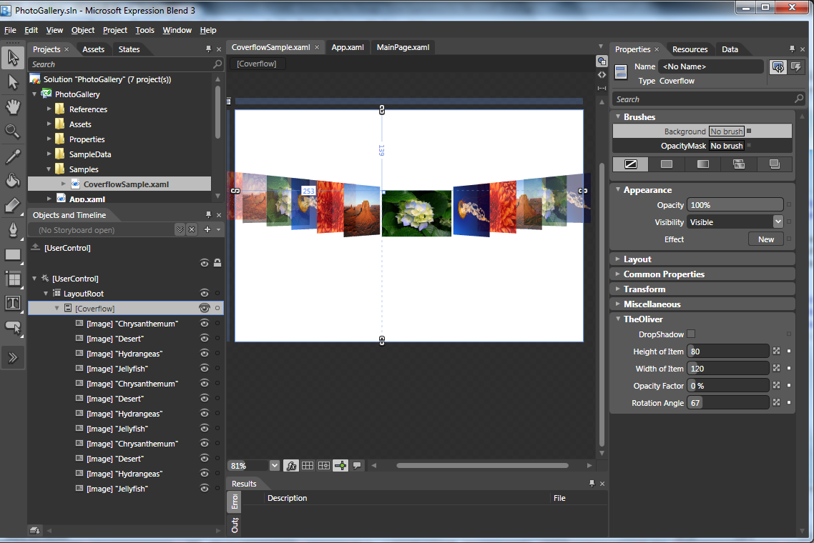

Slide 22
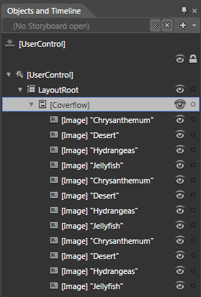
An Easy Way to Insert Elements
Objects and Timelines

Slide 23
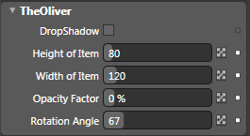
Understandable Properties

Slide 24
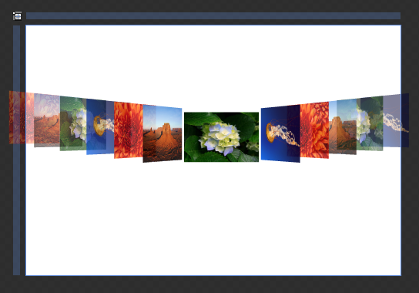
A Preview In The Workspace

Slide 25
What can be done for a better
Design Time Experience
Design Time Visibility
Design Time Data
Behaviors
Attributes
Visual Studio Extensibility
Expression Blend Extensibility
TypeConverters
Templates
WriteableBitmaps

Slide 26
Design Time Visibility

Slide 27
Design Time Visibility
Why are so many controls not visible at Design Time in Blend and Visual Studio?
  They are rendered at runtime
  They access Data that are only available at Runtime
  They are created in MainPage and not in a control

Slide 28
Design a control that renders at Design Time
Inherit from
  UserControl
  Custom Control
Or better
  ItemsControl
  Lists of Items, like Carousel, Coverflows, ListBoxes
  Panel
  Layoutmechanisms, that can be reused in ListBoxes

Slide 29
Don‘t …
…try to access Live Data
…try to access Webservices
…check your current Environment with
DesignerProperties.GetIsInDesignMode()
…deliver Sample Data instead of Live Data
Do …

Slide 30
How to setup a „good“ control
public class Coverflow : Panel
// or ItemsControl, UserControl, etc.
{
public Coverflow() { .. }
// Some Properties ..
// Override ArrangeOverride
}

Slide 31
Demo
Control Setup for Better
Design Time Experiences

Slide 32
Sample Data

Slide 33
Sample Data Feature in
Expression Blend
Enables you to create sample data in Blend
Easy to use and apply

Slide 34
Demo
Sample Data

Slide 35
Adding Properties for Customization

Slide 36
Using Dependency Properties
Expose Features and Settings to consumer
of controls
Enables more flexibility without losing control
of code
Dependency Properties do much more than only appearing in the property window, but Designer see them only in Property Window ☺

Slide 37
Demo
Adding Properties

Slide 38
Using Attributes

Slide 39
System.ComponentModel
Provides classes for run-time and design-time behavior of components and controls
CategoryAttribute
DescriptionAttribute
DisplayAttribute
EditorBrowsableAttribute
TypeConverterAttribute

Slide 40
Attribute Usage
[Category(„My Property Category")]
[Description("The Text that should be displayed")]
public string Text
{
get { return (string)GetValue(TextProperty); }
set { SetValue(TextProperty, value); }
}

Slide 41
Microsoft.Windows.Design
The Microsoft.Windows.Design namespace provides classes for managing state in
a designer
PropertyOrderAttribute
ToolboxBrowsableAttribute
NumberRangeAttribute
NumberIncrementAttribute
NumberFormatAttribute

Slide 42
Demo
Using Attributes

Slide 43
Default-TypeConverter and
Custom-TypeConverter
Demo

Slide 44
Custom Editors

Slide 45
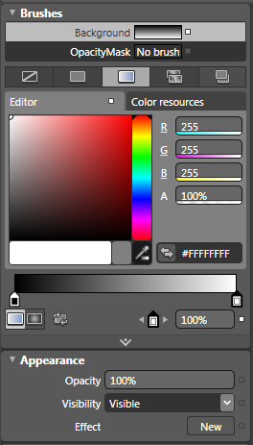
Property Window
Textboxes are boring and
fault-prone
Customization of
Property-Editors

Slide 46
Demo
Custom Editors

Slide 47
So far…
…so good

Slide 48
Now we have a problem …
… and a Solution
All the features for a better Design Time Experience are in the productive code/assembly
Separates Runtime-Code from Design Time-Support Code

Slide 49
Visual Studio &
Expression Blend Extensibility

Slide 50
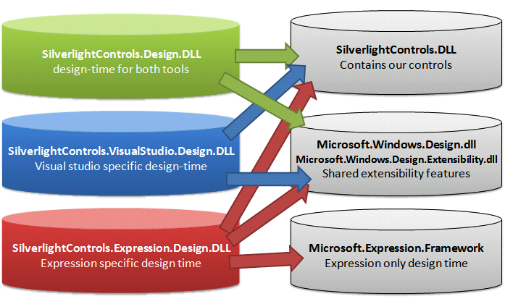
The Target Project Structure

Slide 51
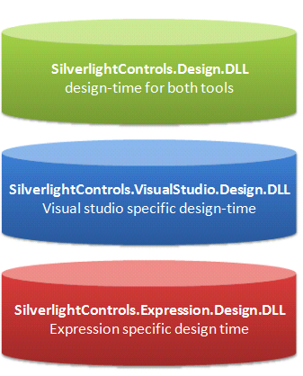
Step 1: We need 3 Projects

Slide 52
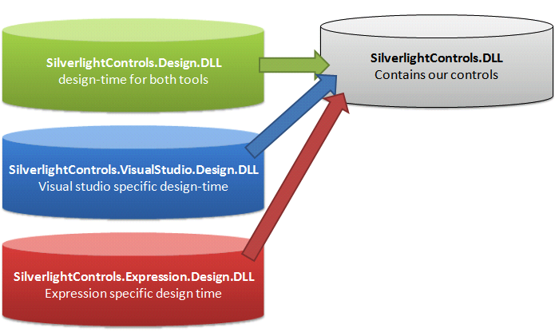
Step 2: Adding References to our Control - DLL

Slide 53
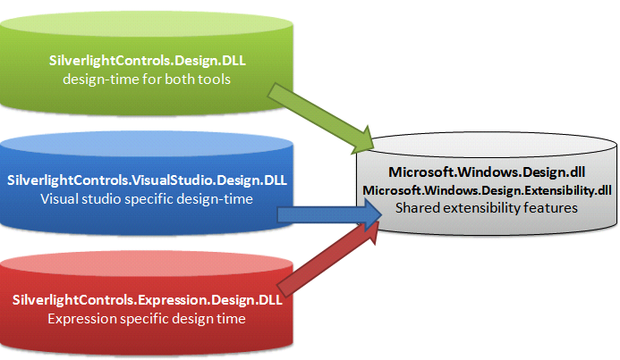
Step 3: Adding a reference to the shared Design Time DLLs

Slide 54
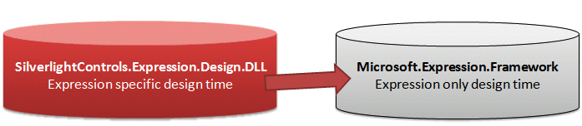
Step 4: Add a reference between Design-Time Project to Blend-specific assemblies

Slide 55
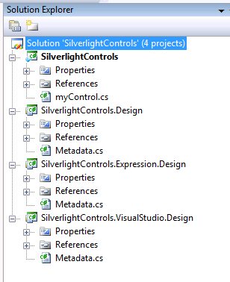
The Final Solution

Slide 56
Naming Conventions
*.Design.dll
will contain design time attributes that work for both Visual Studio WPF/Silverlight designer and Expression Blend
*.VisualStudio.design.dll
Will contain design time features that only work in
Visual Studio
*.Expression.design.dll
will contain design time features that only work in Expression blend
Design time DLLs must be in same directory as the
runtime DLL

Slide 57
Demo
The Project Structure

Slide 58
Demo
Blend Extensibility

Slide 59
Demo
Visual Studio Extensibility

Slide 60
Behaviors

Slide 61
Demo
Behaviors

Slide 62
Goal Check …
Optimize the Experiences for Designers using Silverlight 3
Show Tips and Tricks for Developers to improve the Experiences
Improve the availability of „high reusable“ components and code samples for Silverlight

Slide 63
questions & answers

Slide 64
More Information
Best Practice Showcase: Silverlight Toolkit
http://silverlight.codeplex.com
Silverlight Homepage:
http://silverlight.net
My Homepage:
http://the-oliver.com
Email:
oliver.scheer@microsoft.com

Slide 65




Resources
Required Slide
Speakers,
TechEd 2009 is not producing
a DVD. Please announce that
attendees can access session
recordings at TechEd Online.
www.microsoft.com/teched
  Sessions On-Demand & Community
www.microsoft.com/learning
Microsoft Certification & Training Resources
http://microsoft.com/technet
  Resources for IT Professionals
http://microsoft.com/msdn
  Resources for Developers

Slide 66

Complete an evaluation on CommNet and enter to win an Xbox 360 Elite!

Slide 67

Required Slide
© 2009 Microsoft Corporation. All rights reserved. Microsoft, Windows, Windows Vista and other product names are or may be registered trademarks and/or trademarks in the U.S. and/or other countries.
The information herein is for informational purposes only and represents the current view of Microsoft Corporation as of the date of this presentation. Because Microsoft must respond to changing market conditions, it should not be interpreted to be a commitment on the part of Microsoft, and Microsoft cannot guarantee the accuracy of any information provided after the date of this presentation. MICROSOFT MAKES NO WARRANTIES, EXPRESS, IMPLIED OR STATUTORY, AS TO THE INFORMATION IN THIS PRESENTATION.

