Slide 1

How Microsoft Manages Its Cloud Infrastructure at a Huge Scale
COS211
Rick Bakken
Senior Director, Data Center Evangelism
Microsoft

Slide 2
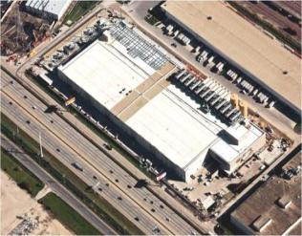
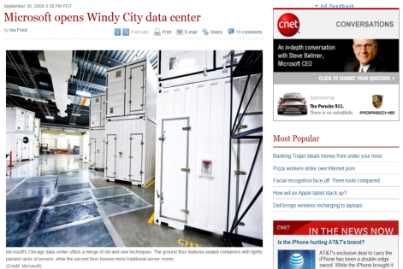
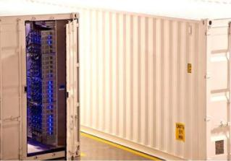
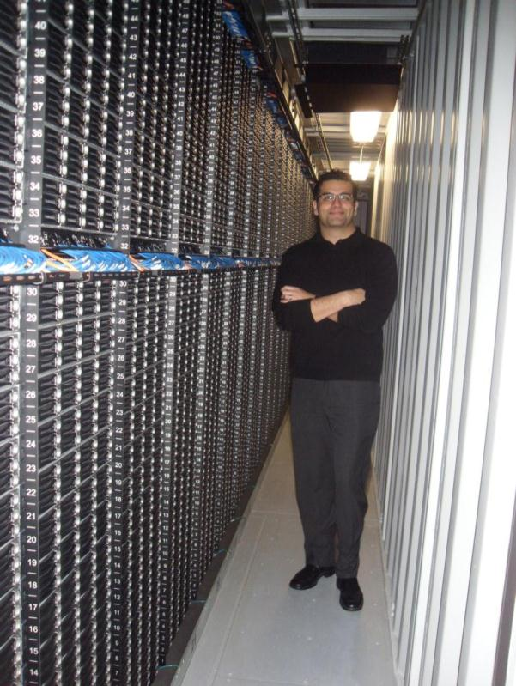

Cloud Data Centers
Chicago (Gen3)
3000 construction-related jobs
700,000+ square feet
$500M+ investment
60 MW Total Critical Power
1.5 million man-hours of labor
3400 tons of steel, 190 miles of conduit
2400 tons of copper
7.5 miles of chilled water piping
26,000 cubic yards of concrete

Slide 3
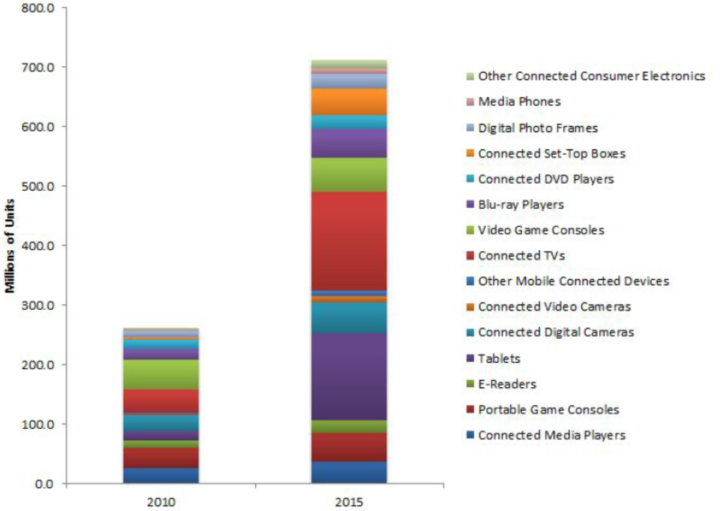
Cloud - Global Connected Device Forecast
60%
Growth
2010
2015
Source - INFINITE RESEARCH - Issue #003 | 03/08/11 | ww.infiniteresearch.net

Slide 4





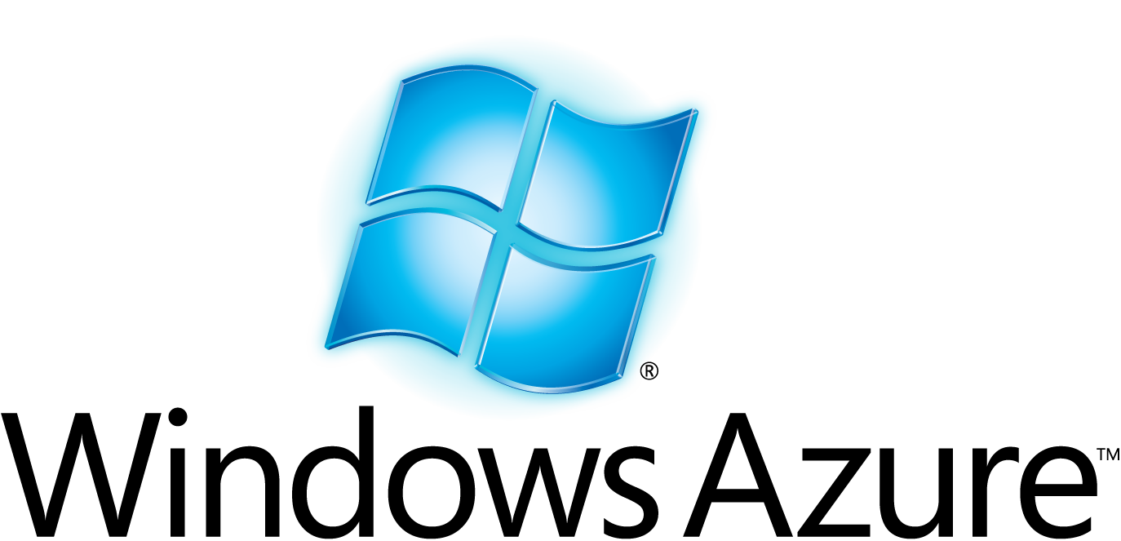
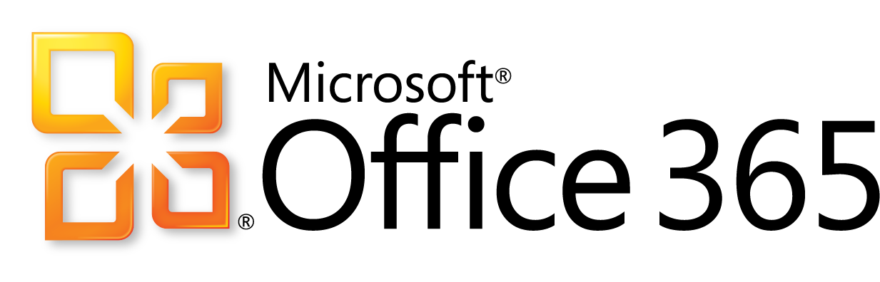
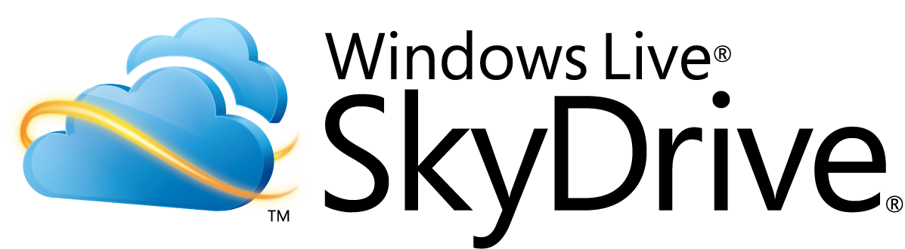




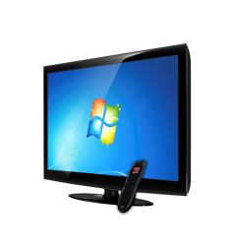

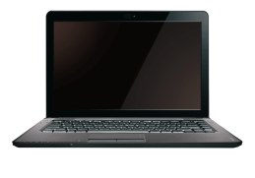









Huge Global Scale 24x7
500M Active Live IDs
59 markets and 36 languages
355M Active Accounts
Over 4B WW Queries Each Month
Over 459M Unique Users
14B Ads
Per Month
Over 303M Users 76 markets and 48 languages
Over 6M Songs In The Catalog
25M Users
2-4 billion emails per day
200+ CLOUD SERVICES
PC
MOBILE
TV/HOME

Slide 5






















Microsoft Datacenter Evolution
Gen 4
Gen 3
Gen 2
Gen 1
PC Era
Portal Era
Online App Era
Web Services Era
Cloud Computing Era
FISMA Cert
First ISO 27001 cert
First SAS-70 cert
Security Development Lifecycle
Trustworthy Computing Directive
Microsoft 1st Data Center
Microsoft.com
1980s
1989
1994-95
1997
2002
2004
2006
2008
2011+

Slide 6
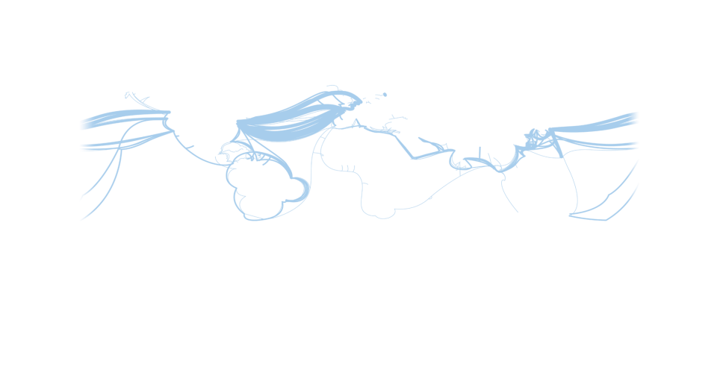
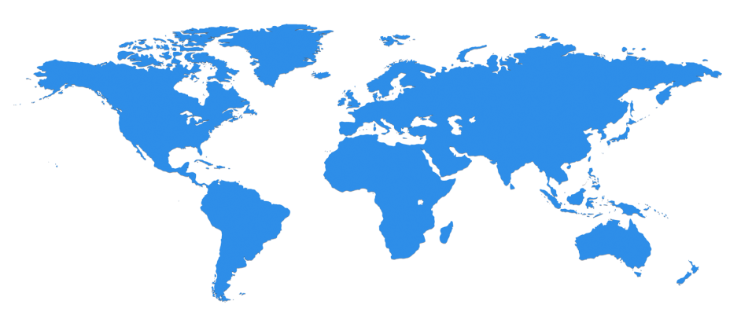



Microsoft Datacenter Scale
Multiple global CDN locations
Dublin
Amsterdam
Quincy
Chicago
Japan
Hong Kong
Des Moines
Boydton
San Antonio
Singapore
Quincy, Washington: approx 500K sq ft, 27MW, uses entirely hydro-electric power
San Antonio, Texas: approx 477K sq ft, 27MW, uses recycled water for cooling
Chicago, Illinois: 707,000 square feet with critical power of 60 MW, uses water side economization, containers
Dublin, Ireland: approx 570K sq ft, up to 27MW, uses outside air for cooling.
"Datacenters have become as vital to the functioning of society as power stations."
The Economist

Slide 7
Cloud Architecture
CDN Service (Edge Node)
Content Delivery Network
edge node
edge node
Benefits
Application/Service Geo Redundancy - (PaaS)
Latency - User proximity to Service deployment
Node Cost - Lower Cost per MW
Cloud Appliance – Data Sovereignty
edge node
Primary
DC
Secondary DC
anchor node
Dark
Fiber
Cloud Appliance
Data Sovereignty
Cloud Appliance
Data Sovereignty
edge node
edge node
edge node
edge node

Slide 8

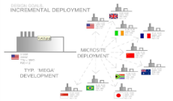





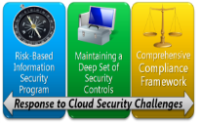






Microsoft Global Foundation Services
Data Centers
Design, Build, Operate
Global Network
Dark Fiber, Routing, Switching, Load-Balancing
Global Capacity
Microsite Strategy
Pre-manufactured buildings
ITPACs
Containers
Lowest $/MW, Rapid Deployment
Geo-independent design
Lower DC to DC costs
    GFS Customers
    300+ MS Product Teams
    Microsoft IT (MS-IT, 1900 LOB apps)
    Cloud Hosting – BPOS & Azure
Security & Compliance
Tools & Automation
Utility Pricing
Cost Transparency
MOC
Global Ticketing
GFS Certifications
ISO27001, SAS70, FISMA (.GOV)
Bangalore, India
Redmond, USA

Slide 9
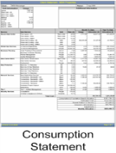

Cloud Services – Consumption based charge back $
Business Problem | Transformation Challenges
Monitoring & Measuring IT elements Rate (IT) / Consumption (Customer) Allocation vs. accuracy “IT is too….. Unresponsive, expensive" | Asset Accuracy Taxonomy Consistency Process Change Systems Implementation IT/User Alignment Allocated/Unallocated
Requires IT Reinvention
CEO Commitment
CFO/SAP Retool
Intelligent Monitoring
User Training
Utility Pricing
Cost Transparency
Confidence in IT as a Service/Platform Provider
Charge back
Cost agreement/ alignment
Monitor/Measurement
Power
Storage
Egress (traffic)
Tickets
Units Consumed
@ rate
SLAs/OLAs

Slide 10

Datacenter Efficiency & Application Effectiveness
Understanding Power Usage Effectiveness (PUE) metric:
In a typical large datacenter, for every watt consumed for server power (PUE=1.0), there can be another 0.5 to 1 watt consumed for power distribution losses and cooling (PUE= 1.5 to 2.0)
PUE = ^{Total Facility Power}/_{IT Equipment Power}
Building Load
Demand from Grid
IT Load
Demand from Servers, Storage, Telecom Equipment, etc.
Power (Switch Gear, UPS, Battery Backup, etc.)
Cooling (Chillers, CRACs, etc.)
Creating Application/Performance/Watt/Dollar metric:
Utility based measurement and pricing. Operators will look at Application/Service level performance per consumption x rate (Power, Network, Storage, Tickets)

Slide 11
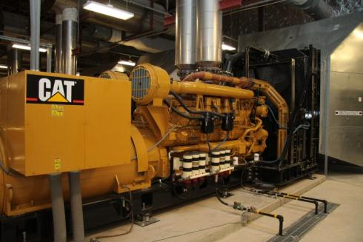
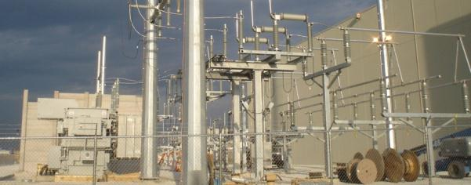
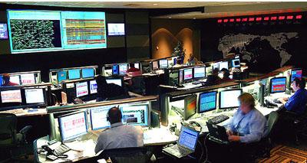
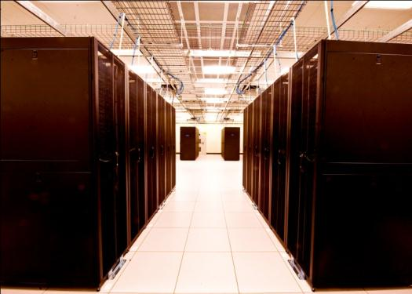
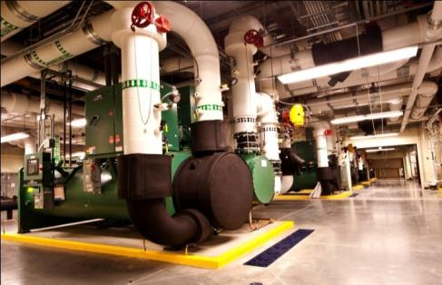
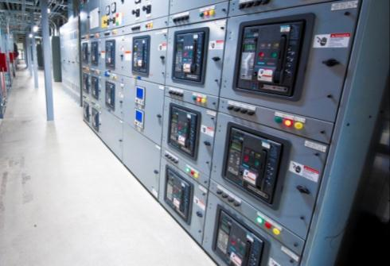
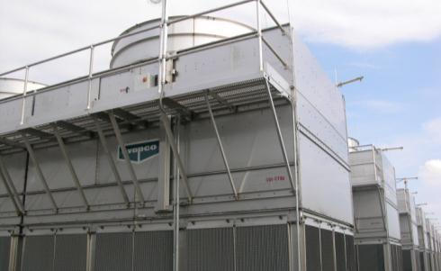
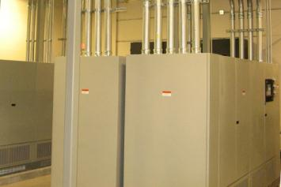
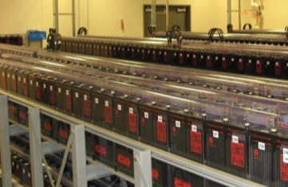
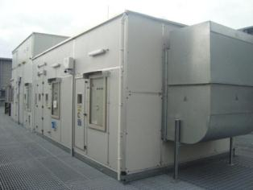
Traditional Datacenter Infrastructure

Slide 12
Datacenter Operational Energy Use
Source: EYP Mission Critical Facilities Inc., New York
Offline UPS technologies can drive Electrical losses substantially down
Widening environment can remove chillers and drive Cooling to zero
Virtualization, active power management increase IT return on investment
Microsoft is focusing on all the pieces of the pie

Slide 13

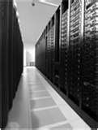
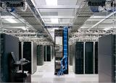
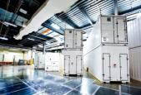
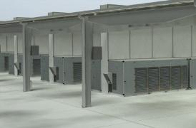

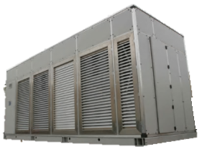

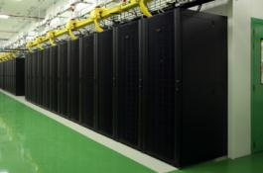
Microsoft’s Data Center Evolution
1989-2005
2007
2008
2010+
Generation 1
Generation 2
Generation 3
Generation 4
Colocation
Density
Containers
Modular
Rack
Containers & Pods
ITPAC
(Pre-Assembled Components)
Server
Capacity
~2 PUE
20 year Technology
Scalability and Sustainability
1.2-1.5 PUE
Air & Water Economization
Differentiated SLAs
Density and Deployment
1.4 – 1.6 PUE
Minimized Resource Impact
Reduced Carbon, Rightsized
1.05-1.15 PUE
Faster Time to Market

Slide 14
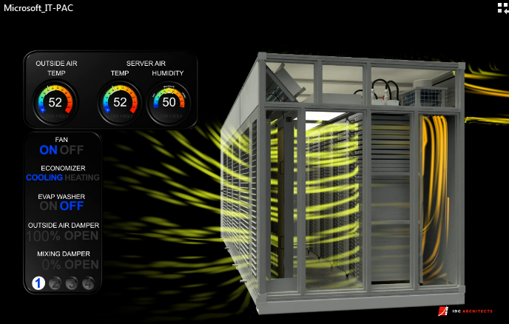
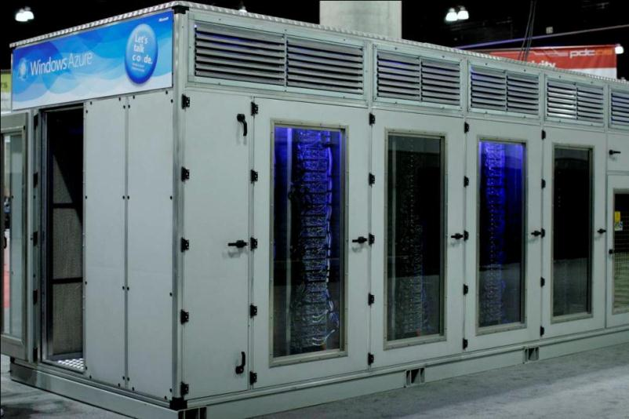
Gen4 ITPAC POC
Airside Economization
Adiabatic Cooling
Modularize and pre-manufacture the entire datacenter
Lower the Total Cost of Ownership
Increase scalability and right time to market
Standardize components to improve operations and reliability

Slide 15
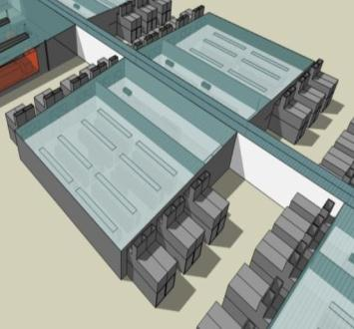
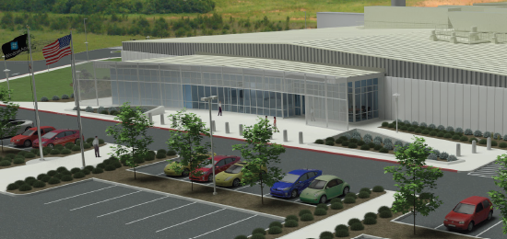

The Modular Datacenter
Forget square footage—relentlessly drive down $/KW per month
Pre-manufacture and build your supply chain to minimize materials/waste
Enable commoditization and scale
Tailor reliability to the applications
Measure, Inform, Report, Improve
Challenge Everything

Slide 16
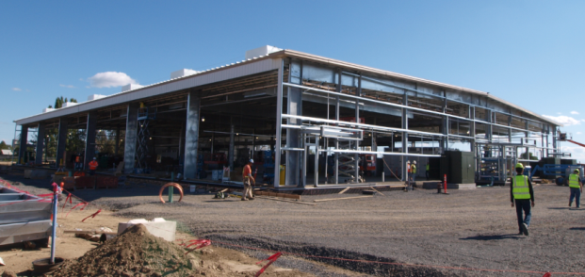
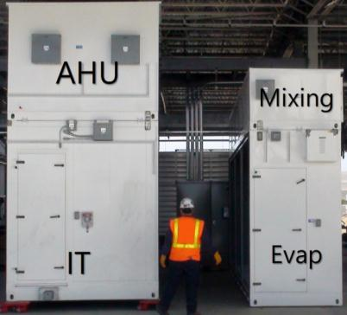
Paradigm Shift to Ultra-Modularity
Pre-manufacture the entire datacenter
Reduce time to market by >50%
50-60% lower capital investment
Scales with business demand
Classes based on availability needs
Free air cooling, low water utilization
Outstanding PUE → Lower TCO

Slide 17
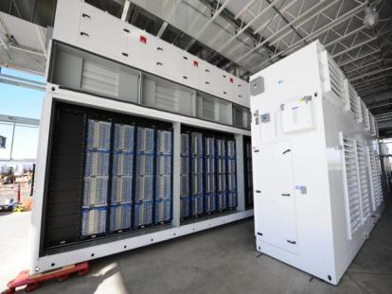
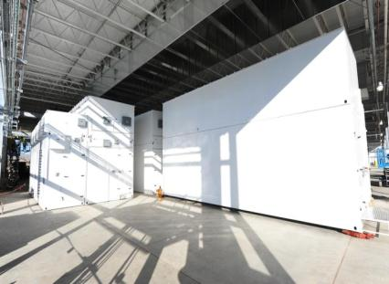
Microsoft’s Modular Datacenter
Quincy 1st ITPac Installations!
PACs are moved into place and connected to each other for complete module deployment

Slide 18
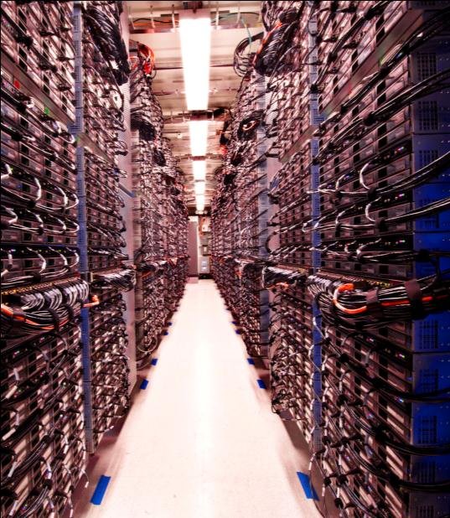
Cloud Considerations
The Datacenter is the Server
Services not Servers (Charge Back)
Application/Performance/Watt/Dollar
Drive change in the industry through strong partnerships
Cloud IT Value? Move up the stack

Slide 19


CTO “Journey to the Cloud” (2008-2020)
1
2
3
4
IT Workload Analysis
What's running where?
Virtualized Data Center
Efficiency gains
Application Migration
Cloud rehost, rewrite ancient code, reduce power
Cloud
Appliance
Resource Pooling
Data
Sovereignty
Rich Developer Tools & Experience
Applications
Value Added Services
Applications
Value Added Services
Owned Platform
Cloud Platform

Slide 20
Cloud Datacenter – Capex/Opex best practices
Datacenter Innovation (Capex)
The Datacenter is the Server, Services not Servers
Use Airside - rethink density, eliminate heat
Drive change through strong partnerships (rationalize partnerships)
Plan for Innovation - 40 GB Enet, SSD’s, SOC
Operational Excellence (Opex)
IT value prop? – self serve, customized app/services (move up the stack)
Remember, free is expensive
IT = utility based pricing (consumption/rate)
Utility = Resource Pools on demand (CPU, Storage, DBsvs)
Use Power on demand (DC sleep states)
Monitoring – Application/Performance/Watt/Dollar
Implement security at all layers / simplify compliance

Slide 21
Track Resources
Don’t forget to visit the Cloud Power area within the TLC (Blue Section) to see product demos and speak with experts about the Server & Cloud Platform solutions that help drive your business forward.
You can also find the latest information about our products at the following links:
Cloud Power - http://www.microsoft.com/cloud/
Private Cloud - http://www.microsoft.com/privatecloud/
Windows Server - http://www.microsoft.com/windowsserver/
Windows Azure - http://www.microsoft.com/windowsazure/
Microsoft System Center - http://www.microsoft.com/systemcenter/
Microsoft Forefront - http://www.microsoft.com/forefront/

Slide 22





Resources
  Connect. Share. Discuss.
http://northamerica.msteched.com
Learning
  Sessions On-Demand & Community
  Microsoft Certification & Training Resources
www.microsoft.com/teched
www.microsoft.com/learning
  Resources for IT Professionals
  Resources for Developers
http://microsoft.com/technet
http://microsoft.com/msdn

Slide 23












Complete an evaluation on CommNet and
enter to win!

Slide 24


Slide 25

© 2011 Microsoft Corporation. All rights reserved. Microsoft, Windows, Windows Vista and other product names are or may be registered trademarks and/or trademarks in the U.S. and/or other countries.
The information herein is for informational purposes only and represents the current view of Microsoft Corporation as of the date of this presentation. Because Microsoft must respond to changing market conditions, it should not be interpreted to be a commitment
on the part of Microsoft, and Microsoft cannot guarantee the accuracy of any information provided after the date of this presentation. MICROSOFT MAKES NO WARRANTIES, EXPRESS, IMPLIED OR STATUTORY, AS TO THE INFORMATION IN THIS PRESENTATION.

