Slide 1

Using Windows Azure
Virtual Machine Role
COS302
Vijay Rajagopalan
Principal Group Program Manager
Microsoft Corporation

Slide 2
A Quick Poll
How many of you…
  Have already attempted migrating an existing application to Windows Azure using VM Role?
  Plan to attempt migrating an existing application to Windows Azure using VM Role

Slide 3
Session Objectives and Takeaways
Background & Motivation
    Windows Azure Fundamentals
    Windows Azure Platform Components
VM Role
    How it fits in with the rest of Windows Azure
    End to End Walkthrough
Prescriptive Patterns & Usage Scenarios
    Deployment patterns
    Managing state
    Best Practices
Q & A

Slide 4
Cloud Fundamentals
Infrastructure as a Service (IaaS):
basic compute and storage resources
  On-demand servers
  Amazon EC2, VMWare vCloud
Platform as a Service (PaaS): cloud application infrastructure
  On-demand application-hosting environment
  E.g. Google AppEngine, Salesforce.com, Windows Azure
Software as a Service (SaaS): cloud applications
  On-demand applications
  E.g. Office 365, GMail, Microsoft Office Web Companions

Slide 5

The Benefits of the Cloud
The Cloud is about cheap, on-demand capacity
Windows Azure
= Managed for You | Standalone Servers | IaaS | PaaS | SaaS
Applications
Runtimes
Database
Operating System
Virtualization
Server
Storage
Networking

Slide 6
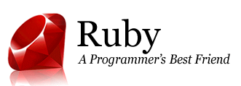



















Windows Azure Platform
  GENERAL PURPOSE PROGRAMMING LANGUAGES
  Windows Azure Platform
Compute
Storage
Management
CDN
App Fabric
Marketplace
Relational data
Management

Slide 7
Windows Azure Components
 | Windows Azure PaaS
Applications | Windows Azure Service Model
Runtimes | .NET 3.5/4, ASP .NET, PHP
Operating System | Windows Server 2008 or 2008 R2-Compatible OS
Virtualization | Windows Azure Hypervisor
Server | Microsoft Blades
Database | SQL Azure
Storage | Windows Azure Storage (Blob, Queue, Table)
Networking | Windows Azure-Configured Networking

Slide 8
Windows Azure Application Platform
Automated, Consistent Application Updates | Automated updates, clean components Local storage and OS are left untouched
Automated, Consistent Configuration Changes | Automated configuration changes Local storage and OS are left untouched
Scale-out | Automated scale-out and initial deployment
Multi-Instance Management | Identical instances are deployed across the service, guaranteed consistency No configuration drift
High Availability | No application downtime Resilient to hardware and application failures
Automated, Consistent OS Servicing | Image-based OS patching Consistent and automated security updates

Slide 9
Basic Windows Azure Functionality
Configuration and deployment:
  Certificate management (e.g. SSL)
  Load-balanced public endpoints
  Internal endpoint configuration and discovery
Operations:
  Remote desktop access management
  Automated OS and runtime updates
  Coordinated updates
Availability:
  Health monitoring
  SLA guaranteed uptime

Slide 10
Modeling Cloud Applications
A cloud application is typically made up of different components
  Front end: e.g. load-balanced stateless web servers
  Middle worker tier: e.g. order processing, encoding
  Backend storage: e.g. SQL tables or files
  Multiple instances of each for scalability and availability
Front-End
HTTP/HTTPS
Windows
Azure
Storage,
SQL Azure
Front
End
Middle Tier
Load Balancer
Cloud Application

Slide 11
The Windows Azure Service Model
A Windows Azure application is called a “service”
  Definition information
  Configuration information
  At least one “role”
Roles are like DLLs in the service “process”
  Collection of code with an entry point that runs in its own virtual machine
  Create multiple instances for availability and scale
Windows Azure compute SLA requires two instances of each role
  99.95% for connectivity to two instances
  Achieved with update and fault domains

Slide 12
Role Contents
Definition:
  Role name
  Role type
  VM size (e.g. small, medium, etc.)
  Network endpoints
Code:
  Web/Worker Role: Hosted DLL
  and other executables
  VM Role: VHD
Configuration:
  Number of instances
  Number of update and fault domains
Cloud Application
Role:
Front-End
Definition
Type: Web
VM Size: Small
Endpoints: External-1
Configuration
Instances: 2
Update Domains: 2
Fault Domains: 2
Role:
Middle-Tier
Definition
Type: Worker
VM Size: Large
Endpoints: Internal-1
Configuration
Instances: 3
Update Domains: 2
Fault Domains: 2

Slide 13
Role Types
There are currently three role types:
  Web Role: IIS7 and ASP.NET in Windows Azure-supplied OS
  Worker Role: arbitrary code in Windows Azure-supplied OS
  VM Role: uploaded VHD with customer-supplied OS
VM Role: is it a VM?
  No, because it is stateless
  Good for:
    Long install (5+ minutes)
    Manual install/config
    Fragile install/config

Slide 14
VM Role – Overview
Control:
  Developers have full control of OS image
  IT Operators can reboot, reimage, and Remote Desktop
Migration: Customers upload their own customized WS08 R2 Enterprise images
Low TCO: Customers use the OS image in the Windows Azure service model for
  Robust service management, e.g.
    Orchestrated OS upgrades and updates (configuration, topology, etc.) by “upgrade domain”
    Allocation of instances across fault domains
  On-premises simulations for debug & test

Slide 15

Where does VM Role fit in?
VM Role
Web Role: The role is a website hosted on IIS
Worker Role: The role is an application hosted on our Windows Image
VM Role: The role is a pre-loaded application hosted on your Windows Image
Web Role
Worker Role
Admin Web Role
Admin Worker Role
(Startup Tasks)
VM Role
Abstraction
(i.e. Less IT & Less Plumbing Code)
Control

Slide 16
VM Role Use Cases
VM Role
Long running application installations
Error-prone application installations
Application installations requiring manual interaction

Slide 17

VM Role – Part of Service Model
A Windows Azure service consists of
  An isolation boundary
  A set of component roles, each with endpoints
  Numbered, identical/similar instances of each role
All of this is specified in a service model
Web
Role
Worker Role
VM Role

Slide 18
Windows Azure Server Management
 | Web/Worker Role | VM Role
OS and Application Monitoring
Remote Desktop Access
Certificate Management
Load-balanced public endpoints
Machine Maintenance
Intra-Application Communication

Slide 19
Windows Azure Application Platform
 | Web/Worker Role | VM Role
Automated, Consistent Application Updates
Automated, Consistent Configuration Changes
Scale-out
Multi-Instance Management
High Availability
Automated, Consistent OS Servicing

Slide 20
Platform capabilities have an application contract
  Stateless Images
    Consistent updates
    Consistent configuration
    Multi-instance management
  Multiple Instance
    Scale-out
    High Availability
Not all applications can be migrated to VM Role!
Platform Capabilities | VM Role
Automated, Consistent Application Updates
Automated, Consistent Configuration Changes
Multi-Instance Management
Scale-out
High Availability

Slide 21
VM Role Lifecycle
Build VM Image
Convert product DVD to a VHD, or use existing VHD
Prepare the VHD
Create Service; Test Locally
Create a service model with the above image.
Test in Development Fabric.
Upload VM Image
Store in Windows Azure blob storage
Deploy Service
Include in service model. Specify instance count.
Package as cspkg.
Upload cskpg.
Maintain Service
Remote Desktop
Reboot
Reimage
Upgrade Service
Repeat above steps, with a new OS image.

Slide 22


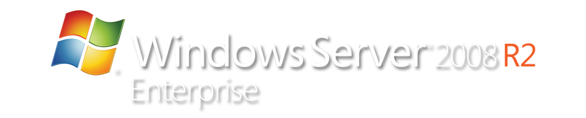

VM Role Workflow
Consistent Images
(Base+Diff)
Base.VHD
VM Role
Instance #1
Boot VHD
Customize VHD
Save Diff.VHD
Windows
Patches
VM Role
Instance #2
Blob Storage
Customer
Applications
VM Role
Instance #3
Sysprep
Windows Azure
Integration Components
On-Premises
Cloud

Slide 23
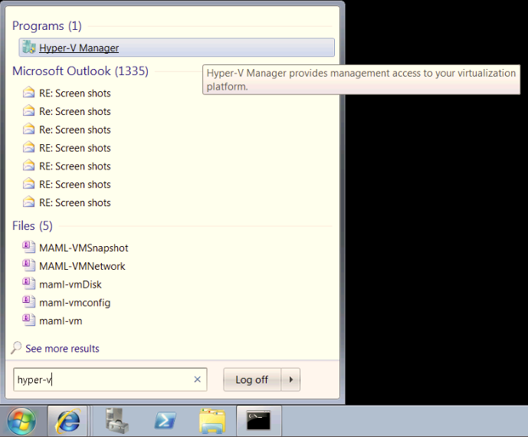
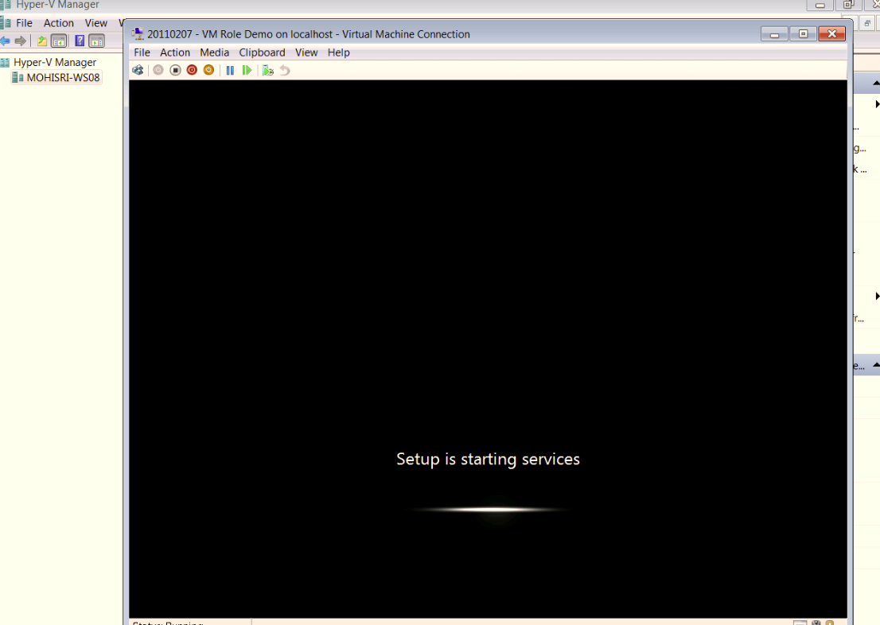
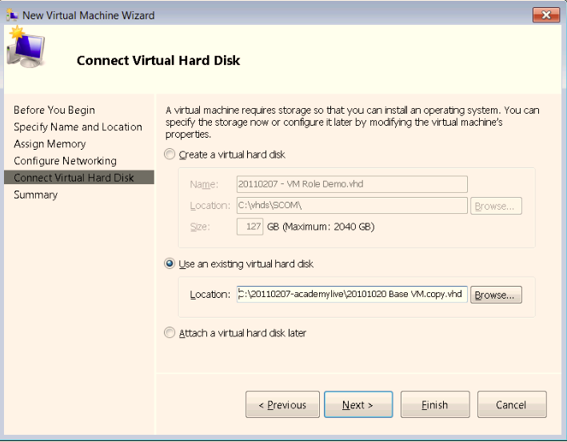
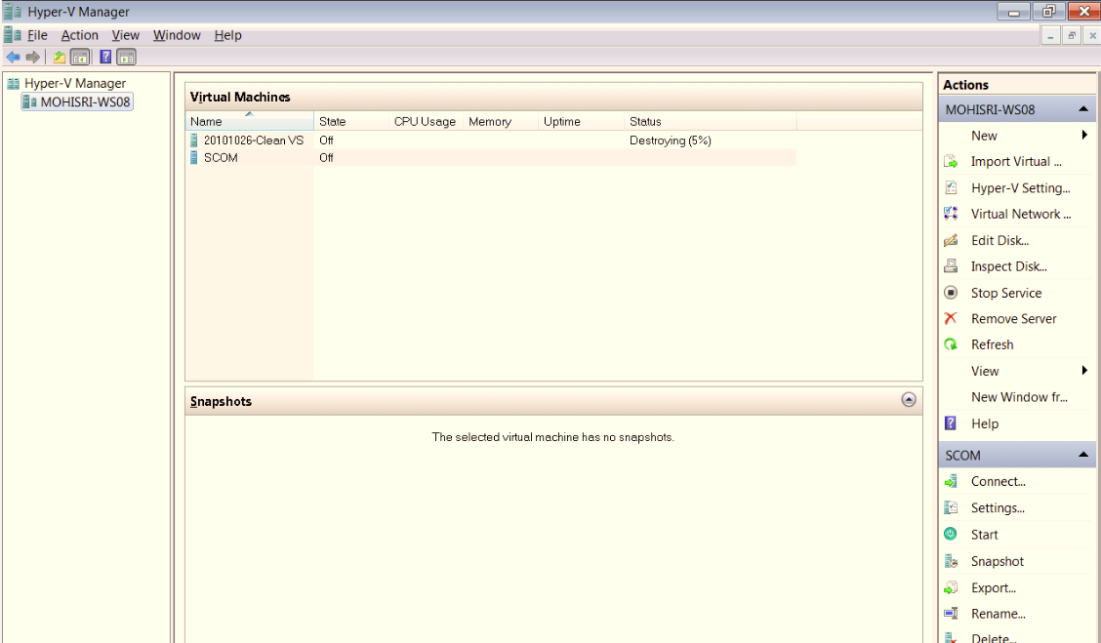
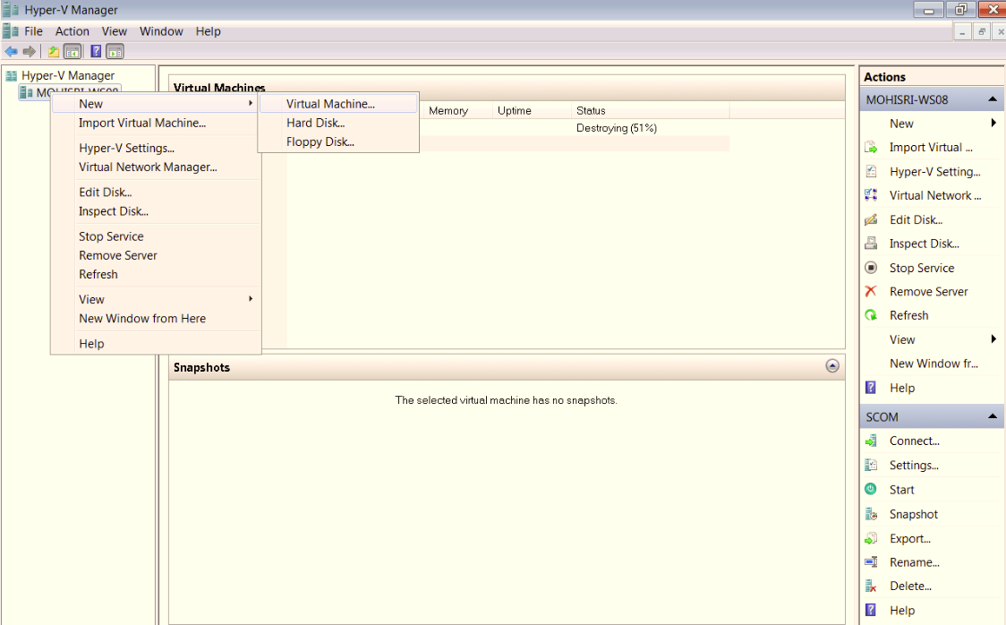
Image Composition
Image Set-up

Slide 24
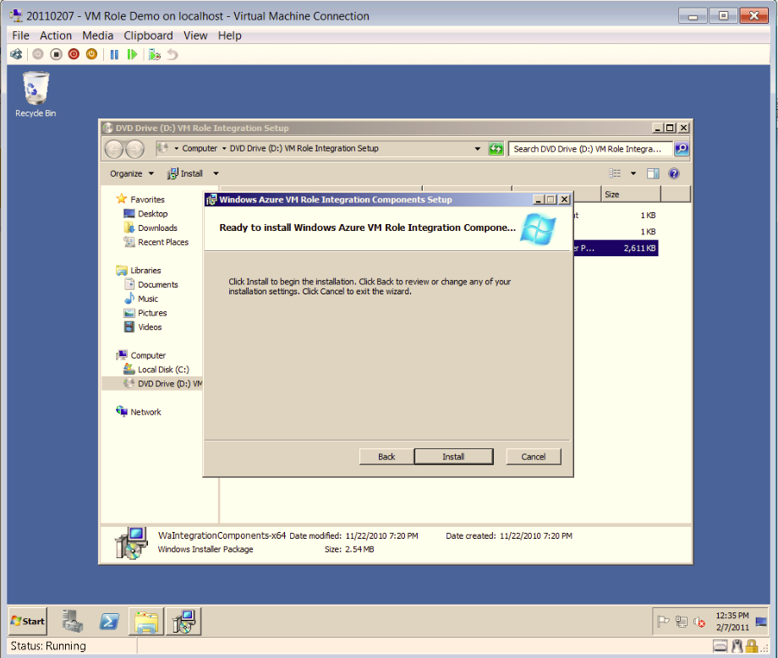
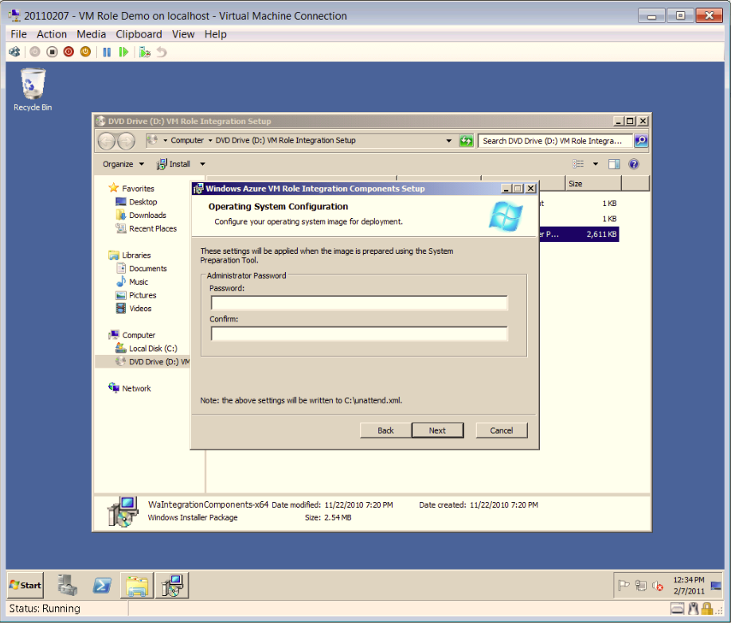
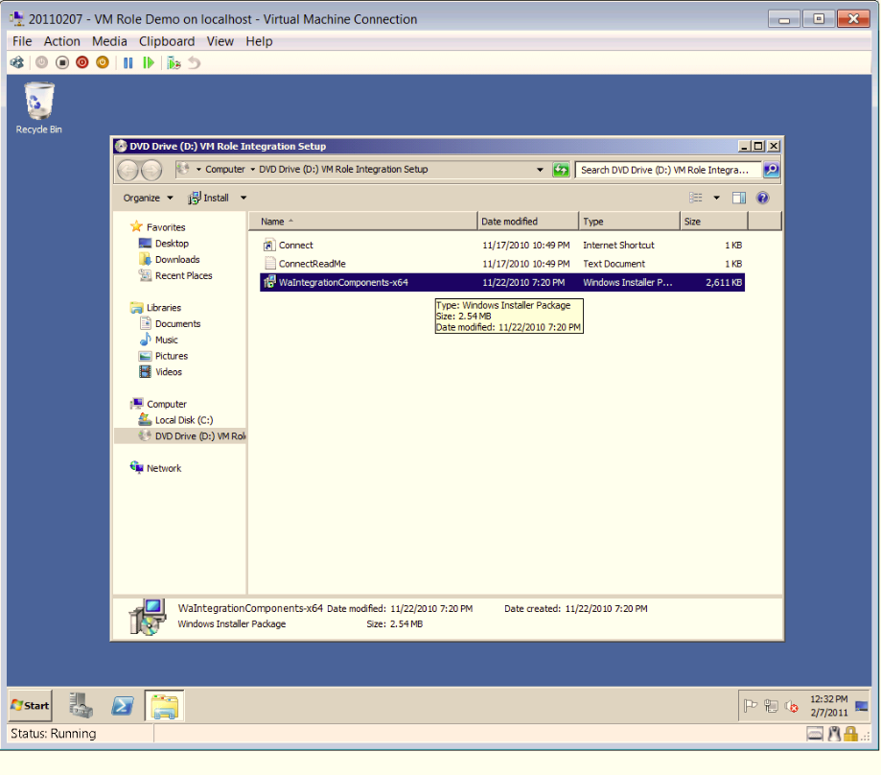
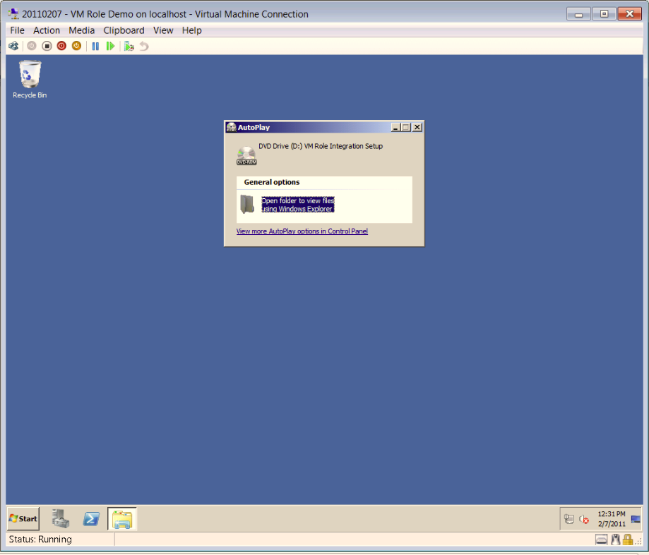
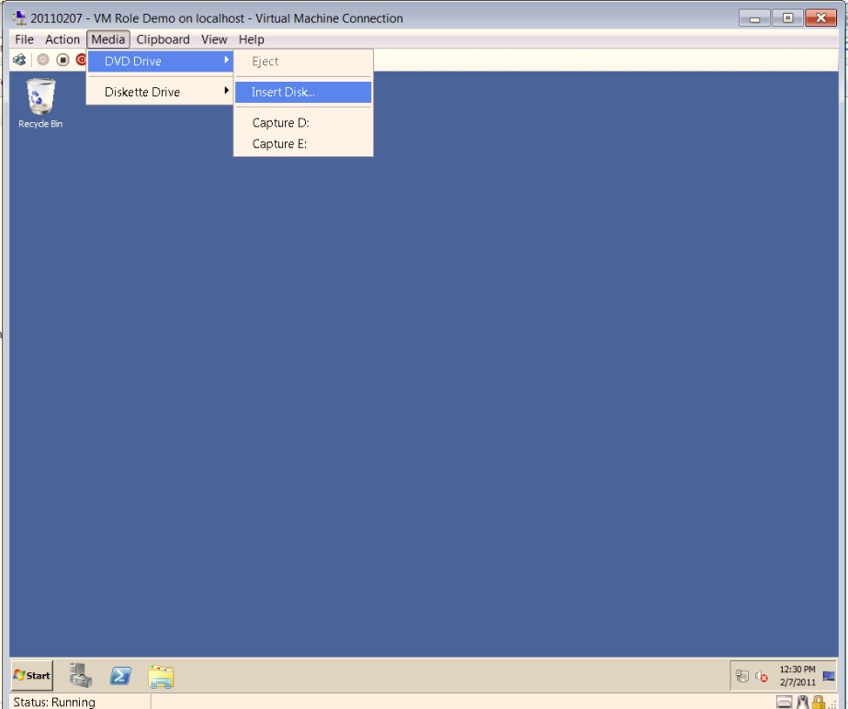
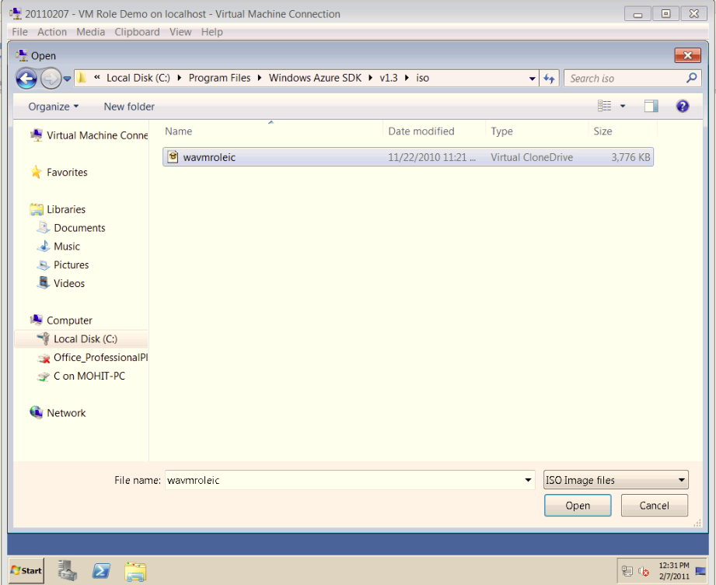
Image Composition
Installing Windows Integration Components

Slide 25
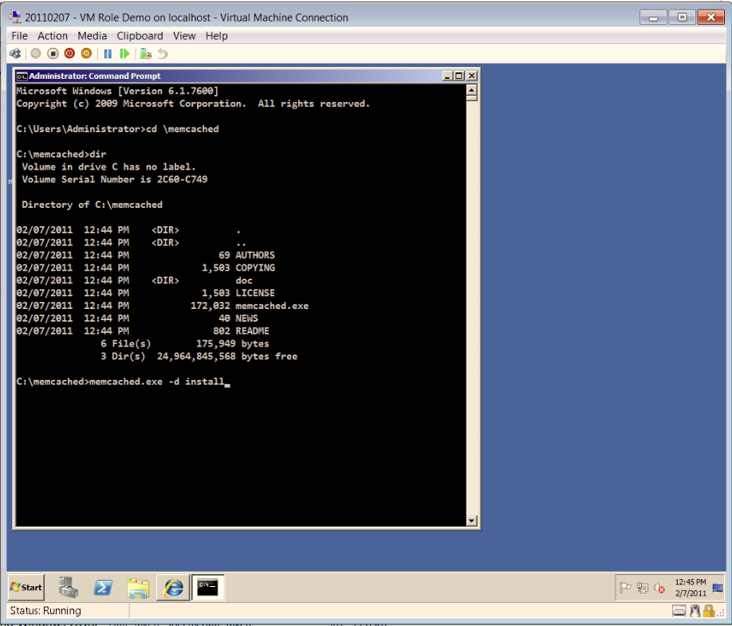
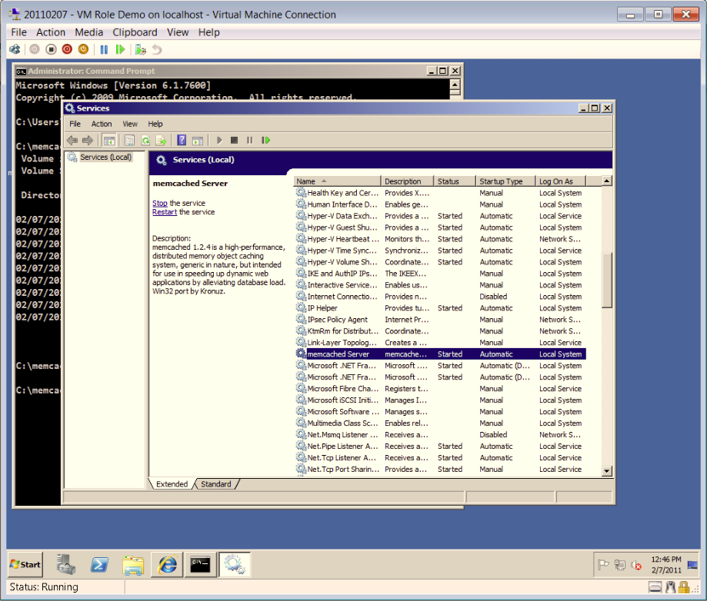
Image Composition
Application Install

Slide 26
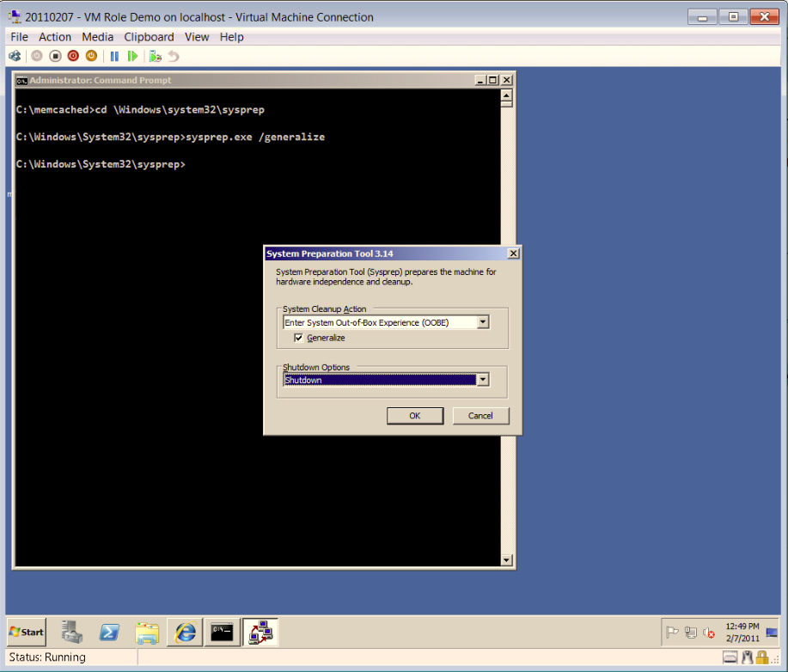
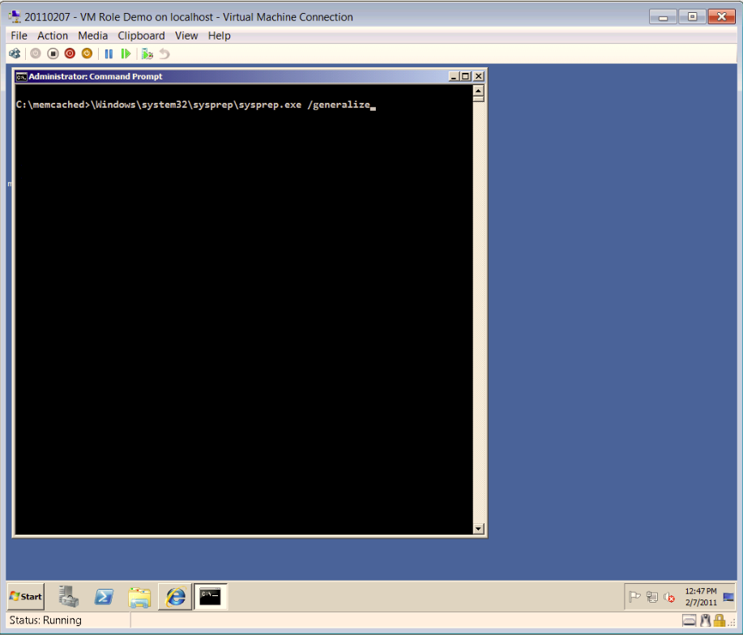
Image Composition
Sysprep Generalize

Slide 27
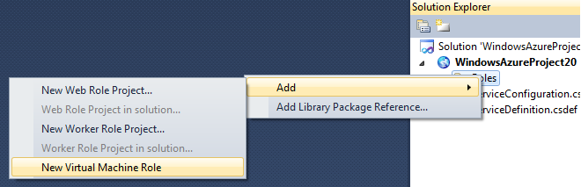
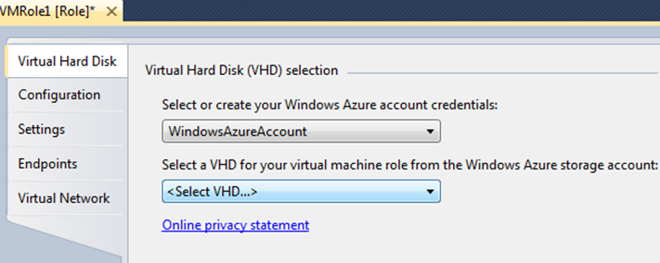
Create Service
Visual Studio

Slide 28
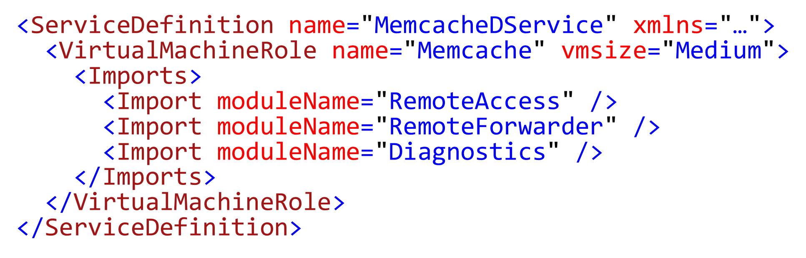
Create Service
Service Definition

Slide 29
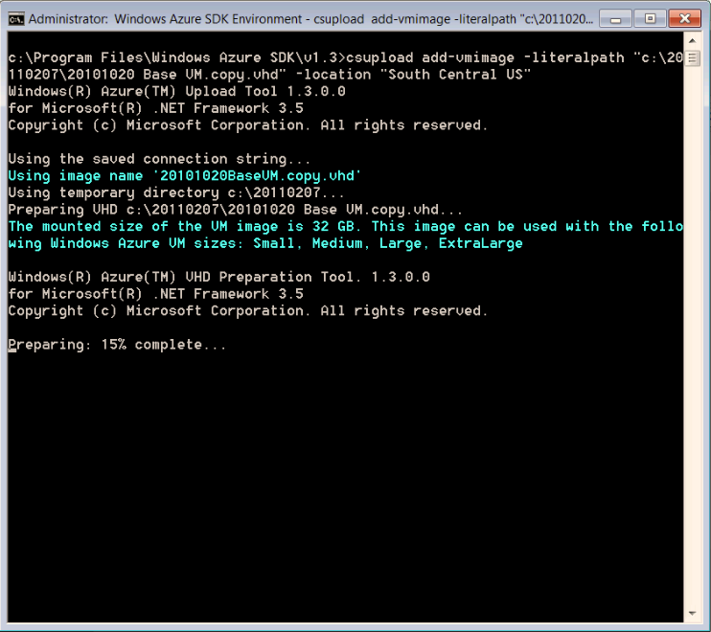
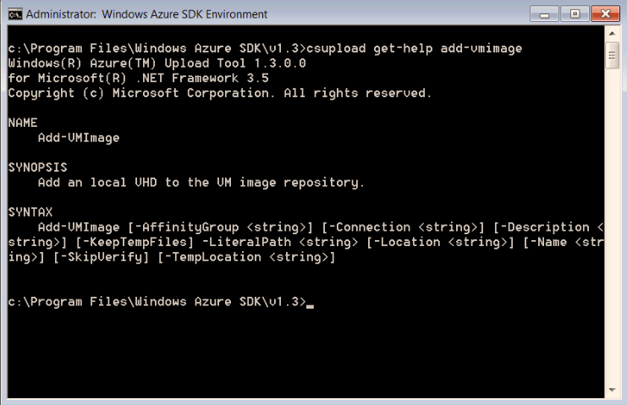
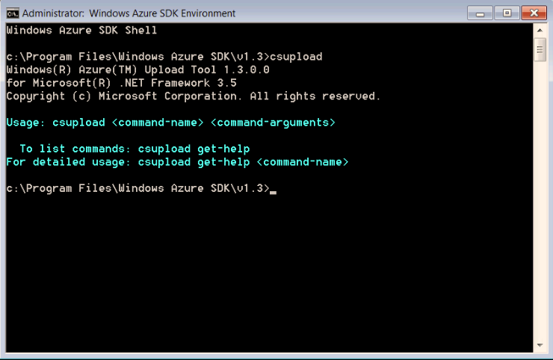
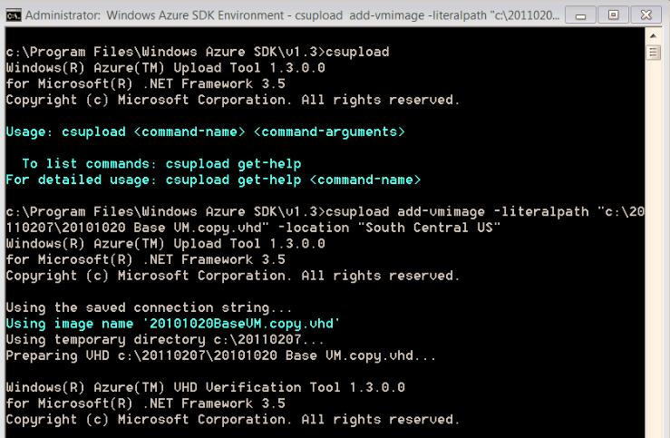
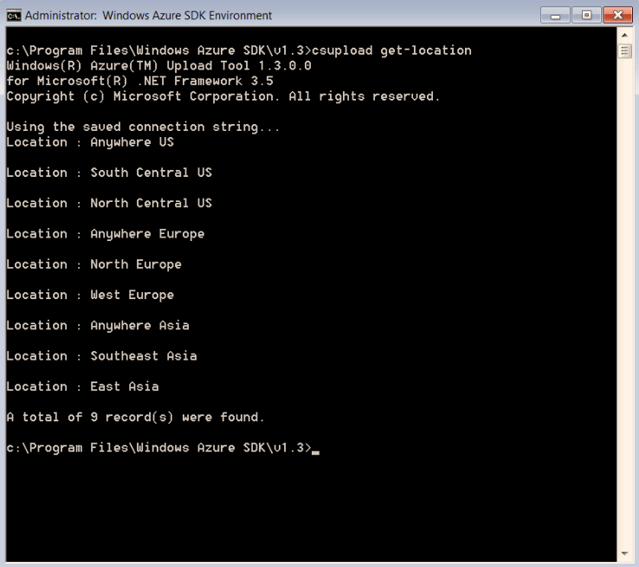
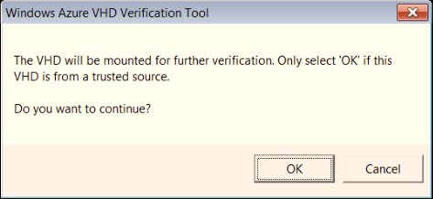
Upload Image
CSUpload

Slide 30
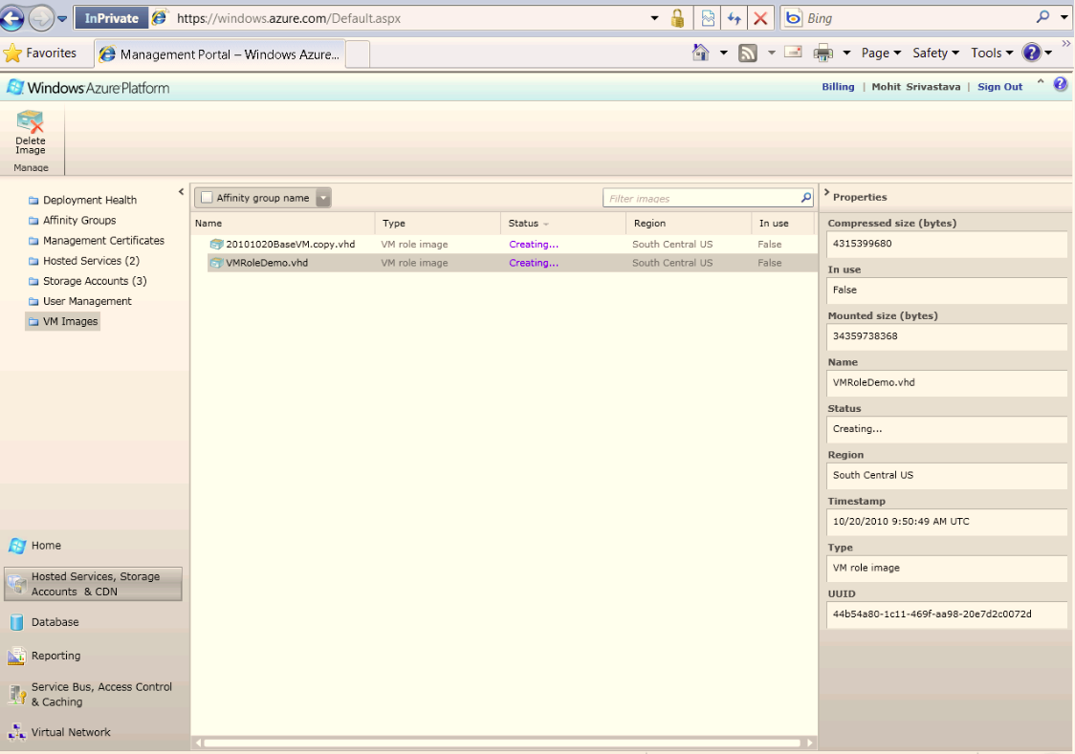
Upload Image
Image Repository

Slide 31
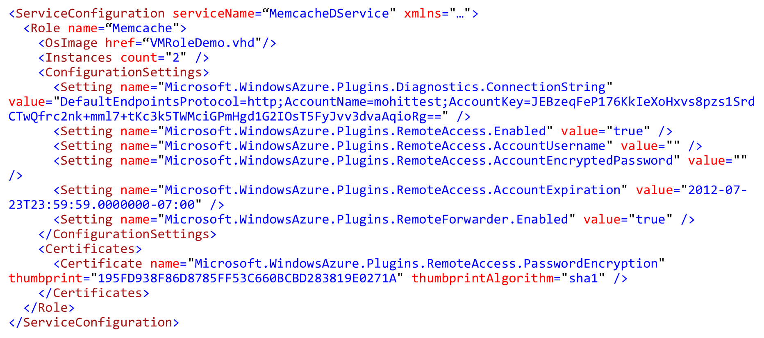
Deploy Service
Service Configuration

Slide 32
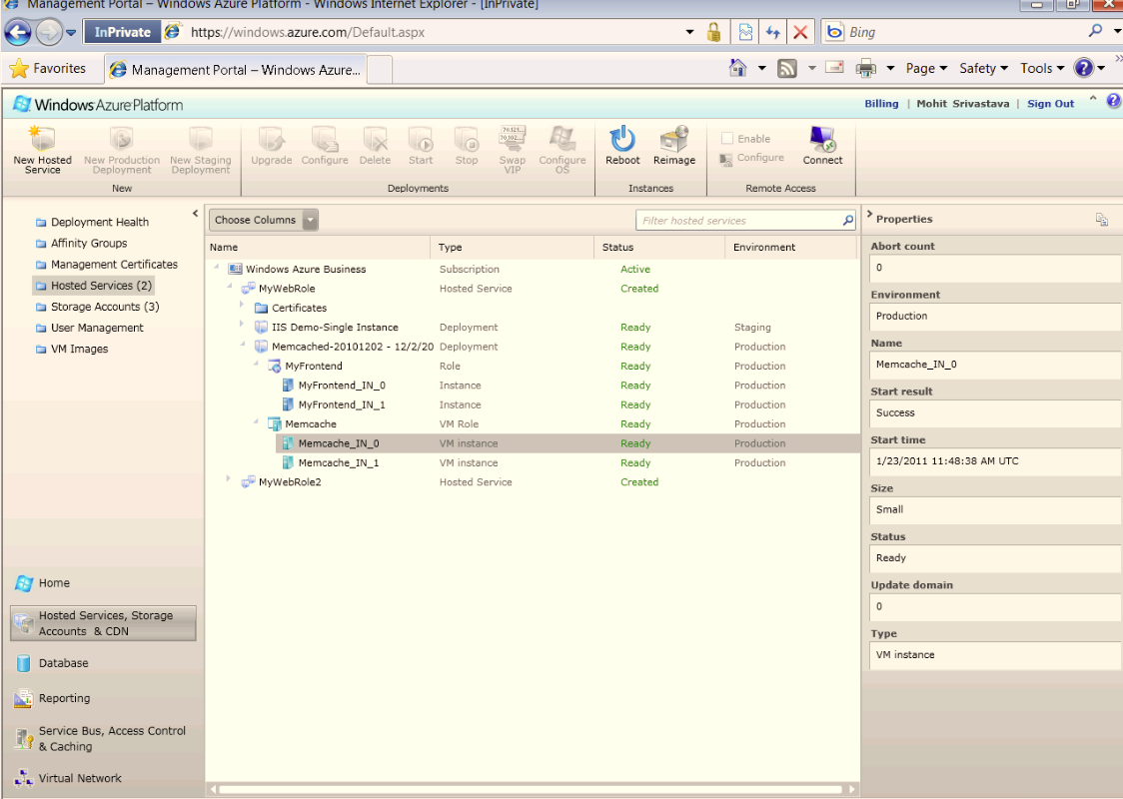
Deploy Service
Portal

Slide 33

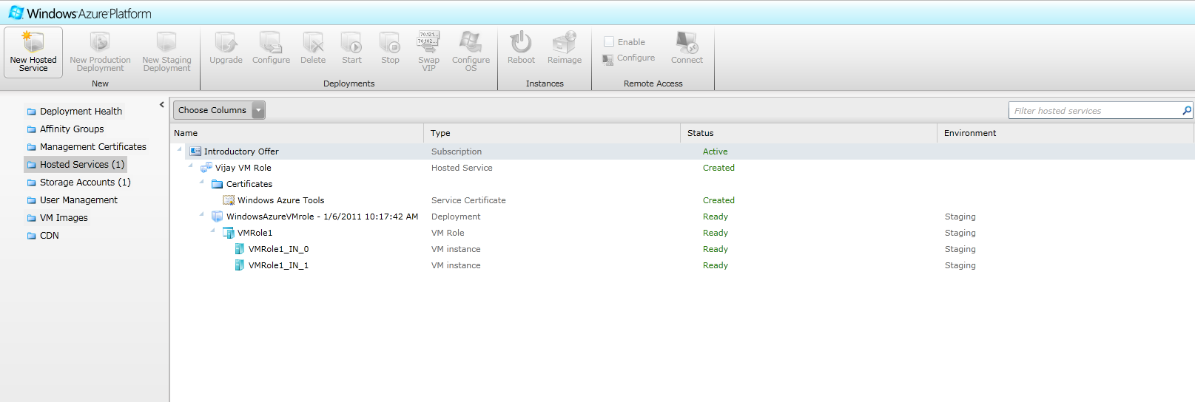
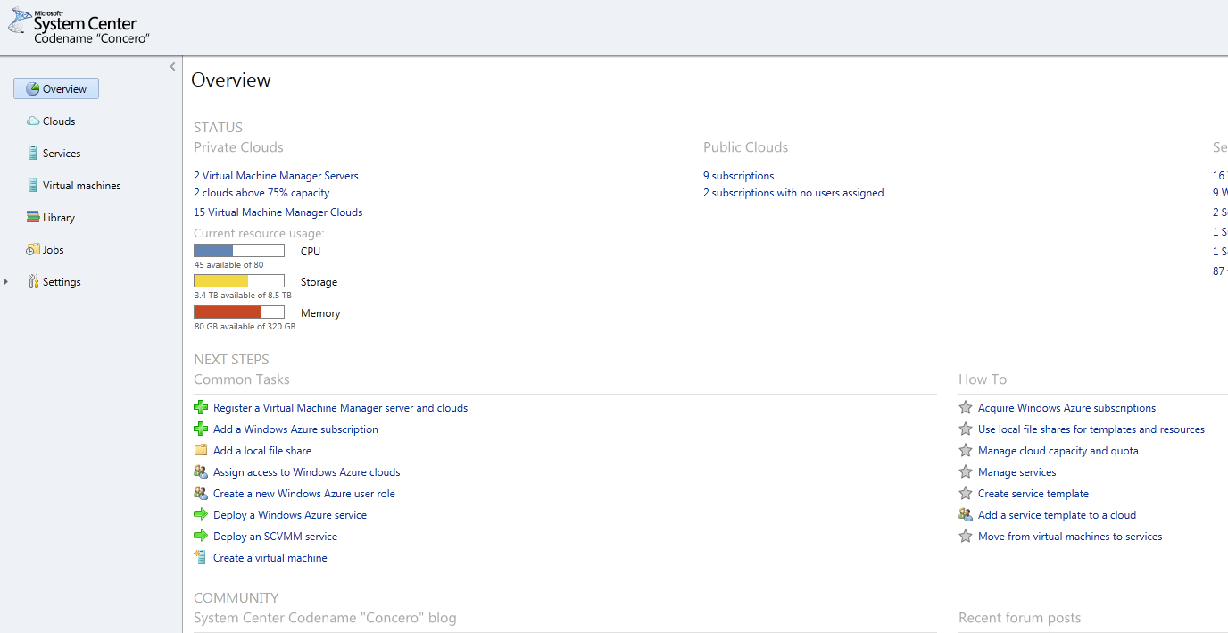
Deploying a Service to the Cloud:
From IT Administrator’s perspective
Service
Windows Azure Portal
System Center “Concero”
Service package uploaded to Windows Azure
  System Center Concero provides IT Pro experience for uploading service package
  Windows Azure portal provides developers the ability to upload service package
  Service package passed to Windows Azure Service Management API which validates and converts package
Service Management sends service to Fabric Controller (FC) based on target region
FC stores image in repository and deploys service
Visual Studio
Windows Azure
Service Management API
US-North Central Datacenter
Fabric Controller

Slide 34
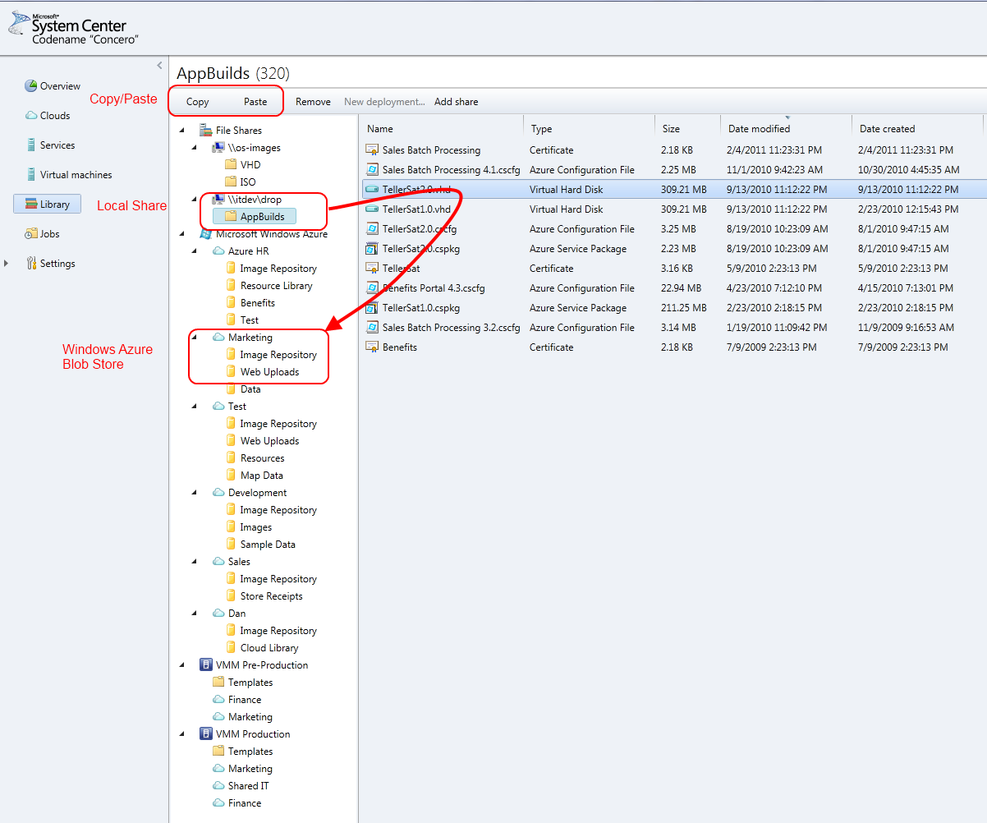
Copying VHD using System Center “Concero”

Slide 35
Deploying a Service Containing a VM Role
demo

Slide 36
Deployment Patterns
Deployment Pattern | Scalability | Ease of Implementing Scalability | State on the VM
Web Farm – “Stateless Identical Frontends” | High | Easy to Implement | None
Compute Farm – “Stateless Identical Compute Node” | High | Easy to Implement | None
Clustered – “Stateful Similar Nodes” | May or May Not Be High | Medium Difficulty | Some on VM, but on Windows Azure drive and not the local disk

Slide 37

Deployment Patterns – High Performance Computing
HPC :- Media Encoding
VM Role 1
HPC:- Media Encoding
SQL Azure
LB
VM Role 2
Stateless Multi-instance VMs connecting to SQL Azure
HPC :- Media Encoding
VM Role 3

Slide 38
Deployment Patterns – Migrating existing Application
Legacy Java/Tomcat Web App
Active Directory
VM Role 1
Legacy Java/Tomcat Web App
DNS
LB
VM Role 2
Windows Azure Connect
SQL Server
On-Premise Machine

Slide 39
VM Role – Common Questions
Will any WS08 R2-based application work?
  No, VM Role inherits some Web/worker restrictions:
    SLA requires at least two identical/similar instances
    No durability of OS image on hardware failure
    One public IP per service (unless using Windows Azure Connect)
Does Windows Azure take care of *everything*?
  No
    With VM Role, the customer creates & maintains the OS
    Windows Azure does not automatically understand the health of the applications running in our VM
  But, since you deploy services instead of individual VM’s, Windows Azure does automate many management tasks.

Slide 40
VM Role – Common Questions
How is it priced?
  It is priced by the CPU-hour
How does licensing in the cloud work?
  Windows:
    Included in the CPU-hour price
    Licensing status of uploaded image is not considered
  Applications: Per the licensing terms of the application

Slide 41
Q & A

Slide 42
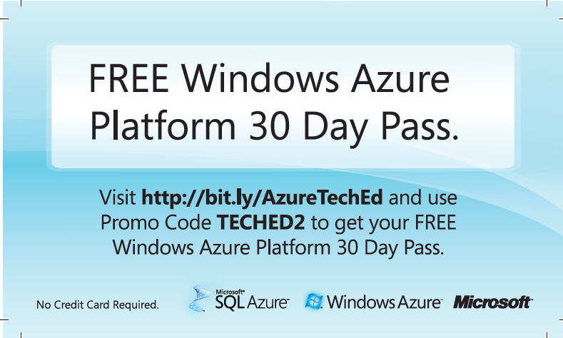
Free Windows Azure Platform 30 Day Pass

Slide 43

Track Resources
Don’t forget to visit the Cloud Power area within the TLC (Blue Section) to see product demos and speak with experts about the Server & Cloud Platform solutions that help drive your business forward.
You can also find the latest information about our products at the following links:
Cloud Power - http://www.microsoft.com/cloud/
Private Cloud - http://www.microsoft.com/privatecloud/
Windows Server - http://www.microsoft.com/windowsserver/
Windows Azure - http://www.microsoft.com/windowsazure/
Microsoft System Center - http://www.microsoft.com/systemcenter/
Microsoft Forefront - http://www.microsoft.com/forefront/

Slide 44





Resources
  Connect. Share. Discuss.
http://northamerica.msteched.com
Learning
  Sessions On-Demand & Community
  Microsoft Certification & Training Resources
www.microsoft.com/teched
www.microsoft.com/learning
  Resources for IT Professionals
  Resources for Developers
http://microsoft.com/technet
http://microsoft.com/msdn

Slide 45












Complete an evaluation on CommNet and
enter to win!

Slide 46


Slide 47

© 2011 Microsoft Corporation. All rights reserved. Microsoft, Windows, Windows Vista and other product names are or may be registered trademarks and/or trademarks in the U.S. and/or other countries.
The information herein is for informational purposes only and represents the current view of Microsoft Corporation as of the date of this presentation. Because Microsoft must respond to changing market conditions, it should not be interpreted to be a commitment
on the part of Microsoft, and Microsoft cannot guarantee the accuracy of any information provided after the date of this presentation. MICROSOFT MAKES NO WARRANTIES, EXPRESS, IMPLIED OR STATUTORY, AS TO THE INFORMATION IN THIS PRESENTATION.

Slide 48
Backup

