Slide 1

Columnstore Indexes Unveiled
DBI 312
Eric N Hanson
Principal Program Manager
Microsoft

Slide 2
Alice, Today

Slide 3
Alice, Today

Slide 4
Alice, Today
SELECT prod ..
FROM Product, ,,,
WHERE ….

Slide 5
Alice, Today

Slide 6
Alice, Today
Mon | Prod | Cus | Sales
Sept | Cxtpo | Aam | 109.23
Oct | Hifyw | Cty | 289.35
Nov | Nrvan | Rrst | 453.89
Dec | Cxtpo | Cty | 321.79

Slide 7
Alice, Today
?
Mon | Prod | Cus | Sales
Sept | Cxtpo | Aam | 109.23
Oct | Hifyw | Cty | 289.35
Nov | Nrvan | Rrst | 453.89
Dec | Cxtpo | Cty | 321.79

Slide 8
Alice, Tomorrow

Slide 9
Alice, Tomorrow
SELECT prod ..
FROM Product, ,,,
WHERE ….

Slide 10
Alice, Tomorrow
Mon | Prod | Cus | Sales
Sept | Cxtpo | Aam | 109.23
Oct | Hifyw | Cty | 289.35
Nov | Nrvan | Rrst | 453.89
Dec | Cxtpo | Cty | 321.79

Slide 11
Alice, Tomorrow
SELECT custom ..
FROM Cust, ,,,
WHERE ….

Slide 12

Alice, Tomorrow
Aha!

Slide 13
Project Apollo
Accelerates data warehouse queries
  New columnstore index
  Improved query execution
Makes SQL Server more interactive
Easy to use
Reduces TCO

Slide 14
Data warehouse workload
Read-mostly
  Load large amounts of data
  Append new data incrementally
  Rarely update existing data
  Often retain data for given time (e.g. 1, 3, 7 yrs)
    Sliding window data management

Slide 15

Sliding window
2010
2010
2011
2009
2009
2010
2008
2008
2009
2007
2008
2007

Slide 16
Data warehouse schemas and queries
Star schema
  Fact tables ⬅ put columnstore indexes here
  Dimension tables
Star joins
Most queries aggregate data

Slide 17
Star schema
FactSales
DimDate
FactSales(CustomerKey int,
ProductKey int,
EmployeeKey int,
StoreKey int,
OrderDateKey int,
SalesAmount money)
DimCustomer(CustomerKey int,
FirstName nvarchar(50),
LastName nvarchar(50),
Birthdate date,
EmailAddress nvarchar(50))
DimProduct …
DimEmployee
DimCustomer
DimStore

Slide 18
Star join query
SELECT TOP 10 p.ModelName, p.EnglishDescription,
SUM(f.SalesAmount) as SalesAmount
FROM FactResellerSalesPart f, DimProduct p, DimEmployee e
WHERE f.ProductKey=p.ProductKey
AND e.EmployeeKey=f.EmployeeKey
AND f.OrderDateKey >= 20030601
AND p.ProductLine = 'M' -- Mountain
AND p.ModelName LIKE '%Frame%'
AND e.SalesTerritoryKey = 1
GROUP BY p.ModelName, p.EnglishDescription
ORDER BY SUM(f.SalesAmount) desc;

Slide 19
“Typical” data warehouse queries
Process large amounts of data
Reporting queries
Often slow (minutes to hours)
DBAs spend considerable effort
  Designing indexes, tuning queries
  Building summary tables, indexed views, OLAP cubes

Slide 20
Query Acceleration With Columnstore Indexes
demo

Slide 21
Columnar storage structure
Row store:
…
C1
C2
C3
C4
C5
C6
Pages
Column store:
Uses VertiPaq
compression

Slide 22
Reduced I/O using columnstore indexes
Fetches only needed columns from disk
Columns are compressed
Less IO
Better buffer hit rates
SELECT region, sum (sales) …
C2
C3
C1
C4
C5
C6

Slide 23
Advanced query execution technology
Batch mode execution of some operations
  Processes rows in batches
  Groups of batch operations in query plan
Efficient data representation
Highly efficient algorithms
Better parallelism

Slide 24
Column segments
Column segment contains values from one column for a set of about 1M rows
Column segments are compressed
Each column segment stored in separate LOB
Column segment is unit of transfer from disk
C1
C2
C3
C4
C5
C6
Set of about 1M rows
Column Segment

Slide 25
Constraints on use with other indexes & partitioning
Base table must be clustered B-tree or heap
Columnstore index:
  nonclustered
  one per table
  must be partition-aligned
  not allowed on indexed view
  can’t be a filtered index

Slide 26
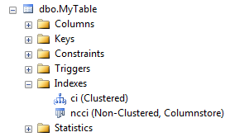
Creating the columnstore index
Create the table
Load data into the table
Create a non-clustered columnstore index on all, or some, columns
    CREATE NONCLUSTERED COLUMNSTORE INDEX ncci ON myTable(OrderDate, ProductID, SaleAmount)
  Object Explorer

Slide 27
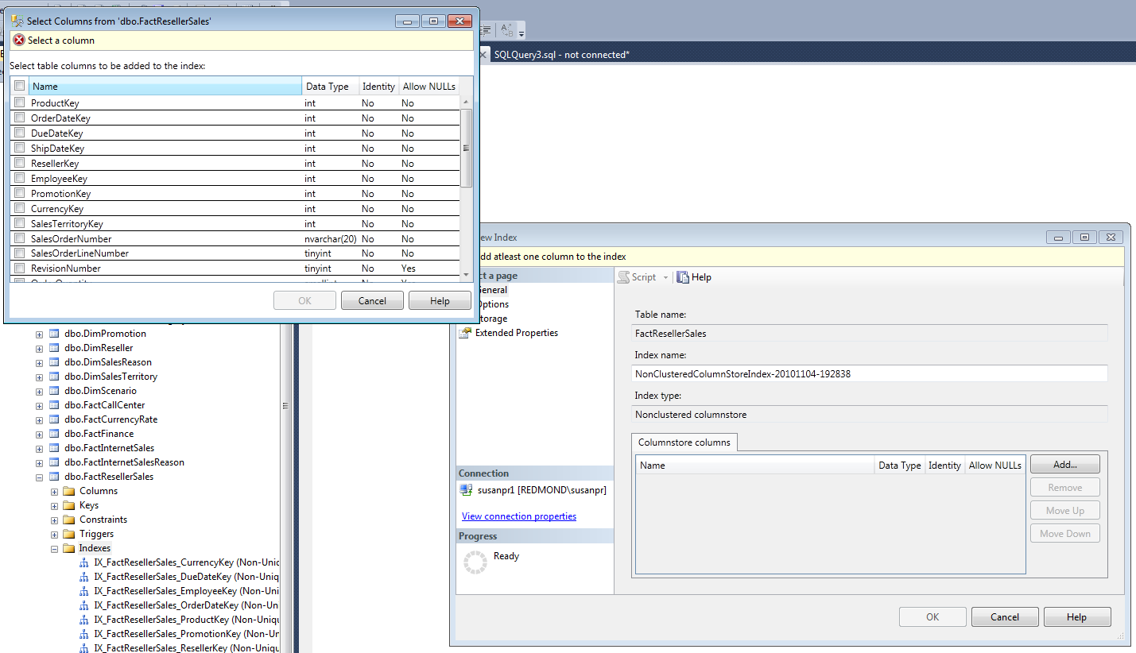
Index dialog makes index creation easy

Slide 28
Query optimization with columnstores
  Cost-based
  Optimizer chooses index
  Optimizer chooses batch mode operators

Slide 29
Using hints with columnstore indexes
use the columnstore index
use a different index
ignore columnstore
select distinct (SalesTerritoryKey)
from dbo.FactResellerSales with (index (ncci))
select distinct (SalesTerritoryKey)
from dbo.FactResellerSales with (index (ci))
select distinct (SalesTerritoryKey)
from dbo.FactResellerSales
option(ignore_nonclustered_columnstore_index)

Slide 30
Memory management
Memory management is automatic
Columnstore persisted on disk
Needed columns fetched into memory
Column segments flow between disk and memory
SELECT C2, SUM(C4)
FROM T
GROUP BY C2;
T.C1
T.C2
T.C3
T.C4
T.C4
T.C1
T.C2
T.C3
T.C1
T.C2
T.C3
T.C4
T.C1
T.C2
T.C4
T.C3
T.C1
T.C2
T.C3
T.C4

Slide 31


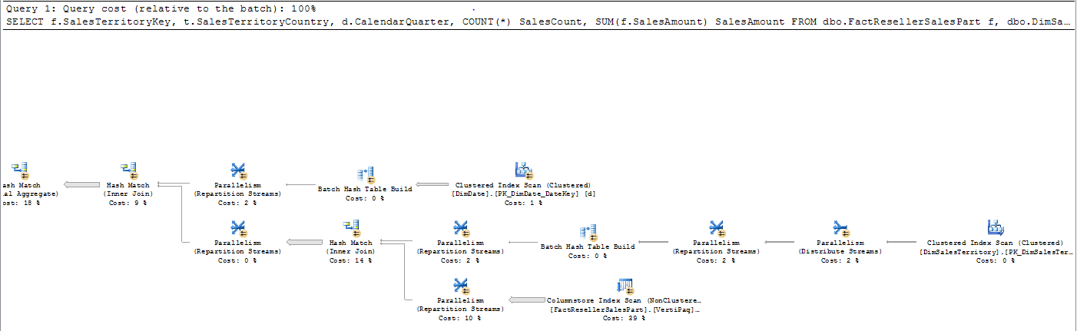
New showplan elements for columnstores and batch processing

Slide 32
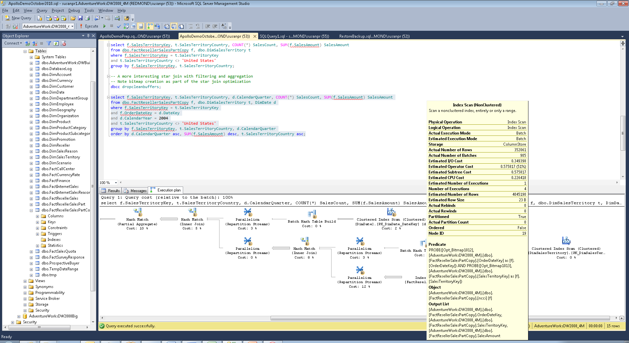

Slide 33
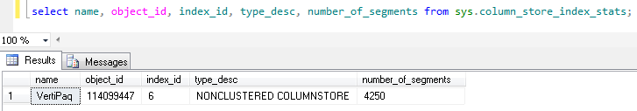
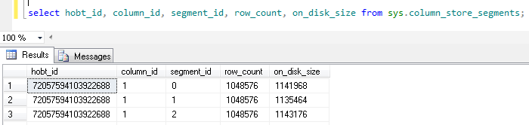
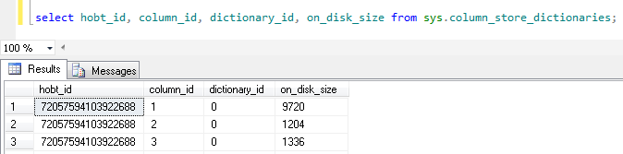
Columnstore index catalog tables

Slide 34
Columnstore indexes: interoperability with the rest of SQL Server
Most things “just work” with columnstore indexes
  Backup and restore
  Mirroring
  Log shipping
  SSMS
  Administration, tools

Slide 35
Data type restrictions
  Unsupported types
    decimal > 18 digits
    Binary
    BLOB
    (n)varchar(max)
    Uniqueidentifier
    Date/time types > 8 bytes
    CLR

Slide 36
Query performance restrictions
Outer joins
Unions
Consider modifying queries to hit “sweet spot”
  Inner joins
  Star joins
  Aggregation

Slide 37
Loading new data into a columnstore index
  Columnstore makes table read-only
  Partition switching allowed
  INSERT, UPDATE, DELETE, and MERGE not allowed
  Two recommended methods for loading data
  Disable, update, rebuild
  Partition switching

Slide 38
Adding data to a table with a columnstore index
Method 1: Disable the columnstore index
Disable (or drop) the index
  ALTER INDEX my_index ON MyTable DISABLE
Update the table
Rebuild the columnstore index
  ALTER INDEX my_index ON MyTable REBUILD

Slide 39
Adding data to a table with a columnstore index
Method 2: Use Partitioning
Load new data into a staging table
Build a columnstore index
    CREATE NONCLUSTERED COLUMNSTORE INDEX my_index ON StagingT(OrderDate, ProductID, SaleAmount)
Split empty partition
Switch the partition into the table
    ALTER TABLE StagingT SWITCH TO T PARTITION 5

Slide 40
Advanced near-real-time append
Partitioned table with columnstore index
Keep copy of data from latest partition in separate row-store table S
While(True) {
    Append new data to S for desired period (say 15 minutes)
    Columnstore index S
    Swap S with newest partition
    Drop columnstore index on S
    Insert rows in S to “catch up” S to current time
  }

Slide 41
When to build a columnstore index
Read-mostly workload
Most updates are appending new data
Workflow permits partitioning or index drop/rebuild
  Typically a nightly load window
Queries often scan & aggregate lots of data

Slide 42
What tables to columnstore index
Large fact tables
(Maybe) very large dimension tables

Slide 43
When not to build a columnstore index
Frequent updates
Partition switching or rebuilding index doesn’t fit workflow
Frequent small look up queries
  B-tree indexes may give better performance
Your workload does not benefit

Slide 44
Summary: Apollo in a nutshell
Columnstore technology
+
Advanced query processing
Astonishing speedup for DW queries

Slide 45
Thank you!

Slide 46

Database Platform (DAT) Resources
Required Slide
Track PMs will supply the content for this slide, which will be inserted during the final scrub.
  Visit the updated website for SQL Server® Code Name “Denali” on www.microsoft.com/sqlserver and sign to be notified when the next CTP is available
  Follow the @SQLServer Twitter account to watch for updates
Try the new SQL Server Mission Critical BareMetal Hand’s on-Labs
Visit the SQL Server Product Demo Stations in the DBI Track section of the Expo/TLC Hall. Bring your questions, ideas and conversations!
Microsoft® SQL Server® Security & Management | Microsoft® SQL Server® Optimization and Scalability
Microsoft® SQL Server® Programmability | Microsoft® SQL Server® Data Warehousing
Microsoft® SQL Server® Mission Critical | Microsoft® SQL Server® Data Integration

Slide 47





Resources
  Connect. Share. Discuss.
http://northamerica.msteched.com
Learning
  Sessions On-Demand & Community
  Microsoft Certification & Training Resources
www.microsoft.com/teched
www.microsoft.com/learning
  Resources for IT Professionals
  Resources for Developers
http://microsoft.com/technet
http://microsoft.com/msdn

Slide 48












Complete an evaluation on CommNet and
enter to win!

Slide 49


Slide 50

© 2011 Microsoft Corporation. All rights reserved. Microsoft, Windows, Windows Vista and other product names are or may be registered trademarks and/or trademarks in the U.S. and/or other countries.
The information herein is for informational purposes only and represents the current view of Microsoft Corporation as of the date of this presentation. Because Microsoft must respond to changing market conditions, it should not be interpreted to be a commitment
on the part of Microsoft, and Microsoft cannot guarantee the accuracy of any information provided after the date of this presentation. MICROSOFT MAKES NO WARRANTIES, EXPRESS, IMPLIED OR STATUTORY, AS TO THE INFORMATION IN THIS PRESENTATION.

