Slide 1

Upgrading to Microsoft SQL Server 2008
R2 and SQL Server Code-Named
“Denali”: A Comprehensive Look
DBI319
Peter Saddow (petersad@microsoft.com)
Senior Program Manager
Microsoft

Slide 2
Agenda
Upgrade Planning
Upgrade Strategies and Considerations
  Stand-alone Upgrade
  Cluster Upgrade
  Database Mirroring
  Log Shipping
  Feature-Specific Information
Upgrade Tools with Demos
Upgrade Resources

Slide 3
Upgrade Planning – Preparation
Review upgrade documentation
  SQL Sever editions/features
  Platform considerations
  Application compatibility
Decide on upgrade strategy
Establish backup and rollback plans
Establish certification process
Include latest SQL Server updates
Test the plan!!!

Slide 4
Including Latest Updates
SQL Server 2008/2008 R2 → Slipstream
  You need to many build slipstream media, see http://blogs.msdn.com/search/searchresults.aspx?q=slipstream&sections=11606
Denali → Product Update
  Builds upon Slipstream
  Obtains SQL Server updates from Windows Update, WSUS Server or a file share

Slide 5
Slipstream/Product Update
Demo

Slide 6
Upgrade Planning – Pre-Upgrade
Check environment
  Run SQL Server Upgrade Advisor
  Run SQL Server Best Practices Analyzer (BPA)
  Check database consistency (DBCC CHECKDB)
  Reduce database size (DBCC SHRINKDATABASE)
  Should trace flags be carried forward?
Back up your environment
  System and user databases including DTS/SSIS packages

Slide 7
Upgrade Planning – The Upgrade
Document the process
Perform the upgrade
Check server, storage and network health
Back up databases after upgrading
Go/No-go (Checkpoint)
  Troubleshoot if there was a failure
  Determine whether you need to roll back
  Sanity test your upgrade

Slide 8
Upgrade Planning – Post-Upgrade
Integrate the new installation into the environment
Conduct end-to-end application acceptance
Decommission/uninstall old hardware/installation
for side-by-side
Revisit Upgrade Advisor suggestions
Run SQL Server BPA again

Slide 9
Upgrade Planning – Post-Upgrade
Ensure optimum performance by
  Executing DBCC CHECKDB WITH DATA_PURITY
  Executing DBCC UPDATEUSAGE
  Ensuring that autostats are turned on
Keep current with critical and security updates

Slide 10
Agenda
Upgrade Planning
Upgrade Strategies and Considerations
  Stand-alone Upgrade
  Cluster Upgrade
  Database Mirroring
  Log Shipping
  Feature-Specific Information
Upgrade Tools with Demos
Upgrade Resources

Slide 11
In-Place Upgrade – Overview
Upgrades existing installation
  On same machine and platform
  Instance name remains
  Old instance is removed
  New shared components are installed
User data and configuration is preserved
Mostly automated process through Setup
Existing instance is intact as long as possible
Can upgrade to same edition or higher

Slide 12
In-Place Upgrade – Matrix
From
SQL Server 2000 SP4
To
SQL Server 2005 SP2
SQL Server 2008 R2
SQL Server 2008
SQL Server 2005 SP4
SQL Server 2008 SP2
SQL Server Denali
SQL Server 2008 R2
NOTE: Minimum SP shown

Slide 13
In-Place Upgrade – Pros/Cons
Pros:
  Faster and less effort than side-by-side
  Setup moves data and configuration
  Connects to same instance after upgrade
  Setup contains many Upgrade Rules
Cons:
  Less flexibility
  Cannot change platform
  Possibly complex to rollback

Slide 14
In-Place Upgrade
Demo

Slide 15
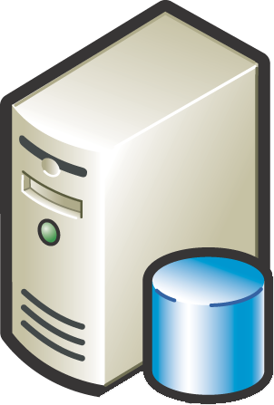












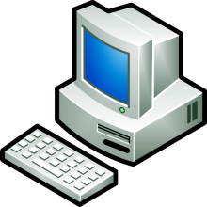
Side-by-Side Upgrade – Overview
SQL Server 2005/2008
Instance
SQL Server Denali
Instance
Compare
and
Verify
Verified!

Slide 16
Side-by-Side Upgrade – Pros/Cons
Pros:
  Ability to change platform
  Existing installation continues to be available
    Do you want to keep data in sync?
    Easier to roll back to old instance
  Better downtime control
Cons:
  Moving data and objects is more complex
  Not practical for very large databases unless using a SAN
  Harder to troubleshoot issues

Slide 17
Agenda
Upgrade Planning
Upgrade Strategies and Considerations
  Stand-alone Upgrade
  Cluster Upgrade
  Database Mirroring
  Log Shipping
  Feature-Specific Information
Upgrade Tools with Demos
Upgrade Resources

Slide 18
Cluster Upgrade – Overview
Rolling upgrade process is significantly different,
started in SQL Server 2008
  Less downtime over prior versions
  Easier to troubleshoot issues
Manually upgrade each node
  Start with passive and move to active node
  Failover happens automatically
Patching process is similar

Slide 19
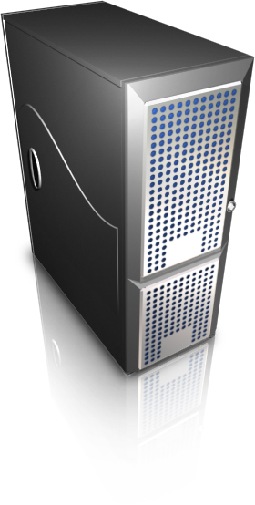


Clustering Upgrade
Active
Passive
2-node cluster
Windows 2008 with Service Pack 2
SQL Server 2005 SP4

Slide 20
Clustering Upgrade – Prerequisites
Step 3:
Install prerequisites and upgrade shared features
Reboot, if prompted
Step 1:
Install prerequisites and upgrade shared features
Reboot, if prompted
Active
Passive
SQL Instance Manual Failover
Step 2:
Fail over to the upgrade node

Slide 21
Clustering Upgrade – Finishing
Step 4:
Upgrade to SQL Server 2008 R2 on passive node
Step 5:
Upgrade to SQL Server 2008 R2 on active node
SQL Server 2008 R2
No client connection for 1-2 minutes
SQL Server 2008 R2
Removed from Cluster Group Possible Owners
Passive
Active
Active
Step 6: Setup performs
the failover

Slide 22
Agenda
Upgrade Planning
Upgrade Strategies and Considerations
  Stand-alone Upgrade
  Cluster Upgrade
  Database Mirroring
  Log Shipping
  Feature-Specific Information
Upgrade Tools with Demos
Upgrade Resources

Slide 23
Database Mirroring
Rolling upgrades supported
Mirror version must be equal or higher than Principal
At least one manual failover required
Remove witness
1. Upgrade Mirror First
2. Wait for Low Activity Window
3. ALTER Mode to SYNCHRONOUS
4. Failover to Mirror: (New Principal)
5. ALTER Mode to ASYNCHRONOUS
6. UPGRADE New Mirror Instance
Asynchronous Mirroring: Steps 1 - 6
Synchronous Mirroring: Steps 1, 4, 6
Notes:
23

Slide 24
Cluster Upgrade with Mirroring
Step 4: Manually failover to the database mirroring partner for each database
Step 1: Upgrade mirrored instance
Step 2: Manual Failover each database to mirroring partner
SQL Server 2008 R2
Step 3:
Upgrade cluster to SQL Server 2008 R2
Mirrored SQL
Principal
SQL Server Cluster
Mirroring suspended
Mirroring resumed
Active
Passive
SQL Server 2008 R2

Slide 25
Agenda
Upgrade Planning
Upgrade Strategies and Considerations
  Stand-alone Upgrade
  Cluster Upgrade
  Database Mirroring
  Log Shipping
  Feature-Specific Information
Upgrade Tools with Demos
Upgrade Resources

Slide 26
Upgrading Log Shipping
No upgrade path from SQL Server 2000
Role change
  Downtime is shortened
  Not generally recommended as more complex
No role change
    Easier
    High-level steps
      Upgrade the instance hosting the secondary database
      Manually restore all transaction logs created while upgrading from primary to secondary
      Make final transaction log backup on primary, and then restore
      Upgrade instance containing the primary
Notes:
26

Slide 27
Agenda
Upgrade Planning
Upgrade Strategies and Considerations
  Stand-along Upgrade
  Cluster Upgrade
  Database Mirroring
  Log Shipping
  Feature-Specific Information
Upgrade Tools with Demos
Upgrade Resources

Slide 28
Upgrading Replication
An in-place upgrade is preferred
Typical upgrade flow: Distributor, Publisher, Subscriber
Mixed versions are supported, but:
  Distributor version must always be equal or newer than Publisher
  Subscribers for transactional replication can be within 2
  versions newer/older of Publisher
  Subscribers for merge replication must be equal to or older
  than Publisher

Slide 29
Upgrading Analysis Services
Upgrading from 2005 to 2008 or Denali
  Either in-place or side-by-side upgrade
Upgrading from SQL Server 2000
  Using the Analysis Services Migration Wizard

Slide 30
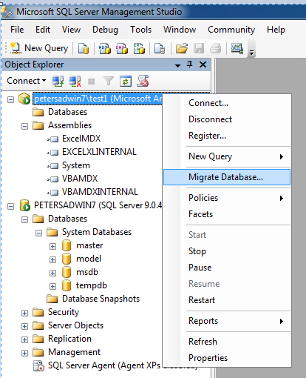
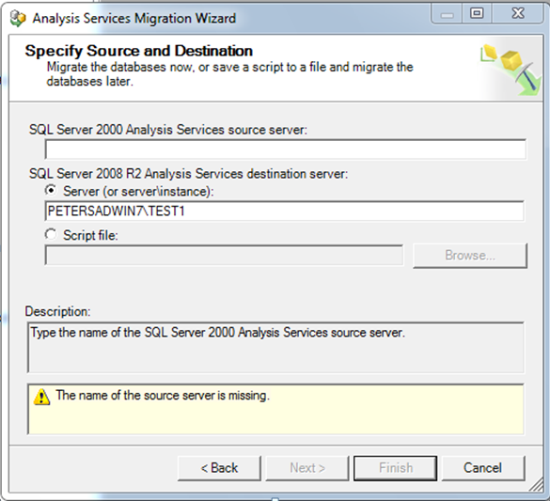
Upgrading Analysis Services

Slide 31
Upgrading Integration Services and DTS
DTS: Use the DTS Package Migration Wizard to migrate
to SSIS format
  No 64-bit design/run time for DTS packages
  No 32-bit design/run time support for DTS packages on
  Itanium-based systems
Conversion tool available from Microsoft partners, such as www.dtsxchange.com
SSIS 2005, run the SSIS Upgrade Wizard

Slide 32
Upgrading PowerPivot
PowerPivot for Excel
  Need to uninstall and install current version
  Upgrading Embedded PowerPivot Databases happens when
  you open a workbook
PowerPivot for SharePoint
  In-place upgrade from SQL Server 2008 R2 PowerPivot for SharePoint to Denali
    Prerequisites
      SharePoint 2010 SP1
      You must be a farm administrator
    Use PowerPivot Configuration Tool to upgrade farm and web
    application solutions

Slide 33
Agenda
Upgrade Planning
Upgrade Strategies and Considerations
  Stand-alone Upgrade
  Cluster Upgrade
  Database Mirroring
  Log Shipping
  Feature-Specific Information
Upgrade Tools with Demos
Upgrade Resources

Slide 34
Upgrade Advisor
Helps you prepare for the upgrade
Analyzes SQL Server installed instances, databases, traces and script files
Generates a report of detected issues
  Provides suggestions for addressing issues
    Blocking issues must be addressed
    Warnings can be addressed after upgrade

Slide 35
Upgrade Advisor
Available through SQL Server Installation Center, on source media, and through SQL Server Feature Pack
Demo

Slide 36
SQL Server Best Practice Analyzer (BPA)
Determine if configurations are set according to best practices
BPA 2005, run against SQL Server 2005
BPA 2008 R2, run against SQL 2008/2008 R2
  Must install Microsoft Baseline Configuration Analyzer 2.0 first
  Installing on a non-domain joined machine
    http://blogs.msdn.com/b/petersad/archive/2011/05/05/installing-sql-server-2008-best-practice-analyzer-bpa-on-a-non-domain-machine.aspx

Slide 37
Best Practice Analyzer
- Available through Microsoft Download Center
Demo

Slide 38
Deprecated Feature Object
Determine whether your application is submitting deprecated commands
Plan for the removal of these deprecated commands

Slide 39
Deprecated Feature Object
- Available through Profiler
Demo

Slide 40
Discover SQL Server Instances
SQL Server Discovery Tool
Microsoft Assessment and Planning (MAP) Toolkit
WMI provider, details at http://msdn.microsoft.com/en-us/library/dd981032.aspx

Slide 41
SQL Server Discovery Tool
- Available through the Installation Center
Demo

Slide 42
Microsoft Assessment and Planning (MAP) Toolkit
- Available through Microsoft Download Center
Demo

Slide 43
Agenda
Upgrade Planning
Upgrade Strategies and Considerations
  Stand-alone Upgrade
  Cluster Upgrade
  Database Mirroring
  Log Shipping
  Feature-Specific Information
Upgrade Tools with Demos
Upgrade Resources

Slide 44
Upgrade Resources
Microsoft SQL Server 2008 Upgrade site
  http://www.microsoft.com/sqlserver/2008/en/us/upgrade.aspx
MSDN technical resources
  http://msdn.microsoft.com/en-us/library/bb677622.aspx
SQL Server 2008 Upgrade Technical Reference
  http://www.microsoft.com/downloads/details.aspx?FamilyID=66d3e6f5-6902-4fdd-af75-9975aea5bea7&displaylang=en
  SQL Server Community: blogs, Channel 9, newsgroups, videos, and webcasts
  http://msdn.microsoft.com/en-us/sqlserver/bb671050.aspx
  http://blogs.msdn.com/b/petersad/
  Deprecated Features Objects
  http://technet.microsoft.com/en-us/library/bb510662.aspx

Slide 45
Upgrade Resources
Upgrade Advisor
  http://www.microsoft.com/downloads/details.aspx?displaylang=en&FamilyID=ceb4346f-657f-4d28-83f5-aae0c5c83d52
Microsoft Assessment and Planning Toolkit
  http://www.microsoft.com/map
Best Practices Analyzer 2005
  http://www.microsoft.com/downloads/en/details.aspx?FamilyId=DA0531E4-E94C-4991-82FA-F0E3FBD05E63
Best Practices Analyzer 2008 R2
  http://www.microsoft.com/downloads/en/details.aspx?FamilyID=0fd439d7-4bff-4df7-a52f-9a1be8725591
Upgrading Mirrored Databases
  http://msdn.microsoft.com/en-us/library/bb677181.aspx
Rolling Cluster Upgrade step-by-step
  http://blogs.msdn.com/b/petersad/archive/2011/05/10/cluster-upgrade-sql-server-2008-r2-gt-sql-server-denali.aspx

Slide 46
Related Content
DBI302 - Microsoft SQL Server Code-Name "Denali" AlwaysOn Series, Part 1: Introducing the Next Generation High Availability Solution
DBI404 - Microsoft SQL Server Code-Name "Denali" AlwaysOn Series, Part 2: Building a Mission-Critical High Availability Solution Using AlwaysOn
DBI373-INT - Microsoft SQL Server Code-Named "Denali" AlwaysOn Series, Part 3: Under the Hood and Much More - A Panel Discussion with the Product Development Team
NOTE: DBI 404 covers migrating from Database Mirroring & Log Shipping to AlwaysOn

Slide 47
Summary
Key to a successful upgrade is planning & testing
There is a wealth of resources available
Feedback through Microsoft Connect will drive improvements in product and upgrade process/tools

Slide 48
Questions and Answers

Slide 49
Appendix

Slide 50
SQL Server Prerequisites
 | Notes | SQL 2008/2008 R2 | Denali
.NET 3.5 SP1 | Available through WU as an important update or the Download Center. Not included in Vista/Win2008 by default, installation requires a reboot | Needed by all features, Setup will install | Setup does not install and will block if needed and not installed. Required by Reporting Services.
Power Shell 1.0 |  | Setup installs from installation media | N/A
Power Shell 2.0 | Available through WU as a recommended update or the Download Center. Not included in Vista/Win2008 by default, installation requires a reboot | N/A | Setup does not install and will block if needed and not installed. Required by Database Engine and Management Tools.
.NET 4.0 |  | Only Express Core 2008 SP1 or Express Core 2008 R2 supports | Setup will install. Required by all features, except Report Services.
Critical update for .NET 2.0/3.5 | KB956250 available through WU and Download Center | N/A | Setup will block if not installed
Windows 2003 Critical Update |  | KB937444 | N/A

Slide 51
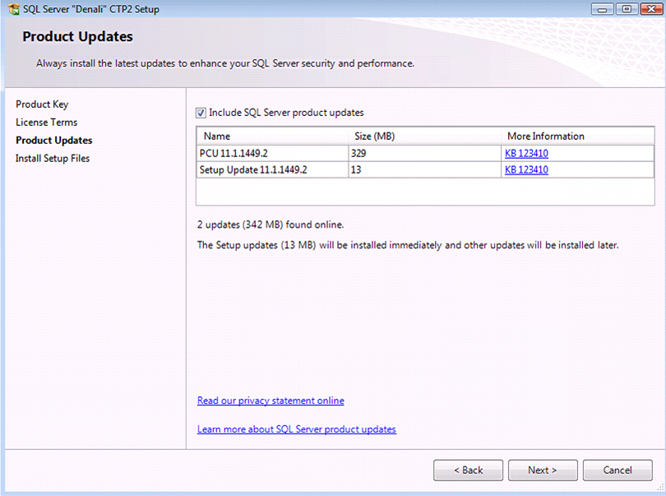
Product Update User Interface

Slide 52
Troubleshooting Tips
Denali log files are created at
  %ProgramFiles%\Microsoft SQL Server\110\Setup Bootstrap\Log
  Note: For SQL Server 2008, use 100 instead of 110
First, look at Summary.txt
Next, look at detail.txt log and search for “Error:”
If Setup does not seem to launch at all, view sqlsetup.log at %temp%
MSI log files, search for “Value 3”

Slide 53
Edition Upgrade
See my blog post at http://blogs.msdn.com/b/petersad/archive/2011/01/24/how-to-perform-an-sql-server-edition-upgrade.aspx

Slide 54
SQL Server 2008 Upgrade Assistant
Used for Application Compatibility Testing (ACT)
Allows testing of actual T-SQL execution
Detects changes in execution method, path and results
Leverages Profiler/Trace capability
Collaborative development among SQL Server development team, DPE, and Scalability Experts
Free download from www.scalabilityexperts.com/ssua

Slide 55
Database Platform (DAT) Resources
Required Slide
Track PMs will supply the content for this slide, which will be inserted during the final scrub.
  Visit the updated website for SQL Server® Code Name “Denali” on www.microsoft.com/sqlserver and sign to be notified when the next CTP is available
  Follow the @SQLServer Twitter account to watch for updates
Try the new SQL Server Mission Critical BareMetal Hand’s on-Labs
Visit the SQL Server Product Demo Stations in the DBI Track section of the Expo/TLC Hall. Bring your questions, ideas and conversations!
Microsoft® SQL Server® Security & Management | Microsoft® SQL Server® Optimization and Scalability
Microsoft® SQL Server® Programmability | Microsoft® SQL Server® Data Warehousing
Microsoft® SQL Server® Mission Critical | Microsoft® SQL Server® Data Integration

Slide 56





Resources
  Connect. Share. Discuss.
http://northamerica.msteched.com
Learning
  Sessions On-Demand & Community
  Microsoft Certification & Training Resources
www.microsoft.com/teched
www.microsoft.com/learning
  Resources for IT Professionals
  Resources for Developers
http://microsoft.com/technet
http://microsoft.com/msdn

Slide 57












Complete an evaluation on CommNet and
enter to win!

Slide 58


Slide 59

© 2011 Microsoft Corporation. All rights reserved. Microsoft, Windows, Windows Vista and other product names are or may be registered trademarks and/or trademarks in the U.S. and/or other countries.
The information herein is for informational purposes only and represents the current view of Microsoft Corporation as of the date of this presentation. Because Microsoft must respond to changing market conditions, it should not be interpreted to be a commitment
on the part of Microsoft, and Microsoft cannot guarantee the accuracy of any information provided after the date of this presentation. MICROSOFT MAKES NO WARRANTIES, EXPRESS, IMPLIED OR STATUTORY, AS TO THE INFORMATION IN THIS PRESENTATION.

