Slide 1

SQL Server Reporting Services “Denali” Integration with
SharePoint 2010
DBI328
Prash Shirolkar
Program Manager
Microsoft SQL Server Reporting Services

Slide 2
Agenda
Background / Overview
End-user experiences
Performance
Architecture / deployment / topologies
IT experiences

Slide 3

Integration with SharePoint 2007 & 2010
SQL SERVER 2005 SP2, 2008, 2008 R2
Seamless authoring, publishing, viewing in full-page or dashboards, management, and delivery of reports with SharePoint 2007 and 2010.
Full SSRS manageability support
Leverage WSS or MOSS collaboration , workflow, AAM capabilities with rich reporting
Shared security principles across Reporting Services & WSS or MOSS
Access 2010 services reporting engine
SharePoint List data extension

Slide 4



Denali Reporting and Alerting
Empower users
Increase Productivity Proactive Intelligence
Increase efficiency
  Project “Crescent”
  Highly visual design experience
  Rich metadata-driven interactivity
  Presentation-ready
  at all times
  End User Alerting
  Defined from within operational or
  ad-hoc reports
  Intuitive Alert rules
  Alerts self-managed through SharePoint
  XLS/Word 2007/2010
  Enabled as SharePoint Shared Service
  Built-in scale-out for RS Service Apps
  SharePoint Cross-farm reporting
  Integrated backup & recovery, ULS logging, PowerShell etc.
Managed Self Service BI – Corporate BI

Slide 5













Increase Efficiency
SITUATION TODAY
SHAREPOINT INTEGRATION REDEFINED
Providing Reporting capability in SharePoint require separate configuration and sometime challenging integration tasks
Only a limited set of SharePoint IT management capability was available
Different skills are required from IT to build reporting capability and SharePoint farm
Reporting Services is now configured and monitored like other SharePoint shared applications.
Maximum set of SharePoint IT management capability enabled
Lower TCO on IT who can now leverage existing SharePoint skillset and experience.

Slide 6
Denali Integration Experience
Reports in SharePoint
Crescent
Alerting
Performance
Demo

Slide 7
SSRS “Denali” Architecture
SSRS Shared Service Application hosted in IIS
Application pool
SSRS Catalog DBs as SharePoint Shared Service Applications DBs
Claims-based authentication via WCF endpoints for SSRS Shared Service
One SharePoint Central Administration Portal to configure and manage SSRS Shared Service

Slide 8
SSRS “Denali” Architecture…
PowerShell command-lets support for scripting SSRS Shared Service configuration and management.
Built-in scale-out with load balancer for SSRS Shared Service and SSRS Service DB in a SharePoint farm
Support for consuming reports cross-farm
Integrated - Backup / Restore, monitoring via ULS etc.

Slide 9
SSRS Shared Service
Create & Manage Service
PowerShell
Shared Service PowerShell
Provisioning SQL Agent
ULS and Backup Recovery
Demo

Slide 10










Architecture step-by-step (clean install)
SSRS Add-in for SharePoint
SSRS Shared Service
SharePoint 2010 WFE
SharePoint 2010 App Server
SharePoint Web Application
WCF Claims
SharePoint Service Application (IIS Hosted)
SSRS Shared Service WCF Endpoint
SSRS and Alerting Service App Runtime
Report Viewer web part
, Crescent & Alerting
Silverlight components
SSRS Add-in bits (incl. Crescent and Alerting XAP) in:
SharePoint 2010 folders,
GAC
SSRS Shared Service bits:
SharePoint 2010 folders,
GAC
Registry entries
Perf ctrs etc.
Background Processing
SSRS
Service
Proxy
SOAP
Data Management
Security
URLAccess
Create SSRS Service Application
SharePoint Object Model
Register SSRS Shared Service
SharePoint Object Model
SharePoint Config / Content DB
SSRS Service Application DB

Slide 11

Upgrade to Denali step-by-step
SSRS Add-in for SharePoint
SSRS Shared Service
SharePoint 2010 App Server
SharePoint 2010 WFE
Report Server
WCF Claims
SharePoint Service Application (IIS Hosted)
SharePoint Web Application
SSRS Shared Service WCF Endpoint
Report Viewer web part
, Crescent & Alerting Silverlight components
SSRS and Alerting Service App Runtime
SSRS Shared Service bits:
SharePoint 2010 folders,
GAC
Registry entries
Perf ctrs etc.
SSRS Add-in bits (incl. Crescent and Alerting XAP) in:
SharePoint 2010 folders,
GAC
Background Processing
SSRS
Service
Proxy
Report management UI
SSRS Proxy
Report Server in SharePoint Mode
(Service Acct 1)
Report Viewer web part
SOAP
Data Management
Security
Security Extension
Data Management
URLAccess
SharePoint Object Model
Create SSRS Service Application
SharePoint Object Model
Register SSRS instance
SSRS Service Application DB
SSRS catalog DB
SharePoint Config / Content DB

Slide 12
Architecture Denali single machine “scale”
Web Front End 1
Shp App Server 1
SSRS in Web Application 1
WCF
Claims
SSRS Shared Service Application 1 (IIS Hosted)
SSRS Shared Service Application 2 (IIS Hosted)
Report Viewer web part
, Crescent & Alerting
Silverlight components
SSRS in Web Application 2
SSRS Shared Service WCF Endpoint
SSRS and Alerting Service App Runtime
Report Viewer web part
, Crescent & Alerting
Silverlight components
SSRS
Service
Proxy
WCF
Claims
SSRS Shared Service WCF Endpoint
SSRS and Alerting Service App Runtime
Background Processing
SSRS
Service
Proxy
Background Processing
SOAP
SOAP
Data Management
URLAccess
Security
Data Management
URLAccess
Security
SharePoint Object Model
SharePoint Object Model
Report Server
Shared Service DBs
Report Server Shared Service DBs
SharePoint Config / Content DBs

Slide 13
Architecture Denali multi-machine scale
WCF
Claims
SSRS Shared Service
SharePoint 2010 WFE
Shp App Server 1
SSRS in Web Application 1
WCF
Claims
Shp App Server 2
Report Viewer web part
, Crescent & Alerting
Silverlight components
Service Application 1 (IIS Hosted)
SSRS
Service
Proxy
WCF
Claims
SSRS Shared Service WCF Endpoint
SSRS and Alerting Service App Runtime
SSRS SharePoint bits:
SharePoint 2010 folders,
GAC
Registry entries
Perf ctrs etc.
Service Application 1 (IIS Hosted)
Background Processing
SSRS Shared Service WCF Endpoint
SSRS and Alerting Service App Runtime
SOAP
Background Processing
URLAccess
Data Management
Security
Data Management
Security
SharePoint Object Model
SharePoint Object Model
Register SSRS instance
SharePoint Object Model
Report Server Shared Service DBs
SharePoint Config / Content DBs
Microsoft Confidential

Slide 14

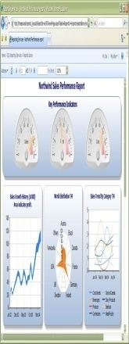


Windows User end-to-end Report rendering
SharePoint 2010 App Server
SharePoint 2010 WFE
SSRS Shared Service Application
Report Viewer web part
WCF Endpoint
Service Runtime (Data
Management)
SSRS Service Proxy
REQUEST
over WCF
Render
Render
(User1)
Security Extension
Processing & Rendering
On-Demand Sync
Windows
USER1
Output
SQL Server Data Source
RESPONSE
over WCF
USER1
SharePoint Object Model
Windows User
SharePoint Object Model
C2WTS Windows Service
SharePoint Config / Content DB
Report Sever Service Application DB

Slide 15
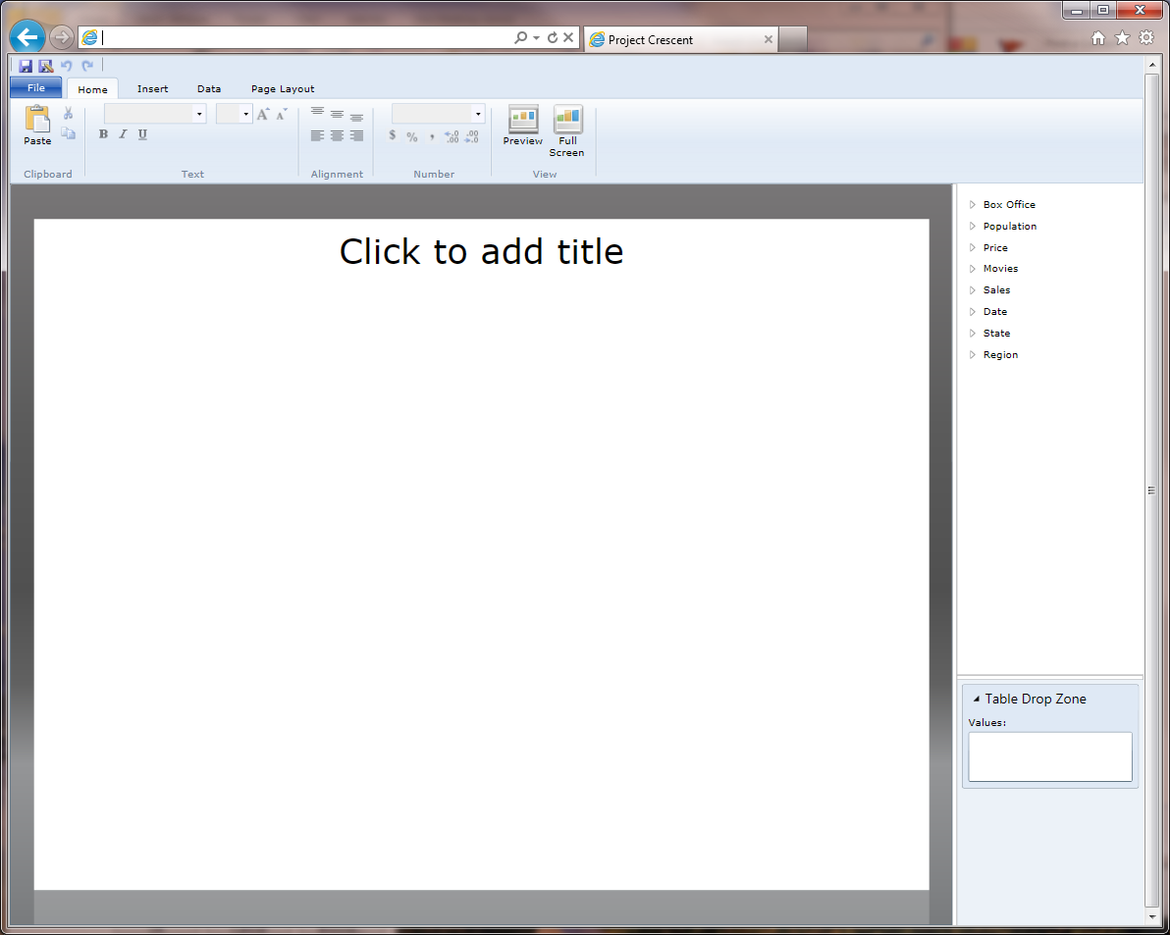
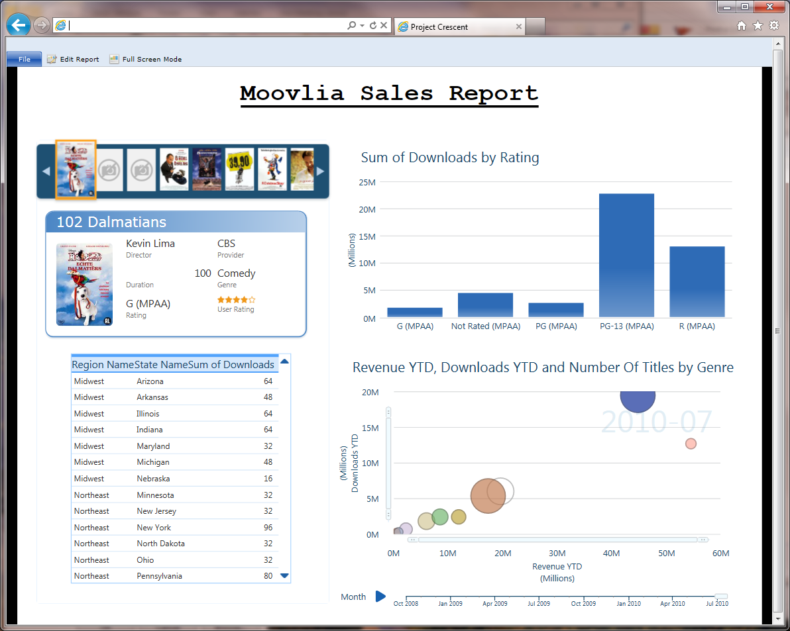
Project Crescent end-to-end data flow
SharePoint 2010 WFE
SharePoint 2010 App Server
SP Web Application
WCF Claims
SP Service Application
URLAccess
SOAP, …
Denali SSRS Add-in for SharePoint functionality
New BISM
connection
Denali SSRS Service Application Functionality
Denali
PowerPivot or
SSAS Service (non-SharePoint)
SharePoint OM
SharePoint OM
SharePoint Config / Content DB
Report Server Shared Service DB

Slide 16
Integrated experience…
“Denali” Report Performance Improvements
  At par or fractions of seconds slower than Native mode
  Use “Denali” Add-in for improved performance
  Browse reports using Report Server proxy
  No more 65K row / 256 column Excel export limitation with new Excel renderer
  New Word renderer

Slide 17
End User Experience
Report Server Proxy Browsing
URL Access
New Rendering Formats
Demo

Slide 18
In Review: Session Objectives and Takeaways
Session Objectives
  Have an overview of SSRS integration with SharePoint and end user experiences.
  Gain an understanding of architecture, deployments etc.
  Gain an understanding of IT experience enhancements.
Call to Action
  Sign-up @ BI Booth to be contacted for “Denali” CTP release
  Provide feedback and evangelize “Denali” SSRS integration with SharePoint

Slide 19


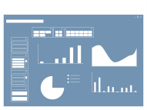













Appendix - Microsoft Business Intelligence
Most Broadly adopted Productivity & Collaboration Tools
SharePoint
Dashboards & Scorecards
SharePoint
Collaboration
Excel
Workbooks
PowerPivot Applications
Analysis
Services
Reporting
Services
Reporting
Services
Most widely deployed EIM & BI Platform
Integration
Services
Master Data
Services
LOB
Apps
Odata
Feeds

Slide 20
Appendix - Architecture SSRS 2008 R2
SSRS 2008 R2 Add-in
SharePoint 2010 WFE
SSRS 2008 R2
Reporting Services Add-in
Report Server in SharePoint Mode (SSRS 2005 SP2, 2008, 2008 R2)
(Connected Mode)
(Local mode)
Report Viewer web part
Report management UI
SSRS Proxy
Security Extension
Data Management
SharePoint Object Model
SharePoint Object Model
Report Sever DB
SharePoint Config / Content DB

Slide 21
Appendix - Denali CTP Features
SSRS SharePoint 2010 Shared Service
  Hosted in SharePoint Shared Service App pool
  SSRS catalog DBs are SharePoint Service App DBs
  WCF and Claims based communication
  PowerShell Cmdlets
  Central Admin UI for all RS administration
  ULS Logging integration
  Built-in scale-out and load balancer
SQL Setup option for SSRS SharePoint service

Slide 22

Appendix - Denali CTP features…
Support for upgrade from SSRS 2008 R2
** Report Performance Improvements **
  For reports in AJAX Viewer
  Parity with Denali Native mode performance
    Top SharePoint mode pain point
    Small reports used to be 2-3 times slower: Fixed
  Faster than 2008 R2 SharePoint mode ~ 30-60%
Provisioning SQL Agent
Mapping Web Application to SSRS Service Application

Slide 23
Appendix – PowerShell script
## 1. Create SSRS Service Application
$RSServiceAppPool = Get-SPServiceApplicationPool "SharePoint Web Services Default"
$RSServiceAppName = "SSRS Service App 2"
$RSDBName = "ReportServerService_dc895a28cc5e4a49858e0789850e2e8b"
$RSServiceApp = New-SPRSServiceApplication -Name $RSServiceAppName -applicationPool $RSServiceAppPool -DatabaseName $RSDBName

Slide 24
Appendix – PowerShell script…
## 2. Create SSRS Service Application Proxy
$RSServiceAppProxyName = "SSRS Service App Proxy 2"
$RSServiceAppProxy = New-SPRSServiceApplicationProxy -Name $RSServiceAppProxyName -ServiceApplication $RSServiceApp

Slide 25
Appendix – PowerShell script…
## 3. Create SSRS Proxy Group
$RSServiceProxyGroupName = "SSRS Service App Proxy Group 2"
$SPRSProxyGroup = New-SPServiceApplicationProxyGroup -Name $RSServiceProxyGroupName
$SPRSProxyGroup.Add($RSServiceAppProxy)
$SPRSProxyGroup.Update()
$AppReg = Get-SPServiceApplicationProxy "2018b787-c3ed-4943-aa89-2edd8f6733f4"
$SPRSProxyGroup.Add($AppReg )
$SPRSProxyGroup.Update()

Slide 26
Appendix – PowerShell script…
## 4. Associate with SPWebApplication "Test App 2 - 27871“
$SPWebApp = Get-SPWebApplication "Test App 2 - 27871"
Set-SPWebApplication $SPWebApp -ServiceApplicationProxyGroup $SPRSProxyGroup

Slide 27
Appendix – PowerShell script…
## Configure to use pickup folder c:\email
$apps = Get-SPRSServiceApplication
foreach ($app in $apps) {
$emailCfg = Get-SPRSExtension -identity $app -ExtensionType 'Delivery' -name 'Report Server Email' | select -ExpandProperty ConfigurationXml
$emailXml = [xml]$emailCfg
$emailXml.SelectSingleNode('//SMTPServer').InnerText = ''
$emailXml.SelectSingleNode('//SMTPServerPickupDirectory').InnerText='C:\Email'
$emailXml.SelectSingleNode('//SendUsing').InnerText = '1'
$emailXml.SelectSingleNode('//SMTPAuthenticate').InnerText = ''
$emailxml.SelectSingleNode('//From').InnerText=‘myemail@myemailserv.com'
Set-SPRSExtension -identity $app -ExtensionType 'Delivery' -name 'Report Server Email' -ExtensionConfiguration $emailXml.OuterXml
Get-SPRSExtension -identity $app -ExtensionType 'Delivery' -name 'Report Server Email' | select -ExpandProperty ConfigurationXml
}

Slide 28
Resources
Internal BI site – http://bi – demos, training, competitive
Internal SharePoint – http://spmarketing
Internal SQL Server – http://infoweb2007/sqlserver/Pages/default.aspx
SafePassage - http://sharepoint/sites/safepassage/pages/default.aspx
Build a Better App – http://www.buildabetterapp.com
DPE for BI - http://sharepoint/sites/dpevan/sql2k8r2/default.aspx
CompHot – http://comphot
Blogs –
    SSRS intergration with SharePoint – http://blogs.msdn.com/prash
    BI TV – http://blogs.msdn.com/b/bi/
    OneClick BI – http://blogs.msdn.com/oneclickbi
  Reporting Services – http://blogs.msdn.com/b/sqlrsteamblog/
  PowerPivot – http://blogs.msdn.com/powerpivot
  Learn PowerPivot – http://learnpowerpivot
Try out PerformancePoint in SharePoint 2010 – http://pps14

Slide 29



What’s Next?
Follow, Tweet and Enter to
win an Xbox Kinect Bundle
GAME ON! Join us at the top
of every hour at the BI booth to
compete in the Crescent Puzzle
Challenge and Win Prizes
Sign up to be notified when
the next CTP is available
at: microsoft.com/sqlserver
Join the Conversation
@MicrosoftBI
/MicrosoftBI

Slide 30





Resources
  Connect. Share. Discuss.
http://northamerica.msteched.com
Learning
  Sessions On-Demand & Community
  Microsoft Certification & Training Resources
www.microsoft.com/teched
www.microsoft.com/learning
  Resources for IT Professionals
  Resources for Developers
http://microsoft.com/technet
http://microsoft.com/msdn

Slide 31











Complete an evaluation on CommNet and
enter to win!

Slide 32


Slide 33

© 2011 Microsoft Corporation. All rights reserved. Microsoft, Windows, Windows Vista and other product names are or may be registered trademarks and/or trademarks in the U.S. and/or other countries.
The information herein is for informational purposes only and represents the current view of Microsoft Corporation as of the date of this presentation. Because Microsoft must respond to changing market conditions, it should not be interpreted to be a commitment
on the part of Microsoft, and Microsoft cannot guarantee the accuracy of any information provided after the date of this presentation. MICROSOFT MAKES NO WARRANTIES, EXPRESS, IMPLIED OR STATUTORY, AS TO THE INFORMATION IN THIS PRESENTATION.

