Slide 1

Can Your BI Solution Scale?
DBI330
Teo Lachev
MVP, MCSD, MCITP, MCT
teo.lachev@prologika.com

Slide 2

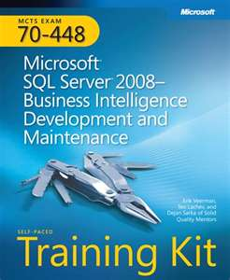


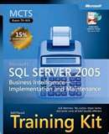
About Me
Consultant, author, and mentor with focus on Microsoft BI
Owner of Prologika –BI consulting and training company based in Atlanta (www.prologika.com)
Microsoft SQL Server MVP for 5 years
Leader of Atlanta BI group (atlantabi.sqlpass.org)

Slide 3
Agenda
Present practical load testing methodology
Load test Reporting Services
Load test Analysis Services
Analyze results and performance bottlenecks
Share performance best practices

Slide 4

Why Load Test?
wikipedia.org
Determine server throughput
Understand how load impact server resources
Plan server hardware

Slide 5

Typical BI Solution

Slide 6
How to Load Test?
Step 1: Establish performance goal
Step 2: Prepare load tests
Step 3: Run and analyze load tests
Do we meet the goal?
  Yes – we are done
  No – identify and eliminate performance bottlenecks
  Go to Step 3.

Slide 7
Establish Performance Goal
Gather
workload usage
Use the SSRS Execution Log, capture SSAS trace
Estimate
future loads
How many more users?
Derive performance goal
Reports/sec or queries/sec
Number of concurrent users
Double estimate just in case
Look for peak times
Concurrent users != Deployed users

Slide 8
Deployed vs. Concurrent Users
Users
Time
2 concurrent users

Slide 9
Establish Performance Goal
Case Study
Gather report workload
  Peak report usage – November 22th, 9 AM – 10 AM
  200 reports executed by 20 distinct users
  200/3,600 = 0.05 reports/sec
Estimate future loads
  500 users – x25 increase (500/20)
  0.05 x 25 = 1.25 reports/sec
Derive performance goal
  Let's double 2 x 1.25 = 2.5 reports/sec

Slide 10



Establish Performance Goal
About reports & queries
Reports are not born equal
A "report" or "query" is an abstraction
Think of "vehicle" if testing highway capacity

Slide 11

Analyzing report and query usage
demo

Slide 12
Prepare Tests
Reporting Services
Identify a report mix
  10-15 reports
  Slow and fast reports
Obtain report URLs and parameter values
Use Visual Studio (Ultimate or Test edition) to create:
  Web performance test – "quick and dirty" tests
  Unit test – custom tests, e.g. for parameter handling

Slide 13

Create Load Test
Reporting Services
Use Create New Load Test wizard and set up
  Load pattern – constant or stepped
  Test mix – a collection of web or/and unit tests
  Counter sets – CPU, memory, disk utilization
  Run settings – counters, warm-up time, test duration or iterations
Tip: Increase the MaxActiveReqForOneUser setting in rsreportserver.config to a large value, e.g. 999999

Slide 14
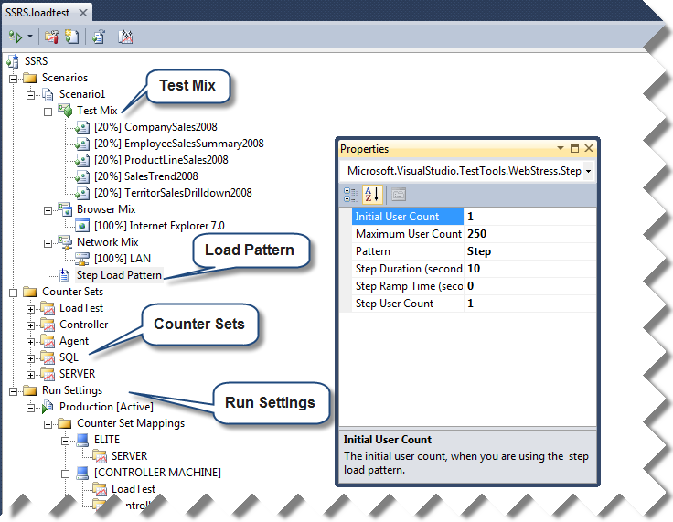
Create Load Test
Reporting Services

Slide 15
Creating SSRS load test
demo

Slide 16
Creating SSRS load test
demo

Slide 17
Run and Analyze Load Tests
Run the load test with stepped load
Aim for no more than 80% server utilization
Obtain and record:
  Reports/sec
  Concurrent users
Watch for errors!
VS supports 250 virtual
users
Throughput
Reports/sec
80%
Users

Slide 18
Finding Performance Bottlenecks
Every system has a saturation point
Use Windows performance
counters to discover bottlenecks
Typical bottlenecks
  CPU (Processor: % Processor
  Time)
  Memory (Memory: Available MBytes)
  HDD (PhysicalDisk: Current Disk
  Queue Length)
  Network (Network Interface:
  Bytes Sent/sec, Bytes Received/sec)
CPU
NETWORK
BUS
HDD
RAM

Slide 19
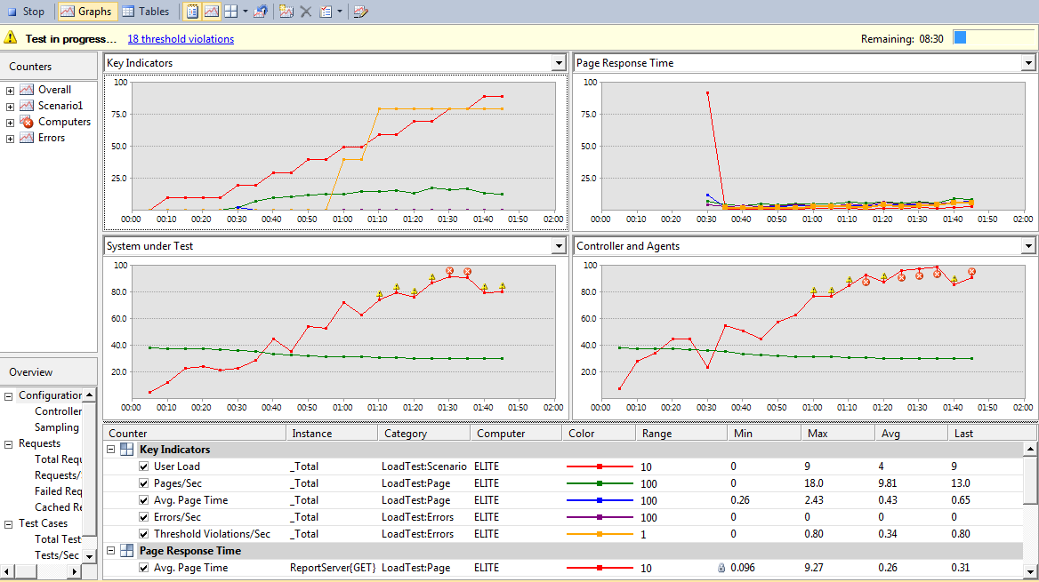
Run and Analyze Tests

Slide 20
Run and analyze SSRS load tests
demo

Slide 21
Run and analyze SSRS load tests
demo

Slide 22
Load Testing Analysis Services
Download the SSAS load testing framework
AS Query Generator (ASQueryGenerator)
  Generates query templates
  Supports parameterized queries
AS Load Simulator (ASLoadSim)
  Implements a Visual Studio custom test plugin
  Includes SSAS Load Testing Best Practices document – read it!
Another option that doesn't require Visual Studio
  AS Performance Workbench
  http://asperfwb.codeplex.com/

Slide 23
Load test Analysis Services
demo

Slide 24
Performance Best Practices
Plan for load testing early in implementation cycle
Tune and optimize before scaling up or out
Reporting Services
  Analyze ExecutionLog and tune queries
  Read SSRS Performance Optimizations whitepaper
  http://tinyurl.com/rsperf
Analysis Services
  Use SQL Profiler to get SE and FE time breakdown
  Tune server and queries – read Analysis Services 2008 Performance Guide
  Use Xperf to understand if queries are disk or CPU bound http://preview.tinyurl.com/xperfssas

Slide 25
Performance Best Practices
Continued
Upgrade to SSRS 2008 or later
  Redesigned processing engine
  Much less memory bound
  Scale to 3-4 x number of users than 2005
Upgrade to SSAS 2008 or later
  Block computation mode
  Queries execute 20-60% faster

Slide 26
Identifying performance bottlenecks
demo

Slide 27
Identifying performance bottlenecks
demo

Slide 28
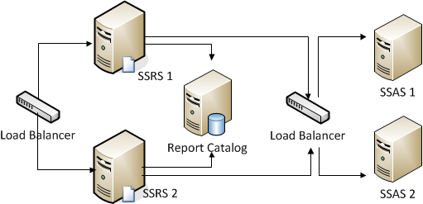
Scaling Out

Slide 29
Resources
Using VS to Perform Load Testing on SSRS by Runying Mao and Heidi Steen
http://msdn.microsoft.com/en-us/library/aa964139(SQL.90).aspx
SSRS Performance Optimizations by Denny Lee, Lukasz Pawlowski
http://tinyurl.com/rsperf
AS Load Simulator and Query Generator
http://sqlsrvanalysissrvcs.codeplex.com
AS Performance Workbench
http://asperfwb.codeplex.com
Analysis Services 2008 Performance Guide
http://tinyurl.com/ssas2008perfguide
SQL CAT website - Scaling Up SSRS vs. SSRS 2005: Lessons Learned
http://tinyurl.com/rs2005to2008
My website and blog
http://www.prologika.com

Slide 30
Selected Case Studies
Fresenius Medical Care
20,000 reports per day
Premier Bankcard
500 SSRS users, 200 concurrent average
Bangkok Bank Public
1,000 users
Esurance
15Tb of data, hundreds of users, 375 reports

Slide 31
Related Content
DBI405: Scale-Out Deployment of Microsoft SQL Server Reporting Services
DBI320: Upsizing and Modernizing with the Microsoft BI Stack and Fast Track Data Warehouse
DBI301: Microsoft SQL Server Reference Architecture and Appliances
DBI320: Upsizing and Modernizing with the Microsoft BI Stack and Fast Track Data Warehouse
Find Me Later At DBI TLC

Slide 32
DPR Track Resources
http://www.microsoft.com/visualstudio
http://www.microsoft.com/visualstudio/en-us/lightswitch
http://www.microsoft.com/expression/
http://blogs.msdn.com/b/somasegar/
http://blogs.msdn.com/b/bharry/
http://www.microsoft.com/sqlserver/en/us/default.aspx
http://www.facebook.com/visualstudio

Slide 33





Resources
  Connect. Share. Discuss.
http://northamerica.msteched.com
Learning
  Sessions On-Demand & Community
  Microsoft Certification & Training Resources
www.microsoft.com/teched
www.microsoft.com/learning
  Resources for IT Professionals
  Resources for Developers
http://microsoft.com/technet
http://microsoft.com/msdn

Slide 34












Complete an evaluation on CommNet and
enter to win!

Slide 35


