Slide 2

What’s New in Security for Microsoft SQL Server Code-Named "Denali"
DBI401
Il-Sung Lee
Senior Program Manager
Microsoft Corp.

Slide 3

Agenda
SQL Server 2008 Security Recap
Security in SQL Server “Denali”
- Security Manageability Enhancements
- SQL Server Audit Enhancements
- Database Authentication
- Crypto Changes

Slide 4
SQL Server 2008 Security Recap

Slide 5
SQL Server 2008 Security Recap
Transparent Data Encryption
Customer challenges
Extensible Key Managements
Security feature
Protect data-at-rest
PROTECT
DATA
Kerberos authentication enhancements
Data/Key separation
CONTROL
ACCESS
SQL Server Audit
Change Data Capture
Use strong authentication
Policy-Based Management
Monitor all activity
Common Criteria Certification (EAL4+)
ENSURE COMPLIANCE
Detect non-compliant configurations
Industry Certification
Notes:
Users need VIEW DEFINITION permissions to see metadata that they do not own
User Schema Separation
For management purposes
Dropping a user does not impact applications
Reducing reliance on DBO schema for sharing semantics
Module Execution Context
Context for execution of statements in a module
Can be used to create custom permission sets
Signatures on modules
To prevent Trojan code
Ability to grant access to modules
“Access, but only when going through a particular module”

Slide 6
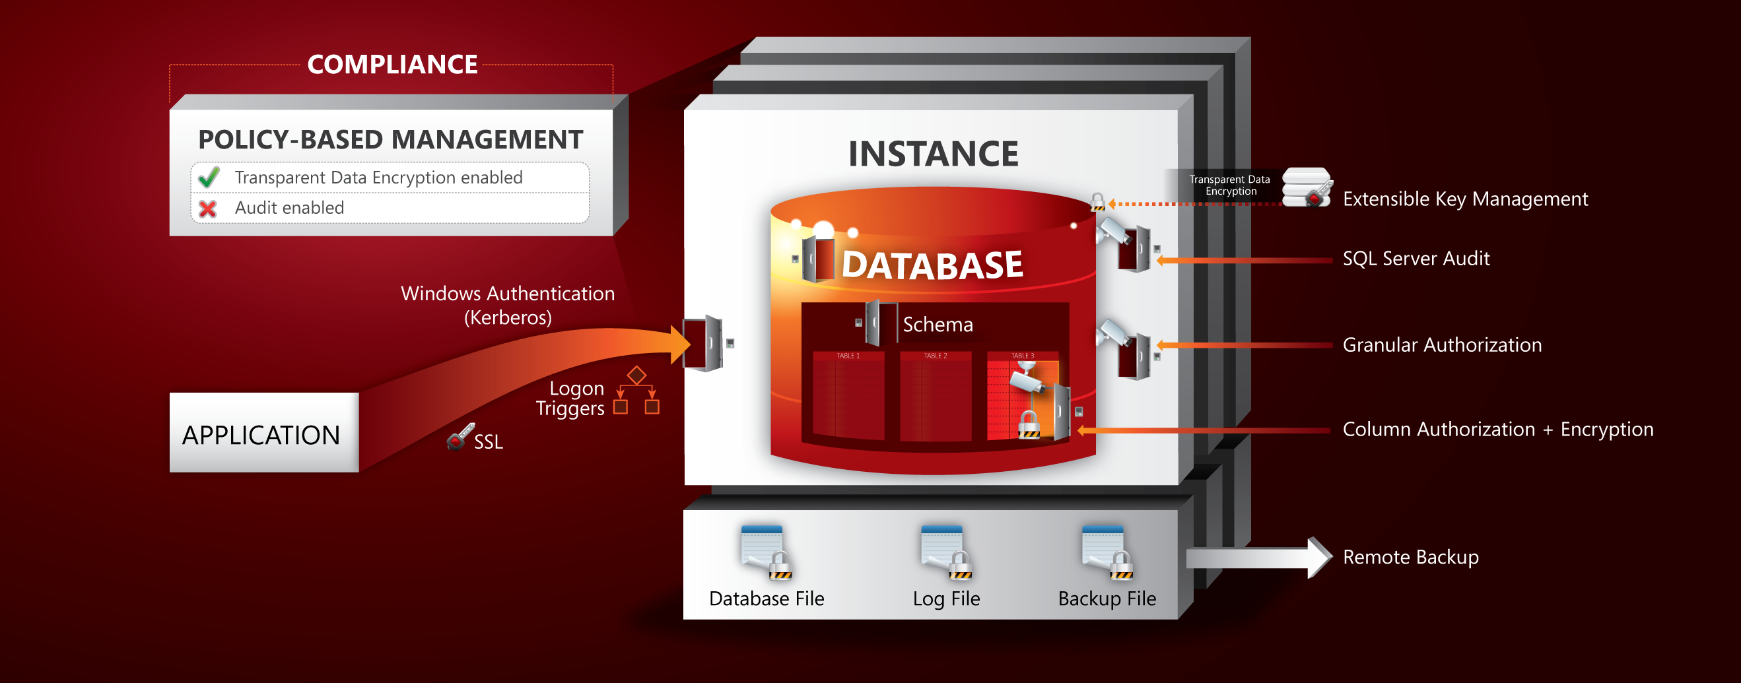
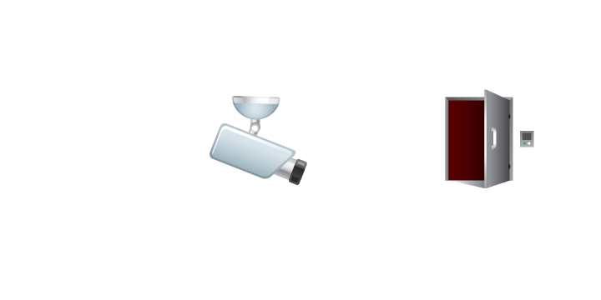
The SQL Server 2008 Security Story

Slide 7
Security In SQL Server "Denali"

Slide 8
Security Manageability Improvements
Default Schema for Groups
User-Defined Server Roles

Slide 9

Default Schema for Groups
Default schema = schema1
Group1
Can now assign default schema to a group
Eases Administration
Avoids implicit schema creation
Reduces chances of wrong schema used in queries

Slide 10

User-Defined Server Roles
Server-level principal
  Administrator defined "server group"
    Collection of principals
    Holds permissions
Compared to fixed roles
  Securable class
  Permission set can change
Increase flexibility, manageability
and facilitate compliance
DBARole
CONTROL SERVER
ALTER ANY LOGIN

Slide 11
User-Defined Server Roles
demo

Slide 12
SQL Server Audit Enhancements
Audit supported on all SKUs
Improved Resilience
User-Defined Audit Event
Record Filtering
T-SQL Stack Information

Slide 13








Audit Supported on All SKUs
Basic Audit on all SKUs
  Server Audit Specs only
  DB Audit Specs for Enterprise and Datacenter
No longer need SQLTrace
Enjoy advantages of Audit
  Performance
  Multiple Audits and multiple targets
  Persist state
  Audit Resilience
SQL Server
Express

Slide 14

Improved Resilience
Before:
  Write failures may silently lose Audit records
  Use ON_FAILURE = SHUTDOWN
Now:
  Automatically recover from most file or network errors
  Added “ON_FAILURE = FAIL_OPERATION”
  Added “MAX_FILES” option
Select…
Rollback

Slide 15
User-Defined Audit Event
sp_audit_write()
exec sp_audit_write
1234,
1,
N‘Hello World’
@user_defined_event_id
@succeeded
@user_defined_info
Audit Log

Slide 16
Record Filtering
CREATE SERVER AUDIT audit_name
TO { [ FILE (<file_options> [ , ...n ]) ] | APPLICATION_LOG | SECURITY_LOG }
[ WITH ( <audit_options> [ , ...n ] ) ]
[ FILTER = <predicate_expression> ]
}
…
<predicate_expression> ::=
{
[ NOT ] <predicate_factor> | {( <predicate_expression> ) }
[ { AND | OR } [ NOT ] { <predicate_factor> | ( <predicate_expression> ) } ]
[ ,...n ]
}
Tightly constrain info written to Audit log
  Audit record generated but not written
Leverages Xevent filtering

Slide 17
T-SQL Stack Information
exec hr.viewsalary
select salary from hr.payroll
hr.viewsalary
hr.payroll
Audit Log

Slide 18
SQL Server Audit Enhancements
demo

Slide 19
Database Authentication
Available in Contained Databases
Allow authentication without Logins
  SQL Users with passwords
  Windows authentication without Login
Easier deployment for some applications
Tightly scoped security boundary

Slide 20


Database Auth – SQL Users
User=Alice; Pwd; IC=NormalDB
Login
User=Alice; Pwd; IC=CDB
Contained
User
(Contained user Alice exists)
User=Alice; Pwd; IC=CDB
Login
(Contained user Alice does not exist)
Notes:
Normally authentication is performed against a login and access to a database is granted based to a link between the user to the login (with the same SID)
With Contained databases, we introduce Database Authentication which allows users to be defined with passwords so that authentication can occur directly against the user instead of the login.
Authentication will occur against the CDB if:
The initial catalog is specified in the connection string and it refers to a CDB
The user named in the connection string exists as a User With Password

Slide 21
Database Auth – Windows Users
User=Domain\Alice; IC=NormalDB
Login
User=Domain\Alice; IC=CDB
Login
(Login Alice exists)
User=Domain\Alice; IC=CDB
Contained
User
(Login Alice does not exist)
Notes:
Normally authentication is performed against a login and access to a database is granted based to a link between the user to the login (with the same SID)
With Contained databases, we introduce Database Authentication which allows users to be defined with passwords so that authentication can occur directly against the user instead of the login.
Authentication will occur against the CDB if:
The initial catalog is specified in the connection string and it refers to a CDB
The user named in the connection string exists as a User With Password

Slide 22
Database Authentication
demo

Slide 23
Crypto Changes
CREATE CERTIFICATE FROM BYTES
SMK/DMK default to AES256
SHA2 (256 and 512) support
RC4 deprecated
Key backups encrypted with AES256
Password hashes use SHA512
4K certificates supported for import

Slide 24

Related Content
Required Slide
Speakers, please list the Breakout Sessions, Interactive Discussions, Labs, Demo Stations and Certification Exam that relate to your session. Also indicate when they can find you staffing in the TLC.
DBI381-HOL Microsoft SQL Server Code-Named "Denali": Implementing Transparent Data Encryption (TDE)
DBI380-HOL Microsoft SQL Server Code-Named "Denali": Working with Contained Databases

Slide 25
Track Resources
SQL Server 2008 Security
Additional Resources
SQL Server “Denali”
SQL Server Database Security and Compliance portal
Designing and Implementing a Contained Database
Security Enhancements
Server Level Roles
Understanding SQL Server Audit
Understanding Transparent Data Encryption
Understanding Extensible Key Management
SQL Server Engine Security Blog
SQL Server Security Forum

Slide 26
Database Platform (DAT) Resources
Required Slide
Track PMs will supply the content for this slide, which will be inserted during the final scrub.
  Visit the updated website for SQL Server® Code Name “Denali” on www.microsoft.com/sqlserver and sign to be notified when the next CTP is available
  Follow the @SQLServer Twitter account to watch for updates
Try the new SQL Server Mission Critical BareMetal Hand’s on-Labs
Visit the SQL Server Product Demo Stations in the DBI Track section of the Expo/TLC Hall. Bring your questions, ideas and conversations!
Microsoft® SQL Server® Security & Management | Microsoft® SQL Server® Optimization and Scalability
Microsoft® SQL Server® Programmability | Microsoft® SQL Server® Data Warehousing
Microsoft® SQL Server® Mission Critical | Microsoft® SQL Server® Data Integration

Slide 27





Resources
  Connect. Share. Discuss.
http://northamerica.msteched.com
Learning
  Sessions On-Demand & Community
  Microsoft Certification & Training Resources
www.microsoft.com/teched
www.microsoft.com/learning
  Resources for IT Professionals
  Resources for Developers
http://microsoft.com/technet
http://microsoft.com/msdn

Slide 28












Complete an evaluation on CommNet and
enter to win!

Slide 29

Notes:
New for TechEd 2011, we will be working with Microsoft Tag (http://tag.microsoft.com/overview.aspx) to create unique Tags for every session at the event. Your session Tag will appear on both the room signage and at the end of your presentation. With your session Tag, attendees will be able to scan as they enter the room to retrieve session details, view speaker bios, and engage in discussions; or scan at the end of the presentation to evaluate your session and download materials. We’re excited to integrate Microsoft Tag across the My TechEd mobile experience this year.

Slide 30

© 2011 Microsoft Corporation. All rights reserved. Microsoft, Windows, Windows Vista and other product names are or may be registered trademarks and/or trademarks in the U.S. and/or other countries.
The information herein is for informational purposes only and represents the current view of Microsoft Corporation as of the date of this presentation. Because Microsoft must respond to changing market conditions, it should not be interpreted to be a commitment
on the part of Microsoft, and Microsoft cannot guarantee the accuracy of any information provided after the date of this presentation. MICROSOFT MAKES NO WARRANTIES, EXPRESS, IMPLIED OR STATUTORY, AS TO THE INFORMATION IN THIS PRESENTATION.

