Slide 1

Microsoft SQL Server Code-Named "Denali" AlwaysOn Series, Part 2: Building a Mission-Critical High Availability Solution Using AlwaysOn
DBI404
Justin Erickson
Program Manager
Microsoft SQL Server

Slide 2
Agenda
AlwaysOn Recap
Upgrade from Previous Versions
  Connection Experience
  Multiple Secondaries
  Quorum Configuration
Active Secondaries
Disaster Recovery

Slide 3
A look back….
Customers are running mission critical applications on SQL Server and achieving SLA’s
Bwin, ServiceU, Caregroup and more……
Undertook a holistic view of the space
    Compete pain points and feature gap analysis
    Future trends and aligning technology with the future

Slide 4
Mission Critical High Availability Solution
Meets mission critical high availability SLA
Integrated
Flexible
Efficient
RPO and RTO
requirements
Planned and
unplanned
downtime
Local HA and
disaster recovery
A unified, simplified
solution
Easy to deploy and
Manage
Reuse existing
investment
SAN vs.. DAS
environments
Cost Effective
  HA hardware
  Utilization
  No idle systems
Improve IT efficiency

Slide 5
AlwaysOn Availability Groups
AlwaysOn Availability Groups is a new feature that enhances and combines database mirroring and log shipping capabilities
Flexible
Integrated
Efficient
  Multi-database failover
  Multiple secondaries
    Total of 4 secondaries
    2 synchronous secondaries
      1 automatic failover pair
  Synchronous and asynchronous
  data movement
  Built in compression and encryption
  Automatic and manual failover
  Flexible failover policy
  Automatic Page Repair
  Application failover using virtual name
  Configuration Wizard
  Dashboard
  System Center Integration
  Rich diagnostic infrastructure
  File-stream replication
  Replication publisher failover
Active Secondary
  Readable Secondary
  Backup from Secondary
Automation using power-shell

Slide 6

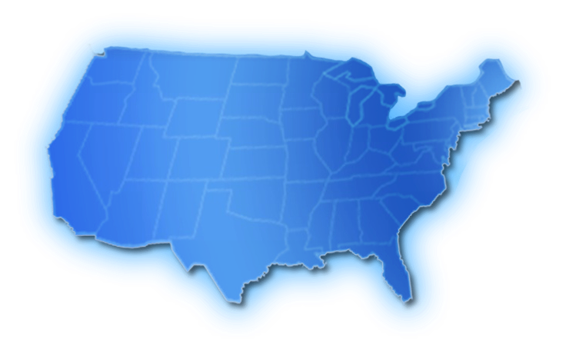



Starting Topology
Database Mirroring
Log Shipping

Slide 7
Upgrading to AlwaysOn Availability Groups
demo

Slide 8
Windows Server Pre-Reqs
KB 976097
  Supports SQL Server Failover Cluster Instances with AlwaysOn Availability Groups
KB 2494036
  Supports configuring optimal quorum with non-automatic failover targets
All nodes should be in the same AD domain
To create WFSC cluster user running creation must have:
  Domain account
  Administrator on all machines
  Have Create Computer objects and Read All Properties rights in AD
  Detailed Article: http://technet.microsoft.com/en-us/library/cc731002(WS.10).aspx

Slide 9
Quorum Configuration
Quorum: need majority of votes to operate and avoid split brain
Two-Steps process:
  Select nodes to vote (KB 2494036)
    1 vote if node’s that host a replica that is currently:
      Primary (if primary is an FCI include all possible owner nodes for that FCI)
      An auto failover target if the primary is also configured for auto failover
    0 votes for rest of nodes
  Select the quorum type:
    Odd number of votes, use “Node Majority”
    Even number of votes, add a witness by either:
      Adding an additional witness node and use “Node Majority”
      Using “Node and File Share Majority” with a protected file share (blog with details)
Re-evaluate and adjust quorum after manual failover outside automatic target

Slide 10
Quorum Configuration
demo

Slide 11
New Topology
A
A
A

Slide 12
New Topology Benefits
Better SLAs
  Multiple no data loss secondaries
  Better data loss protection for DR secondaries through continuous replication
  Faster failover to DR secondaries through virtual name failover
Easier deployment/management
  Unified solution
  Simple deployment
  Unified dashboard
  Rich diagnostics
  Centralized management of client connection topology
  Multi-DB failover

Slide 13
Backup from Secondary
demo

Slide 14
Backup Capabilities
Backups from any replica
  Synchronous or asynchronous secondaries
  Primary backups still work
Log backups done on all replicas form a single log chain
Recovery Advisor makes restores simple

Slide 15
Restrictions, cautions, and gotchas
Differential backups are not supported on secondary
Only Copy-only full backups are supported on secondary
  The only distinction is the differential bitmap clearing
Advisable for backups to be stored centrally

Slide 16
Readable Secondary
demo

Slide 17
Readable Secondary Data Latency
Primary
DB1
DB1
Secondary
Log Capture
Network
Log Receive
Commit
Log Pool
Redo Thread
Log Cache
Log Cache
Redo Pages
Log Flush
Log Harden
Page Updated
DB1 Log
DB1 Data
Acknowledge Commit
DB1 Log
DB1 Data
Secondary read is behind primary
  Log is first hardened and then applied
    Redo thread is asynchronous and runs in the background
  Latency (typically seconds) can be larger for log intensive operations like bulk import or index create/rebuild
  Sync Replica minimizes latency due to network issues

Slide 18
Read Workload Impact
Concurrency and Blocking
  REDO can get blocked by reporting workload
  REDO thread and read workload can deadlock
Solution
  Internally map read workload to non blocking isolation levels (no application changes required)
    Read Uncommitted → Snapshot Isolation
    Read Committed → Snapshot Isolation
    Repeatable Read → Snapshot Isolation
    Serializable → Snapshot Isolation
    Ignore all locking hints
  Never choose REDO as deadlock victim
Result
  Blocking and deadlock between Reporting workload (i.e. Query) and REDO thread is eliminated
  No issues with DML (INSERT/DELETE/UPDATE) as it is not allowed
  Will incur additional cost of row versioning.

Slide 19
Row Versioning Optimizations
No RCSI/SI
Enable RS
Row Version
Primary
Secondary
RCSI/SI
Enable RS
Primary
Secondary

Slide 20
DDL and Reporting Workload
On standalone SQL Server
  Query under SI can block a concurrent DDL
Same can happen on Readable Secondary
  REDO can block Reporting Workload
  Read workload can block REDO thread
Mitigation
  DDL not common in production environment
  You may have flexibility in scheduling maintenance jobs with concurrent Reporting Workload
  An XEvent is generated when REDO is blocked. You can choose to kill Reporting workload
Primary Replica | Secondary Replica
 | Start Reporting workload on table T1 Takes SCH-S lock on table T1
Execute DDL operation on table T1
 | REDO processes the DDL log record Requests SCH-M lock on table T1
 | Reporting Workload completes
 | REDO is unblocked
Blocked

Slide 21
Query Performance on Secondary
Optimized Query Plans
Goal: Comparable query plan on Readable Secondary
Query Optimization and Statistics
  SQL Server uses cost based optimizer that heavily relies on object statistics
  If statistics are missing, SQL Server automatically creates them and persists
Auto-stat on readable secondary will require physical Changes
  Example: Table T1 (C1, C2, C3)
    Query on primary with predicate (C3 > 10).
    SQL Server auto-create the statistics, if needed, on column C3 on primary replica
    Won’t work on Readable Secondary as it will cause physical changes to the database.
  Similar issue if the statistical information is stale on the secondary replica.
Solution
  Auto-create statistics on the secondary replica but persist them in TempDB
  Existing catalog views (e.g. sys.stats) show temporary statistics
Available in CTP2

Slide 22
Disaster Recovery
demo

Slide 23

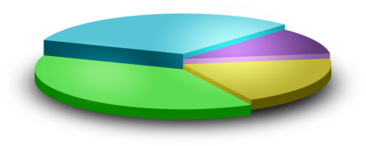




New Topology
A
A
A
A
Reports
Backups
Synchronous
Data Movement
Asynchcronous Data Movement

Slide 24



Additional Topology Examples
AlwaysOn provides the flexibility of different HA configurations
A
A
A
A
A
A
A
Direct attached storage local, regional and geo secondaries
Shared Storage, regional and geo secondaries
Synchronous
Data Movement
Asynchcronous Data Movement

Slide 25
AlwaysOn Availability Groups
AlwaysOn Availability Groups is a new feature that enhances and combines database mirroring and log shipping capabilities
Flexible
Integrated
Efficient
  Multi-database failover
  Multiple secondaries
    Total of 4 secondaries
    2 synchronous secondaries
      1 automatic failover pair
  Synchronous and asynchronous
  data movement
  Built in compression and encryption
  Automatic and manual failover
  Flexible failover policy
  Automatic Page Repair
Application failover using virtual name
Configuration Wizard
Dashboard
System Center Integration
Rich diagnostic infrastructure
File-stream replication
Replication publisher failover
Active Secondary
  Readable Secondary
  Backup from Secondary
Automation using power-shell

Slide 26
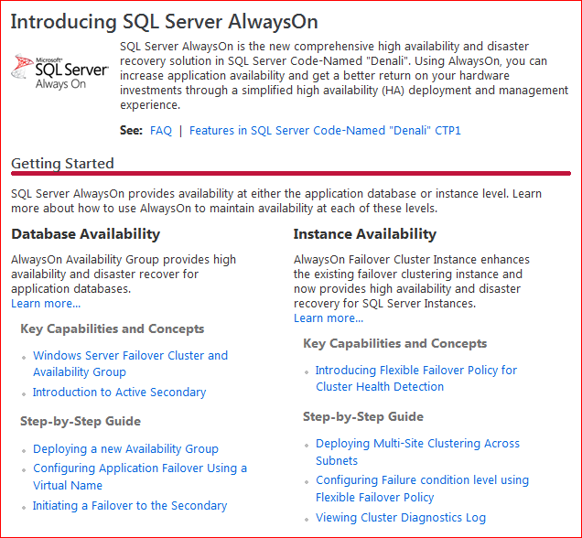
Resource Links
“Denali” AlwaysOn Resource Center: http://msdn.microsoft.com/en-us/sqlserver/gg490638(en-us,MSDN.10)
  CTP download
  Documentation
  MSDN forums
  Microsoft Connect
  AlwaysOn Blog

Slide 27

Related Content
Breakout Sessions (session codes and titles)
  DBI404 | Microsoft SQL Server Code-Named "Denali" AlwaysOn Series, Part 2: Building a Mission-Critical High Availability Solution Using AlwaysOn
  DBI309 | High Availability and Disaster Recovery Customer Panel: Architectures and Lessons Learned
Interactive Sessions (session codes and titles)
  DBI373-INT | Microsoft SQL Server Code-Named "Denali" AlwaysOn Series, Part 3: Under the Hood and Much More - A Panel Discussion with the Product Development Team
Hands-on Labs (session codes and titles)
  DBI394-HOL | BareMetal Mission Critical: Building an HA Platform from Scratch
Find Me Later At the SQL Server Mission Critical Exhibition Hall Booth

Slide 28
Database Platform (DAT) Resources
Required Slide
Track PMs will supply the content for this slide, which will be inserted during the final scrub.
  Visit the updated website for SQL Server® Code Name “Denali” on www.microsoft.com/sqlserver and sign to be notified when the next CTP is available
  Follow the @SQLServer Twitter account to watch for updates
Try the new SQL Server Mission Critical BareMetal Hand’s on-Labs
Visit the SQL Server Product Demo Stations in the DBI Track section of the Expo/TLC Hall. Bring your questions, ideas and conversations!
Microsoft® SQL Server® Security & Management | Microsoft® SQL Server® Optimization and Scalability
Microsoft® SQL Server® Programmability | Microsoft® SQL Server® Data Warehousing
Microsoft® SQL Server® Mission Critical | Microsoft® SQL Server® Data Integration

Slide 29





Resources
  Connect. Share. Discuss.
http://northamerica.msteched.com
Learning
  Sessions On-Demand & Community
  Microsoft Certification & Training Resources
www.microsoft.com/teched
www.microsoft.com/learning
  Resources for IT Professionals
  Resources for Developers
http://microsoft.com/technet
http://microsoft.com/msdn

Slide 30












Complete an evaluation on CommNet and
enter to win!

Slide 31


Slide 32

© 2011 Microsoft Corporation. All rights reserved. Microsoft, Windows, Windows Vista and other product names are or may be registered trademarks and/or trademarks in the U.S. and/or other countries.
The information herein is for informational purposes only and represents the current view of Microsoft Corporation as of the date of this presentation. Because Microsoft must respond to changing market conditions, it should not be interpreted to be a commitment
on the part of Microsoft, and Microsoft cannot guarantee the accuracy of any information provided after the date of this presentation. MICROSOFT MAKES NO WARRANTIES, EXPRESS, IMPLIED OR STATUTORY, AS TO THE INFORMATION IN THIS PRESENTATION.

