Slide 1

Test Automation with
Microsoft Visual Studio 2010
Coded UI Tests and Lab Management
DEV309
Brian Keller
Sr. Technical Evangelist
Microsoft

Slide 2
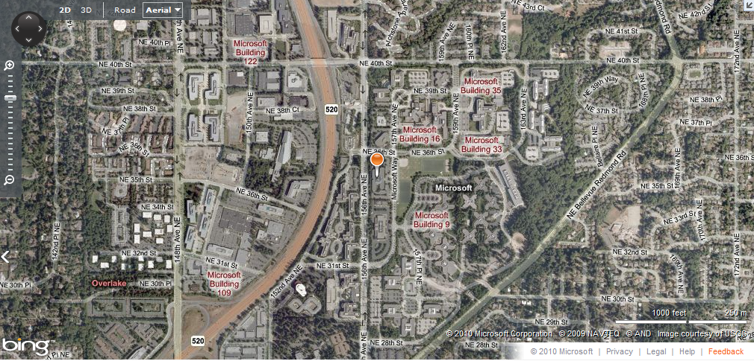
I Work Here…

Slide 3

…on This…

Slide 4
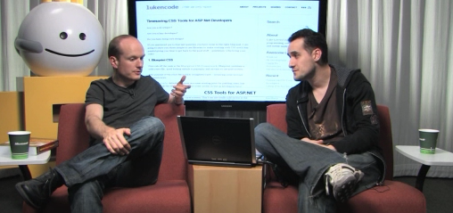
…and This
http://bit.ly/ThisWeekC9

Slide 5
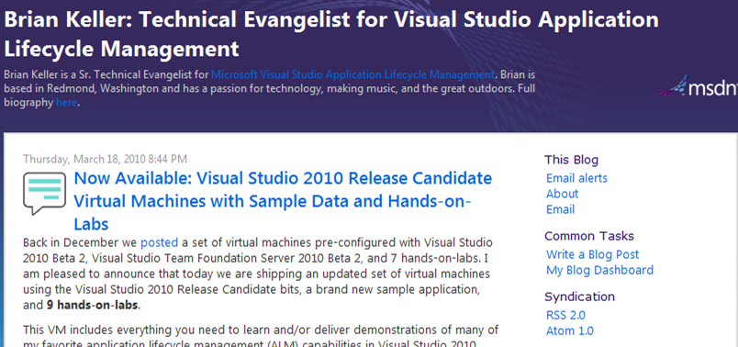
I Blog Here
http://blogs.msdn.com/briankel

Slide 6


http://tinyurl.com/ALM2010Book
http://tinyurl.com/TFSBook

Slide 7


What You’ll Need
Visual Studio 2010
Premium or Ultimate
Feature Pack 2
C# or VB skills
Microsoft Test Manager (optionally)
Testable application

Slide 8
Test Automation Platform Support
PLATFORM | SUPPORT | NOTES
IE7/8 – HTML/AJAX |  | IE9 partially supported in SP1
Windows Forms 2.0+ |  | .NET FX controls fully supported, working on third-party support
WPF 3.5+ |  | .NET FX controls fully supported, working on third-party support
SharePoint 2007 and 2010 |  | See blog post for more info
Firefox – HTML/AJAX |  | Supported in Feature Pack 2 for FF 3.5 and 3.6.
Silverlight |  | Supported in Feature Pack 2 for Silverlight 4, in-browser applications
Windows Win32 |  | May work with some known issues, but not officially supported
Dynamics (AX) |  | Partially supported – see article. Dynamics CRM web client is supported
MFC |  | Partial support – known issues and workarounds
Citrix/Terminal Services |  | The client (MTM or VS) need to be on the remote machine
Office Client Applications
IE 6/Chrome/Opera/Safari |  | Opportunity for partners to add this using the Extensibility support. Docs and samples around extensibility are here
Flash/Java
SAP
Fully supported platform
Partial solution. Further work required in future to complete
Best efforts with known issues. Users can workaround these cases in the code. No major ongoing investment
Currently no support but on
the roadmap for future releases
Currently no support and none planned for now. Opportunity
for partners to add this using the extensibility support. Docs and samples around extensibility
are here
For latest info refer to this article

Slide 9
Visual Studio Feature Pack 2
Test helper for Firefox
Test helper for Silverlight 4
Coded UI test editor
Available to MSDN subscribers

Slide 10
Coded UI Tests
demo

Slide 11
Get Used to Using Using. It’s Useful!
using (ApplicationUnderTest.Launch(this.UIMap.LaunchAppParams.UIMyWindowsFormsAppWindowExePath, this.UIMap.LaunchAppParams.UIMyWindowsFormsAppWindowAlternateExePath))
{
this.UIMap.SimpleTest();
…
}

Slide 12
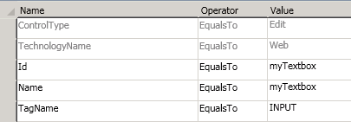
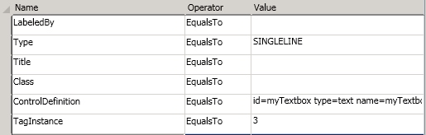
Understand Searching and Filtering http://tinyurl.com/SearchAndFilter
Searching is used to look
for all possible controls
Filtering is used to narrow that list to exactly one match
X, Y is only used to guide where the clicks happen within a control
Mouse.Click(uIGOButton,
new Point(19, 18));

Slide 13
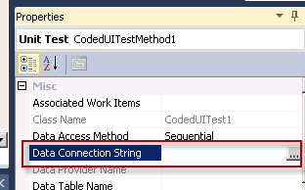
Employ Databinding
Test → Windows →
Test View → Properties →
Select CSV, XML, or Database.
this.UIMap.SimpleTestParams.UIMyTextboxEditText = TestContext.DataRow[“col_name"].ToString();
Note: Databinding to test parameters happens automatically when converting from manual test cases

Slide 14
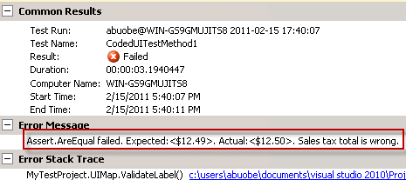
Make Friendlier Assertions
Makes it easier to analyze test run data
Assert.AreEqual(foo, bar, "Sales tax total
is wrong.");

Slide 15
Smile! You’re on Camera
Image pic = this.<top_level_window>.CaptureImage();
//Or for entire desktop: Image pic = UITestControl.Desktop.CaptureImage ();
pic.Save(@"c:\file.bmp");
TestContext.AddResultFile(@"c:\file.bmp");

Slide 16
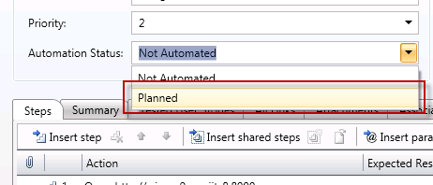
Microsoft Test Manager → CUIT Workflow Tips
Mark each step as pass/fail when recording manual tests
Carefully consider which test cases make sense for automation, and when
Use the Automation Status
field of test cases to identify
candidates for automation

Slide 17
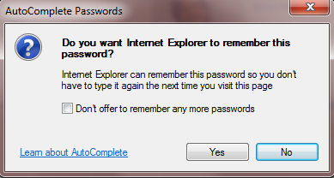

Continue on Error
For actions that
may not happen
every time
Playback.PlaybackSettings.ContinueOnError = true;
or

Slide 18
Testing with Firefox
Firefox 3.5 or 3.6
Requires Visual Studio 2010 Feature Pack 2
//call this at the beginning of your test
BrowserWindow.CurrentBrowser = “Firefox”;
//instead of clicking the close button
This.UIMap.<browser_TLW>.Close();

Slide 19
Multiple UI Map Files http://tinyurl.com/MultipleUIMaps
Allows you to separate logical collections of controls
  Easier to edit independently
  Easier to version control
  Requires a bit more up-front effort
  Doesn’t play well with MTM workflow

Slide 20
Making Your Applications More Testable
Use a testable application stack
Give names to controls
  Use naming conventions and stick with them
  If you need to change the names of controls, refactor them
  along with your tests
Carefully consider the implications of changing UI flows
Educate non-test developers on CUITs
Educate manual testers on CUITs

Slide 21
What About Load Testing?
Coded UI tests assume they have “control” of the mouse and keyboard
Load testing can be accomplished but you need one machine (physical or virtual) per virtual user
See http://msdn.microsoft.com/en-us/library/ff468125.aspx

Slide 22
Playback Settings
Search timeouts
Search behaviors
Error behaviors
See http://tinyurl.com/PlaybackSettings

Slide 23
Windows Automation API 3.0
If running an O/S prior to Windows 7/2008 R2, install this platform update: http://support.microsoft.com/kb/971513/

Slide 24
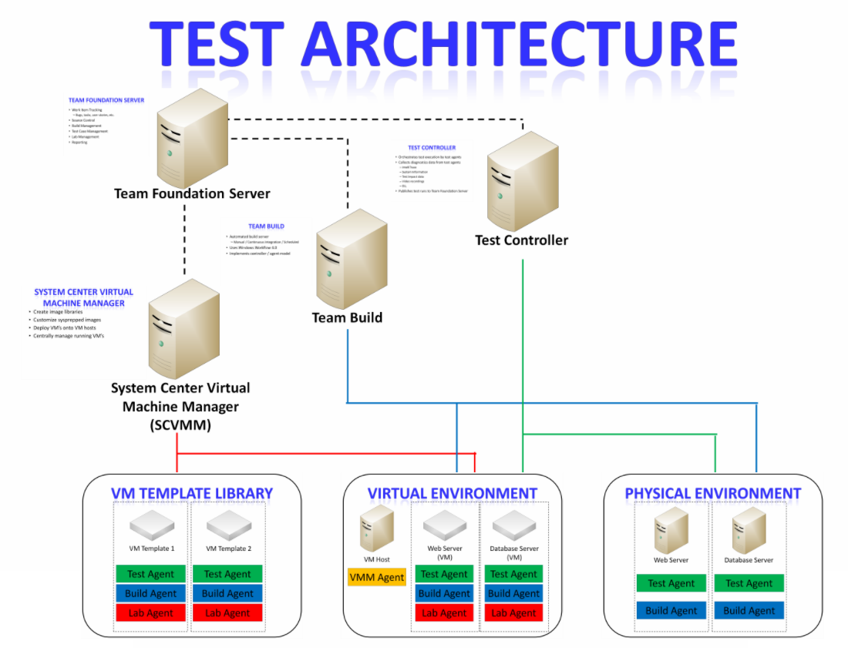

Slide 25
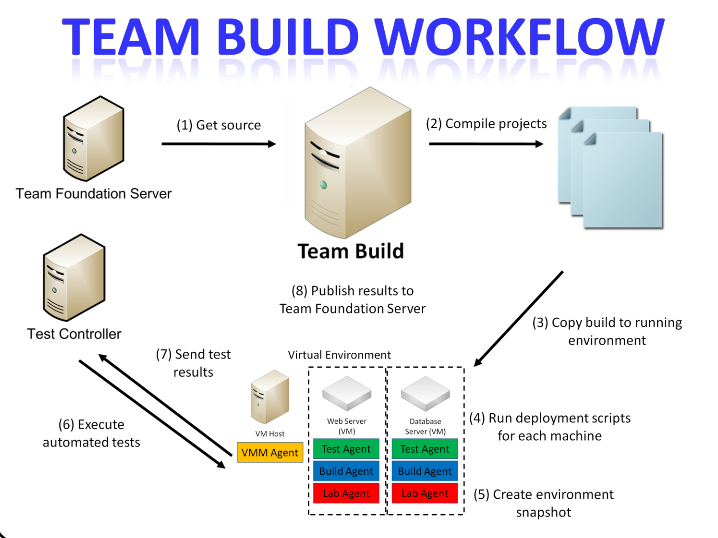

Slide 26
Lab Management
demo

Slide 27
Planning Considerations
Planning considerations – prescriptive guide for planning
  Questions answered
    How many servers do I need?
    What kinds of servers should I buy?
    Can I use a SAN for storage?
    How much storage capacity do I need?
    Can I setup everything on one big machine?
    How do I setup an isolated lab?
  Topics covered
    SCVMM server
    Hyper-V hosts

Slide 28
Resources for Setup
MSDN setup guide
Setting up agents/controllers for lab
Using VM prep tool
Advanced options using tfslabconfig
Advanced permissions for lab management
and how to set them

Slide 29
Best Practice: Topology Guide
Topology 1 – multiple AT, load balancer, and test network with firewall settings,
controlling the test traffic in and out of Corp network
    Network load balancer
    Firewall rules
Topology 2 – multiple ATs and DTs without load balancers and test network with
SAN based library and host
    SAN support
Topology 3 – TMG, Windows NLB, and with test applications having DB tier outside
of virtual environment
    Setting up rules in Threat Management Gateway
    Deployment and testing on a shared machine outside the environment
Topology 4 – multiple ATs and DTs, load balancers, and environments joined to a
different domain
    DNS conditional forwarding

Slide 30
Geo-Distributed Labs
U.S. Lab – Redmond
Host Group
(U.S.)
Host machine
Host machine
Host Machine
Library Share
(U.S.)
Library
Server
TFS AT
SCVMM
Server
India Lab – Hyderabad
Host Group
(IND)
Host machine
Host machine
Host Machine
Library Share
(IND)
Library
Server

Slide 31
Maintenance and Management
Best practice analyzer
Management of hosts and library
  Best practices
    Un-encrypted file transfer
    Host reserve settings
    Host placement settings – enough disk space
    Co-location of library and host in same switch
Test attachments cleaner
Patching of VMs and VM templates
  Offline VM servicing tool 3.0
Managing snapshots
  Machine password expiry
  Clean-up of old snapshots

Slide 32
VMs and Environments
Creating VMs
  Create and store VMs – MSDN doc
  Creating VMs
  Prepare a domain controller VM
Manage virtual environments
  Creating virtual environments – MSDN doc
  Creating and working with virtual environments
  Concepts and guidelines
  Creating network isolated environments
Networking
  Networking basics
  Network isolation

Slide 33
Testing and Deployment
Testing on environments
  MSDN docs
  Manual testing and file rich bugs
  Using snapshots to save state and reproduce the bug
Deployment workflow
  MSDN docs
  Sample for web application
  Customizing the build-deploy-test workflow
    Post 1 and Post 2
    MSDN docs soon
  Macros in the workflow

Slide 34
Troubleshooting
Troubleshooting guide
Architecture – ports and protocols

Slide 35
Other Resources
Product team blog
Videos
VHD
Getting started series
  Part 1, Part 2, Part 3, Part 4
VM prep tool
Lab management data sheet
Lab management product page

Slide 36
What About VMware?
Hyper-V versus VMware versus Physical Machines
VISUAL STUDIO 2010 CAPABILITY/FEATURE | VIRTUAL ENVIRONMENTS (Hyper-V) | PHYSICAL ENVIRONMENTS | VIRTUAL ENVIRONMENTS (non Hyper-V e.g., VMware)
TESTING
Running unit tests
Running manual tests
Running coded UI and other automated tests
Filing rich bugs with diagnostic adapters
BUILD DEPLOYMENT
Automated build-deploy-test workflow
ENVIRONMENT CREATION AND MANAGEMENT
Create environment from VM templates
Start/stop/snapshot environment
Connect to environment using Environment Viewer
Clone environments using network isolation
Supported out of box
Not supported, but possible with customization
Not supported
N/A

Slide 37
DEV Track Resources
http://www.microsoft.com/visualstudio
http://www.microsoft.com/visualstudio/en-us/lightswitch
http://www.microsoft.com/expression/
http://blogs.msdn.com/b/somasegar/
http://blogs.msdn.com/b/bharry/
http://www.microsoft.com/sqlserver/en/us/default.aspx
http://www.facebook.com/visualstudio

Slide 38





Resources
  Connect. Share. Discuss.
http://northamerica.msteched.com
Learning
  Sessions On-Demand & Community
  Microsoft Certification & Training Resources
www.microsoft.com/teched
www.microsoft.com/learning
  Resources for IT Professionals
  Resources for Developers
http://microsoft.com/technet
http://microsoft.com/msdn

Slide 39












Complete an evaluation on CommNet and
enter to win!

Slide 40


Slide 41

© 2011 Microsoft Corporation. All rights reserved. Microsoft, Windows, Windows Vista and other product names are or may be registered trademarks and/or trademarks in the U.S. and/or other countries.
The information herein is for informational purposes only and represents the current view of Microsoft Corporation as of the date of this presentation. Because Microsoft must respond to changing market conditions, it should not be interpreted to be a commitment
on the part of Microsoft, and Microsoft cannot guarantee the accuracy of any information provided after the date of this presentation. MICROSOFT MAKES NO WARRANTIES, EXPRESS, IMPLIED OR STATUTORY, AS TO THE INFORMATION IN THIS PRESENTATION.

