Slide 1

Designing Applications in the era of Many-core Computing
DEV 315
Tiberiu Covaci
Senior Technical Trainer
Many-core

Slide 2
Who am I?
Tiberiu ’Tibi’ Covaci
Software engineer, over 20 years experience
MCT since 2004, teaching .NET
Researcher at KTH Sweden
INETA Speaker & Country Lead for Sweden
Telerik MVP/Insider
@tibor19 #msteched

Slide 3
Current state
Clock speed has reached an upper limit and can not be increased
Moore’s law is alive and kicking
Processors makers are doing multicore
Multicore software is hard
  Amdahl's law (optional)
Three reasons why it is hard
Conclusion, we and no one else has any idea how to do multicore software, but it is a glorious and shiny future.

Slide 4
Agenda
  Definitions
  How to create parallel application
  Finding concurrency
  Strategies for exploiting concurrency
  Algorithm structures
  Supporting structures
  Sharing state

Slide 5
Definitions
Patterns
Pattern languages
Programming roles

Slide 6
Patterns
A generally accepted solution to a recurring problem

Slide 7


Patterns
A generally accepted solution to a recurring problem
Characteristics:
  Name
  Problem
  Context
  Forces
  Solution
  Invariant
  Examples
  Known Uses
  Related patterns

Slide 8
Patterns
A generally accepted solution to a recurring
problem
Characteristics:
  Name
  Problem
  Context
  Forces
  Solution
  Invariant
  Examples
  Known Uses
  Related patterns

Slide 9
Pattern language
Collection of related patterns one flowing in to the other as you solve the problem

Slide 10
Programming roles
Application programmer
Application framework developer
Parallel programming framework developers
Platform programmers

Slide 11
The problem

Slide 12
How to create parallel applications
Original Problem
Finding Concurrency
Original Problem
Tasks, shared and local data
Algorithm Structure
Supporting Structures & Implementation Mechanisms
Task t1 = Task.Factory.StartNew(…);
Corresponding source code
Units of execution & new shared data for extracted dependencies

Slide 13
Finding Concurrency
Original Problem
Finding Concurrency
Original Problem
Tasks, shared and local data

Slide 14

Finding Concurrency
  Decomposition Analysis
  Dependency Analysis
  Design Evaluation

Slide 15
Decomposition Analysis
Task Decomposition
Data Decomposition

Slide 16

Dependency Analysis
Group Tasks
Order Tasks
Data Sharing

Slide 17
  Design Evaluation
    Is the decomposition and the dependency analysis good enough so we can continue?

Slide 18
Demo

Slide 19
Peel and Dice Oninons
Dice The
Meat
Fry the Onion
Add Some Spices
Peel and Dice Potatoes
Cut The Peppers
Step 1
Step 2
Step 3
Step 4
Sprinkle Paprika
Cut And Clean The Chilies
Cook 10 minutes
Cook 5 minutes
Add Water
Cook 40 minutes

Slide 20
Peel and Dice Oninons
Dice The
Meat
Fry the Onion
Add Some Spices
Peel and Dice Potatoes
Cut The Peppers
Sprinkle Paprika
Cut And Clean The Chilies
Cook 10 minutes
Cook 5 minutes
Add Water
Cook 40 minutes

Slide 21
Strategies for exploiting concurrency
Original Problem
Finding Concurrency
Original Problem
Tasks, shared and local data
Algorithm Structure
Units of execution & new shared data for extracted dependencies

Slide 22
Strategies for exploiting concurrency
  Agenda parallelism
  Result parallelism
  Specialist parallelism

Slide 23
Agenda parallelism
Algorithms are naturally expressed in terms of the actions to be carried out by the program

Slide 24
Agenda parallelism
Task Parallelism
  Delightfully parallel
  Separable dependencies
Divide and conquer

Slide 25
Demo

Slide 26
Result parallelism
Algorithms are defined in terms of data structures and how they are decomposed

Slide 27
Result parallelism
Geometric Decomposition
Recursive Data
Data Parallelism

Slide 28
Demo

Slide 29
Specialist parallelism
A fixed set of tasks that data flows through

Slide 30
Specialist parallelism
Pipeline
Event-based Coordination

Slide 31
Demo

Slide 32
Supporting Structures & Implementation mechanism
Original Problem
Finding Concurrency
Original Problem
Algorithm Structure
Tasks, shared and local data
Supporting Structures & Implementation Mechanisms
Task t1 = Task.Factory.StartNew(…);
Corresponding source code
Units of execution & new shared data for extracted dependencies

Slide 33
Supporting Structures &
Implementation mechanism
  Program Structures
  Data Structures
  Unit of Execution Management
  Communication
  Synchronization

Slide 34
Sharing State and Synchronization
Don’t share!
Read only data
Data isolation
Synchronization

Slide 35
Synchronization
Memory synchronization / fences
Barriers
Mutual exclusion

Slide 36
Deadlocks
Mutual exclusion
Hold and wait
No preemption
Circular wait

Slide 37
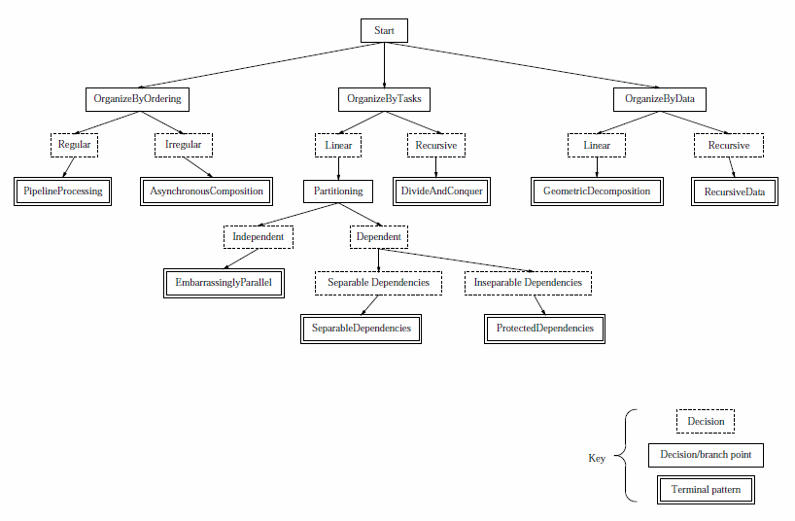
Pipeline
Actors
Divide & Conquer
Distributed
Array
MPMD
Map
Reduce
Producer/
Consumer
SPMD
Loop Parallel
Master/Worker
Shared Queue
Repository
Fork/
Join
SOA Facade
Source: More Patterns for Parallel Application Programs, Berna L. Massingill, Timothy G. Mattson and Beverly A. Sanders

Slide 38
Summary
  Definitions
  How to create parallel application
  Finding concurrency
  Strategies for exploiting concurrency
  Algorithm structures

Slide 39
Summary
  Supporting structures
  Sharing state
  Deadlocks
  How to make Goulash
  How to get help in the kitchen ☺

Slide 40
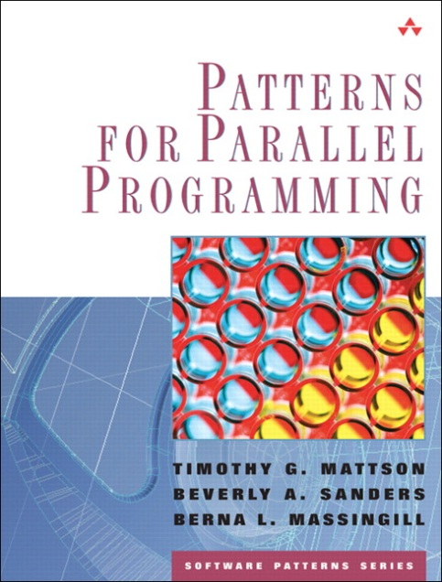

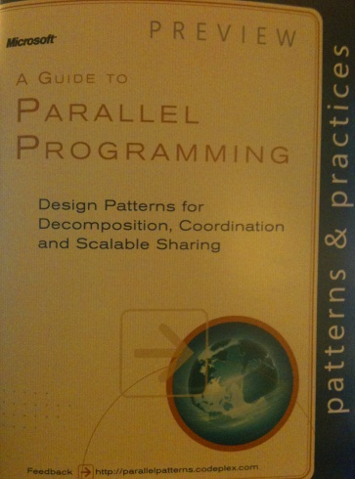
Where do we go from here?
http://msdn.com/concurrency
http://software.intel.com/en-us/multi-core/
http://blog.multi-core.net
tibi@multi-core.net

Slide 41



Conclusions

Slide 42
Embrace parallelism!
Thank you!

Slide 43

Related Content
Required Slide
Speakers, please list the Breakout Sessions, Interactive Discussions, Labs, Demo Stations and Certification Exam that relate to your session. Also indicate when they can find you staffing in the TLC.
DEV303 - Modern Native C++ Development for Maximum Productivity
DEV323 | A Taste of F#: Today and Future
DEV277-HOL Introduction to the Parallel Extensions Library
Find Me Later At Ask an Architect Booth

Slide 44
Questions?
http://msdn.com/concurrency
http://software.intel.com/en-us/multi-core/
http://blog.multi-core.net
tibi@multi-core.net

Slide 45
DEV Track Resources
http://www.microsoft.com/visualstudio
http://www.microsoft.com/visualstudio/en-us/lightswitch
http://www.microsoft.com/expression/
http://blogs.msdn.com/b/somasegar/
http://blogs.msdn.com/b/bharry/
http://www.microsoft.com/sqlserver/en/us/default.aspx
http://www.facebook.com/visualstudio

Slide 46





Resources
  Connect. Share. Discuss.
http://northamerica.msteched.com
Learning
  Sessions On-Demand & Community
  Microsoft Certification & Training Resources
www.microsoft.com/teched
www.microsoft.com/learning
  Resources for IT Professionals
  Resources for Developers
http://microsoft.com/technet
http://microsoft.com/msdn

Slide 47












Complete an evaluation on CommNet and
enter to win!

Slide 48


