Slide 1

Best Practices for Building Custom
Open Data Protocol (OData) Services with Windows Azure
DEV325
Alex James
Program Manager
Microsoft

Slide 2
Do you know how to?
Build a custom OData Service?
Configure and Deploy your OData Service?
Reach your audience?
Share only what you want?
Plan for the future?

Slide 3
Why does this matter?
OData is the easiest way to share data
Do it wrong and it will cost you
Mobile and JavaScript clients are important
Sharing too much can hurt your career
Things change.

Slide 4
What is OData?
HTTP
Reach (devices and platforms)
Metadata
Formats (ATOM & JSON)
Semantics(GET/PUT/POST/DELETE)
Uri Conventions & Query Language
GET ~/Customers(6)
JSON
POST ~/Customers
JSON
ATOM
DELETE ~/Customers(5)
PUT ~/Customers(4)
GET ~/Customers(4)/Orders
ODATA Service
HTTP
JSON
GET ~/Customers?$filter=City eq ‘Atlanta’
metadata

Slide 5
Why OData?
HTTP
Suitable for devices
Simple
Powerful
Eco-system
  Platforms: Javascript, PHP, Java, .NET, Silverlight, Ruby, iOS etc
  Producers: SharePoint, DataMarket, CRM, StackOverflow, Netflix etc.

Slide 6
Building a Custom OData Service
demo

Slide 7
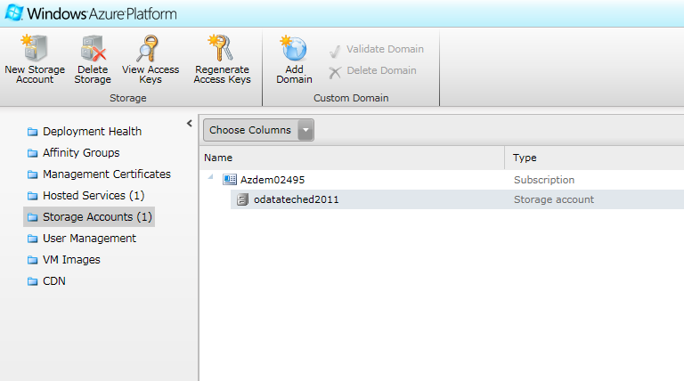
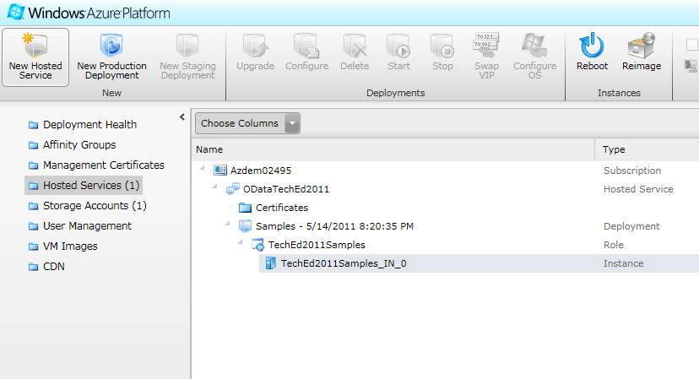
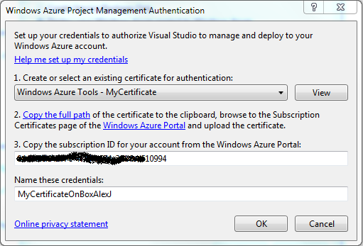
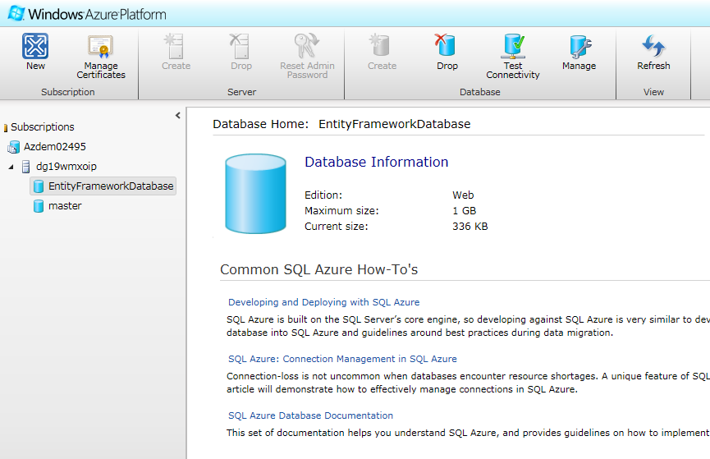
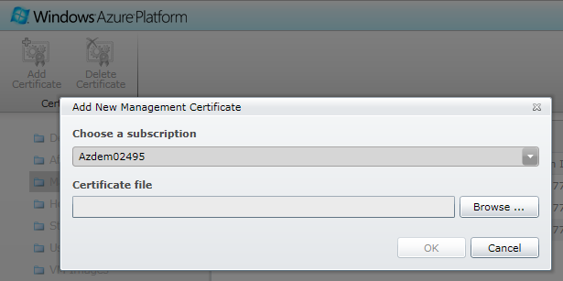
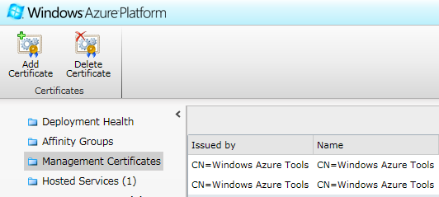
OData and Azure
For development you need:
  Windows Azure SDK and Windows Azure Tools for VS
  Azure account with at least:
    One Storage Account
    One Hosted Service
    Registered Certificate
  SQL Azure Database

Slide 8
Move Model & Data into SQL Azure
Options
  Use SSIS
  Script Database and run script in new database
  Code in your app to initialize database
(Coming Soon) http://www.sqlazurelabs.com/ImportExport.aspx
  (EXPORT) DacImportExportCli.exe
  -s serverName
  -d databaseName
  -f C:\filePath\exportFileName.bacpac
  -x -e
  (IMPORT) DacImportExportCli.exe
  -s serverName.database.windows.net
  -d databaseName
  -f C:\filePath\exportFileName.bacpac
  -i
  -u userName
  -p password

Slide 9
Configuring an OData Service
demo

Slide 10
What is JSONP?
Site 2
.getJSON(..)
<script>
{“x”:1}
callback({“x”:1})
Site 1
Site 1
Site 2

Slide 11
Authentication & Authorization
AuthenticationModule: IHttpModule
Authenticates and sets: HttpContext.Current.User
ODataService: DataService<DataSource>
DataServicesProcessingPipeline.ProcessingRequest
Query Interceptor
Query Interceptor
Change Interceptor
DataSource
Customers
Id Name City
Products
Id Name Category
Suppliers
Id Name Status

Slide 12
Choosing a Security Strategy
AuthN
  Windows Auth – simple for in the enterprise services
  Basic Auth – maximum reach
  Forms Auth – purely for integration
  OAuth – most flexible – but needs custom code
    OAuth HttpModule
    Custom client code to acquire credentials

Slide 13

Scenario1 - Federation with Google/Facebook
Google
Facebook
authenticates
Gives consent
Trusts
Trusts
someone@facebook.com
someone@facebook.com
Identity Provider
someone@facebook.com
Trusts
OAuthModule: IHttpModule
Authenticates and sets: HttpContext.Current.User
ODataService: DataService<DataSource>

Slide 14
Scenario2 - Federation with Corporate Domain
Corp Domain
Try to Authenticate
someone@mycorp.com
Trusts
someone@mycorp.com
someone@mycorp.com
Identity Provider
someone@mycorp.com
Trusts
OAuthModule: IHttpModule
Authenticates and sets: HttpContext.Current.User
ODataService: DataService<DataSource>

Slide 15

Scenario3 - Delegation
need to access x@y.com’s data
Identity Provider
token: x@y.com canread
authenticate
challenge
Trusts
Give consent
token: x@y.com canread
OAuthModule: IHttpModule
Authenticates and sets: HttpContext.Current.User
ODataService: DataService<DataSource>

Slide 16
And finally…

Slide 17
Versioning your service…
With DataServiceContext.IgnoreMissingProperties:
  You can safely
    Add a new optional property
    Remove a property – Read Only
    Add unrelated new types
  But lots of things can go wrong.
    Add a required property or navigation
    Remove a property – Read/Write
    Rename a property (fail).
    Remove a type / feed
Realistic Solution
  V1/service.svc/
  V2/service.svc/

Slide 18
Recap
You just learned how to:
The easiest way to build a web-api
The easiest way to host a web-api
How to do it the right way:
  Configuration
  Security & Reach
  Versioning
You know how to create a REAL service…

Slide 19

SDKs, Samples and posts referenced
Windows Azure SDK and Windows Azure Tools for Microsoft Visual Studio http://bit.ly/mMcoc3
JSONP component (with recent bug fix) http://bit.ly/mbk04c
Using ASP.NET Output Caching with WCF Data Services http://bit.ly/gXmbdE
Authentication posts on the OData team blog http://bit.ly/gXmbdE
The New Hands-on Lab on ACS + WP7 + OAuth2.0 OData Service http://bit.ly/h8gcJV

Slide 20
Related Content
Required Slide
Speakers, please list the Breakout Sessions, Interactive Discussions, Labs, Demo Stations and Certification Exam that relate to your session. Also indicate when they can find you staffing in the TLC.
DEV308 | Creating and Consuming Open Data Protocol (OData) Services – Beth Massi
DEV374-INT | OData Unplugged
Alex James (that me!)
DEV372-HOL | Building and Consuming OData Services
Contact me…
Email: alex.james@microsoft.com
Twitter: @adjames
Blog: blogs.msdn.com/alexj

Slide 21
Track Resources
Required Slide
Track PMs will supply the content for this slide, which will be inserted during the final scrub.
OData: ( http://www.odata.org )
OData & WCF Data Services on MSDN ( http://msdn.microsoft.com/odata )
OData on CodePlex ( http://odata.codeplex.com )
TechEd OData Service ( http://odata.msteched.com/tena2011/sessions.svc )

Slide 22
DEV Track Resources
http://www.microsoft.com/visualstudio
http://www.microsoft.com/visualstudio/en-us/lightswitch
http://www.microsoft.com/expression/
http://blogs.msdn.com/b/somasegar/
http://blogs.msdn.com/b/bharry/
http://www.microsoft.com/sqlserver/en/us/default.aspx
http://www.facebook.com/visualstudio

Slide 23





Resources
  Connect. Share. Discuss.
http://northamerica.msteched.com
Learning
  Sessions On-Demand & Community
  Microsoft Certification & Training Resources
www.microsoft.com/teched
www.microsoft.com/learning
  Resources for IT Professionals
  Resources for Developers
http://microsoft.com/technet
http://microsoft.com/msdn

Slide 24












Complete an evaluation on CommNet and
enter to win!

Slide 25


Slide 26

© 2011 Microsoft Corporation. All rights reserved. Microsoft, Windows, Windows Vista and other product names are or may be registered trademarks and/or trademarks in the U.S. and/or other countries.
The information herein is for informational purposes only and represents the current view of Microsoft Corporation as of the date of this presentation. Because Microsoft must respond to changing market conditions, it should not be interpreted to be a commitment
on the part of Microsoft, and Microsoft cannot guarantee the accuracy of any information provided after the date of this presentation. MICROSOFT MAKES NO WARRANTIES, EXPRESS, IMPLIED OR STATUTORY, AS TO THE INFORMATION IN THIS PRESENTATION.

