Slide 1

Why Web Performance Matters
DEV344
Richard Campbell
Co-Founder
Strangeloop Networks

Slide 2



Richard Campbell
Background
  First laid hands on a microcomputer in 1977, it’s been all downhill from there
  Spent the last fifteen years helping companies scale software on a variety of platforms
Currently
  Co-Founder and Product Evangelist for Strangeloop Networks
  Co-Host of .NET Rocks!
  Host of RunAs Radio

Slide 3

Why Does Web Performance Matter?

Slide 4
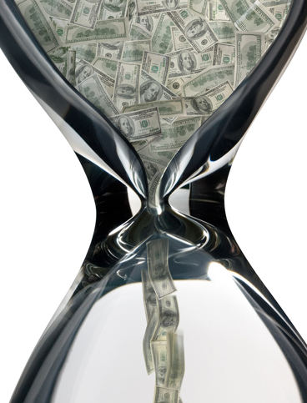
Is This Your Web Site?

Slide 5
ATTENTION
ENGAGEMENT
Business Metric
SEARCH IMPACT
NEW
VISITORS
AD CLICKS
GROWTH
SEARCHES
TWEETS
MENTIONS
ADS SEEN
NUMBER
OF VISITS
PAGES
PER
VISIT
TIME
ON
SITE
USERS Productivity and Satisfaction
LOSS
BOUNCE
RATE
CONVERSION
RATE
x
ORDER
VALUE

Slide 6
So How Do We Prioritize?
Easy Hard
Performance
Cost

Slide 7
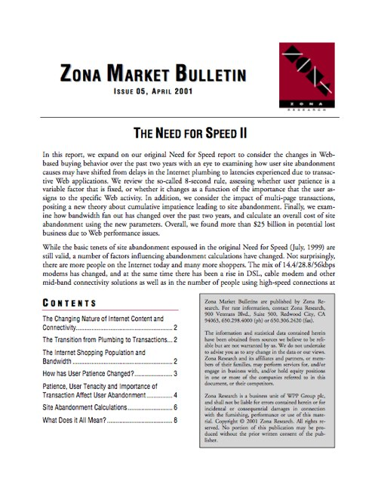
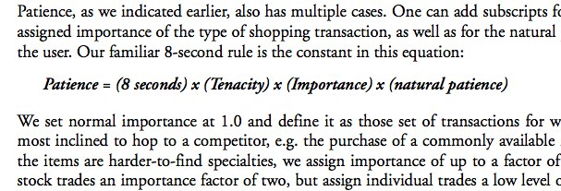
So How Fast is Fast?

Slide 8
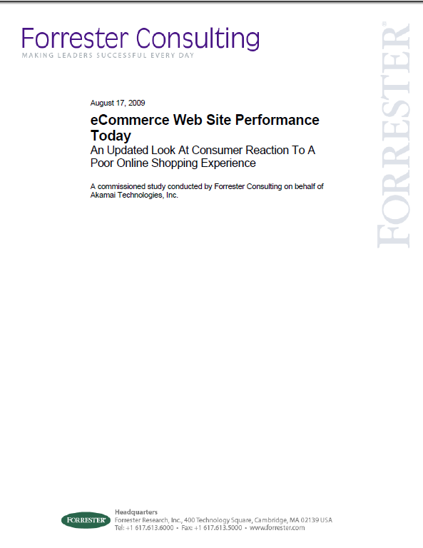
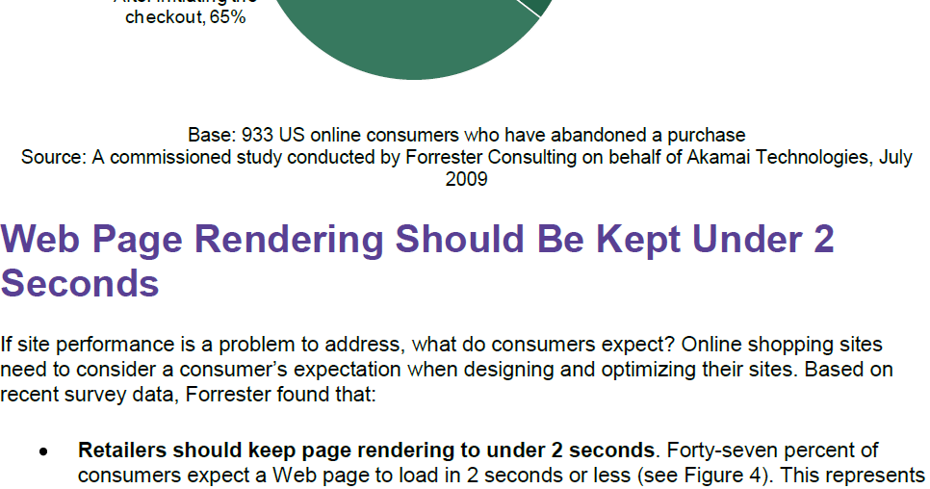
So How Fast is Fast?

Slide 9

The Slow Down Experiments

Slide 10
Impact of additional delay

Slide 11

Massive Optimization

Slide 12
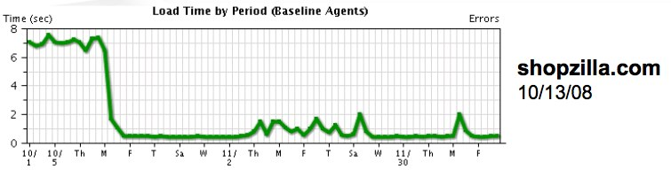
Shopzilla Re-Engineering
Big, high-traffic site
  100M impressions a day
  8,000 searches a second
  20-29M unique visitors a month
  100M products
16 month re-engineering
  Page load from 6 seconds to 1.2
  Uptime from 99.65% to 99.97%
  10% of previous hardware needs

Slide 13
What’s the real benefit?
5-12% Increase in Revenue

Slide 14

No-Code Optimization

Slide 15
What they did
Combining multiple CSS and JavaScript files to reduce external page calls.
Serving static content from a domain without cookies.
Leveraging browser and server-side caching wherever possible.
Compressing image file sizes on output, and serving .png wherever possible.
Asking rich media vendors and the Internet ad industry at large to take performance considerations into account when building and serving rich media ads. Any improvements made will ultimately benefit the advertiser, the server, the publisher and the user.

Slide 16
The Result
19%
0.9%
Performance
Revenue per thousand pages

Slide 17


How About a Regular Mortal Site?
Performance Improvement: From 14 seconds to 7 seconds

Slide 18
Business Impact
6%
9%
29%
38%
Average Order size
Conversion
More Likely to buy on first visit
More Likely to return for a second visit

Slide 19
Strangeloop Research
Tracking Landing Pages
  An Entry Point to a Flow
The First Page Matters
  This where your bounces come from
Landing Pages Impact Business Performance

Slide 20
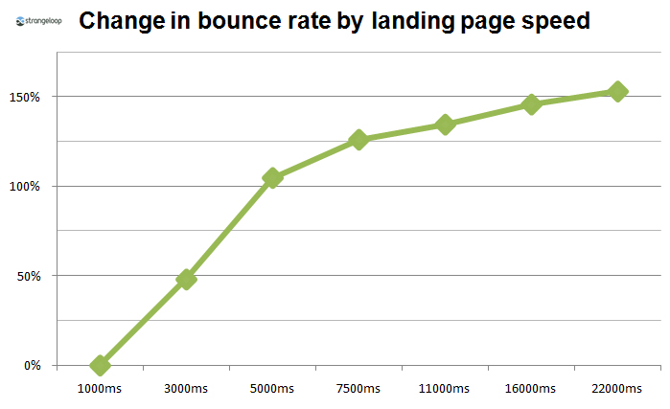

Slide 21
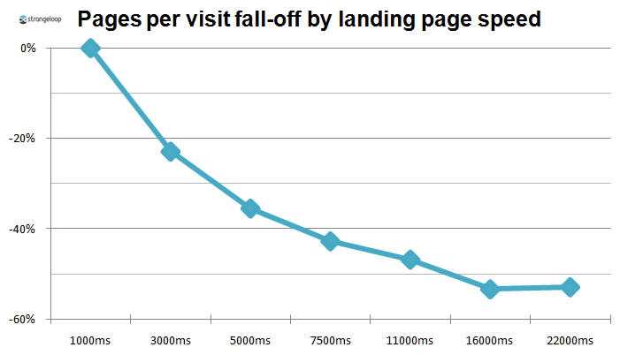

Slide 22
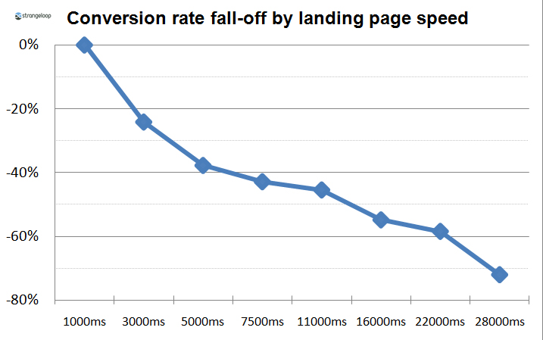

Slide 23
Instrumenting Your Application
Simulations Aren’t Good Enough
Off-the-Shelf Instrumentation is Inadequate
You’ve got to log real production data
It needs to map to YOUR business

Slide 24
Using Web Log Beacons
Adding Javascript to every web page
Record the time from the beginning of the page to the onLoad event firing
Send up a dummy page request with a querystring encoding the time
That’s the easy part

Slide 25

Using WebTimings
getTimings: function (msg, mem, session) {
function wtv(name) { return wtms(name) + ","; }
function wtms(name) {
try {
function calcMs(v) {
if (v == undefined) { return ""; }
return v - navStart; }
if (!wt[name]) {
if (name == "loadEventStart") return calcMs(wt["loadStart"]);
if (name == "loadEventEnd") return calcMs(wt["loadEnd"]);
if (name == "unloadEventEnd") return calcMs(wt["unloadEnd"]);
return ""; }
return calcMs(wt[name]); }
catch (e) { r.e(e, "b", "wtms", name); }

Slide 26
Using WebTimings
var perf, wt, navStart, head, en = null;
try {
if (__$1D0C && __$1D0C.head) { head = __$1D0C.head; }
head = head || r.pg.head || null;
if (head && head instanceof Date) {
msg.hst = head.getTime();
if (r.pg.load) { mem.lt = r.pg.load.getTime() - msg.hst; }
if (session != null && session.lut) {
mem.ut = msg.hst - session.lut;
if (mem.ut < 0) { mem.ut = 0; } }
if (r.pg.content) { msg.ct = r.pg.content.getTime() - msg.hst; }
if (r.pg.body) { mem.bt = r.pg.body.getTime() - msg.hst; }
if (r.pg.paint) { msg.fp = r.pg.paint.getTime() - msg.hst; } }

Slide 27
Using WebTimings
perf = w.performance || w.mozPerformance || w.msPerformance || w.webkitPerformance;
if (perf) { wt = perf.timing; }
if (wt && wt.navigationStart && !isNaN(wt.navigationStart)) { navStart = wt.navigationStart; }
if (navStart) {
msg.wt = perf.navigation.redirectCount + "," + wtv("redirectStart") +
wtv("redirectEnd") + wtv("unloadStart") + wtv("unloadEventEnd") +
wtv("fetchStart") + wtv("domainLookupStart") + wtv("domainLookupEnd") +
wtv("connectStart") + wtv("connectEnd") + wtv("requestStart") +
wtv("requestEnd") + wtv("responseStart") + wtv("responseEnd") +
wtv("domLoading") + wtv("domInteractive") + wtv("domContentLoaded") +
wtv("domComplete") + wtv("loadEventStart") + wtv("loadEventEnd") +
wtv("msStyleContentLoaded") + wtv("firstPaint") + perf.navigation.type;
}

Slide 28
Using WebTimings
if (navStart) {
msg.dct = wtms("loadEventStart");
}
else {
var slt = (r.buf === "true" ? mem.slb : mem.sfb) || null;
if (mem.lt) {
msg.dct = mem.lt;
if (slt && !r.sys.cookie.hcache) { msg.dct += slt; }
}
}

Slide 29
The Hard Part of Web Beacons
Web Beacon data is a LOT of data
And the queries are relatively simple
Consider a NoSQL storage approach (Hadoop is popular for this)

Slide 30
Calls to Action
Instrument Your Production Application
  There’s no substitute for the real data
You can test positively and negatively
  It’s easier to slow down and show the loss than speed up
For the most part, the return-for-performance curve is smooth
  Faster is better = More Money!

Slide 31
Web Track Resources
http://www.asp.net/
http://www.silverlight.net/
http://www.microsoft.com/web/gallery/
http://www.iis.net/
http://weblogs.asp.net/Scottgu/
http://www.hanselman.com/blog/

Slide 32





Resources
  Connect. Share. Discuss.
http://northamerica.msteched.com
Learning
  Sessions On-Demand & Community
  Microsoft Certification & Training Resources
www.microsoft.com/teched
www.microsoft.com/learning
  Resources for IT Professionals
  Resources for Developers
http://microsoft.com/technet
http://microsoft.com/msdn

Slide 33












Complete an evaluation on CommNet and
enter to win!

Slide 34


