Slide 1

DPR208
Debugging a Dysfunctional Team
Richard Hundhausen
President, Accentient
VS ALM MVP, RD

Slide 2

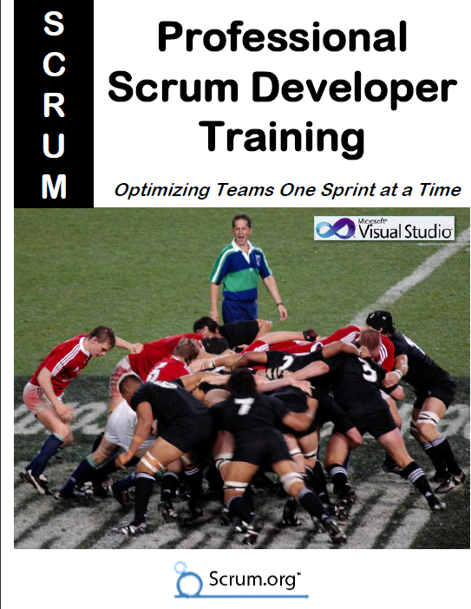




Richard Hundhausen
President of Accentient
From Boise, Idaho
Microsoft Regional Director
Microsoft MVP (Visual Studio ALM)
Author of Professional Scrum Developer course
richard@accentient.com
@rhundhausen

Slide 3
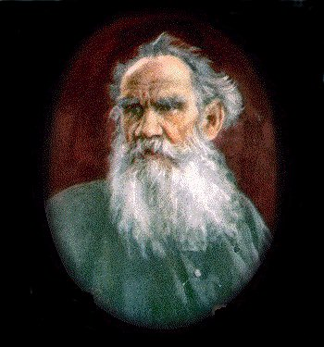
All happy families resemble one another,
each unhappy family is unhappy in its own way.
- Leo Tolstoy

Slide 4
Dysfunction can exist in any of three levels
People
Process
Tools

Slide 5
Let’s start with the hardest one first …
People
Process
Tools

Slide 6
Review: What is the Role of the Team?
To Deliver business value in the form of working software

Slide 7
Teams are made up of people
People come from different cultures
People have different personalities
People work at different speeds
People are not machines
People have emotions
People have bad days
These facts are immutable and are not dysfunctions in and of themselves

Slide 8

Five Dysfunctions of a Team
Absence of trust
Fear of conflict
Lack of commitment
Avoid accountability
Inattention to team results
From the book written by Patrick Lencioni (http://bit.ly/9aBX4U)

Slide 9
Dysfunctions of a Software Development Team
No collaboration
Don’t care / rude
Alphas / cowboys
Won’t listen
Won’t learn
Won’t teach
Specialists
Slackers
Too many meetings
Weasel words
  “That’s not my job”
  “I’m not a tester”
  “I’m 80% done”
  “It compiled on my machine”
  “I did my part”
  “Nothing is blocking me”
  “It was your code that failed”
  “I was on time, you were early”
  “You just can’t implement my design”

Slide 10

Quiz: What do you do when Simon goes missing?
Simon is the application architect and the only one with the vision of what the software should do. Something has happened in his personal life and he’s left for Australia and gone walkabout. Nobody knows how to reach him or if/when he’ll return.

Slide 11
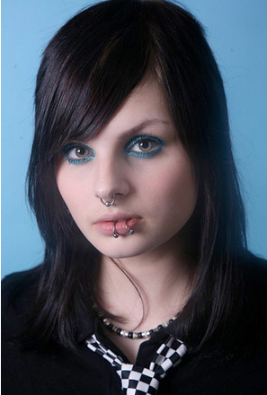
Quiz: What about Laura?
Laura is an excellent C# programmer. She says that it’s the job of QA to test, so she is not going to write unit tests.

Slide 12
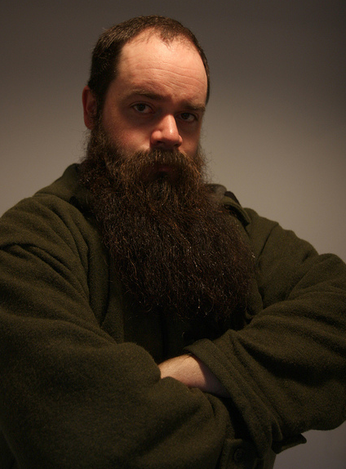
Quiz: What about Dieter?
Dieter is your organization’s only SQL Server administrator. He holds all the passwords and all database changes must go through him. He’s happy to help your team with its database tasks, but only for a few days. He’s very busy, and important. He makes it clear that he doesn’t work for you or your boss and his help is just a courtesy.

Slide 13
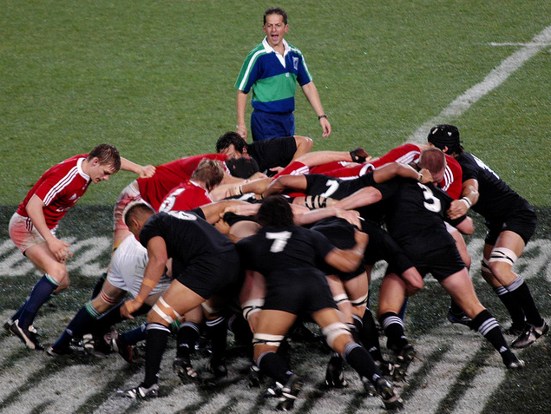
Working Effectively as a Team
Communicate / Listen
Be transparent
Strive to be cross-functional
Know the goal / share the vision
Share objectives
Share commitments
Solve problems together
Have compassion and respect
Learn and improve continually
Earn each others trust
Be ethical

Slide 14
(Bruce) Tuckman Model
In 1965, Bruce Tuckman identified four necessary phases of group (team) development
Performing
Norming
Productivity
Return to Forming whenever a team member leaves or joins!
Forming
Storming
Time

Slide 15
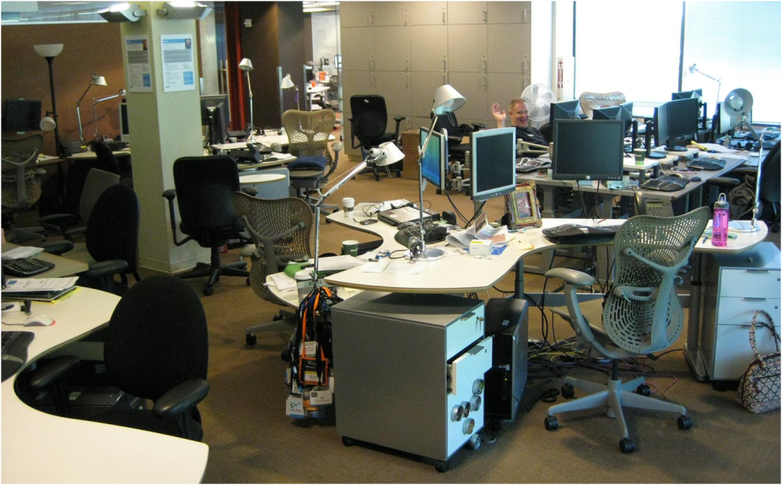
Individual Space vs. Collaborative Dynamic
Collocated teams are productive teams
  But nobody likes to work in a war room 24/7
Balance is important
  Reserve individual time
  and space for yourself
  Respect other’s needs
Let team members wire-in
  http://bit.ly/eWHT0Q

Slide 16
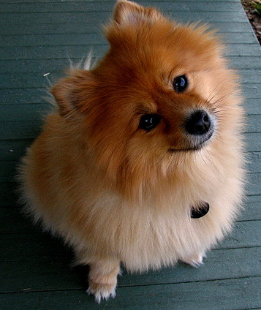
Tactic: Use Active Listening
A communication technique that requires the listener to understand, interpret, and evaluate what he or she hears
  Be active instead of passive
  “Listen” instead of “hear”
  Avoid distractions
  Avoid unrelated thoughts
  Foster an atmosphere of cooperation
  Focus on the speaker
  Consider body language & emotional context

Slide 17

Tactic: Use the Pomodoro Technique
A time management method that uses
a timer to break down periods of work
into 25-minute intervals “pomodoros”
  Decide on the task to be done
  Set the timer (Pomodoro) to 25 minutes
  Work on the task until the timer rings
  Take a short break (5 minutes)
  Every 4 pomodoros take a longer break (15–20 minutes)
For more information http://bit.ly/4q8yD6

Slide 18
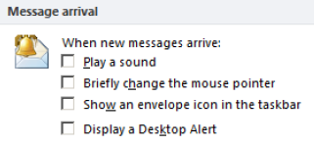
Tactic: Minimize Microsoft Outlook Distractions
Microsoft Outlook likes to offer as many distractions as possible to ensure you can never forget you've got it open and have received mail
Ideally, you should close Outlook
  If you don’t want to do that, then change these options:

Slide 19
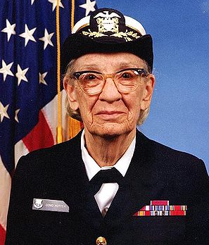
Tactic: Implement the Forgiveness Pattern
“It's easier to ask for forgiveness than
it is to get permission”
  - Rear Admiral Grace Murray Hopper
Take initiative as you tackle your tasks
  The team should be empowered to do what is necessary to deliver on its commitments
  Meetings must provide value, but most don’t
Don’t make bad decisions
Always be transparent

Slide 20
Methodologies, Processes, and Frameworks … oh my
People
Process
Tools

Slide 21
Don’t be Flaccid
Martin Fowler describes it here: http://bit.ly/17aEU
Flaccid teams believe in magic
  They don’t have skills and supportive infrastructure
  They are using inadequate practices and tooling
  They hide behind the waterfall
Flaccid customers believe in magic
  They throw a big book of requirements over the wall
  They avoid inevitable and unavoidable changes
  They think that pressuring the team will work
Don’t just inspect … adapt!

Slide 22
Know when you are “Done”
Done defines when an increment of product functionality is potentially shippable
Definition of Done (DoD)
  A simple, auditable checklist owned by the team
  It can be influenced by organizational standards and specific requirements of the product or release
Can be maintained …
  In a document or wiki
  Using a custom TFS work item control (http://bit.ly/egJdcx)

Slide 23
Example: A Simple Definition of Done
Coded
Acceptance criteria met
Tests pass
Checked-in

Slide 24
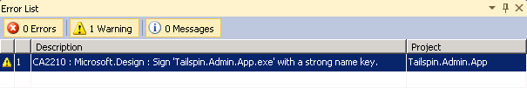
Quiz: What if you are not really done?
Your team believes that they have met their commitments and the customer is quite happy with the increment’s functionality. One of the stories wasn’t completed according to your definition of done. It seems that a Code Analysis warning remains:

Slide 25
Be Transparent
Everyone should be able to inspect …
  The team’s Definition of Done (DoD)
  The product backlog (user stories)
  The sprint backlog (tasks)
  The impediments
  Deployments
  Test results
  Bugs

Slide 26
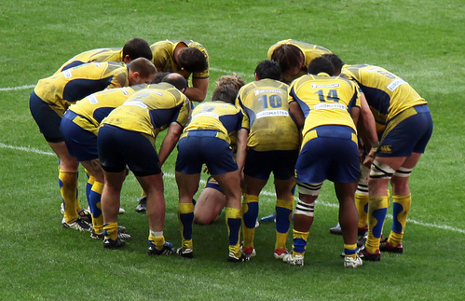
Hold Retrospectives
Look back
  What did we do well?
  What didn’t we do well?
Look forward
  Generate tasks for the next iteration
  Execute these tasks
Whole team participates
  This can get emotional

Slide 27
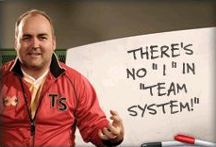
Tactic: Get a coach
A coach is part trainer, consultant, and advisor to the team
A coach can …
  Help a team unlearn dysfunctional practices
  Help adopt and improve methods and practices
  Help a team reach its peak performance

Slide 28
Now for the easy part …
People
Process
Tools

Slide 29
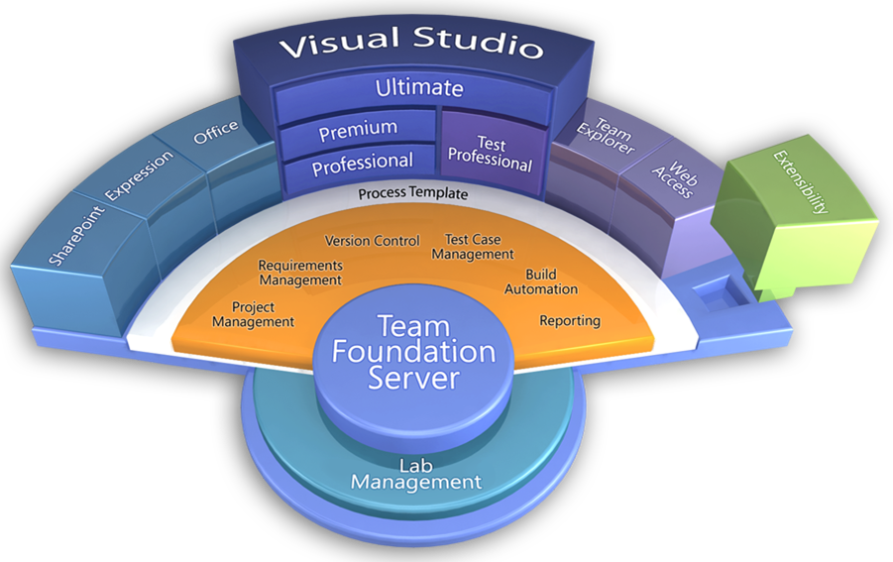
Visual Studio Application Lifecycle Management

Slide 30
Microsoft Visual Studio Scrum 1.0
A process template introduced shortly after Visual Studio 2010 launched
  This demonstrates how popular Scrum is and also Microsoft’s commitment to supporting Scrum
Maps directly to the Scrum concepts
  Sprint vs. Iteration, PBI vs. User Story, Impediment vs. Issue
Available as free download from Microsoft:
  http://bit.ly/hmgkRU

Slide 31

Burndown
What can we consider done?
Dysfunction can exist within the team, process, and tools
Team dysfunctions are the hardest to mitigate
Effective teams are collocated and don’t re-form often
Don’t be flaccid – inspect and adapt
Know your definition of done and own it

Slide 32

Resource: Professional Scrum Developer Program
Learn more here: www.scrum.org
Follow us on Twitter: #proscrumdev
Contact me: richard@accentient.com or @rhundhausen

Slide 33
Related Content
Required Slide
Speakers, please list the Breakout Sessions, Interactive Discussions, Labs, Demo Stations and Certification Exam that relate to your session. Also indicate when they can find you staffing in the TLC.
DEV271INT – Would You, Could You with TFS? (Thursday 8:30 AM in B301)
DPR308 – Emergent Architecture (Thursday 4:30 PM in C302)
DPR306 – The Agile Buffet (Wednesday 10:15 AM in B309)
BOF09DEV – Is Scrum Better for My Projects? (Wed 8:30am in B209)
BOF17DEV – Agile Development: Can It Work for Everyone? (Thu 1pm B209)
Find Me Later At …
  Visual Studio 2010 demo stations
  Microsoft MVP and RD area

Slide 34





Resources
  Connect. Share. Discuss.
http://northamerica.msteched.com
Learning
  Sessions On-Demand & Community
  Microsoft Certification & Training Resources
www.microsoft.com/teched
www.microsoft.com/learning
  Resources for IT Professionals
  Resources for Developers
http://microsoft.com/technet
http://microsoft.com/msdn

Slide 35












Required Slide
Complete an evaluation on CommNet and
enter to win!

Slide 36

© 2011 Microsoft Corporation. All rights reserved. Microsoft, Windows, Windows Vista and other product names are or may be registered trademarks and/or trademarks in the U.S. and/or other countries.
The information herein is for informational purposes only and represents the current view of Microsoft Corporation as of the date of this presentation. Because Microsoft must respond to changing market conditions, it should not be interpreted to be a commitment
on the part of Microsoft, and Microsoft cannot guarantee the accuracy of any information provided after the date of this presentation. MICROSOFT MAKES NO WARRANTIES, EXPRESS, IMPLIED OR STATUTORY, AS TO THE INFORMATION IN THIS PRESENTATION.

