Slide 2

Developing Enterprise-Grade
Mobile Solutions
DPR303
Simon Guest
Director, Mobility Solutions
Neudesic, LLC

Slide 4
Apple will have sold 54 iPhones and 11 iPads

Slide 5
107 unique Android smartphones and
43 Android tablets in market (US)

Slide 6
Microsoft spending $1bn on marketing
& R&D for Windows Phone 7

Slide 8

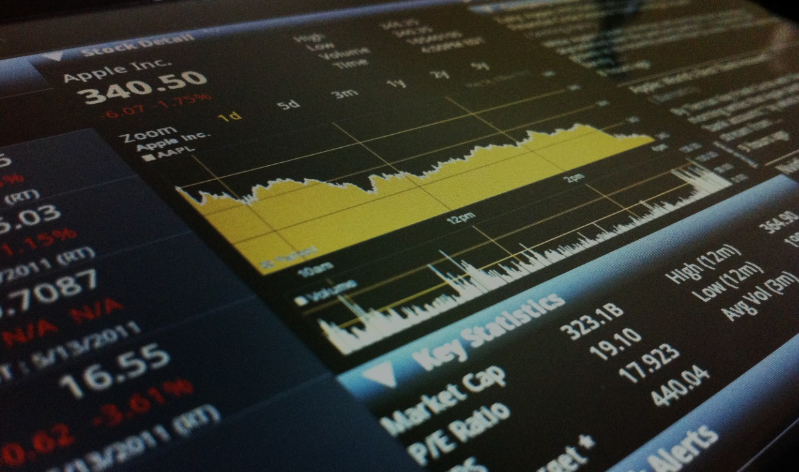

Current and Emerging Trends
Mobile Solutions for the Enterprise
Spark Ideas for your Organization

Slide 10
http://www.gartner.com/it/page.jsp?id=1434613
Operating System | WW Market Share (%age) Forecast end of 2010
Symbian | 40.1
Android | 17.7
RIM | 17.5
iOS | 15.4
WM6.x/WP7 | 4.7
Other | 4.7

Slide 11
http://www.gartner.com/it/page.jsp?id=1434613

Slide 12
Worldwide data doesn’t accurately represent what’s happening in individual countries

Slide 13
Anyone here use Symbian?

Slide 14
comScore MobiLens

Slide 15
http://www.comscore.com/Products_Services/Product_Index/MobiLens
72.5m Active Smartphones in US
Operating System | Share (%age) Feb 2011
Android | 34.7
RIM | 27.1
iOS (Apple) | 25.5
WM6.x/WP7 | 7.5
Palm | 2.8
Other (inc. Symbian) | 2.4

Slide 16
www.comscore.com/Products_Services/Product_Index/MobiLens (trend used for Dec and Mar)

Slide 17
www.comscore.com/Products_Services/Product_Index/MobiLens (trend used for Dec and Mar)

Slide 18
www.comscore.com/Products_Services/Product_Index/MobiLens (trend used for Dec and Mar)

Slide 19
www.comscore.com/Products_Services/Product_Index/MobiLens (trend used for Dec and Mar)

Slide 20
www.comscore.com/Products_Services/Product_Index/MobiLens (trend used for Dec and Mar)

Slide 21
www.comscore.com/Products_Services/Product_Index/MobiLens (trend used for Dec and Mar)

Slide 22
www.comscore.com/Products_Services/Product_Index/MobiLens (trend used for Dec and Mar)

Slide 23
www.comscore.com/Products_Services/Product_Index/MobiLens (trend used for Dec and Mar)

Slide 24
www.comscore.com/Products_Services/Product_Index/MobiLens (trend used for Dec and Mar)

Slide 25
www.comscore.com/Products_Services/Product_Index/MobiLens (trend used for Dec and Mar)

Slide 26
www.comscore.com/Products_Services/Product_Index/MobiLens (trend used for Dec and Mar)

Slide 27
www.comscore.com/Products_Services/Product_Index/MobiLens (trend used for Dec and Mar)

Slide 28
www.comscore.com/Products_Services/Product_Index/MobiLens (trend used for Dec and Mar)

Slide 29
www.comscore.com/Products_Services/Product_Index/MobiLens (trend used for Dec and Mar)
WM6 loses 7.5% share in 12 months. What will WP7 bring?
RIM remains strong, but eroding share (-14% in 12 months)
Android on fire. From 9% to 33% in 12 months
iOS holding steady around 25% market share

Slide 30
What else do we learn from this data?

Slide 31
Take reports, statistics, and analyst
forecasts with a grain of salt

Slide 32
Individual country market share very different
from WW market share

Slide 33
Device lifecycle is very short
(EPA average is around 18 months)

Slide 35
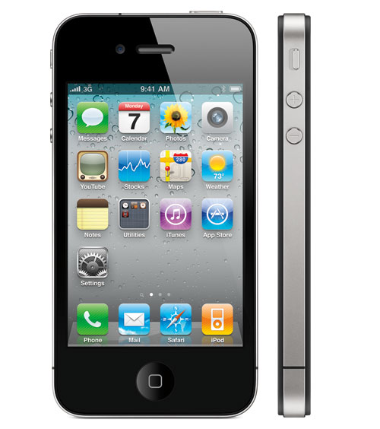
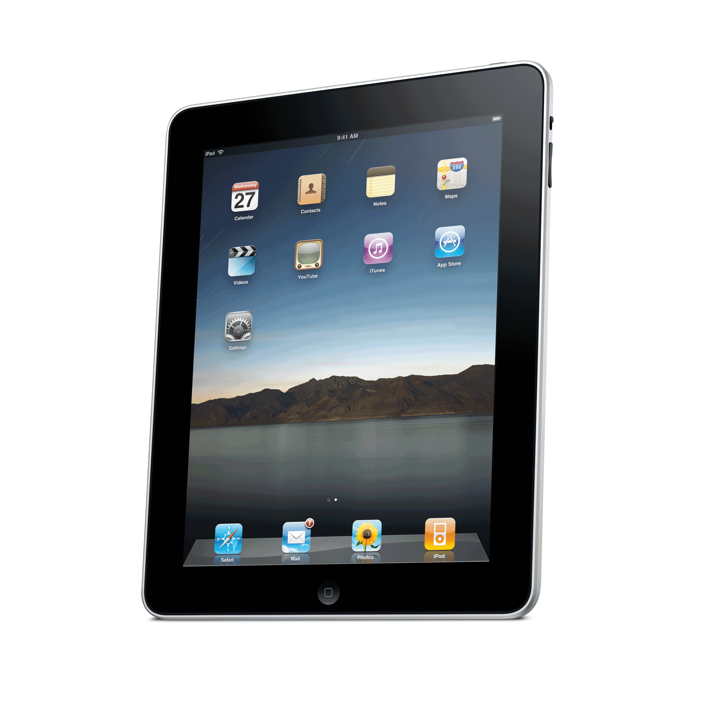
Apple iPhone 4 / iPad 2
87.44m iPhones sold (as of Q4)
2011 forecasts vary – 100m from Wedge Partner Analyst
iPad commanding 95% of tablet shipments WW
Developing for iPhone / iPad
Objective C
XCode IDE (MacOSX only)
Interface Builder (CocoaTouch)
Release of Xcode 4
  LLVM and LLDB (Faster Compiler and Debugger)
  Combined and Enhanced IDE

Slide 36
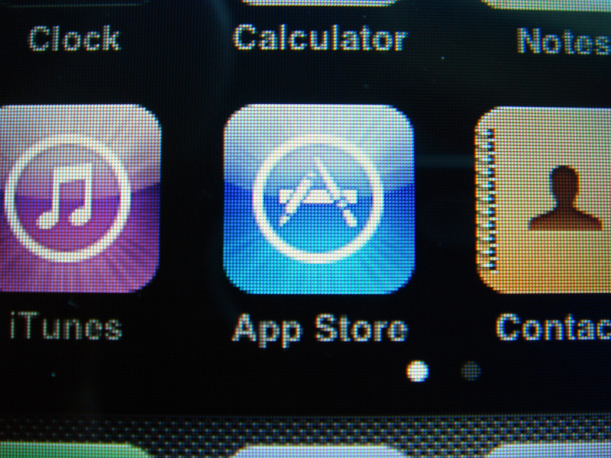
Apple App Store
350k Apps (Jan 2011)
10bn App Downloads
87% iPhone, 7% iPad, 7% multi-tgt
$4.97 avg., iPad apps 23% higher
Apps in the Enterprise
Enabled through iOS Enterprise Development Program ($399 per year)
Wireless App Distribution supported in 4.2+

Slide 37
What Android handset would I show?

Slide 38
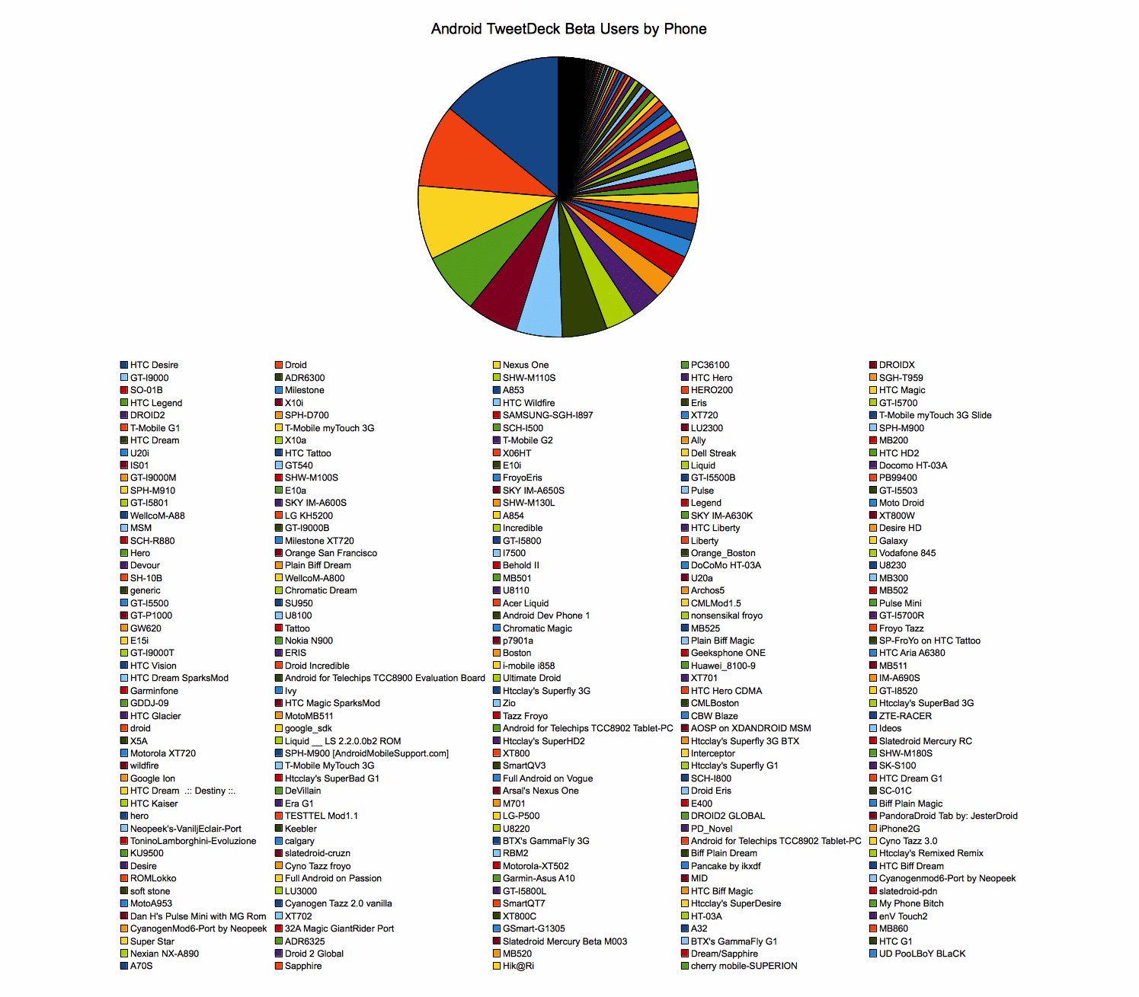
http://blog.tweetdeck.com/android-ecosystem

Slide 39
"Twitter client, Twitter Deck [sic], recently launched their app for Android. They reported that they had to contend with more than 100 different versions of Android software on 244 different handsets. The multiple hardware and software iterations present developers with a daunting challenge.“
[Steve Jobs, Apple]

Slide 40
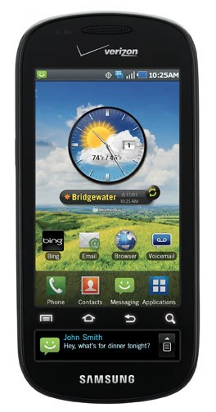
http://www.engadget.com/2010/11/08/samsung-confirms-continuum-dual-display-android-handset-for-veri/
Samsung Continuum
3.4-inch Super AMOLED primary display, 1.8-inch Super AMOLED secondary "ticker" display
Grip sensor to light up the ticker
Left/right swipe on bottom display
Developing for Android
Java Language
Eclipse IDE (Multi-platform)
ADT Plug-in from Google

Slide 41
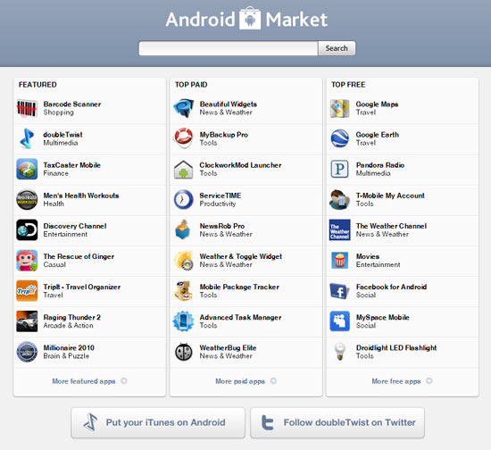
Android Market
Newer than App Store
200k Apps available (Dec 2010)
Fewer restrictions/approval process
More user notifications
Apps in the Enterprise
No requirement that apps have to be sourced from Market
APK File Format
IBM, Google have internal

Slide 42
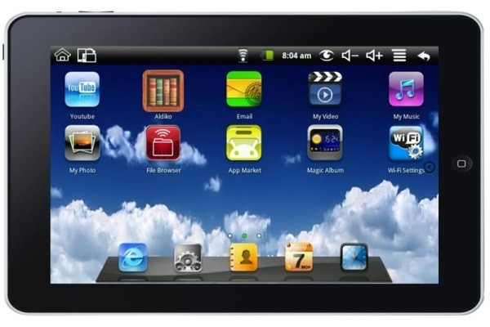
Maylong M-150
Android 1.6
7” resistive touch screen
800x480 resolution
ARM9 VM8505 (400Mhz) processor
WiFi and MicroSD

Slide 43
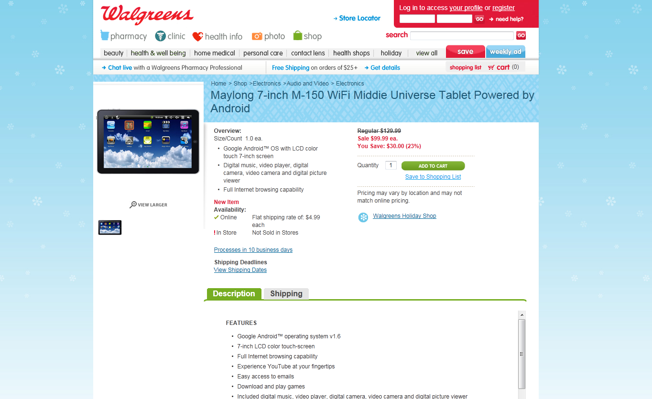

Slide 44
Maylong M-150
Android 1.6
7” resistive touch screen
800x480 resolution
ARM9 VM8505 (400Mhz) processor
WiFi and MicroSD
“May-not-last-long”?

Slide 45
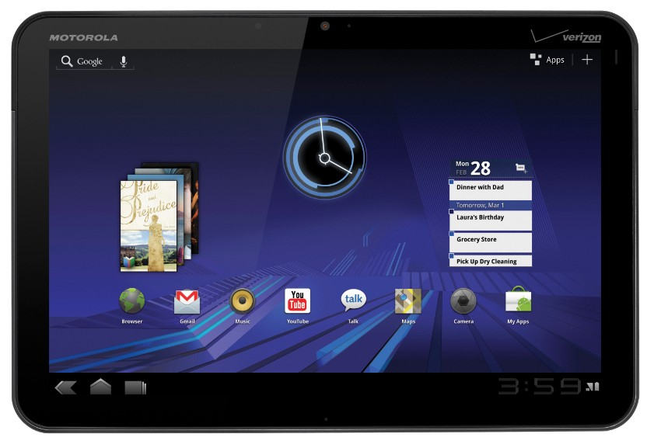
http://www.motorola.com/Consumers/US-EN/Consumer-Product-and-Services/Tablets/ci.MOTOROLA-XOOM-US-EN.alt
Motorola Xoom
Android 3.1 (Honeycomb)
10.1” 1280x800 resolution screen with capacitive touch input
1Ghz Dual Core processor
32Gb storage
Dual Cameras
Both 3G (Verizon) and WiFi Models
IDC forecast around 5.5m Android tablets in 2011

Slide 46
Speaking of Android, isn’t Google getting sued by Oracle?

Slide 47
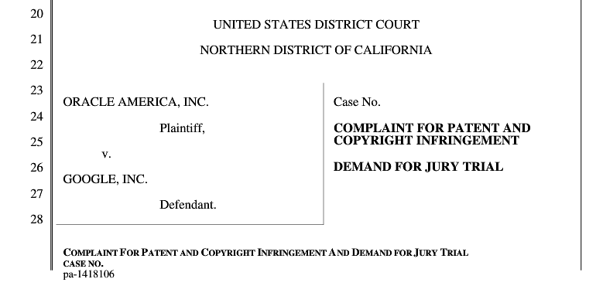
http://news.cnet.com/8301-30684_3-20013546-265.html

Slide 48
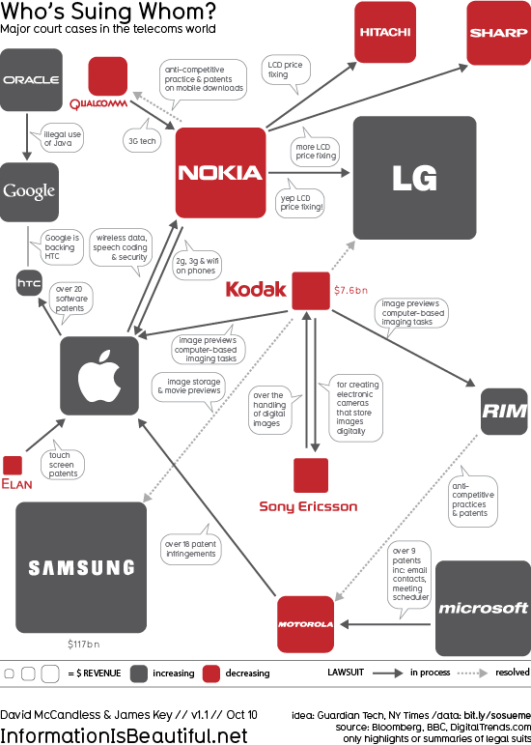
http://flowingdata.com/2010/10/11/mobile-patent-lawsuits/

Slide 49
RIM used to be #1 in the stats…
What are they doing?

Slide 50


Slide 51
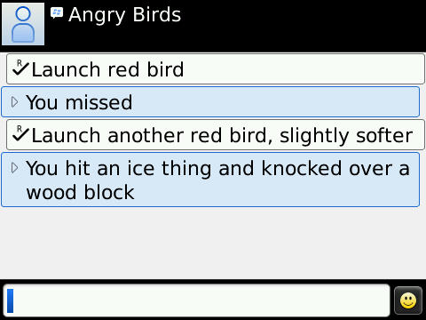

Slide 52
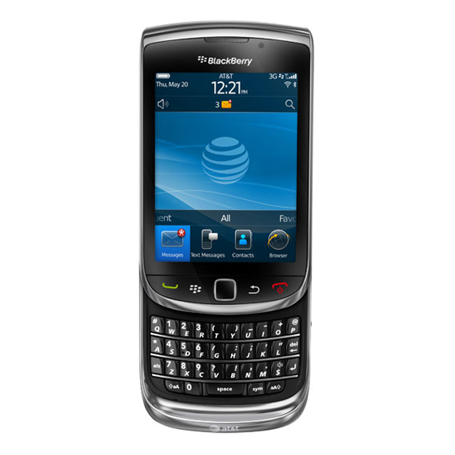
http://www.engadget.com/2010/08/04/blackberry-torch-review/
BlackBerry Torch 9800
Slide out keyboard/touchscreen
3.2” Capacitive Touch Screen, 480x360 resolution
Marvel CPU 624Mhz
BlackBerry 6 OS
  WebKit based
  More polished than 5, but familiar
Developing for BlackBerry
Java Mobile Edition (JME)
BlackBerry Java SDK
Eclipse and NetBeans IDE Support

Slide 53
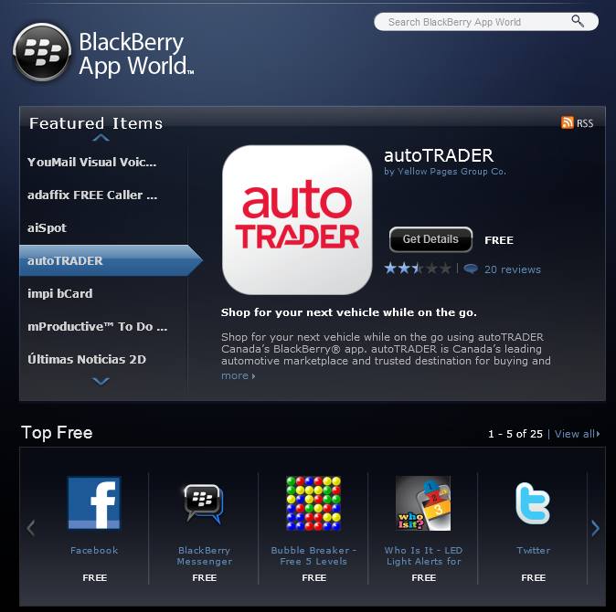
BlackBerry App World
v2.0 Launched on Aug 2010
25k Apps available (Nov 2010)
Similar mix of applications to other app stores
Apps in the Enterprise
BlackBerry Enterprise Server for Applications
Central administration
Wireless deployment

Slide 54
…and what about Microsoft?

Slide 55
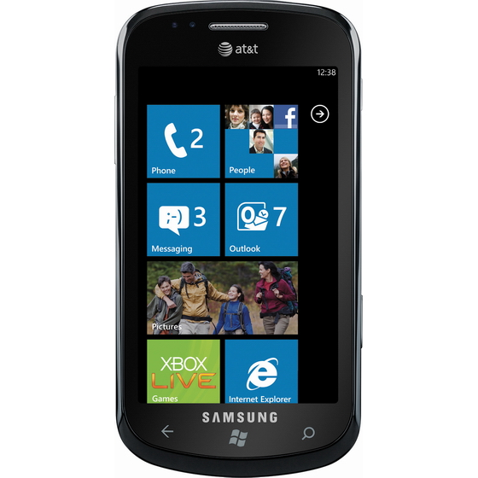
http://www.engadget.com/2010/10/22/samsung-focus-review/
Samsung Focus
4-inch Super AMOLED display
1Ghz Snapdragon processor
512Mb ROM, 1Gb RAM
8Gb internal storage
Developing for Windows Phone 7
C#/XAML based
Silverlight 3.0 on hybrid WinCE 6/7
Visual Studio and/or Expression Blend (Express versions available)

Slide 56
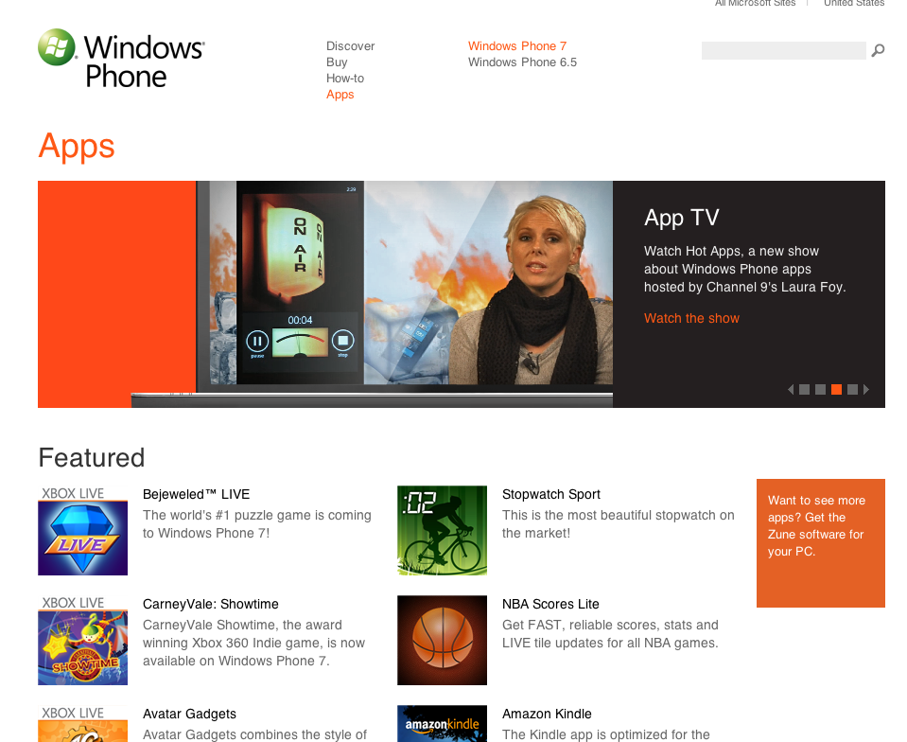
Windows Marketplace
Marketplace on Windows Phone 7
App Hub (http://create.msdn.com)
Launched November 2010
Just passed 10k applications (Mar 11)
Apps in the Enterprise
No enterprise deployment or side loading
Beta and Private marketplaces announced at MIX11 (Mango)

Slide 57
Is there a way to write once for all these devices?

Slide 58
Notes:
Image http://www.w3.org/2006/Talks/0419-MWI-Analysts/mobilechristmas2004.jpeg

Slide 59
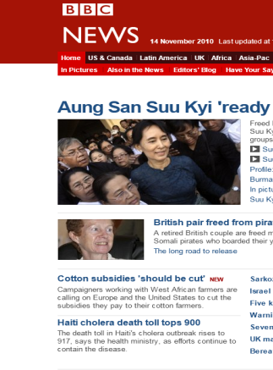
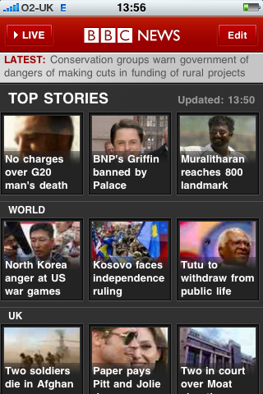
Mobile Web
Native Client
Skills Transfer
Multiple Platforms
No Deploy/Update
Run on Desktop
Monetization
Offline
Performance
Device Features

Slide 60
Hybrid applications

Slide 61
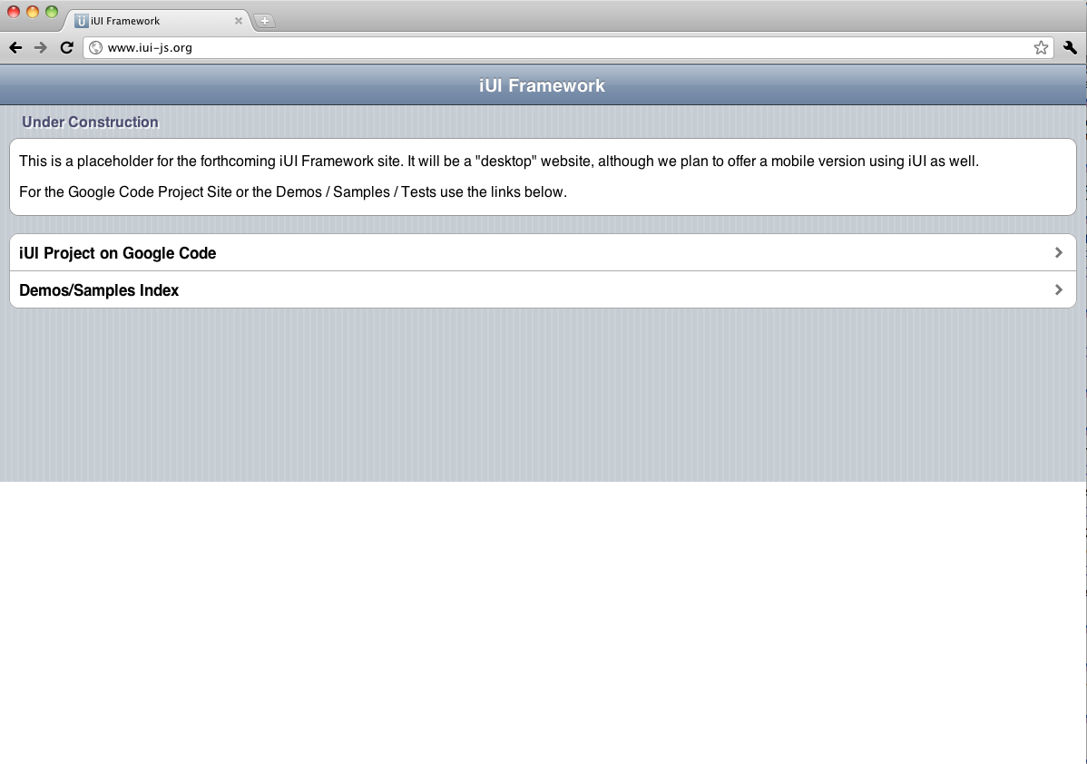
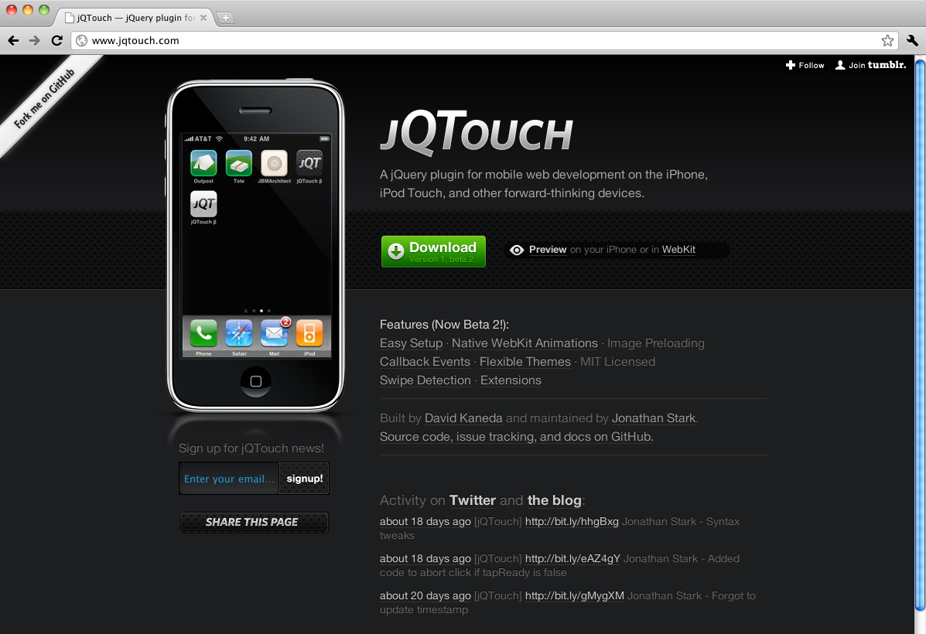
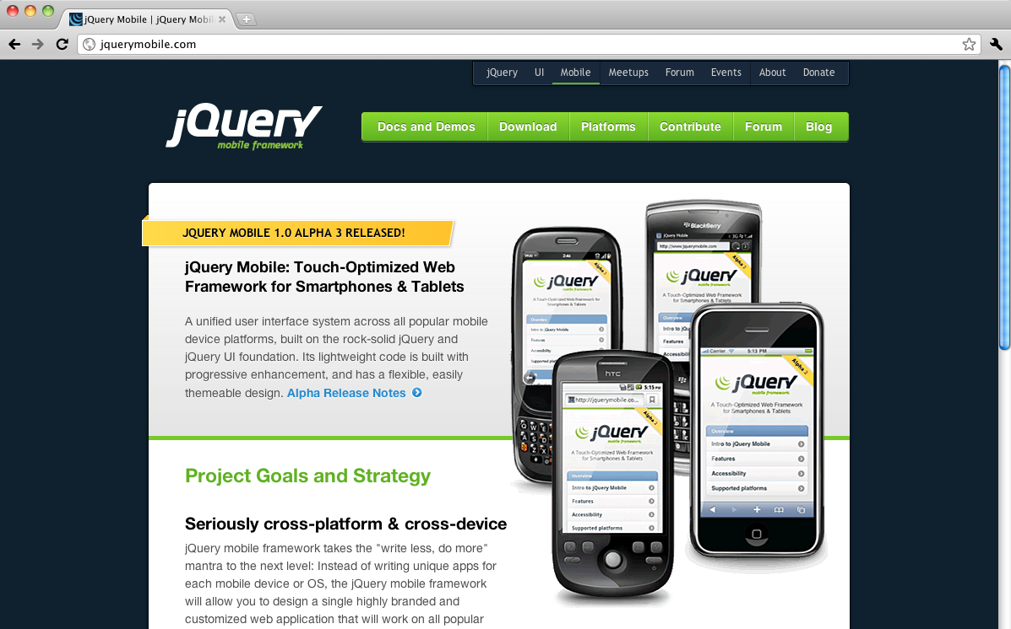
Mobile Web Frameworks
iUI
http://iui-js.org
jQTouch
http://jqtouch.com
jQueryMobile
http://jquerymobile.com

Slide 62
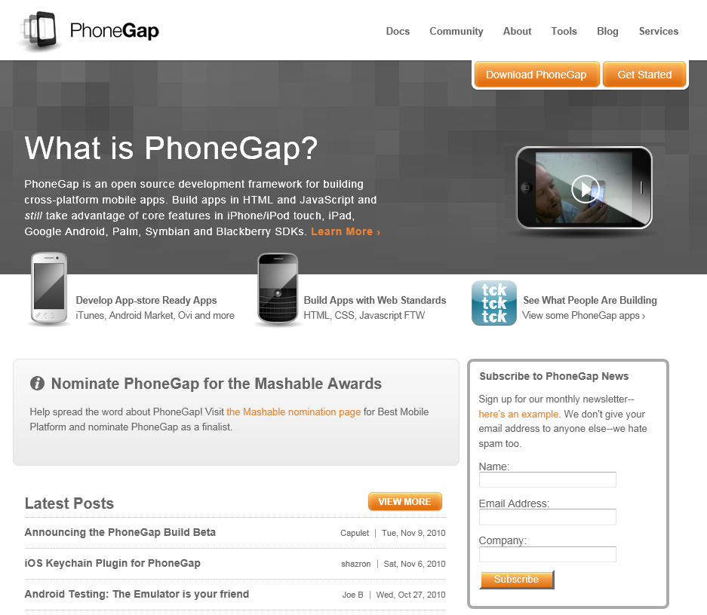
PhoneGap
Open Source (MIT) Framework for building cross platform mobile applications
Started by Nitobi
Build in HTML5/CSS/JS
Use libraries to access phone features
Run offline
Deploy to app store if required

Slide 63
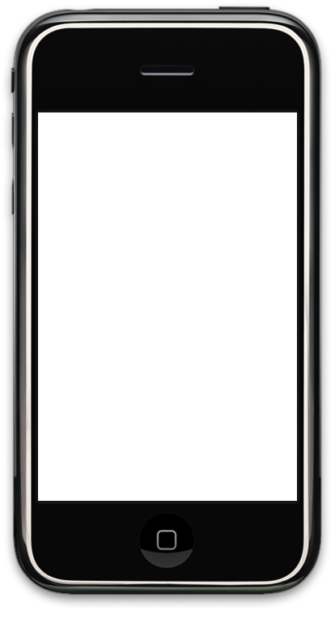

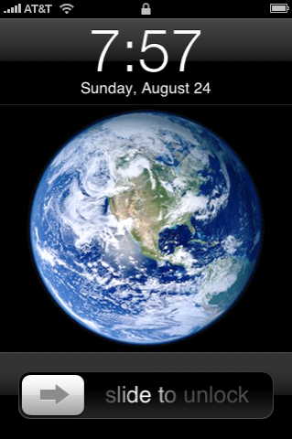
Native shell upload to AppStore
WebViewController
JavaScript bridge
Native Libraries (ObjC)
iPhone OS 4.3.1
Web Server
Local HTML
Web Storage

Slide 65
Mobile enterprise app sales accounted for $2.8bn in 2009. Projected $11bn by 2015.
http://www.fiercemobilecontent.com/special-reports/top-mobile-applications-2010-ten-enterprise-apps-work-hard-so-you-dont-have#ixzz14ozEILJ4

Slide 66
Apple reported that iPad is being deployed or tested by 80% of Fortune 500

Slide 67



Employee Productivity
Business to Consumer
Industry Vertical

Slide 69
Definition: Use of mobile devices to increase productivity of existing business applications and processes

Slide 70
“CxO goes to Apple Store one weekend, buys iPad, on Monday it’s a company standard”

Slide 71
Michael Hedges purchased
4,500 iPads for his organization
http://www.slashgear.com/michael-hedges-purchases-4500-ipads-22109951/

Slide 72
General Productivity
(Email and Office)

Slide 73
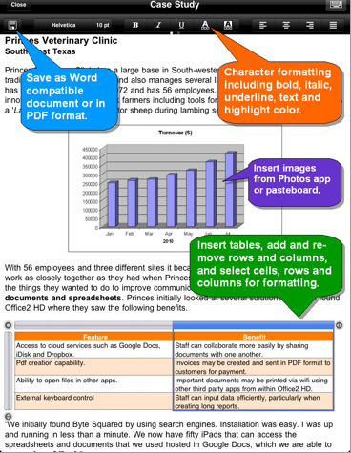
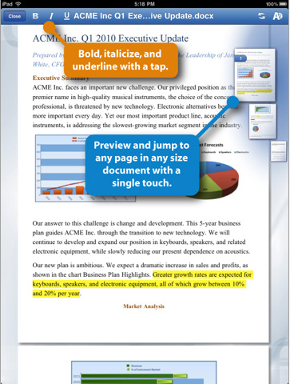
Office2 HD
QuickOffice Connect HD
http://itunes.apple.com/us/app/id364361728?mt=8
http://itunes.apple.com/us/app/quickoffice-connect-mobile/id376212724?mt=8

Slide 74
Access to Enterprise Data

Slide 75
1. Out of the Box
2. Native Client from AppStore
3. Custom Solution

Slide 76
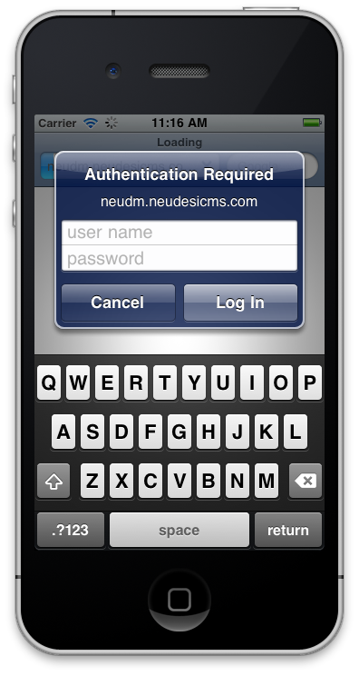
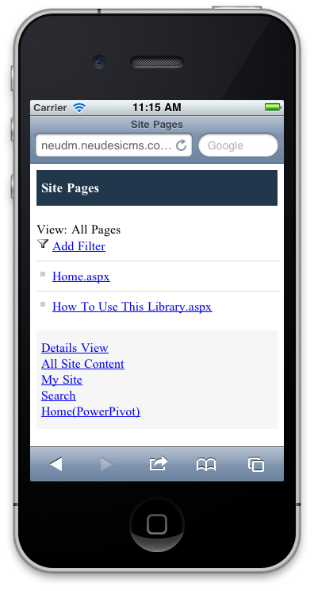
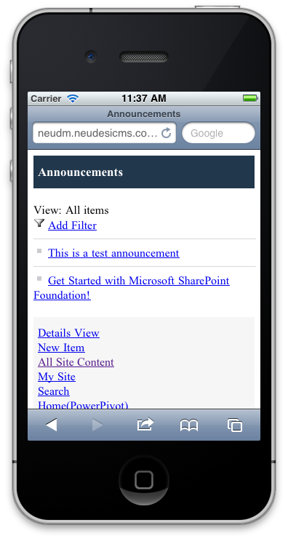
Out of the Box Mobile Access using Microsoft SharePoint 2010

Slide 77
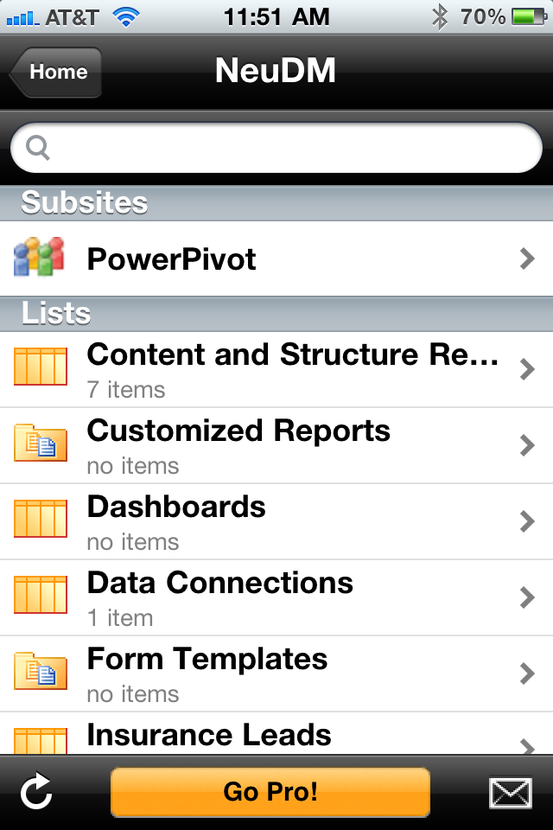
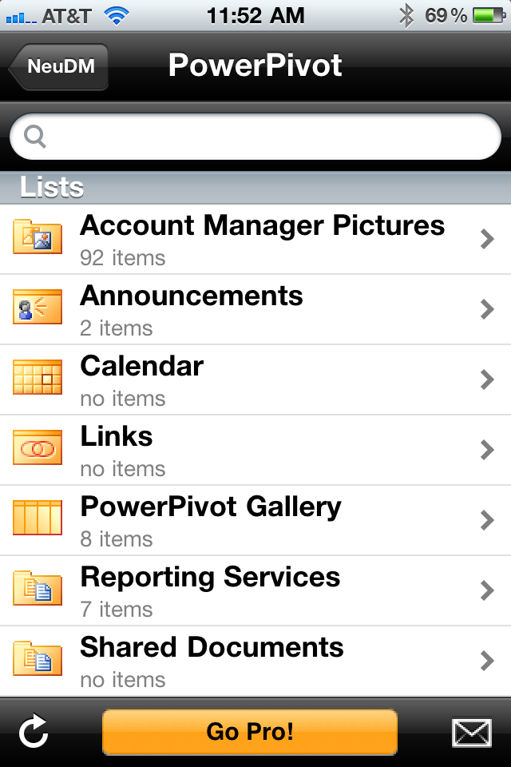
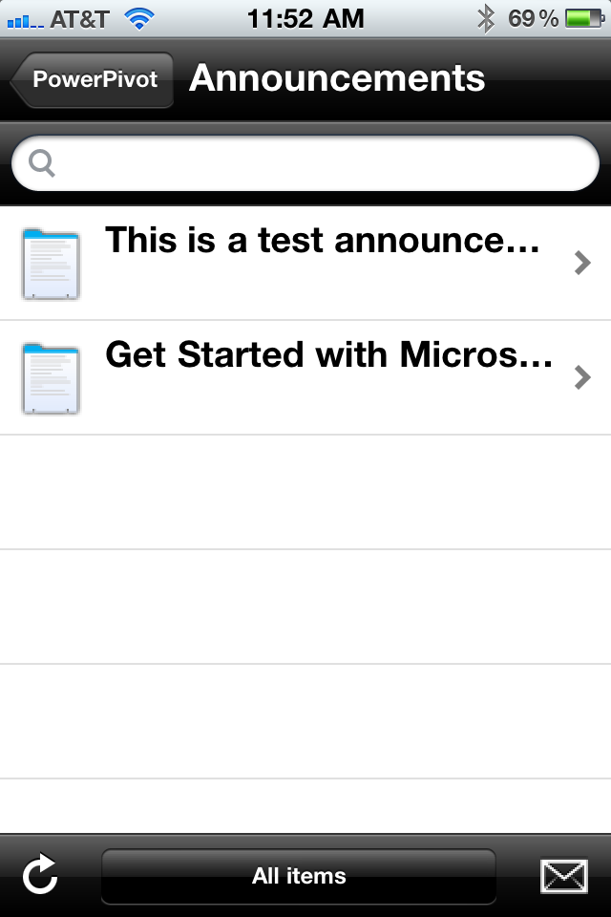
http://itunes.apple.com/us/app/shareplus-office-mobile-client/id364895421?mt=8
SharePlus Office Mobile Client (Both iPhone and iPad)

Slide 78
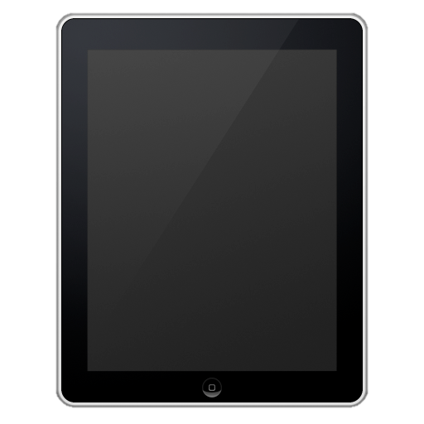
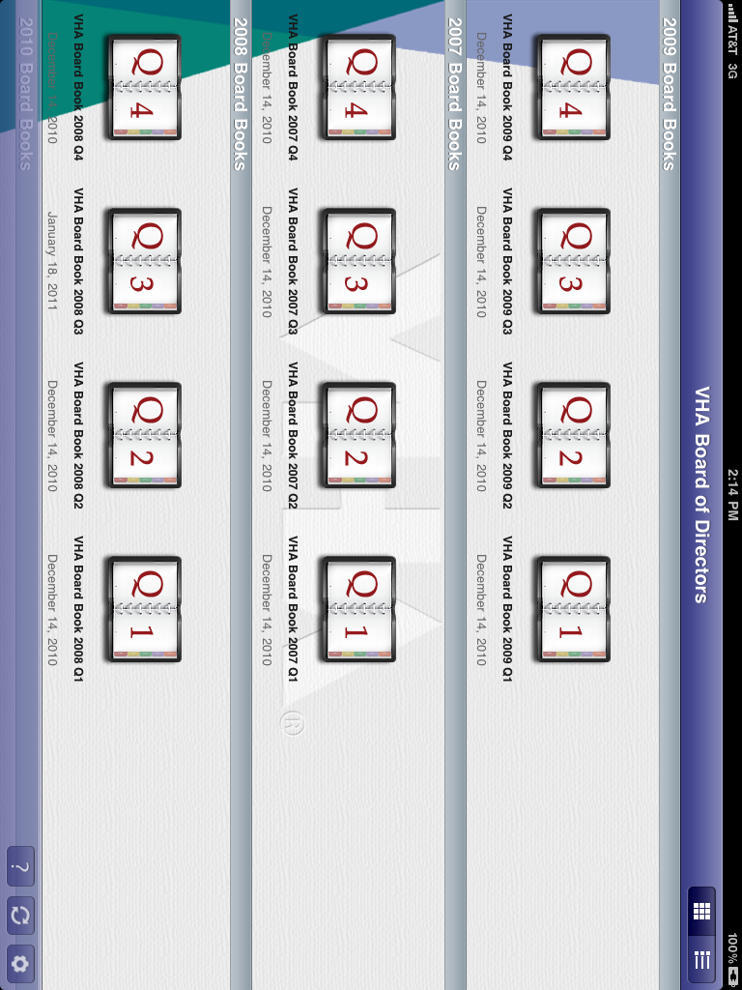
Custom Document Management Client for the iPad

Slide 79
Equipping the Sales Force

Slide 80
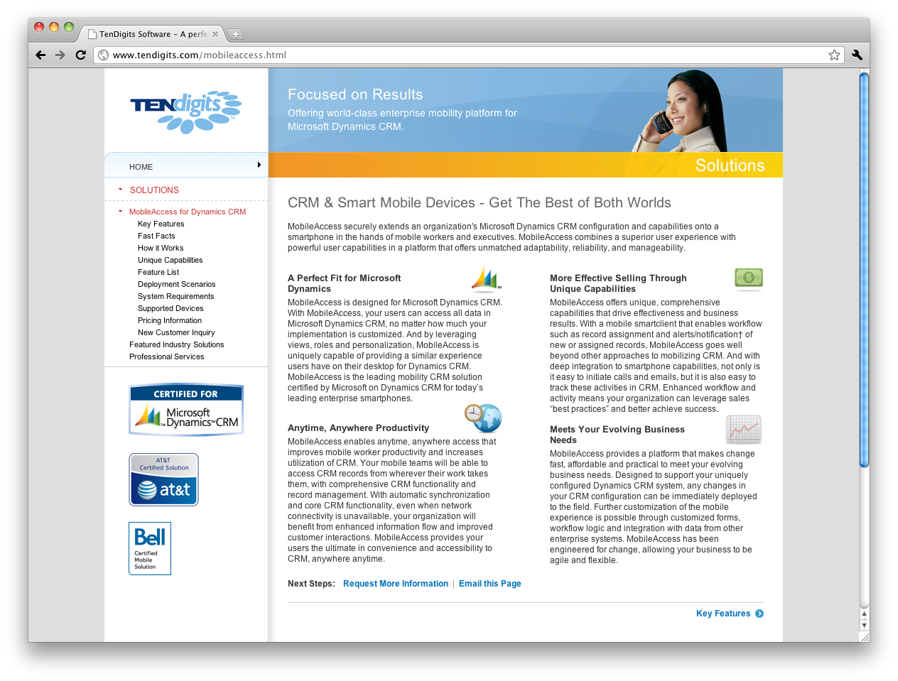
http://accessdynamicscrm.com/
TenDigits MobileAccess Online (Dynamics CRM for BlackBerry and Windows Mobile 6)

Slide 81
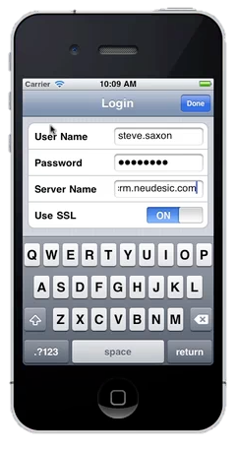
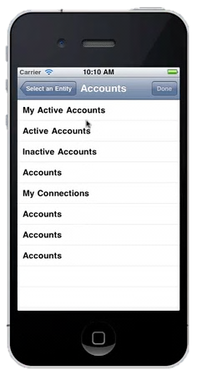
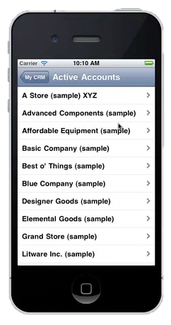
Neudesic - Dynamics CRM Accelerator for iOS

Slide 82
Enterprise Collaboration

Slide 83
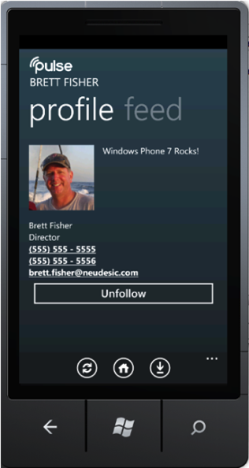
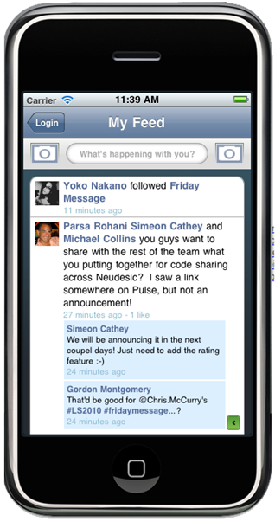
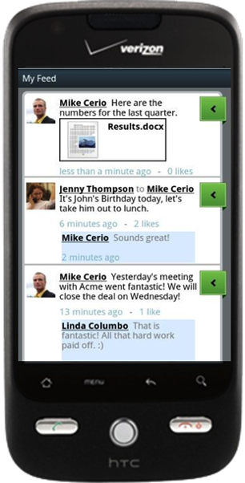
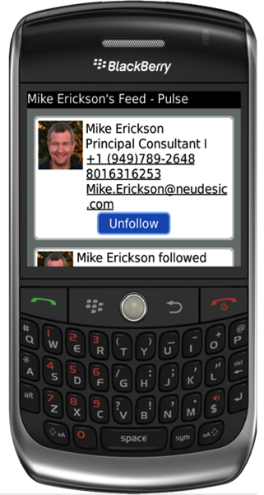
Neudesic Pulse
http://www.whatispulse.com

Slide 84
Business Intelligence

Slide 85
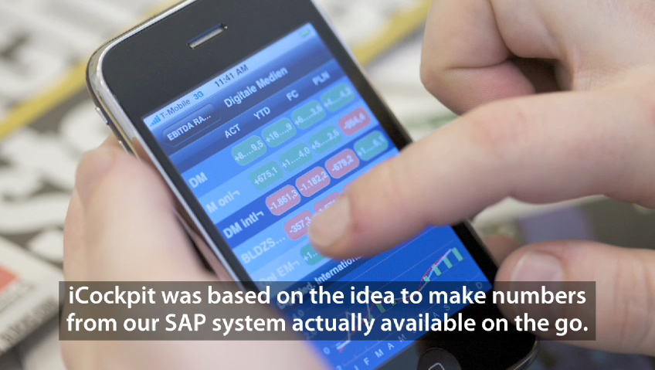
http://www.apple.com/iphone/business/apps/in-house/
Axel Springer (Large Publication House in Germany)

Slide 86
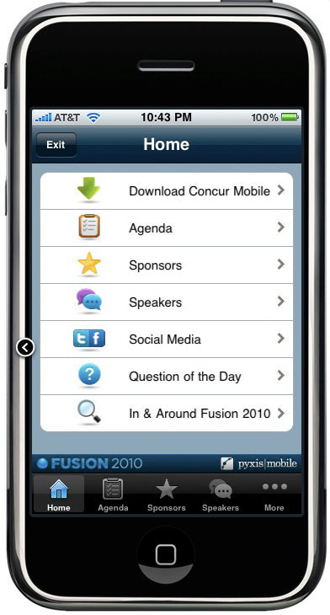
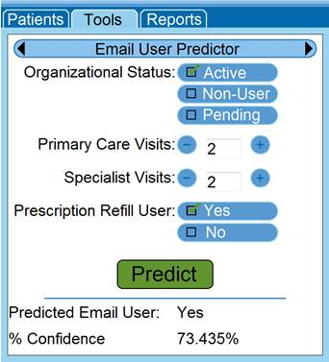
http://www.predixionsoftware.com
Mobile Predictive Analytics

Slide 87
“With great power comes great responsibility”

Slide 89
I don’t want my employees doing [x]. How do I configure policy?
What happens if I leave my device on the [bus|train|plane]?
How do I secure communication from the device?
I’m writing an application. How do I make my application secure?
What other bad stuff should I be aware of?

Slide 90
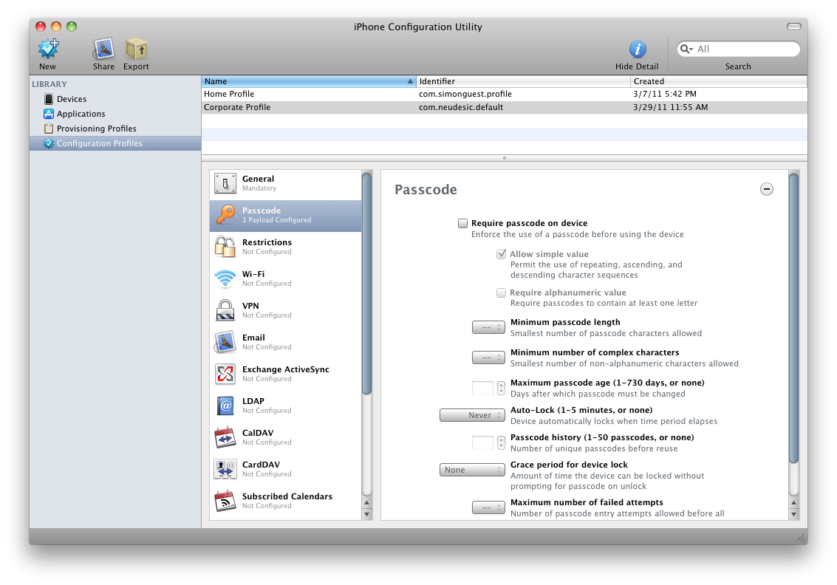

Slide 91
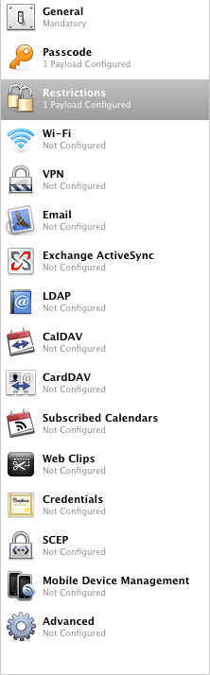
Restrictions on Device Features
Installing Apps, Camera, Facetime, Screen Capture, Sync while Roaming, Voice Dialing, In App Purchases, Multi-player Gaming, Game Center Friends
Restrictions on Applications
Access to YouTube, iTunes, and Safari (various settings)
Content Rating Restrictions
Regional setting, with maximum content ratings across Movies, TV Shows, and Apps

Slide 92
Mobile Device Management (MDM)
  Remote Configuration
    Pushing of configuration profiles to the device
  Remote Query
    Device, network, security, and application information
  Remote Management
    Remote wipe, remote lock, clear passcode, OTA application delivery

Slide 93
Mobile Device Management (MDM)
  API Level
    MDMS APIs announced with iOS 4.2 (although only available via agreement)
    Open APIs on Android
  Products/Vendors
    Zenprise, AirWatch, Sybase Afaria, MobileIron
    Microsoft announced MDM support in SCCM 2012
        http://www.zdnet.com/blog/microsoft/microsoft-readies-tool-for-managing-ipads-iphones-and-android-devices/8987
        Beta 2 - http://www.microsoft.com/systemcenter/en/us/configuration-manager/cm-vnext-beta.aspx

Slide 94
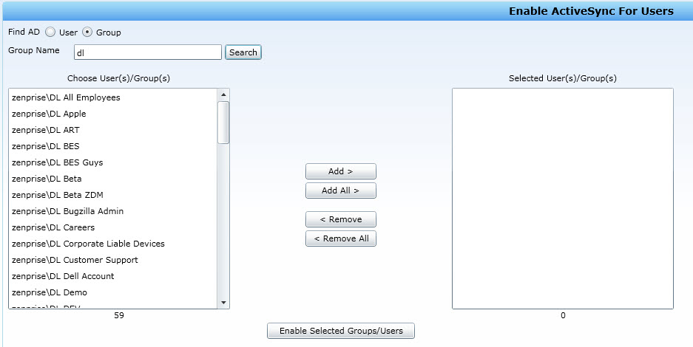
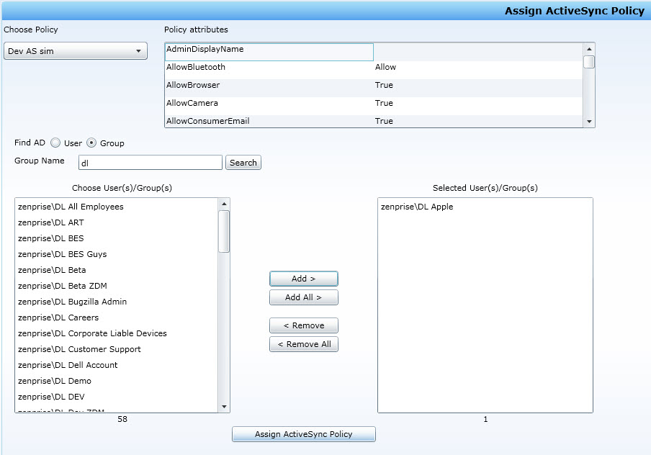

Slide 95


Slide 96

Data Protection (post iOS 4.2)
    Anything written to (flash) storage encrypted with a 256-bit AES key, derived from the user’s passcode
    Strength of data protection dependent on passcode strength
      Brute force with 4 digit simple PIN. A little more challenging when alphanumeric, including non-alpha characters
      Mitigated by PBKDF2 iterations (50ms derivation = ~20 passwords per second)
    However, only applies to applications that use Data Protection API, and apps need to now handle failure

Slide 97

Password Storage
  Don’t store them in user defaults
  UI Abstracts the password, but can be easily accessed from the FileSystem/a simple backup/iPhone Explorer
  Use the Keychain instead
  Resources
    http://software-security.sans.org/blog/2011/01/05/using-keychain-to-store-passwords-ios-iphone-ipad/

Slide 98
Authentication and Authorization
  Authentication
    No concept of users, accounts, passwords on devices
    User is assumed to be authenticated (via pincode)
    No way of re-prompting user for pincode programmatically, nor locking the device
    Authentication for your own application will have to be custom (against back end services)
  Authorization
    No concept of roles, permissions on the device
    User is assumed to be authorized (within the sandbox of the signed application)
  Resources
    http://developer.apple.com/library/mac/#documentation/Security/Conceptual/SecureCodingGuide/Articles/SecuritySvcs.html

Slide 100
Definition: Extending the public/consumer face of business using mobile devices

Slide 101
Mobile as-an-extension-of Web Presence

Slide 102


Slide 103
Within-the-experience mobile applications

Slide 104

Realtor.com (Move, Inc.)
Enabling Move, Inc. to reach mobile users through the new Windows 7 Phone Platform

Slide 105





Kelley Blue Book’s kbb.com
Giving consumers more power at the dealership through KBB mobile application

Slide 106




Jeep TripCast
Track and share details of your off-road travel across social networks

Slide 107


Heathcare/Restaurant/Generic Survey Applications

Slide 108

http://www.zdnet.com/blog/microsoft/microsoft-releases-windows-azure-toolkit-for-apples-ios-android-version-slated-for-june/9386?tag=mantle_skin;content

Slide 110
Definition: Changing the way industries run by using mobile devices

Slide 111
Healthcare

Slide 112
Doctors wandering around hospital with tablets…

Slide 113

http://pwchealth.com/cgi-local/hregister.cgi?link=reg/healthcare-unwired.pdf

Slide 114
“3 in 10 Americans said that they would be willing to monitor health via a mobile device”

Slide 115

“40% would be willing to pay for a remote monitoring device that sends information to their doctor”

Slide 116
Financial Services

Slide 117

http://www.keynote.com/benchmark/images/mobile-banking2-large.jpg
Bank of America – iPhone Online Banking

Slide 118

http://electronicshrug.net/wp-content/uploads/2010/08/quick-deposit-iphone-app-chase.jpg
Chase Mobile Banking – Check Scanning

Slide 119
Retail

Slide 120
In-Store Consumer Experience

Slide 121


QR Code / Code 39 Scanner to interact with display items
Integrates with organization’s product systems to get more data on items and availability
Also enables customers to back-order/order items online that are not available in store (e.g. different color, size, etc.)
Additional angle with back-order online, display mobile coupon, and retail check out

Slide 122
Mobile POS (Point of Sale)

Slide 123

Credit card reader attached to mobile device to enable POS
Integrates with organization’s back end payment systems or third party merchant
Enables checkout of customers without line at back of store
Responsible in part for increasing traffic, sales, and profit margins at Disney’s new stores by 20%
http://www.retailsolutionsonline.com/article.mvc/Mobility-Buzz-At-NRF-0001?user=2423468&source=nl:29706

Slide 124

http://www.itechnews.net/2008/12/23/nec-lavie-ll750-notebook/
FeliCa Contactless card scanner on NEC LaVie Laptop

Slide 125
ISO/IEC 14443

Slide 126

Near Field Communication (NFC)
http://eetimes.eu/en/nfc-comes-to-the-pc.html?cmp_id=7&news_id=222902715

Slide 127

http://farm5.static.flickr.com/4037/4403177680_2afa943170.jpg

Slide 128
Card Emulation:
Device behaves like an existing contactless card
Reader:
Device is active and reads a passive RFID tag
P2P:
Two devices communicate together/exchange

Slide 129
Conclusion
Dynamic Market
  18 month lifecycle, highly competitive, balance between OS, software, hardware, and Telco
Changing the Way Organizations do Business
  2010 about device proliferation, 2011 about enterprise applications
First Mover Advantage
  What is your organization’s roadmap for mobile?

Slide 130

Why Neudesic?
How hard can it be?
It’s just a mobile app
Under the water:
Cloud Integration
On Premise Integration
SAP, Siebel, Dynamics
Offline Access
Sync
Office Integration
Data Security
Authentication
Deployment
Updates
Management
Developer Lifecycle
(TDD, UX Design)

Slide 131





Gold Certified Microsoft Partner
WP7 | iPhone | iPad | Android | Blackberry
Kelley Blue Book Realtor.com Neudesic Pulse | Whole Foods Symetra Financial Neudesic Pulse Azure Toolkit for iOS | SimonMed VHA Inc Kelley Blue Book Symetra Financial | Kelley Blue Book Neudesic Pulse Azure Toolkit for Android | Neudesic Pulse

Slide 132

Simon Guest
Director, Mobility Solutions
simon.guest@neudesic.com
http://simonguest.com
© 2011 Microsoft Corporation. All rights reserved. Microsoft, Windows, Windows Vista and other product names are or may be registered trademarks and/or trademarks in the U.S. and/or other countries.
The information herein is for informational purposes only and represents the current view of Microsoft Corporation as of the date of this presentation. Because Microsoft must respond to changing market conditions, it should not be interpreted to be a commitment
on the part of Microsoft, and Microsoft cannot guarantee the accuracy of any information provided after the date of this presentation. MICROSOFT MAKES NO WARRANTIES, EXPRESS, IMPLIED OR STATUTORY, AS TO THE INFORMATION IN THIS PRESENTATION.

