Slide 2

My Customers Are Using iPhone/Android but I'm a Microsoft Guy/Gal
Now What?
DPR304
Simon Guest
Director, Mobility Solutions
Neudesic, LLC

Slide 4
How many smartphones are there?

Slide 5
ComScore MobiLens

Slide 6
http://www.comscore.com/Products_Services/Product_Index/MobiLens
72.5m Active Smartphones in US
Operating System | Share (%age) Mar 2011
Android | 34.7
RIM | 27.1
iOS (Apple) | 25.5
WM6.x/WP7 | 7.5
Palm | 2.8
Other (inc. Symbian) | 2.4

Slide 7
www.comscore.com/Products_Services/Product_Index/MobiLens (trend used for Dec and Mar)

Slide 8
www.comscore.com/Products_Services/Product_Index/MobiLens (trend used for Dec and Mar)

Slide 9
www.comscore.com/Products_Services/Product_Index/MobiLens (trend used for Dec and Mar)

Slide 10
www.comscore.com/Products_Services/Product_Index/MobiLens (trend used for Dec and Mar)

Slide 11
www.comscore.com/Products_Services/Product_Index/MobiLens (trend used for Dec and Mar)

Slide 12
www.comscore.com/Products_Services/Product_Index/MobiLens (trend used for Dec and Mar)

Slide 13
www.comscore.com/Products_Services/Product_Index/MobiLens (trend used for Dec and Mar)

Slide 14
www.comscore.com/Products_Services/Product_Index/MobiLens (trend used for Dec and Mar)

Slide 15
www.comscore.com/Products_Services/Product_Index/MobiLens (trend used for Dec and Mar)

Slide 16
www.comscore.com/Products_Services/Product_Index/MobiLens (trend used for Dec and Mar)

Slide 17
www.comscore.com/Products_Services/Product_Index/MobiLens (trend used for Dec and Mar)

Slide 18
www.comscore.com/Products_Services/Product_Index/MobiLens (trend used for Dec and Mar)

Slide 19
www.comscore.com/Products_Services/Product_Index/MobiLens (trend used for Dec and Mar)

Slide 20
www.comscore.com/Products_Services/Product_Index/MobiLens (trend used for Dec and Mar)
Android on fire. From 9% to 33% in 12 months
iOS holding steady around 25% market share

Slide 21
Many organizations adopting iOS/Android

Slide 23
Not much help available…

Slide 24
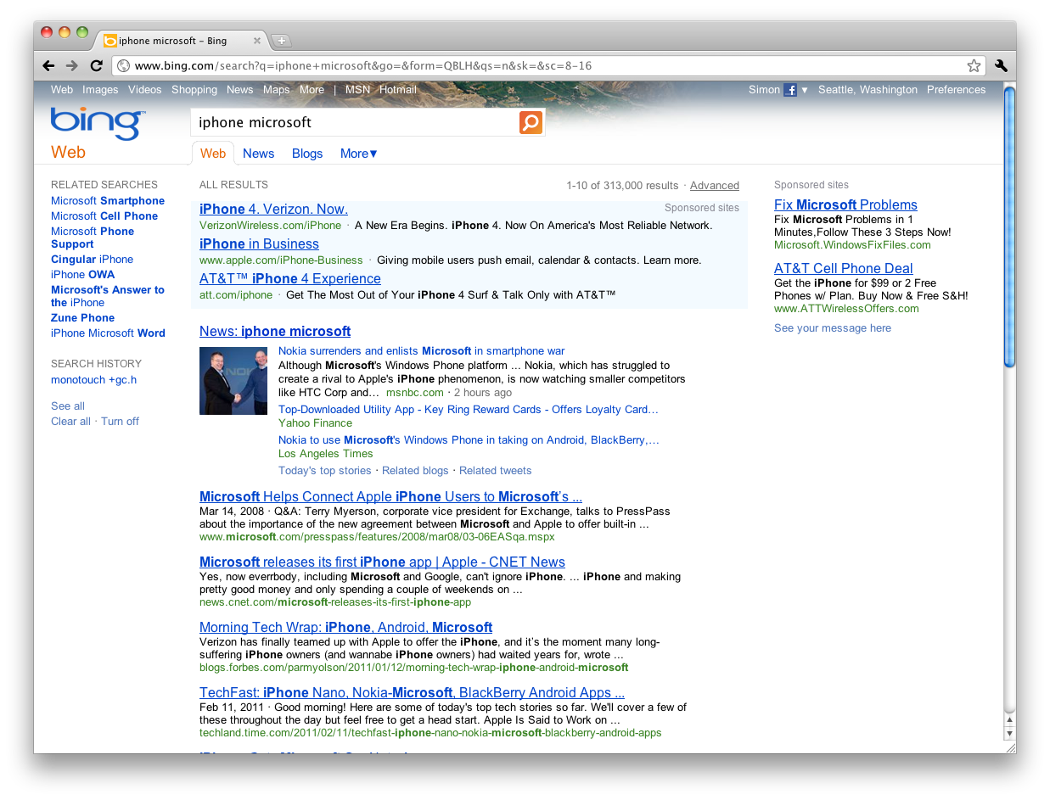

Slide 25


Slide 26
To give you the tools and knowledge
to integrate iPhone, iPad, and Android devices
into an existing Microsoft development environment

Slide 29
“Can I make an existing web site work on iPhone and Android?”

Slide 30
First, how do we know it’s a mobile device?

Slide 31


User-Agent: Mozilla/4.0 (compatible; MSIE 8.0; Windows NT 6.1; WOW64; Trident/4.0; SLCC2; .NET CLR 2.0.50727; .NET CLR 3.5.30729; .NET CLR 3.0.30729; .NET4.0C; .NET4.0E; InfoPath.3; MS-RTC LM 8)
HTTP Request
HTTP Response
Pages
Windows 7 / IE8.0

Slide 32
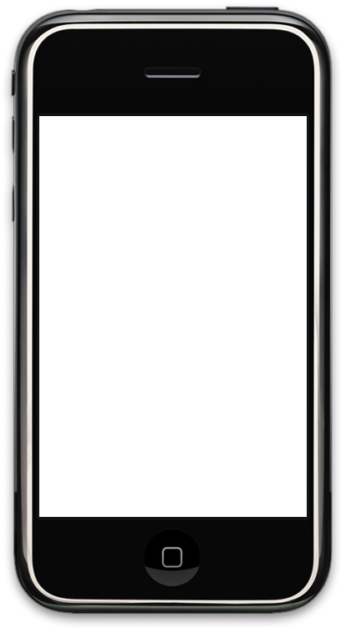
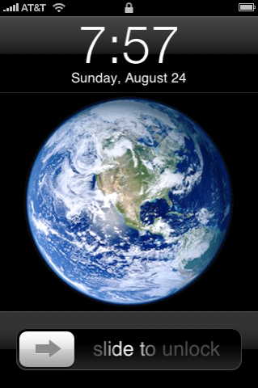
UserAgent: Mozilla/5.0 (iPhone; U; CPU iPhone OS 4_3_1 like Mac OS X; en-us) AppleWebKit/533.17.9 (KHTML, like Gecko) Version/5.0.2 Mobile/8C148 Safari/6533.18.5
HTTP Request
HTTP Response
Pages
iPhone OS 4.3

Slide 33

Mozilla/5.0 (iPad; U; CPU OS 3_2 like Mac OS X; en-us) AppleWebKit/531.21.10 (KHTML, like Gecko) Version/4.3.1 Mobile/7B334b Safari/531.21.10
HTTP Request
HTTP Response
Pages
iPad OS 4.3

Slide 34
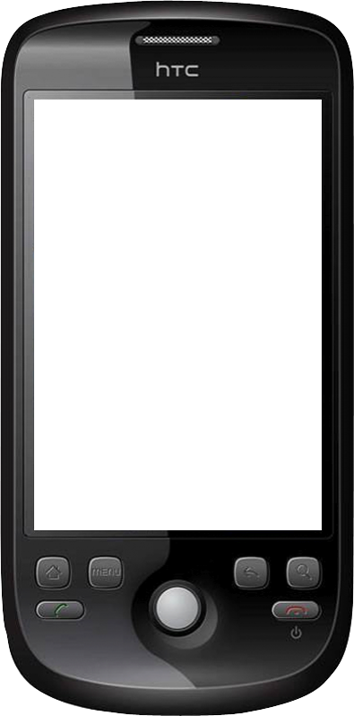
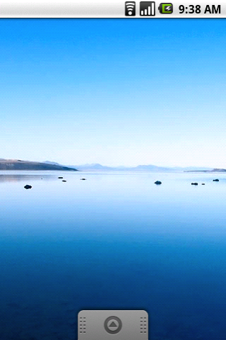
Mozilla/5.0 (Linux; U; Android 2.3; en-gb; Nexus One Build/FRF50) AppleWebKit/533.1 (KHTML, like Gecko) Version/4.0 Mobile Safari/533.1
HTTP Request
HTTP Response
Pages
Android 2.3

Slide 35
if (useragent contains
”MSIE”)…
User-Agent: Mozilla/4.0 (compatible; MSIE 8.0; Windows NT 6.1; WOW64; Trident/4.0; SLCC2; .NET CLR 2.0.50727; .NET CLR 3.5.30729; .NET CLR 3.0.30729; .NET4.0C; .NET4.0E; InfoPath.3; MS-RTC LM 8)
Windows 7 / IE8.0
Pages
if (useragent contains ”Android”)…
Mozilla/5.0 (Linux; U; Android 2.3; en-gb; Nexus One Build/FRF50) AppleWebKit/533.1 (KHTML, like Gecko) Version/4.0 Mobile Safari/533.1
Android 2.3
Pages

Slide 36
if (useragent contains
”MSIE”)…
User-Agent: Mozilla/4.0 (compatible; MSIE 8.0; Windows NT 6.1; WOW64; Trident/4.0; SLCC2; .NET CLR 2.0.50727; .NET CLR 3.5.30729; .NET CLR 3.0.30729; .NET4.0C; .NET4.0E; InfoPath.3; MS-RTC LM 8)
Windows 7 / IE8.0
View
CSS
Controller
if (useragent contains ”Android”)…
Mozilla/5.0 (Linux; U; Android 2.3; en-gb; Nexus One Build/FRF50) AppleWebKit/533.1 (KHTML, like Gecko) Version/4.0 Mobile Safari/533.1
View
CSS
Android 2.3

Slide 37
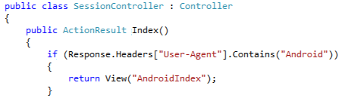
if (useragent contains
”MSIE”)…
User-Agent: Mozilla/4.0 (compatible; MSIE 8.0; Windows NT 6.1; WOW64; Trident/4.0; SLCC2; .NET CLR 2.0.50727; .NET CLR 3.5.30729; .NET CLR 3.0.30729; .NET4.0C; .NET4.0E; InfoPath.3; MS-RTC LM 8)
Windows 7 / IE8.0
View
CSS
Controller
if (useragent contains ”Android”)…
Mozilla/5.0 (Linux; U; Android 2.3; en-gb; Nexus One Build/FRF50) AppleWebKit/533.1 (KHTML, like Gecko) Version/4.0 Mobile Safari/533.1
View
CSS
Android 2.3

Slide 38
if (useragent contains
”MSIE”)…
User-Agent: Mozilla/4.0 (compatible; MSIE 8.0; Windows NT 6.1; WOW64; Trident/4.0; SLCC2; .NET CLR 2.0.50727; .NET CLR 3.5.30729; .NET CLR 3.0.30729; .NET4.0C; .NET4.0E; InfoPath.3; MS-RTC LM 8)
Windows 7 / IE8.0
View
CSS
Controller
ASP.NET MVC
ViewEngine
if (useragent contains ”Android”)…
Mozilla/5.0 (Linux; U; Android 2.3; en-gb; Nexus One Build/FRF50) AppleWebKit/533.1 (KHTML, like Gecko) Version/4.0 Mobile Safari/533.1
View
CSS
Android 2.3

Slide 39
Demo: Mobile View Engines in ASP.NET MVC 3
All demos can be found on http://github.com/simonguest

Slide 40
“But it still looks like my original webpage”

Slide 41
User-Agent: Mozilla/4.0 (compatible; MSIE 8.0; Windows NT 6.1; WOW64; Trident/4.0; SLCC2; .NET CLR 2.0.50727; .NET CLR 3.5.30729; .NET CLR 3.0.30729; .NET4.0C; .NET4.0E; InfoPath.3; MS-RTC LM 8)
Windows 7 / IE8.0
View
CSS
Controller
ASP.NET MVC
ViewEngine
Mozilla/5.0 (Linux; U; Android 2.3; en-gb; Nexus One Build/FRF50) AppleWebKit/533.1 (KHTML, like Gecko) Version/4.0 Mobile Safari/533.1
View
CSS
Android 2.3

Slide 42
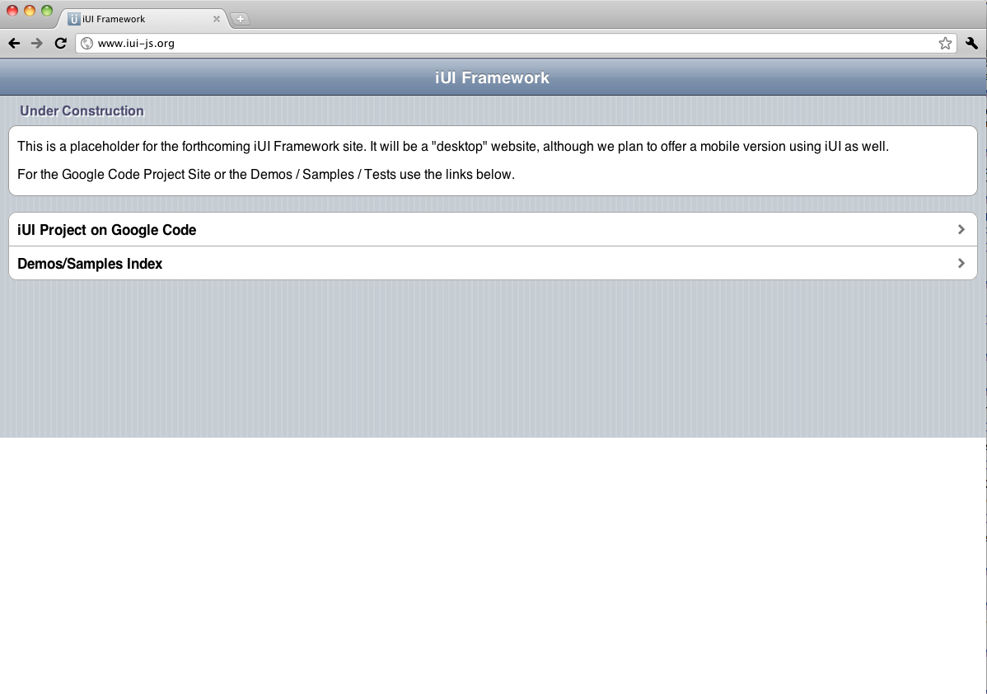
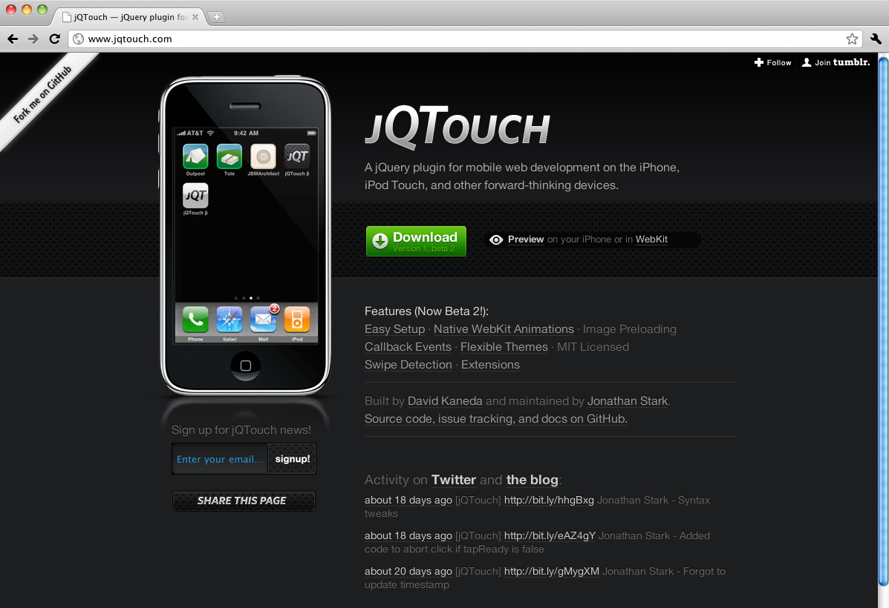
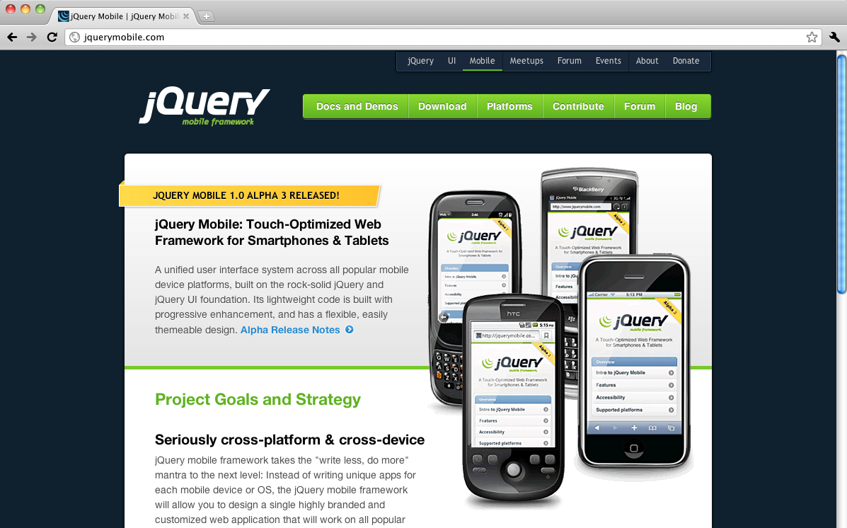
Mobile Web Frameworks
iUI
http://iui-js.org
jQTouch
http://jqtouch.com
jQueryMobile
http://jquerymobile.com

Slide 43
User-Agent: Mozilla/4.0 (compatible; MSIE 8.0; Windows NT 6.1; WOW64; Trident/4.0; SLCC2; .NET CLR 2.0.50727; .NET CLR 3.5.30729; .NET CLR 3.0.30729; .NET4.0C; .NET4.0E; InfoPath.3; MS-RTC LM 8)
Windows 7 / IE8.0
View
CSS
Controller
ASP.NET MVC
ViewEngine
Mozilla/5.0 (Linux; U; Android 2.3; en-gb; Nexus One Build/FRF50) AppleWebKit/533.1 (KHTML, like Gecko) Version/4.0 Mobile Safari/533.1
View
CSS
Android 2.3

Slide 44
Demo: Using jQueryMobile to create native look and feel
All demos can be found on http://github.com/simonguest

Slide 45



Takeaways
Recommendations:
Mobile Web sites will let you target multiple devices with a single back end
Use ASP.NET MVC with ViewEngine support for device specific views
Use ASP.NET MVC 3 for improved HTML5 attributes
Watch out for:
Many different UI frameworks – choose carefully
MEAPs – Mobile Enterprise Application Platforms (auto gen’d UI from single source)

Slide 47
“We’ve built services using REST/SOAP. Can I consume these?”

Slide 48
Native Application
REST
iPad/iPhone OS 4.3 (ObjC)
Android 2.3 (Java)

Slide 49
Native Application
REST
REST.svc
<%@ ServiceHost Service=”TechEd.Web.Services.SessionService" Factory="System.ServiceModel.Activation.WebServiceHostFactory" %>
iPad/iPhone OS 4.3 (ObjC)
Android 2.3 (Java)

Slide 50
Native Application
SessionService.cs
REST
public class SessionService : ISessionService
{
public SessionSummary[] GetData()
{
// return active sessions
}
}
iPad/iPhone OS 4.3 (ObjC)
Android 2.3 (Java)

Slide 51
Native Application
ISessionService.cs
REST
[ServiceContract]
public interface ISessionService
{
[WebGet(UriTemplate = "/Sessions", RequestFormat = WebMessageFormat.Xml, ResponseFormat = WebMessageFormat.Json, BodyStyle = WebMessageBodyStyle.Bare)]
[OperationContract]
SessionSummary[] GetData();
}
iPad/iPhone OS 4.3 (ObjC)
Android 2.3 (Java)

Slide 52
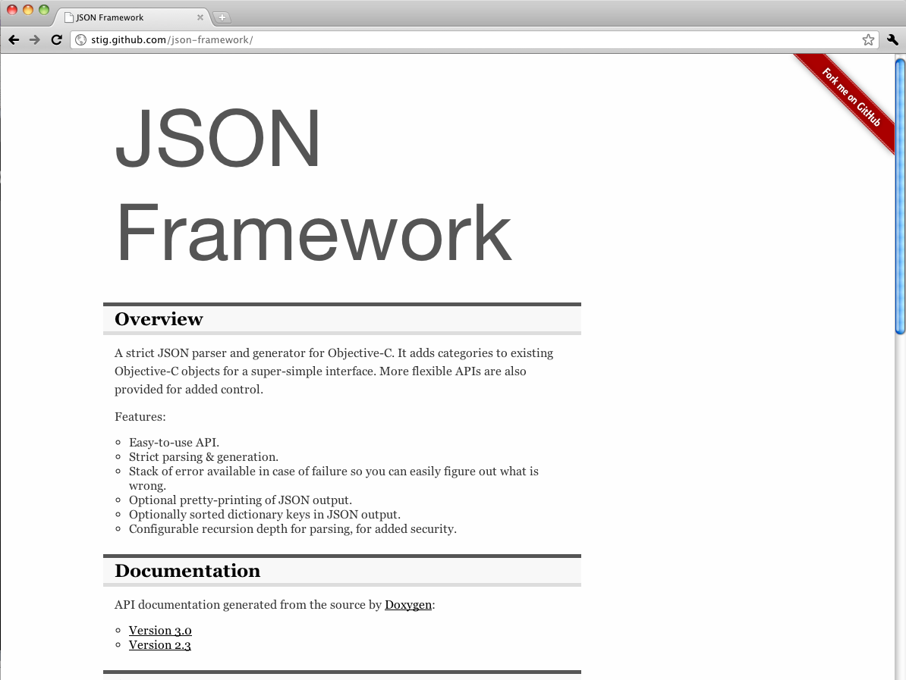
Native Application
REST
iPad/iPhone OS 4.3 (ObjC)
Step 1: You need a JSON library
http://stig.github.com

Slide 53
iPhoneClientViewController.m
-(IBAction)callRESTService:(id)sender
{
NSURL *url = [NSURL URLWithString:@"http://sguest01/TechEdDemoMVC/Services/REST.svc/Sessions"];
NSMutableURLRequest *request = [NSMutableURLRequest requestWithURL:url];
[request setHTTPMethod:@"GET"];
connection = [[NSURLConnection alloc] initWithRequest:request delegate:self];
if (connection)
{
NSLog(@"Connection was established");
receivedData = [[NSMutableData data] retain];
}
else {
NSLog(@"Connection was null");
}
}
Native Application
REST
iPad/iPhone OS 4.3 (ObjC)
Step 2: Use NSMutableURLRequest to call the service

Slide 54
iPhoneClientViewController.m
- (void)connection:(NSURLConnection *)connection didReceiveResponse:(NSURLResponse *)response
{
NSLog(@"Received response from the REST call");
[receivedData setLength:0];
}
-(void)connection:(NSURLConnection *)connection didReceiveData:(NSData *)data
{
NSLog(@"Received data from the REST call");
[receivedData appendData:data];
}
-(void)connection:(NSURLConnection *)connection didFailWithError:(NSError *)error
{
NSLog(@"REST call failed with an error");
}
Native Application
REST
iPad/iPhone OS 4.3 (ObjC)
Step 3: Handle callbacks

Slide 55
iPhoneClientViewController.m
-(void)connectionDidFinishLoading:(NSURLConnection *)connection
{
NSLog(@"Connection finished loading");
NSString *responseString = [[NSString alloc]initWithData:receivedData encoding:NSUTF8StringEncoding];
NSLog(@"%@",responseString);
NSArray *dict = [responseString JSONValue];
for (id obj in dict)
{
NSDictionary *session = [[NSDictionary alloc] initWithDictionary:obj];
NSString *sessionCode = [session valueForKey:@"Code"];
NSLog(@"%@",sessionCode);
}
NSLog(@"Complete");
}
Native Application
REST
iPad/iPhone OS 4.3 (ObjC)
Step 4: Get the response, deserialize JSON

Slide 56
“REST appears to be fairly straightforward –
but how about my services use SOAP?”

Slide 57
Native Application
iSOAP.cs
[ServiceContract]
public interface ISOAP
{
[OperationContract]
List<SessionSummary> GetSessions();
}
SOAP (WS-I)
iPad/iPhone OS 4.3 (ObjC)
SOAP.svc.cs
public class SOAP : ISOAP
{
public List<SessionSummary> GetSessions()
{
// code to return active sessions
}
}
Android 2.3 (Java)

Slide 58
“It’s not as easy as you were hoping!”

Slide 59
Native Application
SOAP (WS-I)
iPad/iPhone OS 4.3 (ObjC)
Option 1: Handcraft the SOAP request/handle the SOAP response

Slide 60
Native Application
SOAP (WS-I)
iPad/iPhone OS 4.3 (ObjC)
Option 2: Your searches will likely take you down the road of gSOAP and WSMakeStubs

Slide 61
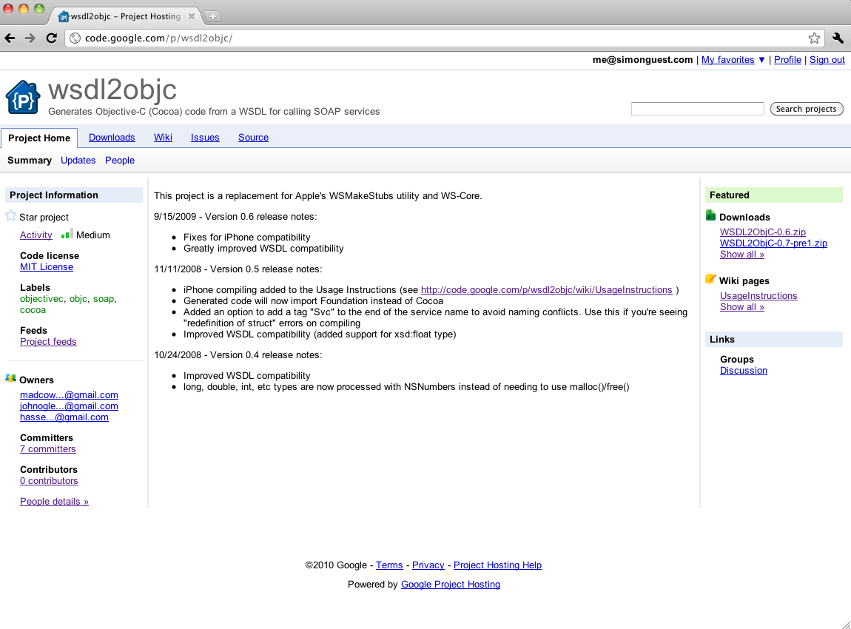
Native Application
SOAP (WS-I)
iPad/iPhone OS 4.3 (ObjC)
Option 3: wsdl2objc
(http://code.google.com/p/wsdl2objc/)
Version 0.7-pre1 recommended
http://code.google.com/p/wsdl2objc

Slide 62
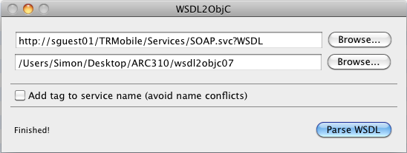
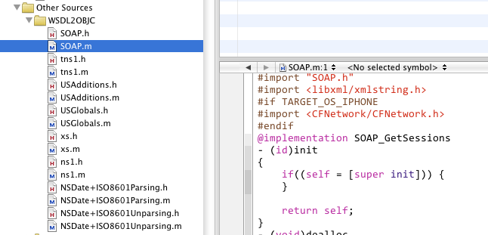
Native Application
SOAP (WS-I)
iPad/iPhone OS 4.3 (ObjC)
Option 3: wsdl2objc
(http://code.google.com/p/wsdl2objc/)
Version 0.7-pre1 recommended

Slide 63
iPhoneClientViewController.m
BasicHttpBinding_ISOAPBinding *myBinding = [SOAP BasicHttpBinding_ISOAPBinding];
myBinding.logXMLInOut = true;
SOAP_GetTitleForCode *parameters = [[SOAP_GetTitleForCode new] autorelease];
parameters.code = [[NSString alloc]initWithString:[numberTextField text]];
BasicHttpBinding_ISOAPBindingResponse *response = [myBinding GetTitleForCodeUsingParameters:parameters];
NSArray *responseBodyParts = response.bodyParts;
for (id bodyPart in responseBodyParts)
{
NSString *message = [bodyPart GetTitleForCodeResult];
}
Native Application
SOAP (WS-I)
iPad/iPhone OS 4.3 (ObjC)
Option 3: wsdl2objc
(http://code.google.com/p/wsdl2objc/)
Version 0.7-pre1 recommended

Slide 64
Demo: Consuming REST and SOAP based services on iPhone/iPad
All demos can be found on http://github.com/simonguest

Slide 65
“Great! Is it a similar process on Android?”

Slide 66
Native Application
Main.java
REST
HttpClient httpClient = new DefaultHttpClient();
HttpGet request = new HttpGet("http://sguest01/TRMobile/Services/REST.svc/Sessions");
HttpEntity restEntity = httpClient.execute(request).getEntity();
String restResult = new BufferedReader(new InputStreamReader(restEntity.getContent())).readLine();
Android 2.3 (Java)
Step 1: Use HttpClient and HttpGet to make connection

Slide 67
Native Application
Main.java
REST
JSONArray jArray = new JSONArray(restResult);
for(int i=0; i<jArray.length(); i++)
{
JSONObject session = jArray.getJSONObject(i);
Log.i("Session retrieved", "Code: "+session.getString("Code")+" - "+session.getString("Title"));
}
Android 2.3 (Java)
Step 2: Use org.json libraries to deserialize JSON

Slide 68
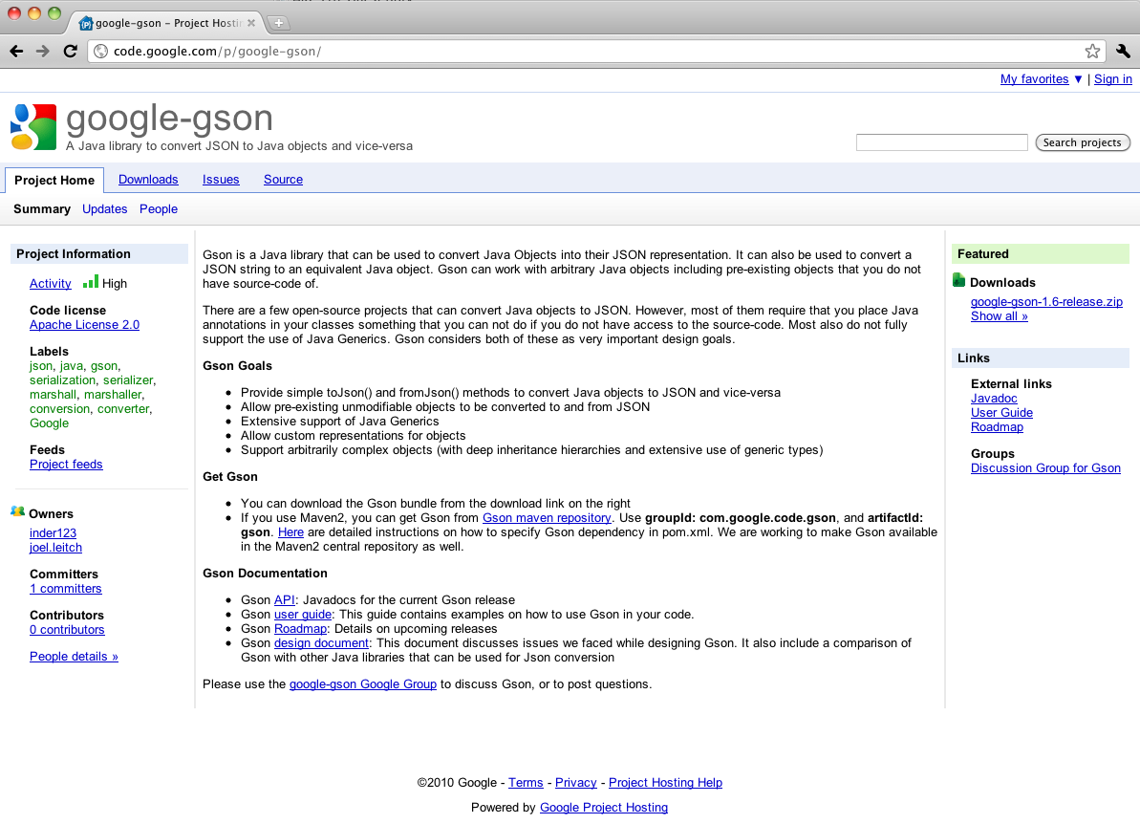
Native Application
REST
Android 2.3 (Java)
Step 3: Optional – use GSON to support serialization
http://code.google.com/p/google-gson

Slide 69
“How about SOAP support on Android? A similar story?”

Slide 70
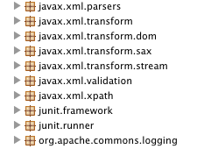
wsimport
Usage: wsimport [options] <WSDL_URI>
where [options] include:
-b <path> specify jaxws/jaxb binding files or additional schemas
(Each <path> must have its own -b)
-B<jaxbOption> Pass this option to JAXB schema compiler
-catalog <file> specify catalog file to resolve external entity references
supports TR9401, XCatalog, and OASIS XML Catalog format.
-d <directory> specify where to place generated output files
-extension allow vendor extensions - functionality not specified
by the specification. Use of extensions may
result in applications that are not portable or
may not interoperate with other
...
Native Application
SOAP (WS-I)
Android 2.3 (Java)
You would think that wsimport should work

Slide 71
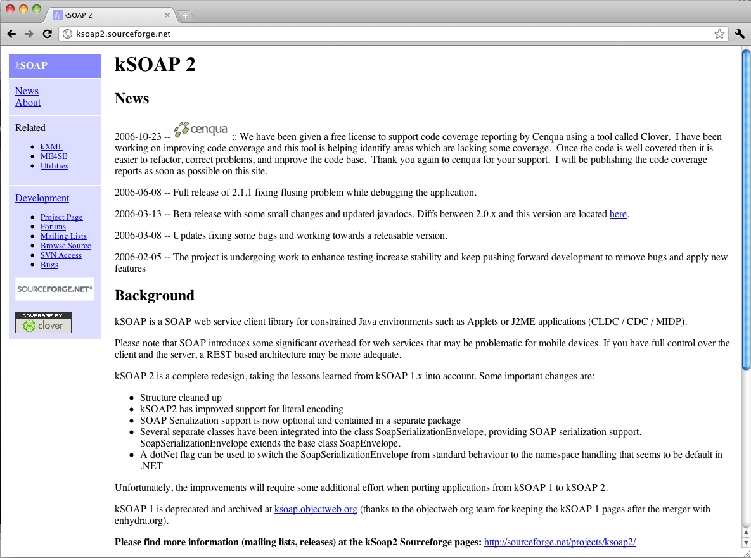
Native Application
SOAP (WS-I)
Android 2.3 (Java)
http://ksoap2.sourceforge.net

Slide 72
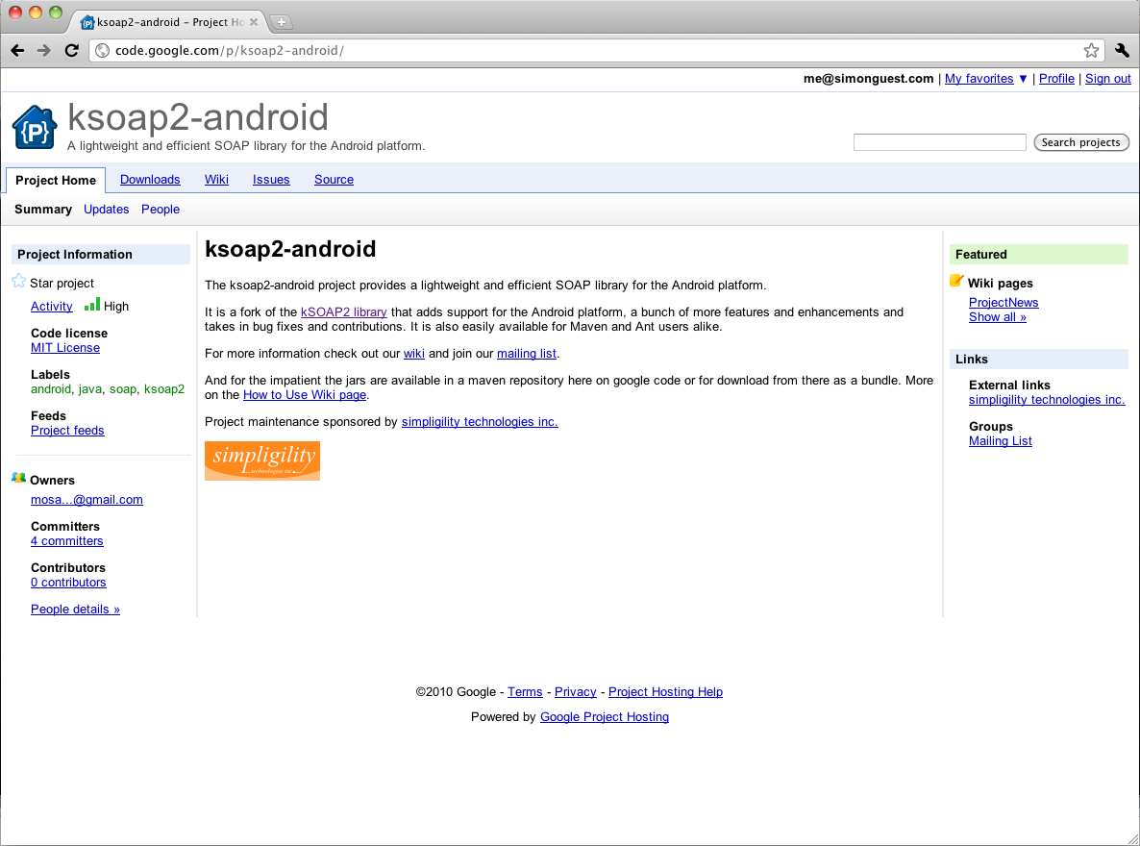
Native Application
SOAP (WS-I)
Android 2.3 (Java)
http://code.google.com/p/ksoap2-android

Slide 73
Native Application
SOAP (WS-I)
Android 2.3 (Java)
maven install
KSOAP2-Android

Slide 74
Main.java
String SOAP_ACTION = "http://tempuri.org/ISOAP/GetTitleForCode";
String METHOD_NAME = "GetTitleForCode";
String NAMESPACE = "http://tempuri.org/";
String URL = "http://sguest01/TRMobile/Services/SOAP.svc";
SoapObject request = new SoapObject(NAMESPACE, METHOD_NAME);
request.addProperty("code","ARC310");
SoapSerializationEnvelope env = new SoapSerializationEnvelope(SoapEnvelope.VER11);
env.dotNet = true;
env.setOutputSoapObject(request);
HttpTransportSE transport = new HttpTransportSE(URL);
transport.call(SOAP_ACTION, env);
SoapPrimitive returnedTitle = (SoapPrimitive)env.getResponse();
Native Application
SOAP (WS-I)
Android 2.3 (Java)

Slide 75
Demo: Consuming REST and SOAP based services on Android
All demos can be found on http://github.com/simonguest

Slide 76
“How about Windows Azure?”

Slide 77

Blob Storage
Table Storage

Slide 78
Most suitable for binary data (images, video, audio)
Container-based approach
8k metadata for each blob
Blob Storage
Table Storage

Slide 79
Blob Storage
Table Storage
Most suitable for structured data
Dynamic schema
Partitioning to enable scale

Slide 80
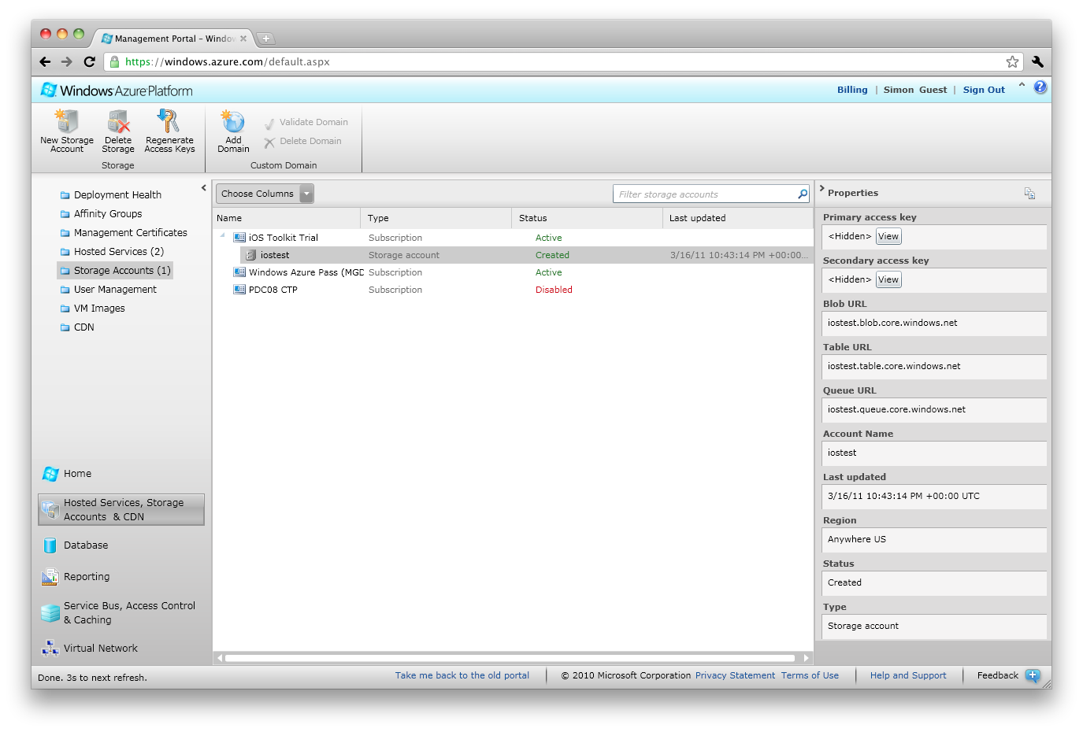
Blob Storage
Table Storage

Slide 81
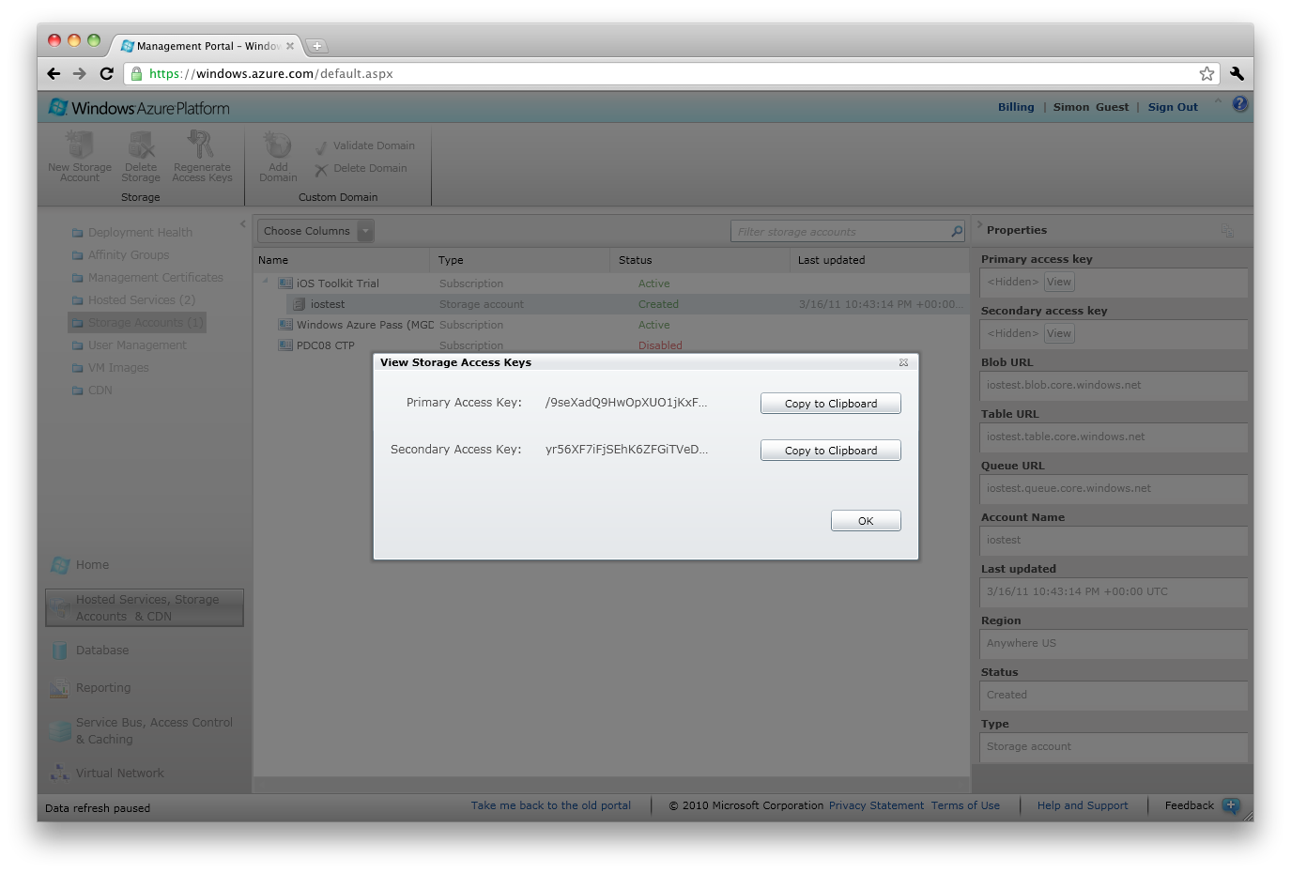
Blob Storage
Table Storage

Slide 82

REST Endpoint:
http://[account].blob.core.windows.net
List, Create, and Delete Containers
List, Put, Get, Delete Blobs
photos
Blob Storage

Slide 83
REST request for listing all containers
GET http://iostest.blob.core.windows.net/?comp=list&include=metadata
x-ms-date: Thu, 14 Apr 2011 20:30:00 GMT
x-ms-version: 2009-09-19
x-ms-blob-type: BlockBlob
Authorization: SharedKey iostest:[ComputedHash]
REST Endpoint:
http://[account].blob.core.windows.net
Blob Storage

Slide 84
…but how do I get that computed hash?
To calculate the computed hash:
AccountKey: /9seXadQ9HwOpXUO1jKxFN8q…
Request: GET\n\n\n\n\n\n\n\n\n\n\n\nx-ms-blob-type:BlockBlob\nx-ms-date:Thu, 14 Apr 2011 20:30:00 GMT\nx-ms-version:2009-09-19\n/iostest/\ncomp:list\ninclude:metadata
Hash = HMACSHA256(UTF8Encode(Request), Base64Decode(AccountKey))
REST Endpoint:
http://[account].blob.core.windows.net
photos
Blob Storage
Account Key:
/9seXadQ9HwOpXUO1jKxFN8q…

Slide 85
GET http://iostest.blob.core.windows.net/?comp=list&include=metadata
x-ms-date: Thu, 14 Apr 2011 20:30:00 GMT
x-ms-version: 2009-09-19
x-ms-blob-type: BlockBlob
Authorization: SharedKey iostest:[ComputedHash]
<?xml version="1.0" encoding="utf-8"?>
<EnumerationResults AccountName="http://myaccount.blob.core.windows.net/">
<Prefix>c</Prefix>
<MaxResults>3</MaxResults>
<Containers>
<Container>
<Name>container1</Name>
<Url>http://iostest.blob.core.windows.net/photos</Url>
<Properties>
<Last-Modified>Sun, 14 Apr 2011 20:09:03 GMT</Last-Modified>
</Properties>
</Container>
</Containers>
REST Endpoint:
http://[account].blob.core.windows.net
photos
Blob Storage

Slide 86
REST request (PUT) for adding a new photo
PUT http://iostest.blob.core.windows.net/photos/myphoto.jpg
x-ms-date: Thu, 14 Apr 2011 20:30:00 GMT
x-ms-version: 2009-09-19
x-ms-blob-type: BlockBlob
Authorization: SharedKey iostest:[ComputedHash]
{...binary representation of photo...}
REST Endpoint:
http://[account].blob.core.windows.net
photos
Blob Storage

Slide 87
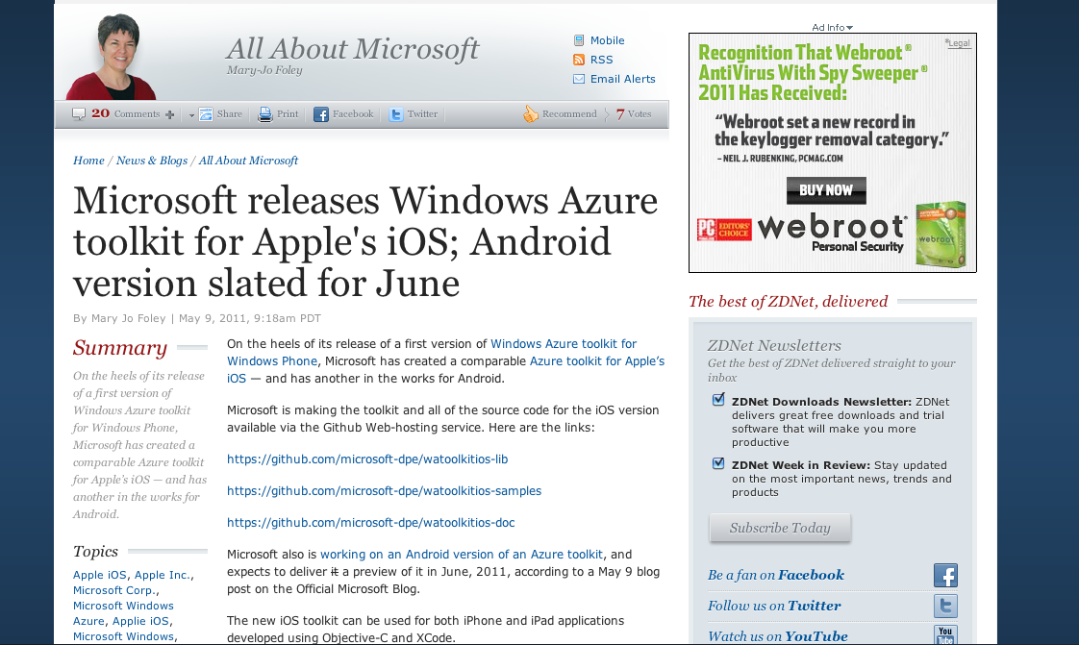
http://www.zdnet.com/blog/microsoft/microsoft-releases-windows-azure-toolkit-for-apples-ios-android-version-slated-for-june/9386?tag=mantle_skin;content

Slide 88
Demo: Windows Azure Toolkit for iOS
(http://github.com/microsoft-dpe)
All demos can be found on http://github.com/simonguest

Slide 89


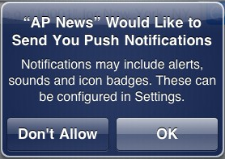
App Registration
Apple Push Notification Service
gateway.sandbox.push.apple.com
Native Application
iPad/iPhone OS 4.3.1
User Acceptance

Slide 90
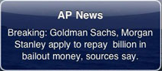
App Registration
Send Message Payload
Apple Push Notification Service
gateway.sandbox.push.apple.com
Native Application
Token Length
Payload Length
JSON formatted
0
0
32
deviceToken
Azure Role optimized for background tasks
0
34
message
Worker Role
iPad/iPhone OS 4.3.1
User Acceptance

Slide 91
App Registration
Send Message Payload
Apple Push Notification Service
gateway.sandbox.push.apple.com
Native Application
Worker Role
iPad/iPhone OS 4.3.1
Windows Azure Queue
User Acceptance

Slide 92
App Registration
Send Message Payload
Apple Push Notification Service
gateway.sandbox.push.apple.com
Native Application
Worker Role
Request Changed Session
Details
iPad/iPhone OS 4.3.1
Windows Azure Queue
Web Role
User Acceptance
Session Updated through Web
Update Queue
Receive Message, Launch App

Slide 93
Demo: Apple Push Notifications from ASP.NET MVC
All demos can be found on http://github.com/simonguest

Slide 94
Takeaways
Recommendations:
Use REST whenever you have a choice
Windows Azure Toolkit for iOS
Push notification to both iOS and Android possible using Windows Azure worker roles
Get a good development environment setup with Fiddler/Charles
Watch out for:
Async vs Sync operation. Both iOS and Android support sync, but don’t use it!
Very limited support for WS-* on native iOS and Android libraries

Slide 96
“Many of Microsoft’s server products also expose REST/SOAP. What options exist for consuming these?”

Slide 97
“Let’s start with SharePoint Server”

Slide 98
Custom: Native Client to Services
or Mobile Web Middle Tier
Packaged: Use AppStore/Market Client
iPad/iPhone OS 4.3
Basic: Use OOB Mobile Rendering
SharePoint Server
2007/2010
Android 2.3

Slide 99
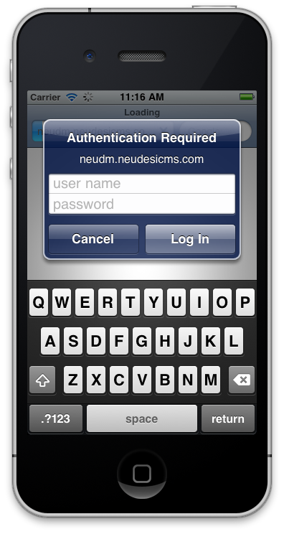
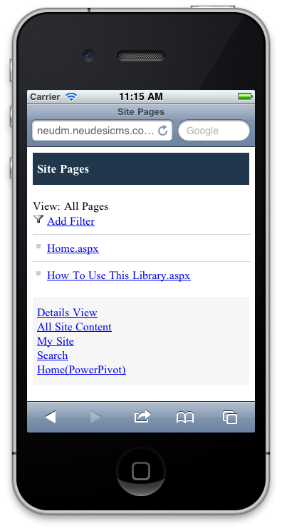
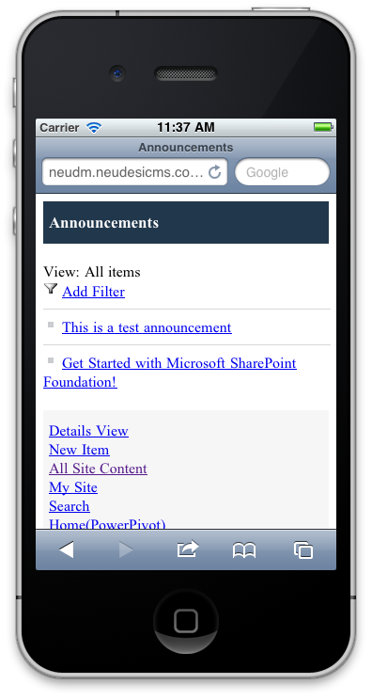
iPad/iPhone OS 4.3
SharePoint Server
2007/2010
Android 2.3

Slide 100
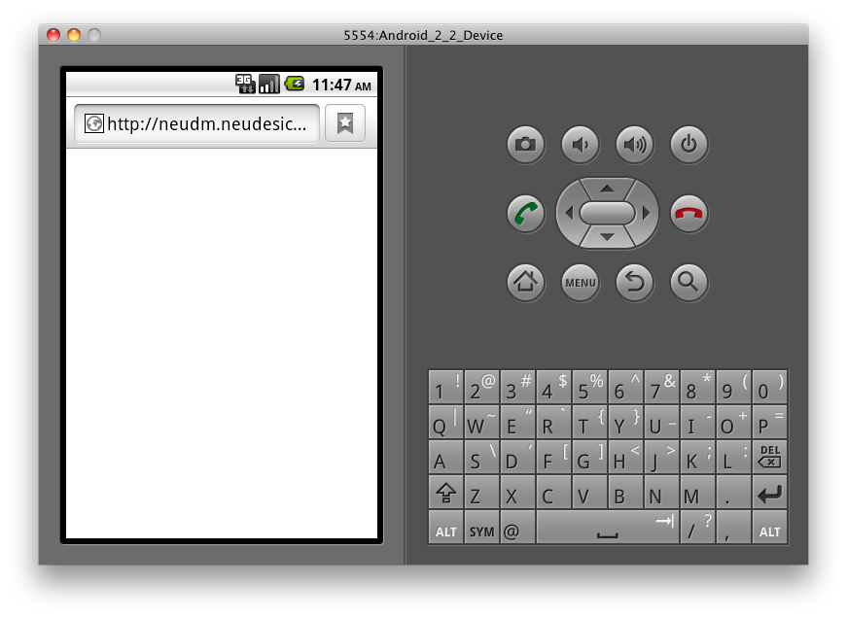
iPad/iPhone OS 4.3
SharePoint Server
2007/2010
Android 2.3

Slide 101
Basic: Use OOB Mobile Rendering
Pros: Easy to setup, works out of the box (with SPS2010)
Cons: Basic, non-native CSS.
No support for browser-based NTLM from Android.
No caching of username/password credentials.
iPad/iPhone OS 4.3
SharePoint Server
2007/2010
Android 2.3

Slide 102
Custom: Native Client to Services
or Mobile Web Middle Tier
Packaged: Use AppStore/Market Client
iPad/iPhone OS 4.3
Basic: Use OOB Mobile Rendering
SharePoint Server
2007/2010
Android 2.3

Slide 103
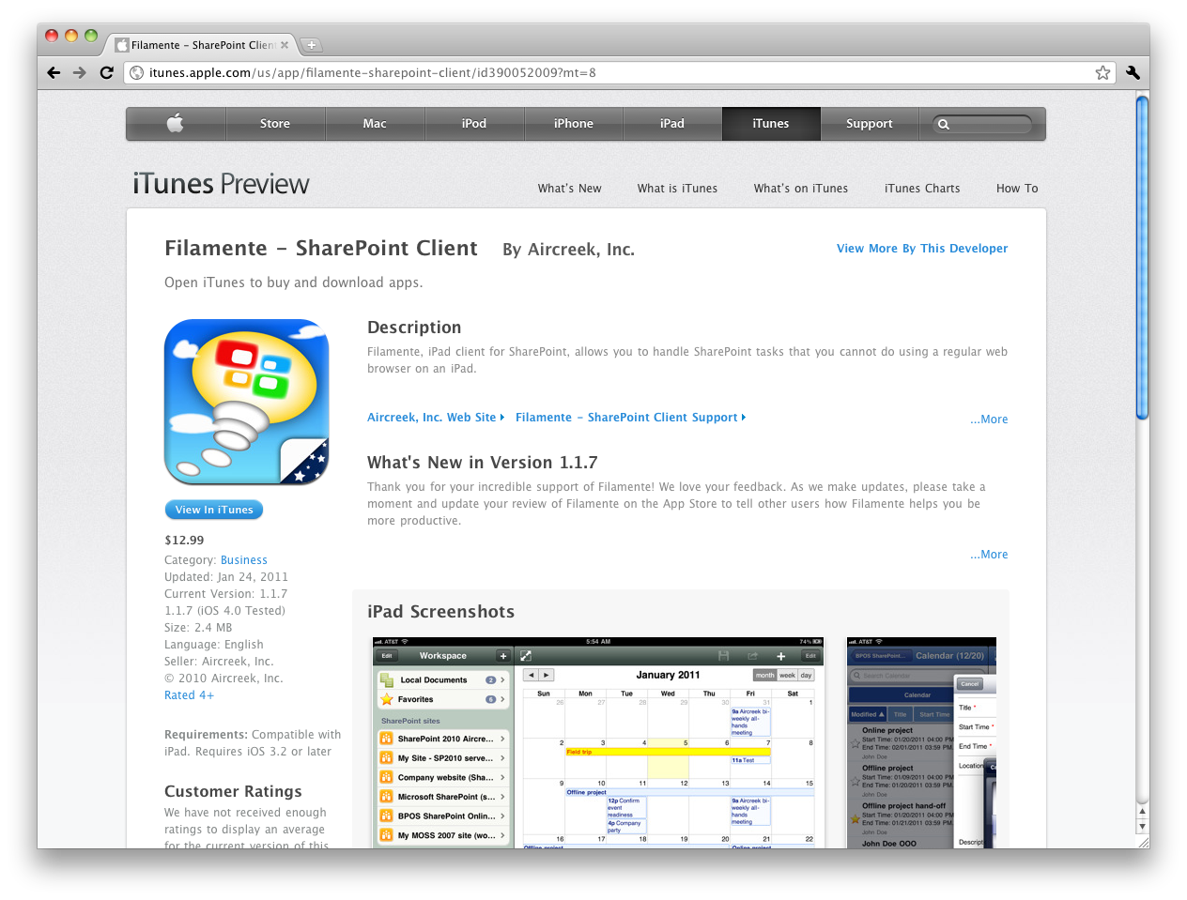
iPad/iPhone OS 4.3
SharePoint Server
2007/2010
Android 2.3
http://itunes.apple.com/us/app/filamente-sharepoint-client

Slide 104
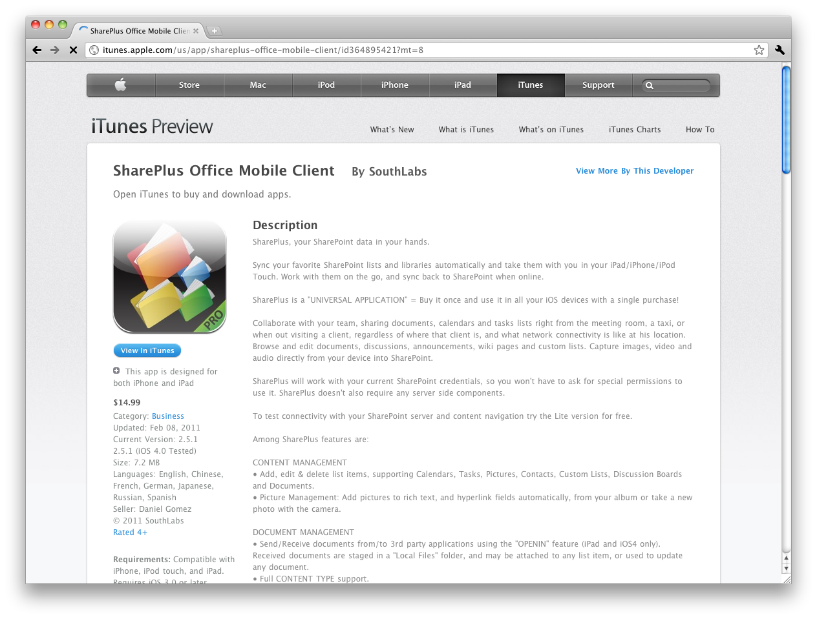
iPad/iPhone OS 4.3
SharePoint Server
2007/2010
Android 2.3
http://itunes.apple.com/us/app/shareplus-office-mobile-client

Slide 105
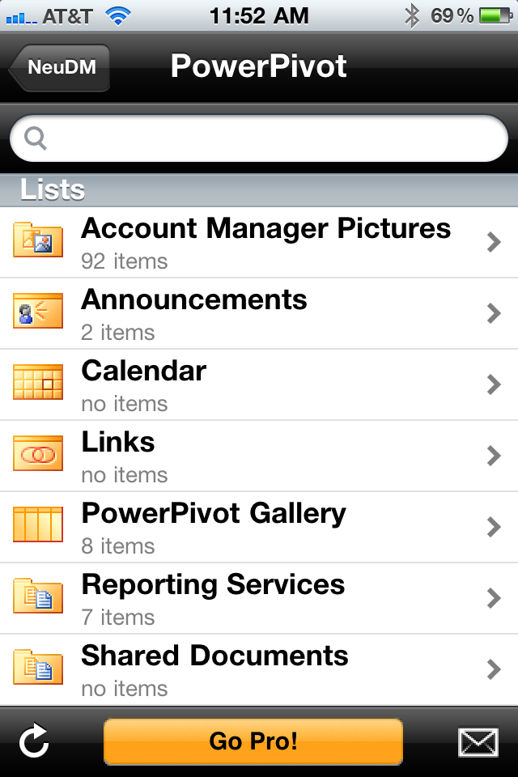
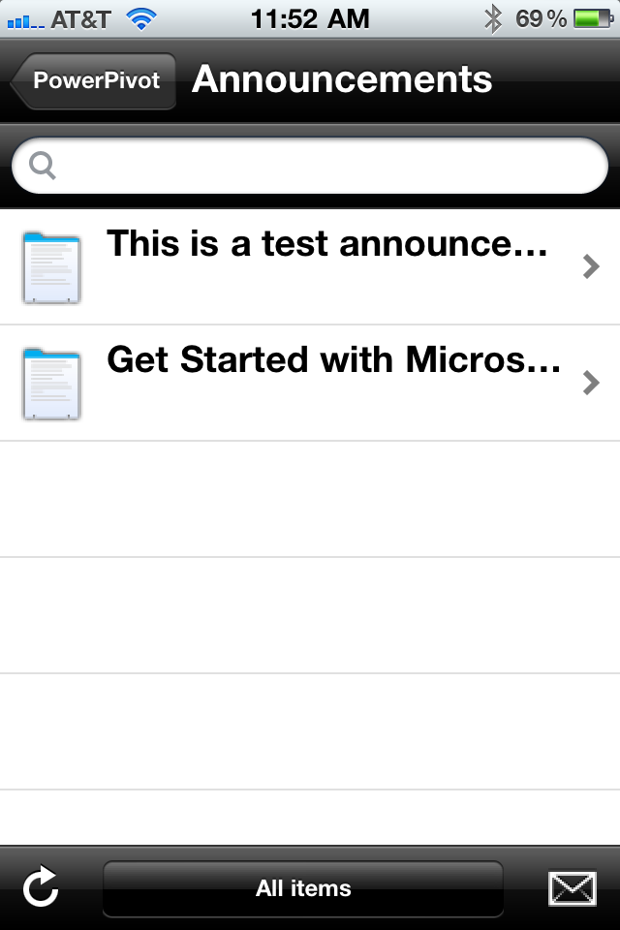
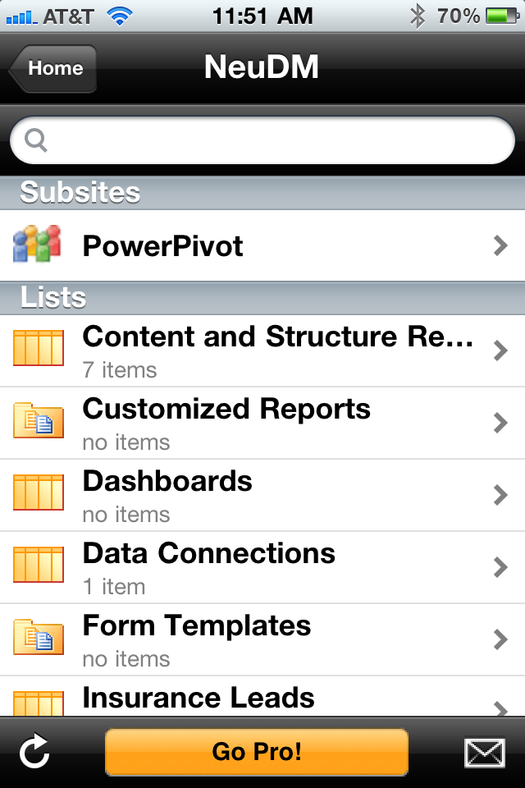
iPad/iPhone OS 4.3
SharePoint Server
2007/2010
Android 2.3

Slide 106
Packaged: Use AppStore/Market Client
Pros: Cheap ($10 – $20 per client).
Multiple authentication schemes.
Cached credentials.
Some offline/sync support.
Cons: All site content for mobile users.
Leaf nodes are mostly read only HTML (e.g. Announcements). Most solutions are iPhone only (limited Android)
iPad/iPhone OS 4.3
SharePoint Server
2007/2010
Android 2.3

Slide 107
Custom: Native Client to Services
or Mobile Web Middle Tier
Packaged: Use AppStore/Market Client
iPad/iPhone OS 4.3
Basic: Use OOB Mobile Rendering
SharePoint Server
2007/2010
Android 2.3

Slide 108
SPWeb (2007)
ODATA (2010)
iPad/iPhone OS 4.3
SharePoint Server
2007/2010
Android 2.3

Slide 109

SPWeb (2007)
ODATA (2010)
iPad/iPhone OS 4.3
Mobile Web Rendering of information
useful to Mobile clients
ASP.NET MVC
Middle Tier
(jQueryMobile)
SharePoint Server
2007/2010
Android 2.3

Slide 110
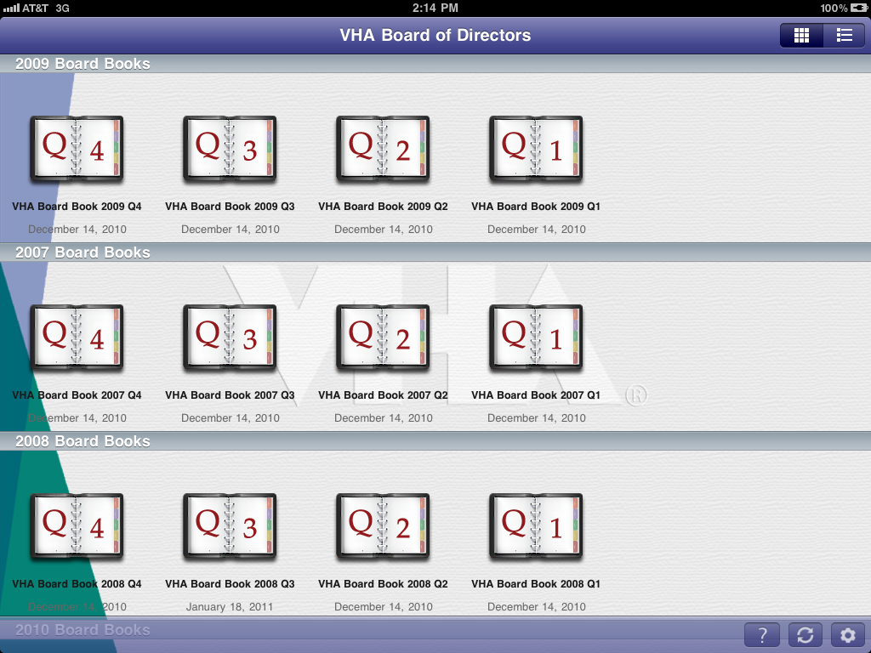
SPWeb (2007)
ODATA (2010)
iPad/iPhone OS 4.3
Mobile Web Rendering of information
useful to Mobile clients
ASP.NET MVC
Middle Tier
(jQueryMobile)
SharePoint Server
2007/2010
Android 2.3

Slide 111
SPWeb (2007)
ODATA (2010)
Custom: Native Client or Middle Web Tier
Pros: Complete custom solution.
Can even hide fact that back end is SharePoint-based.
Cons: More expensive option.
Limitations with SOAP client libraries for iPhone/Android.
iPad/iPhone OS 4.3
Mobile Web Rendering of information
useful to Mobile clients
ASP.NET MVC
Middle Tier
(jQueryMobile)
SharePoint Server
2007/2010
Android 2.3

Slide 112
“Do the same options apply to Dynamics CRM?”

Slide 113
Custom: Native Client to Services
or Mobile Web Middle Tier
Packaged: Use AppStore/Market Client
iPad/iPhone OS 4.3
Basic: Use OOB Mobile Rendering
Dynamics CRM
4.0/2011
Android 2.3

Slide 114
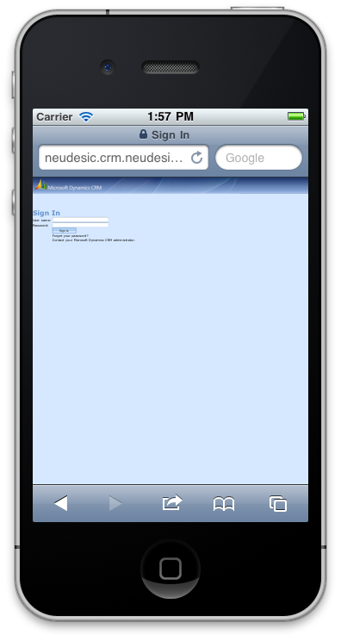
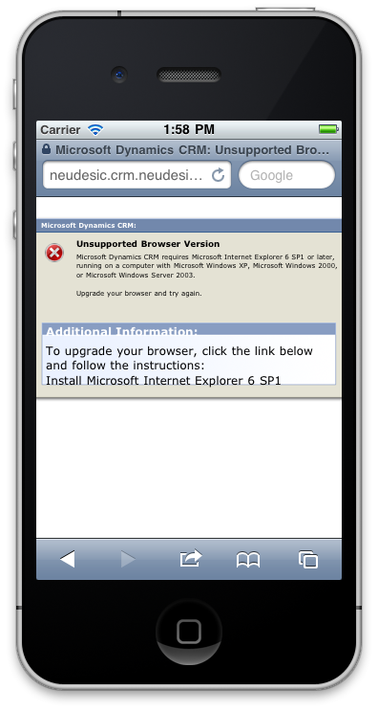
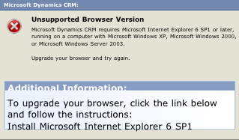
iPad/iPhone OS 4.3
Dynamics CRM
4.0/2011
Android 2.3

Slide 115
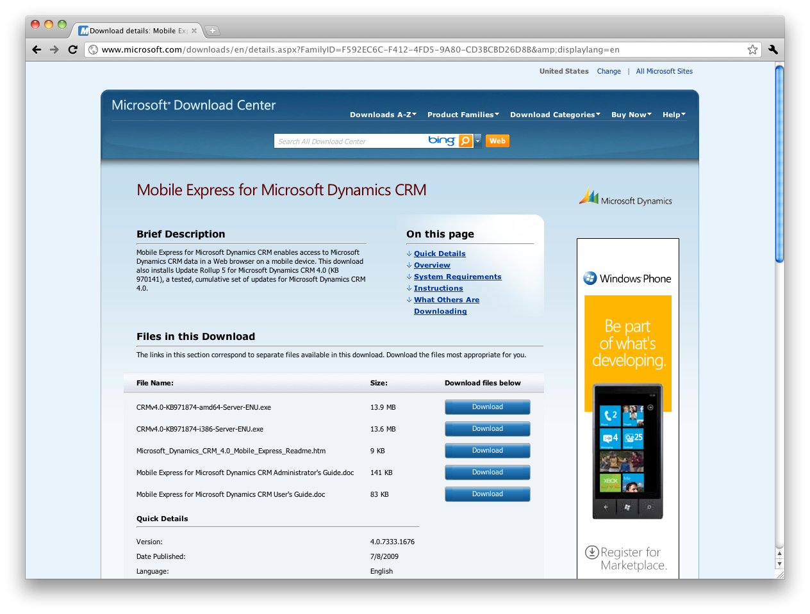
iPad/iPhone OS 4.3
Dynamics CRM
4.0/2011
Android 2.3
http://www.microsoft.com/downloads/en/details.aspx?FamilyID=f592ec6c-f412-4fd5-9a80-cd3bcbd26d8b

Slide 116
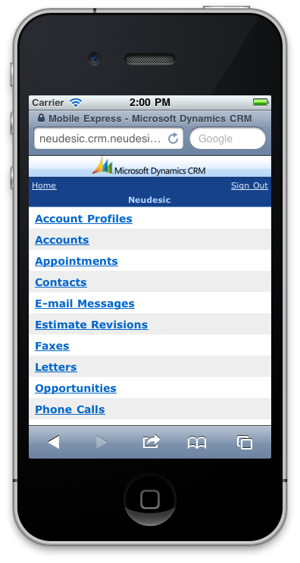
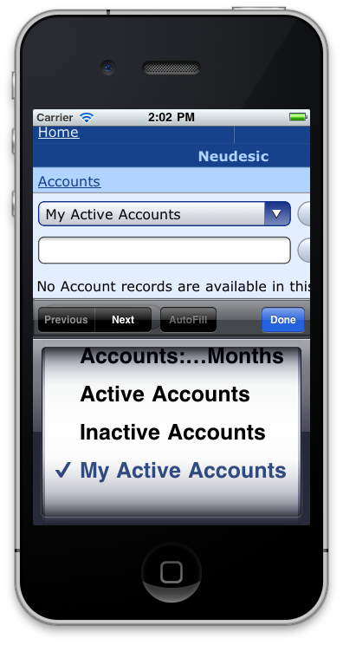
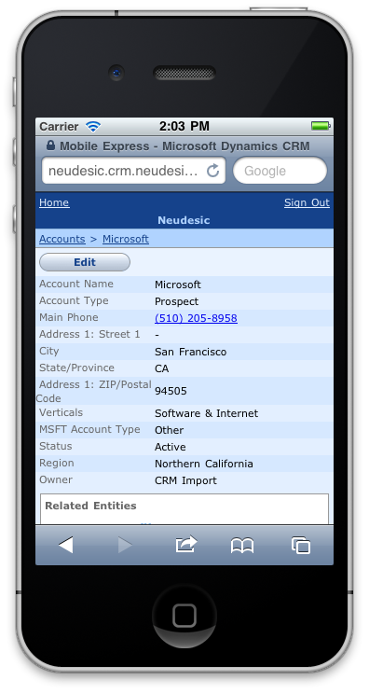
iPad/iPhone OS 4.3
Dynamics CRM
4.0/2011
Android 2.3

Slide 117
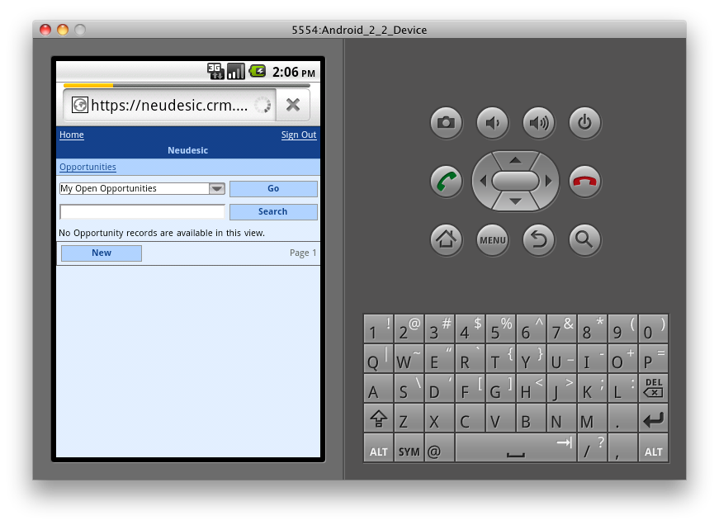
iPad/iPhone OS 4.3
Dynamics CRM
4.0/2011
Android 2.3

Slide 118
Basic: Use OOB Mobile Rendering
Pros: Easy to setup, works out of the box.
Forms based authentication works with non-NTLM browsers.
Cons: Basic, non-native CSS.
Controls a little awkward.
No user-agent detection.
No caching of username/password credentials.
iPad/iPhone OS 4.3
Dynamics CRM
4.0/2011
Android 2.3

Slide 119
Custom: Native Client to Services
or Mobile Web Middle Tier
Packaged: Use AppStore/Market Client
iPad/iPhone OS 4.3
Basic: Use OOB Mobile Rendering
Dynamics CRM
4.0/2011
Android 2.3

Slide 120
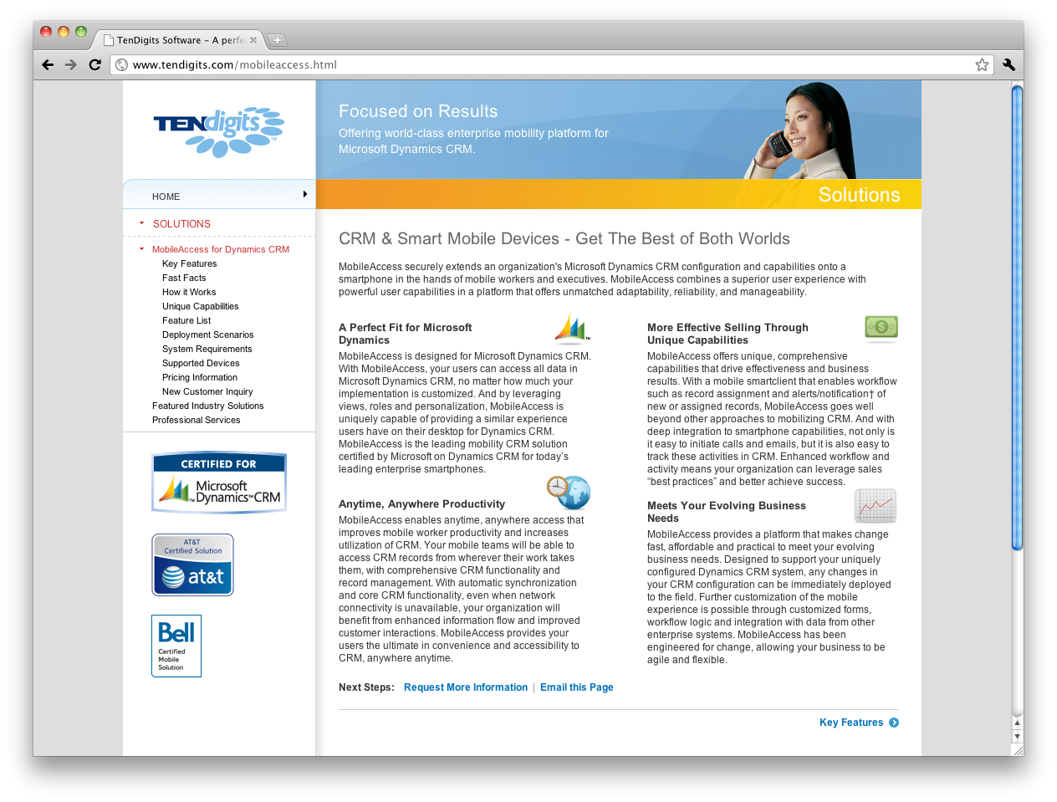
iPad/iPhone OS 4.3
Dynamics CRM
4.0/2011
Android 2.3
http://tendigits.com/mobileaccess.html

Slide 121
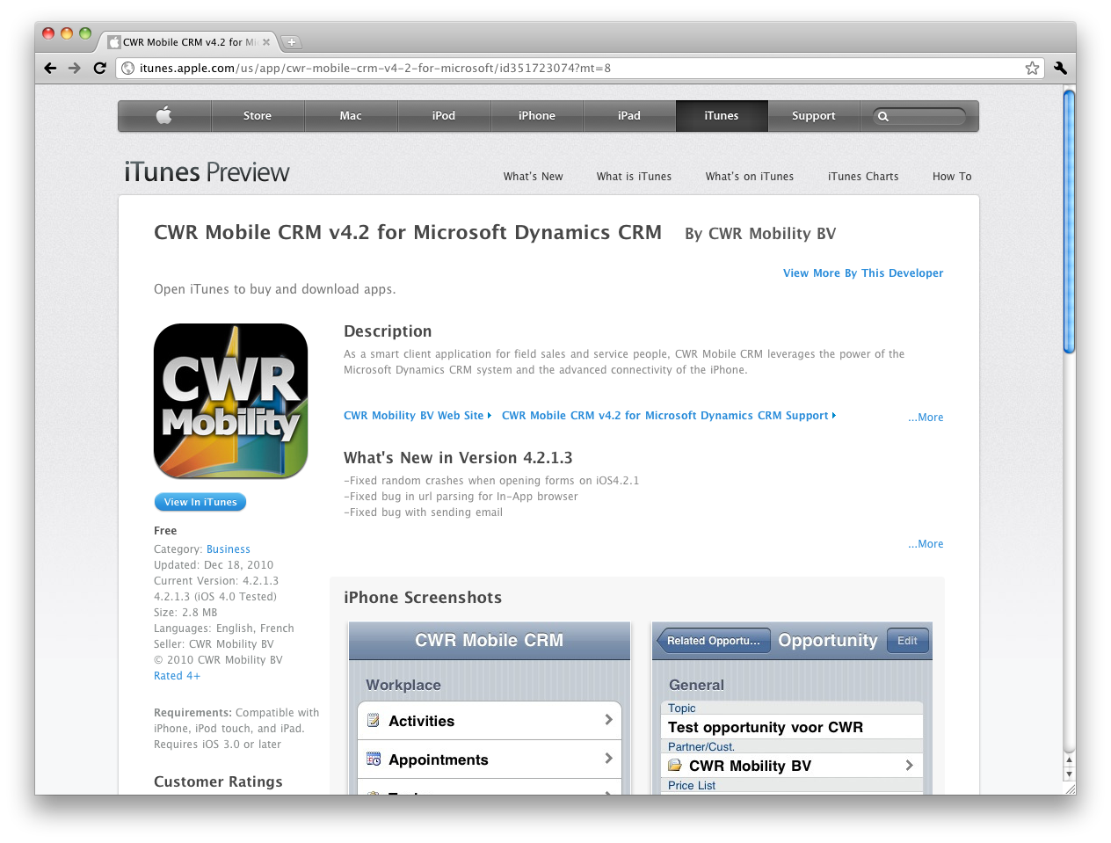
iPad/iPhone OS 4.3
Dynamics CRM
4.0/2011
Android 2.3
http://itunes.apple.com/us/app/cwr-mobile-crm-v4-2-for-microsoft

Slide 122
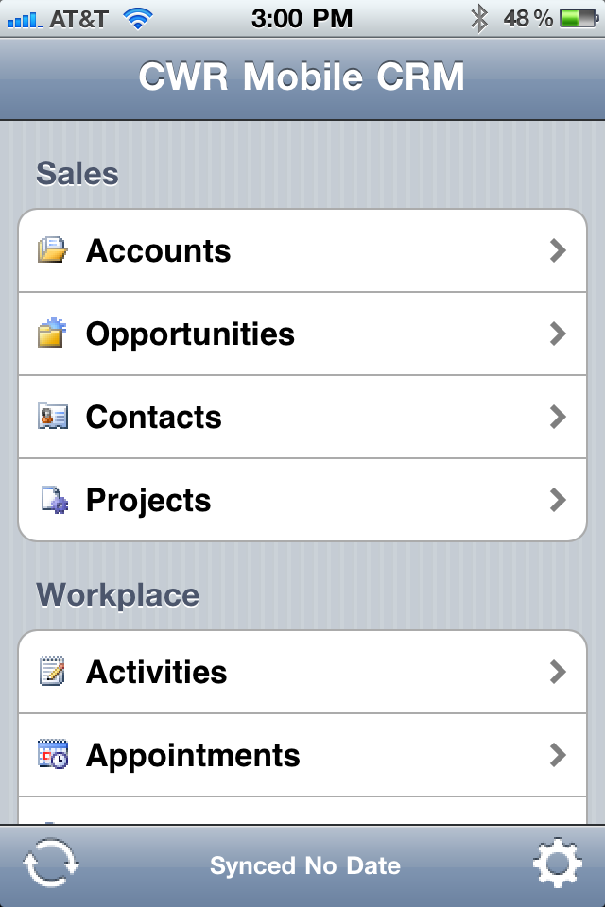
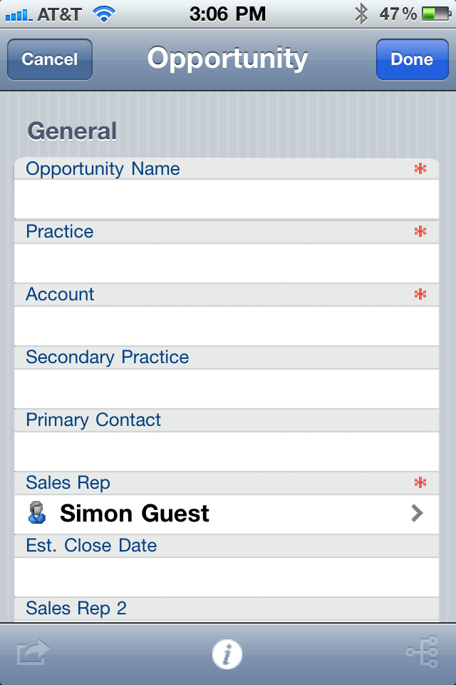
iPad/iPhone OS 4.3
Optimized rendering
CWR/TenDigits
Middle Tier
Dynamics CRM
4.0/2011
Android 2.3

Slide 123
Packaged: Use AppStore/Market Client
Pros: Offline access.
Cached credentials.
Cons: All site content for mobile users.
Most solutions are iPhone only (limited Android)
iPad/iPhone OS 4.3
Optimized rendering
CWR/TenDigits
Middle Tier
Dynamics CRM
4.0/2011
Android 2.3

Slide 124
Custom: Native Client to Services
or Mobile Web Middle Tier
Packaged: Use AppStore/Market Client
iPad/iPhone OS 4.3
Basic: Use OOB Mobile Rendering
Dynamics CRM
4.0/2011
Android 2.3

Slide 125
SOAP Web Services (4.0)
REST Endpoint (2011)
Updated Web Services (2011)
ODATA (2011)
iPad/iPhone OS 4.3
Dynamics CRM
4.0/2011
Android 2.3

Slide 126
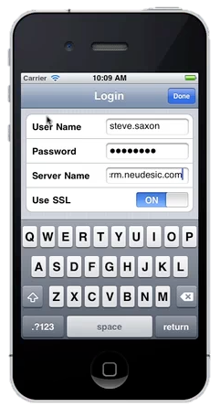
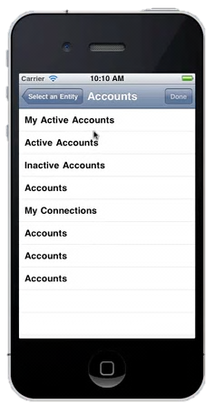
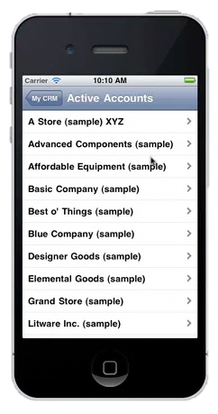
SOAP Web Services (4.0)
REST Endpoint (2011)
Updated Web Services (2011)
ODATA (2011)
iPad/iPhone OS 4.3
Dynamics CRM
4.0/2011
Android 2.3
Neudesic CRM Accelerator for iOS – http://neudesic.com

Slide 127
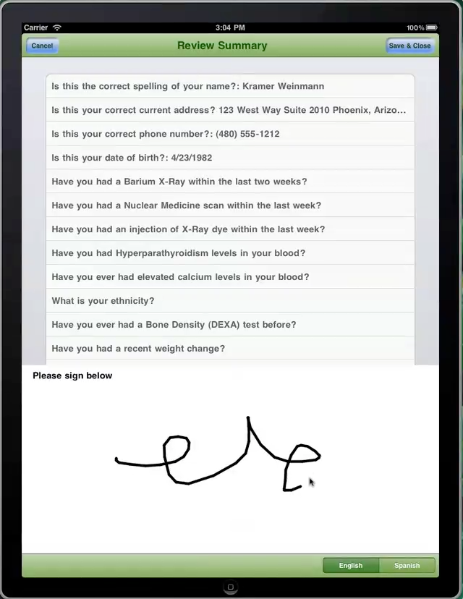
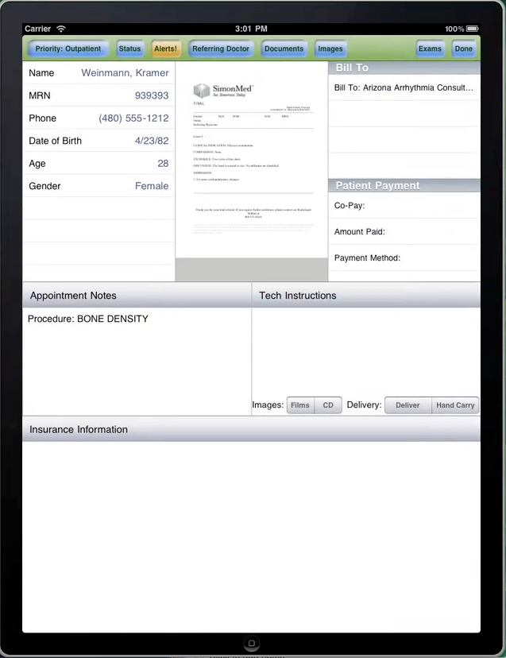
SOAP Web Services (4.0)
REST Endpoint (2011)
Updated Web Services (2011)
ODATA (2011)
iPad/iPhone OS 4.3
Dynamics CRM
4.0/2011
Android 2.3

Slide 128
Custom: Native Client or Middle Web Tier
Pros: Complete custom solution.
Can even hide fact that back end is Dynamics-based.
Cons: Limitations with SOAP client libraries for iPhone/Android. On CRM 2011, REST endpoint only provides limited CRUD.
Web Service (SOAP) endpoint uses WS-Security with Kerberos.
SOAP Web Services (4.0)
REST Endpoint (2011)
Updated Web Services (2011)
ODATA (2011)
iPad/iPhone OS 4.3
Dynamics CRM
4.0/2011
Android 2.3

Slide 129
Takeaways
Recommendations:
Think about accessing SPS/CRM three ways
  Basic Web
  Packaged
  Custom
Custom is (IMO) the most interesting to customers
Watch out for:
Mobile Web is very basic
Packaged solutions are good, but expose whole site
CRM 2011 REST interface only allows certain CRUD operations
CRM 2011 Web Service uses WS-Security w/ Kerberos tokens

Slide 130
“You’ve mentioned ODATA many times. What’s the story?”

Slide 132
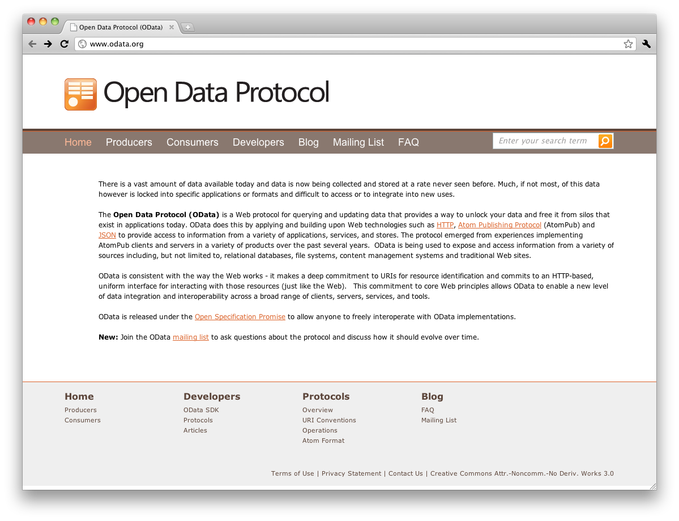

X
TDS Protocol
iPad/iPhone OS 4.3
SQL Server
Android 2.3

Slide 133
Native Application
OData
iPad/iPhone OS 4.3 (ObjC)
EDMX
WCF
Data
Service
SQL Server

Slide 134
Native Application
ODATA.svc
public class ODATA : DataService<SessionModelContainer>
{
public static void InitializeService(DataServiceConfiguration config)
{
config.SetEntitySetAccessRule("*", EntitySetRights.AllRead);
config.DataServiceBehavior.MaxProtocolVersion = DataServiceProtocolVersion.V2;
}
}
ODATA
iPad/iPhone OS 4.3 (ObjC)
WCF
Data
Service
EDMX
SQL Server

Slide 135

Native Application
ODATA
iPad/iPhone OS 4.3 (ObjC)
WCF
Data
Service
EDMX
SQL Server
http://interoperabilitybridges.com

Slide 136
Native Application
odatagen
./odatagen /uri=http://sguest01/TRMobile/Services/ODATA.svc /out=.
-rw-r--r-- 1 Simon staff 5738 Feb 10 13:09 SessionModelContainer.h
-rw-r--r-- 1 Simon staff 14735 Feb 10 13:09 SessionModelContainer.m
OData
iPad/iPhone OS 4.3 (ObjC)
WCF
Data
Service
EDMX
SQL Server

Slide 137
iPhoneClientViewController.m
Native Application
-(IBAction)callODATAService:(id)sender
{
SessionModelContainer *proxy = [[SessionModelContainer alloc] initWithUri:@"http://sguest01/TRMobile/Services/ODATA.svc" credential:nil];
QueryOperationResponse *response = [proxy execute:@"Sessions"];
NSMutableArray *sessions =[response getResult];
for (id session in sessions)
{
NSLog(@"Session Code: %@",[session getCode]);
NSLog(@"Session Title: %@", [session getTitle]);
}
NSLog(@"Complete");
}
OData
iPad/iPhone OS 4.3 (ObjC)
WCF
Data
Service
EDMX
SQL Server

Slide 138
Native Application
OData
Android 2.3
WCF
Data
Service
EDMX
SQL Server

Slide 139

Native Application
ODATA
Android 2.3
WCF
Data
Service
EDMX
SQL Server
http://code.google.com/p/odata4j

Slide 140


Native Application
ODATA
Android 2.3
WCF
Data
Service
EDMX
SQL Server
http://www.restlet.org

Slide 141

Note: Must be done with the full JSE version of Restlet.jar libraries (no generator in the Android version)!
Native Application
Proxy Generation
lib Simon$ java -cp org.restlet.jar:org.restlet.ext.xml.jar:org.restlet.ext.atom.jar:org.restlet.ext.freemarker.jar:org.restlet.ext.odata.jar:org.freemarker.jar org.restlet.ext.odata.Generator http://sguest01/TRMobile/Services/ODATA.svc ~/Desktop/ARC310/restlet-proxy/
---------------------------
OData client code generator
---------------------------
...
The source code has been generated in directory: /Users/Simon/Desktop/ARC310/restlet-proxy
ODATA
Android 2.3
WCF
Data
Service
EDMX
SQL Server

Slide 142
Main.java
Native Application
TrmobileWebModelsService service = new TrmobileWebModelsService();
Query<sessionmodel.Session> query = service.createSessionQuery("/Sessions?$filter=startswith(Code,'VIR')%20eq%20true");
for (Session session : query)
{
// do work
}
OData
Android 2.3
WCF
Data
Service
EDMX
SQL Server

Slide 143
Demo: Consuming an OData service on iPhone and Android
All demos can be found on http://github.com/simonguest

Slide 144
Takeaways
Recommendations:
Easy to create feeds using OData
Easy to consume through native libraries
Easy to consume lists exposed by SharePoint 2010
Watch out for:
Anything that looks like SQL library on device
OData+Sync not supported today
Consuming OData feeds from Office 365

Slide 146
“…but I don’t want to learn Objective C or Java!”
“I just want to do C#...”

Slide 147
Mono 1.0
(C# 1.0)
1.2
(C# 2.0)
2.0
(C# 3.0)
Mono
Touch 1.0
2.8
(C# 4.0)
Mono
Droid
1.0
Sharp
Develop
Full
AOT
Mono
Touch 2.0/3.0
1.1
2004
2005
2006
2007
2008
2009
2010
2011

Slide 148

MacOSX/XCode specific
MonoDevelop
Interface Builder
Uses
Uses
C#
UI Kit
Mono compiler
Saved as
MSIL
XIB
“mscorlib.dll”
AOT (Ahead of Time) compiler
Native
iPad/iPhone OS 4.3

Slide 149
Demo: A simple application using MonoTouch
All demos can be found on http://github.com/simonguest

Slide 150

Eclipse optional
MonoDevelop
Eclipse ADT
Uses
Saved as
Android bindings
C#
main.axml
Mono compiler
MSIL
<application>.apk – includes assemblies and “runtime”
Android 2.3
Dalvik VM

Slide 151
Takeaways
Recommendations:
Ability to re-use existing C# skills and business logic
Features of .NET that are easier than ObjC and Java (LINQ, XML Parsing, Generics)
Watch out for:
No benefits for UI (UI Kit or main.axml)
Price Tag ($1000 per MonoDevelop enterprise license)
Future?

Slide 152

http://tirania.org/blog/archive/2011/May-16.html

Slide 154

Popularity of iOS and Android will likely remain high with your customers…

Slide 155

Knowledge and tools to ensure that your apps are able to take full advantage of the Microsoft platform

Slide 156






Gold Certified Microsoft Partner
Windows Phone 7 | iPhone | iPad | Android | Blackberry
Kelley Blue Book Realtor.com Neudesic Pulse | Whole Foods Symetra Financial Neudesic Pulse Azure Toolkit for iOS | SimonMed VHA Inc Kelley Blue Book Symetra Financial | Kelley Blue Book Neudesic Pulse Azure Toolkit for Android | Neudesic Pulse

Slide 157

Simon Guest
Director, Mobility Solutions
simon.guest@neudesic.com
http://simonguest.com
© 2011 Microsoft Corporation. All rights reserved. Microsoft, Windows, Windows Vista and other product names are or may be registered trademarks and/or trademarks in the U.S. and/or other countries.
The information herein is for informational purposes only and represents the current view of Microsoft Corporation as of the date of this presentation. Because Microsoft must respond to changing market conditions, it should not be interpreted to be a commitment
on the part of Microsoft, and Microsoft cannot guarantee the accuracy of any information provided after the date of this presentation. MICROSOFT MAKES NO WARRANTIES, EXPRESS, IMPLIED OR STATUTORY, AS TO THE INFORMATION IN THIS PRESENTATION.

