Slide 1

MVC, MVP and MVVM:
A Comparison of
Architectural Patterns
DPR305
Joe Homnick
joe@homnick.com
HSI Knowledge

Slide 2
What This Session Is And What It Is Not
It is:
  An investigation of how different software architecture patterns relate to different Microsoft developer technologies
  A what to use where discussion
It is not:
  An exhaustive architectural discussion of software patterns with a bunch of mental pontifications.

Slide 3
Overview
What, why, how of Model-view-controller(C) or presenter(P) or View Model(VM) architecture patterns
Model-View-Controller (MVC) pattern
  ASP.Net MVC 3 example
Model-View-Presenter (MVP) pattern
  Web Forms/SharePoint example
Model-View-ViewModel (MVVM) pattern
  Silverlight example
What to use where

Slide 4
What is Model/View/(C or VM or P)
Patterns that describe a modular approach to
software development
Modules include:
  Model – Data
  View – Presentation Layer
  C or VM or P – Glue Logic
They are based upon a “Separation of Duties”
  Seen in many other types o,f system frameworks
How is this different from nTier development in the 90’s - anybody remember Distributed interNet Architecture (DNA)

Slide 5
Why Model-View-(C or VM or P)
The Patterns all have similar goals, however, achieve
them in different ways
The Patterns goals are to increase:
  Modularity
  Flexibility
  Testability
  Maintainability

Slide 6
Model-View-Controller (MVC)
First described in 1979 for Smalltalk at Xerox PARC
Controller is centerpiece that decouples the Model
and View
Control flow:
  User interaction event
  Controller handles event and converts it to a user action the Model can understand
  Model manages the behavior and data of the application domain
  The View interacts with the Controller and Model to generate a user interface

Slide 7
Client/Server (DNA) vs MVC
Client
-----------------------
Business Objects
Controller
Server
-----------------------
Business Objects
Data
View
Model

Slide 8
MVC Observer Pattern
Controller
View
Model

Slide 9
ASP.Net MVC 3
demo

Slide 10
Model-View-Presenter (MVP)
MVP originated in early 1990s
MVP is a derivative of MVC
Two types of implementation
  Passive View
  Supervising Controller
Presenter assumes the functionality of the MVC Controller
View is responsible for handling UI events
Model becomes strictly a Domain Model
More User Interface centric

Slide 11
MVC vs MVP (Passive)
Controller
Presenter
View
Model
View
Model

Slide 12
MVP – Supervising Controller Pattern
Presenter
View
Model

Slide 13
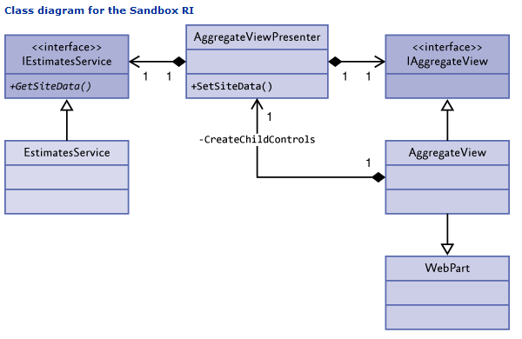
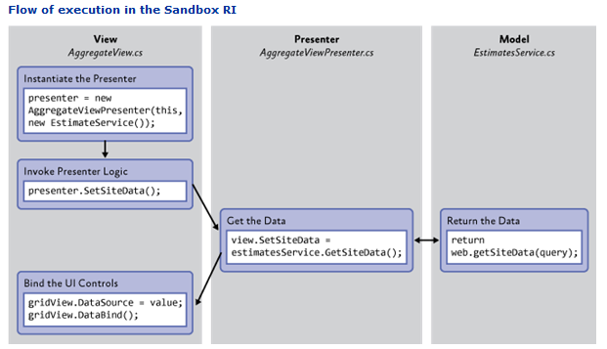
SharePoint 2010 Developer Guidance
MVP Class Diagram and Flow of Execution for the SandBox Execution Model

Slide 14
MVP Using ASP.Net Web Forms
Name
Title
Group
demo

Slide 15
Model-View-ViewModel (MVVM)
Largely based on MVC
Specialization of the MVP pattern known as the Presentation Model
Built specifically for the WPF and Silverlight environments
Model and View works just like MVC
ViewModel is a “Model of the View”
  It extends the Model with Behaviors the View could use
  Data Binding between View and Model
  Passes commands between the View and Model

Slide 16
MVP (Passive) vs MVVM
Presenter
ViewModel
View
Model
View
Model

Slide 17
MVVM Using Silverlight
Name
Title
Group
demo

Slide 18
What To Use Where
Model-View-Controller (MVC) pattern
  ASP.Net MVC 3
  Disconnected Web Based Applications
Model-View-Presenter (MVP) pattern
  Web Forms/SharePoint, Windows Forms
  UI state logic already wired up
Model-View-ViewModel (MVVM) pattern
  Silverlight, WPF
  Two way data-binding

Slide 19
ARC Track Resources
http://www.microsoft.com/visualstudio
http://www.microsoft.com/visualstudio/en-us/lightswitch
http://www.microsoft.com/expression/
http://blogs.msdn.com/b/somasegar/
http://blogs.msdn.com/b/bharry/
http://www.microsoft.com/sqlserver/en/us/default.aspx
http://www.facebook.com/visualstudio

Slide 20





Resources
  Connect. Share. Discuss.
http://northamerica.msteched.com
Learning
  Sessions On-Demand & Community
  Microsoft Certification & Training Resources
www.microsoft.com/teched
www.microsoft.com/learning
  Resources for IT Professionals
  Resources for Developers
http://microsoft.com/technet
http://microsoft.com/msdn

Slide 21












Complete an evaluation on CommNet and
enter to win!

Slide 22


