Slide 2
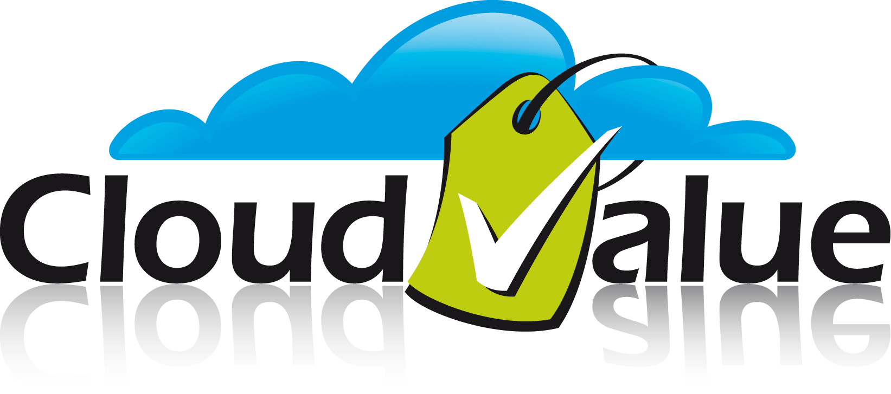
DPA307 - Cost Oriented Development
Shy Cohen | Alon Fliess
CEO | CTO

Slide 3
Not accounting for the cost implications of your architecture design, and implementation will result in lower cost-efficiency

Slide 4
Optimizing Resources Usage
Using Your Money Wisely ☺
demo

Slide 5
The Real Cost of Software
software
runtime costs
runtime costs
Acquisition cost is 10% of IT Spend
hardware
network
Operating cost is 90% of IT Spend
facilities
management tools
disaster recovery
support
Cloud Computing Addressed Many of the “Hidden Costs”
storage
IT labor
security
maintenance
power/cooling
backup
Emphasizes Others
procurement & accounting
Source: IDC

Slide 6
The Cloud Challenge
Pay-per-use consumption model
Huge cost savings
Trouble if cost is not managed properly
At development time
When deployed in the cloud

Slide 7
Raising to the Challenge
Create a cost-management strategy
Understand your application
Architecting & designing with cost in mind
Implementing efficiently
The key to all of the above:
Cost Insight

Slide 8
Cost and Your Application
Operations
Testing
Implementation
Architecture & Design
Requirement Capturing
Cost is important at every stage of the application lifecycle
For every application type

Slide 9
Cost Orientation Strategy
Solve
Plan
Understand
Review
Operations
Testing
Implementation
Architecture & Design
Requirement Capturing
S
P
U
R
S
P
U
R
S
P
U
R
S
P
U
R
S
P
U
R

Slide 10
Cost Oriented Requirements
Functional Requirements
Non-Functional Requirements
Constraints
Huge impact on construction expenses & operational expenses (OpEx)

Slide 11
Cost Oriented Requirements Having the right conversations
Cost-analyze the requirements
Discuss implications & alternatives with stakeholders
Pay more for user experience?
Cheaper alternative experience?
Clever solutions?
Review the options you considered
Document cost implication of each requirement
Or you will return to these discussions again and again ☺
Understand
Plan
Solve
Review

Slide 12
Functional Requirements Putting a cost on business needs
Understand the cost of business requirements
Are is absolutely required?
Can we perform expensive operations on demand?
Plan & solve
The right feature set
Mitigations
The right business models
Review & document the cost for each option, and the decision made
Understand
Plan
Solve
Review

Slide 13
Non-Functional Requirements
Requirements
Time
Quality
Business Value
Resources
Engineering: making compromises
Architecture: building product while answering many quality attributes
OpEx Reduction: one of the more important quality attributes
Expense lasts the longest
Might contradict other important qualities
For example: High availability

Slide 14
Non-Functional Requirements Putting a cost on quality attributes
Understand the cost of the desired qualities
Availability, Latency, Robustness
Plan for the optimal way to achieve them
Consider the tradeoffs
Implement right architecture & mitigations
Document the cost for each architectural option
Understand
Plan
Solve
Review

Slide 15
Non-Functional Requirements Cost-oriented tradeoffs on quality attributes
Cost vs. Latency
Speed of processing requests as a factor of the cost of instances
Quality vs. Performance
Image quality as a factor of the cost to generate and transmit
Data Size vs. Data Accessibility
Normalized vs. Denormalized
Compression vs. Searchability
Relational vs. No-SQL
Etc.

Slide 16
Cost Oriented Constraints
Constraints come from many places
Competitive
Regulatory
Business
Budget
Etc.
They can effect cost drastically
Compute example: Need to encrypt information at rest
Storage example: Need to keep users’ data for 7 years
Networking example: Data must reside in a certain geography

Slide 17
Constraints Putting a cost on things you can’t avoid
Understand the cost of each constraint
Plan for the optimal way to address constraints
Devise a solution to each constraint
This is a good time to assess fiscal feasibility!
Document the cost for each of the constraints, and the decisions made
Understand
Plan
Solve
Review

Slide 18
Cost Orientation: Focusing on Value
Not just about lowering cost
Cost limits are Constraints
Constraints can be negotiated / managed
Mainly about maximizing your investment
Maximizing value is a Quality Attribute

Slide 19
Requirements & Cost Key takeaways
Understand the cost of
Functional Requirements
Non-Functional Requirements
Constrains
Consider tradeoffs and plan mitigations
Make cost-impact an integral part of project documents

Slide 20
Operations
Testing
Implementation
Architecture & Design
Requirement Capturing
✓

Slide 21
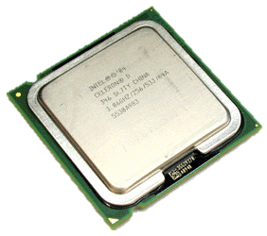
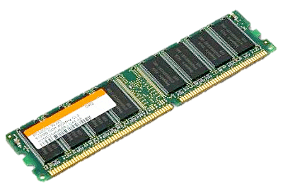
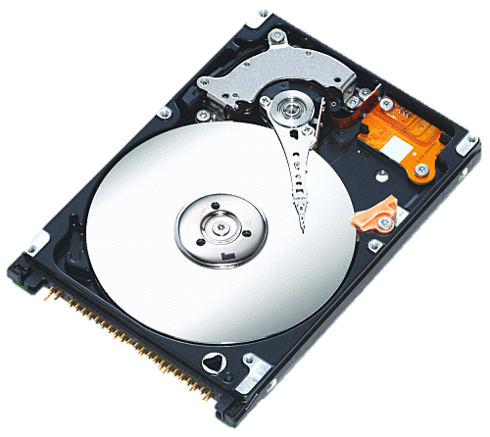
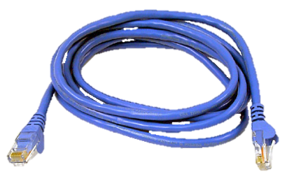
Understanding Your Application Your application’s component utilization characteristics

Slide 22
Understanding Your Application Computational requirements
Is your Application CPU bound?
Does it have constant load?
Does the load change or fluctuate over time?
Can you benefit from throttling? Elasticity?
Instance Size | CPU | Memory | Instance Storage | I/O Perf | Cost per Hour | Month
Extra Small | 1 GHz | 768 MB | 20 GB | Low (5 Mbps) | $0.05 | $36
Small | 1.6 GHz | 1.75 GB | 225 GB | Moderate (100 Mbps) | $0.12 | $86
Medium | 2 x 1.6 GHz | 3.5 GB | 490 GB | High (200 Mbps) | $0.24 | $173
Large | 4 x 1.6 GHz | 7 GB | 1,000 GB | High (400 Mbps) | $0.48 | $346
Extra large | 8 x 1.6 GHz | 14 GB | 2,040 GB | High (800 Mbps) | $0.96 | $691

Slide 23
Understanding Your Application Storage requirements
Estimate the size and type of the storage you need
Fixed storage size
Per-user storage size
Is the data really relational?
What is the rate of new data?
What types of queries do you need?
How long should the data be kept for?
How often do you need to retrieve the data?
How quickly do you need to retrieve the data when asked for?
Would it make sense to save computation by storing pre-processed data?
Storage Type | Component | Cost
SQL Azure | Storage | $10 / GB / Month
Windows Azure | Storage | $0.15 / GB / Month
 | Transaction | $0.01 / 10,000 tx

Slide 24
Understanding Your Application Communication requirements
Where will your users be located?
What are your network traffic patterns?
Do you need to connect with existing systems?
Systems of record
Connecting across network boundaries
What’s your expected ingress and egress?
Baseline traffic
Variable traffic
System generated traffic
User generated traffic
Region | Price for 1 GB
 | In | Out
North America and Europe regions | $0.10 | $0.15
Asia Pacific Region | $0.10 | $0.20

Slide 25
Application Cost Analysis A really simplified example
Our app provides up-to-date Cost Insight & Analysis
Compute Analysis
4 instances (2 front-end, 2 back-end)
Application is relatively CPU-light → No requirements on instance size
Storage Analysis
Projected data accrual rate is _____ per user per day
Data is retained for ____ days
Data is not relational → we can use Azure Storage
Communication Analysis
Web: inbound is negligible, est. ___ outbound per user per day
Email: no inbound, ___ outbound per user per day
Meet communication limits for ___ instance
Throttling Strategy
Must scale to sample every account every 5 minutes
Soft deadlines on outbound email
Elasticity Strategy
Soft limit + hard Limit
Conclusion
Running COST will cost a $___ per 1000 clients per month

Slide 26
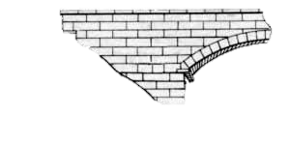
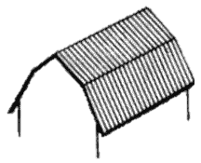
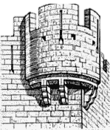
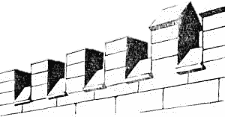
COA Consideration Known architecture patterns

Slide 27
SOA and the Cloud
Services are units of functionality and composition
Roles are units of deployment and scalability
Don’t mix architecture and deployment strategy
Web Role 1
Web Role 1
Service A
Service A
Worker Role 1
Worker Role 2
Worker Role 1
Worker Role 2
Service B
Service C
- 40%
Service B
Service C
Worker Role 3
Worker Role 4
Service D
Service E
Service D
Service E

Slide 28
SOA and the Cloud Rethinking solutions
Sometimes, the “standard” solution is not the best one
Example, dividing work
Master-Slave
Peer-to-Peer
Worker Role 2
Worker Role 1
Worker Role 2
Worker Role 1
Peer
Peer
Master
Master
Reduction of 2/(n+2)
Worker Role 3
Worker Role 4
Non-Dedicated Master
Slave
Slave
Worker Role 1
Worker Role 2
Master + Slave
Slave

Slide 29
Optimizing Compute Resources Guidance
Combine services
Mind the cost boundary
Optimize # of instances
Create a “Compute Pool”
Offload work to worker roles
Use queues to manage compute loads
Use statistical information to pre-load instances
Offload work to deployments in different regions
Leverage AppFabric Caching to share calculation results

Slide 30
Architecting Interfaces
Design a service interface that optimizes cost-benefit
Avoid chatty interfaces
Provide the right amount of information
Don’t force complex operations in the implementation
Don’t perform unnatural acts
What will be the cost of implementation and maintenance?
Is the saving meaningful?

Slide 31
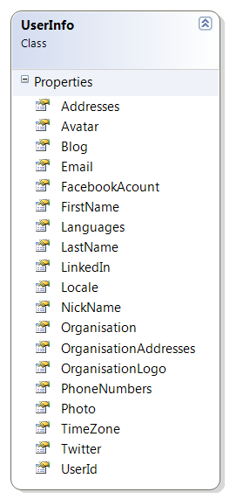
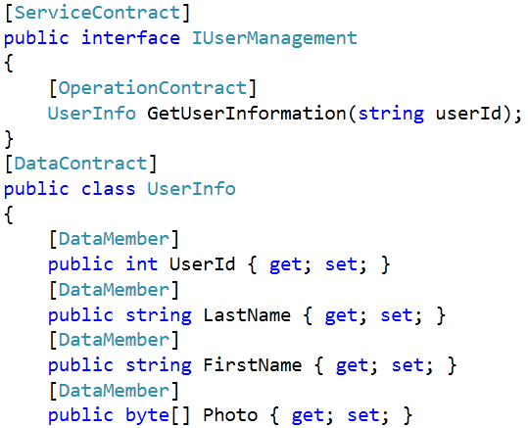
Architecting Interfaces Reduce costs
Design a service interface that optimizes cost-benefit

Slide 32
Architecting Interfaces Consider the impact of the frameworks you use
DataSets are easy to use, but they can be wasteful
Send the original value when saving a change
(As opposed to using a timestamp or an E-tag)
Using Entity Framework can result in unexpected traffic
Self-tracking entities
Lazy loading of referenced objects
Etc.

Slide 33
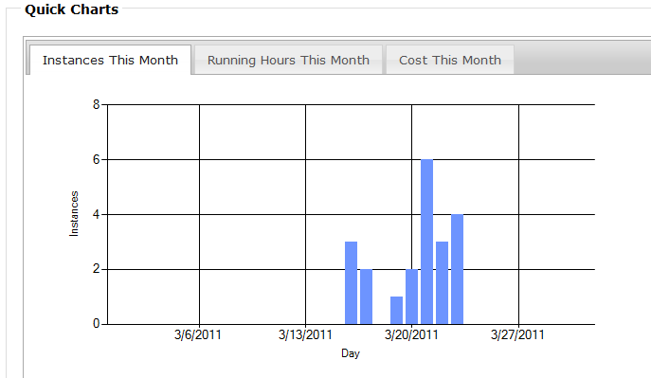
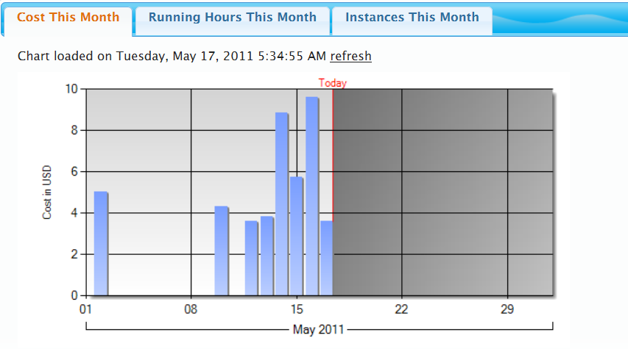
Saving Cost of Content Generation
Before: 2.1 charts/visit
Order | Instances | Hours | Cost
Used | 100% | 23% | 89%
After: 1.6 charts/visit
Order | Cost | Instances | Hours
Used | 100% | 37% | 22%
Choosing the right order of the tabs
Loading tab content when tab is displayed

Slide 34
Resource Optimization
Creating the Correct user Experience
DEMO

Slide 35
More Ways to Save Additional guidance
Avoid computation
Use the client CPU
Use storage account
Use SQL Azure
Use optimal role sizes
Different sizes for the different roles
Different sizes for the same role at different times
Avoid storage access
Use cookies for client conf
Lower computation cost
Use storage in tandem with compute
Use the CDN
Defer content generation until it’s needed

Slide 36
Cost Optimization Techniques
Standard optimization techniques
Speed of execution
Memory usage
Cloud specific code-optimization
Optimal cloud resource usage

Slide 37
Offloading Work to the Client
Generating UI on the Client Side
Demo

Slide 38
Cost Oriented Architecture Summary
Use SOA principles
But don’t conflate architecture with deployment
Create effective interfaces
Without over-complicating their implementation
Determine the actual cost impact of your design
Measure the right things

Slide 39
Operations
Testing
Implementation
Architecture & Design
Requirement Capturing
✓
✓

Slide 40
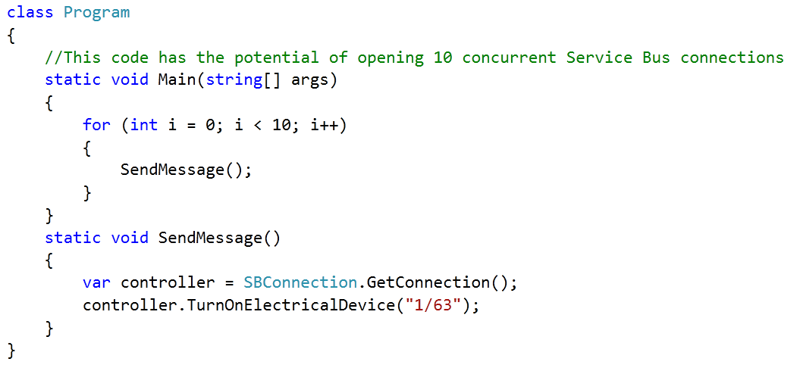
The Cost of Your Code
Code: Affected by architecture but independent from it

Slide 41
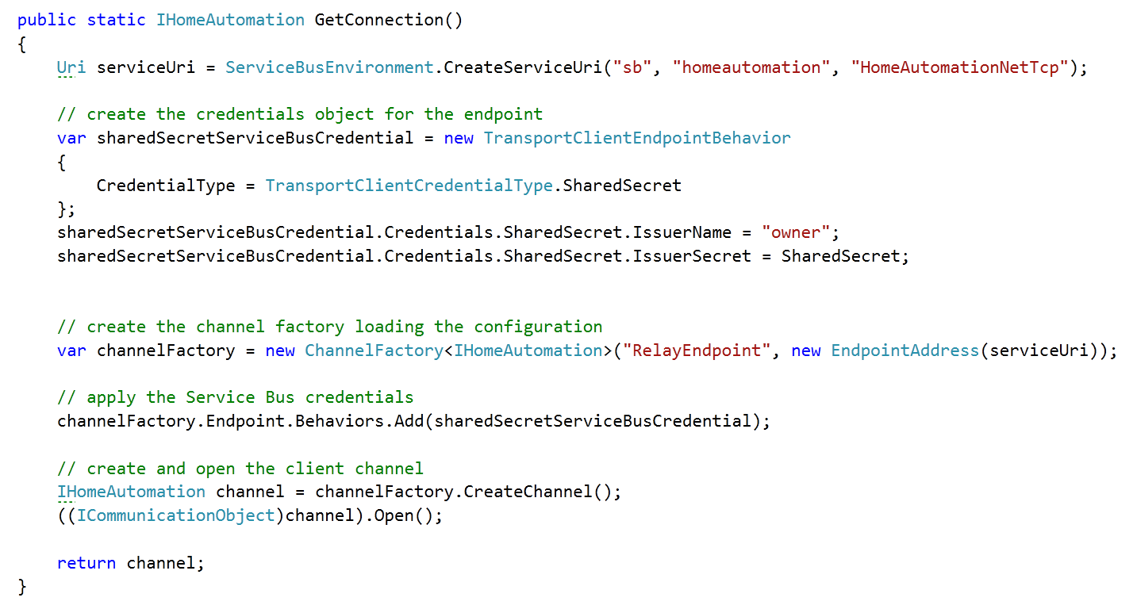
.NET Defers Resource Collection

Slide 42
Better Ways to Manage Connection Cost
using(…)
Close the connection explicitly
Reuse the connection
Factory pattern
Close when not being used
Cost profiling & optimization is key

Slide 43
Cost Oriented Development
Understanding the Impact of Code
Demo

Slide 44
Thinking Outside The Code
The Cost Of Data
The Cost Of Connectivity
The Cost Of Security
The Cost Of Development
The Cost of QA
The Cost Of Bugs

Slide 45
The Cost of Data
Data Size
What’s the required fidelity? (Images, Videos, etc.)
Does data compression pay? (CPU vs. Network & Storage)
Data Retention Policy

Slide 46
Optimizing Storage Services
Data storage options
Table Storage
Queue Storage
BLOB Storage (page & block), and Azure Drives
SQL Azure
AppFabric Caching
The CDN
Understand storage consumption and pricing models
Select the right storage option for your needs

Slide 47
Optimizing Storage Services Guidance
Compute data at the right time
Use the CDN’s dynamic-content-caching
Create views over large data dynamically
Batch operations to reduce store transactions
Optimize serialization formats & compression
Make fewer queries (e.g. use CSS Image Sprites)
Leverage AppFabric Caching to share calculation results
Reuse SQL Azure database instances during development

Slide 48
More Ways to Save Additional guidance
Protect against "data leaks“
Optimize your queue pulling strategy
Optimize your SQL Azure data schema
Make sure you are using a “right sized” SQL Azure db
Heed the cost of failed storage requests & poison msg
Understand the cost using the Azure Client Library
Understand the cost of using Azure Drive
Don't blindly cache everything

Slide 49
Optimizing Storage Services Things to avoid
Storing large binary data in SQL Azure
Allowing unrestricted upload sizes
Allowing unrestricted queries

Slide 50
Optimizing Connectivity Services
Connectivity requirements have 2 sources
Architecture
Code
Understand connectivity consumption & pricing models
Ingress and egress costs
The AppFabric Service Bus costs
Windows Azure Connect costs

Slide 51
Optimizing Connectivity Services Guidance
Throttle communication
Optimize internet traffic for web roles
Multiplex over service bus connections
Provide on-premises fan-out for events
Close connections when you are not using them
Put services are in same region as the data they access
Use AppFabric Caching in cross-region comm. Scenarios

Slide 52
Optimizing Connectivity Services Things to avoid
Transmitting repetitive data
Chatty communication channels
Keeping connections open
Excessive cross-region communication
But remember that in some cases it can actually save money!

Slide 53
The Cost Of Development
Understand the cost of the development process
Unit Tests & CI
Integration Tests
Load Tests
How much does a check-in cost?

Slide 54
The Cost of QA
The cost of testing
Manual testing
Load testing
The cost of debugging
How much does a full test-pass cost?
Is this bug or change request worth the cost of testing it?

Slide 55
The Cost Of Bugs
Leaks
Memory
System resources (e.g. handles)
Connections
Storage
etc.
Instance crash and recycling
Consuming resources without making progress
Bad handling of poison messages

Slide 56
Operation Is Still Very Important Rumors of its demise have been greatly exaggerated
Data backup
DROP TABLE Customers … Oops!
Backup/version of BLOBs via snapshots
Creating cost-effective data retention policies
Monitoring resource consumption on a regular basis

Slide 57
Avoiding the Dangers of Cost Orientation
Shifting cost models can throw you off
Focus on the high level model
Avoid over-tuning to a particular price point
Encapsulate highly-optimized areas
Be agile
Avoid unnatural acts in the name of cost reduction
Don’t create overly complex architectures in the name of cost
Don’t create un-maintainable code in the name of cost
Follow the general rules regarding architecting for the cloud
They will ultimately lead you down the right path

Slide 58
Not accounting for the cost implications of your architecture design, and implementation will result in lower cost-efficiency

Slide 59
Summary
Cost Orientation: Maximizing the value of your investment
A Quality Attribute, not a Constraint
CO touches every aspect of the app lifecycle
Cost Oriented Requirements
Cost Oriented Architecture & Design
Cost Oriented Implementation
Cost Oriented Testing
Cost Oriented Operations
Integrate CO into every phase of your project!

Slide 60
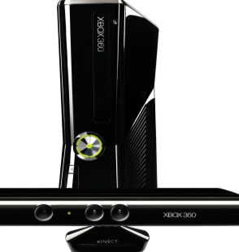
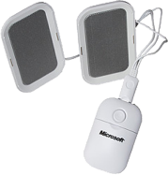
Complete an evaluation on CommNet and enter to win!

Slide 62
© 2011 Microsoft Corporation. All rights reserved. Microsoft, Windows, Windows Vista and other product names are or may be registered trademarks and/or trademarks in the U.S. and/or other countries.
The information herein is for informational purposes only and represents the current view of Microsoft Corporation as of the date of this presentation. Because Microsoft must respond to changing market conditions, it should not be interpreted to be a commitment on the part of Microsoft, and Microsoft cannot guarantee the accuracy of any information provided after the date of this presentation. MICROSOFT MAKES NO WARRANTIES, EXPRESS, IMPLIED OR STATUTORY, AS TO THE INFORMATION IN THIS PRESENTATION.

