Slide 1

Adapt or Perish: How 2012 Will Change IT Architecture
DPR310
Angela Yochem
Business Information Executive
Dell

Slide 2

What’s happening in IT?

Slide 3

Consumer expectations and appetites are evolving

Slide 4

Solutions are becoming targeted/personalized

Slide 5

Corporate/public customers have
shifted focus to best overall value

Slide 6


Winning companies will make the best usage of information

Slide 7

Social aspects of decision-making are dominant

Slide 8

  Logically and geographically distributed resources and ownership

Slide 9
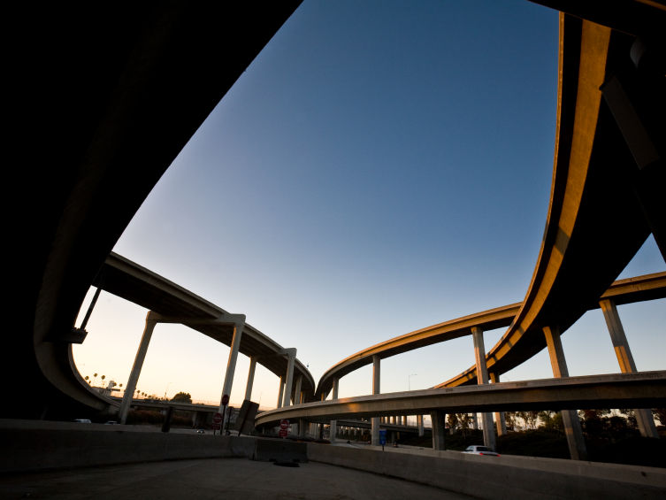
Mobility is changing long-standing business models and processes

Slide 10

Security considerations continue to evolve

Slide 11

Economic conditions will remain volatile

Slide 12

Plan for change in the role of the architect and the practice of architecture

Slide 13

The re-emergence of the “lone architect”

Slide 14

BUSINESS
IT
Shifting alignment

Slide 15

Architect Capabilities must evolve
Design
Quality Attributes
IT Environment
Business Technology Alignment
Human Dynamics
The IASA Skills Taxonomy – www.iasaglobal.org

Slide 16
Understanding impact
Estimate optimal SLAs
Tracking environmental behavior
Understanding distributed (hidden) costs
Forecasting resource consumption
Increase focus on agility
Define new routines to drive to desired capabilities within IT
Design
Quality Attributes
Auditable transparency

Slide 17
New questions to ask
Black box vs transparent solutions
Aligning deployments
Interdependency management
Testing considerations
Managing quality
Measuring
adaptability and
efficiency
Highly distributed
resources
IT Environment
Get your management processes right

Slide 18
Understand changing business dynamics
Go to market
What will catapult your company ahead of its competition?
Move beyond request/response engagement
Know the players
Speak the language
Don’t play the hero
Business Technology Alignment

Slide 19
These are not my beautiful stakeholders
Be brief
Be impactful
You can’t control the circumstances of communication – be ready
Be the Voice of Reason
Influence without passion
Now is the time to fill your capability gaps
Human Dynamics

Slide 20

What is the Opportunity?

Slide 21

Re-craft yourself
Re-define architecture
Change our world

Slide 22
ARC Track Resources
http://www.microsoft.com/visualstudio
http://www.microsoft.com/visualstudio/en-us/lightswitch
http://www.microsoft.com/expression/
http://blogs.msdn.com/b/somasegar/
http://blogs.msdn.com/b/bharry/
http://www.microsoft.com/sqlserver/en/us/default.aspx
http://www.facebook.com/visualstudio

Slide 23





Resources
  Connect. Share. Discuss.
http://northamerica.msteched.com
Learning
  Sessions On-Demand & Community
  Microsoft Certification & Training Resources
www.microsoft.com/teched
www.microsoft.com/learning
  Resources for IT Professionals
  Resources for Developers
http://microsoft.com/technet
http://microsoft.com/msdn

Slide 24












Complete an evaluation on CommNet and
enter to win!

Slide 25


