Slide 1

Combining Public and Private
Clouds into Useful Hybrids
DPR311
David Chou
Architect
Microsoft

Slide 2
Focus of This Session
Cloud computing
Microsoft cloud platform
Architecture
  Hybrid cloud scenarios
  Hybrid application models
  Principles, patterns, practices
More about development & design; less about deployment
Not product features

Slide 3

NIST Definition of Cloud Computing http://www.nist.gov/itl/cloud/upload/cloud-def-v15.pdf
Essential Characteristics
  On-demand self-service
  Broad network access
  Resource pooling
  Rapid elasticity
  Measured service
Service Models
  Software as a Service
  Platform as a Service
  Infrastructure as a Service
Deployment Models
  Private
  Public
  Hybrid
  Community

Slide 4
Private Cloud
Implementation of cloud services on resources that are dedicated to your organization, whether they exist on-premises or off-premises
Typically, your organization owns and controls the resources/assets, definition of services, costs and risks
  Variations exist – such as hosted and virtual private clouds
Microsoft solutions
  Windows Server 2008 R2 Hyper-V, System Center (IaaS)
  Windows Azure Appliance (PaaS)

Slide 5
Public Cloud
Implementation of cloud services on resources that are shared between many customers, managed off-premises
Typically, cloud provider owns and controls the resources/assets, definition of services, costs and risks
  Variations exist – such as hosters and integrated cloud platforms
Microsoft solutions
  Office 365 (SaaS)
  Dynamics CRM Online (SaaS)
  Windows Intune (SaaS)
  Windows Azure platform (PaaS)

Slide 6
Private Cloud vs. Public Cloud
More than a location and ownership distinction
Not just a deployment model
Private Cloud
  Control
  Conventional storage
  Custom policies
  Heterogeneous infrastructure
  Regulatory compliance & data sovereignty
Public Cloud
  Scale
  Cloud storage
  Common policies
  Homogeneous infrastructure
  Work in progress

Slide 7
Cloud Service Models
Traditional IT
Infrastructure
(as a Service)
Platform
(as a Service)
Software
(as a Service)
Applications
Applications
You manage
Applications
Applications
Data
You manage
Data
Data
Data
Runtime
Runtime
Runtime
Runtime
Delivered as a service
You manage
Middleware
Middleware
Middleware
Middleware
Delivered as a service
Operating System
Operating System
Operating System
Operating System
Virtualization
Virtualization
Delivered as a service
Virtualization
Virtualization
Servers
Servers
Servers
Servers
Storage
Storage
Storage
Storage
Networking
Networking
Networking
Networking

Slide 8










Platform as a Service
Marketplace
Application
Marketplace
Information Marketplace
Frameworks
Services Hosting
Workflow Hosting
Distributed Cache
Security
Secure Token Service
Declarative Policies
Claims-Based Identity
Federated Identities
Integration
Service Bus
Messasging
Registry
Data
Relational Database
ADO.NET, ODBC, PHP
Transact-SQL
Data Synchronization
Compute
C / C++
Win32
VHD
Storage
Dynamic Tabular Data
Blobs
Message Queues
Distributed File System
Content Distribution
Networking
On-Premises Bridging

Slide 9




Platform as a Service
DataMarket
Applications
Marketplace
Frameworks
Caching
Composite App
Security
Access Control
Integration
Service Bus
Integration
Connect
(BizTalk)
Data
Relational Database
DataSync
Reporting
Compute
Web Role
Worker Role
VM Role
Storage
Table Storage
Blob Storage
Queue
Drive
Content Delivery Network
Connect
Networking

Slide 10






Targeting Apps to Public Cloud Platform
Questions To Consider
Application State
Application Scale
Data Sensitivity
Connectivity Needs
Application Portability
Some Easy Cases
  e.g., web site sharing public data
Latency Between
Components
Often, Forklift Approach
Will Not Work
Regulation and Compliance
  Careful decomposition needed

Slide 11
Targeting Apps to Public Cloud Platform
Application Data | State must be replicated, by app directly or in a replicated store
Application Configuration & Installation | Configuration state only a cache; no lengthy install step
Application Scale | App must scale horizontally (scale-out) not vertically (scale-up)
Application Dependencies | App must be able to run on cloud platform with no special hardware needs
Latency Needs | Shared cloud systems may not guarantee uniform/low latency among app components
Connectivity Needs | Intra- and inter- app connectivity needs must be clear
Data Sensitivity | Public clouds may not be able to host all sensitive data; encryption may be needed
Regulation & Compliance | Location and type of cloud matters

Slide 12


Hybrid Cloud
Mixed/blended model of private and public clouds
  Variations and multiple interpretations exist
On-premises and off-premises bridging
  Most common scenario today
  Especially for large enterprises
More than a deployment / delivery model
  Application design, architectural model
+

Slide 13
Hybrid Cloud Deployment
Workload Patterns
Elastic/burst capacity (e.g., apps with variable load, HPC / parallel processing, etc.)
Temporal applications (e.g., marketing apps, test & QA environments, etc.)
Cloud-based DMZ / Perimeter Zone
High Performance Compute
Backup and storage
Disaster recovery
These work, but they are still deployment models

Slide 14

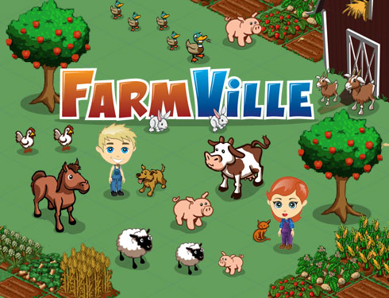
Zynga’s “Hybrid Cloud”
Active unique players
  250M monthly (updated 2011.05) ; 60M daily
  90M+ in CityVille
  1M daily 4 days after launch; 10M after 60 days
  3B neighborhood connections
Cloud infrastructure
  “Z Cloud” private cloud implementation
    Westmere generation of Intel Xeon processors
    2-4 CPUs with 24-96GB of RAM and 140-600GB of disk
  12,000 Amazon EC2 nodes (updated 2010.10)
  Adding 1,000 servers per week (updated 2010.10)
  Moving 1PB data per day (updated 2010.10)
Public cloud for variable capacity, private cloud for predictable capacity
Source(s):
“How FarmVille Scales to Harvest 75 Million Players a Month”, HighScalability.com, 2010.02.08, Tedd Hoff
“Zynga Moves 1 Petabyte Of Data Daily; Adds 1,000 Servers A Week”, TechCrunch.com, 2010.09.22, Leena Rao
“Lessons From FarmVille: How Zynga Uses The Cloud”; InformationWeek, 2011.05.16, Charles Babcock

Slide 15
Cloud-based DMZ / Perimeter Zone
Move assets closer to intended users
  Public-facing apps and websites (microsites, mobile app services, etc.) in public cloud
  Internal enterprise systems and apps in private cloud
Leverage optimized infrastructure models
  Higher scalability, reliability, and agility for applications servicing external customers, with higher opportunistic benefits
  Higher control and customization for core business processes accessed by internal users, with higher systematic benefits
  Lower conflict with compliance and data sovereignty requirements
Still a deployment model
  Need proper application and data integration

Slide 16

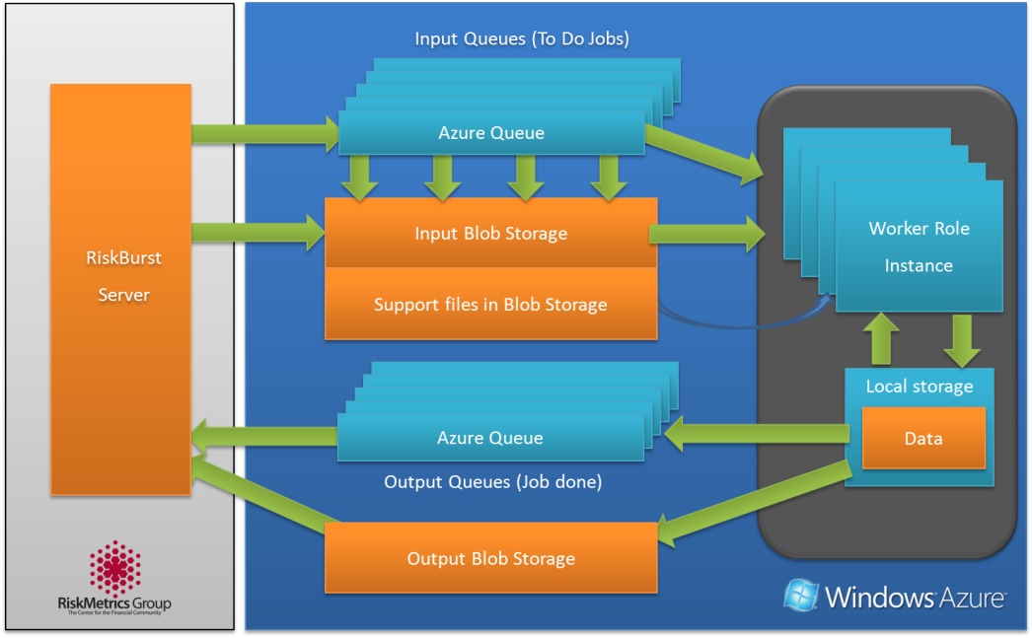
High Performance Compute
Context
  RiskMetrics Group
  Complex Monte Carlo simulations to calculate financial risks
  Daily risk analysis load equivalent to processing 4 trillion US Stocks
  Existing on-premise HPC implementation
Implementation
  Massively scalable compute leveraging cloud capacity
  Deployed on 2K Windows Azure instances; 10K+ planned in 2010
  Windows Azure Worker Role
  Windows Azure Blob and Queue
  AppFabric Service Bus

Slide 17
Hybrid Cloud Applications
Development Principles
Apply appropriate decomposition
Cloud-optimized design and implementation
Data and storage-driven design (e.g., keeping processes local to dependent data)
Account for environmental constraints (e.g., network latency, data locality, performance, security, etc.)
Application integration considerations
Dependent on application profiles and specific requirements

Slide 18
Hybrid Cloud Applications
Application Patterns
Hybrid Enterprise Application
Integrated Cloud Storage
Global Data Synchronization
Composite Applications
Cloud-based Application Messaging

Slide 19

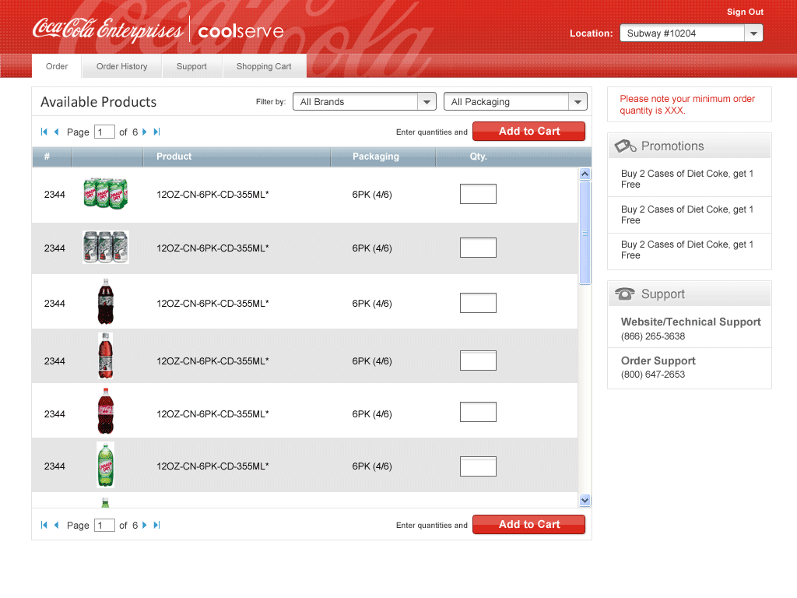
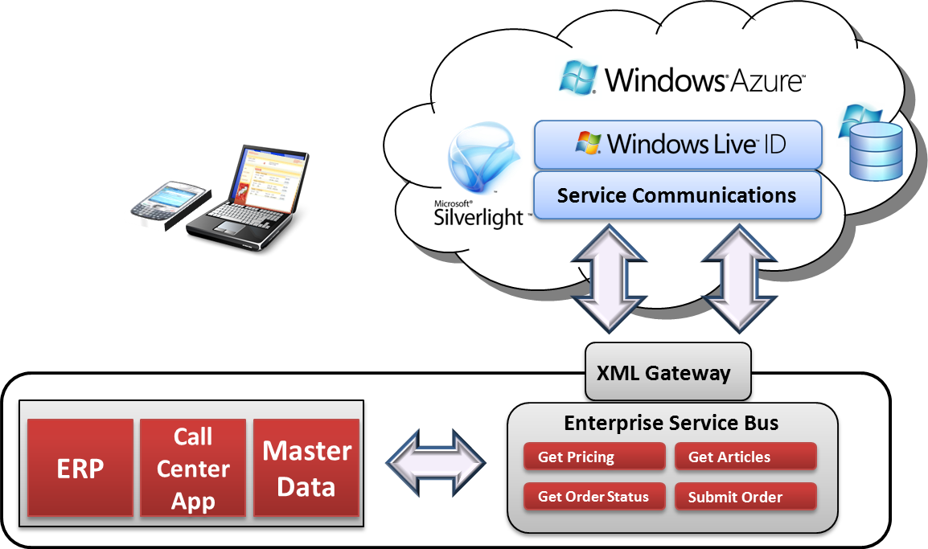
Hybrid Enterprise Application
Context
  Coca-Cola Enterprises
  An SAP on-premise instance which holds all the actual order history data, plus 2 enterprise LOB apps handling pricing, targeted promotions, & delivery schedules
  ~1 million customers worldwide
Implementation
  Cloud-based Web-enablement of on-premise assets
  Windows Azure Web Role (20) + Silverlight
  Web services integration via on-premise ESB endpoints

Slide 20

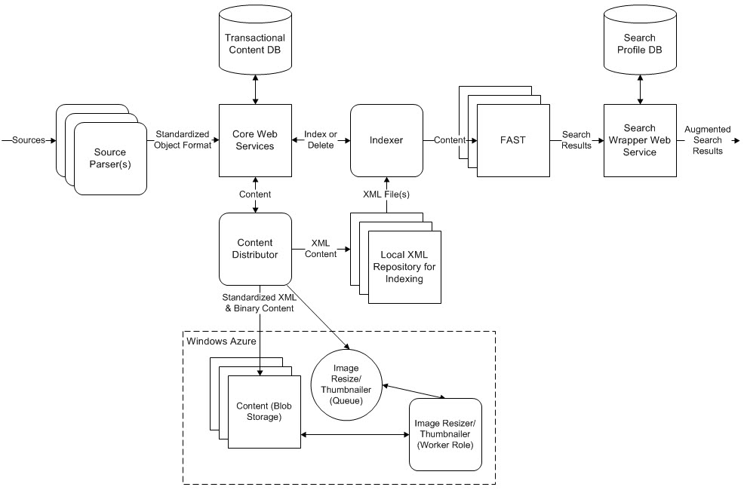
Integrated Cloud Storage
Context
  Tribune Company
  100GB editorial content / day
  100TB net growth annually
  >8TB at each of 23 TV stations / year
  32 data centers, 4K servers
  25 / 162 years of historical content digitized
Implementation
  10-20 Worker Roles creating thumbnails (~15 / photo) and placed in Blob Storage
  Integrated with FAST Search Server
  Integrated with on-premises processes
  Plans to implement Windows Azure CDN

Slide 21

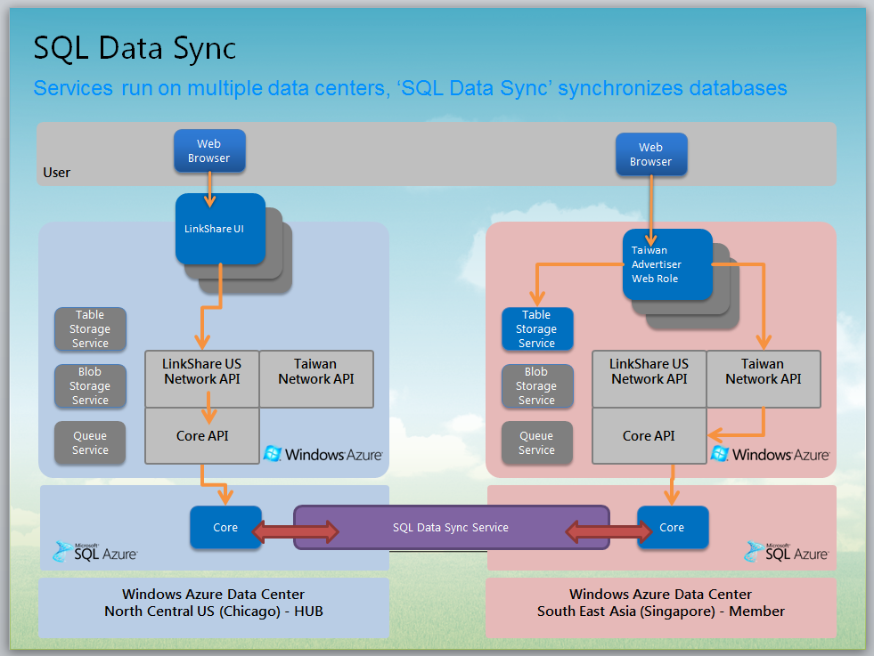
Global Data Synchronization
Context
  LinkShare Corporation
  Need to scale its ad management application to handle billions of online ad impressions during peak holiday traffic
  Need to support a global ecommerce business platform
  100GB / month projected data growth
Implementation
  ASP.NET Web Roles for websites
  Worker Roles asynchronously handle back-end processing of incoming data
  Raw data in Windows Azure Table Storage
  Relational data in SQL Azure
  SQL Azure Data Sync used to synchronize globally distributed databases, including on-premises SQL Server instances

Slide 22
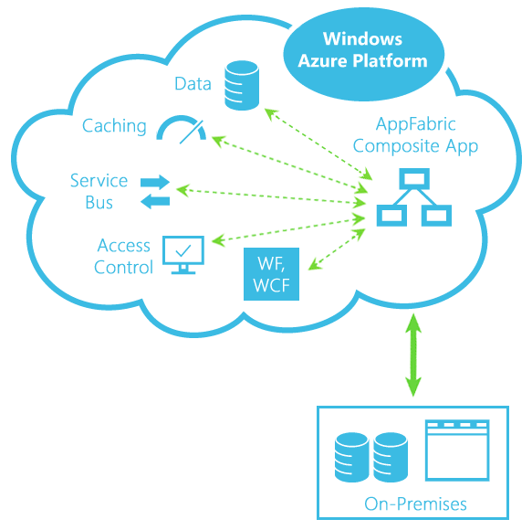
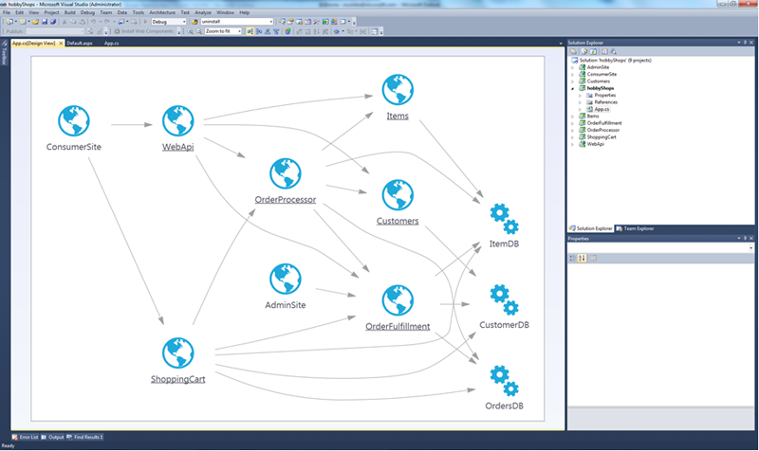
Composite Applications
Combination of on-premises and cloud-based application components and services
Examples
  Windows Azure AppFabric
  SharePoint and Windows Azure
  Applications leveraging cloud-based service APIs

Slide 23
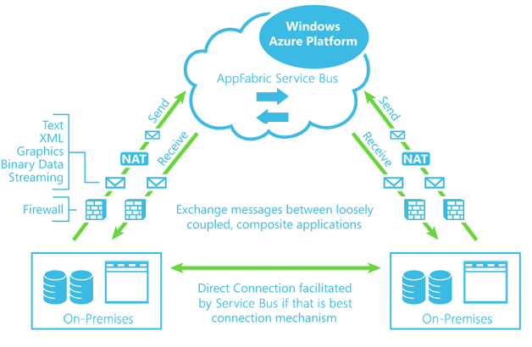
Cloud-based Application Messaging
Cloud eventing pattern
  Asynchronous messaging
  Event-driven architecture
    On-premises and cloud
    Cloud and cloud
    Loosely coupled clients & servers
Leverages cloud-based message queues
  Windows Azure AppFabric Service Bus
  Windows Azure Storage Queue Service

Slide 24
Cloud Integration
ADFS2
Security
AppFabric Access Control
BizTalk
Integration
AppFabric Integration
AppFabric Service Bus
SQL Server
Data
SQL Azure Data Sync
.NET WCF
Compute
.NET WCF
Storage
Queue Storage
Table Storage
Blob Storage
Networking
Connect

Slide 25
Summary
Hybrid cloud infrastructure
  Application deployment model
  Capacity planning and cost allocation
  Reuse existing workloads
  Aligns with infrastructure cloud services
Hybrid cloud applications
  Application development model
  Leverage cloud-optimized capabilities
  Integration via multiple layers (application, data, security, network)
  Aligns with platform cloud services

Slide 26
Next Steps
Federated Clouds
  Multiple clouds – private, public, community, etc.
  Focus on integration and interoperability (development model), not portability (deployment model)
Federated Applications
  Combination of applications and services from multiple organizations
Cloud Ecosystems
  Ecosystems of applications and services, regardless of deployment topologies

Slide 27
ARC Track Resources
http://www.microsoft.com/visualstudio
http://www.microsoft.com/visualstudio/en-us/lightswitch
http://www.microsoft.com/expression/
http://blogs.msdn.com/b/somasegar/
http://blogs.msdn.com/b/bharry/
http://www.microsoft.com/sqlserver/en/us/default.aspx
http://www.facebook.com/visualstudio

Slide 28





Resources
  Connect. Share. Discuss.
http://northamerica.msteched.com
Learning
  Sessions On-Demand & Community
  Microsoft Certification & Training Resources
www.microsoft.com/teched
www.microsoft.com/learning
  Resources for IT Professionals
  Resources for Developers
http://microsoft.com/technet
http://microsoft.com/msdn

Slide 29












Complete an evaluation on CommNet and
enter to win!

Slide 30


Slide 31

© 2011 Microsoft Corporation. All rights reserved. Microsoft, Windows, Windows Vista and other product names are or may be registered trademarks and/or trademarks in the U.S. and/or other countries.
The information herein is for informational purposes only and represents the current view of Microsoft Corporation as of the date of this presentation. Because Microsoft must respond to changing market conditions, it should not be interpreted to be a commitment
on the part of Microsoft, and Microsoft cannot guarantee the accuracy of any information provided after the date of this presentation. MICROSOFT MAKES NO WARRANTIES, EXPRESS, IMPLIED OR STATUTORY, AS TO THE INFORMATION IN THIS PRESENTATION.

