Slide 1

Archiving and Discovery in Microsoft Exchange 2010 SP1 and
Exchange Online
EXL302
Krish Sundaresan
Program Manager
Microsoft Corp

Slide 2



Archiving and Compliance
Storage Management
Balance mailbox size demands with available storage resources
Reduce the proliferation of .PST files stored outside of IT control
Improve overall application and network performance
Data Retention
Meet industry and regulatory e-mail data retention requirements
Support ongoing compliance, litigation, or personnel matters
Preserve valuable intellectual property and corporate assets
Discovery
Respond to strict timelines for legal discovery orders
Reduce costs involved in searching for and retrieving e-mail data
Report on e-mail communications as part of auditing procedures

Slide 3
Archiving and Compliance Roadmap
World Today
Archive enabled applications
Discovery, Policy, Reporting
Federated Discovery, Policy, Reporting
Exchange
External Repository
Exchange
SharePoint
IMs
Other…
SharePoint
Give customers a choice by making the application
archive enabled In-place archiving
Application provides APIs for federation
Federation built by Microsoft and partners.

Slide 4

Archive & Discovery in Exchange 2010 SP1
Integrated e-mail archiving capabilities offer tools to preserve and discover e-mail data, without changing the user or IT professional experience
Preserve
Discover
Personal Archive
Policy
Multi-Mailbox Search
Secondary mailbox with separate quota
Can be on different database from primary
Appears in Outlook (’07, ‘10) & OWA
Managed through EMC or PowerShell
Direct PST Import into Archive
Admin Delegation
EWS Support
Move/Delete Policy
Hold Policy
Audit Policy
Web-based UI
Search primary, archive, and recoverable items
Role based access
Search Preview
De-duplication
Annotations
Search & Destroy
Auditing
Automated and time-based criteria
Set policies at item or folder level
Managed through EMC or PowerShell
EWS Support
Capture deletes & edits
Offer single item restore
Notify user on hold
Auto primary to archive dumpster transfer
Managed through EMC, ECP and PowerShell
Configuration Audit logged to regular mailbox
Mailbox & discovery audit
Reporting and export

Slide 5
Archive: Office 365 Deployment Scenarios
Standalone Remote Archive
Fully Hosted Cloud Primary + Archive
Primary
Archive
Primary
Archive
Cloud
On-Premises
On-Premises
Cloud
Cross-premises Rich Co-Existence
Primary
Primary
Archive
Archive
On-Premises
Cloud
*All these deployment scenarios requires E14 SP1 On-Premises

Slide 6
Personal Archive
IW and IT Pro Experience

Slide 7
Personal Archive: Overview
End User
  Builds on and improves the PST experience
  Seamless end-user workflow for accessing, searching, operating on mail items in archive
  Archive mailbox access is online only.
  May use policy to automate moving items to archive based on age.
  On-Premises vs. Cloud is transparent to the user.
IT Pro
  Builds on mailbox, so same management experience as primary
  Archive always associated with a user who has a primary mailbox
  At most one archive per user
  Similar management experience across On-Premises and Cloud

Slide 8
Configure and Access Archive
demo

Slide 9
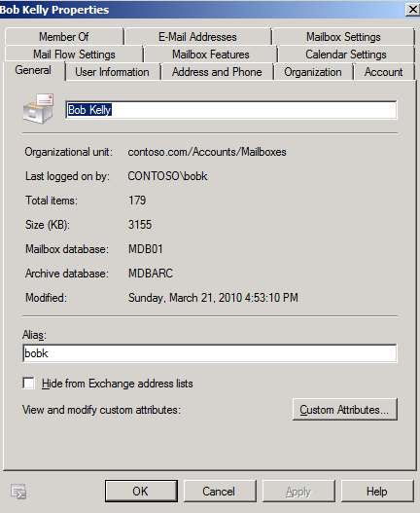
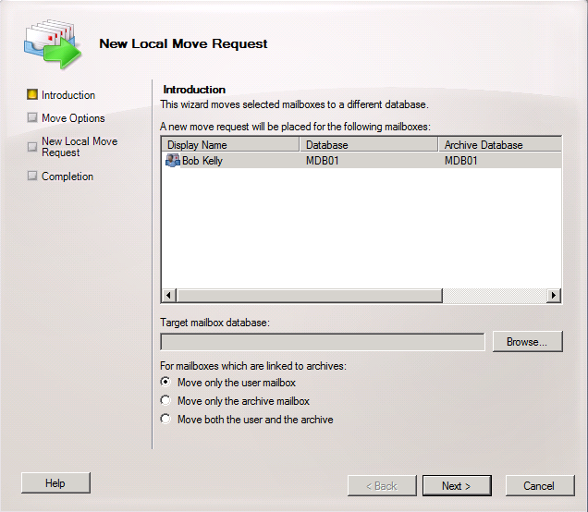

Archive : Support for Tiered Storage
SP1
Primary & archive can be on same or different databases
  Supports both homogenous and differentiated storage models
  Exchange Online betting on homogenous storage model in the datacenter
Allows for different storage hardware DAGs, RPOs, RTOs for primary vs. archive
Archive may be located remotely in Exchange Online.
Storage
  Archive mailbox is cold data
  Primary is recent “hot” data.
    Guidance: provide enough primary mailbox storage to hold ~ 2 years of data

Slide 10
Archives in Office 365
Archiving is a per user feature
Two choices
  Primary + Archive in the cloud
    Setup tenant
    Provision archives per-user
  Standalone Archive
    Setup tenant
    Setup Rich Co-Existence between on-prem and tenant
    Provision archives per-user

Slide 11
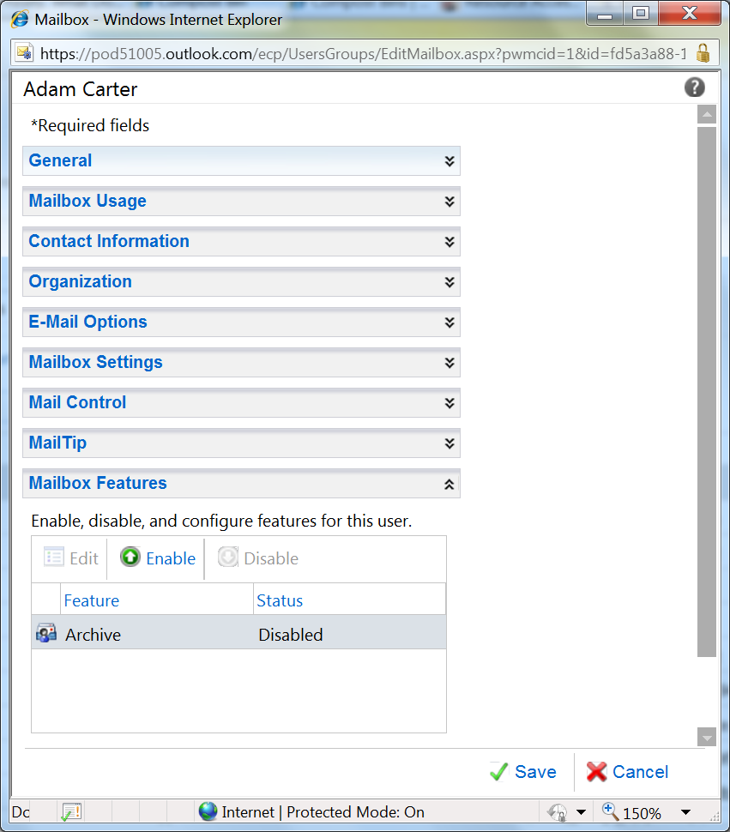
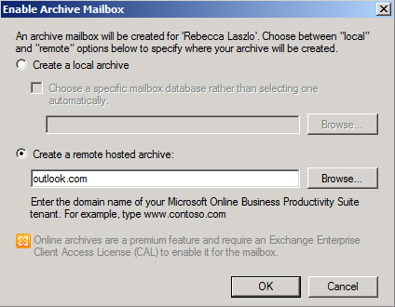
Archive Provisioning Experience in Office 365
For cloud only deployments
For all other deployments
Enable archiving for an Exchange Online user
Create a remote archive for an Exchange Server 2010 mailbox
Create cloud archives for local users
Requires Exchange Server 2010 SP1 on-premises
Manage the archive using the Exchange Management Console
If primary mailbox is later moved to the cloud, archive moves with it
Easily add archiving capabilities for cloud-based users
Manage the archive from the Exchange Control Panel

Slide 12
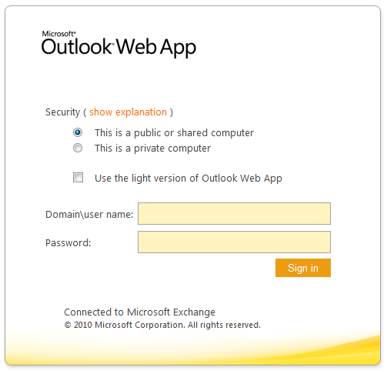
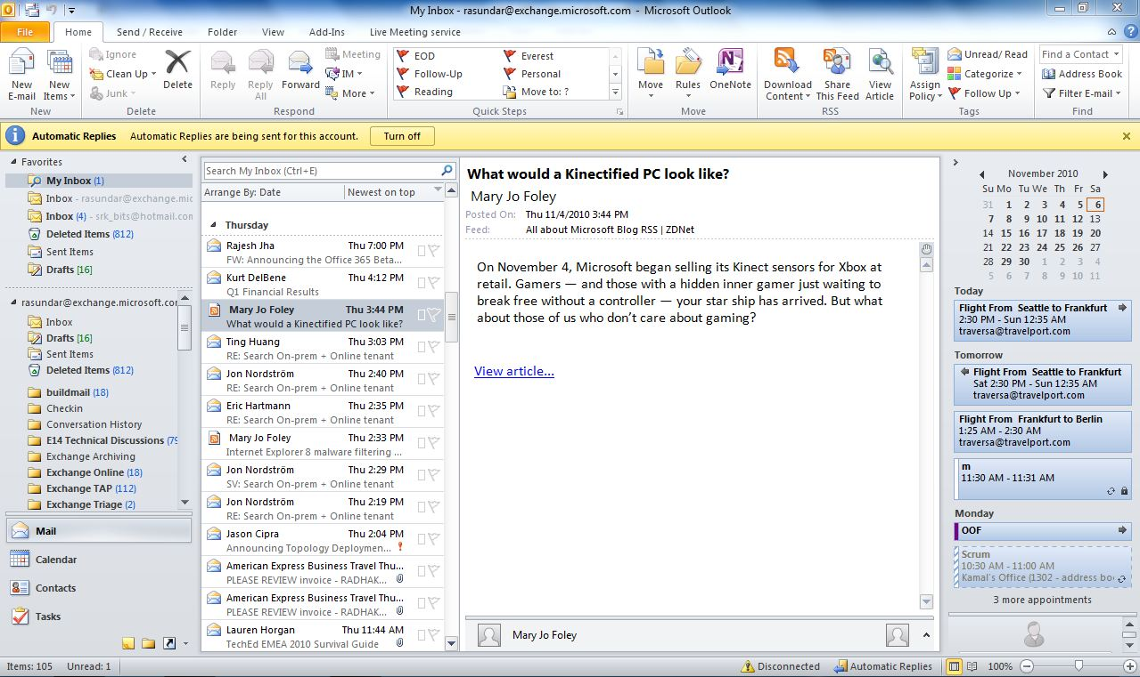
Remote Archive Client Access
Clients should configured to talk to on-prem CAS
Outlook communicates directly with remote archive
OWA relies on on-prem CAS to proxy traffic to remote archive
OWA
CAS
CAS
P
A
Exchange On-Premises
Exchange Online
Outlook

Slide 13
PST Ingestion & Export
SP1
Make it easy to import data into personal archives from non-Exchange data sources
Native support for PST export and import from Exchange
Same job scheduling semantics as mailbox moves
Ability to import directly into the archive
Import to Office 365 in the works
  Workaround: Import using Outlook
New-MailboxImportRequest –Mailbox … -IsArchive

Slide 14
Preserve: Move and DELETE Policy
IW and IT Pro Experience

Slide 15
Preserve: Message Retention
Archive Policy: automatically moves mail to the archive
  End User Impact: Keeps Mailbox under quota
  Like Outlook Auto-Archive – without PSTs!
Delete Policy: automatically deletes mail
  End User Impact: Unwanted mail is removed from view
  End User Impact: Keeps Mailbox under quota
  Delete Policies apply whether in primary or archive
  Per item policies take precedence over folder policies
  Policy properties are preserved so message retention is respected in third party systems.

Slide 16
Preserve: Move and Delete Concepts
Retention Tags
  Name, Action, Time period
  Admin mandated or User applied
    All Items in Inbox are deleted in 3 years
    Items and Folders may have a 2 year Archive Policy
Retention Policies
  Retention tags
  Policies span to groups of users like ‘Accounting’
  User has one policy and many tags applied

Slide 17
Deploying Message Retention Policy
demo

Slide 18
Message Retention V. Managed Folders
Compliance management is a spectrum
  Full IT Admin control to no IT control (End user tool)
Managed folders (Exchange 2007)
  Addresses only one end of the spectrum
  Very little end user flexibility
Message Retention (Exchange 2010)
  Addresses both ends on the spectrum
    Framework for IT admins to associate policy with mailboxes and system folders
    Framework for end users to optionally associate policy with their folders and mail items

Slide 19
Talk about policy precedence
Archive policy and delete policy are orthogonal
Delete policy stamped in mail item will be preserved when moved to archive
Precedence rule:
  Policy tag that is closest scope to a mail item wins

Slide 20
MRM Mailbox Assistant
MRM Scheduling is a Mailbox Assistant
  Runs as a background process to crawl mailboxes and take action on “expired” mail items
  Assistant name is ManagedFolderAssistant
Exchange 2010 RTM
  Specify a start and end time and frequency
  If unable to process mail items within said time, will resume on next cycle
  Can result in processing being forever behind
Exchange 2010 SP1
  Specify how often to run assistant (in days/hours…)
  Assistant runs in background, throttled to not compete with critical mailbox server resources
  Will continue to run till all mailboxes are processed
  In Office 365 cycle is 7 days
Caveat:
  The MRM Mailbox Assistant also enforces dumpster cleanup and single item recovery.

Slide 21
Preserve: Migrating Policy to Cloud
Migrating Primary mailboxes to cloud:
  MRM policy not automatically migrated or synced
  Scripts shipped to automate migration and sync*
    Export-RetentionTags.ps1
    Import-RetentionTags.ps1
Not required for pure archive in the cloud case.
Export
Import
Export-RetentionTags.ps1
Import-RetentionTags.ps1
.xml
MRM Policy
P
A
P
A
On-Premises
Cloud
    *Location: %Program Files%\Microsoft\Exchange Server\V14\Scripts

Slide 22
Preserve: Hold Policy
Legal Hold, Single Item Recovery and the Dumpster

Slide 23
Preserve: Legal Hold
Overview
Preserve items for recovery and discovery for an finite or indefinite period of time without impacting end user experience
Captures all edits/deletes on a mailbox (user/admin or by delete policy)
User workflow is unchanged, items captured in hidden folders in Dumpster 2.0.
Both Primary & archive mailboxes have dumpsters
Multi-mailbox search can retrieve items indexed in Dumpster 2.0.
Users may receive notification they are on hold; eliminates manual process.
No end-user impact

Slide 24
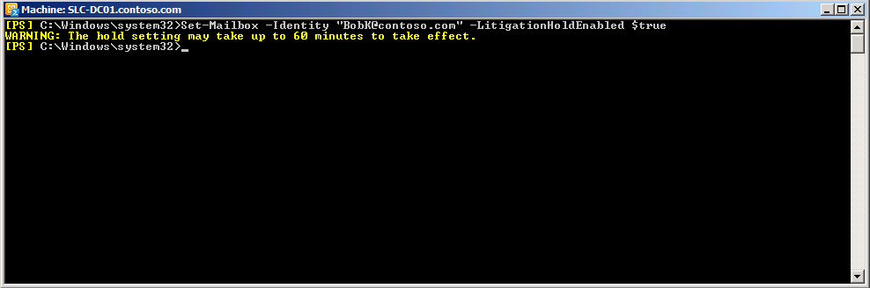
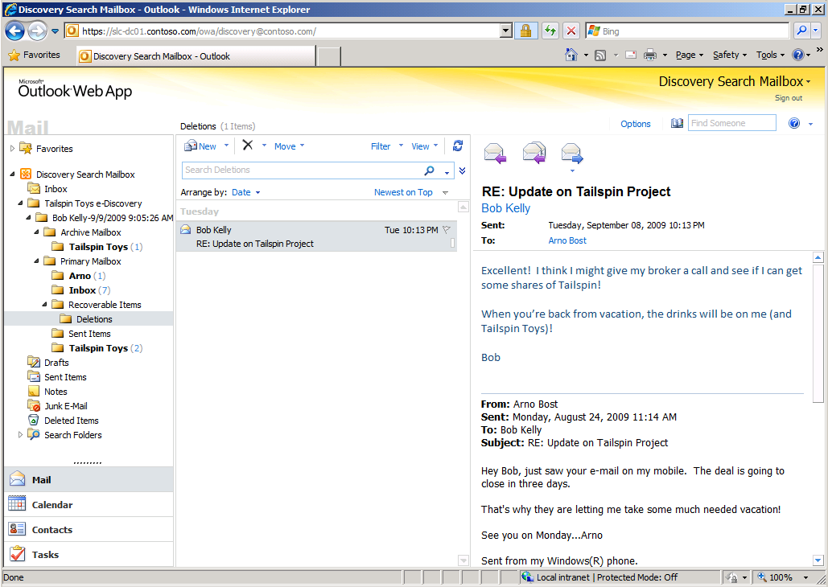
Preserve: Legal Hold
Configuration
Set legal hold to capture all changes indefinitely
Captured e-mail data found in multi-mailbox search results
                Provides separate settings to enable single item restore
                Optional alert message for users with Outlook 2010 and OWA

Slide 25
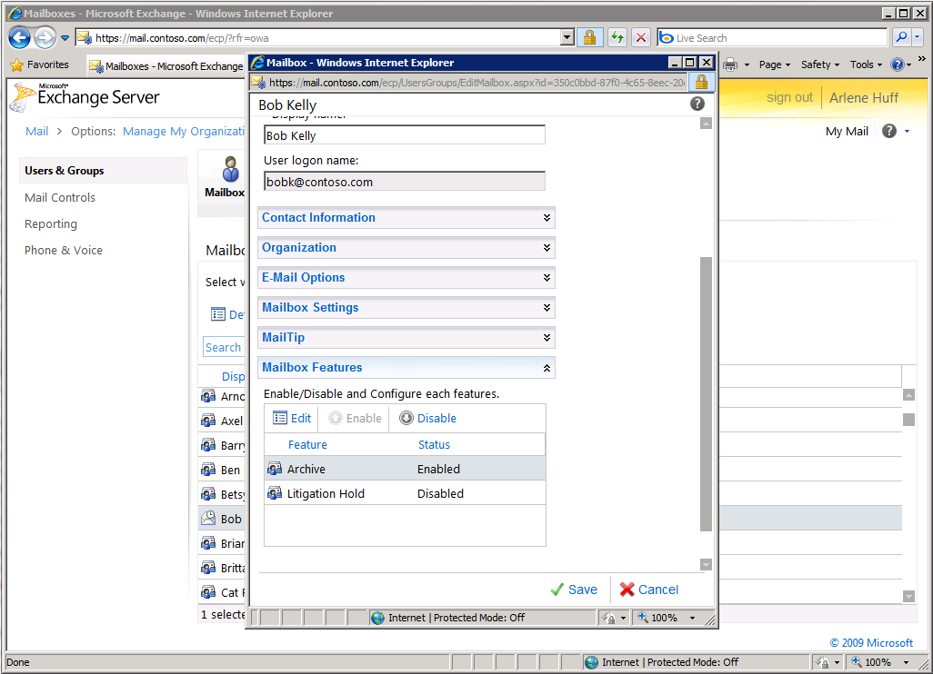
Legal Hold ECP Config in SP1

Slide 26
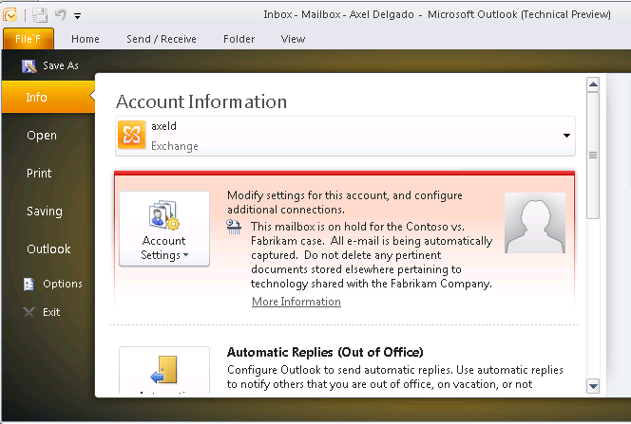
Preserve: Hold Policy
IW Experience
IW is told how to comply (no action needed for e-mail)
URL links to additional info

Slide 27
Single Item Recovery & Fixed Retention
Fixed Retention: The ability to preserve user data for a rolling window of time that overrides user actions
Can be achieved using Single Item Recovery (SIR)
SIR captures all edits and stores them for the specified time period
> Set-Mailbox -Identity bobk -SingleItemRecoveryEnabled $true
Off by default on-premises
On by default in the datacenter with a default window of 14 days.
Datacenter admin can change retention window per-tenant

Slide 28
Single Item Recovery & Fixed Retention
demo

Slide 29
Preserve: 2010 Hold Message Flow
Hold Period of 10 years
(1) Message delivered
Primary Mailbox
Inbox
(2) Message Edited/Deleted
…
Deleted Items
(3) Message Permanently Deleted
Dumpster 2.0
Recoverable Items
(5) Message removed from system after Hold Period (10 years)
(4) Message “purged” by user
Edits
Purges

Slide 30
Discover: Multi-Mailbox Search
Discovery Console in ECP and PowerShell search

Slide 31
Discover: Multi-Mailbox Search
Goals and Assumptions
  Performs distributed search across end user mailboxes located on multiple servers.
  Search is throttled and parallelized
  Results are copied to discovery mailbox after search
  Admins by default do not have access to search all mailboxes, specific RBAC Discovery Role is required
  Partners: Enable web services access to the multi-mailbox search for partners to build discovery solutions.

Slide 32
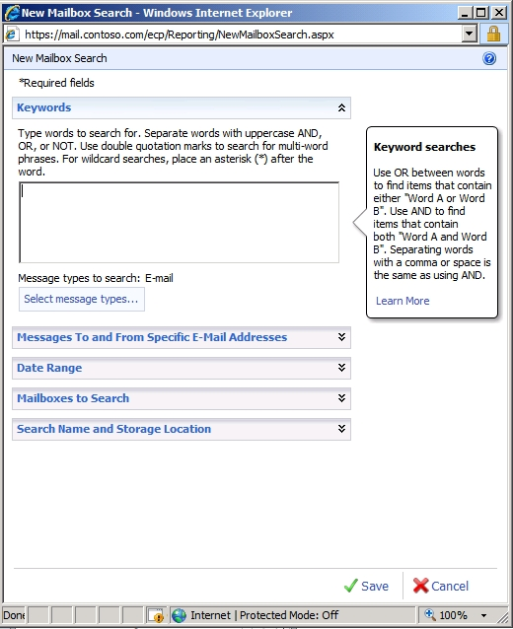
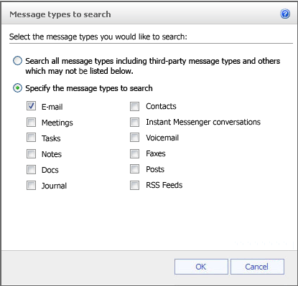
Multi-Mailbox Search
Simple, role-based GUI
Delegate
access to search
to HR, compliance, legal manager
Search all
mail items (email, IM, contacts, calendar) across primary mailbox, archives
Filtering includes: sender, receiver, expiry policy, message size, sent/receive date, cc/bcc, regular expressions, IRM protected items

Slide 33
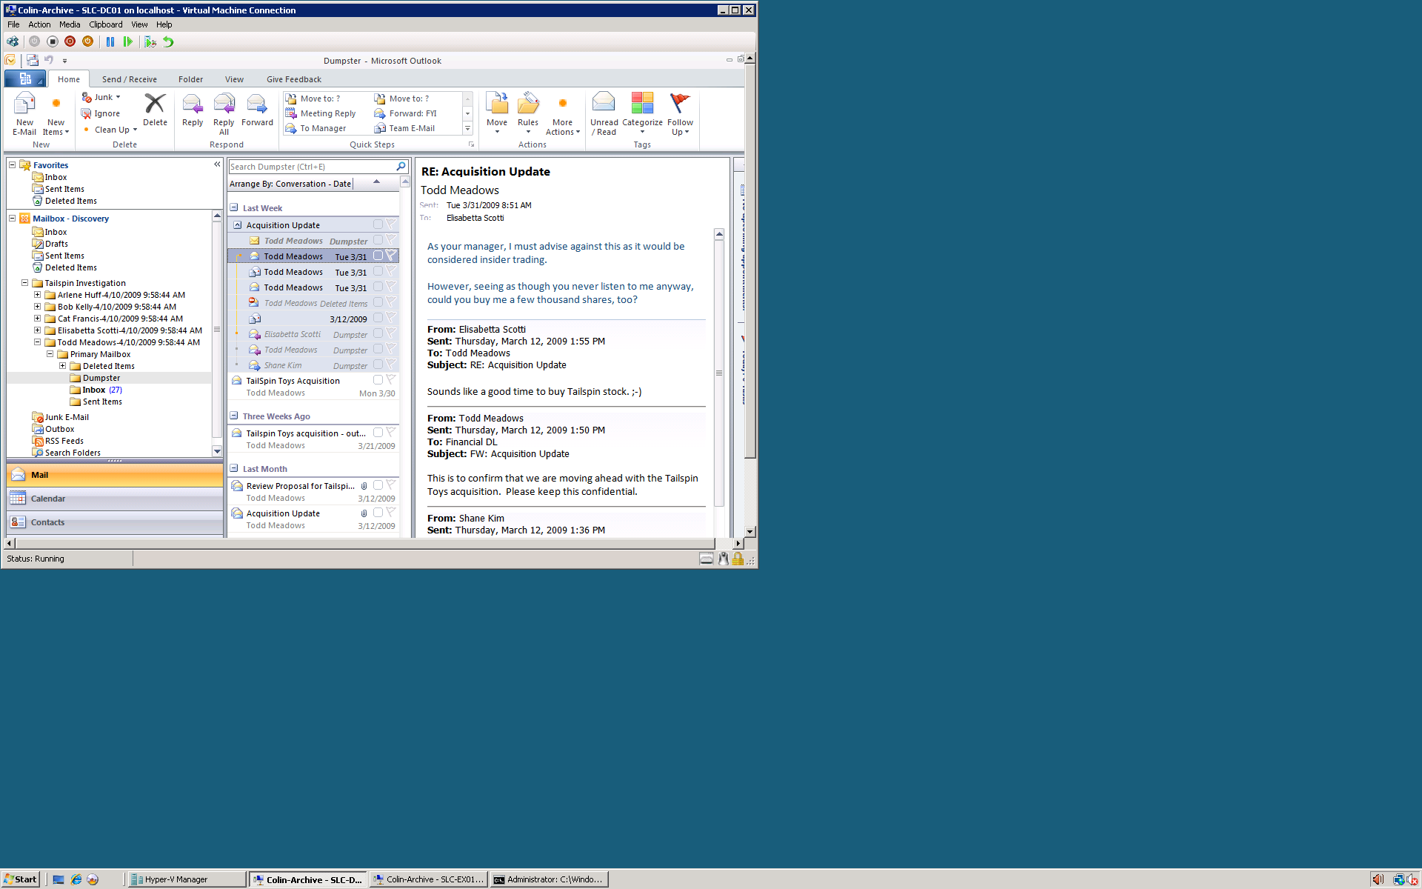
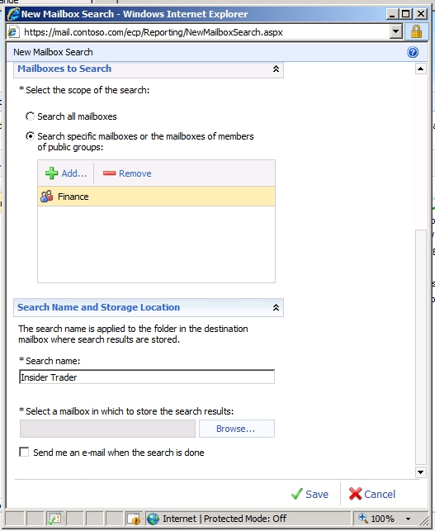
Multi-Mailbox Search
Additional eDiscovery features
Search specific mailboxes or DLS
Export search results to a mailbox or SMTP address
Search results organized per original hierarchy
Request email alert when search is complete
API enables 3rd tool integration with query results for processing

Slide 34
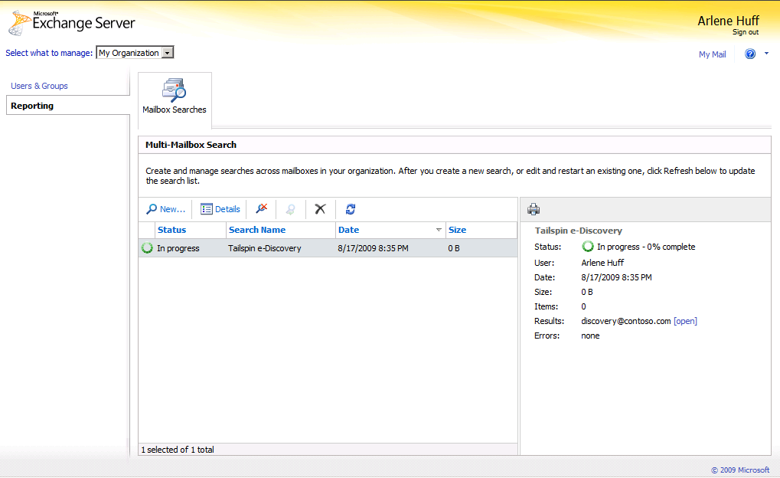
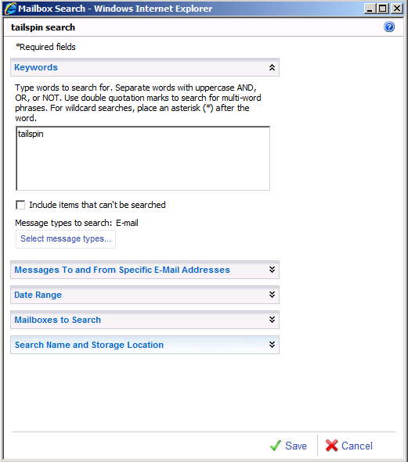
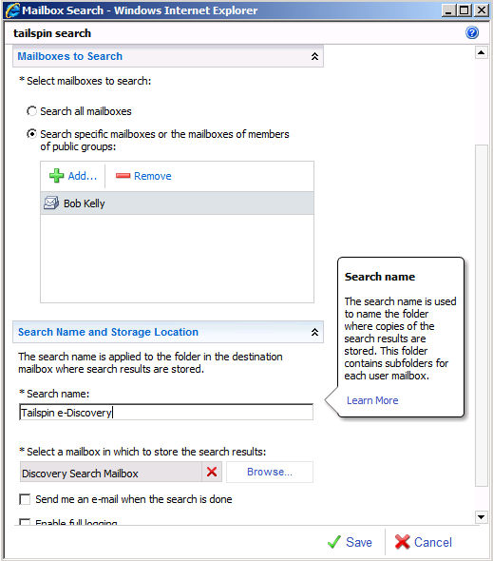
SP1: Multi-Mailbox Search
Empower compliance officers to conduct multi-mailbox searches with ease
Delegate capability to specialist users
Rich search criteria and targeting options
Results stored in specialized discovery mailbox

Slide 35
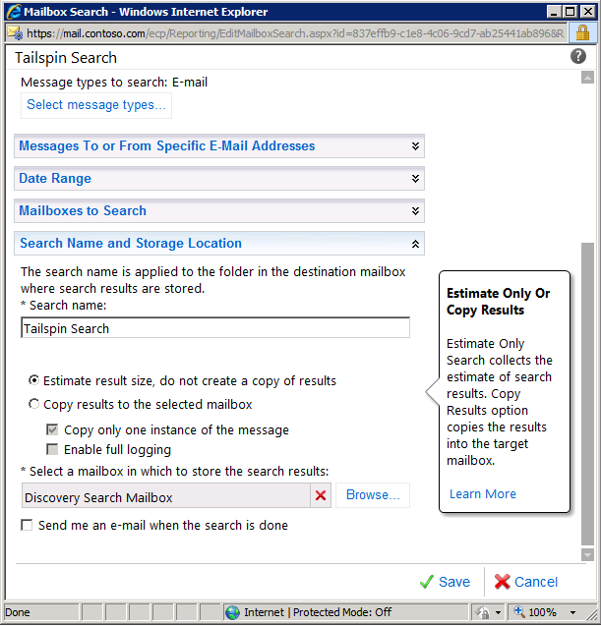
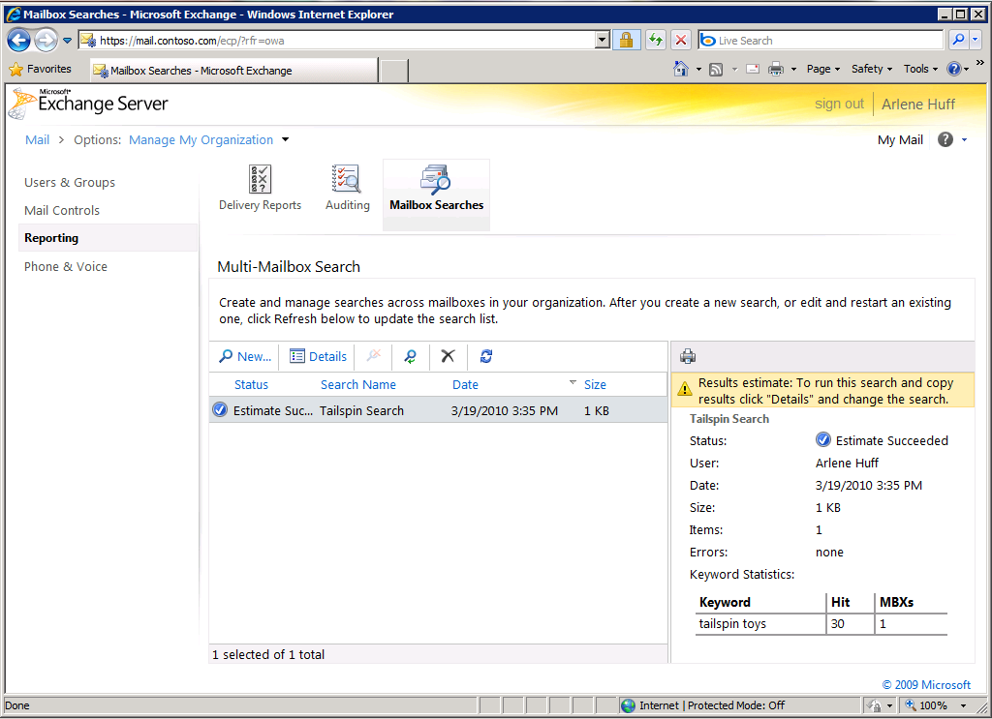
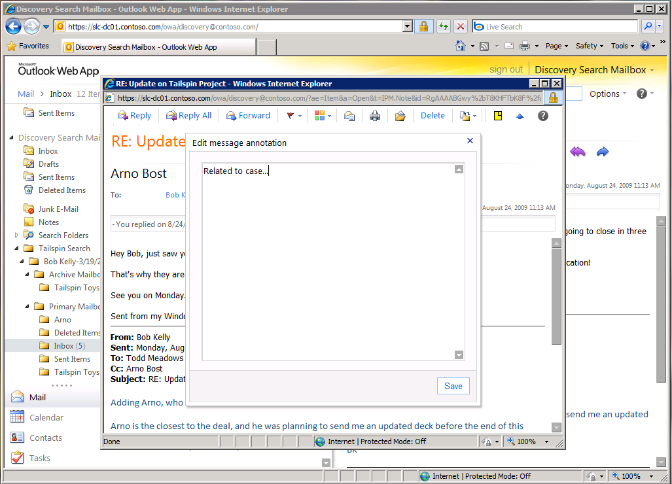
Improved Workflow in SP1
Search preview provides info on estimated number of results with keyword statistics before copying result set to designed discovery mailbox
De-duplication of search results copies only one instance of a message
Searchable annotation offers tagging of reviewed items

Slide 36
Discover: On-Premises Vs.
Cloud Discovery Search
Provide a single org-wide discovery console across on-premises and cloud

Slide 37
Auditing & Reporting
Configuration Audit and Mailbox Audit

Slide 38
Auditing
Compliance Configuration
All the configuration changes made by the administrators from any of the UIs
Was litigation hold ever removed from this mailbox?
Who has been running Discovery searches?
What was the old value of retention period?
Mailbox
Mailbox data access actions performed by Administrators/Delegates/Owners
Who is reading my emails?
Who really sent that e-mail

Slide 39

Audit: Configuration Audit
Configured per tenant organization
  Set-AdminAuditConfig
Logged to tenant arbitration mailbox
Results can be searched/exported using
  Search-AdminAuditLog
  New-AdminAuditLogSearch
  ECP UI
Default retention of 90 days
  Set-AdminAuditLogConfig -AdminAuditLogAgeLimit

Slide 40
Audit: Mailbox Audit
Configure per mailbox using set-mailbox
  Admin
  Delegate
  Owner
Logged to special Audit folder in user mailbox
Results can be searched/exported using
  Search-MailboxAuditLog
  New-MailboxAuditLogSearch
  ECP UI

Slide 41
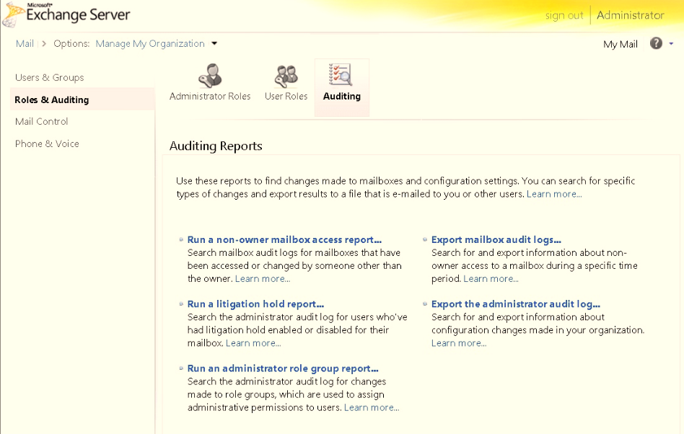
Audit: Reports in ECP UI

Slide 42
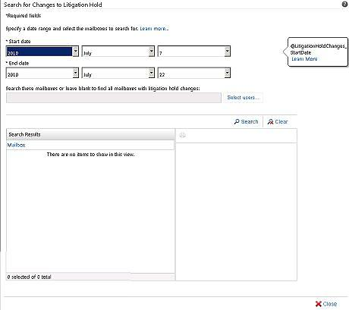
Audit: Litigation Hold report

Slide 43
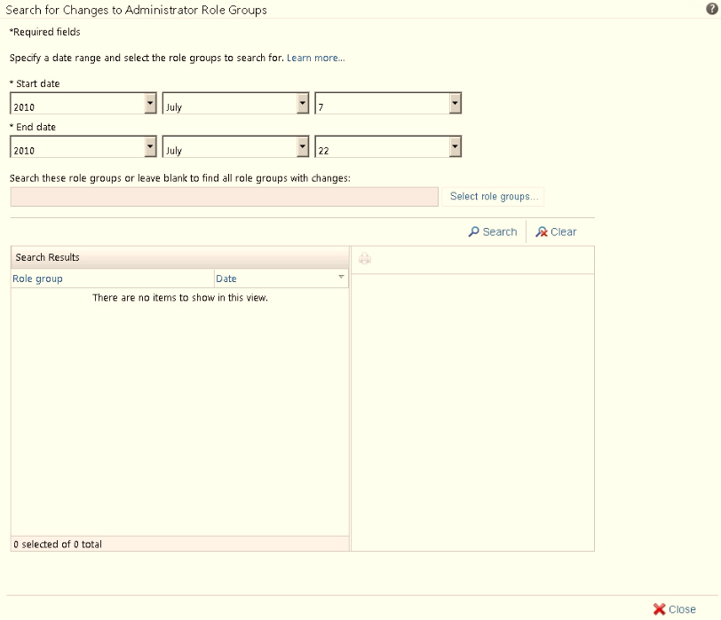
Audit: Role Group change

Slide 44
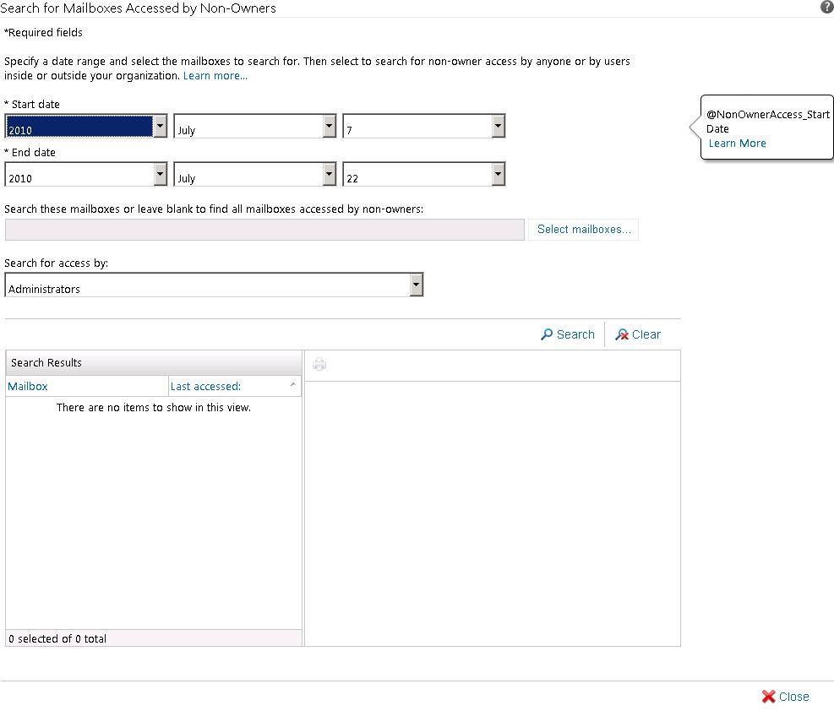
Audit: Non Owner access

Slide 45
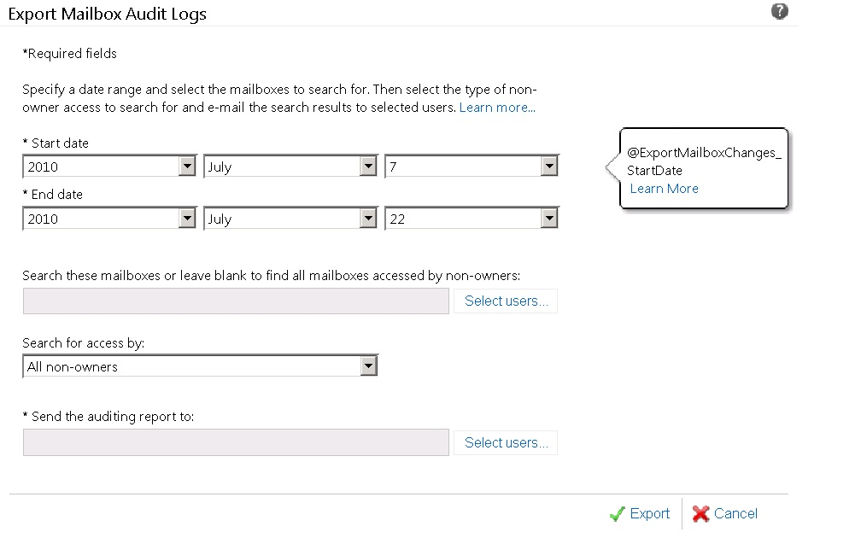
Audit Export: Mailbox access

Slide 46
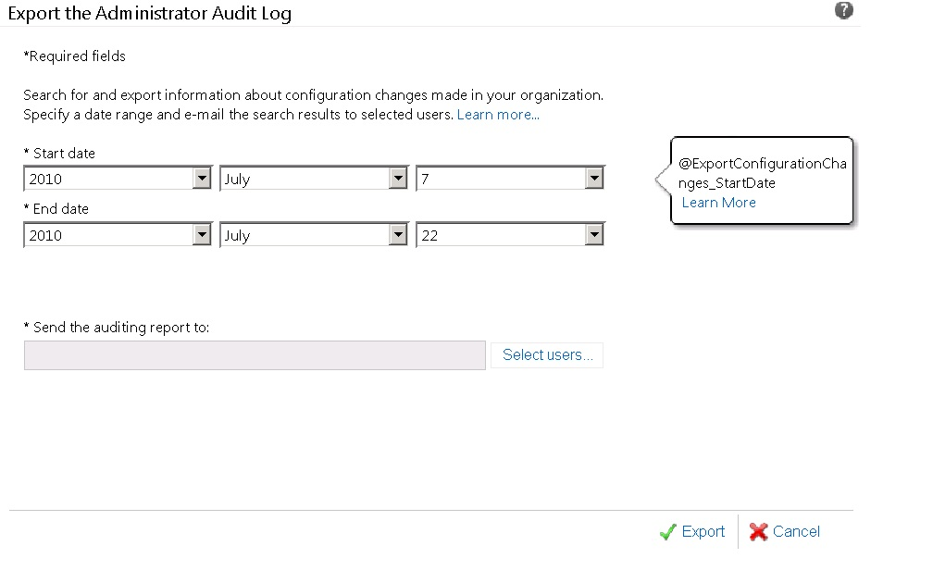
Audit Export: Configuration

Slide 47
Configuration Auditing
demo

Slide 48
Related Content
Required Slide
Speakers, please list the Breakout Sessions, Interactive Discussions, Labs, Demo Stations and Certification Exam that relate to your session. Also indicate when they can find you staffing in the TLC.
Breakout Sessions
EXL311: Microsoft Exchange Server & Office 365: How to set up Hybrid deployment
EXL375-INT: Understanding Archiving & Compliance in Exchange Online
EXL383-HOL: Exchange Compliance, Archiving & Retention
Find Me Later At…
  rasundar@microsoft.com

Slide 49





Resources
  Connect. Share. Discuss.
http://northamerica.msteched.com
Learning
  Sessions On-Demand & Community
  Microsoft Certification & Training Resources
www.microsoft.com/teched
www.microsoft.com/learning
  Resources for IT Professionals
  Resources for Developers
http://microsoft.com/technet
http://microsoft.com/msdn

Slide 50












Complete an evaluation on CommNet and
enter to win!

Slide 51


Slide 52

© 2011 Microsoft Corporation. All rights reserved. Microsoft, Windows, Windows Vista and other product names are or may be registered trademarks and/or trademarks in the U.S. and/or other countries.
The information herein is for informational purposes only and represents the current view of Microsoft Corporation as of the date of this presentation. Because Microsoft must respond to changing market conditions, it should not be interpreted to be a commitment
on the part of Microsoft, and Microsoft cannot guarantee the accuracy of any information provided after the date of this presentation. MICROSOFT MAKES NO WARRANTIES, EXPRESS, IMPLIED OR STATUTORY, AS TO THE INFORMATION IN THIS PRESENTATION.

