Slide 1

Microsoft Exchange Online in Microsoft Office 365: Simple Migration Live!
EXL310
Ram Poornalingam
Program Manager
Microsoft Corporation

Slide 2
Session Objectives and Takeaways
Session Objective(s):
  Overview of the migration space and the available tools
  Explain and demonstrate Exchange Migration tools in Office 365
    Cut-Over EM
    Staged EM
Key Takeaways
    Office 365 provides out of the box online migrations tool that are simple to use

Slide 3





Deployment Plan
Stages
1. Plan
2. Prepare
3. Migrate
4. Decommission
Read case studies
and documentation
Add and Verify SMTP domains
Configure On Premise
DNS Administration

Slide 4

Deployment Plan
Factors
Size
Identity Management
Hybrid
Large
Medium
Small
On-Premise
Single Sign-On
On-Cloud
Hybrid
No Hybrid
Source Server
Provisioning
DEPLOYMENT PLAN
Migration solution is part of the plan
Exchange
IMAP
Lotus Notes
Google
DirSync
Bulk Provisioning
NSPI Provisioning

Slide 5
Today’s Focus
Deployment Plan
Choices to fit your organization
IMAP migration
  Supports wide range of e-mail platforms
  E-mail only (no calendar, contacts, or tasks)
Cut-Over Exchange migration (C-EM)
  Good for fast, cutover migrations
  No server required on-premises
Staged Exchange migration (S-EM)
  No server required on-premises
  Identity federation with on-premises directory
 | IMAP migration | Exchange migration | Staged migration | Hybrid
Exchange 5.5 | X
Exchange 2000 | X
Exchange 2003 | X | X | X | X
Exchange 2007 | X | X | X | X
Exchange 2010 | X | X |  | X
Notes/Domino | X
GroupWise | X
Other | X
Migration
Hybrid deployment (MRS)
  Manage users on-premises and online
  Enables cross-premises calendaring, smooth migration, and easy off-boarding
Hybrid
* Additional options available with tools from migration partners

Slide 6
How to pick an Exchange migration solution?
MRS
Migration Solutions
S-EM
C-EM
1 150 5,000 25,000
Organizational Size in Users
<1 Week 2 Weeks 3 Weeks Several Months
Time For Migration including Planning
None Mailflow/GalSync Free/Busy, Archive in Cloud
Co-existence

Slide 7
Office 365: Creating Custom Plans (Onboarding Wizard)
Demo

Slide 8
IT Pro Experience
Cutover Exchange Migration (CEM)

Slide 9
Cutover Exchange Migration
Objective
  A simple Exchange migration solution for small and medium businesses to move to Office 365
Capability
No on-premise deployment required
Migration from Exchange Server 2003 and greater
On-premise or hosted systems
Integrated Provisioning
High fidelity migrations - Mail, calendar, tasks and many more
Requirement
  Organization should be less than 1000 in size
  Outlook Anywhere service
  Identity management in the cloud

Slide 10
Deployment Plan
Plan
1. Plan
2. Prepare
3. Migrate
4. Decommission
Read case studies
and documentation
Add and Verify SMTP domains
Configure On Premise
DNS Administration

Slide 11



Plan
Internet
Read a few case studies
Read Documentation on help.outlook.com
Decide when you want to kick-off the migrations
Create the deployment plan

Slide 12
Deployment Plan
Prepare
1. Plan
2. Prepare
3. Migrate
4. Decommission
Read case studies
and documentation
Add and Verify SMTP domains
Configure On Premise
DNS Administration

Slide 13
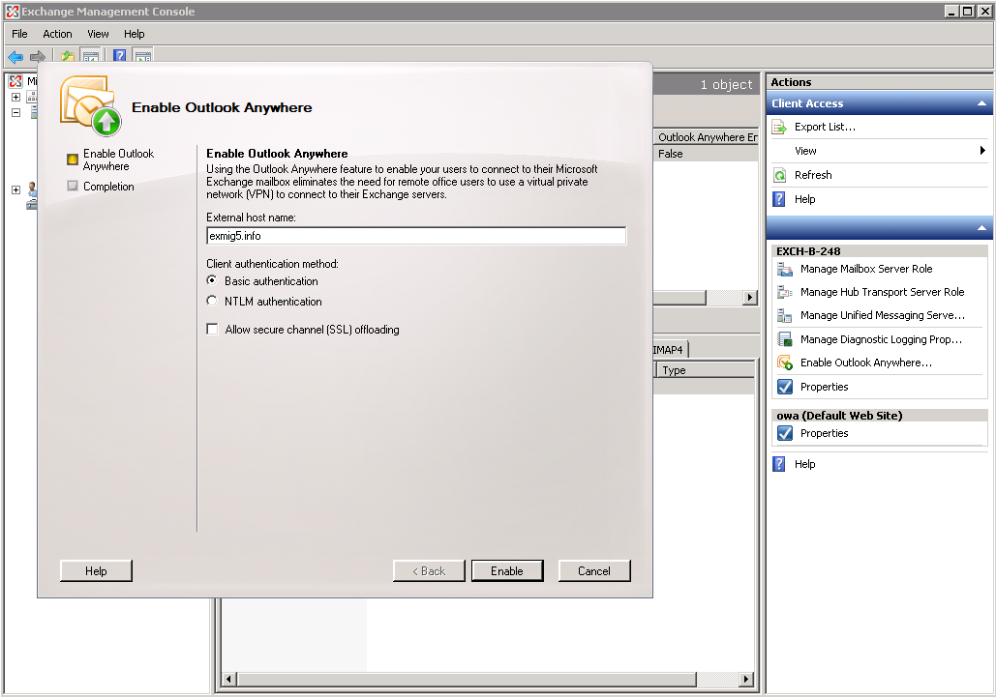
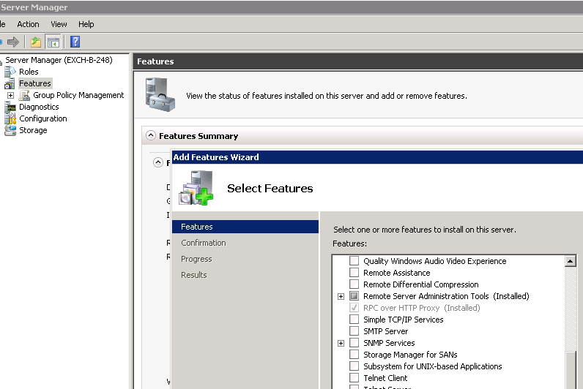
Prepare
Internet
Public third party CA Issued certificate
Enable Outlook Anywhere
Create Migration Admin Mailbox (i.e. migAdmin)
Permissions
  For Hosted Scenarios, give full access to miguser on all the mailboxes to be migrated
  For on-premises, give receive-as access to miguser . This can be done at the DB scope

Slide 14
Deployment Plan
Migrate
1. Plan
2. Prepare
3. Migrate
4. Decommission
Read case studies
and documentation
Add and Verify SMTP domains
Configure On Premise
DNS Administration

Slide 15
Migration Flow
Every 24 hrs
New Migration
Provision users,
groups, mailboxes
etc. through NSPI
Initial Sync
Migrate All Mailboxes
Incremental Sync
Switch User to Cloud
through MX Record
License Users

Slide 16
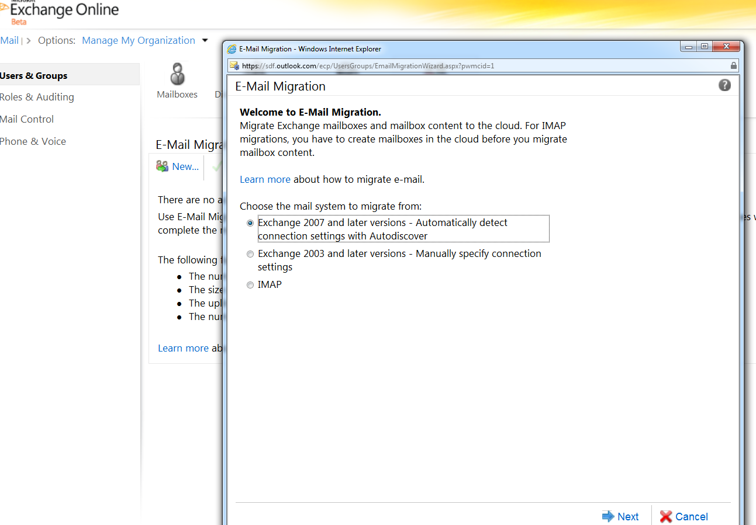
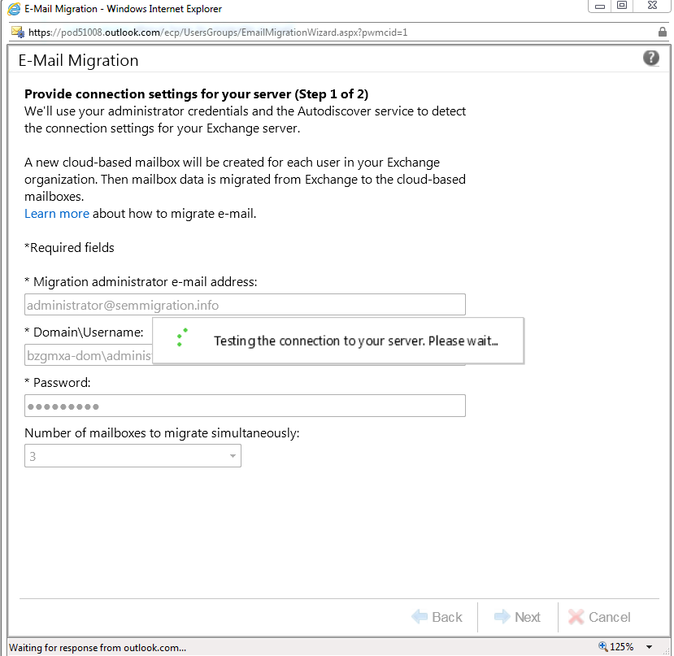
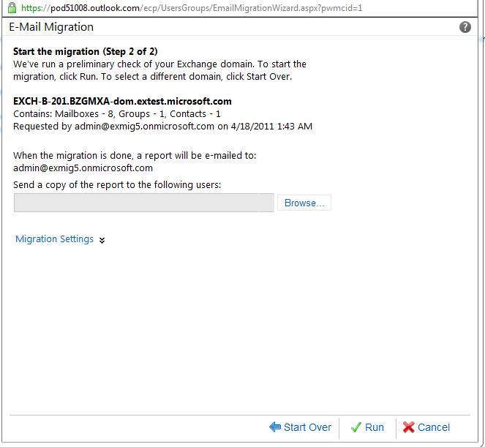
Migration Flow
New Batch
MX Record:
On Premise
Internet
Exchange Online

Slide 17
Migration Flow
Provision
MX Record:
On Premise
Internet
Exchange Online
Create users,
groups, contacts

Slide 18
Migration Flow
Initial Sync
MX Record:
On Premise
Internet
Exchange Online
Initial Sync

Slide 19
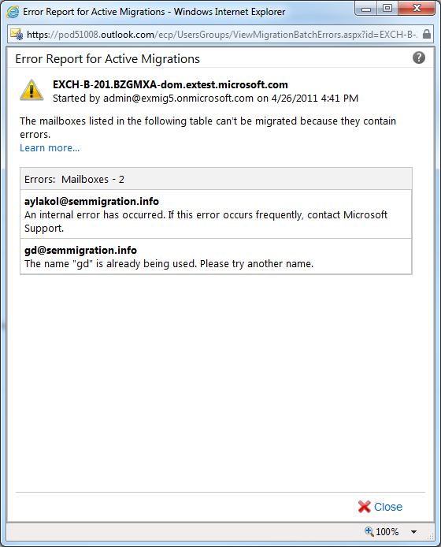
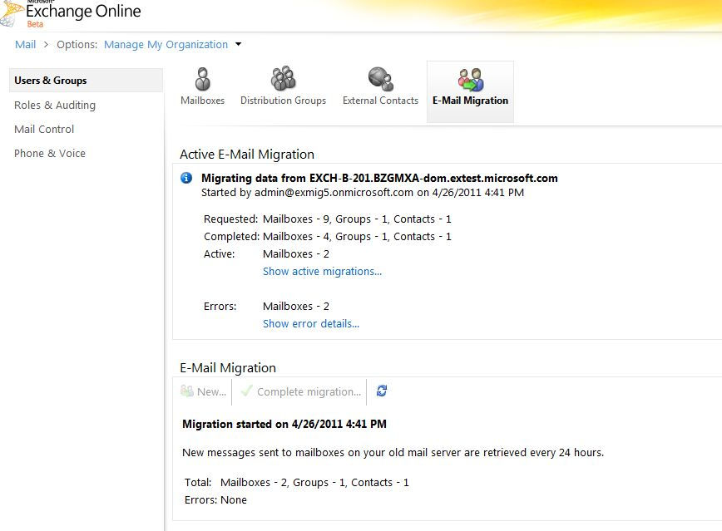
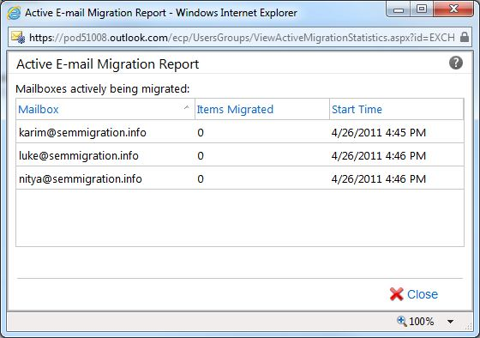
Migration Flow
Get-MigrationBatch
MX Record:
On Premise
Internet
Exchange Online
Initial Sync

Slide 20
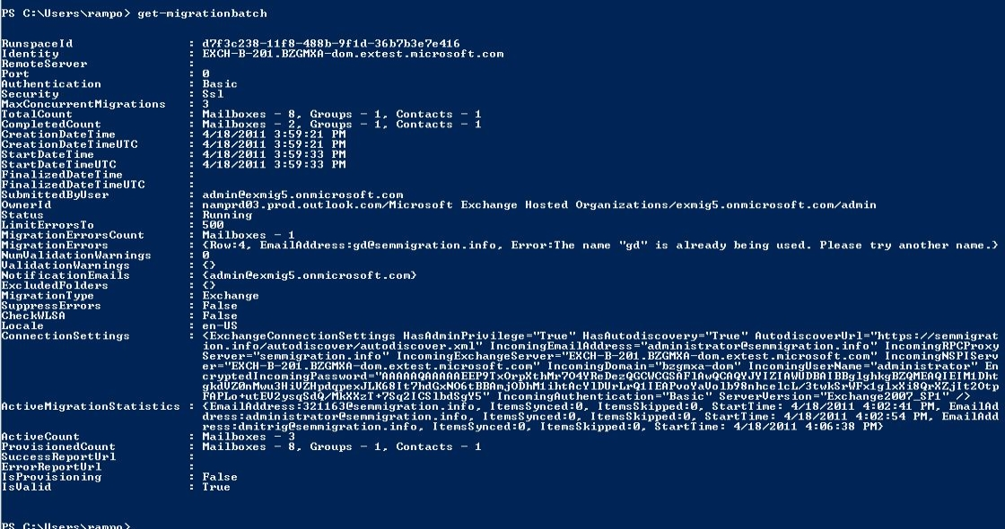
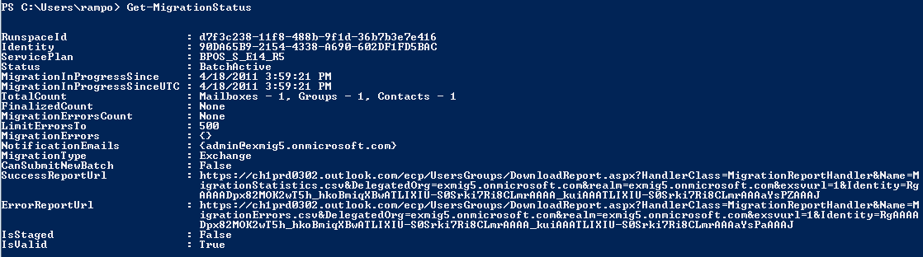
Migration Flow
Get-MigrationBatch

Slide 21
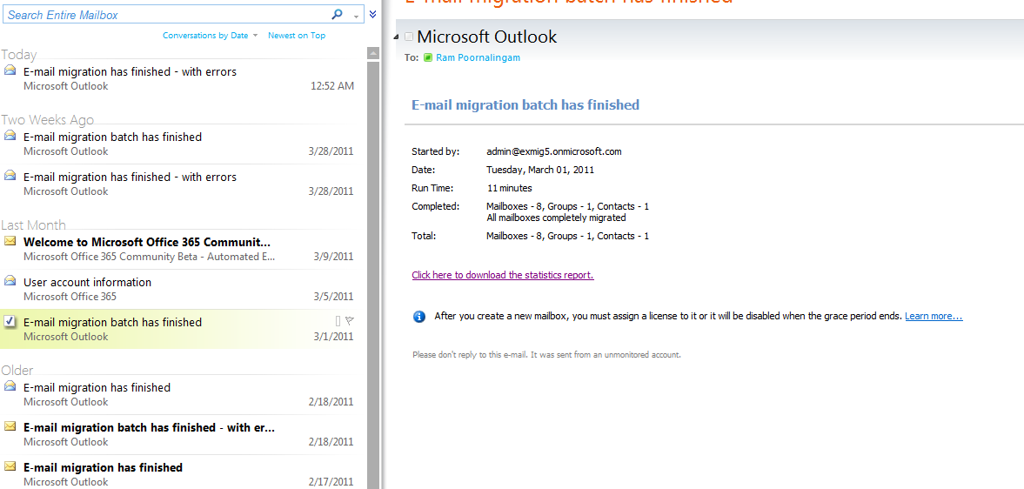
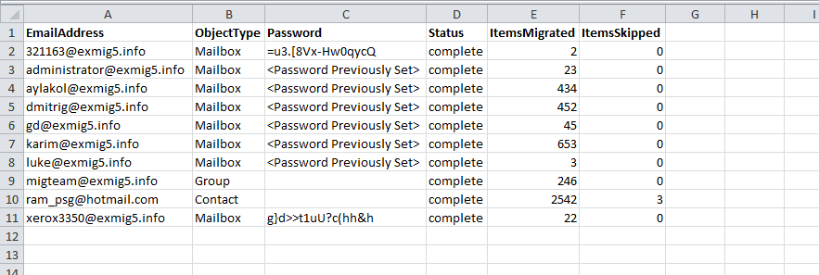
Migration Flow
Admin Migration Reports

Slide 22
Migration Flow
Incremental Sync
MX Record:
On Premise
Internet
Exchange Online
Incremental sync happens every 24 hrs
Incremental sync is throttled
Incremental Sync

Slide 23
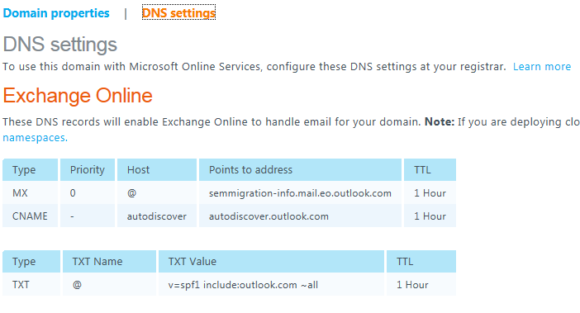
Migration Flow
Switch to Cloud
MX Record:
Cloud
Internet
Exchange Online
Update MX Record with the below information

Slide 24
Migration Flow
Users to Office 365
MX Record:
Cloud
Internet
Exchange Online

Slide 25
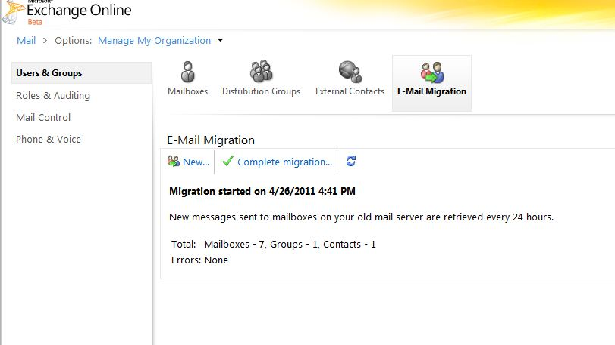
Migration Flow
Complete-Migration
MX Record:
Cloud
Internet
Exchange Online
One final sync before completing the migration
One more
incremental sync

Slide 26
Deployment Plan
Decommission
1. Plan
2. Prepare
3. Migrate
4. Decommission
Read case studies
and documentation
Add and Verify SMTP domains
Configure On Premise
DNS Administration

Slide 27
Cutover Exchange Migration
Demo

Slide 28
IT Pro Experience
Staged Exchange Migration (SEM)

Slide 29
Staged Exchange Migration
Objective
  A simple Exchange migration solution for medium and large size organizations
Capability
Migration from Exchange Server 2003 and Exchange 2007 only.
Migrate in batches
High fidelity migrations - Mail, calendar, tasks and many more
Require
  Directory sync

Slide 30
Deployment Plan
Migrate
1. Plan
2. Prepare
3. Migrate
4. Decommission
Read case studies
and documentation
Add and Verify SMTP domains
Configure On Premise
DNS Administration

Slide 31
Migration Flow
New Batch
Switch User to
Cloud by setting
target address
License
Initial Sync
Migrate mailboxes
in batches

Slide 32
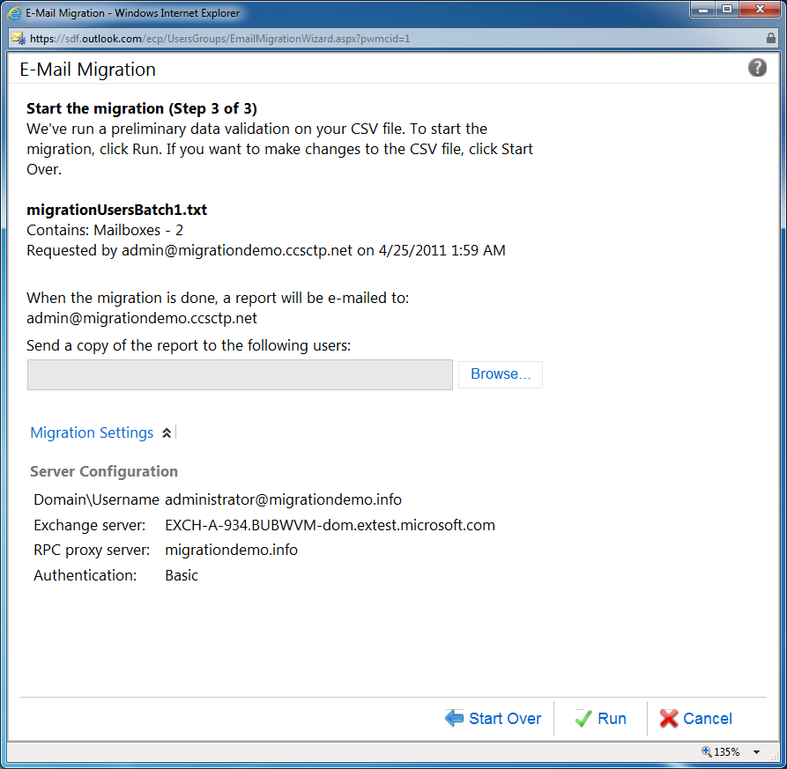
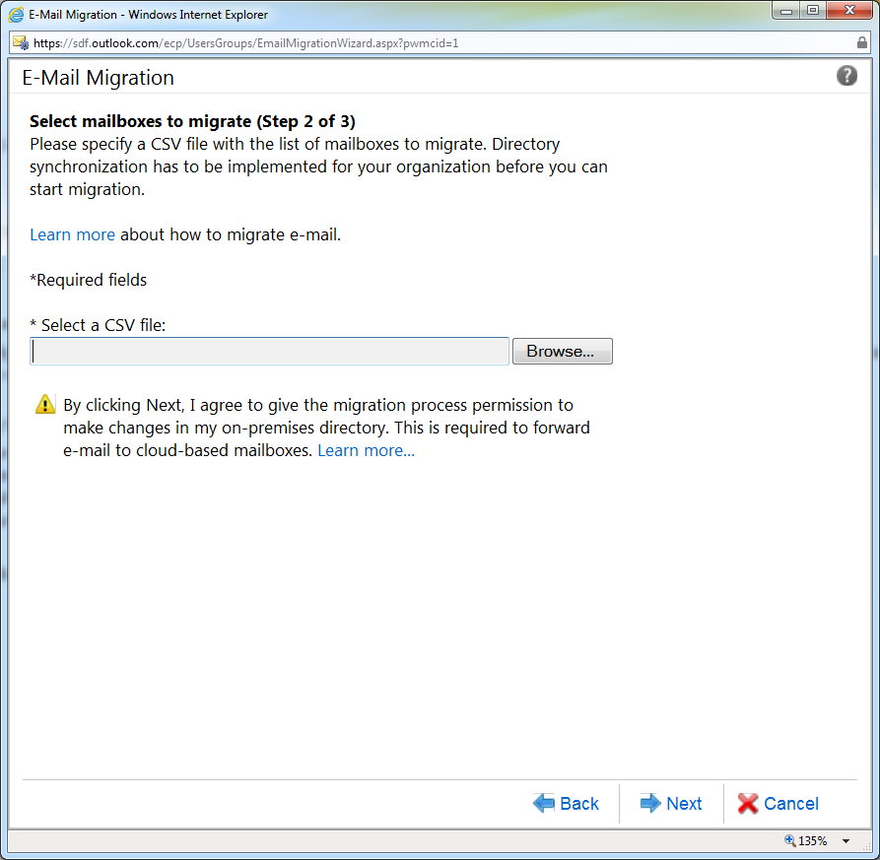
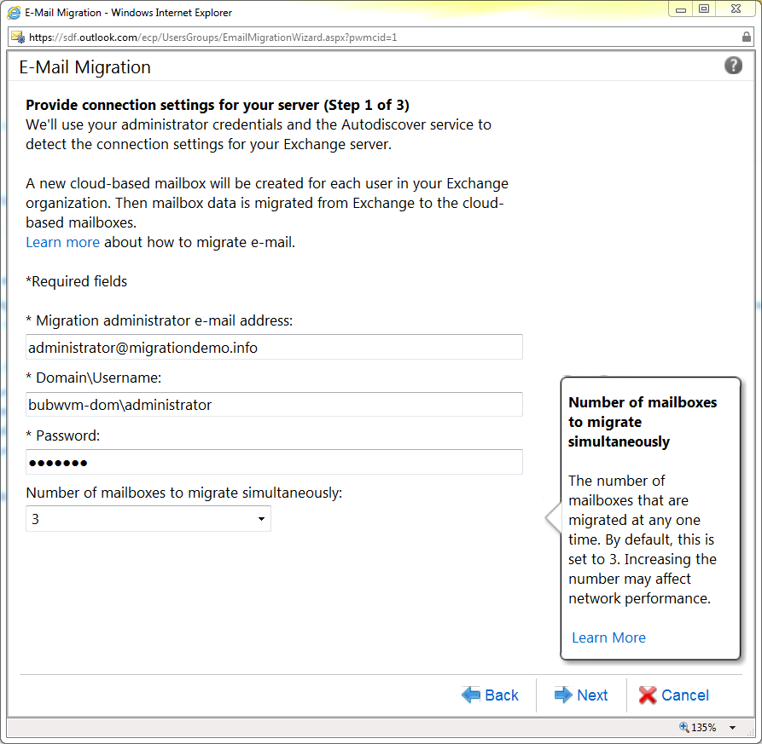
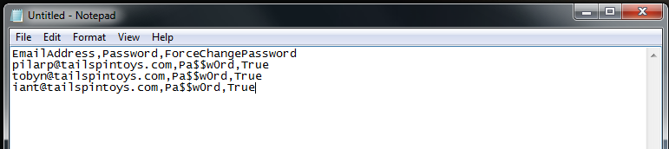
Migration Flow
New Batch
MX Record:
On Premise
Internet
Exchange Online

Slide 33
Migration Flow
Switch Users in Batch to Cloud
MX Record:
On Premise
Internet
Exchange Online
Migrate users in batches as many times as needed
Initial Sync
NOTE: Customers are migrated to the cloud once you start the migration batch

Slide 34
Migration Flow
Users in Batch Move to Office 365
MX Record:
On Premise
Internet
Exchange Online
Initial Sync
NOTE: Customers are migrated to the cloud once you start the migration batch

Slide 35
Migration Flow
Get-MigrationBatch
MX Record:
On Premise
Internet
Exchange Online
Initial Sync

Slide 36
Migration Flow
Admin Migration Reports

Slide 37
Migration Flow
Update MX Record
MX Record:
On Premise
Internet
Exchange Online
Migrate users in batches as many times as needed
Once you are done update the mx record and complete the migration

Slide 38
IT Pro Experience
Exchange Migration
Mailbox COPY Algorithm

Slide 39

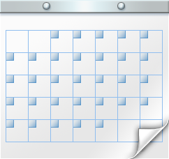


Mailbox Copy
Initial Sync
Mirror Folder Structure first
In each of the folders, we copy latest first
Source Mailbox
Target Mailbox
CONTACTS
CONTACTS
CALENDAR
CALENDAR
TASKS
TASKS
NOTES
NOTES
2
INBOX
2
INBOX
SENT ITEMS
SENT ITEMS
OTHERS
OTHERS

Slide 40
Mailbox Copy
Incremental Sync
We will Sync the difference in incremental sync
  We will add new mail and folders
  We will delete mails and folder
Source Mailbox
Target Mailbox
CONTACTS
CONTACTS
CALENDAR
CALENDAR
TASKS
TASKS
NOTES
NOTES
2
INBOX
2
INBOX
SENT ITEMS
SENT ITEMS
OTHERS
OTHERS

Slide 41
IT Pro Experience
What Isn’t and is migrated?

Slide 42
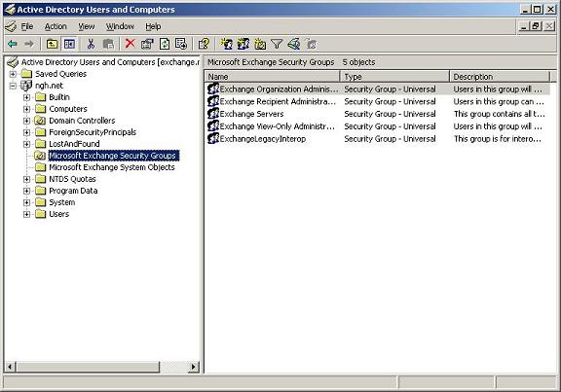
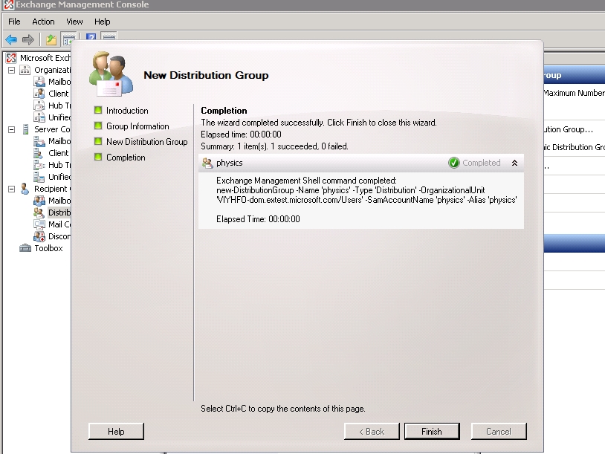
Not Migrated
Security Groups

Slide 43
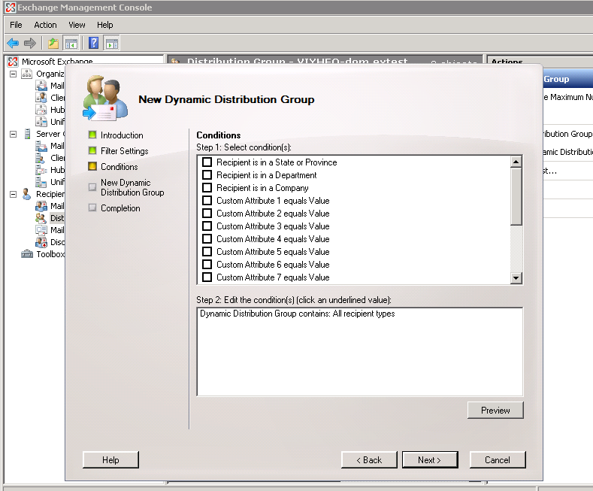
Not Migrated
Dynamic Distribution Lists (DDL)

Slide 44
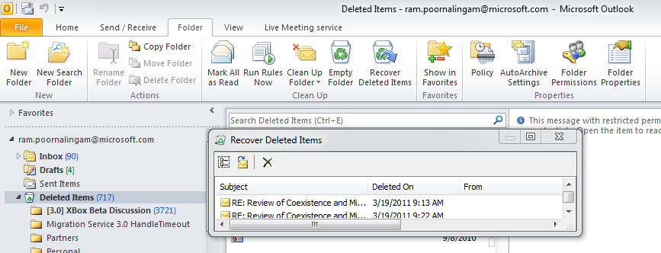
Not Migrated
Dumpster 1.0

Slide 45
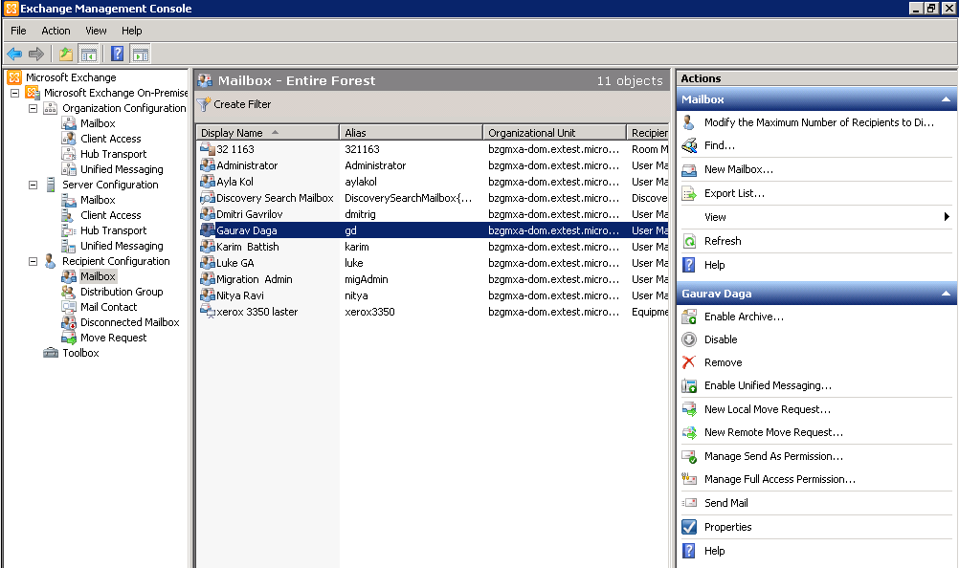
Not Migrated
Send-As Permissions

Slide 46
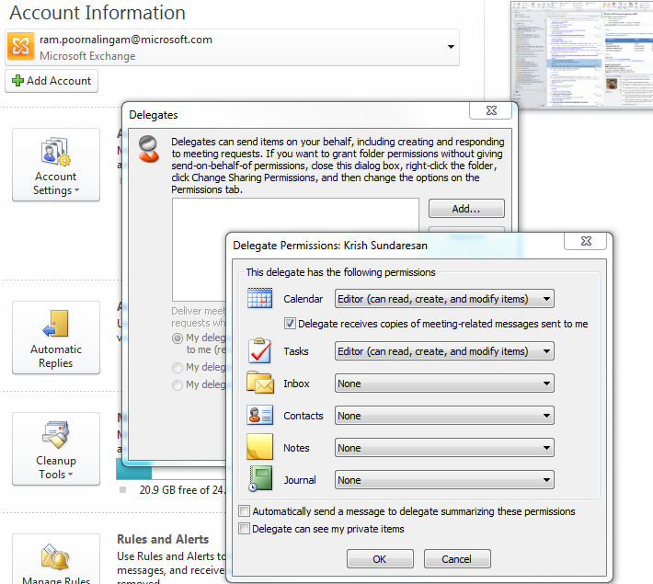
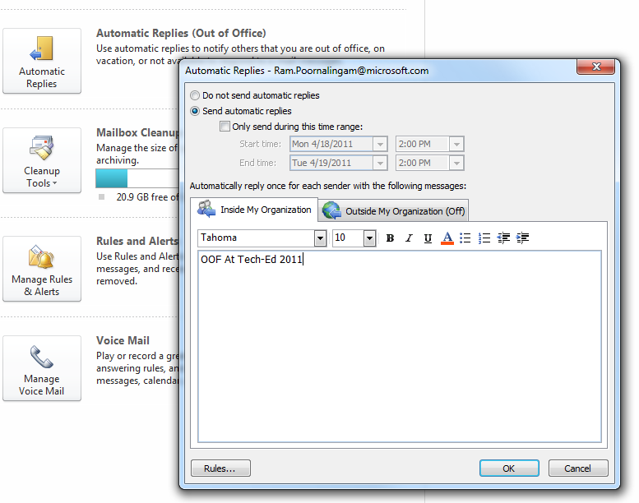
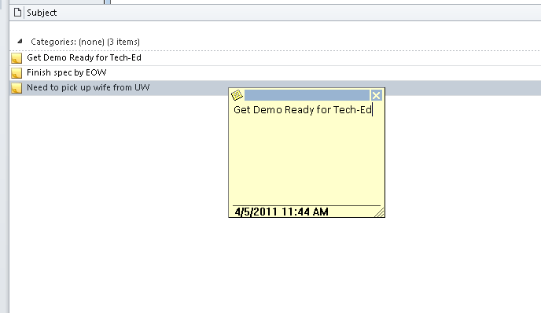
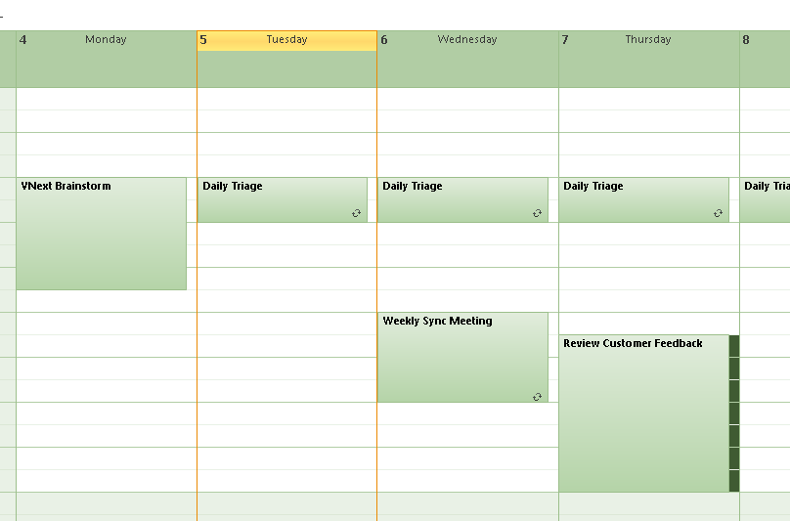
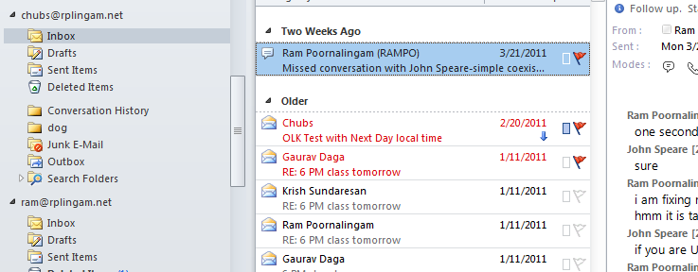
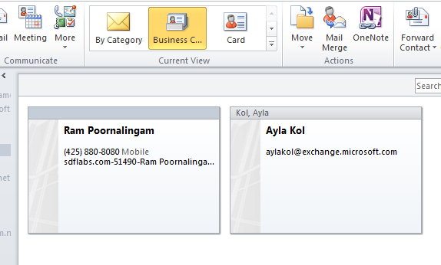
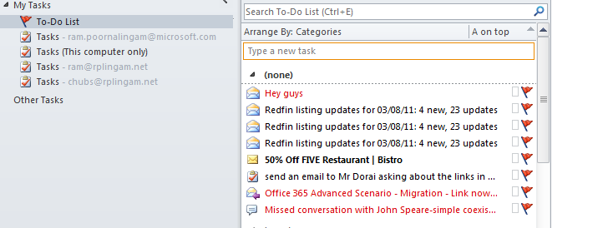
Migrated

Slide 47
IT Pro Experience
Troubleshooting TIPS

Slide 48
Troubleshooting
Scenarios
  Performance
  Connectivity Issues
    Not Viable CA Cert
    Unable to set target address
  User Content Not Migrated
    Large Messages
    Bad Item

Slide 49
Troubleshooting Performance
Migration Throughput
Exchange
Online
One knob to control them all - MaxConcurrentMigrations
Limiting Factors
  Source Servers
  Disk Spindles
  Network
Internet

Slide 50
Troubleshooting Performance
How to Identify
Variable | Observation tool
CPU | \Processor(_total)\% Processor Time
Memory | \Memory\Available MBytes \Memory\Page Faults/sec
Disk IO | PhysicalDisk(*)\Current Disk Queue Length
Network Bandwidth | \Network Interface(*)\Bytes Sent/sec \Network Interface(*)\Bytes Total/sec \Network Interface(*)\Current Bandwidth
Latency

Slide 51
Troubleshooting Performance
Fix – Increase Concurrency
Exchange
Online
Internet
Increase the concurrency to an acceptable level

Slide 52
Troubleshooting Performance
Fix – Load Balance
Exchange
Online
Internet
Ensure that batch contains mailboxes from multiple source servers

Slide 53
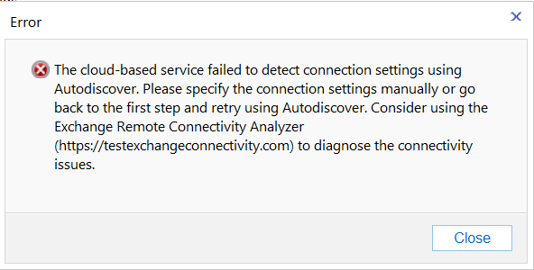
Troubleshooting Connectivity

Slide 54
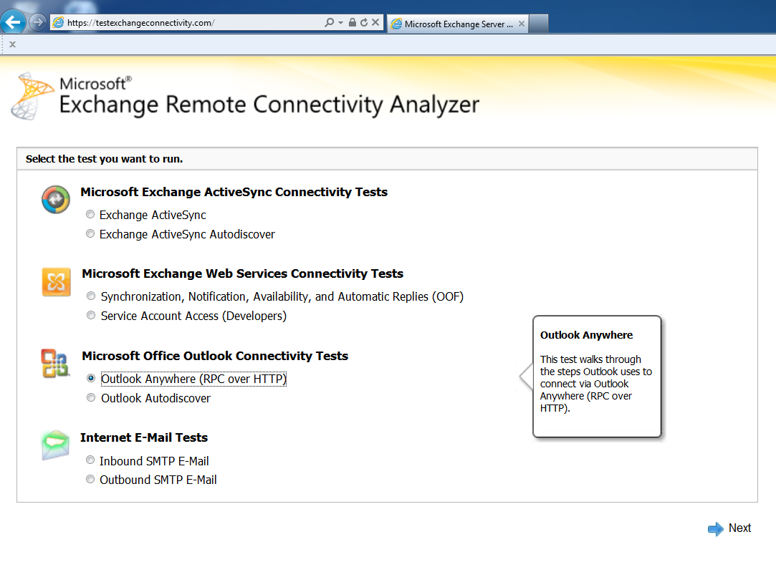
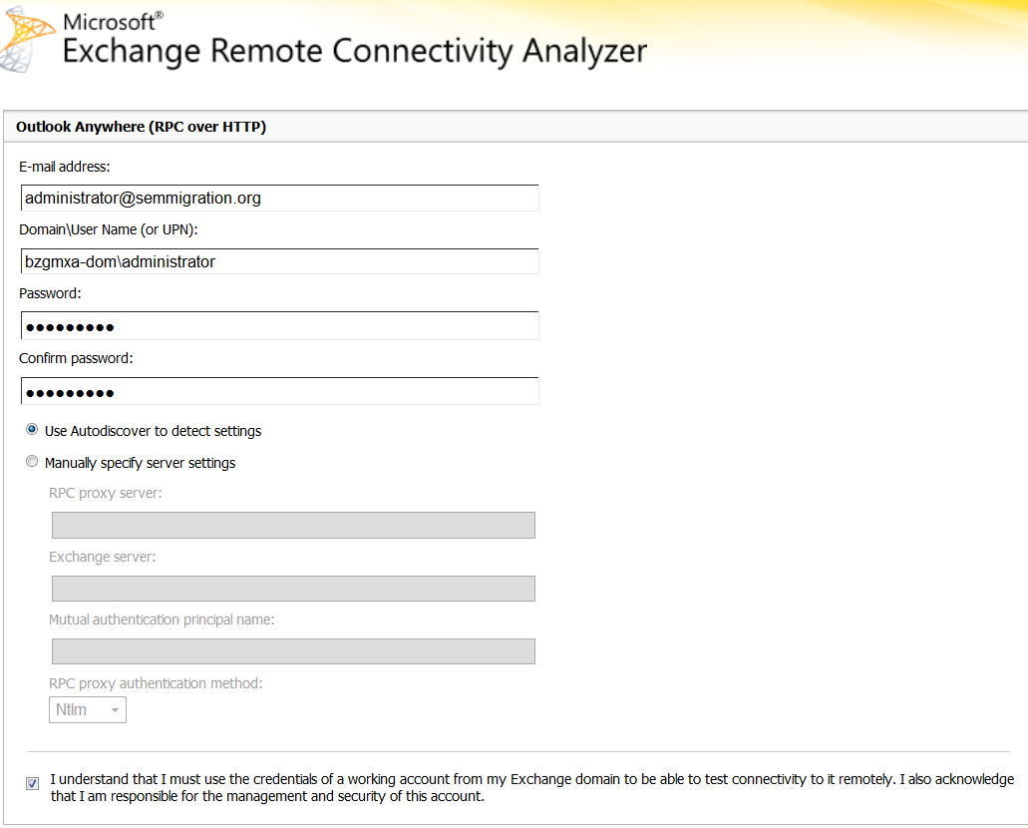
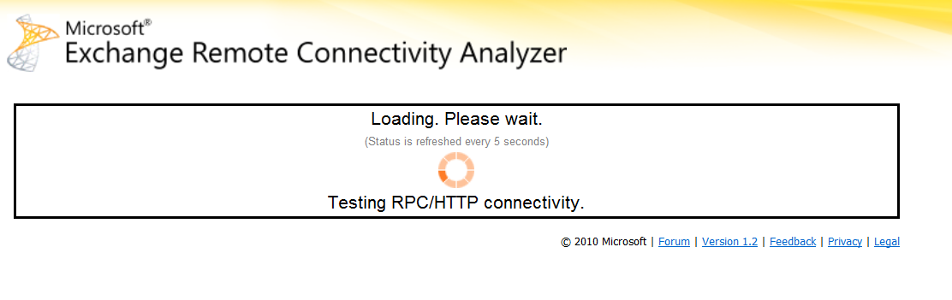
Troubleshooting Connectivity
Enter migration Admin credentials

Slide 55
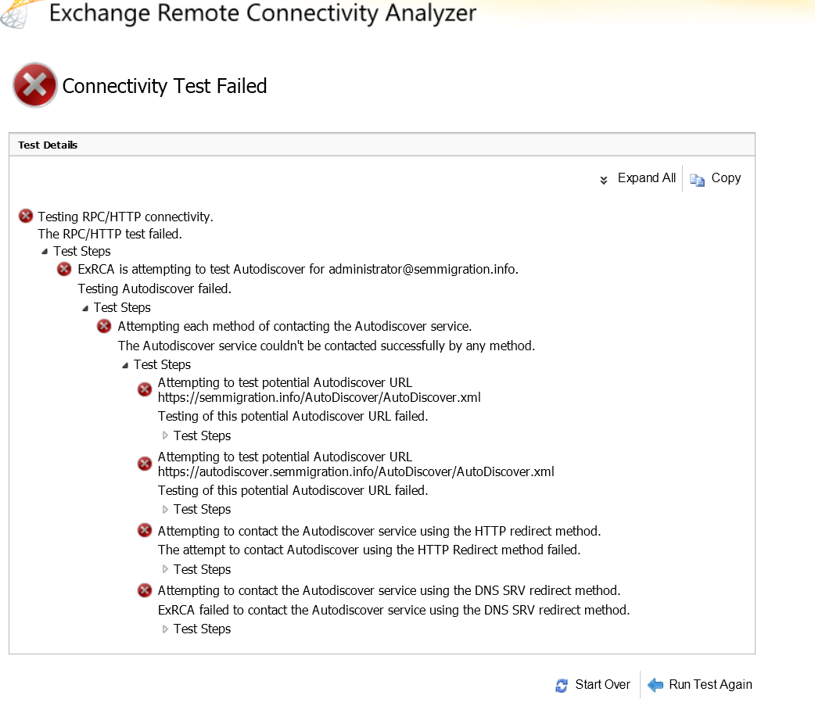
Troubleshooting Connectivity
Notice Auto discover is failing

Slide 56
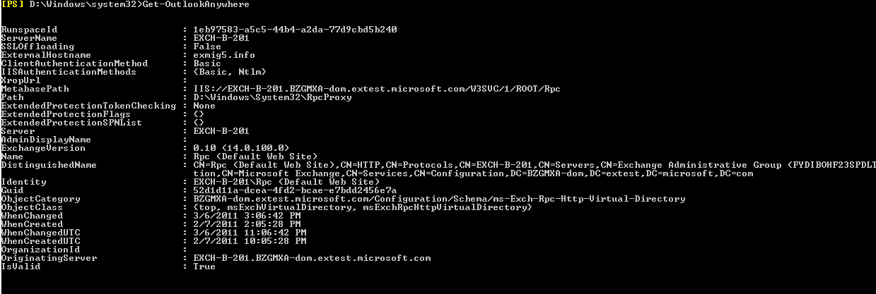
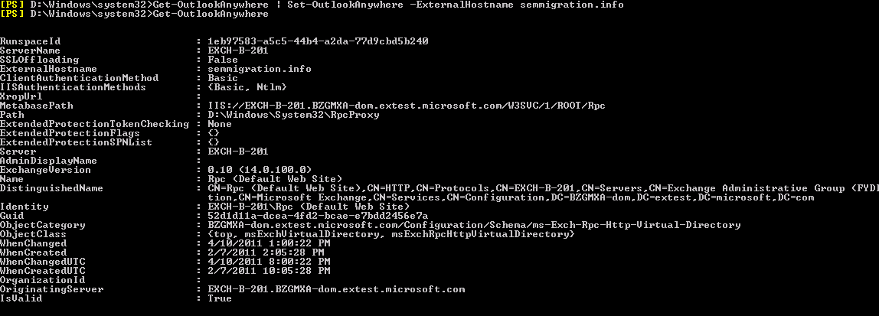
Troubleshooting Connectivity
Wrong ExternalHostName. Should have been semmigration.info

Slide 57
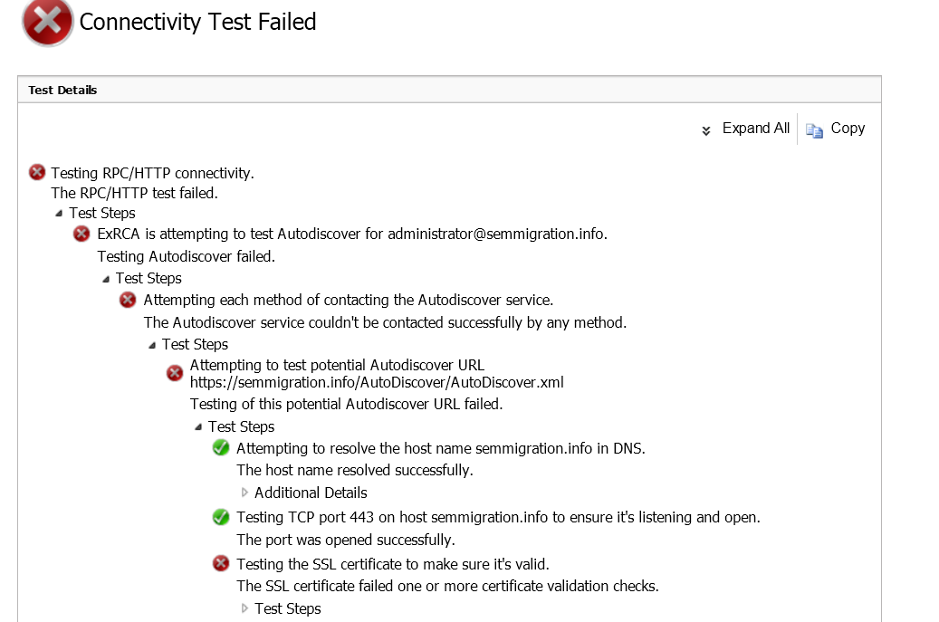
Troubleshooting Connectivity
Enter migration Admin credentials

Slide 58
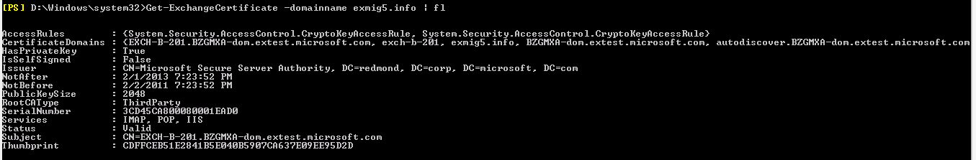
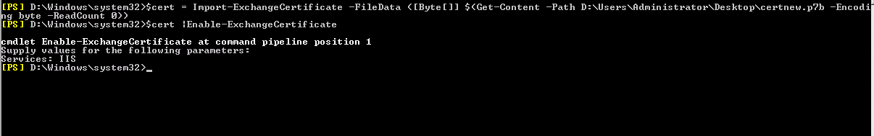
Troubleshooting Connectivity
Ensure SAN name contains domain name, autodiscover name , internal domain name

Slide 59
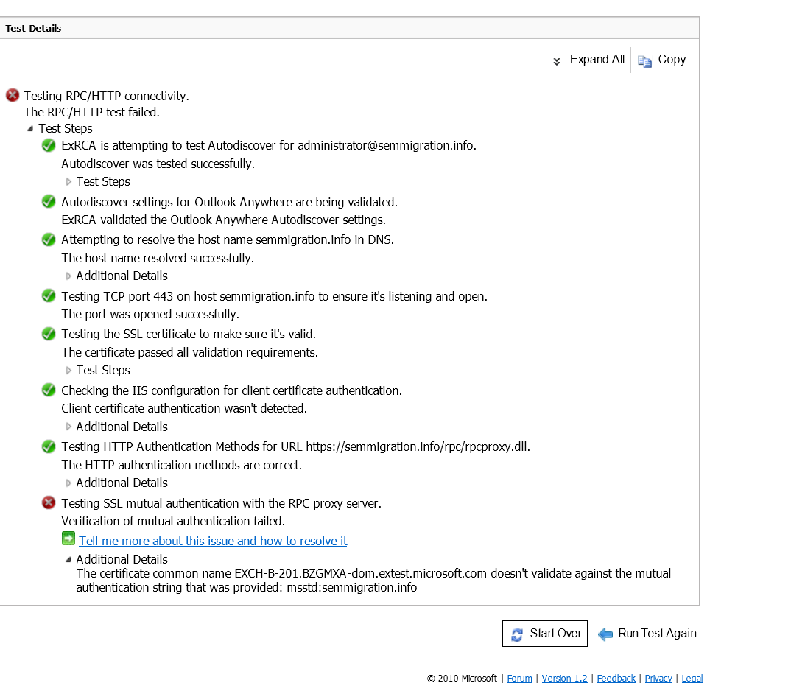
Troubleshooting Connectivity

Slide 60
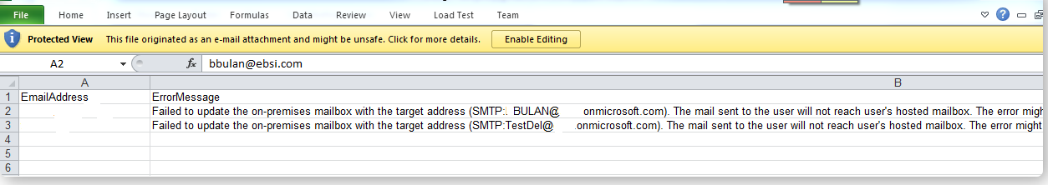
Troubleshooting Connectivity
Unable to Set TargetAddress
Are you migrating from Exchange 2010 or Exchange 2010 Sp1 with SSEM ? This is not supported
Add-ADPermission -Identity "CN=Users,DC=WOMYHV-dom,DC=extest,DC=microsoft,DC=com" -User migAdmin -AccessRights WriteProperty -Properties TargetAddress -InheritanceType SelfAndChildren”

Slide 61
Troubleshooting: User Content Not Migrated
Large Messages
Source Mailbox
Target Mailbox
INBOX
INBOX
Max Email Message size is 25 MB
Skipped Item Count +=1

Slide 62

Troubleshooting: User Content Not Migrated
Bad Messages
Source Mailbox
Target Mailbox
INBOX
INBOX
Skipped Item Count +=1

Slide 63

Troubleshooting Internal Errors
Typically target side errors.
  Retry Migration
  If it still persists, please contact support

Slide 64
W Experience
Steps to Take Post Migration

Slide 65
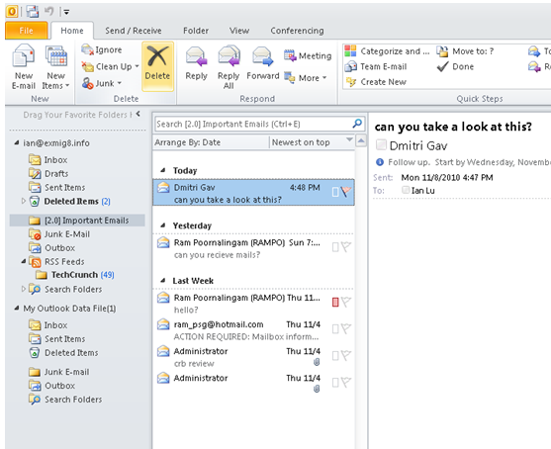
End-User Experience – Outlook after Migration

Slide 66
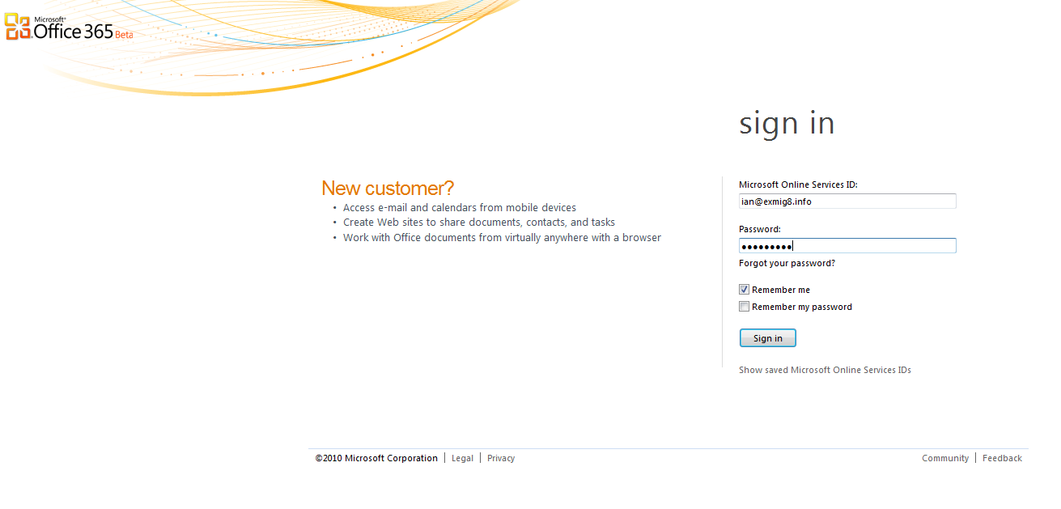
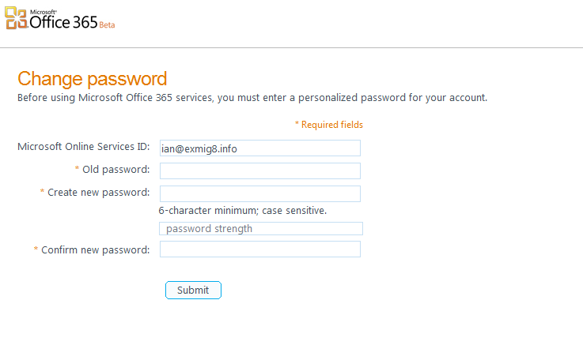
End-User Experience – First logon

Slide 67
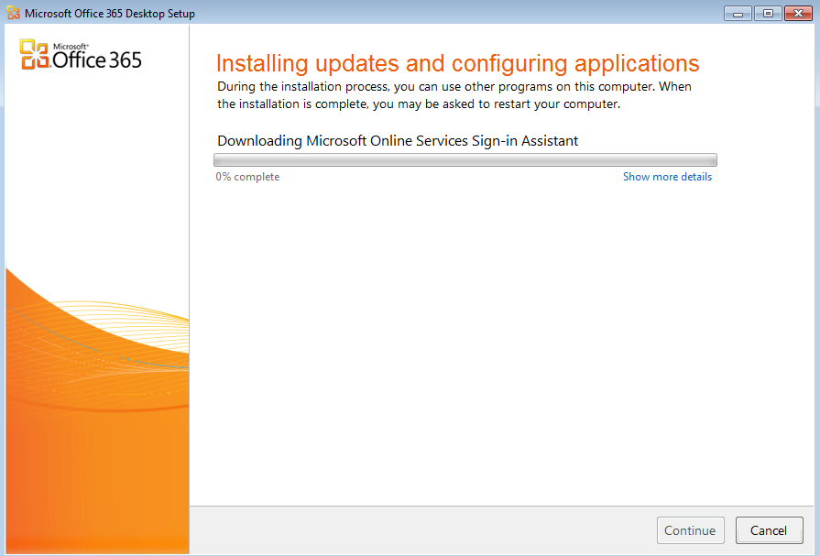
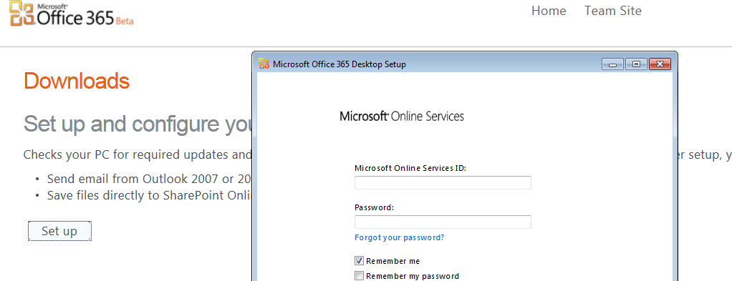
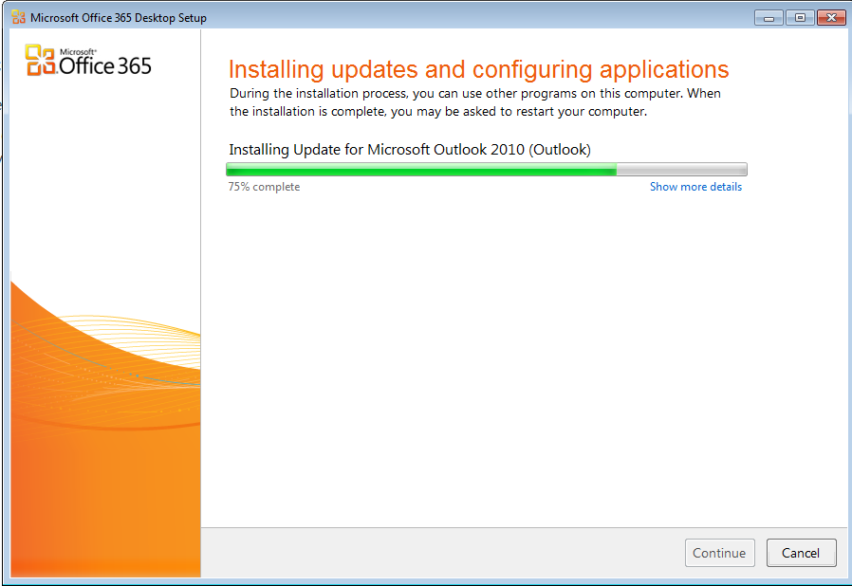
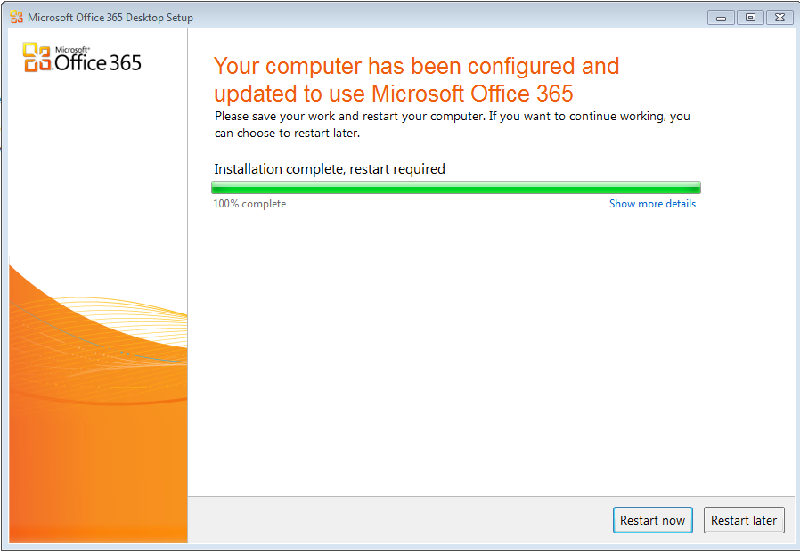
Installs Connector

Slide 68

End-User Experience – Remove account

Slide 69

End-User Experience – Create new Profile and Resync OST

Slide 70

Migrated but needs fixing - Outlook Rules
End-User need to edit the rule and fix the folder references

Slide 71

Migrated but needs fixing - Outlook Rules
End-User need to edit the rule and fix the folder references

Slide 72


Migrated but needs fixing– Quick Steps
End-User need to fix the quick step

Slide 73

Migrated but needs fixing– Search Folders
End-User needs to recreate the search folder

Slide 74
Session Objectives and Takeaways
Session Objective(s):
  Overview of the migration space and the available tools
  Explain and demonstrate Exchange Migration tools in Office 365
    Cut-Over EM
    Staged EM
Key Takeaways
    Office 365 provides out of the box online migrations tool that are simple to use

Slide 75
Related Content
EXL311: Microsoft Exchange Server and Microsoft Office 365: How to Set Up a Hybrid Deployment
OSP325: Microsoft Office 365: Directory Synchronization
EXL309: Exchange Online in Office 365: Migration Case Study
EXL326: What’s New in Exchange Server 2010 SP2
Find Me Later At…
  rampo@microsoft.com

Slide 76





Resources
  Connect. Share. Discuss.
http://northamerica.msteched.com
Learning
  Sessions On-Demand & Community
  Microsoft Certification & Training Resources
www.microsoft.com/teched
www.microsoft.com/learning
  Resources for IT Professionals
  Resources for Developers
http://microsoft.com/technet
http://microsoft.com/msdn

Slide 77












Complete an evaluation on CommNet and
enter to win!

Slide 78


Slide 79

© 2011 Microsoft Corporation. All rights reserved. Microsoft, Windows, Windows Vista and other product names are or may be registered trademarks and/or trademarks in the U.S. and/or other countries.
The information herein is for informational purposes only and represents the current view of Microsoft Corporation as of the date of this presentation. Because Microsoft must respond to changing market conditions, it should not be interpreted to be a commitment
on the part of Microsoft, and Microsoft cannot guarantee the accuracy of any information provided after the date of this presentation. MICROSOFT MAKES NO WARRANTIES, EXPRESS, IMPLIED OR STATUTORY, AS TO THE INFORMATION IN THIS PRESENTATION.

