Slide 2

Microsoft Exchange Online:
Unified Messaging in Microsoft Office 365
EXL322
Michael Wilson
Program Manager Lead
Microsoft

Slide 3
Agenda: Exchange Online Unified Messaging
Introduction
Architecture and Configuration
  Setting Up with a Generic PBX
  Demonstration of Exchange Online UM
  Setting Up with Microsoft Lync
Operation
  Feature Comparison with Exchange 2010 UM
  Migration of UM-enabled Mailboxes
  High Availability and SIP Redirection
Summary

Slide 4
Introduction

Slide 5
Exchange Online Unified Messaging
Benefits for the User: Anywhere Access
  Voice mail accessible from any Exchange client
    Easy playback in Outlook and OWA
  Outlook Voice Access: speech/DTMF interface to Exchange
  Voice Mail Preview (7 of 26 UM language packs)
  Call Answering Rules (greetings by caller/time, Find-me, etc.)
Benefits for the Organization: Lower Cost of Ownership
  Voice mail transported, stored and managed by Exchange
  Single identity management system
  Single set of administration tools
  Office 365 subscription: infrastructure and upgrades included

Slide 6
Exchange Online UM: Summary
Hosted voice mail
  Call answering
  Outlook Voice Access
  Automated Attendant
Requires “dial tone” from customer’s telephony solution
  Lync or compatible PBX
Part of Office 365 for Enterprises (E3, E4 plans)

Slide 7
Architecture & Configuration

Slide 8

Connecting to UM Online: Microsoft Lync
Lync Server required
  All roles must be Lync
  OCS not supported
  Edge role required
Hosted Voice Mail Policy
  Lync can route voice mail calls to UM Online
  Policy can be applied per forest, per site or per user
Lync (Enterprise Voice) here is on customer’s premises

Slide 9
Connecting to UM Online: PBXs and IP PBXs
Customer premises equipment
  VoIP Gateway (if not IP PBX)
  Session Border Controller (SBC)
Similar interoperability story (compared to UM on-prem)
  UM Telephony Advisor
    PBXs, VoIP Gateways tested with Exchange 2010 UM
  Will add content for SBCs
SBCs here used as transparent VoIP proxies and firewalls

Slide 10
Session Border Controllers for UM Online
Vendor | Product/Version | Type | Capacity*
Acme Packet | Net-Net 4500 SCX6.2.0 MR-3 Patch 2 | SBC | 1000, 2000, 4000, 8000
AudioCodes | Mediant 1000 MSBG 6.00AL.014 | SBC/VoIP Gateway | 10, 30, 60, 150
Ingate | SIParator 19 v4.8.4 (+patches) | SBC | 5, 10, 15, 20, 25
NET | VX1200 4.7.2v47 | SBC/VoIP Gateway | 30, 60, 90, 120, 150, 270, 390
* Capacity = maximum # concurrent calls. Number of UM-enabled users supported per call: 30 – 100.
Configuration notes describe connection to UM Online
  More makes/models will be qualified
  Microsoft Unified Communications Open Interoperability Program
Some devices also act as VoIP Gateways
  Gateway, SBC capabilities licensed separately

Slide 11

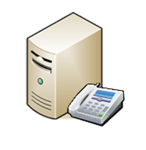
Connecting a PBX to Exchange Online UM: 1
Contoso Corporation
Office 365 Services
❶
❷
Exchange
UM Servers
PBX
VoIP Gateway
SBC
SBC
SIP/TLS/SRTP
172.42.23.12
SIP/TLS/SRTP
Active Directory
The steps are essentially the same for an IP PBX, but no separate gateway is needed.
(Office 365 SBCs are pre-configured by Microsoft to send calls to UM servers)
(UM servers in Office 365 are pre-configured by Microsoft to send calls via SBCs)

Slide 12
Connecting a PBX to Exchange Online UM: 2
Contoso Corporation
Office 365 Services
❺
umsbc.contoso.com
Exchange
UM Servers
❸
❹
SBC
PBX
VoIP Gateway
SBC
SIP/TLS/SRTP
172.42.23.12
SIP/TLS/SRTP
Active Directory
Connect/configure VoIP gateway communication with PBX (details at UM Telephony Advisor)
UM Systems Integrator (SI) partners can assist Contoso with these steps, as with
on-prem UM deployments
Connect SBC, configure gateway to communicate with SBC’s internal interface, and vice versa.
Obtain CA-signed cert containing SBC’s external name in CN, and load into SBC. Add public DNS entry for SBC (e.g. umsbc.contoso.com).

Slide 13
Connecting a PBX to Exchange Online UM: 3
Contoso Corporation
Office 365 Services
umsbc.contoso.com
Exchange
UM Servers
PBX
VoIP Gateway
SBC
SBC
SIP/TLS/SRTP
172.42.23.12
SIP/TLS/SRTP
❻
❼
Active Directory
Contoso UM administrator creates UM Dial Plan, UM Mailbox Policy, UM IP Gateway
Contoso UM administrator configures UM IP Gateway object with the public address (umsbc.contoso.com) of Contoso’s SBC

Slide 14
Connecting a PBX to Exchange Online UM: 4
Contoso Corporation
Office 365 Services
umsbc.contoso.com
Exchange
UM Servers
PBX
VoIP Gateway
SBC
SBC
SIP/TLS/SRTP
❽
172.42.23.12
SIP/TLS/SRTP
guid.um.outlook.com
Active Directory
Configure SBC to talk SIP/TLS and SRTP on external interface to forwarding address of UM IP Gateway object created in steps 6 and 7. All addresses are of the form guid.um.outlook.com, e.g.
494F4B4C-76A4-4C6D-A2B4-E41582E4156D.um.outlook.com.
The guid uniquely identifies the calling organization to the UM Online service.

Slide 15
Connecting a PBX to Exchange Online UM: 5
Contoso Corporation
Office 365 Services
umsbc.contoso.com
Exchange
UM Servers
PBX
VoIP Gateway
SBC
SBC
SIP/TLS/SRTP
172.42.23.12
SIP/TLS/SRTP
guid.um.outlook.com
❾
Active Directory
Contoso UM administrator UM-enables
the users’ mailboxes

Slide 16
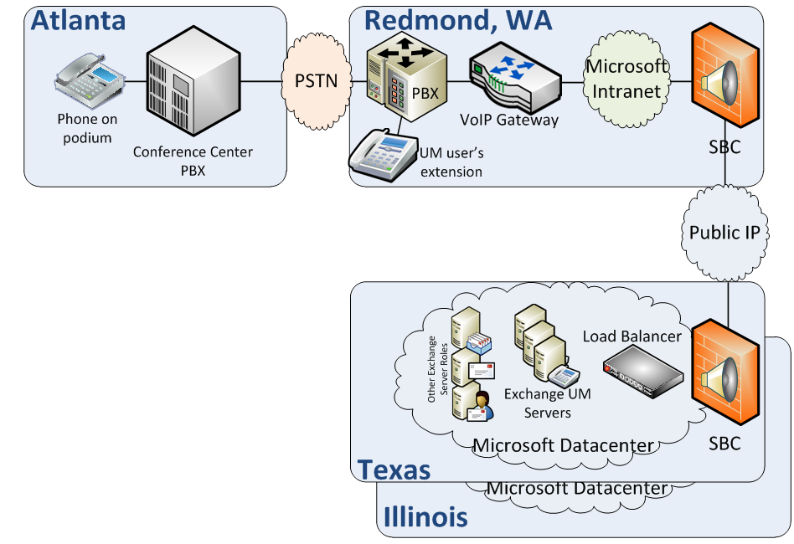
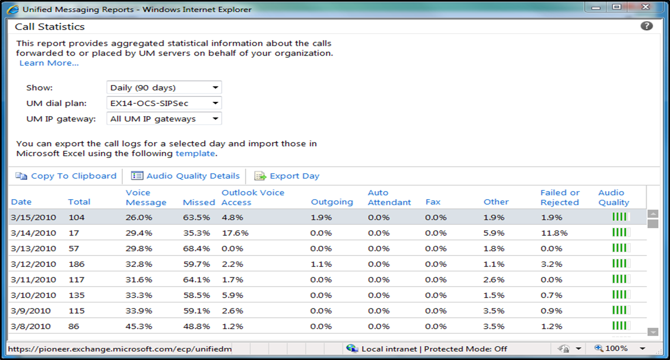
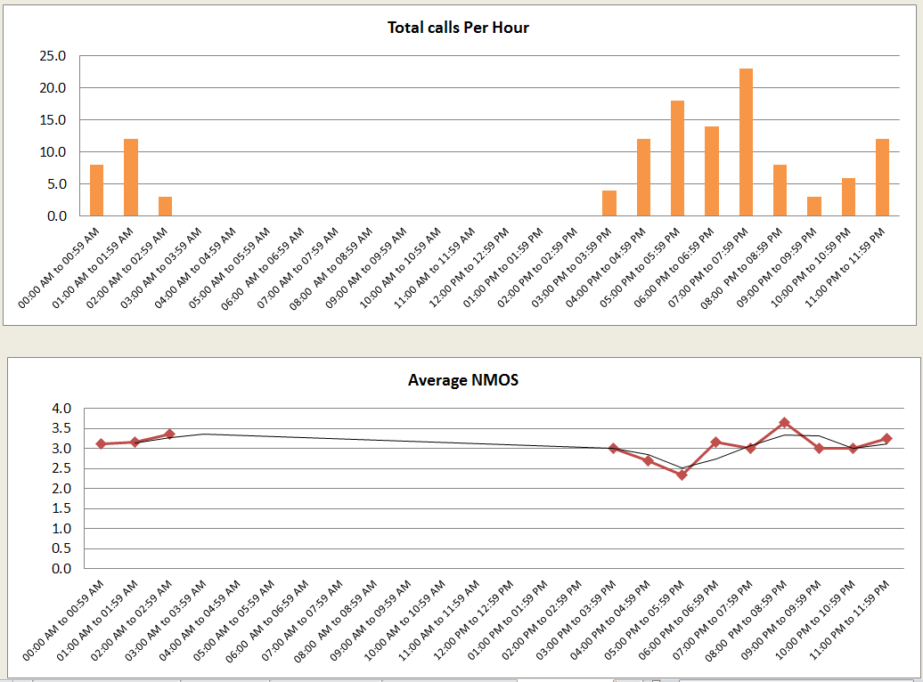
UM Online: Configuration, Use and Reporting
demo
Reporting template can be downloaded, here.

Slide 17
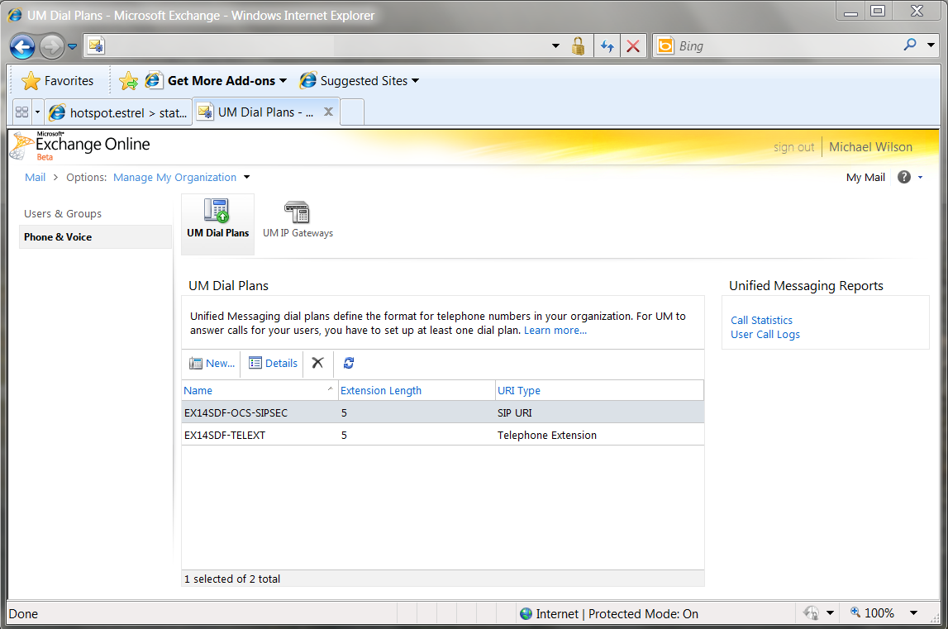
Exchange Control Panel: UM Dial Plans

Slide 18
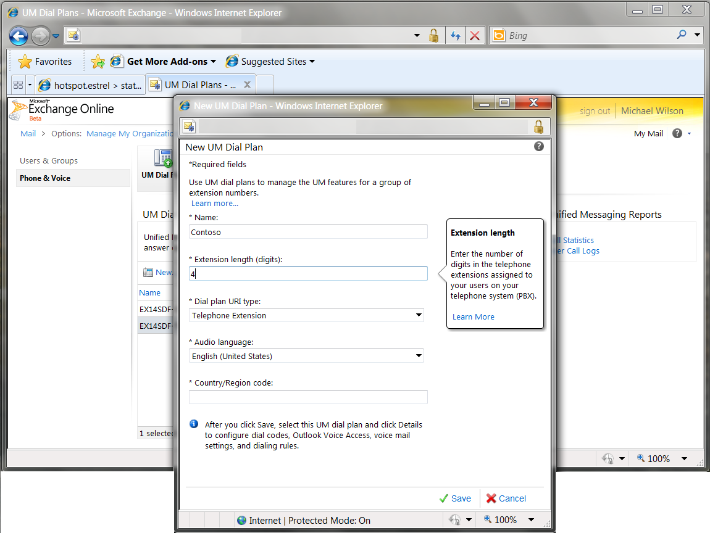
Exchange Control Panel: New UM Dial Plan

Slide 19
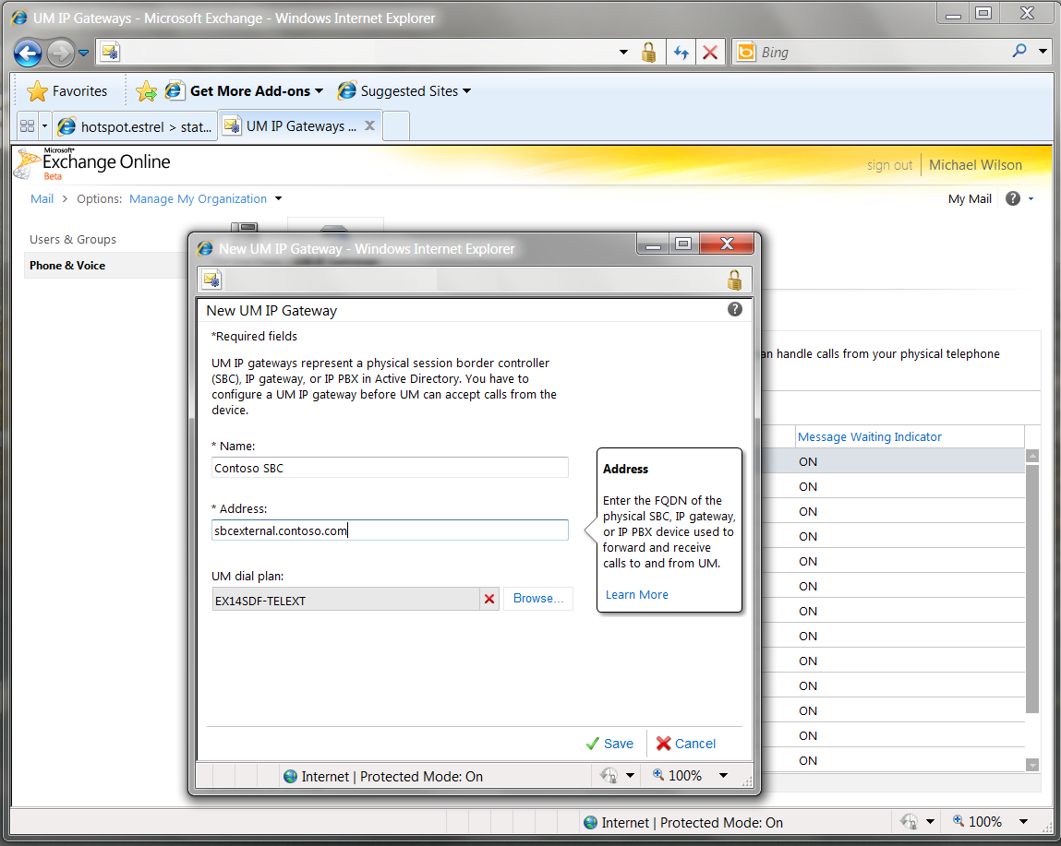
Exchange Control Panel: New IP Gateway

Slide 20
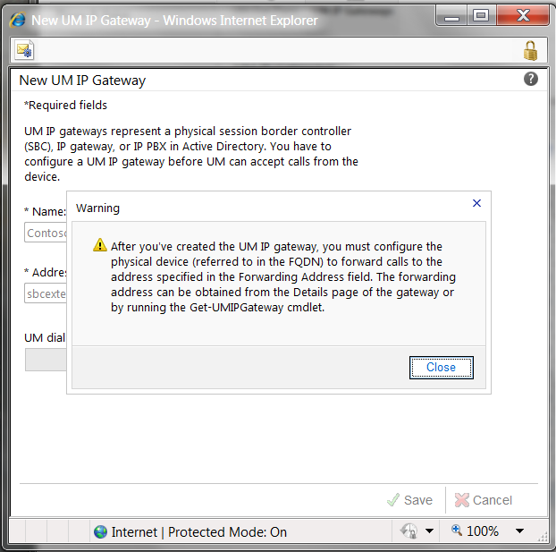
Exchange Control Panel: New IP Gateway (2)

Slide 21
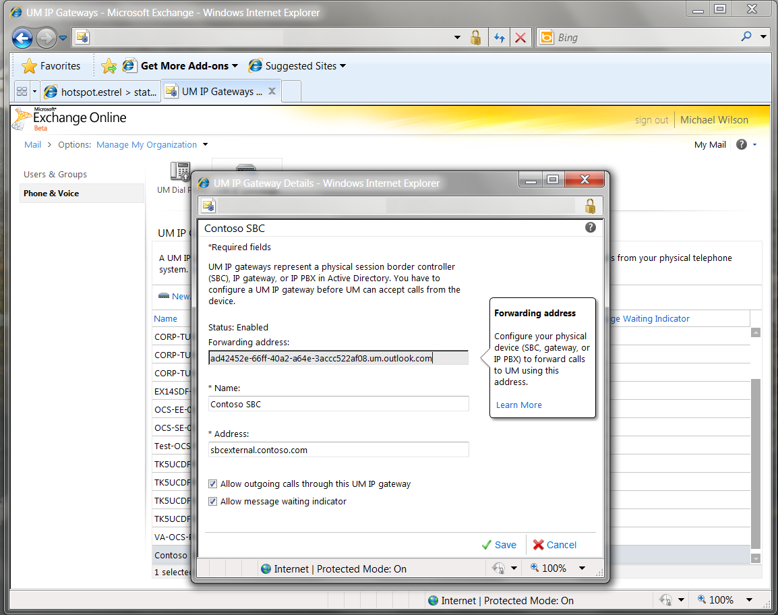
Exchange Control Panel: Edit IP Gateway

Slide 22
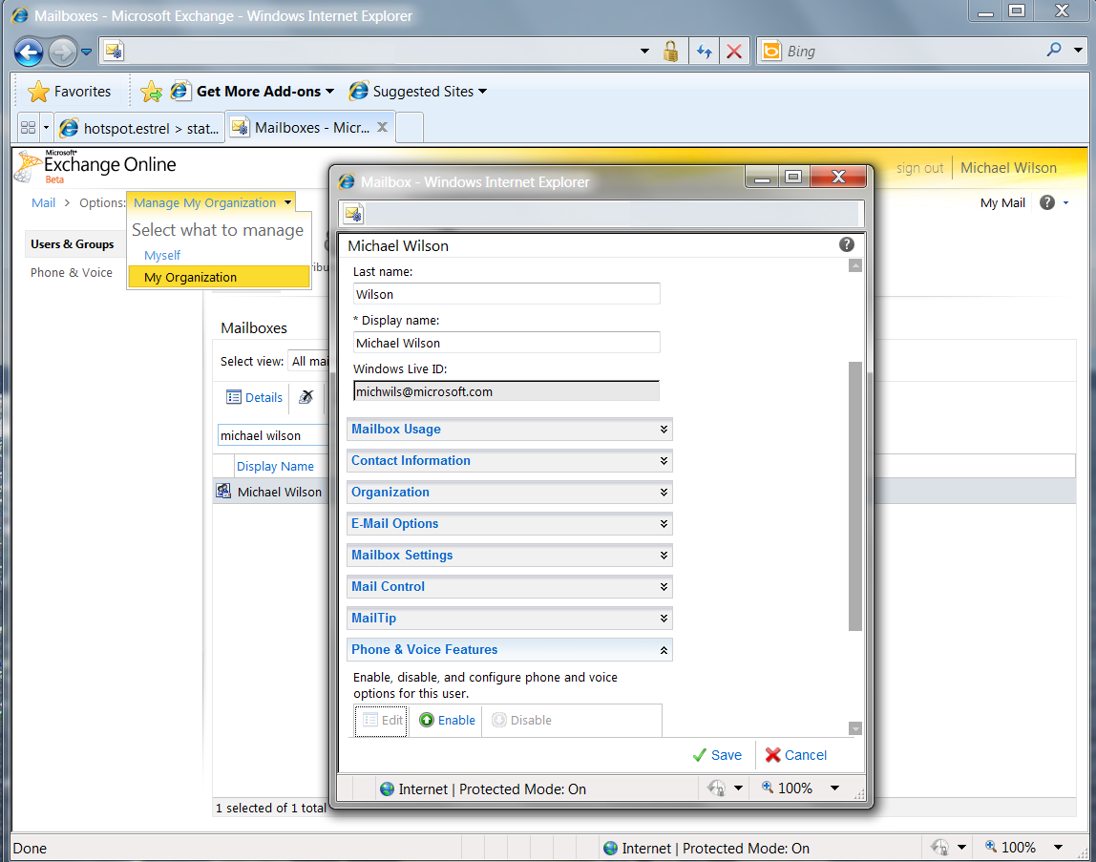
Exchange Control Panel: User Mailbox Settings

Slide 23
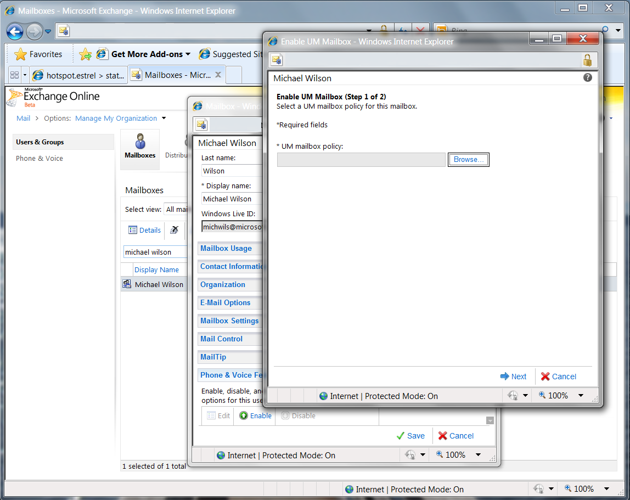
Exchange Control Panel: Enable UM Mailbox

Slide 24
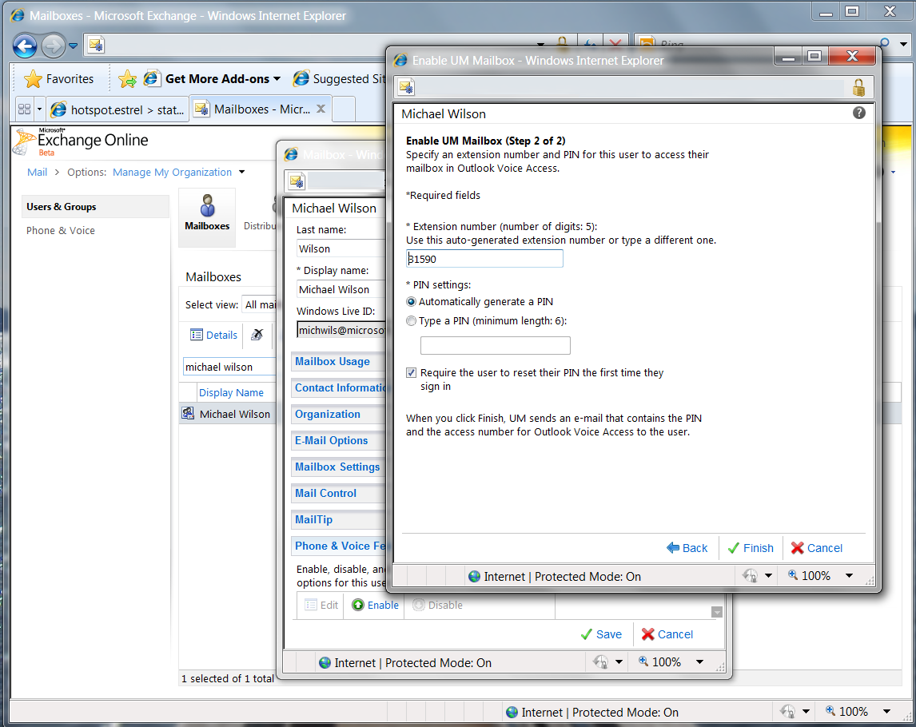
Exchange Control Panel: Enable UM Mailbox (2)

Slide 25
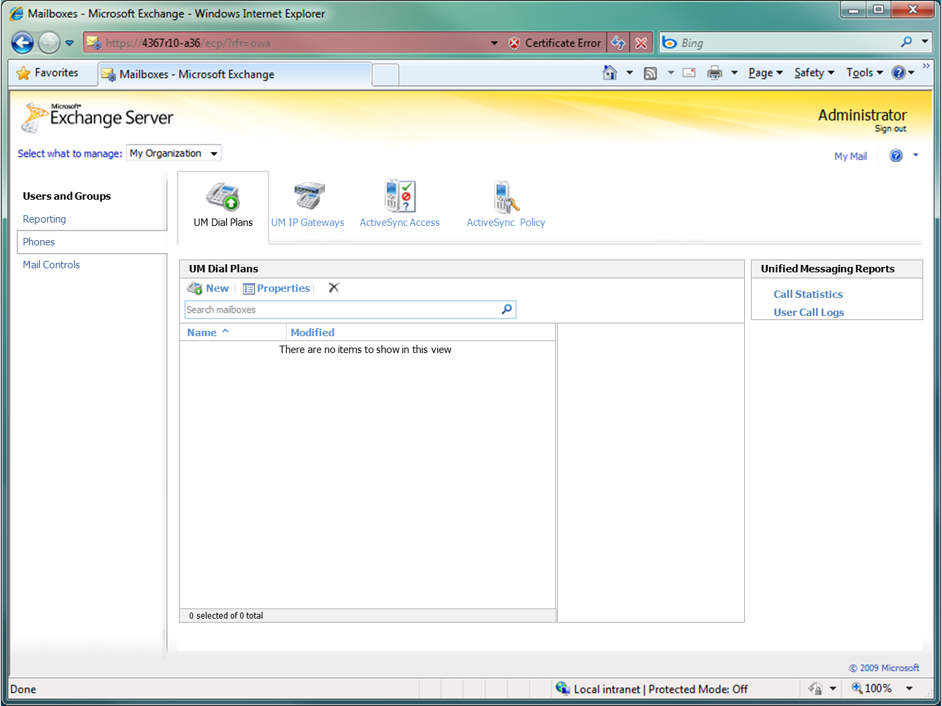
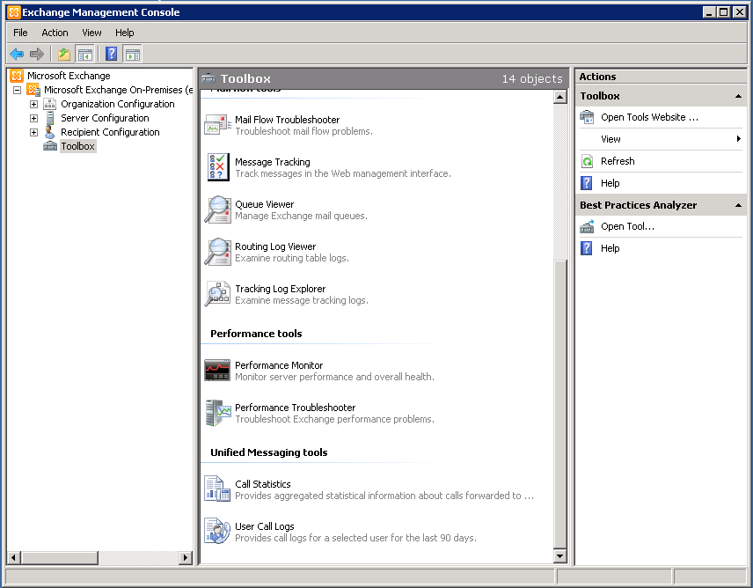
Accessing UM Reports
Exchange Control Panel
Exchange Management Console

Slide 26
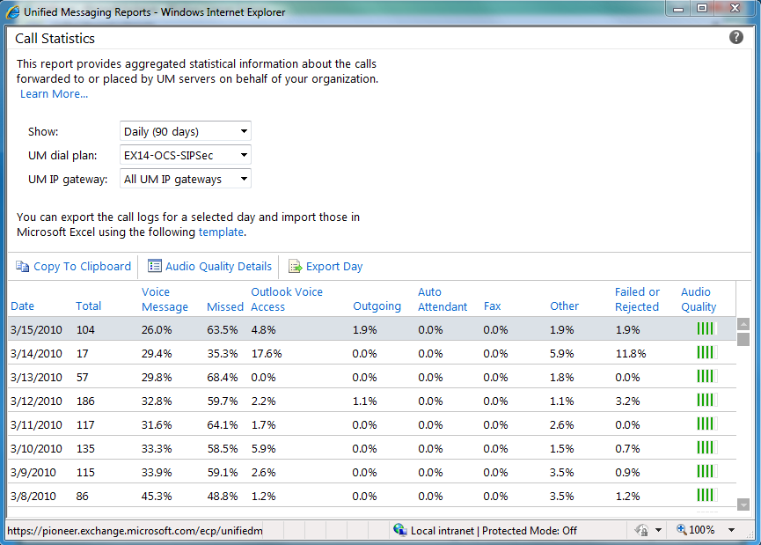
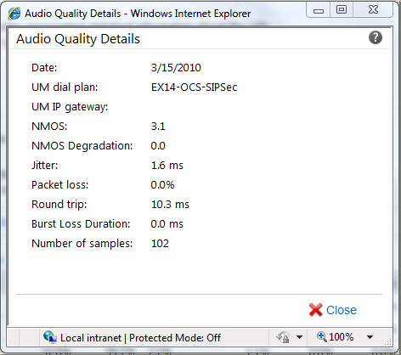
Exchange Control Panel: UM Call Summary Reports

Slide 27
Connecting Lync to Exchange Online UM: 1
Lync user
Office 365 Services
Fabrikam, Inc.
Lync user
Exchange
UM Servers
VoIP Gateway
❶
❷
Lync Edge Server
SIP/TLS/SRTP
SIP/TLS/SRTP
SIP/TLS/SRTP
Lync Mediation Server
Lync Servers
Lync Edge Server Pool
Active Directory
Active Directory
(Office 365 Lync Edge Server Pool is pre-configured
by Microsoft to send calls to UM servers)
(UM servers in Office 365 are pre-configured by
Microsoft to send calls via Lync Server Edge Pool)

Slide 28
Connecting Lync to Exchange Online UM: 2
Lync user
Office 365 Services
Fabrikam, Inc.
Lync user
Exchange
UM Servers
VoIP Gateway
❸
Lync Edge Server
SIP/TLS/SRTP
SIP/TLS/SRTP
❹
SIP/TLS/SRTP
Lync Mediation Server
Lync Servers
Lync Edge Server Pool
Active Directory
Active Directory
Fabrikam Lync administrator configures Lync Servers
Fabrikam Lync administrator configures Lync Edge Server

Slide 29
Connecting Lync to Exchange Online UM: 3
Lync user
Office 365 Services
Fabrikam, Inc.
Lync user
Exchange
UM Servers
VoIP Gateway
Lync Edge Server
SIP/TLS/SRTP
SIP/TLS/SRTP
SIP/TLS/SRTP
❺
Lync Mediation Server
Lync Servers
Lync Edge Server Pool
Active Directory
Active Directory
Fabrikam UM administrator creates UM Dial Plan,
UM Mailbox Policy, and sets E.164 access number
on the UM Dial Plan.

Slide 30
Connecting Lync to Exchange Online UM: 4
Lync user
Office 365 Services
Fabrikam, Inc.
Lync user
Exchange
UM Servers
VoIP Gateway
❻
Lync Edge Server
SIP/TLS/SRTP
SIP/TLS/SRTP
SIP/TLS/SRTP
Lync Mediation Server
Lync Servers
Lync Edge Server Pool
Active Directory
Active Directory
Where Lync voice mail routing sends calls for users in this policy
Fabrikam Lync administrator creates Hosted Voice Mail Policy object(s) (per forest, site or user), specifying:
  – FQDN of Lync Server Edge Pool in Office 365
    – Always exap.um.outlook.com
  – Exchange Online organizational routing domain
e.g. fabrikam.com: This enables UM Online to identify the customer

Slide 31
Connecting Lync to Exchange Online UM: 5
Lync user
Office 365 Services
Fabrikam, Inc.
Lync user
Exchange
UM Servers
VoIP Gateway
❼
Lync Edge Server
SIP/TLS/SRTP
SIP/TLS/SRTP
SIP/TLS/SRTP
Lync Mediation Server
Lync Servers
Lync Edge Server Pool
Active Directory
Active Directory
For each UM Dial Plan (or UM Auto Attendant) created online, the Fabrikam Lync administrator:
  – Creates a contact object and adds the DP/AA E.164 number
  – Associates the contact with a Hosted Voice Mail Policy

Slide 32
Connecting Lync to Exchange Online UM: 6
Lync user
Office 365 Services
Fabrikam, Inc.
Lync user
Exchange
UM Servers
VoIP Gateway
Lync Edge Server
SIP/TLS/SRTP
SIP/TLS/SRTP
SIP/TLS/SRTP
❽
Lync Mediation Server
Lync Servers
Lync Edge Server Pool
Active Directory
Active Directory
Fabrikam UM admin UM-enables the users’ mailboxes.
This not only writes EUM proxy addresses (as on-prem), but also sets a value on the
ms-Exch-UC-Voice-Mail-Settings attribute (used by Exchange and Lync). In hybrid
Exchange deployments, this attribute will be sync’d back to Fabrikam’s AD.

Slide 33
Connecting Lync to Exchange Online UM: 7
Lync user
Office 365 Services
Fabrikam, Inc.
Lync user
Exchange
UM Servers
VoIP Gateway
❾
Lync Edge Server
SIP/TLS/SRTP
SIP/TLS/SRTP
SIP/TLS/SRTP
Lync Mediation Server
Lync Servers
Lync Edge Server Pool
Active Directory
Active Directory
For each UM-enabled user online, the Fabrikam Lync administrator:
  – Enables the user for Enterprise Voice
  – Associates the user with a Hosted Voice Mail Policy
  – If ms-Exch-UC-Voice-Mail-Settings is not sync’d back from the “cloud”, uses Lync Set-CsUser cmdlet to set EnableHostedVoiceMail to True

Slide 34
Operation

Slide 35
Feature Comparison (On-Prem and Online)
Feature set is the same, with a few exceptions
Difference for users: no speech access to online directory
  No “Find messages from <name>” in Outlook Voice Access
  Speech access to Personal Contacts and PDLs is supported
  Touch tone (DTMF) access to directory in Outlook Voice Access, Automated Attendants
Differences for administrators:
  No Get/Set-UMServer, Get-UMActiveCalls or Test-UMConnectivity
    UM Troubleshooting Tool provides diagnostics (online or on-prem)
  Exchange Control Panel provides admin UI
  No SIP OPTIONS “ping” from UM online to on-prem equipment

Slide 36
Migration of UM-enabled Mailboxes
UM-enabled mailboxes may move online, or back on-prem
Typically, the user’s telephony arrangements won’t change
  Same phone, same extension number, etc.
Convenience for administrator depends on migration method
UM Mailbox Policies can be “mapped to the cloud”
  By default, map source policy named X to destination policy X
Requirement | Simple migration | Staged migration | Hybrid (Rich coexistence)
Migrate UM-enabled mailboxes without manually re-enabling them | No | No | Yes
Migrate the UM PIN | No | No | Yes
Create additional UM pilot number and PBX hunt group | No | Yes | Yes
Migrate voice mail, UM greetings and recorded name | Yes | Yes | Yes

Slide 37
International Availability of UM Online
UM will not be offered in all Office 365 countries
  In-country regulation and legislation may prohibit the service
  Research is still in progress as Office 365 expands
Restrictions applied at user (not organization) level
  Enable-UMMailbox checks country-of-origin (business address)
  Current list of countries for which UM-enabling is possible:
Argentina | Bulgaria | Cyprus | France | Indonesia | Kuwait | Malta | Peru | Saudi Arabia | Spain | UAE
Australia | Canada | Czech Rep | Germany | Ireland | Latvia | Mexico | Poland | Serbia | Sweden | Ukraine
Austria | Chile | Denmark | Greece | Israel | Liechtenstein | Netherlands | Portugal | Singapore | Switzerland | United Kingdom
Bahrain | Colombia | Estonia | Hong Kong | Italy | Lithuania | New Zealand | Puerto Rico | Slovakia | Taiwan | United States
Belgium | Costa Rica | Egypt | Hungary | Japan | Luxembourg | Norway | Romania | Slovenia | Trinidad & Tobago | Venezuela
Brazil | Croatia | Finland | Iceland | Jordan | Malaysia | Oman | Russia | South Africa | Turkey

Slide 38
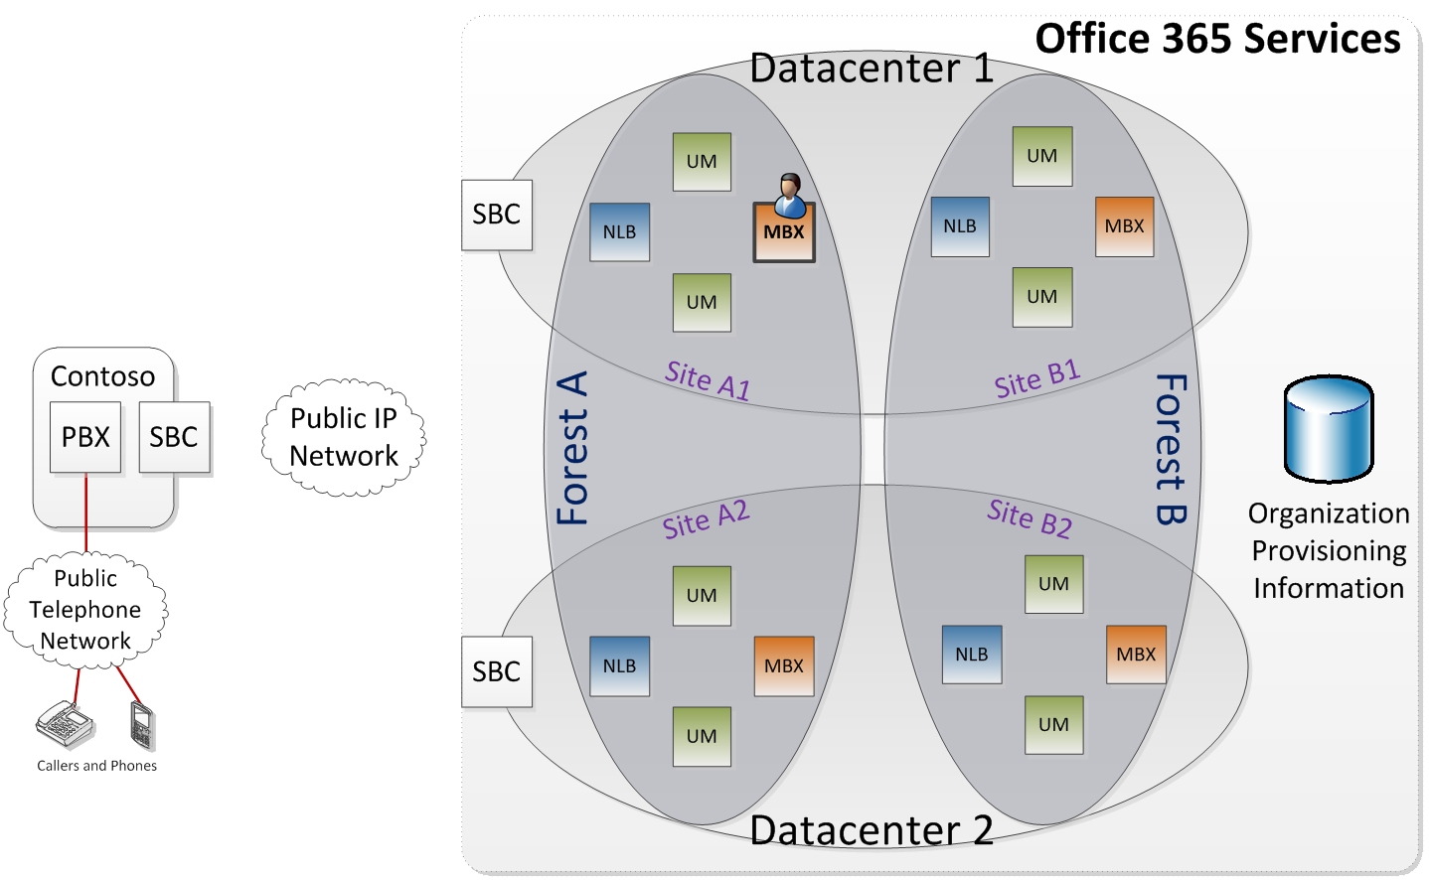
Availability, Redundancy and Redirection
The active copy of this Contoso user’s mailbox is in site A1
In each region, UM (Exchange) operates in multiple sites, in multiple datacenters

Slide 39
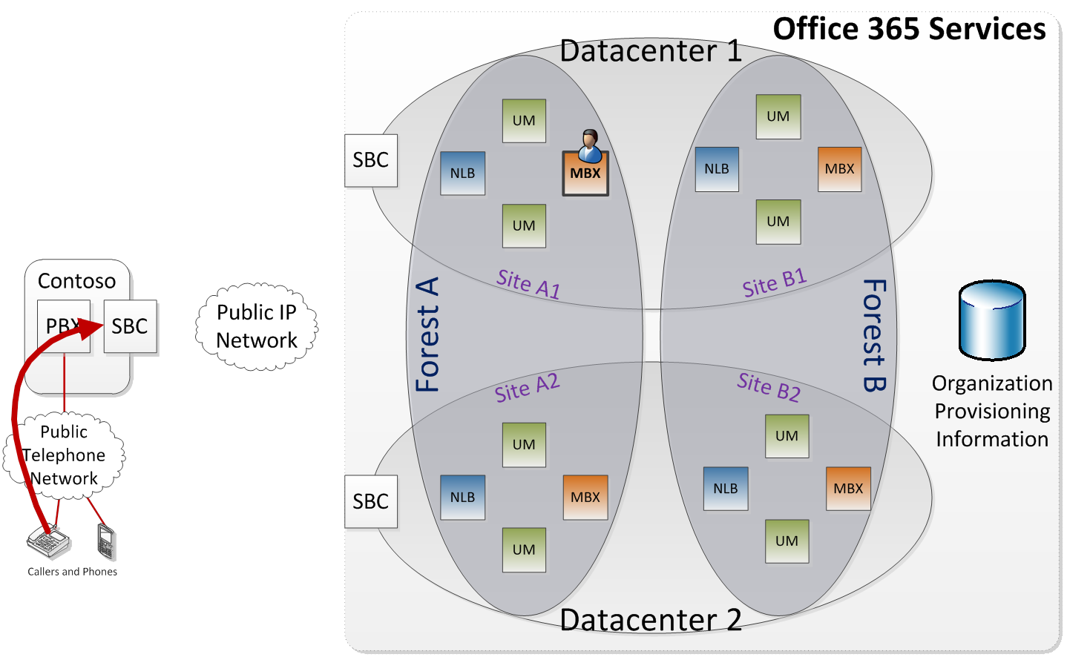
Availability, Redundancy and Redirection
Call arrives at Contoso for the user: forwarded on no-answer to ‘voice mail’ (UM Online via SBC)

Slide 40
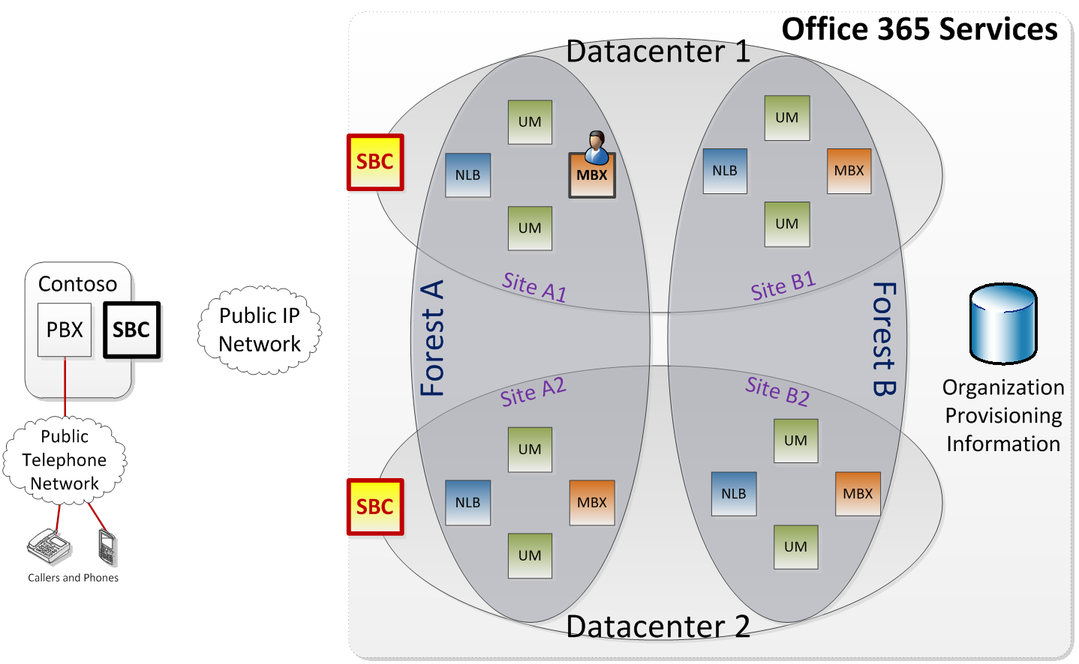
Availability, Redundancy and Redirection
SBC uses DNS to resolve guid.um.outlook.com, finds IP addresses of UM Online SBCs in the region

Slide 41
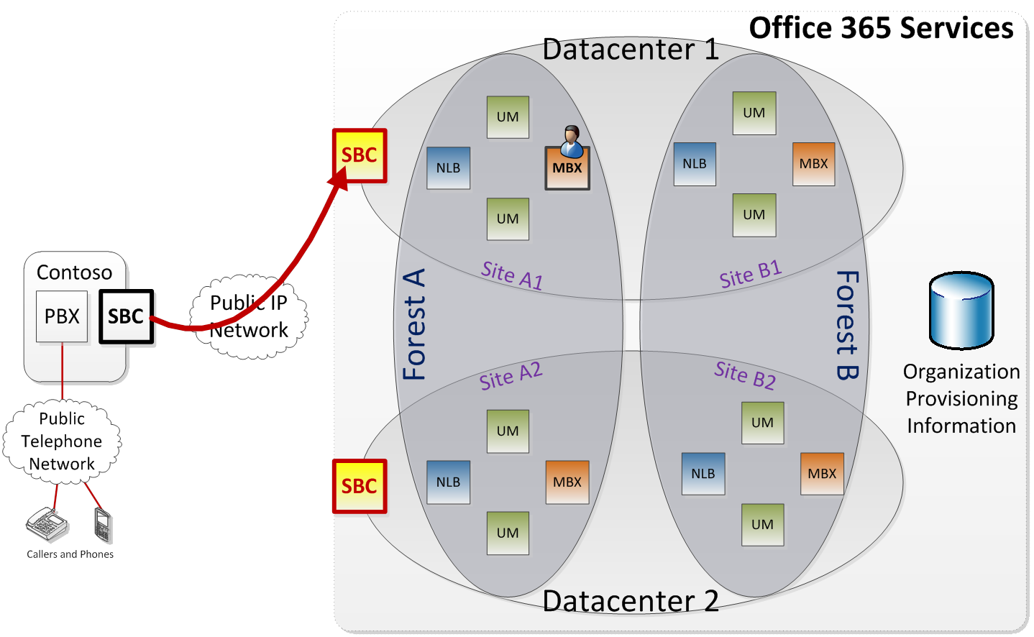
Availability, Redundancy and Redirection
SBC sends the call to one of the UM Online SBCs that it has discovered

Slide 42
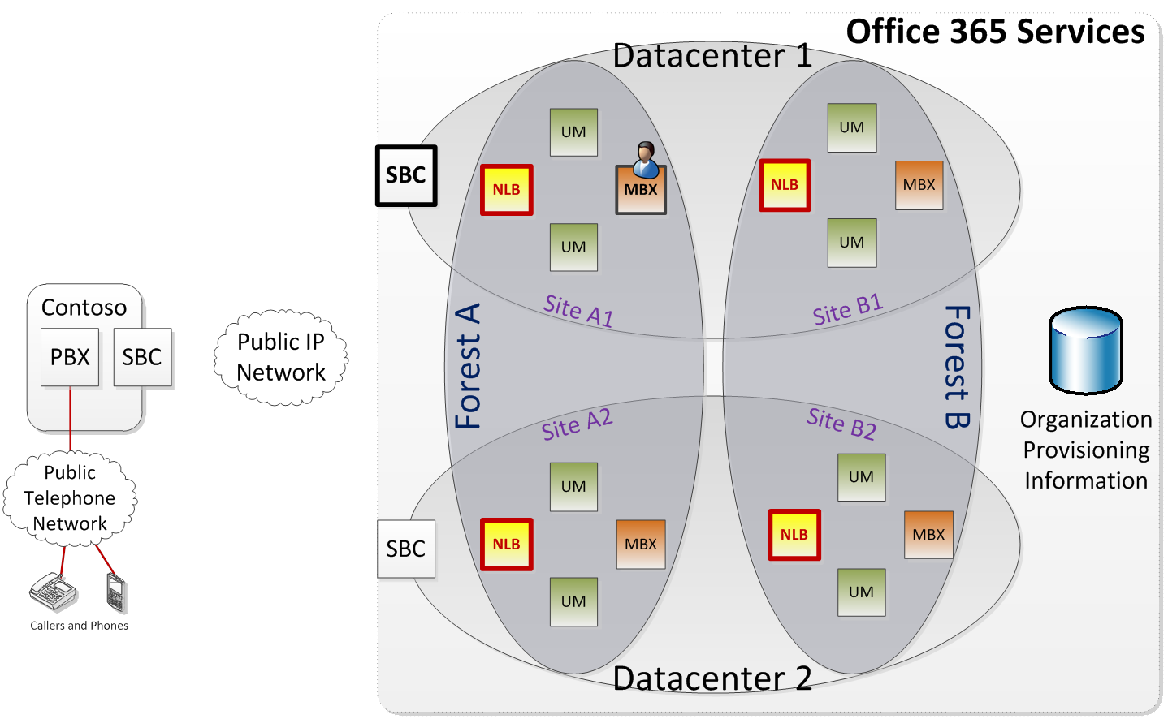
Availability, Redundancy and Redirection
UM Online SBC obtains addresses of all UM load balancers in the region

Slide 43
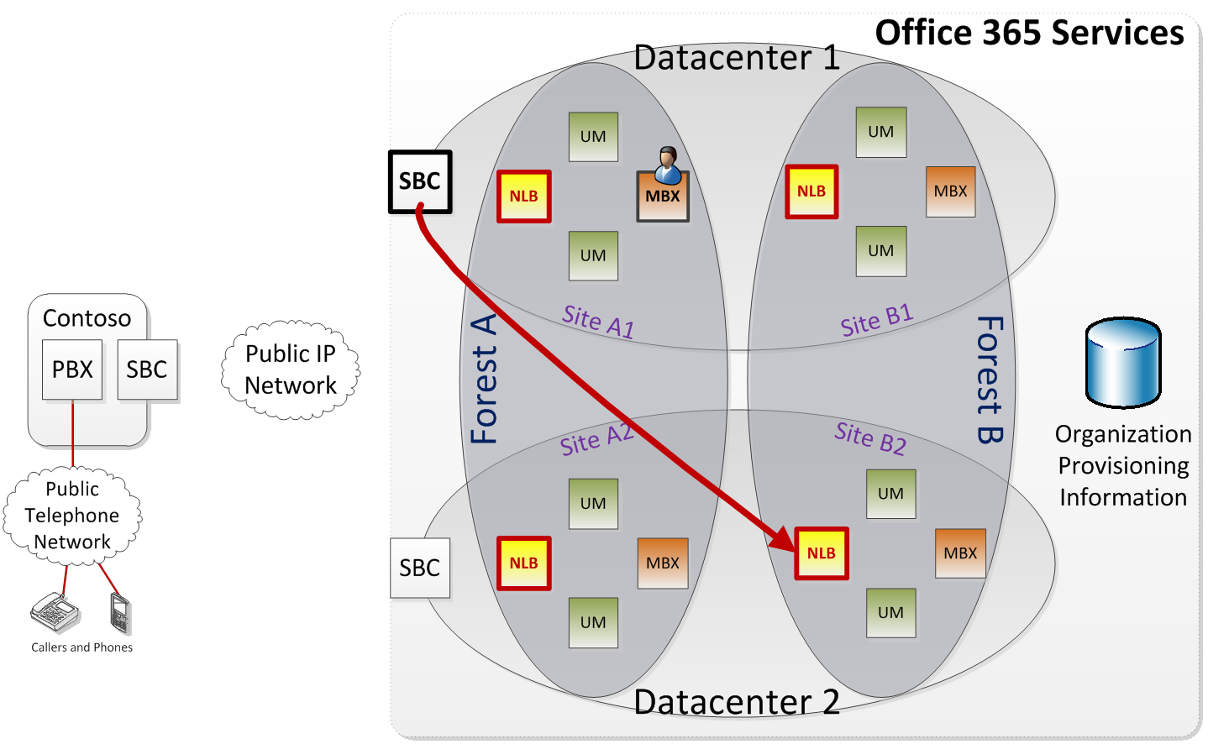
Availability, Redundancy and Redirection
UM Online SBC sends the call to one of the UM load balancers that it discovered

Slide 44
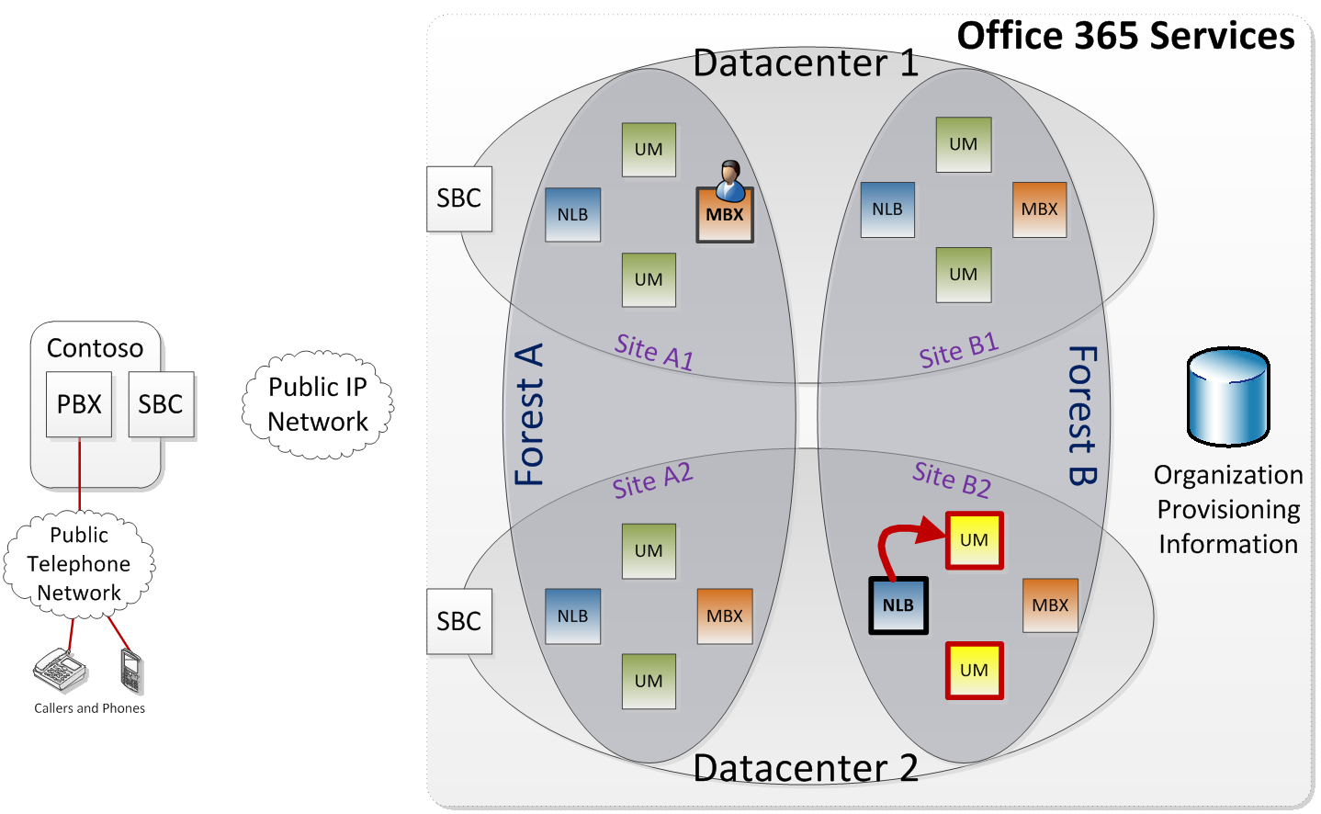
Availability, Redundancy and Redirection
Load balancer sends call to an active UM server in the site

Slide 45
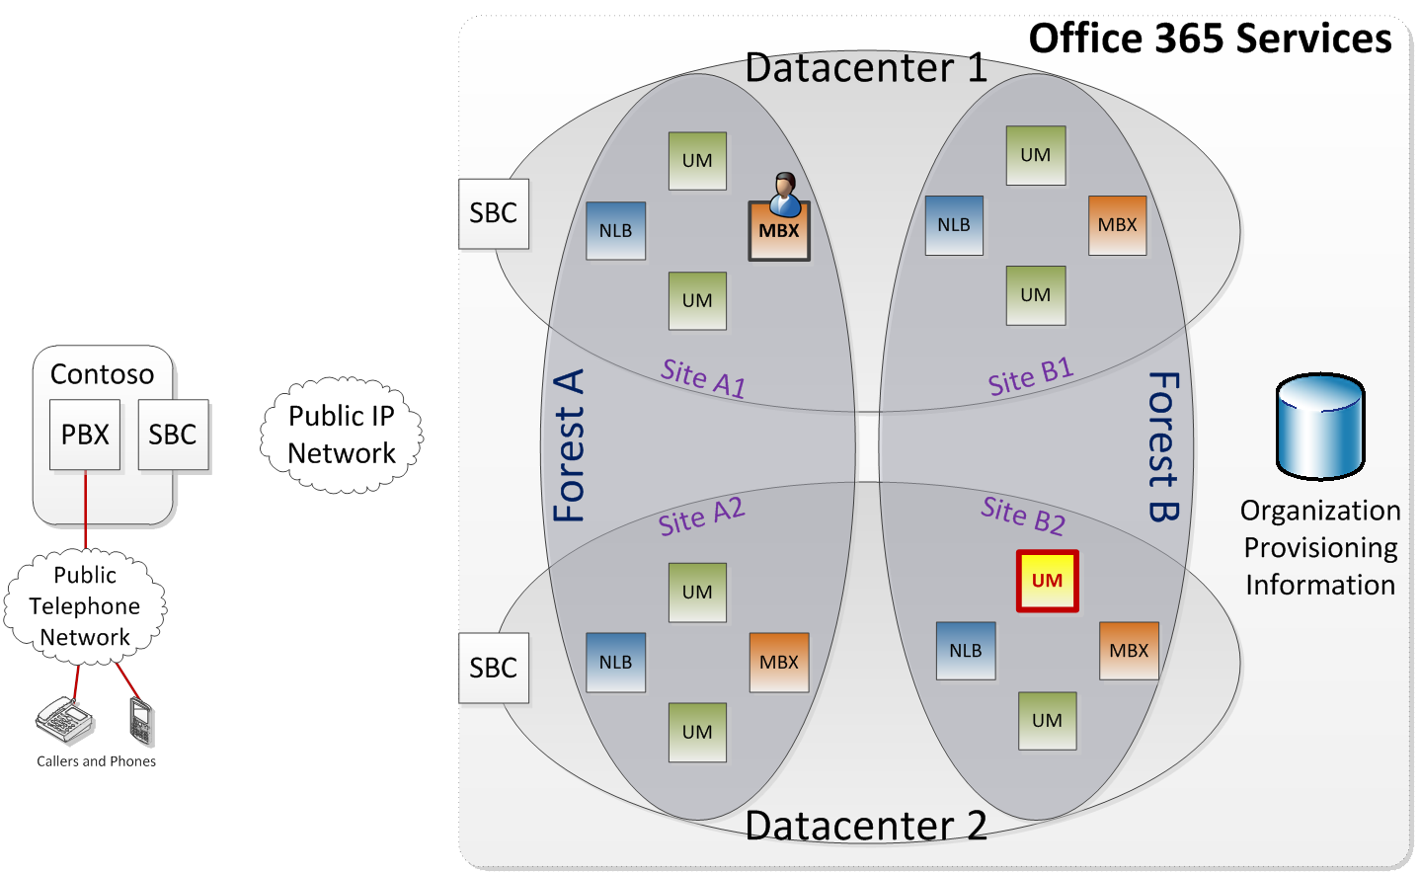
Availability, Redundancy and Redirection
UM server looks for organization matching guid in Forest B: fails to find it

Slide 46
Availability, Redundancy and Redirection
UM server searches organization provisioning information for Contoso guid and discovers forid

Slide 47
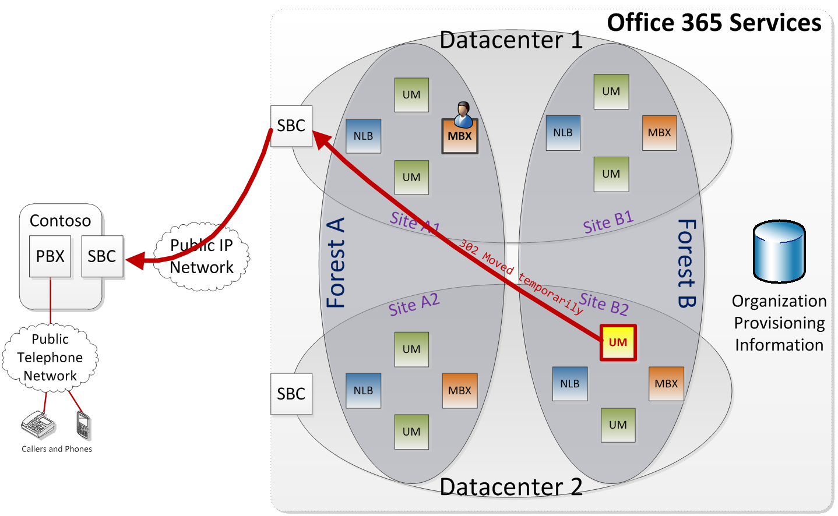
Availability, Redundancy and Redirection
UM server sends redirection response to forid.um.prod.outlook.com back to Contoso’s SBC

Slide 48
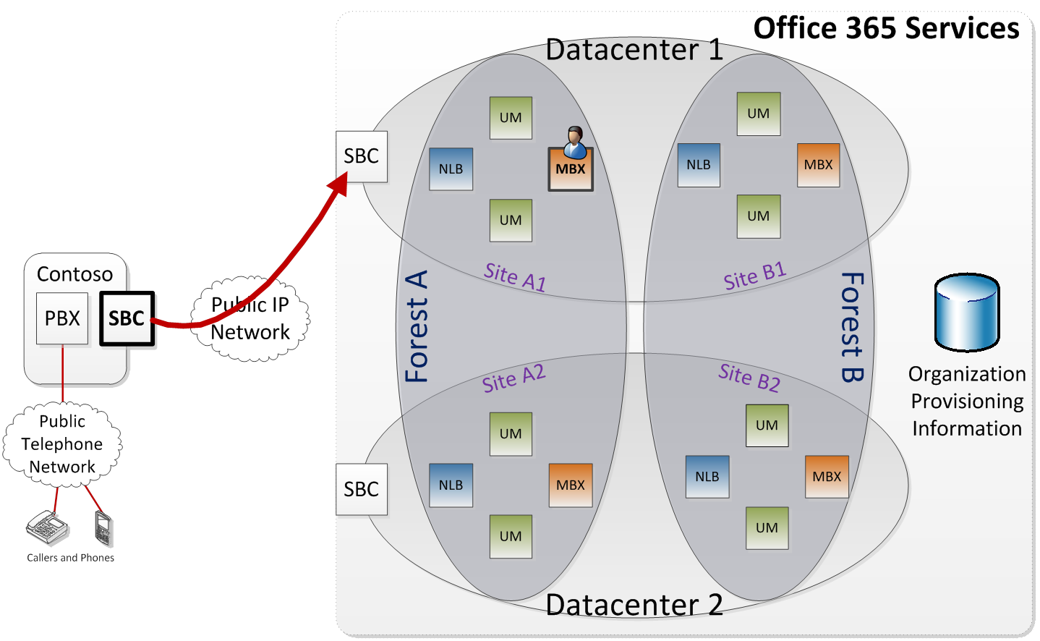
Availability, Redundancy and Redirection
Contoso’s SBC sends call to forid.um.prod.outlook.com

Slide 49
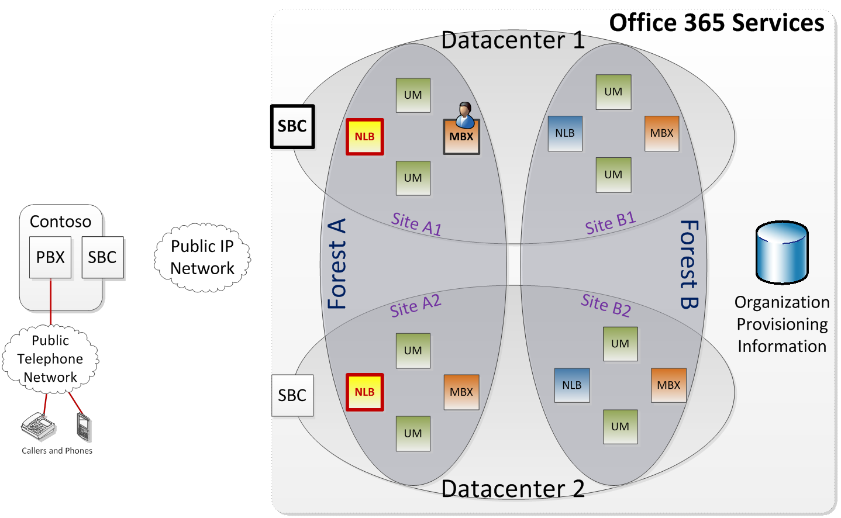
Availability, Redundancy and Redirection
Online SBC uses DNS to resolve forid.um.prod.outlook.com, obtains IP addresses of UM load balancers for the forest

Slide 50
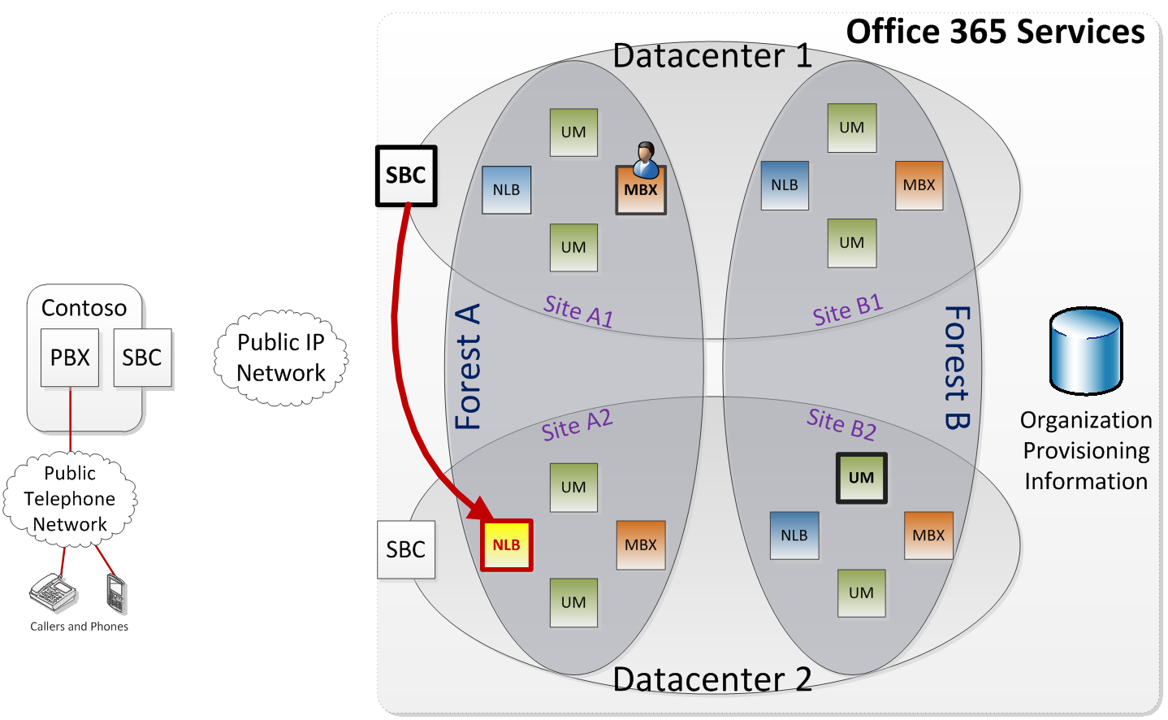
Availability, Redundancy and Redirection
UM Online SBC sends the call to one of the UM load balancers that it discovered

Slide 51
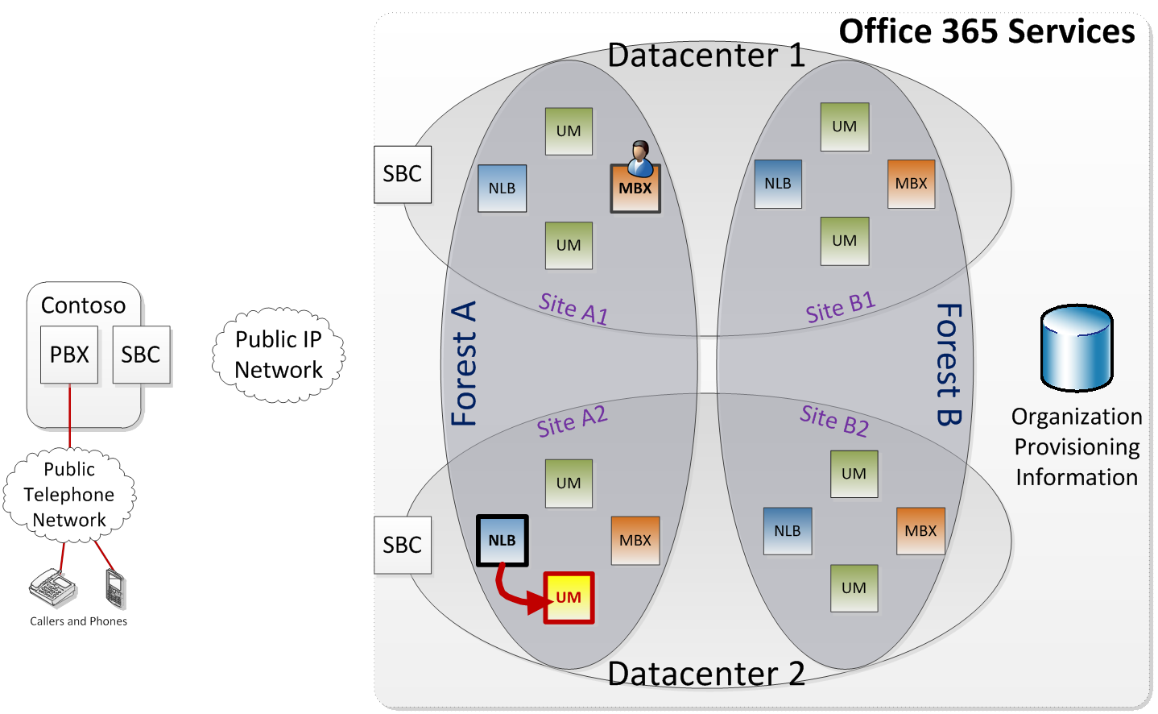
Availability, Redundancy and Redirection
UM load balancer sends the call to one of the UM servers in the site

Slide 52
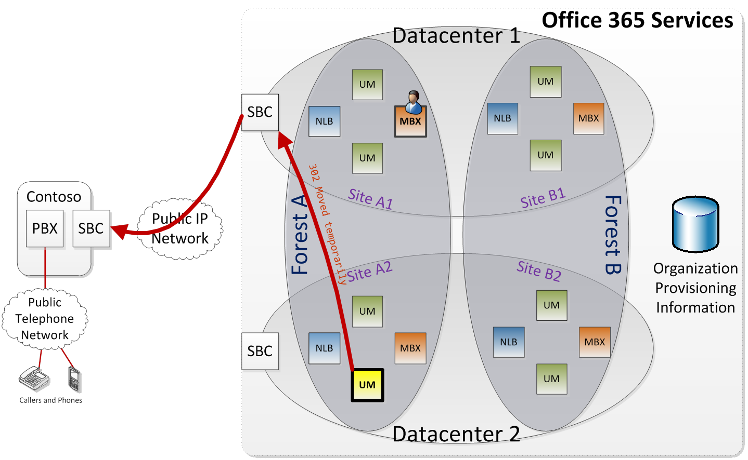
Availability, Redundancy and Redirection
UM server discovers IP gateway object (in Forest A) matching the CN in Contoso’s certificate, sends redirect to UM worker process

Slide 53

Availability, Redundancy and Redirection
Contoso SBC sends call to UM worker process

Slide 54
Availability, Redundancy and Redirection
UM worker process discovers that user’s mailbox is in Site A1, sends redirect to siteid.um.prod.outlook.com

Slide 55
Availability, Redundancy and Redirection
Contoso’s SBC sends call to siteid.um.prod.outlook.com

Slide 56
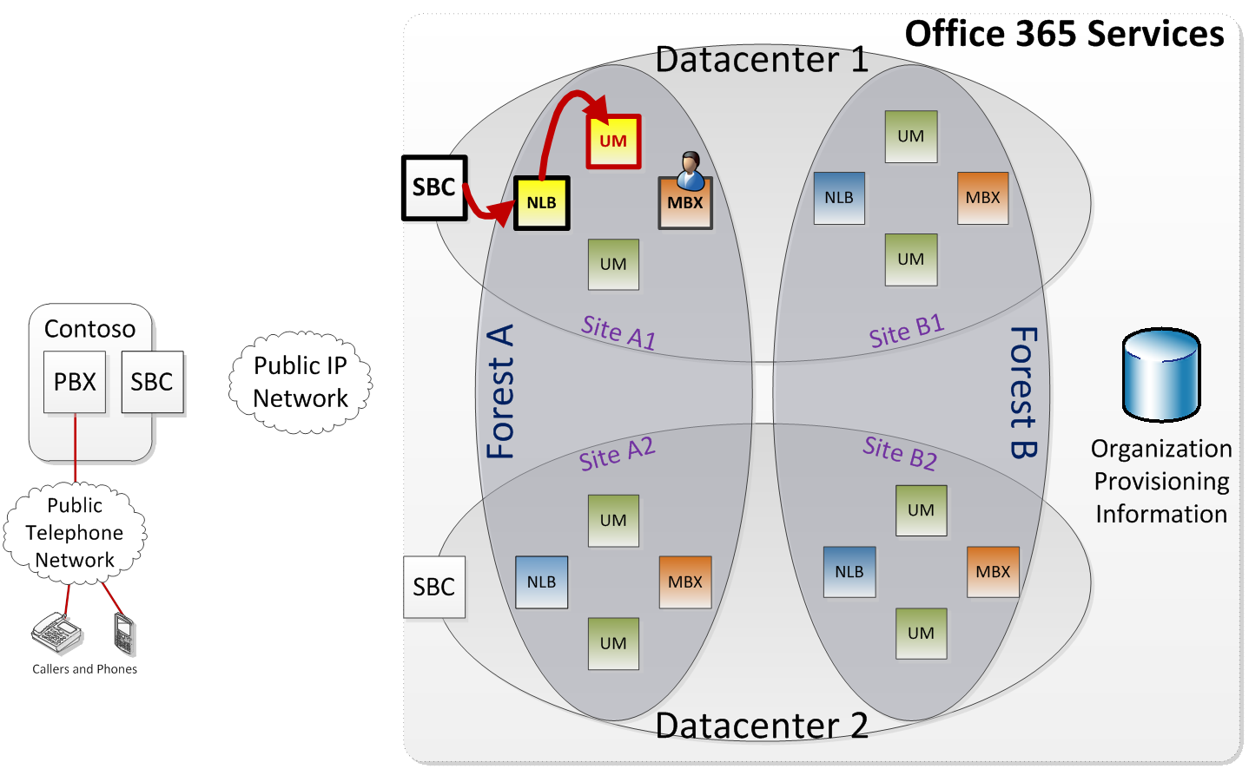
Availability, Redundancy and Redirection
Online SBC sends call to UM load balancer, which sends it to a UM server in the site

Slide 57
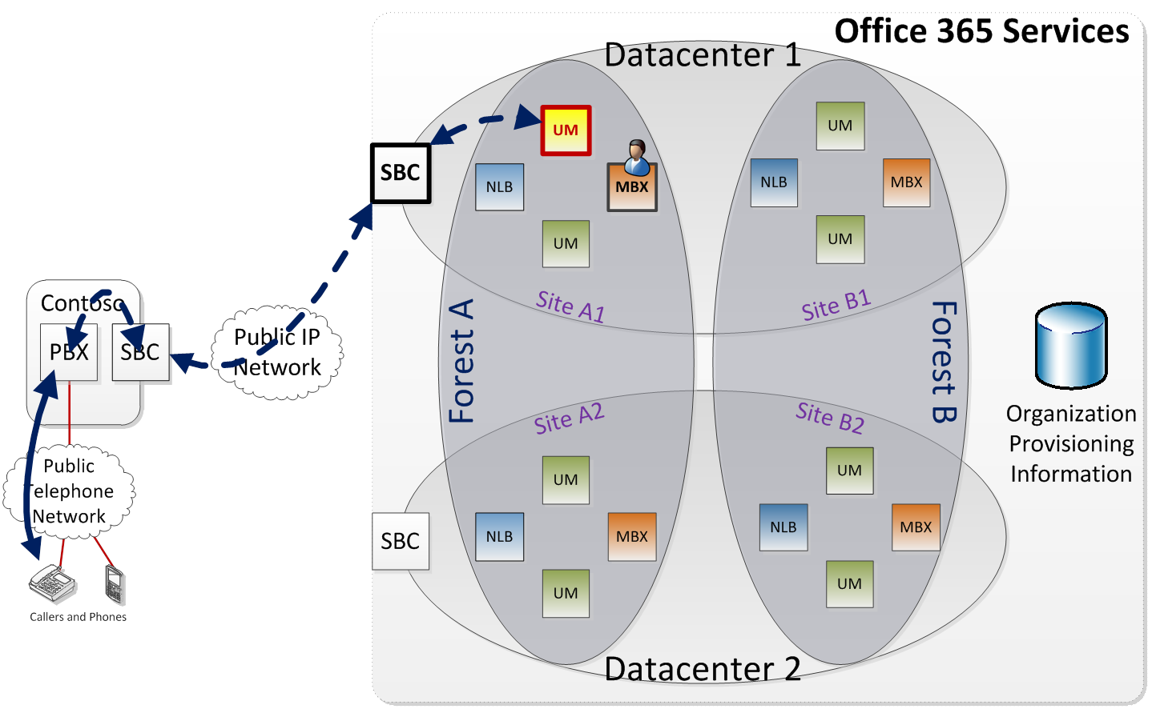
Availability, Redundancy and Redirection
UM server answers the call, negotiates 2-way audio media, opens mailbox, plays user’s greeting, record message, etc.

Slide 58
Availability and Redundancy: Discussion
Similar design (to SBC call flows) for calls sent from Lync
Indirection increases system flexibility and availability
Configure as directed
  Lync: Hosted Voice Mail Policy ➔ exap.um.outlook.com
  SBC: Forwarded traffic ➔ guid*.um.outlook.com
These addresses will provide service even if…
  …your mailboxes are moved to another site
  …there is a failure at UM server, site or datacenter level
* Forwarding address (globally unique) of the UM IP Gateway object

Slide 59
Summary

Slide 60
Unified Messaging in Microsoft Office 365
Exchange UM: Software and Online Service
  Software: Exchange 2010 SP1 UM
  Service: Exchange UM Online
Features almost identical
Customer must have “dial tone” provided on their premises
  Lync Server 2010 (including Lync Edge Server role), or
  UM-compatible PBX, VoIP Gateway* and Session Border Controller
Available to users in most countries offering Office 365
* VoIP Gateway not needed for PBXs with all-IP integration with UM

Slide 61
Related Content
EXL311 Microsoft Exchange Server and Microsoft Office 365: How to Set Up a Hybrid Deployment
EXL323 Setting Up and Deploying Microsoft Lync Server 2010 Edge Servers
OSP216 Office 365 Deployment Overview

Slide 62
Track Resources
New information for anyone running Exchange 2010 (including UM):
Best Practices for Virtualizing Exchange Server 2010 with Windows Server® 2008 R2 Hyper V™ (White Paper)
http://www.microsoft.com/downloads/en/details.aspx?FamilyID=8647c69d-6c2c-40ca-977e-18c2379b07ad

Slide 63





Resources
  Connect. Share. Discuss.
http://northamerica.msteched.com
Learning
  Sessions On-Demand & Community
  Microsoft Certification & Training Resources
www.microsoft.com/teched
www.microsoft.com/learning
  Resources for IT Professionals
  Resources for Developers
http://microsoft.com/technet
http://microsoft.com/msdn

Slide 64












Complete an evaluation on CommNet and
enter to win!

Slide 65

Notes:
New for TechEd 2011, we will be working with Microsoft Tag (http://tag.microsoft.com/overview.aspx) to create unique Tags for every session at the event. Your session Tag will appear on both the room signage and at the end of your presentation. With your session Tag, attendees will be able to scan as they enter the room to retrieve session details, view speaker bios, and engage in discussions; or scan at the end of the presentation to evaluate your session and download materials. We’re excited to integrate Microsoft Tag across the My TechEd mobile experience this year.

Slide 66

© 2011 Microsoft Corporation. All rights reserved. Microsoft, Windows, Windows Vista and other product names are or may be registered trademarks and/or trademarks in the U.S. and/or other countries.
The information herein is for informational purposes only and represents the current view of Microsoft Corporation as of the date of this presentation. Because Microsoft must respond to changing market conditions, it should not be interpreted to be a commitment
on the part of Microsoft, and Microsoft cannot guarantee the accuracy of any information provided after the date of this presentation. MICROSOFT MAKES NO WARRANTIES, EXPRESS, IMPLIED OR STATUTORY, AS TO THE INFORMATION IN THIS PRESENTATION.

