Slide 1

Microsoft Lync Server 2010
Edge Servers
EXL323
Rui Maximo
Principal Content Architect

Slide 2





NextHop Community http://nexthop.info
Aims to foster the Lync community:
  blog roll
Listen to customers:
  doc feedback: LyncDoc@microsoft.com
  email: nexthop@microsoft.com
Stimulate a dialogue:
  tweet: http://www.twitter.com/DrRez
  Facebook

Slide 3

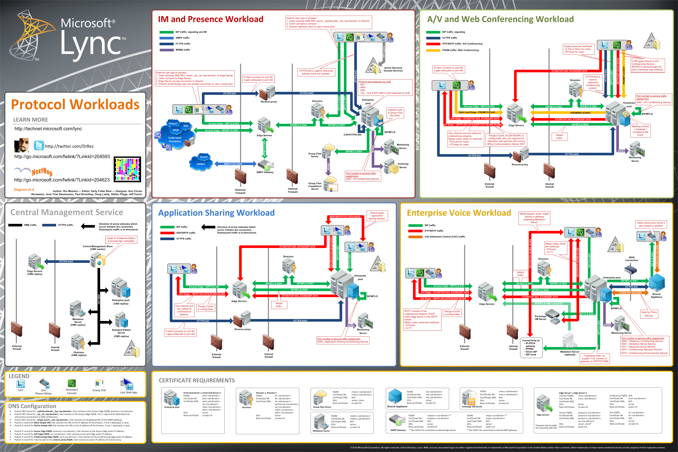
Educate and inform
  Tech Center home page
  Technical Library
  First Run videos
  Visio Protocol Flow poster
  Lync Powershell blog
  Next Hop blog

Slide 4
Lync Server Edge scenarios
  External User Access
    Lync clients can transparently connect to the Lync Server deployment over the public Internet
  PIC
    Connecting with public IM providers
  Federation
    Federation with other Enterprises
    IM&P only, or
    All modalities A/V and Application Sharing

Slide 5
Edge supported scenarios
Scenario | Remote User | Federated | Anonymous | PIC/ Interop
Presence | ü | ü |  | ü
IM Peer-to-Peer | ü | ü |  | ü
IM conferencing | ü | ü | ü
Collaboration | ü | ü | ü
A/V Peer-to-Peer | ü | ü |  | ü (Latest WLM*)
A/V Conferencing | ü | ü | ü
File Transfer | ü | ü
* Windows Live Messenger

Slide 6
Why should I care?
Traversing NATs

Slide 7
More Terms & Acronyms
Candidate
  Possible combination of IP address and port for media channel
NAT
  Network Address Translation
TURN
  Traversal Using Relay NAT
STUN
  Simple Traversal of UDP through NAT
  Session Traversal Utilities for NAT

Slide 8

Home NATs
General NAT/Firewall behavior
  Allow connections from the private network
  Blocks connection from the Internet
Security/usability tradeoff
  Blocks attackers from harming your system
  PROBLEM: Also blocks incoming signaling and media
Home
Internet
Home NAT

Slide 9
Corporate Firewalls
Though more scrutinized, goals are similar
  Sharing of IP addresses
  Controlling data traffic from the internet
Two firewalls isolate via perimeter network
Work
Internet
Perimeter
Network
Outer FW
Inner FW

Slide 10
Why is NAT Traversal a problem?
UDP
TCP
SIP signaling over TCP uses Access Edge
UDP media flows over separate channel
Pre-ICE endpoints uses local IPs & ports
No media can be sent between (a) and (w)
INVITE
m/c = a
Access
Edge
200 OK
m/c = w
Home
Work
a
w
Home NAT
Outer FW
Inner FW

Slide 11
Solution – STUN, TURN, ICE
Add a Media Relay (aka A/V Edge Server)
  STUN reflects NAT addresses (b) and (e)
  TURN relays media packets (c) (d) (x) (y)
ICE exchanges candidates (cand) and determines optimal media path
All three protocols based IETF standards
UDP
TCP
INVITE
m/c = a
Access
Edge
200 OK
m/c = w
Home
cand=a,b,c,d,e
cand=w,x,y
Work
a
b
c
STUN
TURN Server
(AV Edge)
e
d
w
x
y
Home NAT
Outer FW
Inner FW

Slide 12
What Reference Architectures can I use?
  Edge with single IP address
  Edge with multiple IP addresses
  Edge with NAT-ed IP addresses
Edge Topologies

Slide 13

Single IP address Edge
Edge Server
edge.contoso.com
131.107.155.10
SIP: 5061
Web Conf: 444
A/V Conf: 443, 3478
edge-int.contoso.com
172.25.33.10
SIP: 5061
Web Conf: 8057
A/V Conf: 443, 3478
External
Internal

Slide 14
Multiple IP address Edge
access.contoso.com
131.107.155.10 443, 5061
Edge Server
External SIP
edge-int.contoso.com
172.25.33.10
SIP: 5061
Web Conf: 8057
A/V Conf: 443, 3478
webcon.contoso.com
131.107.155.20 443
External Web Conf
Internal
av.contoso.com
131.107.155.30 443, 3478
External AV

Slide 15
Edge using NAT IP addresses
Public IP space
NAT
Edge Server
IP1’
IP1
External SIP
Lync Server does not need
to know translated SIP and
Web Conf IP
IP2’
IP2
Client
External Web Conf
Int
Clients connect to
IP for A/V traffic
Translated AV IP must
be configured in Lync
Server
IP3’
IP3
External AV

Slide 16
What Load Balancing options are available?
  DNS Load Balancing using NAT
  Hardware Load Balancing (HLB)
Edge Topologies

Slide 17
DNS Load Balanced Edge
Public IP space
Edge Server 1
IP1
DNS A records
access.contoso.com IP1 and IP4
webcon.contoso.com IP2 and IP5
av.contoso.com IP3 and IP6
IP2
Int
IP3
Edge Server 2
Client
IP4
IP5
Int
Client can retrieve and handle multiple IP
addresses and can fail over
DNS server returns randomized IP address
IP6

Slide 18
DNS Load Balanced Edge using NAT
NAT
Public IP space
Edge Server 1
IP1’
IP1
DNS A records
access.contoso.com IP1’ and IP4’
webcon.contoso.com IP2’ and IP5’
av.contoso.com IP3’ and IP6’
IP2’
IP2
Int
IP3’
IP3
Translated AV IP addresses must
be configured in Lync Server individually
IP3 to IP3’
IP6 to IP6’
Edge Server 2
IP4’
IP4
IP5’
IP5
Int
IP6’
IP6

Slide 19
Hardware Load Balanced Edge
HLB
Public IP space
Edge Server 1
IP1
DNS A records
access.contoso.com VIP1
webcon.contoso.com VIP2
av.contoso.com VIP3
IP2
Int
VIP1
IP3
VIP2
AV client connections are initiated over the VIP.
Subsequent client AV traffic (UDP) connect directly to Edge.
TCP traffic continues to use VIP.
NAT and HLB is not possible
VIP3
Edge Server 2
IP4
IP5
Int
IP6

Slide 20
DNS Load Balancing and Interop/Migraion
Co-existence/Side-by-Side
  OCS 2007 OR OCS 2007 R2 pool and Edge Server can co-exist with Lync Server pool and Lync Edge Server
  Only a single Edge (server/pool) for Federation is possible
DNS Load Balancing
  Legacy components do not support DNS LB
  If co-existence time is short: DNS LB
  If co-existence time is long: Hardware LB

Slide 21
Why do you need it?
Reverse Proxy

Slide 22
Reverse Proxy and external access
  Forwards External HTTPS and HTTP traffic to Front End and Director Pool
  HTTPS
    Simple URLs (Join Launcher URL)
    Address Book (download and/or web service) ABS
    Distribution List Expansion DLX
    Web Ticket (Web Auth)
  HTTP
    Device Updates (Firmware)
    Device Update logs upload

Slide 23
Reverse Proxy and external access
  Simple URL forward to Director (recommended)
    Forwarding rule for Simple URL to a single Director (or Pool); port 443
    Reverse Proxy certificate’s SAN to contain base FQDN of each Simple URL
  Web External Pool traffic forwarded to pools by Reverse Proxy
    Reverse Proxy requires a forwarding rule each Web External FQDN (Front End Pool and Director); port 443
    If external Phone Devices are implemented, Reverse Proxy rule for port 80 is required
    Reverse Proxy certificate’s SAN to contain base FQDN of all configured Web external Pools (Front End Pool and Director)

Slide 24
Reverse Proxy
Front End Pool1
Reverse Proxy
Front End Pool2
Client
Director
join.contoso.com to Director
meet.fabrikam.com to Director
webext1.contoso.com to Pool 1
webext2.contoso.com to Pool 2
DNS LB not supported for HTTP/S traffic
SAN in Reverse Proxy Certificate

Slide 25
How do clients establish A/V connections?
Authentication

Slide 26

Credentials for remote client
SIP Subscribe
200 OK
Access
Edge
ms-user-logon-data: RemoteUser
<mrasUri>sip:Mras.contoso.com
OCS FE
Server
SIP Service
<location>internet</location>
200 OK
<hostName>avedge.contoso.com
<udpPort>3478
<tcpPort>443
<username> 77qq8yXccBc2lwOmFy
<password> Wnujl0eo00YkV/5dg=
<duration>480
Service
MTLS
200 OK
MRAS
A/V
Edge
Outer
Firewall
Inner
Firewall
Endpoint

Slide 27
Credentials for Conferencing
SIP Invite
OCS FE
Server
Access
Edge
200 OK
<hostName>avedge.contoso.com
<udpPort>3478
<tcpPort>443
<username> 77qq8yXccBc2lwOmFy
<password> Wnujl0eo00YkV/5dg=
<duration>480
3CP: Add User
200 OK
{MRAS Credentials}
Service
MTLS
A/V
MCU
200 OK
A/V Auth
A/V
Edge
Endpoint
Outer
Firewall
Inner
Firewall

Slide 28
How do I secure my Edge Server?
Security

Slide 29
Tips to secure my Edge Servers
Use a different subnet.
Lock down the routing rules for access to that subnet (disable broadcast, multicast, and traffic to other perimeter network subnets).
Sandwich the Edge Server between 2 firewalls.
Leverage the Lync Server 2010 security guide
Read and use the information in Protecting the Edge Server Against DoS and Password Brute-Force Attacks in Lync Server 2010

Slide 30
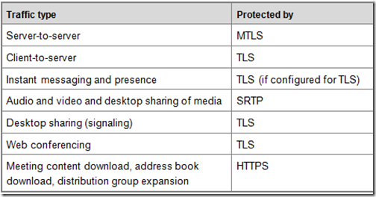
Secure Communications in Lync
Can someone sniff the packets and access my IM/audio/video/data?

Slide 31


Lync Server Security Filter
What is it?
SPL script + .NET service that runs on the Edge Server.
Must be registered to Edge Server via PowerShell.
Intercepts all remote user sign-in requests/responses.
2
3
Count:
1
Lockout: 2
Timeout: 5 minutes
Sign-in request
Sign-in request
response
response
Sign-in request
Sign-in request
response
response
Sign-in blocked

Slide 32
Lync Server Security Filter
What does it do?
Cracks the NTLM and TLS-DSK authentication payload (SIP request).
Extracts unique identifier from authentication packet.
  TLS-DSK: extracts client certificate.
  NTLM: extracts username and domain name.
Tracks number of failed sign-in attempts (SIP response).
If number of failed sign-in attempts exceed threshold, subsequent sign-in requests are blocked at Edge Server.
Once timeout period expires, user can attempt to sign-in again.

Slide 33
What to exclude from my antivirus program running on my Lync Server 2010
Lync Server 2010 processes:
Directories:
FileTransferAgent.exe
MasterReplicatorAgent.exe
MediaRelaySvc.exe
MRASSvc.exe
OcsAppServerHost.exe
QmsSvc.exe
ReplicaReplicatorAgent.exe
RTCArch.exe
RtcCdr.exe
RTCSrv.exe
%systemroot%\System32\LogFiles
%systemroot%\SysWow64\LogFiles

Slide 34
What to exclude from my antivirus program running on my Edge Server
IIS processes:
%systemroot%\system32\inetsrv\w3wp.exe
%systemroot%\SysWOW64\inetsrv\w3wp.exe
SQL Server processes:
%ProgramFiles%\Microsoft SQL Server\MSSQL10.MSSQLSERVER\MSSQL\Binn\SQLServr.exe
%ProgramFiles%\Microsoft SQL Server\MSRS10.MSSQLSERVER\Reporting Services\ReportServer\Bin\ReportingServicesService.exe
%ProgramFiles%\Microsoft SQL Server\MSAS10.MSSQLSERVER\OLAP\Bin\MSMDSrv.exe

Slide 35
Edge Validation
Public Web Service Tool available for Edge Validation
Supports OCS 2007 R2 and Lync Server 2010
https://www.testocsconnectivity.com

Slide 36
How to establish connections across firewalls?
Address Discovery

Slide 37
Address Discovery (AV)
nic
a
c
default
a
MRAS
b
candidate list
Allocate UDP
b
c
c
Media
Relay
d
Allocate TCP
d
e
e
local
remote
UDP
TCP
Endpoint
NAT/Firewall

Slide 38
Address Discovery (Desktop Sharing)
nic
a
c
default
a
MRAS
b
c
candidate list
Media
Relay
Allocate TCP
b
c
local
remote
UDP
TCP
Endpoint
NAT/Firewall

Slide 39
Address Exchange
nic
nic
a
b
x
w
SIP INVITE
c :: a,b,c,d
local
remote
remote
local
c
default
y
c
default
y
183 Session Progress
y :: w,x,y,z
a
w
a
w
x
200 OK
y :: w,x,y,z
b
b
x
candidate list
candidate list
c
y
c
y
d
z
d
z
c
y
TURN
TURN
d
z
SIP
Endpoint
NAT/Firewall
NAT/Firewall
Endpoint
39

Slide 40
What ports do I really need to open?
Federation

Slide 41
Port Requirements for Audio/Video
Lync 2010
    UDP 3478, TCP 443
  UDP/TCP 50,000-59,999 inbound/outbound
    Enables federation with OCS 2007 Edges
OCS 2007 R2
  UDP 3478, TCP 443
    No additional ports needed for remote access only
  TCP 50,000-59,999 outbound
    Enables federation with R2 Edges
  UDP/TCP 50,000-59,999 inbound/outbound
    Enables federation with OCS 2007 Edges
OCS 2007
  UDP 3478, TCP 443
  UDP/TCP 50,000-59,999 inbound/outbound

Slide 42

A/V Federation 2007-2007
Access
Proxy
Access
Proxy
Work1
OC/Console
A/V MCU
w1
w2
Work2
OC/Console
A/V MCU
UDP
3478
TCP
443
UDP
3478
TCP
443
UDP/TCP
50000
.
.
.
.
.
.
.
.
.
UDP/TCP
59999
UDP/TCP
50000
.
.
.
.
.
.
.
.
.
UDP/TCP
59999
w1
w2
w1
w2
Inner FW
2007
Edge
Outer FWs
(no NAT)
2007
Edge
Inner FW

Slide 43
A/V Federation R2 Tunnel Mode
Access
Proxy
Access
Proxy
Work1
OC/Console
A/V MCU
w1
w2
Work2
OC/Console
A/V MCU
UDP
3478
TCP
443
UDP
3478
TCP
443
UDP/TCP
50000
.
.
.
.
.
.
.
.
.
UDP/TCP
59999
UDP/TCP
50000
.
.
.
.
.
.
.
.
.
UDP/TCP
59999
w1
w2
w1
w2
Inner FW
R2
Edge
Outer FWs
(no NAT)
R2
Edge
Inner FW

Slide 44

A/V Federation R2-2007 Interop
Access
Proxy
Access
Proxy
Work1
OC/Console
A/V MCU
w1
w2
Work2
OC/Console
A/V MCU
UDP
3478
TCP
443
UDP
3478
TCP
443
UDP/TCP
50000
.
.
.
.
.
.
.
.
.
UDP/TCP
59999
UDP/TCP
50000
.
.
.
.
.
.
.
.
.
UDP/TCP
59999
w1
w2
w1
w2
Inner FW
R2
Edge
Outer FWs
(no NAT)
2007
Edge
Inner FW

Slide 45
A/V Federation Lync
Access
Proxy
Access
Proxy
Work1
OC/Console
A/V MCU
w1
w2
Work2
OC/Console
A/V MCU
UDP
3478
TCP
443
UDP
3478
TCP
443
UDP/TCP
50000
.
.
.
.
.
.
.
.
.
UDP/TCP
59999
UDP/TCP
50000
.
.
.
.
.
.
.
.
.
UDP/TCP
59999
Inner FW
Lync
Edge
Outer FWs
(no NAT)
Lync
Edge
Inner FW

Slide 46

Related Content
Required Slide
Speakers, please list the Breakout Sessions, Interactive Discussions, Labs, Demo Stations and Certification Exam that relate to your session. Also indicate when they can find you staffing in the TLC.
Breakout Sessions (session codes and titles)
Interactive Sessions (session codes and titles)
Hands-on Labs (session codes and titles)
Product Demo Stations (demo station title and location)
Related Certification Exam
Find Me Later At…

Slide 47
Track Resources
Required Slide
Track PMs will supply the content for this slide, which will be inserted during the final scrub.
Planning for External User Access
Protecting the Edge Server Against DoS and Password Brute-Force Attacks in Lync Server 2010
Lync Server 2010 security guide
Ports and Protocols for Internal Servers

Slide 48





Resources
  Connect. Share. Discuss.
http://northamerica.msteched.com
Learning
  Sessions On-Demand & Community
  Microsoft Certification & Training Resources
www.microsoft.com/teched
www.microsoft.com/learning
  Resources for IT Professionals
  Resources for Developers
http://microsoft.com/technet
http://microsoft.com/msdn

Slide 49












Required Slide
Complete an evaluation on CommNet and
enter to win!

Slide 50

© 2011 Microsoft Corporation. All rights reserved. Microsoft, Windows, Windows Vista and other product names are or may be registered trademarks and/or trademarks in the U.S. and/or other countries.
The information herein is for informational purposes only and represents the current view of Microsoft Corporation as of the date of this presentation. Because Microsoft must respond to changing market conditions, it should not be interpreted to be a commitment
on the part of Microsoft, and Microsoft cannot guarantee the accuracy of any information provided after the date of this presentation. MICROSOFT MAKES NO WARRANTIES, EXPRESS, IMPLIED OR STATUTORY, AS TO THE INFORMATION IN THIS PRESENTATION.

