Slide 1

Development Insights of Microsoft Exchange Server and Microsoft Lync Server 2010 against Microsoft Office 365
EXL324
Robin Thomas – Sr Program Manager
Albert Kooiman – Sr Technical Product Manager
Microsoft

Slide 2
Microsoft Exchange Server

Slide 3
Exchange API Evolution
1992
1995
1996
1997
1998
2000
2001
2003
2006
2009
2010-11
MS Mail 3.0
Simple MAPI 1.0
Exchange 5.0
Active Messaging 1.1 (a.k.a. CDO 1.1)
Exchange 2000
Backup and Restore API (a.k.a. ESEdbcli2)
CDO for Exchange 2000 (CDOEx)
CDO for Exchange Management (CDOExM)
CDO for Workflow
Exchange Installable File System
Exchange OLEDB provider (ExOLEDB)
WSS Forms + FrontPage Extensions
OWA URL commands
Queue Viewer API
Store Events
WebDAV
WMI classes for Exchange management
Workflow Designer for Exchange 2000
Exchange 2007
Exchange Web Services
PowerShell
Transport APIs
Exchange 4.0
Directory API
Electronic Forms Designer
Exchange Developer Kit Gateway API
OLE Messaging 1.0a (a.k.a. CDO 1.0a)
Common Messaging Calls 1.0
Exchange 5.5
Collaborative Data Objects 1.2
CDO Rendering Library (CDOHTML)
Event Service Agents
Exchange 2010
Exchange Web Services
Managed API 1.0
Remote PowerShell
Exchange 5.5 SP1
CDO 1.2.1
Routing Objects
HTML Forms Converter
Exchange Web Services Managed API 1.1
Exchange Web Services Java API 1.1
Exchange 5.5 SP3
Virus Scanning API 1.0
Exchange 2000 SP1
Virus Scanning API 2.0
Windows 95
Extended MAPI
Exchange 2003
Virus Scanning API 2.5
NT Option Pack 4.0
CDO for Windows NT (CDONTS)
Windows 2000
CDO for Windows 2000 (CDOSYS)
SMTP Transport Events

Slide 4
Exchange Server 2010 API Changes
Deprecated APIs and alternatives
Exchange Server 2003 client APIs are in to extended support
  Collaboration Data Objects (CDO) 1.2.1
  Microsoft Exchange Server MAPI Client
  (Messaging Application Programming Interface)
Both can be replaced by Exchange Web Services
API | Functionality | Replacement
CDOEX | Mailbox Access | EWS
Exchange WebDAV | Remote Mailbox Access | EWS
ExOleDB (ADO provider) | Mailbox Access | EWS
OWA URL Commands | Free/Busy and Name Resolution | EWS
Store Events | Asynchronous and Synchronous Events | Transport Delivery Events/ EWS
No support for ExchangeOnline!

Slide 5
EWS: Compared against Legacy APIs
EWS is the one API to support all application models
 | ExOleDB | CDO 3.0 for Exchange | CDO 1.2.1 | Exchange MAPI Client | Exchange WebDAV | Exchange Web Services | EWS Managed API 1.1
Supports User Experience Consistent with Outlook |  | √ | √ |  |  | √ | √
Supports Local Access |  | √ |  |  |  | √ | √
Supports Intranet Access |  |  | √ | √ |  | √ | √
Supports Internet Access |  |  |  |  | √ | √ | √
Supports New Exchange 2007 and Exchange 2010 functionality |  |  |  |  |  | √ | √
Mainstream Support Available |  |  |  |  |  | √ | √
Works on Exchange 2003 | √ | √ | √ | √ | √

Slide 6
The Way Forward
Content, Management, Control
Exchange Web Services APIs
  API for interacting with Mailbox Content
  Email, Calendaring, Contacts, Tasks
  Endpoint Discovery (AutoDiscover)
  Authentication and Login
  Delegation and Impersonation
  Change Notifications
  User and Application Settings Configuration
Online Ready
PowerShell APIs
  API for Exchange Management
  Mailbox creation
  Server Configuration
  Resource Management
Online Ready
Transport APIs
  API for controlling the flow of content
  Access to message properties and content in transport

Slide 7
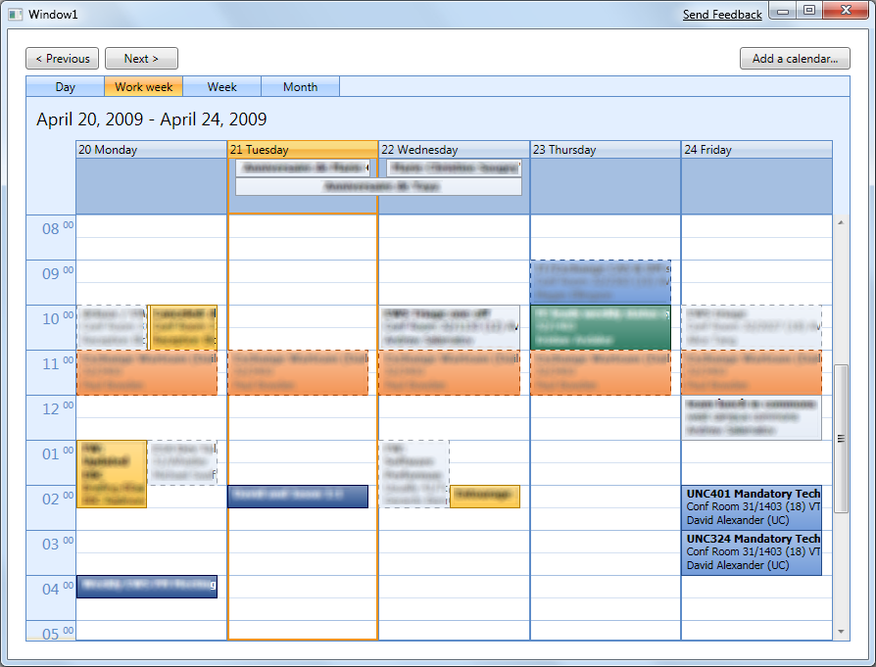

Exchange Web Services
The power of Web Services
  Rich Experience
  Enables full client functionality
  Application logic consistent
  with Outlook
  Easy to Use
  .NET Managed API
    Full Visual Studio integration
  Java API
  Online-Ready
  Single API for On-Premise + Cloud
  deployments

Slide 8
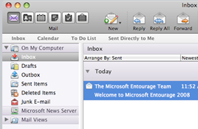
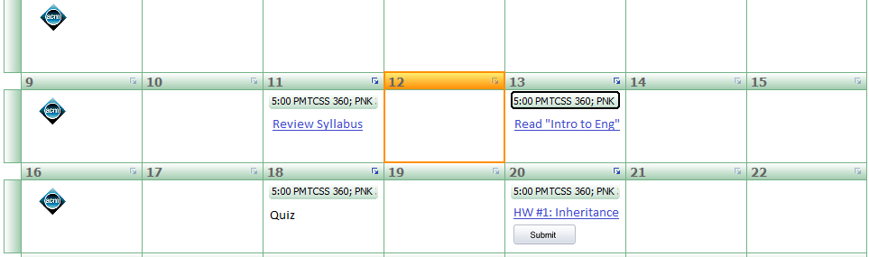

Sample Application Models Using EWS
Client Applications
  Email clients
  IM clients
  Mobile device applications
  VoiceMail solutions
Portal Applications
  Web Parts
    Shared Calendar Views
    5 Most Recent E-mails
  PIM Systems
    Course Management
    Room Availability
Service Applications
  Synchronization
    CRM/Back Office Integration
  Notifications
    Auto-Scheduler Applications
    Mailer Applications

Slide 9

Development Choices
Coding in the various EWS APIs paradigms available
GetFolderType request = new GetFolderType();
request.FolderShape = new FolderResponseShapeType();
request.FolderShape.BaseShape = DefaultShapeNamesType.AllProperties;
DistinguishedFolderIdType inboxId = new DistinguishedFolderIdType();
inboxId.Id = DistinguishedFolderIdNameType.inbox;
request.FolderIds = new BaseFolderIdType[] { inboxId };
GetFolderResponseType response = serviceBinding.GetFolder(request);
FolderInfoResponseMessageType responseMessage =
response.ResponseMessages.Items[0] as FolderInfoResponseMessageType;
if (responseMessage.ResponseClass == ResponseClassType.Success)
{
FolderType inbox = responseMessage.Folders[0] as FolderType;
}
<soap:Envelope>
<soap:Body>
<m:GetFolder>
<m:FolderShape>
<t:BaseShape>AllProperties</t:BaseShape>
</m:FolderShape>
<m:FolderIds>
<t:DistinguishedFolderId Id="inbox" />
</m:FolderIds>
</m:GetFolder>
</soap:Body>
</soap:Envelope>
<s:Envelope>
<s:Body>
<m:GetFolderResponse>
<m:ResponseMessages>
<m:GetFolderResponseMessage
ResponseClass="Success">
<m:ResponseCode>NoError</m:ResponseCode>
<m:Folders>
<t:Folder>
<t:FolderId Id="..." ChangeKey="..." />
<t:FolderClass>IPF.Note</t:FolderClass>
<t:DisplayName>Inbox</t:DisplayName>
...
</t:Folder>
</m:Folders>
</m:GetFolderResponseMessage>
</m:ResponseMessages>
</m:GetFolderResponse>
</s:Body>
</s:Envelope>
Folder inbox = Folder.Bind(service, WellKnownFolderName.Inbox);
Increased Productivity
Raw XML
Auto-generated proxies
EWS Managed API
  “After working with Exchange for about 10 years I can say that this is by far the most intuitive and easy to use API ever and developers who never worked with Exchange before have little trouble using it. “
  – Fortune 500 Financial Services Company Developer
Cross-platform
No client-side logic
Manual plumbing
  Multiple platforms
  Class-based access
  No client-side logic
Multi-Platform (.NET 3.5 & Java)
Fully Object Oriented
Smart client-side logic

Slide 10

AutoDiscover
GOAL
Provide application with mailbox configuration information…
…and the most appropriate server URLs for client connectivity
The application is connecting from within the firewall, where should it go for MailTips?
AD Site: Main-US
https://main-us
AutoDiscover should be considered a requirement for a successful Exchange Online application!
https://spysrus.com
ISA-US
CAS-US
MBX-US
External
Firewall
Internal
Firewall
The application is outside the firewall, what is the right EWS URL?
AD Site: Main-Europe
The user is logging in from the Europe AD site but the mailbox is in US. What URL should it use for Availability Service?
https://main-eu
https://emea.spysrus.com
ISA-EU
CAS-EU
MBX-EU

Slide 11

AutoDiscover
ExchangeService service = new ExchangeService();
service.AutodiscoverUrl(“bobk@contoso.com");

Slide 12
AutoDiscover (Advanced)
AutodiscoverService autoDService = new AutodiscoverService();
List<string> users = new List<string>();
users.Add("sue@contoso.com");
users.Add(“joe@contoso.com");
UserSettingName[] properties = new UserSettingName[] { UserSettingName.ExternalEwsUrl, UserSettingName.UserDisplayName };
GetUserSettingsResponseCollection data = autoDService.GetUsersSettings(users, properties);

Slide 13
AutoDiscover
demo

Slide 14
Availability Service
The Availability Service retrieves free/busy information directly from the target resource (user, conference room, public folder, etc) including cross-forest resources.
In addition, the availability service provides:
  Meeting time suggestions
  Attendee working hours
  Additional data about attendee calendar appointments

Slide 15
Availability Service
List<AttendeeInfo> attendees = new List<AttendeeInfo>();
AttendeeInfo requiredAttendee = new AttendeeInfo(“carl@contoso.com");
requiredAttendee.AttendeeType = MeetingAttendeeType.Required;
requiredAttendee.ExcludeConflicts = true;
attendees.Add(requiredAttendee);
AttendeeInfo optionalAttendee = new AttendeeInfo(“sally@contoso.com");
optionalAttendee.AttendeeType = MeetingAttendeeType.Optional;
attendees.Add(optionalAttendee);
TimeWindow timeWindow = new TimeWindow(DateTime.Now, DateTime.Now.AddDays(2));
GetUserAvailabilityResults results = service.GetUserAvailability(attendees, timeWindow, AvailabilityData.FreeBusyAndSuggestions);

Slide 16
Availability Service
demo

Slide 17
Accessing mailboxes other than your own
Exchange supports two types of non-primary mailbox access:
  Delegate Access
  Application Impersonation
Delegate Access allows Kerry to access Bob’s mailbox “as Kerry” using Kerry’s credentials
  Think Outlook delegate access
Application Impersonation allows service account-like access to Bob’s mailbox acting “as Bob”

Slide 18



Application Impersonation
Enable middle-tier application to access user data without username/passwords
Creates a model for “impersonating” a user that is secure and easy
Application server verifies John’s identity
AppSrv01 was granted the ApplicationImpersonation role to John’s department
“John” connects to application server
AppSrv01$\NetworkService Impersonating “John”
Request for mailbox data made “as” John
Client
Application Server
Exchange 2010
Client Access Server
Exchange 2010
Mailbox Server

Slide 19
Delegate Access vs Application Impersonation
Delegate Access
ExchangeService service = new ExchangeService();
service.Credentials = kerryCreds;
FolderId folderId = new FolderId(WellKnownFolderName.Inbox, new Mailbox("bob@contoso.com"));
Folder Inbox = Folder.Bind(service, folderId);
Application Impersonation
ExchangeService service = new ExchangeService();
service.Credentials = svcAcctCreds;
service.ImpersonatedUserId = new ImpersonatedUserId(ConnectingIdType.SmtpAddress, "bob@contoso.com");
Folder inbox = Folder.Bind(service, WellKnownFolderName.Inbox);

Slide 20
Staying up to date
As of 2010 SP1, Exchange provides three options for getting individual change events from the mailbox
  Pull subscriptions, Push subscriptions, and Streaming notifications
Pull Subscriptions - After defining subscription criteria, the application asks the server for new events on a regular interval and “pulls” down the data.
Push Subscriptions - The application defines a subscription and a target URL, Exchange will then “push” events to that URL
Streaming Notifications - For a given subscription, the application will open a long lived connection to Exchange, Exchange will “stream” events back as they happen without closing the connection

Slide 21

Streaming Notifications
Available in ExchangeOnline and Exchange 2010 SP1
GetStreamingEvents Request
Notification
Subscription
Subscription Request
Event Data
Subscription Response
Client Application
Exchange 2010 SP1
Client Access Server
Exchange 2010 SP1
Mailbox Server

Slide 22

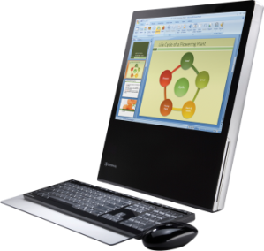


Transition To Exchange Online
Roadmap for Exchange Cloud Development
    Traditional Development
      Exchange on Premise
      Applications on Premise
Exchange
2007 SP1
    Hybrid S+S Software
      Exchange in the cloud (Exchange Online)
      Applications on Premise
Exchange
2010 SP1
    Pure Cloud Development
      Exchange in the Cloud (Exchange Online)
      Applications in the Cloud (Azure)
Exchange
2010 + Azure

Slide 23

Transition To Exchange Online
Area | Exchange 2007 On-Premise | Exchange 2010 On-Premise | Exchange 2010 Online
URL Discovery | AutoDiscover | AutoDiscover | AutoDiscover
Authentication | Windows Integrated | Windows Integrated | HTTP/S Basic
Authorization | Delegation | Delegation Application Impersonation | Delegation Application Impersonation
Throttling | Service Level | N/A | Service and User Level
  Plan for throttling and minimize your load on Exchange
  Think through cloud deployment and application provisioning
  Determine the authentication model that works best
      End User Credentials
      Application Impersonation for service account access

Slide 24
Microsoft Lync Online

Slide 25
Two Key APIs: Lync & UC Managed APIs
.NET
.NET
Your Client Application
Your Server Application
Integrate Lync 2010
Contextual Conversations
Extend Lync 2010
Build your Kiosk UI
Notifications & Alerts
Bots & IVR
Contact Center
Portals & Gateways
Lync 2010 Managed API
UC Managed API 3.0
Lync 2010
SIP / SIMPLE
Lync Server 2010

Slide 26
Lync 2010 Managed API
Integrate Lync Experiences
  Use SL & WPF controls to add UC to your LoB Apps
Contextualize Conversations
  Use the Controls and the Managed API to contextualize conversations
Extend Lync Capabilities
  Extend the Lync 2010 experience with your applications
Custom Client UI
  Customize controls. Build custom UI for standalone applications

Slide 27
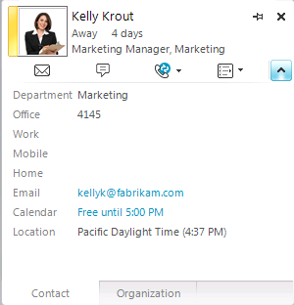
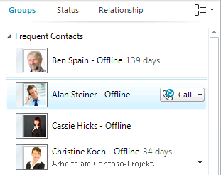
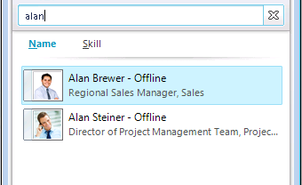
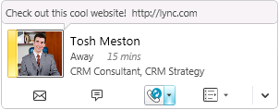


Integrate Lync Experiences
Silverlight and WPF Controls
Check details
Browse People
Find People
Click to communicate
Set personal status

Slide 28
Build Lync-look alike in 60 seconds
mini demo

Slide 29
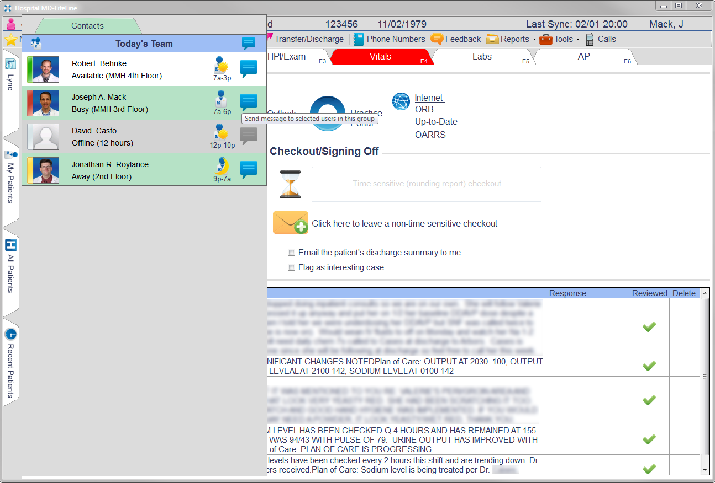
MedOne - MDLifeLine.Hospital software

Slide 30
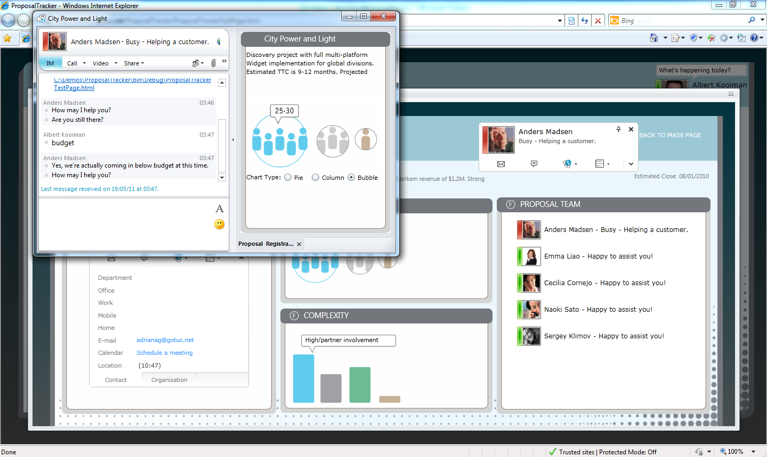
Make Lync Conversations Contextual
Conversation Window Extension
Launched by menu or programmatically:
UIWindow.ShowExtensibilityWindow(…);

Slide 31
Proposal Tracker
Integrate Lync in your LOB application
mini demo

Slide 32
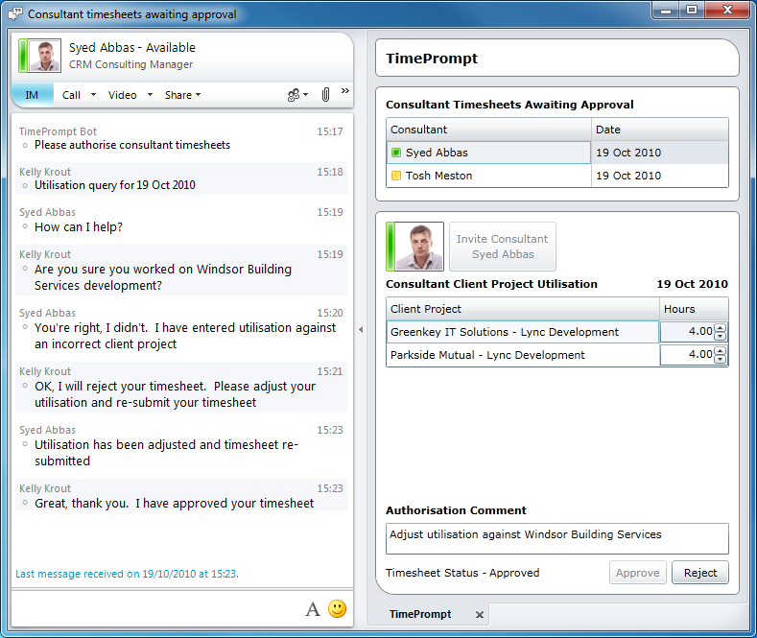
Extend the Lync Experience

Slide 33
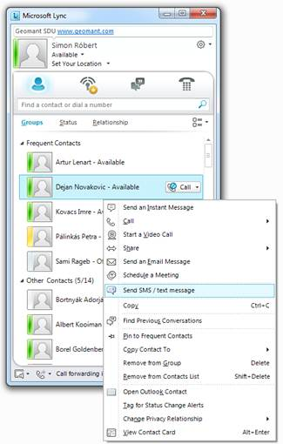
Extend the Lync Experience

Slide 34
Lync-Guistic
http://lyncguistic.cloudapp.net/
mini demo

Slide 35
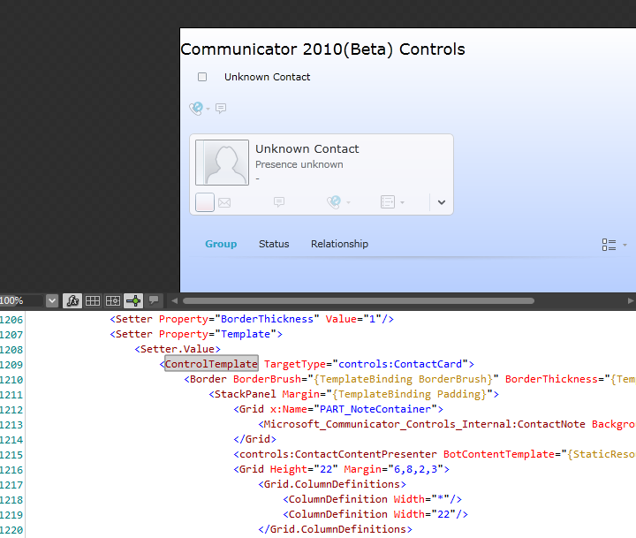
Lync Custom UI - re-templating
Re-templating and restyling the controls
Support for re-templating / styling
via Expression Blend and Visual Studio
Access to the XAML files
Alter or extend the User Interface
of any Lync Control
Examples:
  Add entry points into any application
  from within Lync Controls
  Alter “Look & Feel”

Slide 36
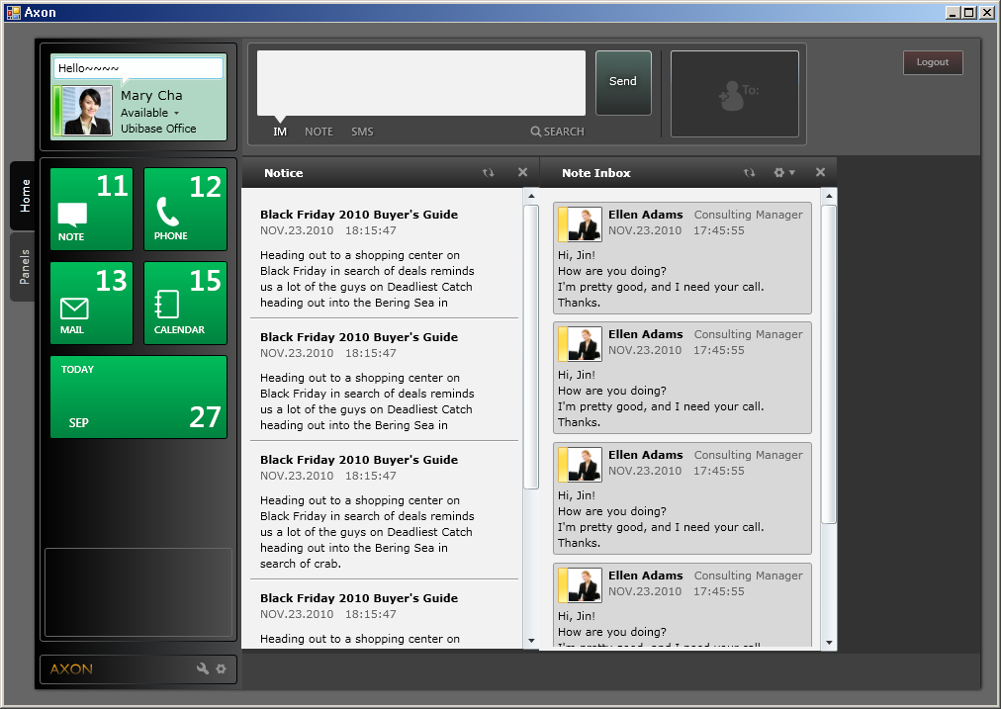

UbiBASE AXON

Slide 37
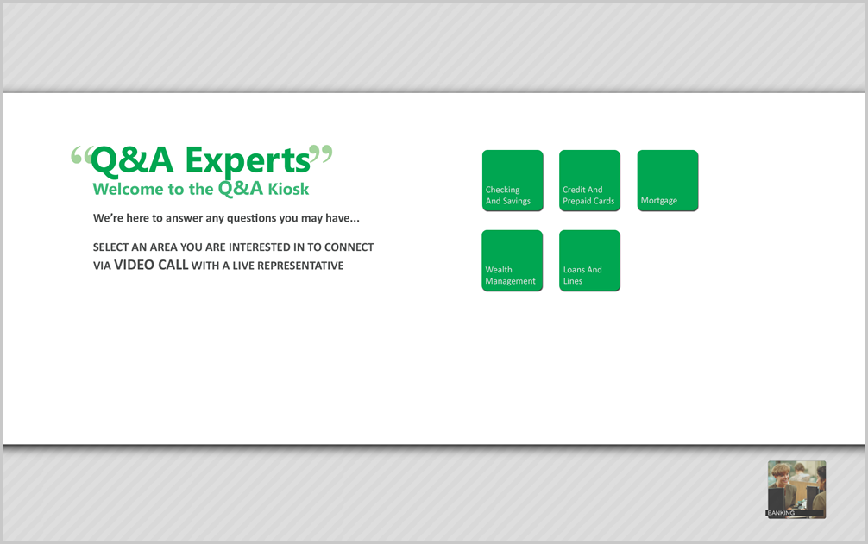




Lync Custom UI - the new Managed API
Suppress the Lync User Interface

Slide 38
Lync Custom UI - the new Managed API
Public namespaces
Microsoft.Lync
.Model
.Group
.Conversation
.Conversation.AudioVideo
SignIn / Search / ContactInfo / Availability
Contact List/Group Management
Start Conversation / Instant Messaging / Participants / Conferencing
Audio/Video Conversations
.Devices
.Extensibility
Audio/Video Device Management
Lync Automation/Extensibility/Contextual Conversations
Public classes

Slide 39
UCMA and Lync Online
UCMA applications
  Cannot be provisioned in Lync Online
  Cannot be hosted inside Office 365
  Cannot be hosted inside Azure
  Yet can be leveraged through Federation
    Provisioned On-prem
    Hosted On-prem

Slide 40









UCMA & Lync Online
Office 365 users
Application Server Pool
UCMA Application
UCMA Application
UCMA Application
UCMA Application
Exchange Online
SharePoint Online
Lync
Online
Lync Server 2010
Federated Trust
Data Center
Office 365
Data Center
Lync On-Prem

Slide 41
Other Lync APIs
PowerShell
  Currently no Remote PowerShell can be run against Lync Online
Lync Server 2010 SDK
  SIP Processing Language code cannot be uploaded/run

Slide 42





Resources
  Connect. Share. Discuss.
http://northamerica.msteched.com
Learning
  Sessions On-Demand & Community
  Microsoft Certification & Training Resources
www.microsoft.com/teched
www.microsoft.com/learning
  Resources for IT Professionals
  Resources for Developers
http://microsoft.com/technet
http://microsoft.com/msdn

Slide 43












Complete an evaluation on CommNet and
enter to win!

Slide 44


Slide 45

© 2011 Microsoft Corporation. All rights reserved. Microsoft, Windows, Windows Vista and other product names are or may be registered trademarks and/or trademarks in the U.S. and/or other countries.
The information herein is for informational purposes only and represents the current view of Microsoft Corporation as of the date of this presentation. Because Microsoft must respond to changing market conditions, it should not be interpreted to be a commitment
on the part of Microsoft, and Microsoft cannot guarantee the accuracy of any information provided after the date of this presentation. MICROSOFT MAKES NO WARRANTIES, EXPRESS, IMPLIED OR STATUTORY, AS TO THE INFORMATION IN THIS PRESENTATION.

