Slide 1
EXL 325 -Troubleshooting Lync Server 2010
Byron Spurlock
Principal Architect
QuadranTechnologies
Byrons@quadrantechnologies.com
Quadrantechnologies.com

Slide 2
Who am I
UC Architect (OCS, OCS 2007R2, Lync)
Former Microsoft UC Consultant
TAP\RDP
Participated in 1st OCS Masters Program
Trainer (30%) \ Consultant(70%) OCS \ Lync
Resource Kit Contributor
Too Many Deployments!

Slide 3
Agenda
Top Core & Voice Issues
Deployment Issues
Migration Issues
Tools
Takeaways
Learning what can go wrong with inital Lync Server deployments
Learning what tools are available to assist with migrations and deployments
Learning how to better address issues that might occur through complex deployments

Slide 4
Top Issues!

Slide 5
Top Troubleshooting Core Issues
Load balancers
Not allowing SIP, HTTP(s)
Firewall configuration
Incorrect Ports
Certificates
Missing or incorrect parameters (SN/SAN)
Certificate chain/root certificate missing
Server mis-configuration
Permissions

Slide 6
Top Troubleshooting Core Issues (continued)
DNS issues
Not correct (A) and SRV Records
Coexistence between OCS 2007(R2) and Lync 2010
Edge Configuration
UM Integration
Dial Plans
Client Policies

Slide 7
Top Troubleshooting Voice Issues
Audio Quality
User Device
Network
PSTN
Audio Connectivity
User phone number assignment / format
Gateway configuration
Phone number normalization
Call routes
UM connectivity – certificate and configuration

Slide 8
Real World Deployment Examples

Slide 9
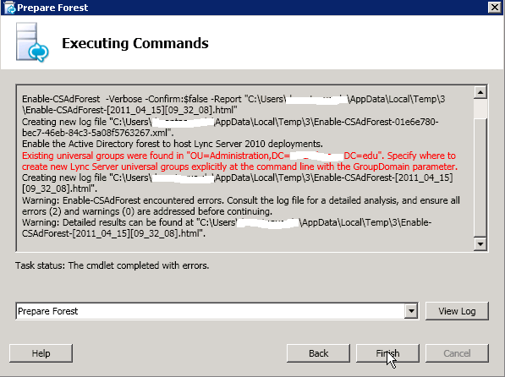
Lync Server deployment issue
Schema Prep
Forest Prep
Domain Prep

Slide 10
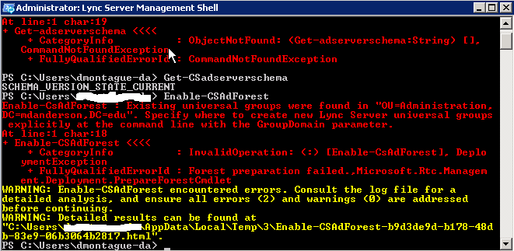
Lync Server deployment issue
Next Steps?
Verify permissions
Try again

Slide 11
Lync Server deployment issue
Next Steps?
Verify permissions
Try again

Slide 12
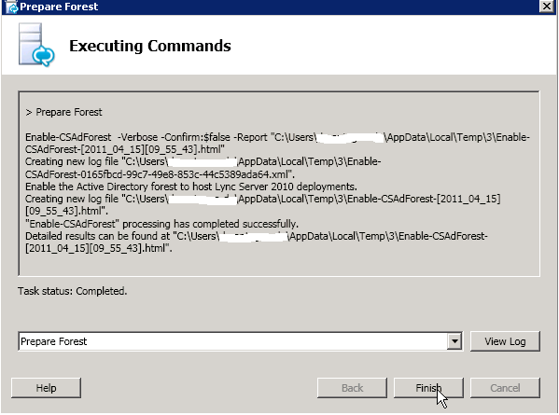
Lync Server deployment issue
Resolution
Enable-CsAdForest -GroupDomain domain
GroupDomain ensures
that the USGs will be created in the specific
domain.

Slide 13
Real World Migration Examples

Slide 14
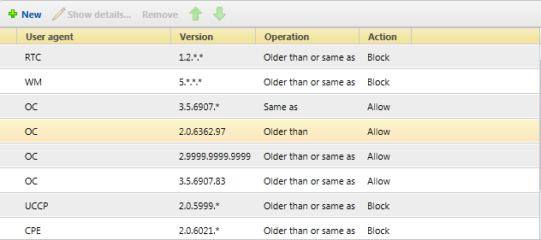
Lync Server Migration issue
Issue – Users not able
Connect
Fix – Modified the client
Version policy

Slide 15
Synthetic Transactions – Dial in Conferencing
$cred1 = Get-Credential "litwareinc\pilar"
Test-CsDialInConferencing -TargetFqdn atl-cs-001.litwareinc.com -UserSipAddress "sip:pilar@litwareinc.com" -UserCredential $cred1

Slide 16
Synthetic Transactions – P2P AV Sessions
$cred1 = Get-Credential "litwareinc\pilar"
$cred2 = Get-Credential "litwareinc\kenmyer"
Test-CsP2PAV -TargetFqdn atl-cs-001.litwareinc.com -SenderSipAddress "sip:pilar@litwareinc.com" -SenderCredential $cred1 -ReceiverSipAddress "sip:kenmyer@litwareinc.com" -ReceiverCredential $cred2

Slide 17
Synthetic Transactions – Presence Validation
$$cred1 = Get-Credential "litwareinc\pilar"
$cred2 = Get-Credential "litwareinc\kenmyer"
Test-CsPresence -TargetFqdn atl-cs-001.litwareinc.com -SubscriberSipAddress "sip:pilar@litwareinc.com" -SubscriberCredential $cred1 -PublisherSipAddress "sip:kenmyer@litwareinc.com" -PublisherCredential $cred2

Slide 18
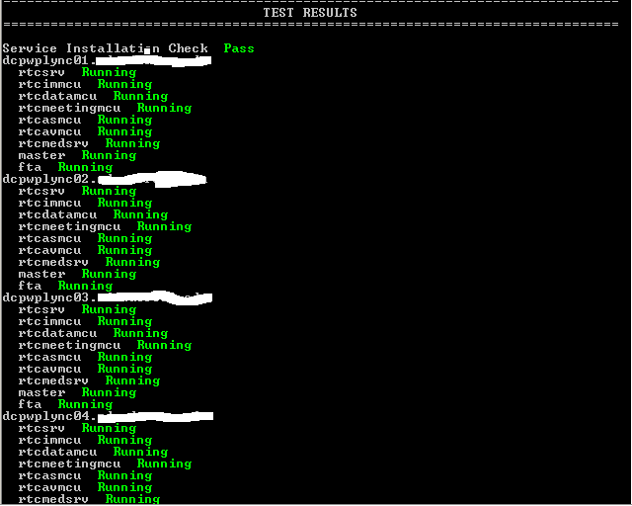
Topology Validator - Good
Tool – Topology Validator
Purpose – Provides Administrators a way to
Provide a quick check on the state of the
Environment.
Location – Lync Resource Kit Tools

Slide 19
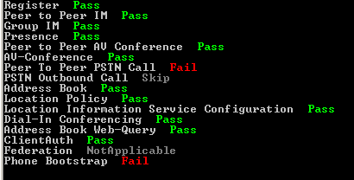
Topology Validator - Bad
Tool – Topology Validator
Purpose – Provides Administrators a way to
Provide a quick check on the state of the
Environment.
Location – Lync Resource Kit Tools

Slide 20
Tools!

Slide 21
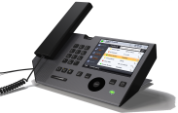
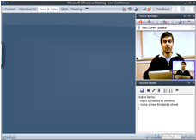
Troubleshooting Areas
Meeting
Client
Lync Client
Lync Phone Edition
x24
IP
Lync
Edge
Lync
Lync Mediation
Server
UC
Gateway
PBX/ PSTN
Internet
PSTN

Slide 22
Finding The Right Tool…
Lync Meeting
Client
Lync Client
Lync Phone
A/V Tuning wizard
Audio Test Service
Logs
Logging Tool
IP
RouteHelper
Lync
Edge
Lync
Lync Mediation
Server
UC
Gateway
PBX/ PSTN
Synthetic Transactions
SCOM
Internet
Snooper
PSTN
(QoE) Monitoring Server

Slide 23
Finding The Right Tool
Lync Best Practice Analyzer
Proactively perform checks, verifying that the configuration is set according to recommended best practices.
DBAnalyzer
Lync database details
Call Parkometer
Call Parkometer is a command-line application that provides easy access to the Call Park Server orbit database

Slide 24
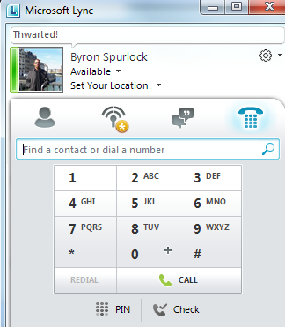
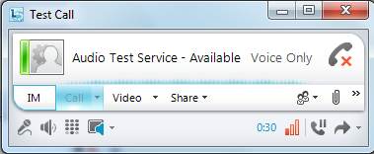
Audio Test Service
When to use?
Checking audio quality
What it does?
The tool acts as a voice recorder. Any user can call the tool, leave a message and get the message played back to the user

Slide 25
Lync Server Management Shell (1 of 3)
Errors output is red and usually point to what a problem is

Slide 26
Lync Server Management Shell (2 of 3)
Use the –verbose switch to get additional debugging information (shown in yellow)

Slide 27
Lync Server Management Shell (3 of 3)
If the Error output and –verbose switch don’t lead you to the error, there is tracing output you can collect via Lync Server 2010 Logging tool:
PowerShell – gives a bit of additional information for PowerShell cmdlets run
ADConnect – Shows interactions with Active Directory should the cmdlet need to do so

Slide 28
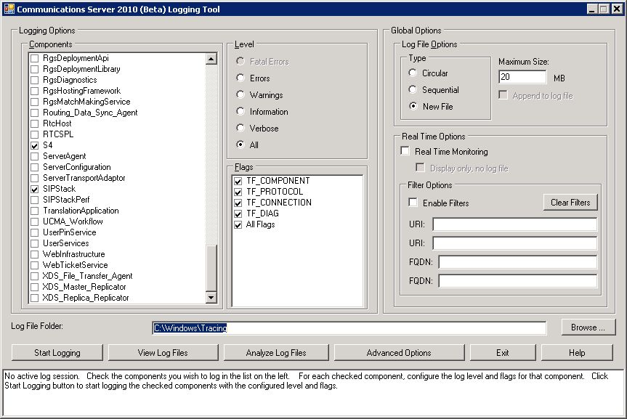
Lync Logging Tool

Slide 29
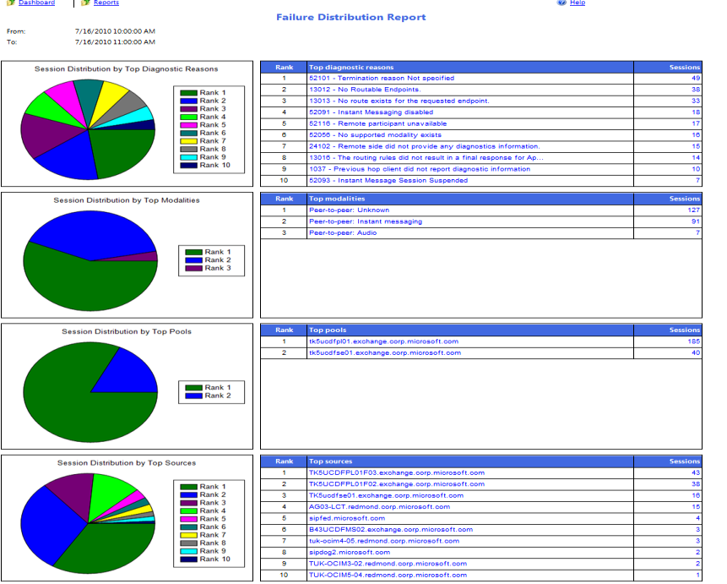
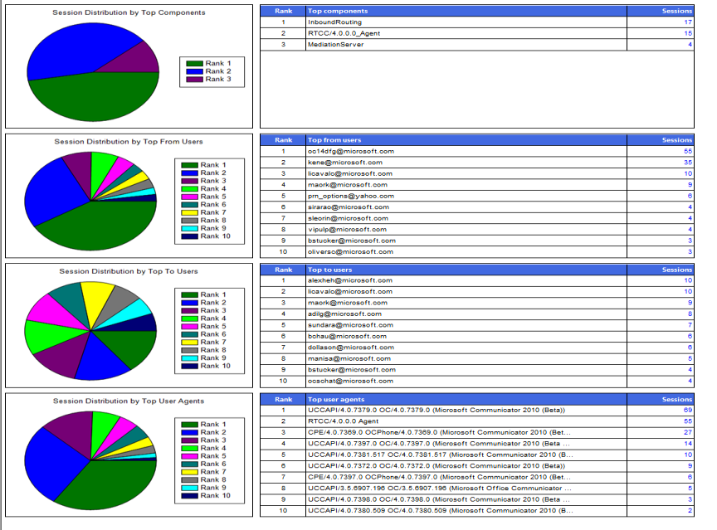
Monitoring Server Reporting Dashboard – Expected Failures Report Samples

Slide 30
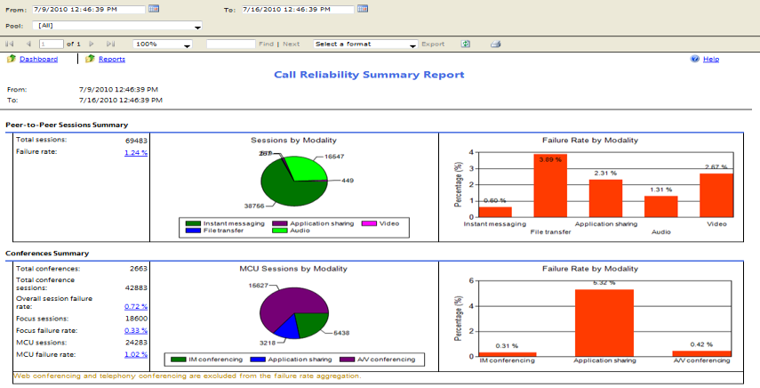
Monitoring Server Reporting Reports – Call Reliability Report Samples

Slide 31
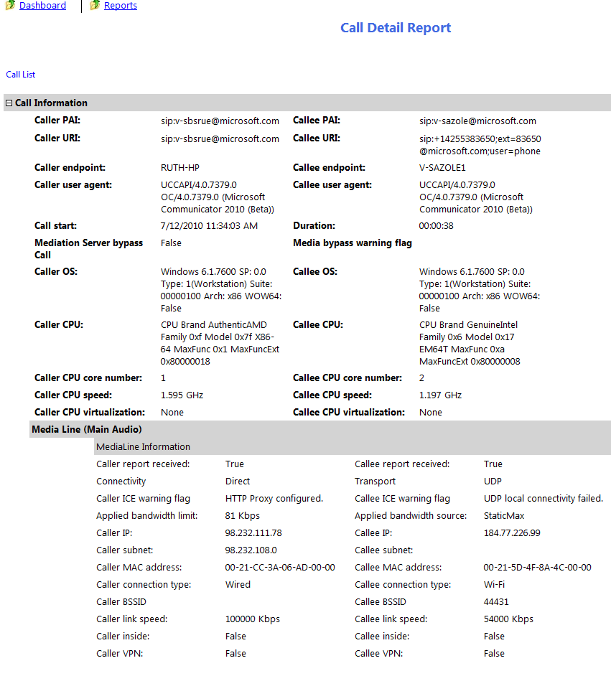
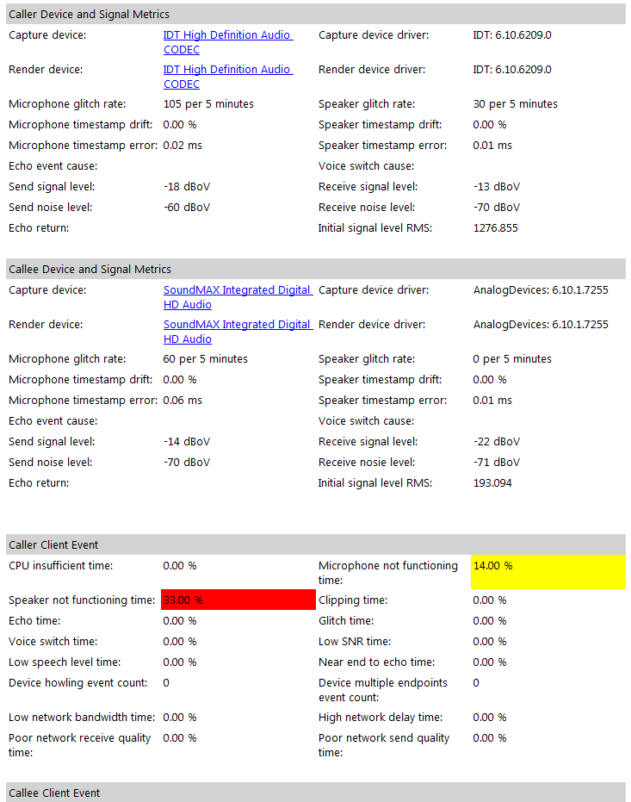
Monitoring Server Reporting Reports – Call Detail Report Samples

Slide 32
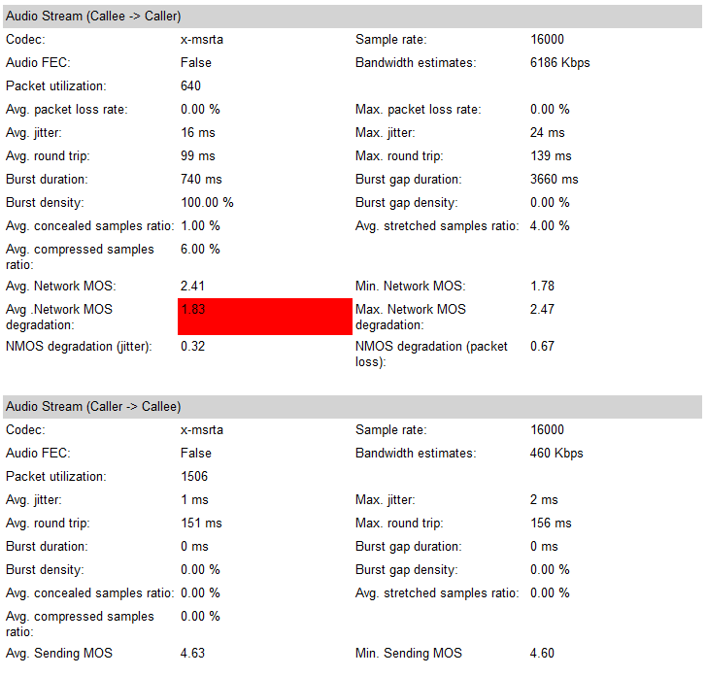
Monitoring Server Reporting Reports – Call Detail Report Samples

Slide 33
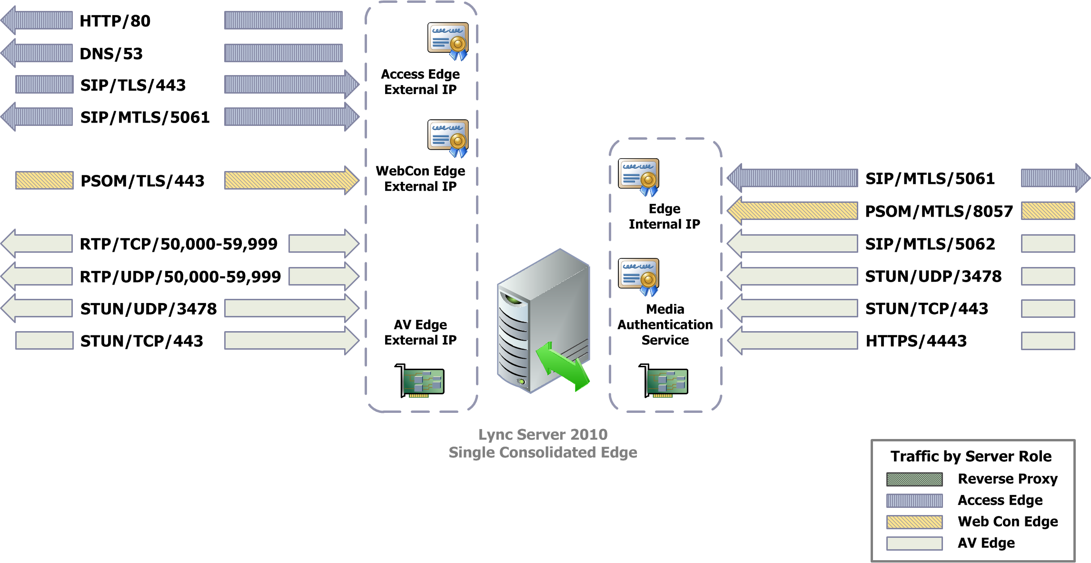

Slide 34
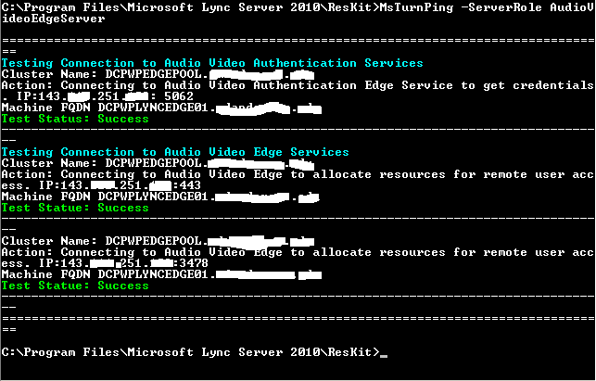
Edge Server Validation
Resource Kit Tool – MSTurnPing:
Verifying that the Lync Server Audio/Video Authentication service is started and can issue proper credentials.
Verifying that the Lync Server Audio/Video Edge service is started and can allocate the resources on the external edge successfully.

Slide 35
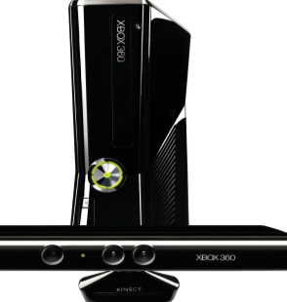
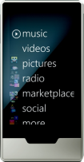
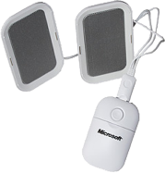
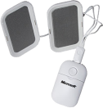
Required Slide
Complete an evaluation on CommNet and enter to win!

Slide 36
© 2011 Microsoft Corporation. All rights reserved. Microsoft, Windows, Windows Vista and other product names are or may be registered trademarks and/or trademarks in the U.S. and/or other countries.
The information herein is for informational purposes only and represents the current view of Microsoft Corporation as of the date of this presentation. Because Microsoft must respond to changing market conditions, it should not be interpreted to be a commitment on the part of Microsoft, and Microsoft cannot guarantee the accuracy of any information provided after the date of this presentation. MICROSOFT MAKES NO WARRANTIES, EXPRESS, IMPLIED OR STATUTORY, AS TO THE INFORMATION IN THIS PRESENTATION.

Slide 37
Partner Title
Name
Title
Company
partner

Slide 38
Customer Title
Name
Title
Company
customer

