Slide 1

Exchange Server 2010 High Availability Management and Operations
EXL401
Scott Schnoll
scott.schnoll@microsoft.com
Principal Technical Writer
Microsoft Corporation

Slide 2
Agenda
High Availability Cmdlets and Scripts
  Deployment and Configuration
  Maintenance
  Troubleshooting and Monitoring
  Recovery
  Ancillary
Operational Best Practices
Real-World Operational How To’s
Operational Notes

Slide 3
High Availability Cmdlets and Scripts

Slide 4
Deployment and Configuration
Database Availability Groups
New-DatabaseAvailabilityGroup | Create a DAG in Active Directory
Get-DatabaseAvailabilityGroup | View DAG properties
Set-DatabaseAvailabilityGroup | Configure DAG properties
Remove-DatabaseAvailabilityGroup | Delete a DAG from Active Directory
Database Availability Group Membership
Add-DatabaseAvailabilityGroupServer | Add a Mailbox server to a DAG
Remove-DatabaseAvailabilityGroupServer | Remove a Mailbox server from a DAG

Slide 5
Deployment and Configuration
Database Availability Group Networks
New-DatabaseAvailabilityGroupNetwork |  |  | Create a DAG network
Get-DatabaseAvailabilityGroupNetwork |  |  | View properties of a DAG network
Set-DatabaseAvailabilityGroupNetwork |  |  | Configure properties of a DAG network
Remove-DatabaseAvailabilityGroupNetwork |  |  | Delete a DAG network
Mailbox Database Copies
Add-MailboxDatabaseCopy | Create a passive copy of a mailbox database
Set-MailboxDatabaseCopy | Configure properties of a mailbox database copy
Remove-MailboxDatabaseCopy | Delete a passive copy of a mailbox database

Slide 6
Maintenance
Mailbox Database Copies
Suspend-MailboxDatabaseCopy | Suspends continuous replication and/or activation for a passive copy of a mailbox database
Resume-MailboxDatabaseCopy | Resumes continuous replication and/or activation for a passive copy of a mailbox database
Update-MailboxDatabaseCopy | Seeds a passive copy of a mailbox database and/or it’s content index catalog
Move-ActiveMailboxDatabase | Perform a database or server switchover and activates passive copy(ies) of mailbox database(s)

Slide 7
Maintenance
DAGs and DAG Members
StartDagServerMaintenance.ps1 | Put a DAG member into maintenance mode to being a scheduled outage
StopDagServerMaintenance.ps1 | Take a DAG member out of maintenance mode to end a scheduled outage
RedistributeActiveDatabases.ps1 | Balance a DAG that has become un-balanced over time

Slide 8
Troubleshooting and Monitoring
DAGs and Continuous Replication
Get-MailboxDatabaseCopyStatus | View health and status information for a replicated mailbox database
Test-ReplicationHealth | Check health of all aspects of replication, replay and cluster for a DAG
CollectOverMetrics.ps1 | Gather information about database mounts, moves, and failovers over a specific time period
CollectReplicationMetrics.ps1 | Collect performance metrics for continuous replication in real-time
CheckDatabaseRedundancy.ps1 | Checks for and alerts on condition where you are down to a single copy of a replicated database

Slide 9
Recovery
Site Resilience / Datacenter Switchovers
Stop-DatabaseAvailabilityGroup | Mark DAG members as down during a datacenter switchover
Restore-DatabaseAvailabilityGroup | Shrink DAG and restore quorum to surviving DAG members during a datacenter switchover
Start-DatabaseAvailabilityGroup | Reincorporate recovered or restored DAG members during re-activation of (failback to) a primary datacenter
Move-ActiveMailboxDatabase | Perform a database or server switchover and activate passive copy(ies) of mailbox database(s)

Slide 10
Ancillary
Auto database mount dial / Database activation policy
Get-MailboxServer | View properties of a Mailbox server (AutoDatabaseMountDial, DatabaseCopyAutoActivationPolicy, MaximumActiveDatabases, and DAG membership)
Set-MailboxServer | Configure AutoDatabaseMountDial, MaximumActiveDatabases or DatabaseCopyAutoActivationPolicy for a DAG
Get-MailboxDatabase | View properties of a mailbox database (DataMoveReplicationConstraint)
Set-MailboxDatabase | Configure DataMoveReplicationConstraint for a replicated mailbox database

Slide 11
Operational best practices

Slide 12
Performance Data Collection – Active Copy
Database IO latency
  MSExchange Database\I/O Database Reads (Attached) Average Latency should average < 20 ms and have spikes no greater than 100 ms
  MSExchange Database\I/O Database Writes (Attached) Average Latency should be less than above counter when using battery-backed write caching
  Database\Database Page Fault Stalls/sec should always = 0 on production Mailbox servers

Slide 13
Performance Data Collection – Active Copy
Log IO latency
  MSExchange Database\IO Log Writes Average Latency should always be < 10 ms
  Database\Log Record Stalls/sec should average < 10 per second, with spikes no greater than 100 per second
  Database\Log Threads Waiting should average < 10

Slide 14
Performance Data Collection – Passive Copy
Database IO latency
  MSExchange Database\I/O Database Reads (Recovery) Average Latency should average < 200 ms, with spikes no greater than 1000 ms
  MSExchange Database\I/O Database Writes (Recovery) Average Latency should be less than above counter when using battery-backed write caching
  Database\Database Page Fault Stalls/sec should be 0 on production servers
Log IO latency
  MSExchange Database\IO Log Reads Average Latency should average
  < 200 ms, with spikes no greater than 1000 ms

Slide 15
Performance Data Collection
Collect important non-HA counters
  Information Store and Information Store RPC
  Database
  Content Indexing
  RPC Client Throttling
  Store Client Requests
  Mailbox Assistants
  Calendar Attendant
See http://technet.microsoft.com/en-us/library/ff367871.aspx for list of counters and thresholds

Slide 16
Event Log Collection
Custom Views
  Microsoft Exchange with Database Availability Group Events
HA Event Sources
  MSExchange Cluster
  MSExchangeCluster
  MSExchangeRepl
Non-HA, but related Event Sources
  ESE
  ExchangeStoreDB
  MSExchangeIS Mailbox Store

Slide 17
Event Log Collection
Crimson Channel Events
  Applications and Services Logs\Microsoft\Exchange
    HighAvailability
      BlockReplication
      Debug
      Operational
      TruncationDebug
    MailboxDatabaseFailureItems
      Debug
      Operational
  Applications and Services Logs\Microsoft\Windows
    FailoverClustering

Slide 18
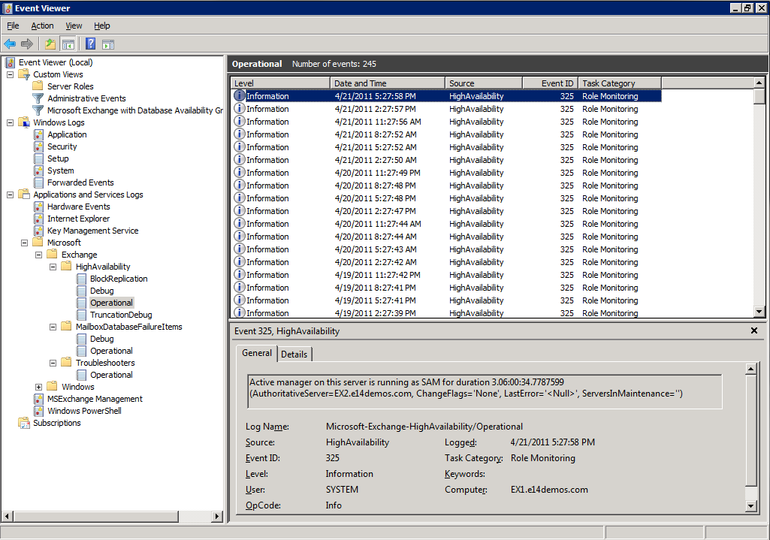
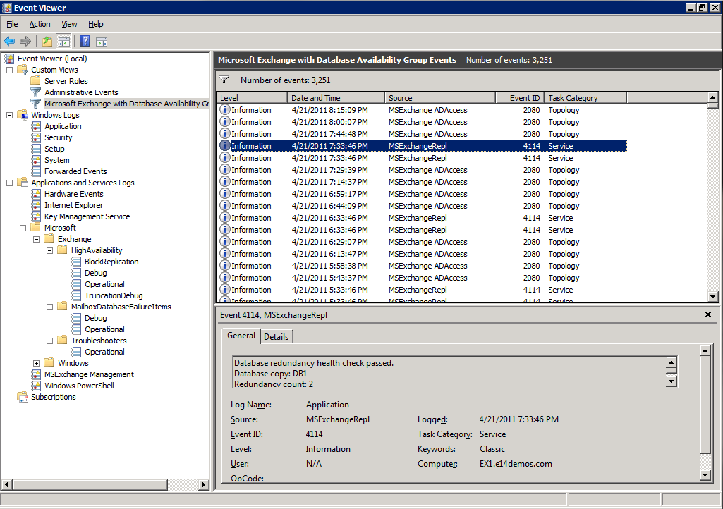
Event Log Collection

Slide 19
Alerts
Primary conditions for sending alerts
  Replication not keeping up
  Database or content index unhealthy
  Free disk space low on database or log volume
  Database or log file corruption
  DAG or cluster problems
  Single copy alerts

Slide 20
Single Copy Alert
Monitor for periods in which a replicated database is down to a single healthy copy
Particularly critical in JBOD environments
  In a RAID environment, a single disk failure does not affect an active mailbox database copy
  In a JBOD environment, a single disk failure triggers a database failover

Slide 21
Single Copy Alert
CheckDatabaseRedundancy.ps1
  Monitors the redundancy of replicated mailbox databases by validating that there is at least two configured and healthy and current copies, and to alert you when only a single healthy copy of a replicated database exists
    Both active and passive copies are counted when determining redundancy
  CheckDatabaseRedundancy.ps1 -MailboxDatabaseName DB1

Slide 22
Single Copy Alert
Automatically installed as a scheduled task in SP1
  Database One Copy Alert
  Allow task to run as part of regular operations
By default, script runs every 60 minutes
  http://technet.microsoft.com/en-us/library/dd351258.aspx#CheckDBRedun

Slide 23
Maintaining Balanced DAGs
Active mailbox database copies change hosts several times throughout a DAG's lifetime
As a result, DAGs can become unbalanced

Slide 24
Maintaining Balanced DAGs
DAG with 4 databases and 4 copies of each database (16 databases on each server)
  Four copies of each database, therefore only four possible values for Activation Preference (1, 2, 3, or 4)
  DAG is unbalanced in terms of number of active databases hosted by each DAG member, number of passive databases hosted by each DAG member, and activation preference count of the hosted databases
Server | Active databases | Passive databases | Mounted databases | Dismounted databases | Preference count list
EX1 | 5 | 11 | 5 | 0 | 4, 4, 3, 5
EX2 | 1 | 15 | 1 | 0 | 1, 8, 6, 1
EX3 | 12 | 4 | 12 | 0 | 13, 2, 1, 0
EX4 | 1 | 15 | 1 | 0 | 1, 1, 5, 9

Slide 25
Maintaining Balanced DAGs
RedistributeActiveDatabases.ps1 balances a DAG
  BalanceDbsByActivationPreference Script attempts to move databases to their most preferred copy, based on Activation Preference, without regard to Active Directory site
  BalanceDbsBySiteAndActivationPreference Script attempts to move active databases to their most preferred copy, while also trying to balance active databases within each Active Directory site
Server | Active databases | Passive databases | Mounted databases | Dismounted databases | Preference count list
EX1 | 5 | 11 | 5 | 0 | 4, 4, 3, 5
EX2 | 1 | 15 | 1 | 0 | 1, 8, 6, 1
EX3 | 12 | 4 | 12 | 0 | 13, 2, 1, 0
EX4 | 1 | 15 | 1 | 0 | 1, 1, 5, 9
Server | Active databases | Passive databases | Mounted databases | Dismounted databases | Preference count list
EX1 | 4 | 12 | 4 | 0 | 4, 4, 4, 4
EX2 | 4 | 12 | 4 | 0 | 4, 4, 4, 4
EX3 | 4 | 12 | 4 | 0 | 4, 4, 4, 4
EX4 | 4 | 12 | 4 | 0 | 4, 4, 4, 4

Slide 26
Maintaining Balanced DAGs
RedistributeActiveDatabases.ps1 has many parameters
  You can produce reports, log events, include non-replicated databases, etc.
  See http://technet.microsoft.com/en-us/library/dd335158.aspx for list of parameters
Server | Active databases | Passive databases | Mounted databases | Dismounted databases | Preference count list
EX1 | 4 | 12 | 4 | 0 | 4, 4, 4, 4
EX2 | 4 | 12 | 4 | 0 | 4, 4, 4, 4
EX3 | 4 | 12 | 4 | 0 | 4, 4, 4, 4
EX4 | 4 | 12 | 4 | 0 | 4, 4, 4, 4

Slide 27
Real-world operational how-to’s

Slide 28
Configuration tasks

Slide 29
Configure DAG Properties
Set-DatabaseAvailabilityGroup
  IP Address(es)
  Witness Server, Witness Directory
  Alternate Witness Server, Alternate Witness Directory
  DAC Mode
  Replication Port
  Network Discovery
  Network Compression
  Network Encryption

Slide 30
Configure DAG Properties
Set-DatabaseAvailabilityGroup
  Set-DatabaseAvailabilityGroup -Identity DAG1
  -AlternateWitnessDirectory C:\DAGFSW\DAG1.contoso.com
  -AlternateWitnessServer EXHUB3
  Set-DatabaseAvailabilityGroup -Identity DAG1
  -DatabaseAvailabilityGroupIpAddresses 10.0.0.8,10.0.1.8
  Set-DatabaseAvailabilityGroup -Identity DAG1
  -DatacenterActivationMode DagOnly
  Set-DatabaseAvailabilityGroup -Identity DAG1 -ReplicationPort 63132
  Set-DatabaseAvailabilityGroup –Identity DAG1 -DiscoverNetworks

Slide 31
DAG Networks and iSCSI
Prevent DAG from using iSCSI network as DAG network
  Set-DatabaseAvailabilityGroupNetwork -Identity DAG2\DAGNetwork02 -ReplicationEnabled:$false
  -IgnoreNetwork:$true
  Cluster network ClusterNetworkName /prop Role=0

Slide 32
Configure AutoDatabaseMountDial
Property of Mailbox server
    Set-MailboxServer EX1 -AutoDatabaseMountDial GoodAvailability
Admin control of automatic recovery based on number of missing log files
  Default Setting is BestAvailability (12 logs)
  Other settings
    GoodAvailability (6 logs)
    Lossless (0 logs)
    BestEffort (boundless; switchovers only)
    Custom value
      Directly modify the msExchDataLossForAutoDatabaseMount attribute of the Mailbox server object

Slide 33
Monitoring tasks

Slide 34
Check Database Availability Group Status
Get-DatabaseAvailabilityGroup DAG1 | %{ $_.Servers | %{ Get-MailboxDatabaseCopyStatus -Server $_ } }
  Name Status CopyQueue ReplayQueue LastInspectedLogTime ContentIndex
  Length Length State
  ---- ------ --------- ----------- -------------------- ------------
  DB2\E14EX2 Mounted 0 0 Healthy
  DB1\E14EX2 Healthy 0 0 11/9/2010 9:27:49 AM Healthy
  DB3\E14EX2 Healthy 0 0 11/9/2010 1:48:02 AM Healthy
  DB4\E14EX2 Mounted 0 0 Healthy
  DB1\E14EX1 Mounted 0 0 Healthy
  DB3\E14EX1 Mounted 0 0 Healthy
  DB4\E14EX1 Healthy 0 0 11/9/2010 2:16:38 PM Healthy
  DB2\E14EX1 Healthy 0 0 11/9/2010 2:17:10 PM Healthy

Slide 35
Check Database Availability Group Status
Get-DatabaseAvailabilityGroup DAG1 | %{ $_.Servers | %{ Test-ReplicationHealth -Server $_ } }
  Server Check Result Error
  ------ ----- ------ -----
  E14EX2 ClusterService Passed
  E14EX2 ReplayService Passed
  E14EX2 ActiveManager Passed
  E14EX2 TasksRpcListener Passed
  E14EX2 TcpListener Passed
  E14EX2 DagMembersUp Passed
  E14EX2 ClusterNetwork Passed
  E14EX2 QuorumGroup Passed
  E14EX2 FileShareQuorum Passed
  E14EX2 DBCopySuspended Passed
  E14EX2 DBCopyFailed Passed
  E14EX2 DBInitializing Passed
  E14EX2 DBDisconnected Passed
  E14EX2 DBLogCopyKeepingUp Passed
  E14EX2 DBLogReplayKeepingUp Passed
  E14EX1 ClusterService Passed
  E14EX1 ReplayService Passed
  E14EX1 ActiveManager Passed
  E14EX1 TasksRpcListener Passed
  …

Slide 36
Verify Mailbox Database Backups
Backup status for all mailbox databases in Org
Get-MailboxDatabase -Status | ft Name, Server, *Backup*
Backup status for mailbox databases on specific server
$Databases = Get-MailboxDatabase -Server <ServerName> -Status
$Databases | ft Name, *Backup*

Slide 37
Check Database Distribution (DAG Balancing)
Check current database distribution
  RedistributeActiveDatabases.ps1 -DagName DAG1
  -ShowDatabaseDistributionByServer | ft
Rebalance a DAG using activation preference and show a summary report when finished
  RedistributeActiveDatabases.ps1 -DagName DAG1
  -BalanceDbsByActivationPreference
  -ShowFinalDatabaseDistribution

Slide 38
RECOVERY AND MAINTENANCE TASKS

Slide 39
Perform a Server Switchover
A task that you perform to move all active mailbox database copies from their current Mailbox server to one or more other Mailbox servers in the DAG
  Move-ActiveMailboxDatabase -Server MBX1
  Move-ActiveMailboxDatabase -Server MBX4
  -ActivateOnServer MBX5

Slide 40
Perform a Database Switchover
A task that you perform to designating a passive copy as the new active copy of a mailbox database
  Move-ActiveMailboxDatabase DB3 -ActivateOnServer MBX4
  Move-ActiveMailboxDatabase DB4 -ActivateOnServer MBX3
  -MountDialOverride:GoodAvailability
  Move-ActiveMailboxDatabase DB5 MBX6
  –SkipClientExperienceChecks
  Move-ActiveMailboxDatabase DB5 MBX6 -SkipLagChecks

Slide 41
Operational notes

Slide 42
Active Manager
Provides the interface for administrative tasks
The server holding the Primary Active Manager (PAM) role performs the tasks
Consider the following database switchover…

Slide 43
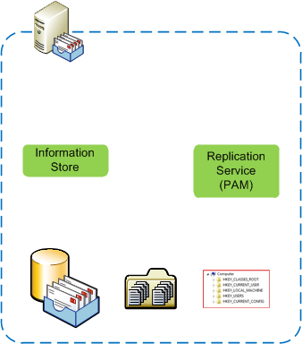

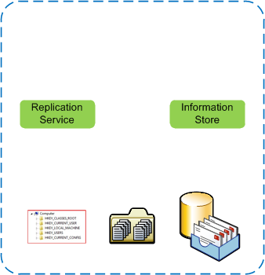
Database Switchover
An administrator starts a task to perform a database switchover (Move-ActiveMailboxDatabase)
The task client makes an RPC call to the Microsoft Exchange Replication service on a DAG member (based on lookup msExchMasterServerOrAvailabilityGroup)
If server contacted is not the PAM, the task is referred to the PAM. If server contacted, is the PAM continue and initiate move RPC.
PAM service locates mounted database copy by consulting persistent storage

Slide 44
Database Switchover
If the server with the active database is reachable, the PAM issues a dismount request:
If the database is mounted remotely, send the request via RPC to the remote Replication service
If the database is mounted locally, send the request to the Information Store service
When the dismount completes, the PAM reads and updates database location information in persistent storage
PAM Replication service contacts the Replication service on the server that is to host the new active copy of the database via RPC

Slide 45
Database Switchover
The Source Replication service copies the remaining logs to the target server
The Target Replication service issues mount request to the Target Information Store service
The Information Store service replays logs and mounts database
The Target Information Store service returns success or failure to the Target Replication service
The Target Replication service reports success or failure to the PAM
The PAM reports success or failure to the remote PowerShell
Remote PowerShell returns success or failure message to the task initiator

Slide 46
Active Manager
Which server is the current PAM?
  Get-DatabaseAvailabilityGroup DAG1 | fl PrimaryActiveManager
Move PAM role
  Move-ClusterGroup “Cluster Group” -Node MBX2
  or
  Cluster group “cluster group” /move

Slide 47
Database Switchovers
Bypass internal checks to perform a switchover
  SkipHealthChecks - bypass database status check and move an active copy that is in a Failed state
    Performs additional validation to ensure that the log files are consistent, which can take a considerable amount of time
  SkipLagChecks - allow a copy to be activated that has replay and copy queues outside of the configured auto database mount dial
  SkipClientExperienceChecks - bypass content index health check and activate a copy with an unhealthy or unusable content index

Slide 48
Database Seeding
Seeding is explicitly performed unless you use SeedingPostponed
Seeding uses internal (private) ESE streaming backup APIs
  Replication service on target initiates a seeding request to Replication service on source using TCP socket on DAG seeding port
  Source Replication service initiates a local ESE backup session to the Information Store service
  Source Replication service streams data to target Replication service
Exchange 2010 can seed from any healthy database copy
Database and index can be seeded together or independently

Slide 49
Database Seeding
Default network selection for seeding
  If the source and server are on same subnet and a replication network has been configured that includes the subnet, the replication network will be used
  If the source and target are on different subnets, even if a replication network that contains those subnets has been configured, the MAPI network will be used for seeding

Slide 50
Database Seeding
Override default network selection
  Update-MailboxDatabaseCopy -Identity DB1\MBX1
  -SourceServer MBX2 -Network DAG1\Replication
Override default DAG encryption / compression settings
  Update-MailboxDatabaseCopy -Identity DB1\MBX1
  -SourceServer MBX2 -Network DAG1\Replication
  –NetworkCompressionOverride:Off
  Update-MailboxDatabaseCopy -Identity DB1\MBX1
  -SourceServer MBX2 -Network DAG1\Replication
  –NetworkEncryptionOverride:UseDAGDefault

Slide 51
Questions?

Slide 52

Related Content
Required Slide
Speakers, please list the Breakout Sessions, Interactive Discussions, Labs, Demo Stations and Certification Exam that relate to your session. Also indicate when they can find you staffing in the TLC.
EXL302 | Archiving and Discovery in Microsoft Exchange 2010 SP1 and Exchange Online
EXL306 | Best Practices for Virtualization of Microsoft Exchange 2010
EXL307 | Load Balancing with Microsoft Exchange Server 2010
EXL312 | Designing Microsoft Exchange 2010 Mailbox High Availability for Failure Domains
EXL320 - Microsoft Lync 2010: High Availability and Resiliency
EXL327 | Real-World Site Resilience Design in Microsoft Exchange Server 2010

Slide 53
Track Resources
Required Slide
Track PMs will supply the content for this slide, which will be inserted during the final scrub.
Exchange Team Blog – http://blogs.technet.com/b/exchange
Exchange TechCenter – http://technet.microsoft.com/en-us/exchange/default.aspx
Lync TechCenter – http://technet.microsoft.com/en-us/lync
Lync Team Blog – http://blogs.technet.com/b/lync/

Slide 54





Resources
  Connect. Share. Discuss.
http://northamerica.msteched.com
Learning
  Sessions On-Demand & Community
  Microsoft Certification & Training Resources
www.microsoft.com/teched
www.microsoft.com/learning
  Resources for IT Professionals
  Resources for Developers
http://microsoft.com/technet
http://microsoft.com/msdn

Slide 55












Required Slide
Complete an evaluation on CommNet and
enter to win!

Slide 56
MS Tag Placeholder Slide
Required Slide
Your MS Tag will be inserted here during the final scrub.

Slide 57

© 2011 Microsoft Corporation. All rights reserved. Microsoft, Windows, Windows Vista and other product names are or may be registered trademarks and/or trademarks in the U.S. and/or other countries.
The information herein is for informational purposes only and represents the current view of Microsoft Corporation as of the date of this presentation. Because Microsoft must respond to changing market conditions, it should not be interpreted to be a commitment
on the part of Microsoft, and Microsoft cannot guarantee the accuracy of any information provided after the date of this presentation. MICROSOFT MAKES NO WARRANTIES, EXPRESS, IMPLIED OR STATUTORY, AS TO THE INFORMATION IN THIS PRESENTATION.

