Slide 1

From Servers to Services:
On-Premise and in the Cloud
FDN05
Norm Judah
CTO – WW Service
Microsoft

Slide 2
Four Demos
Building a private cloud
Hybrid event based applications
SharePoint burst out to Azure
Redeploying from on-premises to the cloud

Slide 3


Contoso TechNews Today
March 2015
Today the Contoso Bank, announced the 3rd year of error free continuous delivery of their new global banking system, successfully launched in 2012. The system was initially launched simultaneously in 25 countries in 10 languages, with recent extensions into Latin American and Africa, growing countries to 43 and languages to 15.
Today, Contoso customers anywhere in the world can securely access, view, and transact within all their financial accounts anywhere, anytime, from any device. Banking customers can walk up and securely gesture to their ATMs, reload VirtualCash™, talk to their Virtual Teller® via their Windows Phone 9 or even rent 3D movies via “At the Movies” on their XBox720.

Slide 4
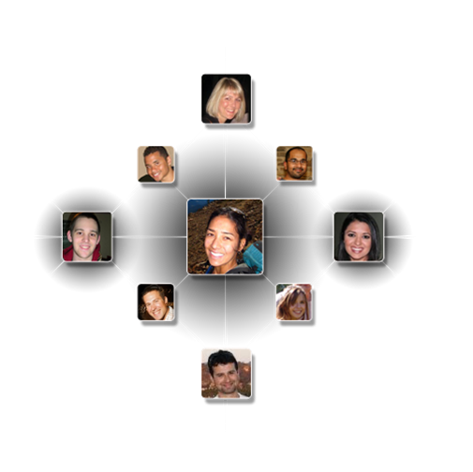


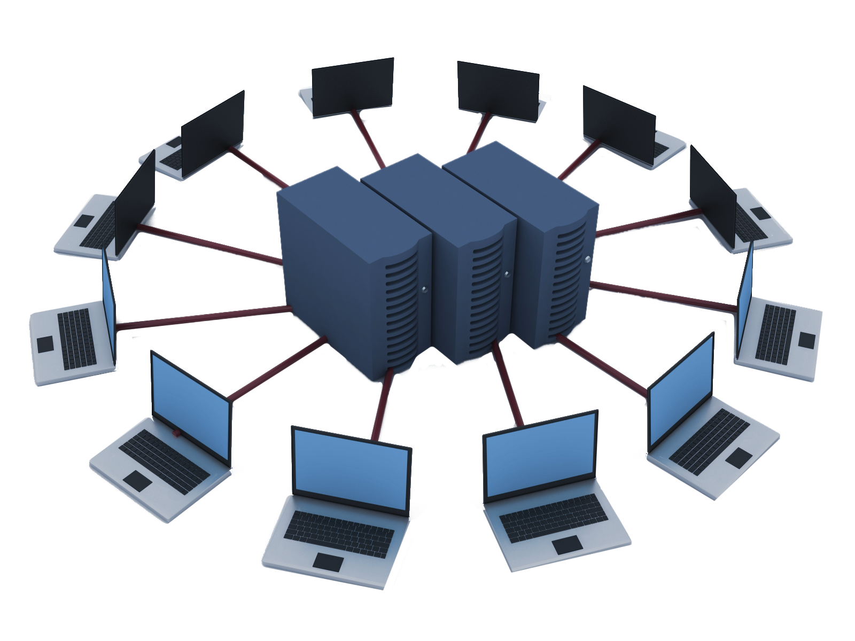
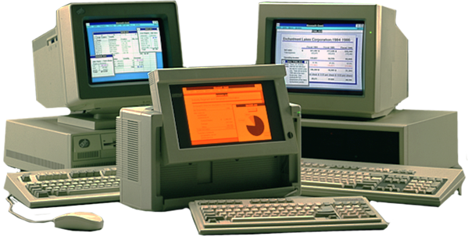
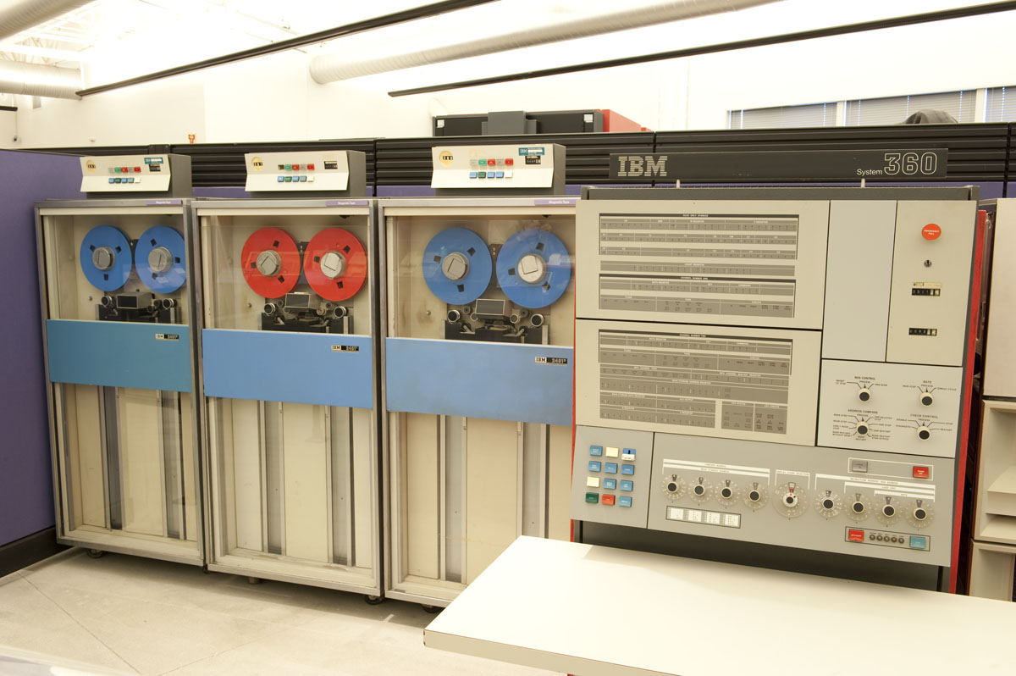
The Next Generation of Computing
CLOUD Late 2000s and Future
Cloud Computing, Social Networks
Products>Solutions>Services
INTERNET Mid ‘90s & early 2000s
Browsers, Email, eCommerce,
Hosting, Wi-Fi, Web 2.0
CLIENT/SERVER Mid ‘80s
Distributed Computing
PC and APPS Early ’80s
Word Processor, Spreadsheets
DOS, GUI, Windows
MAINFRAME ’60s and ‘70s
Financial, MRP
Reservations

Slide 5
Add another annimation, played on click that disolves “software” and becomes “servers”
SOFTWARE
INTO
SERVICES

Slide 6
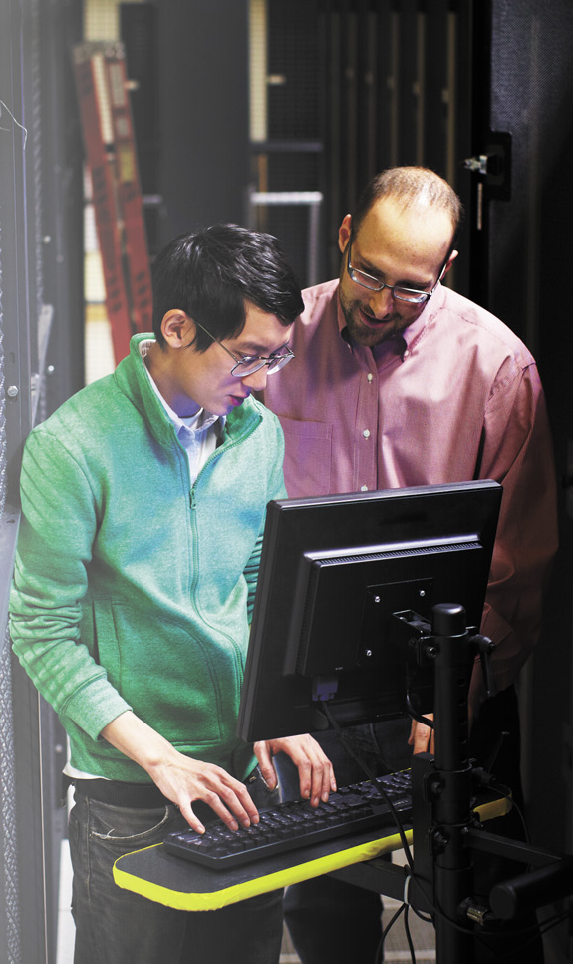


DATACENTER ADMIN
DEVELOPER
APPLICATION OWNER
EVER CHANGING ROLES

Slide 7

What Constitutes A Good Cloud Customer?
IT Pro loses Control over infrastructure and policies
  Demand Visibility and situational awareness
Expectation of Server/Service parity in features, flexibility, customizability
Higher expectations and scrutiny over availability, performance – especially enterprise

Slide 8
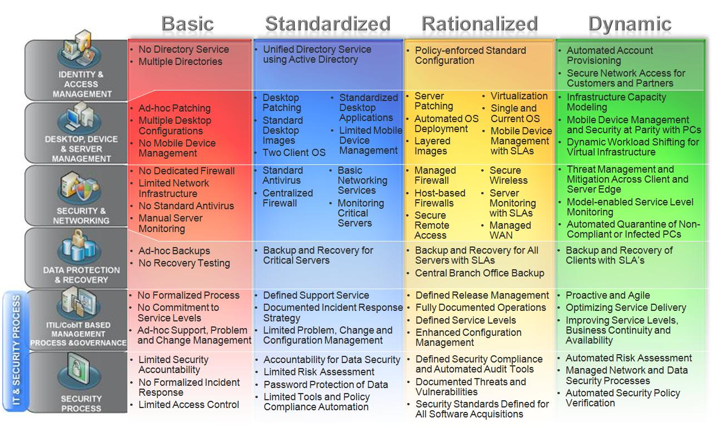


Deploying the Cloud - Leapfrog to Dynamic
Downtime Hours
per Year
9.42
1.13
0.73
Labor $ per
Server per Year
$ 23,807
$ 10,163
$ 1,201

Slide 9
What Constitutes a Cloud ?
Virtualization ≠ cloud
Automation Engines
management tooling
-Abilities

Slide 10

What Constitutes a Service?

Slide 11
Two Orthogonal Dimensions
APPLICATIONS
VERSIONING
DATA
INSTRUMENT
RUNTIME
COMMERCE
MIDDLEWARE
QUOTA
O/S
Platform
RESILIENCY
VIRTUALIZATION
ELASTICITY
SERVERS
BALANCING
STORAGE
Automation
MIGRATION
NETWORKING
PROVISIONING

Slide 12
Cloud Maturity Model – Self Service & Elasticity
Basic
Standardized
Rationalized
Dynamic
Cost Saving
Time to Market
Service Quality
& Availability
Control
Portal for Infrastructure Services
Portal for
Internal Tenants
Multi-tenant Self Service Portal
Multi-tenant Extensible Self Service Portal
Script Based
Scale Out
Script Based
Scale Out for
Platform & Infra
Event & Workflow Driven for Compute, Storage, & Network
Event & Workflow Driven for
PaaS & SaaS
Consolidated Infrastructure
Automated Infrastructure
& Platform
Multi-tenant Infrastructure, Platform & Software
Unified Fabric with Delegated Control

Slide 13
Three Orthogonal Dimensions?
APPLICATIONS
VERSIONING
DATA
INSTRUMENT
RUNTIME
COMMERCE
MIDDLEWARE
QUOTA
O/S
Platform
RESILIENCY
VIRTUALIZATION
ELASTICITY
SERVERS
Maturity
BALANCING
STORAGE
MIGRATION
Automation
NETWORKING
PROVISIONING

Slide 14



Enterprise IaaS
BPIO SaaS
App SaaS
App SaaS
App SaaS
New IaaS
New IaaS Private Cloud to host multiple workloads

Slide 15
BP SaaS on Existing Infrastructure
BP SaaS
Existing Infrastructure
Existing infrastructure and deploys the BP Suite

Slide 16
VDI SaaS on existing Infrastructure
VDI
BP SaaS
Existing Infrastructure
Existing infrastructure and deploys BP VDI services

Slide 17
Hoster/Gov/Enterprise IaaS & SaaS Isolated
BP SaaS
BP SaaS
BP SaaS
BP SaaS
IaaS
IaaS
IaaS
IaaS
Deploy the BP Suite to service multiple customers in fully isolated environments

Slide 18
Hoster/Gov/Enterprise SaaS Isolated
BP SaaS
BP SaaS
BP SaaS
BP SaaS
IaaS
IaaS
IaaS
New IaaS
IaaS
Deploy the BP Suite to service multiple customers in fully isolated environments, with shared infrastructrure

Slide 19

Hoster/Gov/Enterprise SaaS Shared
BP SaaS
BP SaaS
BP SaaS
BP SaaS
BP SaaS
IaaS
IaaS
IaaS
New IaaS
IaaS
Deploy the BP Suite to service multiple customers in a Single Multi-Tenant environments

Slide 20
Building A Private Cloud
Kenon Owens
Technical Product Manager
Microsoft
demo

Slide 21
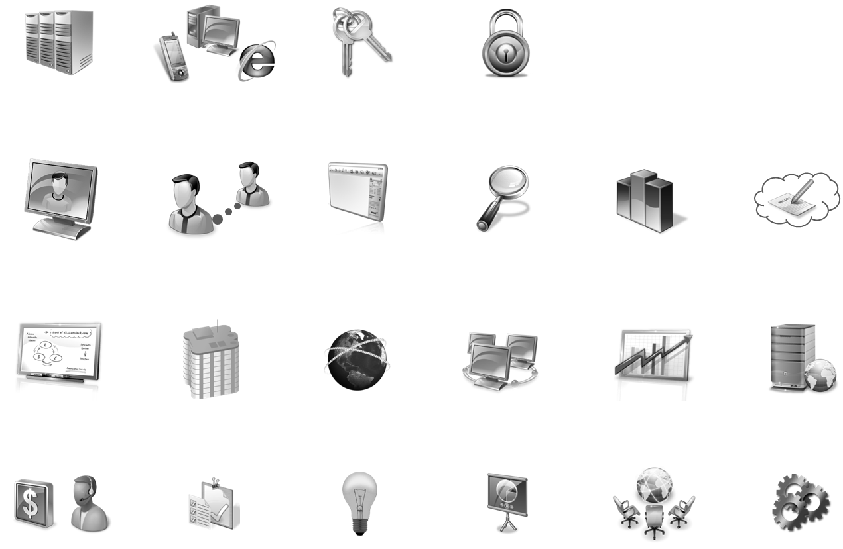
It’s The Workload !
Datacenter Services | Client Services | Identity and Security Services | IT Process and Compliance
Unified Communications | Collaboration | Enterprise Content Management | Enterprise Search | Self-Service BI¹ | Authoring and Ideation¹
Custom Development | Line of Business Platform | Web | Integration | Reporting and Analysis | Data Warehousing
Sales and Service | Governance, Risk and Compliance | Innovation | Business Insight | Digital Marketing | Industry or Vertical Specific

Slide 22
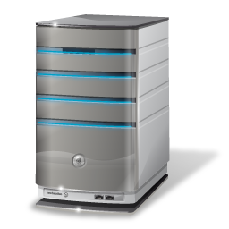







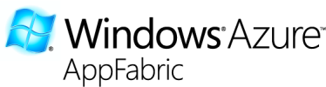
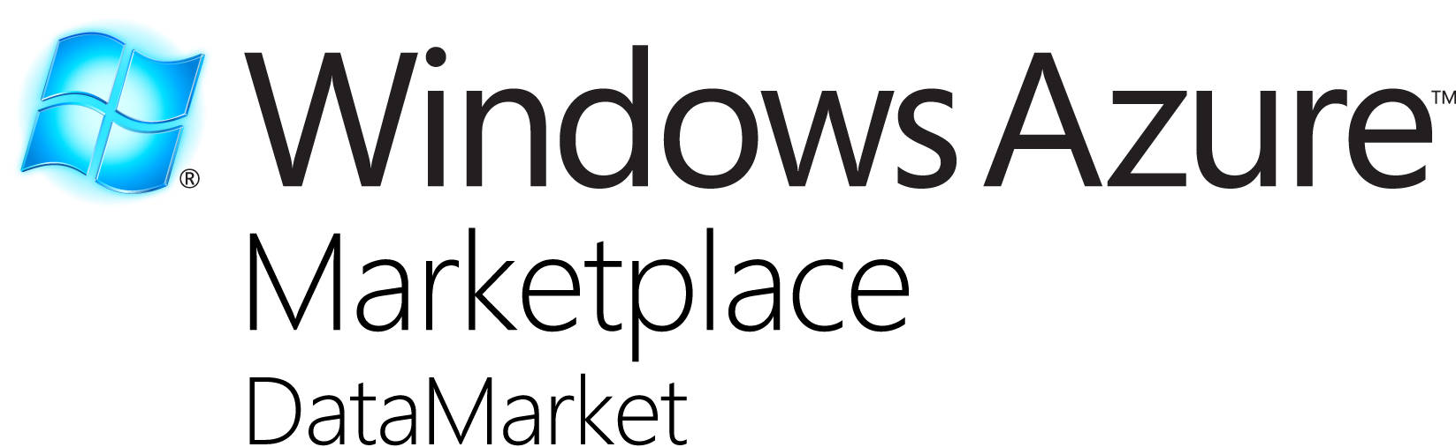





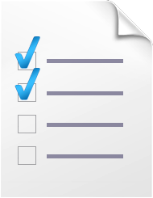
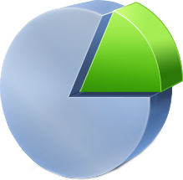







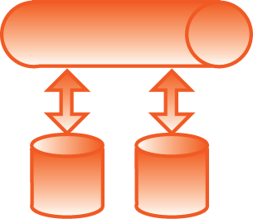


The Windows Azure Platform
  Developer Experience
  Use existing skills and tools
Storage
Reporting
Integration
Composite App
Service Bus
Caching
Access control
Flexible APIs
Information Marketplace
Compute
Management
Relational data
Management

Slide 23
Windows Azure AppFabric Community Technology Preview
announcement

Slide 24
Windows Azure AppFabric May CTP
New Service Bus pub/sub messaging capabilities
Comprehensive messaging capabilities for Windows Azure Platform
  All common messaging patterns: one-way, request/response, bi-directional, multicast , queuing and now publish/subscribe
  Reliable end-to-end delivery of messages
  Filtering rules enable intelligent subscriptions to messaging topics
  Simple REST/HTTP programming model for broad platform reach
  Rich .NET API for easy access to advanced messaging features
  All this adds to existing cross-firewall relay connectivity available in Service Bus today
New usage scenarios
  Async Cloud Eventing – Distribute event notifications to occasionally connected clients
  Event-driven SOA – Loose coupling to enable easy evolution of messaging topology over time
  Intra-App Messaging – Load leveling and load balancing for building highly scalable, resilient applications

Slide 25
Service Bus V2
Clemens Vasters
Principal Technical Lead
Microsoft Corporation
demo

Slide 26
Windows Azure AppFabric June CTP
New AppFabric Application Manager and Developer Tools
Application Manager
  Runtime capabilities that enable automatic deployment, management of the end to end Azure application (across web, middle tier, dabase)
  Enables ITPros to have advanced monitoring and analytics about the full application
Developer Tools
  Enhancements to Visual Studio that will enable to visually design and build an end to end Azure application
Composition Model
  An application manifest shared by both Developer Tools and Application Manager
  Extends the existing code and declarative artifacts in your existing applications

Slide 27
Symmetrical Clouds

Slide 28
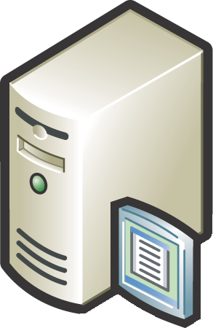
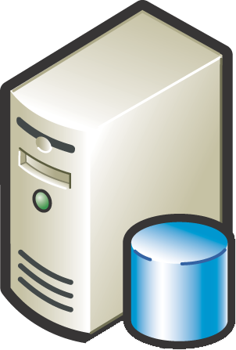
Asymmetrical Clouds

Slide 29
SharePoint Cloud Burst Out
Steve Fox
Director Evangelism
Microsoft
demo

Slide 30
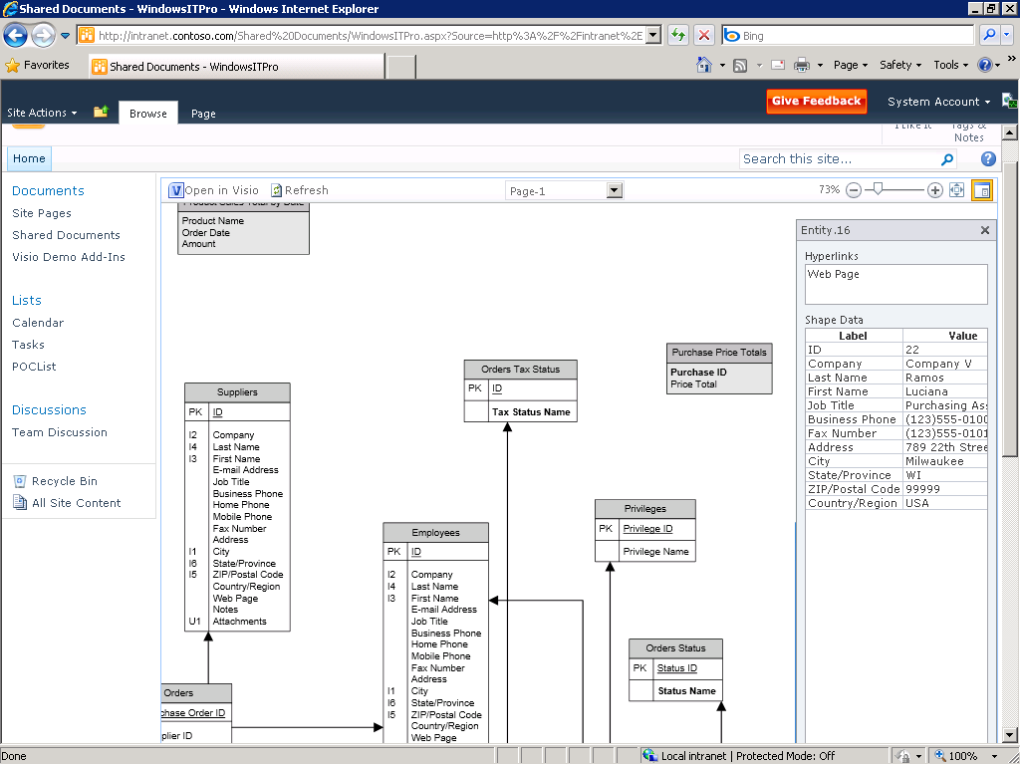
Are DBAs Becoming Extinct ?

Slide 31
SQL Azure
announcement

Slide 32
SQL Azure
Service update available later this summer
  Import/Export features in management portal - simplifies archiving a SQL Azure database, and eases migration between on-premises SQL Server and SQL Azure
  Enhanced Management Experience - additional schema management, and a new service for managing SQL Azure databases through an OData endpoint
Project Codename “Austin”
  StreamInsight’s complex event processing capabilities available as a service - build event-driven applications where the analysis of the events is performed in the cloud
  Available in a private CTP as of today, and a public CTP will be released on the SQL Azure Labs site later this CY

Slide 33
Who Owns The Running System ?
Microsoft
Cloud
Customer
Cloud

Slide 34
How Big Is Your Virus ?
PaaS by Windows Azure

Slide 35
Azure Application Migration
Michael Washam
Technical Evangelist
Microsoft
demo

Slide 36
Four Demos
Building a private cloud
Hybrid event based applications
SharePoint burst out to Azure
Redeploying from on-premises to the cloud

Slide 37
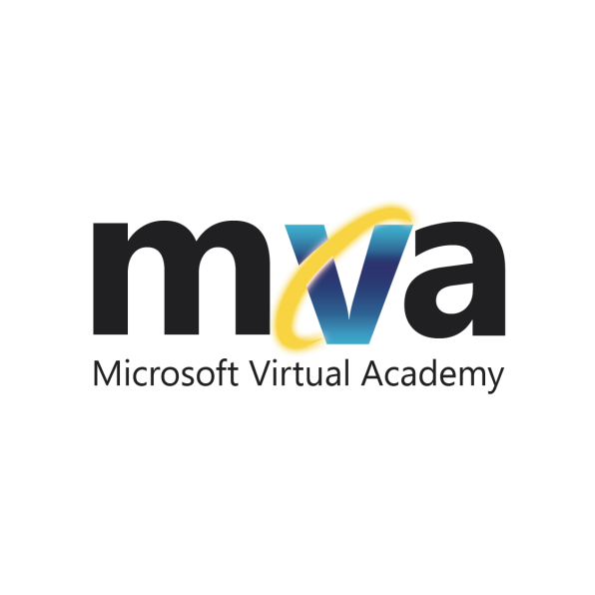
Enrol in Microsoft Virtual Academy Today
Why Enroll, other than it being free?
The Microsoft Virtual Academy helps you to improve your IT skill set and advance your career with a free, easy to access training portal that allows you to learn at your own pace, focusing on Microsoft technologies.
What Do I get for enrolment?
Free training to make you become the Cloud-Hero in my Organization
Help mastering your Training Path and get the recognition
Connect with other IT Pros and discuss The Cloud
Where do I Enrol?
www.microsoftvirtualacademy.com
Then tell us what you think.
TellTheDean@microsoft.com

Slide 38
Related Content
Required Slide
Speakers, please list the Breakout Sessions, Interactive Discussions, Labs, Demo Stations and Certification Exam that relate to your session. Also indicate when they can find you staffing in the TLC.
Demo 1: VMM2012
SIM336 | Microsoft System Center Virtual Machine Manager 2012: Server Fabric Lifecycle, Part 1 - Configuring Networking and Storage
SIM361 | Microsoft System Center Virtual Machine Manager 2012: Server Fabric Lifecycle, Part 2 - OSD, OOB and Agent Management
SIM357 | Microsoft System Center Virtual Machine Manager 2012: Server Fabric Lifecycle, Part 3 - Cluster Creation, Update Management
SIM211 | Microsoft System Center Virtual Machine Manager 2012: What’s in It, and How It Enables the Building of Private Clouds and Federation to the Public Cloud
COS312 | An IT Pro View of Windows Azure

Slide 39
Related Content
Required Slide
Speakers, please list the Breakout Sessions, Interactive Discussions, Labs, Demo Stations and Certification Exam that relate to your session. Also indicate when they can find you staffing in the TLC.
Demo 2: Service Bus V2 CTP2
MID312 | Windows Azure AppFabric Service Bus: New Capabilities
COS318 | A Lap around Windows Azure AppFabric
MID201 | An Overview of the Microsoft Middleware Strategy
Demo 3: SharePoint
OSP301 | Integrating Microsoft SharePoint 2010 with Windows Azure
OSP308 | Claims Identity in Microsoft SharePoint 2010
DBI328 | Integrating Microsoft SQL Server Reporting Services with Microsoft SharePoint Technologies
Demo 4: Application Migration
COS313 | Moving Applications to the Cloud
COS303 | Connecting Cloud and On-Premises Applications Using Windows Azure Virtual Network
COS302 | Using Windows Azure Virtual Machine Role

Slide 40



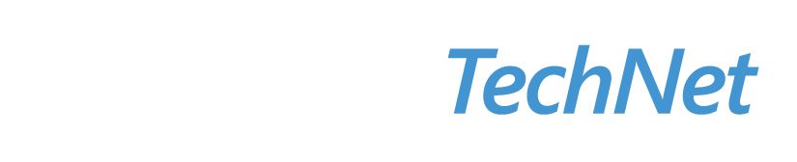

Resources
  Connect. Share. Discuss.
http://northamerica.msteched.com
Learning
  Sessions On-Demand & Community
  Microsoft Certification & Training Resources
www.microsoft.com/teched
www.microsoft.com/learning
  Resources for IT Professionals
  Resources for Developers
http://microsoft.com/technet
http://microsoft.com/msdn

Slide 41












Required Slide
Complete an evaluation on CommNet and
enter to win!

Slide 42


Slide 43

© 2011 Microsoft Corporation. All rights reserved. Microsoft, Windows, Windows Vista and other product names are or may be registered trademarks and/or trademarks in the U.S. and/or other countries.
The information herein is for informational purposes only and represents the current view of Microsoft Corporation as of the date of this presentation. Because Microsoft must respond to changing market conditions, it should not be interpreted to be a commitment
on the part of Microsoft, and Microsoft cannot guarantee the accuracy of any information provided after the date of this presentation. MICROSOFT MAKES NO WARRANTIES, EXPRESS, IMPLIED OR STATUTORY, AS TO THE INFORMATION IN THIS PRESENTATION.

