Slide 2

Workflow in Windows Azure AppFabric
MID313
Dave Cliffe
Program Manager
Microsoft

Slide 3
Why am I here?
I’ve used WF and loved it …
what’s next?
I’ve used WF, but it wasn’t
easy and there were
some missing pieces
I’ve heard so much about AppFabric …
how does WF fit in?
I’m doing “workflow”, but not WF …
what does the future look like?

Slide 4
Agenda
Recap: why Workflow and how today?
Addressing top customer asks in Workflow
Unlocking the power of Workflow in AppFabric

Slide 5





Why Workflow?
Long running work
Coordination of work
Transparency
Customizable business processes
2
3
4
1
5

Slide 6
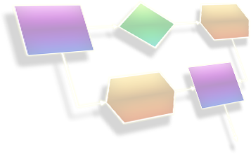
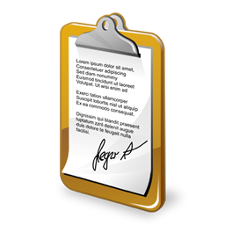
Recap: WF Services in AppFabric Server
Deploy
  Publish WF definition (.xamlx) to AppFabric
Host
  WorkflowServiceHost infers contracts from the WF & opens endpoints
  Wire up persistence & tracking store
Manage
  Tracking & instance mgmt using AppFabric Dashboard
T
A
Contracts inferred from Receive / Reply activities
Persistence and Tracking configured
Deploy Workflow Service definition (.xamlx)
M
Endpoints opened
SQL
Instance
Store

Slide 7
David Letterman’s Top 10:
Workflow asks (demands?) for v.Next
Cliffe’s
Show me State Machine.
My project type is C#, what’s this VB thingie?
I need to create a new version of my process.
I want to update existing instances to a new definition.
I already have a contract, let me use that one.
Turn the crank on the designer experience.
Ok, I’ve built my workflow … now I want to test it.
Make it easier to author large workflows (navigation, perf, etc.).
Building a custom InstanceStore is too difficult.
More activities! SendMail, Http/REST, Database, …

Slide 8
Contract First Authoring of Workflow Services
In WF v.Next you can …
  Implement your workflow service from a contract
  Validate that the workflow service correctly implements a contract

Slide 9
Contract-First Authoring of a Workflow Service
demo

Slide 10
Side-by-Side Versioning
Applications Started Before 1/1/2011
Applications Started After 1/1/2011
Client
Mortgage
Application Process
Receive
Application
Side-by-Side Execution
Mortgage Application Process
Receive
Application
Verify
Income
Approve
Application
Approve or Reject
Application
Issue
Loan
Issue
Loan

Slide 11
Workflow Services SxS Versioning
SxS versioning semantics
  New instances are started with the latest version
  Existing instances are completed with their original version
In WF v.Next WFSH is a multi-version host!
  No router required, no “smart client” required
  Versions hosted on the same endpoint
  Leverages the concept of WorkflowIdentity
Mortgage Application Process v1.0.0.0 .xamlx
Mortgage Application Process v2.0.0.0 .xamlx
Client
Workflow ServiceHost

Slide 12
SxS Versioning of a
Workflow Service
demo

Slide 13
To
AppFabric!
But wait, there’s more!

Slide 14










AppFabric: Next-generation Middleware Platform
A platform and middleware services for Cloud and Server applications
Applications
Custom Code
AppFabric
Developer
Tools
Caching
Service Bus
Access Control
Integration
Web Services
Workflows
Composition
Model
Web Tier
AppFabric Services
Data Tier
AppFabric
App
Manager
Windows Server
Windows Azure
AppFabric
Container
SQL Server
SQL Azure
Server
Cloud

Slide 15
Why Workflow in AppFabric?
What does AppFabric bring to WF?
  Pre-configured, always on host
  WF can leverage a high scale, multi-tenant environment
What does WF bring to AppFabric?
  Model for supporting efficient use of resources via idle/unload/load cycles
  Orchestration across AppFabric services
  Application visibility
  Great extensibility story for ISVs
  Provides an easier way to build scalable, consistent applications

Slide 16

AppFabric Workflow: Design Goals
Natural evolution of WF4
  Same programming model, same runtime
  New activities and runtime enhancements to support AppFabric
  Ability to author as part of an AppFabric Application
Provide a great deployment and management experience
Host at scale and high density
Provide consistency w/o DTC
Integrate with ServiceBus messaging
  Scale-out (message → instance)
  Pub/Sub

Slide 17
Authoring a WF in AppFabric CTP
demo

Slide 18
AppFabric Workflow
Management
Using AppFabric Management Portal
  Instance status
    Including instance control: Suspend, Terminate, Cancel, etc.
  Health monitoring
    # of instances started, completed, etc. over time
  View your Tracking records
    Based on a custom profile
  Diagnostic logs
  Workflow web viewer

Slide 19
AppFabric Workflow
Management
Monitoring
  Instances Created
  Instances Completed
  Instances Terminated
Instance Mgmt
  Terminate
  Cancel
  Suspend/Resume

Slide 20
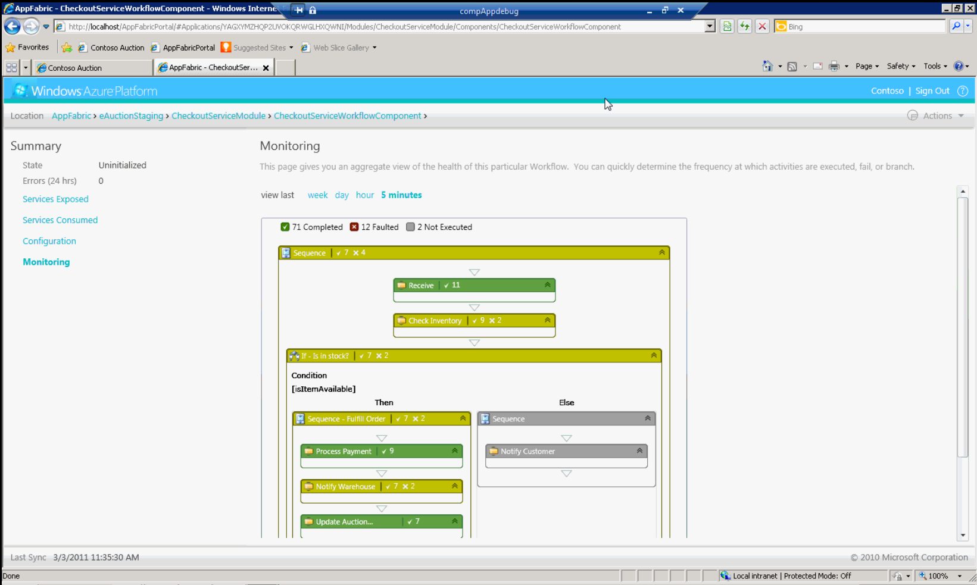
Workflow Web Viewer

Slide 21

AppFabric Workflow
Scale-out (using ServiceBus Messaging)
WFSH #1
WF4 – Physical View
WFSH #2
Load
Balancer
Instance
Locked
Exception!
Instance Storage
---------------------
…
WFSH #N

Slide 22
AppFabric Workflow
Scale-out (using ServiceBus Messaging)
WF Node
WF Node
Instance 123
AppFabric – Logical View
WF Node
Instance 456
Correlation
ServiceBus
…
WF Node
Instance XYZ

Slide 23
AppFabric Workflow
Eventual Consistency
Workflow Service
All side-effects are committed to ServiceBus in a single local TX.
Receive
(Activate)
Send
Send
Send
ServiceBus
ReceiveReply
Checkpoint

Slide 24
AppFabric Workflow
Messaging
Legend:
Available in CTP
WCF
Endpoint
Infrastructure
Workflow
Coming soon
ServiceBus
Receive
SendReply
Topic
Receive?
af://imports/IService
IService
Send
IService
Queue
IService.Foo
Send + ReceiveReply
SOAP
IService.Foo
HTTP/
REST
Http*
Send?
Topic

Slide 25
AppFabric Workflow future investments
Authoring
  Integrate the Add Service Reference experiences
Management
  Provide a rich instance management experience in AppFabric Application Manager
Messaging
  Enable pub/sub as a first-class pattern
  Support external addressability via (consistent) WCF endpoints
  Leverage Content-based correlation
  Consume Http (REST, OData) services
And much, much more …

Slide 26
Timeline: AppFabric CY11
Strategy: 2-3 releases/year on Azure, 2-3 year release cadence on Server
April
May
June
CY11 H2
GA – Caching
GA – Access Control
CTP – Pub/Sub
CTP - Queues
CTP – AF Dev Tools
CTP – AF App Mgr
CTP – WF/WCF
GA – SB Pub/Sub & Queues
CTP2 – Dev Tools/App Mgr/WF/WCF
CTP – Integration
CTP2
AppFabric
Developer
Tools
GA
GA
GA
CTP
CTP2
Custom Code
Composition
Model
Caching
Service Bus
Access Control
Integration
Web Services
Workflows
CTP2
AppFabric
App
Manager
AppFabric Container
Cloud

Slide 27
Conclusion
Workflow is continuously improving thanks to great customer feedback … keep it coming!
Workflow is an integral part of AppFabric
.NET/VS v.Next
AppFabric
Tooling
Designer
Up-leveled tooling experience across your application
Activities for new cloud capabilities and messaging
Host built for cloud scale & consistency
Integration with AppFabric for deployment/mgmt
C# Expressions
Contract-First WF Services
Designer enhancements
SxS Versioning
Dynamic Update
Activities
Host
Runtime

Slide 28
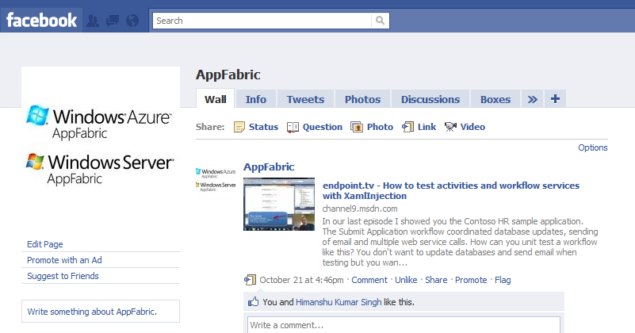
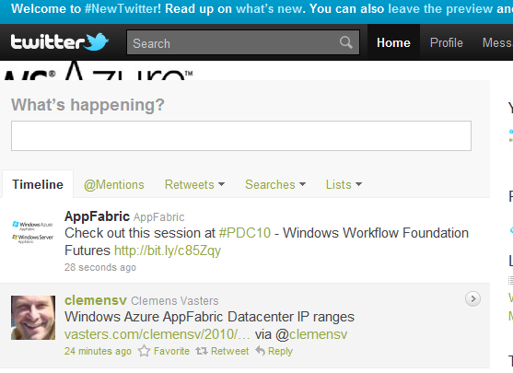
Talk to us
http://facebook.com/AppFabric
Twitter: @appfabric, @ronljacobs
Email: appfabric@microsoft.com

Slide 29

Related Content
Required Slide
Speakers, please list the Breakout Sessions, Interactive Discussions, Labs, Demo Stations and Certification Exam that relate to your session. Also indicate when they can find you staffing in the TLC.
Breakout Sessions (Thursday)
  8:30 – 9:45am: MID315 – Building Highly Scalable and Available WCF Services with Windows Azure AppFabric
  10:15 – 11:30am: MID305 – Building State Machine Workflows with Windows Workflow Foundation
Breakout Sessions (Previous)
  COS311 – Intro to Windows Azure AppFabric Composite Applications
  MID312 – Windows Azure AppFabric ServiceBus: New Capabilities
  MID201 – An Overview of the Microsoft Middleware Strategy
  MID310 – Windows Communication Foundation Futures
Find Me Later At the AppFabric (WF/WCF) Booth in the Middleware Section

Slide 30
Track Resources
Required Slide
Track PMs will supply the content for this slide, which will be inserted during the final scrub.
Windows Azure Platform Training Kit
Windows Server AppFabric Training Kit
BizTalk 2010 Developer Training Kit
AppFabric Team Blog
Windows Azure AppFabric on MSDN
Windows Server AppFabric on MSDN

Slide 31





Resources
  Connect. Share. Discuss.
http://northamerica.msteched.com
Learning
  Sessions On-Demand & Community
  Microsoft Certification & Training Resources
www.microsoft.com/teched
www.microsoft.com/learning
  Resources for IT Professionals
  Resources for Developers
http://microsoft.com/technet
http://microsoft.com/msdn

Slide 32












Complete an evaluation on CommNet and
enter to win!

Slide 33


Slide 34

© 2011 Microsoft Corporation. All rights reserved. Microsoft, Windows, Windows Vista and other product names are or may be registered trademarks and/or trademarks in the U.S. and/or other countries.
The information herein is for informational purposes only and represents the current view of Microsoft Corporation as of the date of this presentation. Because Microsoft must respond to changing market conditions, it should not be interpreted to be a commitment
on the part of Microsoft, and Microsoft cannot guarantee the accuracy of any information provided after the date of this presentation. MICROSOFT MAKES NO WARRANTIES, EXPRESS, IMPLIED OR STATUTORY, AS TO THE INFORMATION IN THIS PRESENTATION.

Slide 35
C# Expressions
WF4 provides VB support for writing expressions
  Intellisense, auto-complete, etc.
I love WF but I don’t like writing VB expressions in a C# project!
  Did you hear that before?
  In WF v.Next, this won’t an issue anymore…
Migration scenario: C# side by side with VB, so workflows created with WF4 run seamlessly

Slide 36
[Flowchart] Designer Improvements
I love the Flowchart but…
  Adding a new node between existing nodes is hard
  Adding a new node requires precision
  Can’t add explanations / notes to the activities
  Hard to navigate a big flowchart with the scrollbars
  Can’t search for an activity
  Can’t set a descriptive label to decisions
→ Auto-Insert
→ Auto-Connect
→ Annotations
→ Pan
→ Search
→ DisplayName on
Decision and Switch

Slide 37
Versioning & Dynamic Update
Workflow identity (name + version)
  Allows a host to easily associate an instance with its definition
  Mismatches can be detected at load time
Dynamic update
  Update workflow instance data to match new definition
  Scenario
    Developer modifies a definition with “change tracking” on
    IT Administrator applies definition changes to one or more instances in production

Slide 38
Side-by-Side Versioning in WF4
Service
Ver. 1
…V1…
Client
Routing
Service
…V1…
…V2…
…V2…
Service
Ver. 2
…V2…
…V2…

Slide 39
AppFabric Workflow
Scale-out (using ServiceBus Messaging)
WF4
AppFabric Workflow
WFSH #1
Instance 123
Load &
Lock Instance
Load
Balancer
WFSH #2
Instance Storage
Instance Storage
Correlation
Instance 456
…
…
WFSH #N
Instance XYZ

Slide 40
Inbound Messaging & WF
Activation
1) Initiating Receive
2) Activating Notify
3) Correlating Receive
4) Subscribe & Notify
P2P
Pub/Sub
Correlation

