Slide 1

Exploring the Office Developer Story in Microsoft Office 365
OSP206
Devinder Singh
Senior Product Manager
Microsoft

Slide 2
Session Objectives and Takeaways
Session Objective(s):
  Getting started with Office development in Office 365
  What remains same and what changes in the Developer Story?
Key Takeaway
  To have an understanding of how Office 365, being an online service, shapes Office solution development.

Slide 3





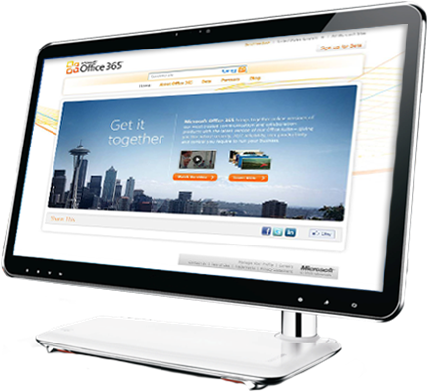


Experience Office as it was meant to be… without the complexity of setting up servers.

Slide 4
Office 365
Plan components
Kiosk Users (K Plans)
Enterprise Users (E plans)
Plan E4
Voice
Office Pro Plus
Plan E3
Components
V.mail & Advanced Archive Capabilities
Office Web Apps
Plan K2
Forms, Access
Excel, & Visio Services
Office Web Apps
Plan E2
SharePoint Online
Kiosk
Plan K1
Email, calendar, AV/AS, Personal Archive
Plan E1
Collaboration Portal
Exchange Online
Kiosk
Conferencing
IM & presence

Slide 5










Office Professional Plus is
Full rich client suite
Monthly subscription
Per user provisioning, up to 5 devices
Same apps as Office Pro Plus 2010
Office Web Apps on Office 365
32 or 64 bit
Word
Publisher
Excel
Access
PowerPoint
InfoPath
SharePoint
Workspace
OneNote
Outlook
Excel
OneNote
PowerPoint
Word
Notes:
Per user licencing – each user can install on up to 5 machines

Slide 6
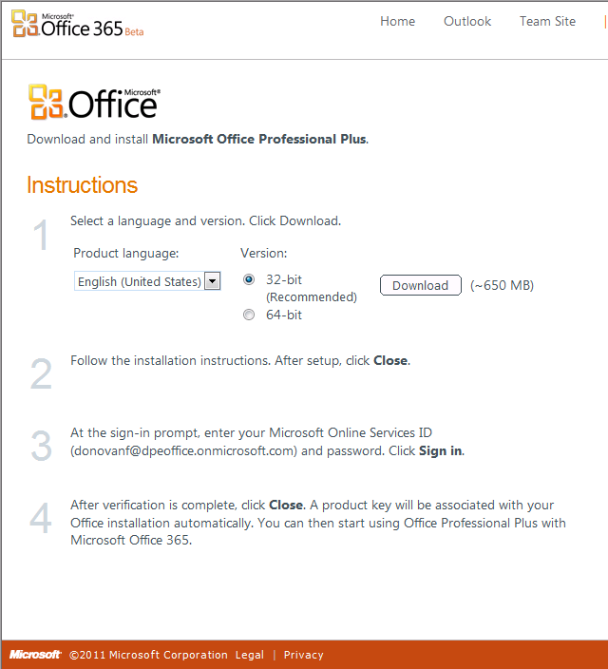
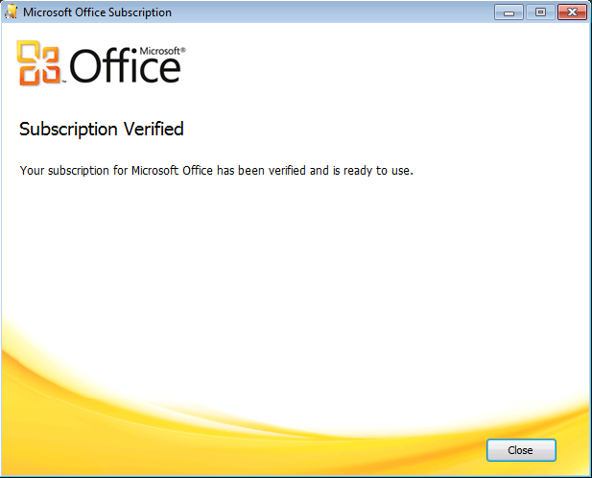
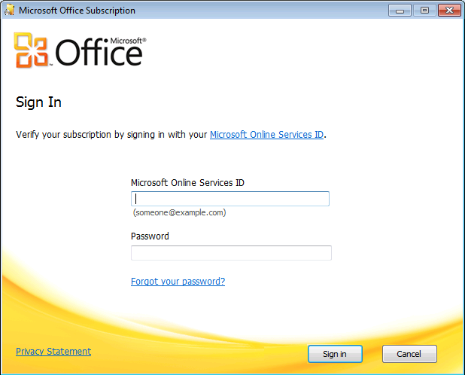
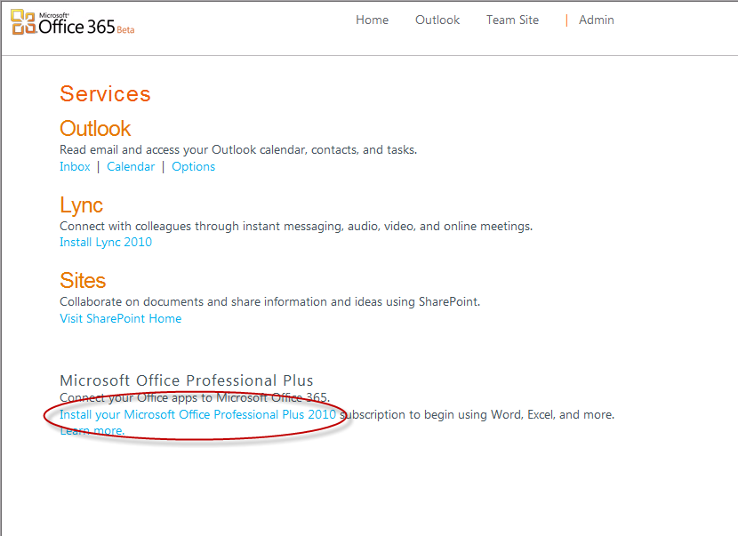
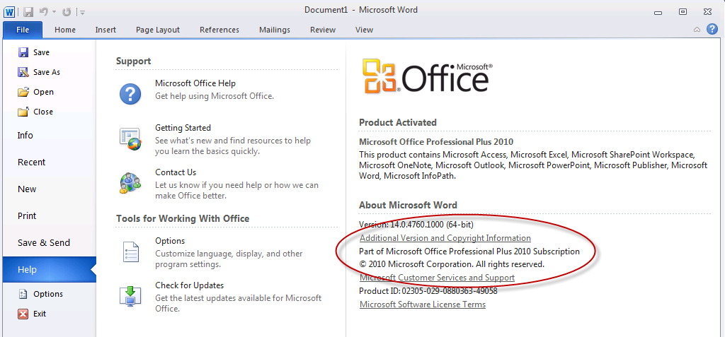
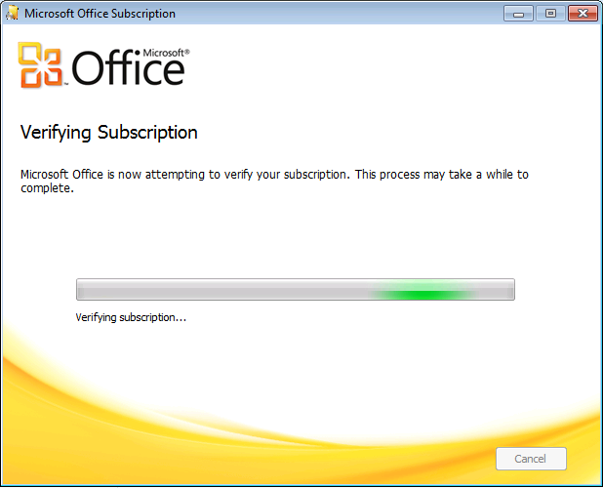
Office Professional Plus Setup Flow

Slide 7
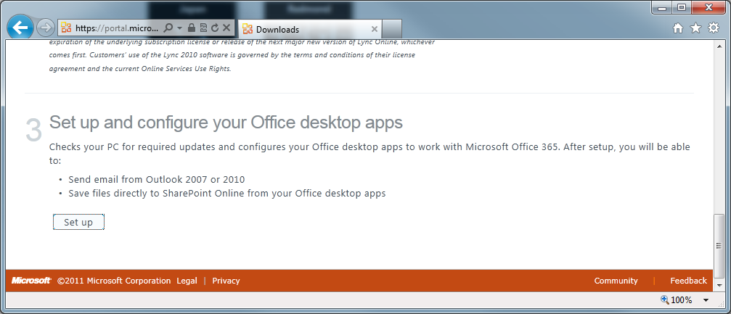
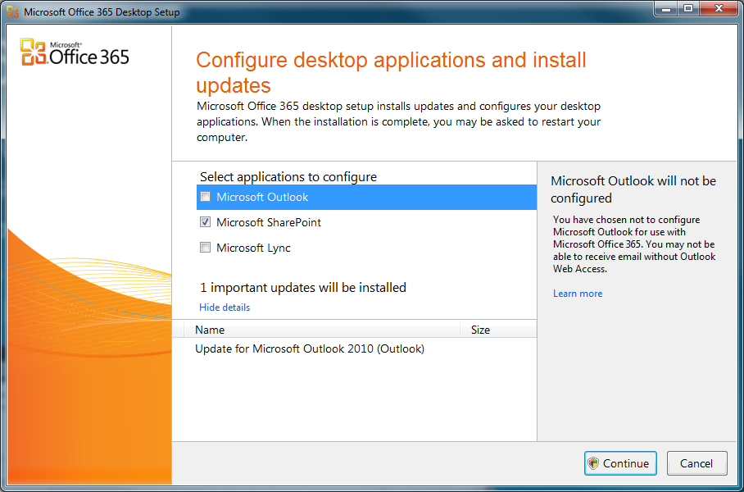
Office 365 Desktop Setup
Updates client PCs to work with Office 365 Services
Configure clients for subscribed services
Notes:
Installs SPs patches, fixes and configures Outlook, IE and Lync (Separate download)
At GA – wont be called the connector – but will be a process part of the portal setup process
For the enterprise – we are documented requirements (patches, fixes, config) so that they can be setup in platforms such as SCCM
WSUS = Windows Software Update Services
WU= Windows Update
NOTE:
Beta - the connector will configure Outlook, Lync 2010, and IE to work with Office 365.

Slide 8
Development Environment
Operating System
Windows 7 RTM
Windows Server® 2008 R2
Microsoft Vista® SP2
Windows: XP SP3 with Internet Explorer® 7
Office
Office Professional Plus 2010 Subscription
Office 2010 RTM
Office 2007 SP2
Visual Studio
Visual Studio 2010

Slide 9




Office 365 Identity Architecture
Identity Options
Microsoft Online IDs
Microsoft Online IDs + DirSync
Microsoft Online Services
Federated IDs + DirSync
Identity Platform
Trust
Federation
Gateway
Exchange
Online
Contoso Customer (on-premises)
Active Directory Federation Server 2.0
Authentication platform
IdP
SharePoint®
Online
IdP
MS Online Directory Sync
Provisioning
platform
AD
Directory
Store
Lync™
Online
Admin Portal

Slide 10
What Remains Same for Office developers?
  Round-tripping of documents with VBA
  Add-ins
  UI Customization
    Ribbon
    Backstage
  Excel Services, Access Services, Visio Services, Infopath Services

Slide 11
What Changes for Office Developers targeting solutions in Office 365?
  Accessing SharePoint Online Data using SP Client Object Model
  Word Automation Services not available
  Business Connectivity Services(BCS) not available
  Follow guidance regarding Sandbox solution development

Slide 12
Accessing SharePoint Online Data
Using
  Visual Studio 2010
  Office Professional Plus
SharePoint Client Object Model (SP COM)
  Unified object model across all clients
  Subset of Server OM
Article: Remote Authentication in SharePoint Online Using Claims-Based Authentication http://msdn.microsoft.com/en-us/library/hh147177.aspx
Notes:
Unified object model across all clients
JavaScript, .NET CLR, Silverlight CLR
Subset of Server OM
Webs, Lists, ListItems, Content Types, Fields, etc.
Limited to Site Collections, Site level and below

Slide 13




SharePoint Client Object Model Solution
Office Pro Plus 2010 Client
Add-in using SP COM
SharePoint Online
Look at:
- A SP COM
document-level solution
List

Slide 14
Solution with VS 2010,
SharePoint COM & Office
Add-ins in Office 365
demo

Slide 15

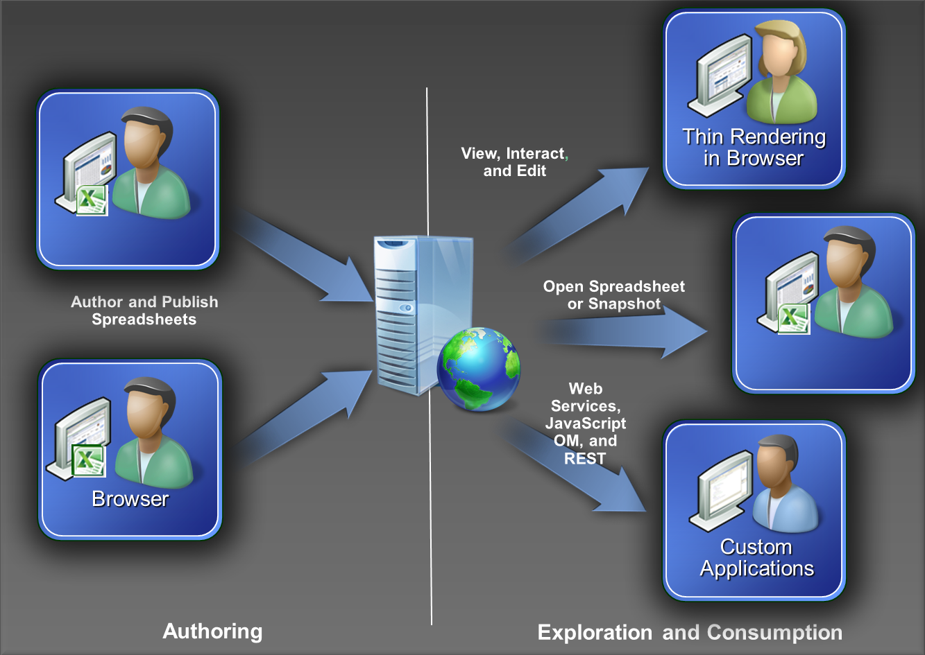
Excel & Excel Services
REST API
  Enables embedding of ranges and charts contained in a workbook
  on a web page
  Changes in underlying workbook are automatically reflected when web page
  is (re-) loaded

Slide 16
Excel & Excel Services in Office 365
demo

Slide 17

InfoPath 2010 Scenarios
Information Worker
  Customize List Forms
  Take Lists Offline
  Application Data in Lists
Office Business Application Builder
  Workflows in SharePoint Designer
  Custom code running in Sandbox

Slide 18
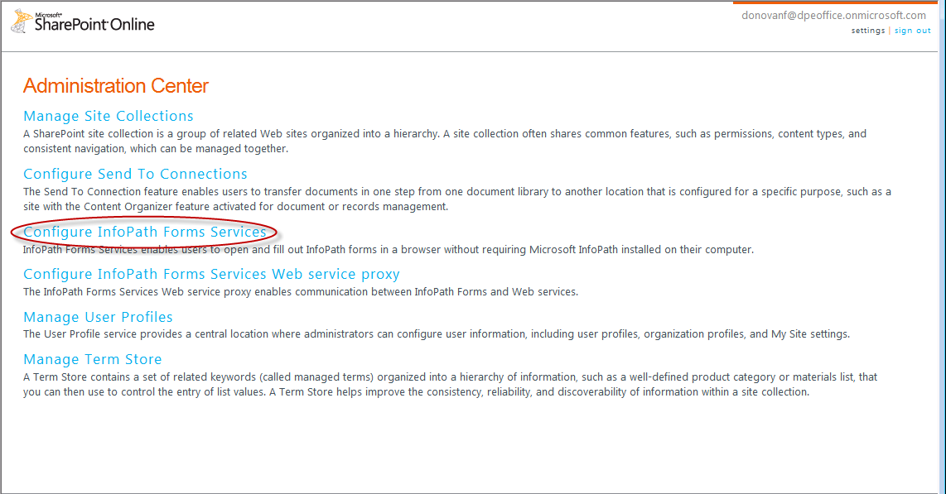
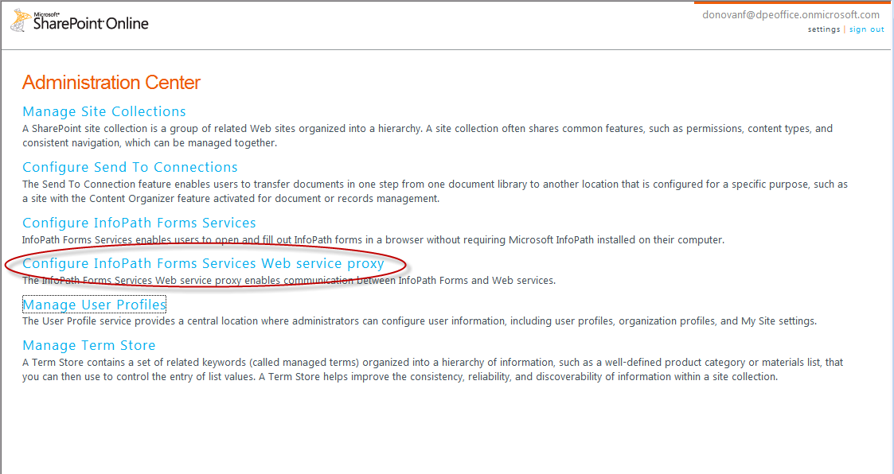
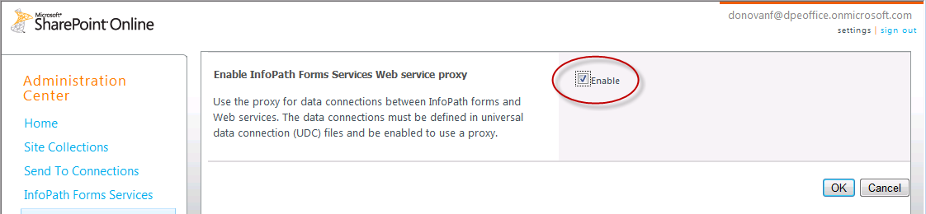
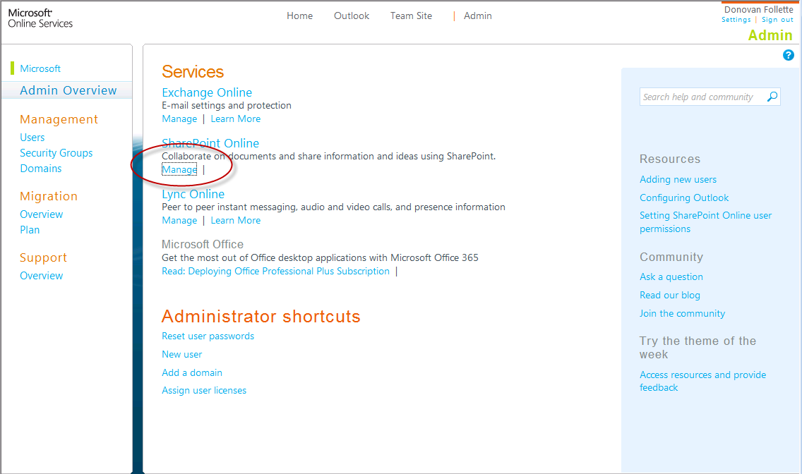
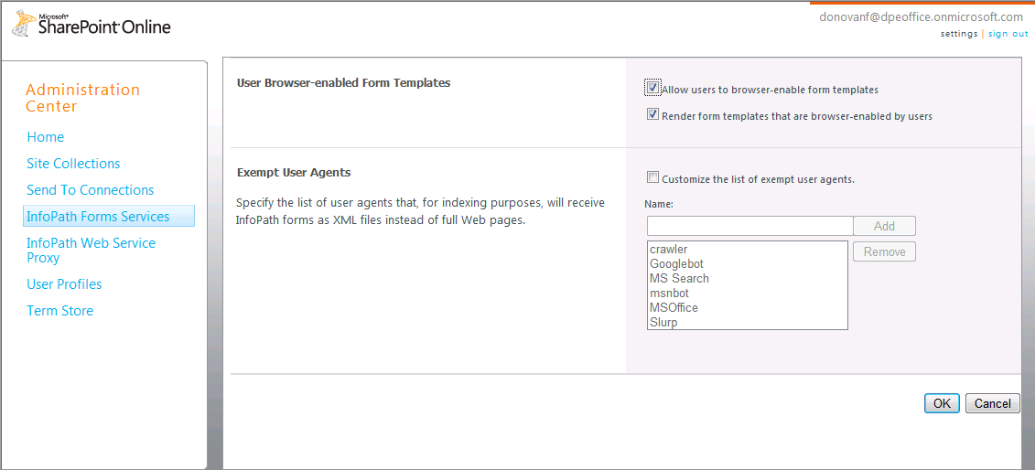
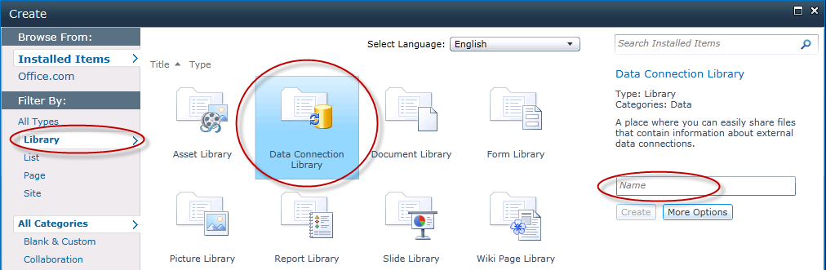
Configure Office 365 Forms Services

Slide 19
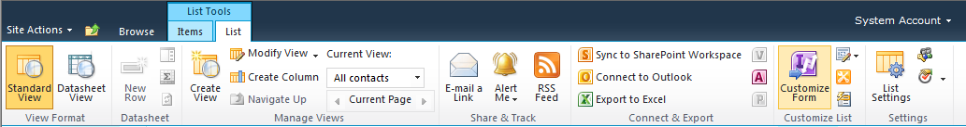
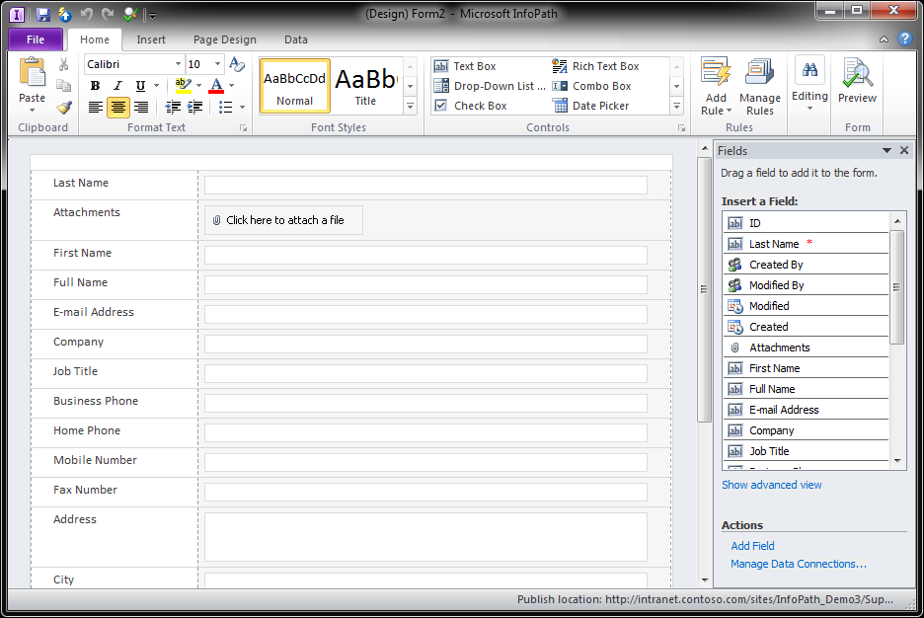
Customize SharePoint Online List Forms
Accessible with a single click in SharePoint

Slide 20
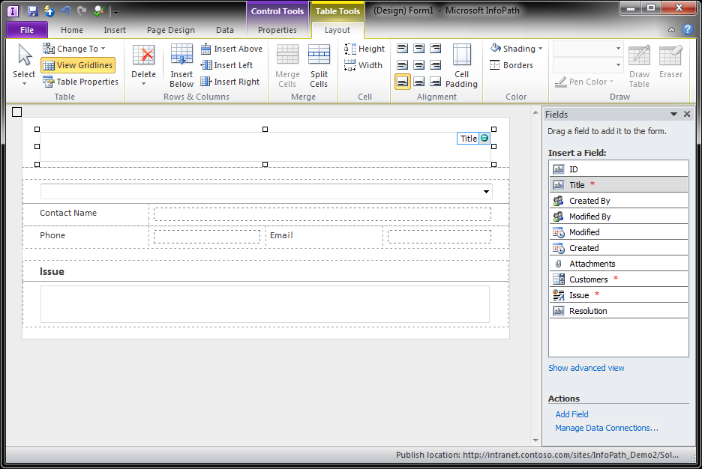
Rich Form Design Experience
InfoPath 2010 provides design services
Layout
  Themes
  Table Layout
Behavior
  Rules
  Custom Code
Data
  Binding
  External Data

Slide 21
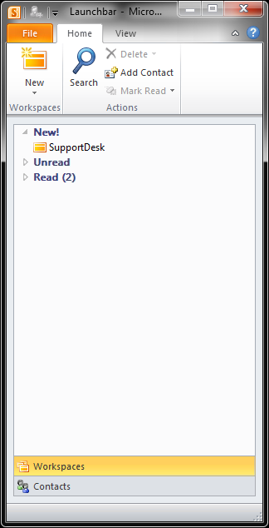
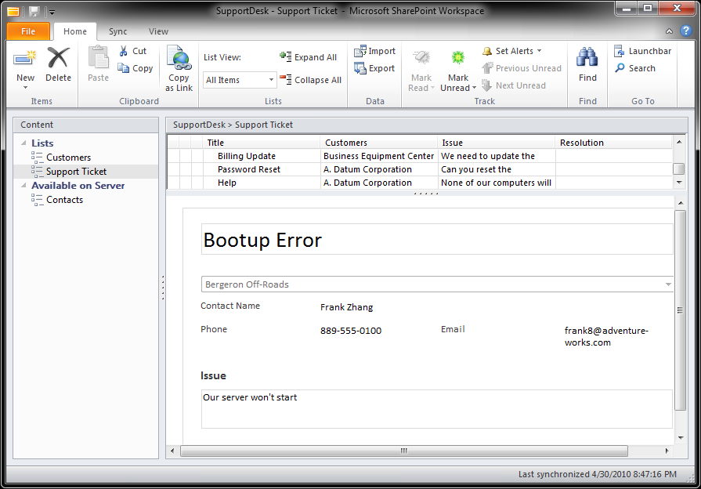
Offline Support in InfoPath 2010
Handled by SharePoint Workspace
  Provides an offline cache of SharePoint sites
  Hosts custom InfoPath Forms
  Same forms that are used by Forms Services

Slide 22
InfoPath & Forms Services in Office 365
demo

Slide 23


Access & Access Services
With Access 2010, you can
  Centrally store and distribute Access solutions
  Build a Web Database
  Publish to a SharePoint on premises or online
  Provide data access from anywhere
  Share and collaborate with others
  Use SharePoint permissions to determine
  who can see what

Slide 24
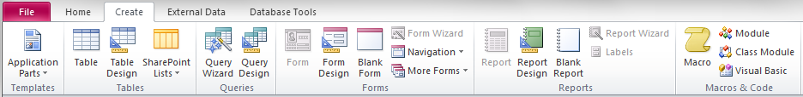
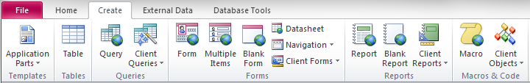
Web Database Design Considerations
Create Database Objects for the Web
Use Web Ready objects
Add client-only forms or VBA only if needed
  Not usable in web environment, but still can be used on the client
Create tab of a client only database:
Create tab of a web database:
Note Globes in icons which signify it is a Web Ready object

Slide 25
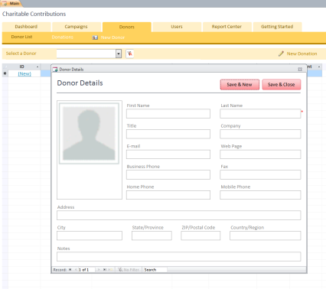


Publish to Access Services Online
ACCDB → SharePoint Site
Access Tables → SharePoint Lists
Access Forms → ASPX Pages
Access Reports → RDL (SQL Server Reports)
UI Macros → JavaScript
Data Macros → SharePoint Workflows

Slide 26
Access & Access Services in Office 365
demo

Slide 27

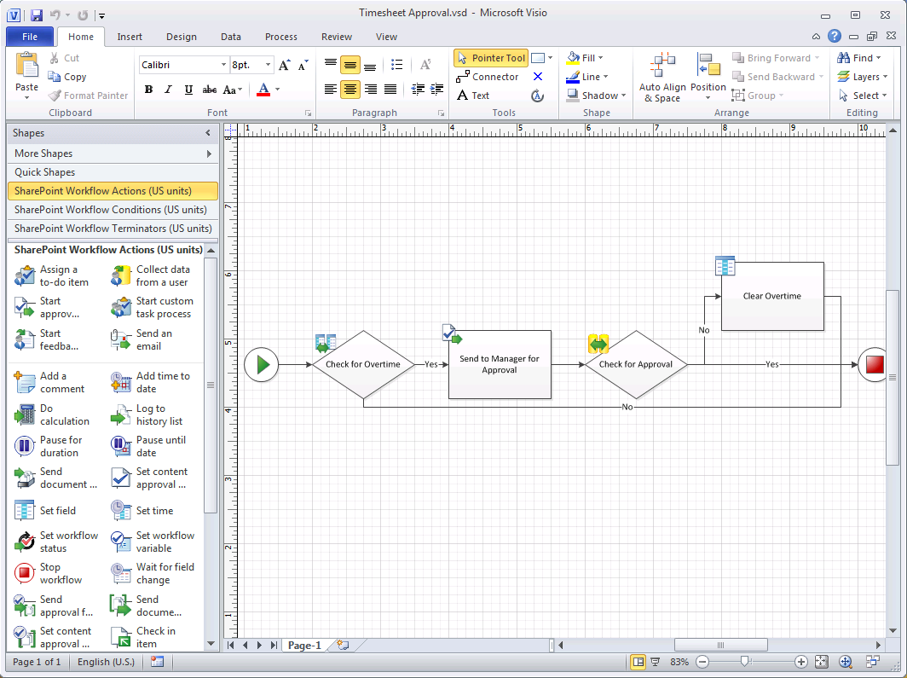
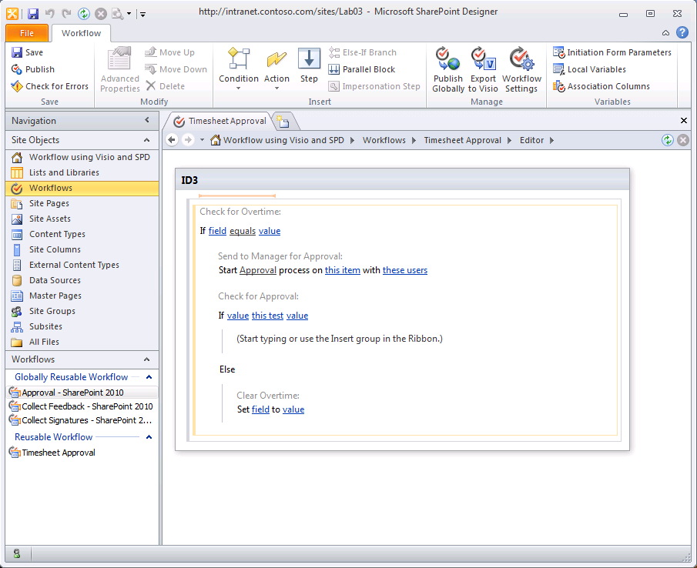
Visio 2010 & SharePoint Designer 2010
Visio 2010
  New SharePoint workflow template
    Supports almost all actions & conditions in SPD
  Exports .vwi file
SharePoint Designer 2010
  Imports .vwi file
  Supports round-trips to Visio

Slide 28
Visio, SharePoint Designer &
Declarative Workflows in Office 365
demo

Slide 29


SharePoint Workspace & Outlook
Taking data offline
  All lists & libraries can be taken offline to
  SharePoint Workspace
  Libraries and some lists can be taken offline
  into Outlook
  Synchronization
    Off-line/on-line aware
    Read/Write

Slide 30







Summary
There are a number of Office integration options
  Excel & Excel Services REST
  InfoPath & Forms Services
  Access & Access Services
  Visio & SharePoint Designer for Workflows
  Visual Studio 2010 to build Office Add-ins

Slide 31
Related Content
Code | Title | Schedule
OSP312 | Developing Microsoft Office Business Solutions That Span the PC, Windows Phone and the Web | Tuesday 8:30AM
OSP319 | Taking Office to the Cloud: Integrating Microsoft Office 2010 and Windows Azure | Wednesday 8:30AM
OSP320 | Managing Microsoft Access Databases in Your Organization with Microsoft SharePoint | Wednesday 1:30PM
OSP206 | Exploring the Office Developer Story in Microsoft Office 365 | Thursday 10:15AM
OSP271-INT | Redefining IT Dashboards and Other Game-Changers with Microsoft Visio 2010 and Microsoft SharePoint 2010 | Thursday 2:45PM
Hands-On Labs
OSP377-HOL | Using Business Connectivity Services with Microsoft Office 2010

Slide 32
Track Resources
Office Developer Center:
  http://msdn.microsoft.com/en-us/office/default.aspx
Office Developer Map:
  http://msdn.microsoft.com/en-us/office/gg549099
Office Related Blogs:
  Donovan Follette: http://blogs.msdn.com/b/donovanf/
Office Related Twitter Accounts:
  @OfficePlatform
  @bshiers

Slide 33





Resources
  Connect. Share. Discuss.
http://northamerica.msteched.com
Learning
  Sessions On-Demand & Community
  Microsoft Certification & Training Resources
www.microsoft.com/teched
www.microsoft.com/learning
  Resources for IT Professionals
  Resources for Developers
http://microsoft.com/technet
http://microsoft.com/msdn

Slide 34












Required Slide
Complete an evaluation on CommNet and
enter to win!

Slide 35

Required Slide
Your MS Tag will be inserted here during the final scrub.
Notes:
New for TechEd 2011, we will be working with Microsoft Tag (http://tag.microsoft.com/overview.aspx) to create unique Tags for every session at the event. Your session Tag will appear on both the room signage and at the end of your presentation. With your session Tag, attendees will be able to scan as they enter the room to retrieve session details, view speaker bios, and engage in discussions; or scan at the end of the presentation to evaluate your session and download materials. We’re excited to integrate Microsoft Tag across the My TechEd mobile experience this year.

Slide 36

© 2011 Microsoft Corporation. All rights reserved. Microsoft, Windows, Windows Vista and other product names are or may be registered trademarks and/or trademarks in the U.S. and/or other countries.
The information herein is for informational purposes only and represents the current view of Microsoft Corporation as of the date of this presentation. Because Microsoft must respond to changing market conditions, it should not be interpreted to be a commitment
on the part of Microsoft, and Microsoft cannot guarantee the accuracy of any information provided after the date of this presentation. MICROSOFT MAKES NO WARRANTIES, EXPRESS, IMPLIED OR STATUTORY, AS TO THE INFORMATION IN THIS PRESENTATION.

