Slide 1

Integrating Microsoft SharePoint
2010 with Windows Azure
OSP301
Steve Fox
Director, DPE
Microsoft Corp.
stefox@microsoft.com | http://blogs.msdn.com/steve_fox | @redmondhockey

Slide 2
Why?
Cost optimization
Cloud-based services and data
Parity across SharePoint & Office 365

Slide 3
service
remote access
data
security

Slide 4
Service
Reuse existing cloud-based services
  Windows Azure Marketplace DataMarket
Deploy custom WCF services to Windows Azure
Create service-based worker role
Extend capabilities of core SharePoint functionality
  Workflow
  Event receivers
Integrate cloud-based service or data into SharePoint
Leverage services for SharePoint to Office 365 parity
  Deploy once, use everywhere

Slide 5



Service
Reporting on Crime with WCF Service
SPS or O365
Choose data source
Create WCF Service
Deploy to Windows Azure
Create Silverlight app or Web Part
Deploy to SharePoint
You can extend with SP Client Object Model
Silverlight/ Web Part
GetCrimeData()
Azure Marketplace DataMarket (DATA.gov)

Slide 6
Crime Reporting
demo

Slide 7
Data
Use SQL Azure for relational database in the cloud
  No-code and code-based solutions for SQL Azure
Migrate or mirror data from on-premises to cloud
Query data from cloud-based apps or services
Leverage BLOB for storage for archival or media streaming
Data mash-ups and applications

Slide 8
Data
Using Windows Azure BLOB Storage
SPS
Create Upload page
Create IFRAME Web Part
Create Silverlight viewer for BLOBS
Deploy both Web part and Silverlight to SharePoint
You can extend with SP Client Object Model
You can use Web parts as uploader
You can deploy Silverlight to SPO
You can use Shared Access Permissions
Web Part
<iframe>
Default.aspx
(Upload BLOBs)
BLOB Storage
Silverlight
SP List

Slide 9
Marketing Image Viewer
demo

Slide 10
Remote Access
Deploy services locally as listeners and connect via Windows Azure
Use Windows Azure as a service layer
  Connect to remote devices, different languages and platforms
Expose data from cloud-based services
Secure using the Access Control Service (ACS)
Extend on-premises code to the cloud

Slide 11

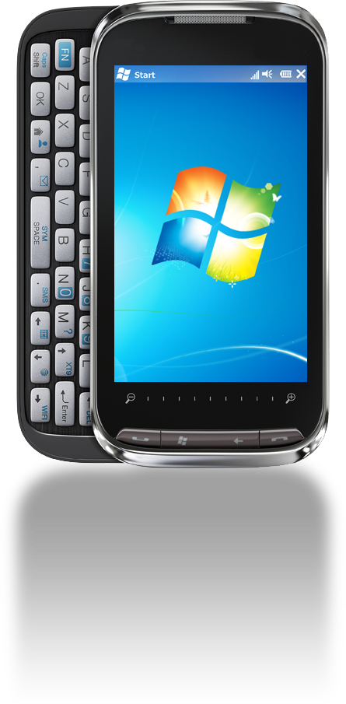
Remote Access
Accessing SharePoint Data using Windows Phone 7
SPS
GetSalesCaller SVC
Create on-premises service
Create service and deploy to Windows Azure
Connect via Service Bus
Connect via remote device
You can connect and use the service from any WCF conversant device, application or platform
GetSalesLstnr SVC
Service Bus
SharePoint
List

Slide 12
Accessing SharePoint Data on Windows Phone 7
demo

Slide 13
Security
Business Connectivity Services (BCS)
  Application ID – mediates connection to SQL Azure
  BCS Permissions on external list
AppFabric
  ACS
    Simple: Token and secret key
    Complex: Service-based claims and STS endpoints
    WS-Federation/WS-Trust
    Claims-based authentication for web apps/WCF services
BLOB Storage
  Token and secret key to access the BLOB
  Shared Access Permissions
Certificates
  Use trusted certificate as handshake

Slide 14

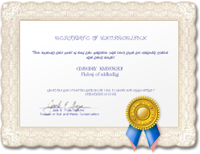




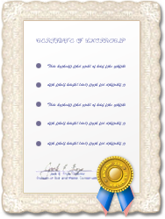

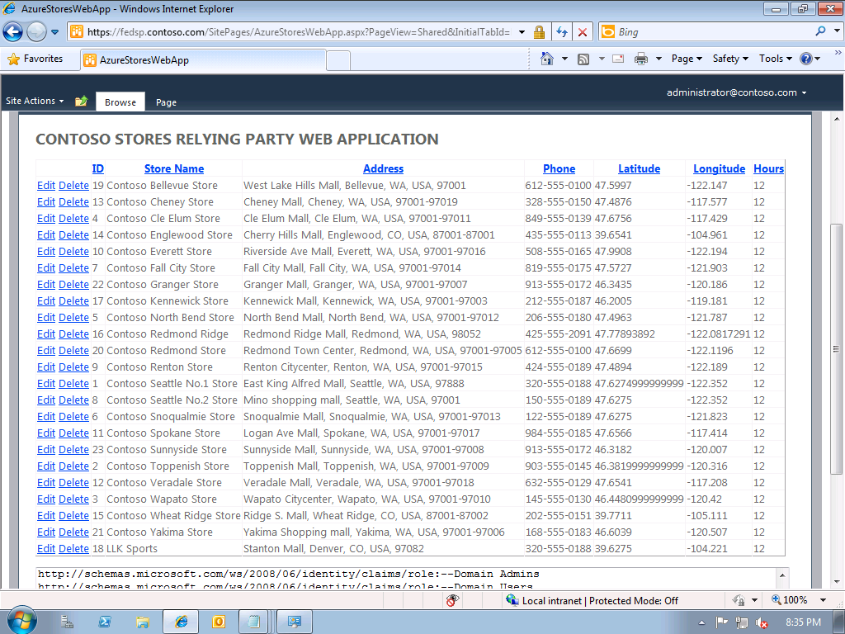
Single Sign-on Between SharePoint & Azure Web Application
Identity Provider (IP)
Federation Provider (FP)
Create Azure RP Web application
Wire it up to accept ACS security tokens
Configure Trust relationship between ACS and AD FS v2.0
Configure SharePoint Web application as a RP to AD FS
Experience SSO
Access Control Service
AD FS
Trust
Active
Directory
Trust
Trust
Relying Party
(RP)
Stores Web Application
Contoso

Slide 15
Federated ADFS
demo

Slide 16
More about Office 365
Think of Office 365 as a point of extensibility
No external service calls with Sandboxed Solutions
BUT
Silverlight & jQuery/JavaScript can act as mediators
Use SP COM to integrate with SharePoint from client
InfoPath supports data connections and service calls in the cloud
  Connect and leverage WCF/Data connections in forms
Use the service bus to interact with on-premises data
You can federate authentication or leverage claims

Slide 17
Bringing It All Together: Contoso Oil & Gas
demo

Slide 18
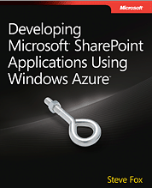
What’s next?
For Development
Download SharePoint VM
Channel 9 SharePoint Developer Training Kit
Channel 9 Azure Developer Training Kit
Azure and SharePoint Developer Primer
For Reference
Check out Steve’s blog for code and walkthroughs
Read Developing Microsoft SharePoint Applications using Windows Azure
This Week
Come see us at the Microsoft Booth!

Slide 19





Resources
  Connect. Share. Discuss.
http://northamerica.msteched.com
Learning
  Sessions On-Demand & Community
  Microsoft Certification & Training Resources
www.microsoft.com/teched
www.microsoft.com/learning
  Resources for IT Professionals
  Resources for Developers
http://microsoft.com/technet
http://microsoft.com/msdn

Slide 20












Complete an evaluation on CommNet and
enter to win!

Slide 21


Slide 22

© 2011 Microsoft Corporation. All rights reserved. Microsoft, Windows, Windows Vista and other product names are or may be registered trademarks and/or trademarks in the U.S. and/or other countries.
The information herein is for informational purposes only and represents the current view of Microsoft Corporation as of the date of this presentation. Because Microsoft must respond to changing market conditions, it should not be interpreted to be a commitment
on the part of Microsoft, and Microsoft cannot guarantee the accuracy of any information provided after the date of this presentation. MICROSOFT MAKES NO WARRANTIES, EXPRESS, IMPLIED OR STATUTORY, AS TO THE INFORMATION IN THIS PRESENTATION.

