Slide 2

Integrating Microsoft SharePoint 2010 and Microsoft Dynamics CRM Online
OSP309
Girish Raja
Technical Evangelist
Microsoft
http://blogs.msdn.com/girishr
http://twitter.com/girishr

Slide 3
Agenda
Built-in Connection Points
Web Parts & Silverlight
Business Connectivity Services (BCS)

Slide 4
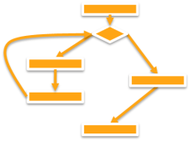








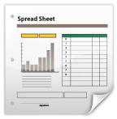

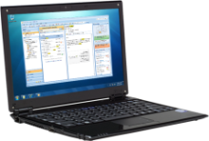
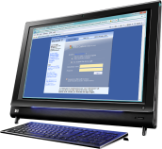



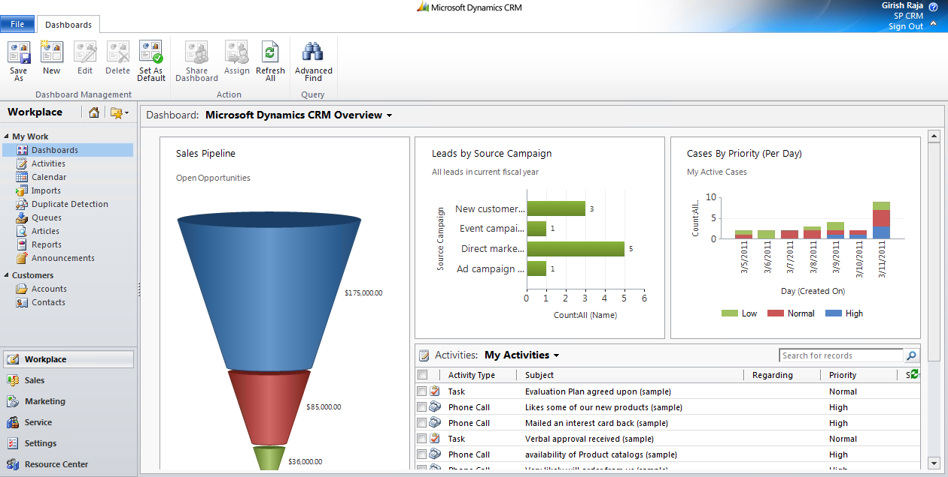
Lot More Opportunities
LOB
Integration
Human
Workflow
Document
Processing
Reporting
and Analysis
Application Experience
Internet Sites &
Information Access
SharePoint
Dynamics CRM

Slide 5




SharePoint Developer Platform
Developer Productivity
First Class SharePoint Developer Tools
Faster Solution Debugging & Tuning
Choice of Development Workstation
Rich Platform Services
Business Connectivity Services
LINQ, REST and Data Improvements
Client Object Model
Workflow Improvements
Flexible Deployment
Application Lifecycle Management - TFS
Sandboxed Solutions
SharePoint Online

Slide 6
CRM/xRM Developer Platform
Rapid Development
.NET 4 & WF4
Solution Packaging
Strong types & LINQ
Visualizations
Rich Platform Services
Web Services - WCF / REST / oData
Transaction Support
SharePoint, Office
Claims Authentication
Cloud
Custom code on Server
Sandbox with external calls
Azure Integration
Global Markets

Slide 7
SharePoint and CRM/xRM are Complementary
Combined strengths cover broad business needs
Structured & Semi-structured Data
Social Engagement & Collaboration
Information Evolution & Storage
Informal Rules
Enterprise Search
Across Teams & Domains
SharePoint
Structured Relational Data
Interactions, Activities & Tasks
Information Generation & Analytics
Formalized Processes
Data Query & Filter
Within Teams & Domains
xRM

Slide 8
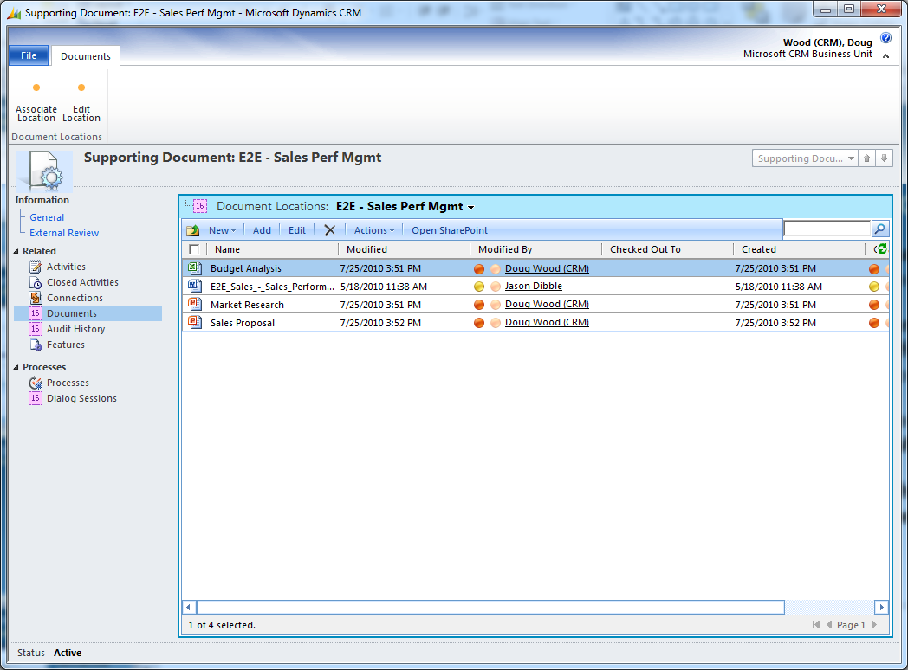

Contextual SharePoint
Use SharePoint & CRM Together for Better Collaboration
Associate SharePoint documents with CRM records
One-time configuration with on-demand folder creation per CRM record
Associate SharePoint folders with any CRM entity
Works with SharePoint Online, SharePoint 2007 & 2010

Slide 9
Contextual SharePoint Documents within Dynamics CRM
demo

Slide 10



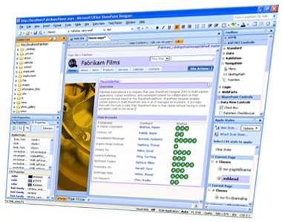


Developer Tools to Get Started
SPD, Expression & Visual Studio
SharePoint Designer
& Expression Blend
Microsoft Visual Studio
SharePoint Customization
SharePoint Applications
Visual Studio Integration
Office Add-Ins
Real-Time Cloud Updates
Application Lifecycle Management
Dynamic UI Design (WPF/Silverlight)
Cloud Deployment

Slide 11
.NET Version Differences
Myth
Myth or Fact?
SharePoint is in .NET 3.5 & CRM is in .NET 4.0, so they can’t talk to each other!
Use CRM’s WSDL based Web Services Proxy in SharePoint

Slide 12
“Hello World” Web Part
Simple Web part in SharePoint
Connecting to CRM
Using WCF WSDL
demo

Slide 13
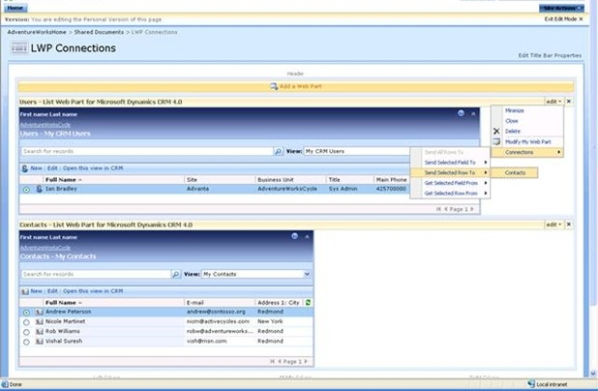
Good ol’ List Web Part
Works with CRM 2011
Works with SharePoint 2007 & SharePoint 2010 On-Premises
Server-side Web Part with
“Web Part Connections” built in.
Available for 32 & 64-bit servers with detailed setup documentation

Slide 14

BCS Architecture
Office Client
SharePoint Server 2010
External Business Parts
SharePoint Site
Custom Code
VSTO
Package
External
List
Office Integration
Search, Workflow, Web Parts
Business Connectivity Services
Secure Store Service (SSS)
Business Connectivity Services
BDC Client Runtime
Cache
External Content
Types (ECT)
BDC Server Runtime
SQL
Web
Service
Custom
.NET Assembly
Connector
External Data

Slide 15



External Content Types
Describes the schema and data access capabilities of an external data source and its behavior within Office and SharePoint
*formerly known as BDC Entity
Office Clients (Rich)
BCS
External Content Type
(ECT)
External Data Source
(Web Service, DB, .NET Assembly Connector, external systems, Web 2.0 service, etc.)
SharePoint (Thin)
BCS

Slide 16
Business Connectivity Services (BCS) Connector
Database vs Web Services
Tool to generate BCS Model for a given CRM Entity Model
CRM Online
User
BCS
Local
WCF

Slide 17
BCS Connector
Accessing CRM Online data
Within SharePoint 2010
Using BCS
demo

Slide 18

Silverlight Client
What Does it Mean for CRM & SharePoint
Dynamic User experience
OOB in SharePoint 2010
Different ways to integrate with SharePoint
  No touch
  Low touch
  High touch
Code reusability
Watch out for Cross Domain calls
SharePoint
Silverlight
SP COM
ASMX/WCF/BCS

Slide 19
Silverlight Web Part
Connecting Office 365 (SP Online) & CRM Online
demo

Slide 20
School of Fine Arts Demo (SOFA)
Business App Entirely in Cloud
SharePoint Online with Silverlight ,
Azure &
CRM Online
demo

Slide 21
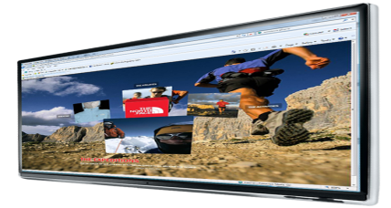
SOFA Demo Architecture
Azure
Web Service
Professor
Student
CRM Online
Azure Storage
SP Online
(Office 365)

Slide 22
Summary
Getting Started is Simple and Easy
CRM has Native SharePoint Integration
Easy Extensibility and Connection to Cloud

Slide 23
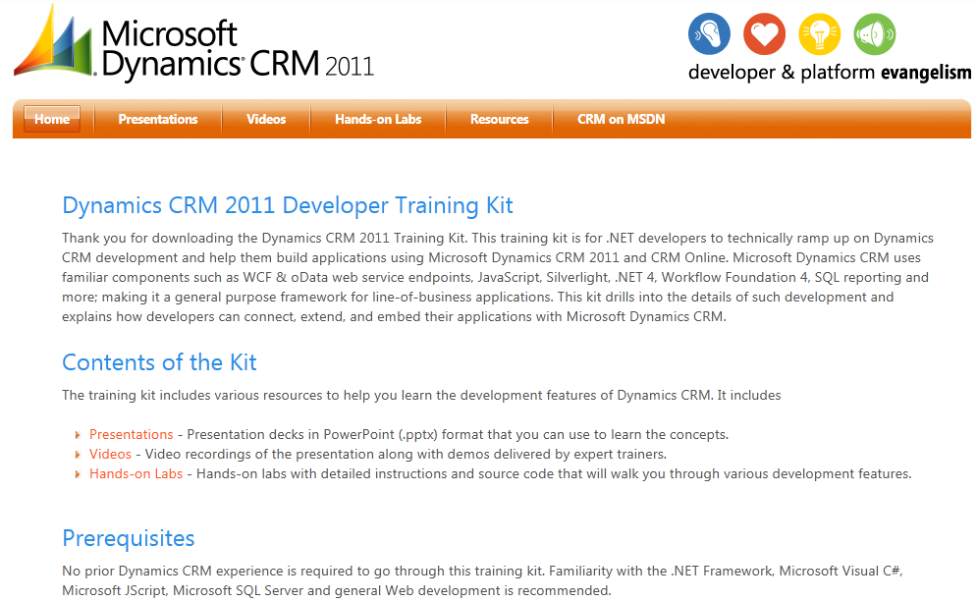
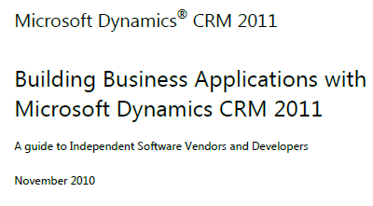
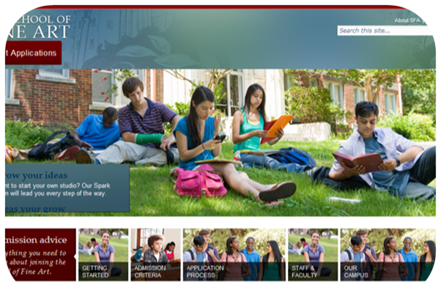
Resources
Developer Training Kits
  Presentations, Hands-on Labs & Videos
  CRM 2011 Developer Training Kit
  SharePoint 2010 Developer Training Kit
  SharePoint and Windows Azure Training Kit
Whitepapers
  Building Business Apps with CRM 2011
  Comparing xRM & Force.com
More Resources
  http://blogs.msdn.com/girishr
  Basic to Advanced Development Walkthroughs
  Email me for a preview of BCS Connector & Silverlight Web Part code

Slide 24

Related Content
Required Slide
Speakers, please list the Breakout Sessions, Interactive Discussions, Labs, Demo Stations and Certification Exam that relate to your session. Also indicate when they can find you staffing in the TLC.
OSP301 - Integrating Microsoft SharePoint 2010 with Windows Azure
OSP302 - Advanced SharePoint Data Access with Microsoft Silverlight
OSP372-INT - Building Cloud Apps Using Microsoft Dynamics CRM Online and Windows Azure
OSP372-WRK-R - Microsoft SharePoint 2010 Development Boot Camp
Find Me Later At the SharePoint Developer Booth

Slide 25
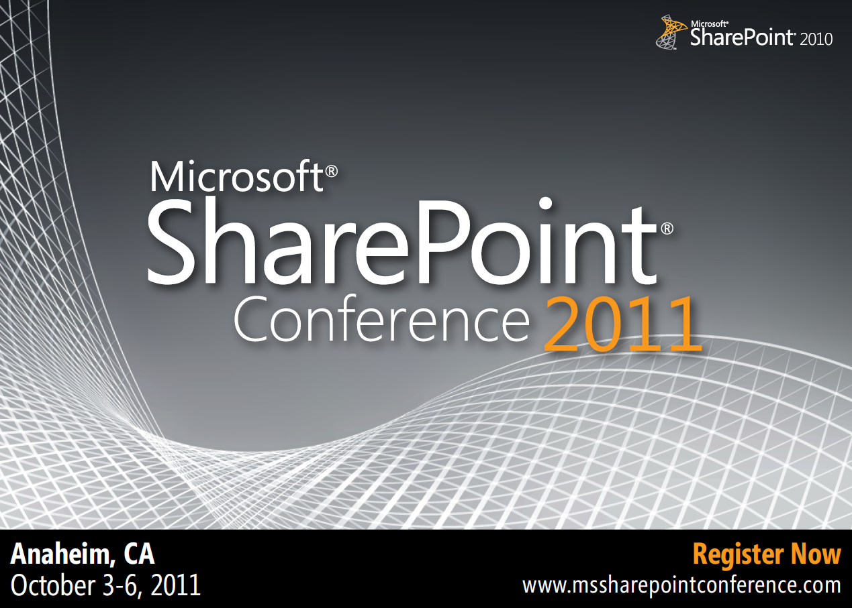

Slide 26





Resources
  Connect. Share. Discuss.
http://northamerica.msteched.com
Learning
  Sessions On-Demand & Community
  Microsoft Certification & Training Resources
www.microsoft.com/teched
www.microsoft.com/learning
  Resources for IT Professionals
  Resources for Developers
http://microsoft.com/technet
http://microsoft.com/msdn

Slide 27












Complete an evaluation on CommNet and
enter to win!

Slide 28

Notes:
New for TechEd 2011, we will be working with Microsoft Tag (http://tag.microsoft.com/overview.aspx) to create unique Tags for every session at the event. Your session Tag will appear on both the room signage and at the end of your presentation. With your session Tag, attendees will be able to scan as they enter the room to retrieve session details, view speaker bios, and engage in discussions; or scan at the end of the presentation to evaluate your session and download materials. We’re excited to integrate Microsoft Tag across the My TechEd mobile experience this year.

Slide 29

© 2011 Microsoft Corporation. All rights reserved. Microsoft, Windows, Windows Vista and other product names are or may be registered trademarks and/or trademarks in the U.S. and/or other countries.
The information herein is for informational purposes only and represents the current view of Microsoft Corporation as of the date of this presentation. Because Microsoft must respond to changing market conditions, it should not be interpreted to be a commitment
on the part of Microsoft, and Microsoft cannot guarantee the accuracy of any information provided after the date of this presentation. MICROSOFT MAKES NO WARRANTIES, EXPRESS, IMPLIED OR STATUTORY, AS TO THE INFORMATION IN THIS PRESENTATION.

